Slide 1
Microsoft Defender for Business
Name
Date

Slide 2

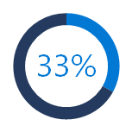
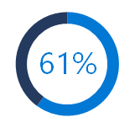
SMBs are increasingly a target of cyberattacks like ransomware
COVID-19 exploited by
malicious cyber actors
“…groups and cybercriminals are targeting individuals, small and medium enterprises, and large organizations with COVID-19-related scams and phishing emails.”
Increase in ransomware attacks
“… small businesses comprise approximately one-half to three-quarters of the victims of ransomware," he said. Overall, ransomware attacks have been up almost 300% in the past year, he said. “
Department of Homeland Security, April 8, 2020, CISA Alert (AA20-099A)
Homeland Security Secretary Alejandro Mayorkas, 06 May 2021 ABC report
1/3rd of all cyberattacks are targeted at small businesses.¹
of small businesses that experienced a recent cyberattack were not able to operate.²
$108K
average cost of a SMB data breach.³
Source: 1 Introduction to the 2020 DBIR | Verizon Enterprise Solutions, 2 Microsoft commissioned Forrester Research, 2020, 3 Kaspersky Global Corporate IT Security Risks Survey, 2019

Slide 3
Microsoft Defender for Business
Elevate your security
Elevate your security with enterprise-grade endpoint protection specially built for businesses with up to 300 employees.
Enterprise-grade protection
Security for all your devices with next-generation protection, endpoint detection and response, and threat and vulnerability management.
Easy to use
Streamline onboarding with wizard-driven set up and recommended security policies activated out-of-the-box to quickly secure devices.
Cost-effective
Endpoint security that keeps you productive and works with your IT without compromising budget.
*Not all capabilities available at time of preview

Slide 4

Microsoft Defender for Business
Microsoft Defender
for Business
Elevate your security
Threat & Vulnerability Management
Attack Surface
Reduction
Next Generation
Protection
Endpoint Detection
& Response
Auto Investigation
& Remediation
Simplified Onboarding and Administration
APIs and Integration
*Not all capabilities available at time of preview

Slide 5

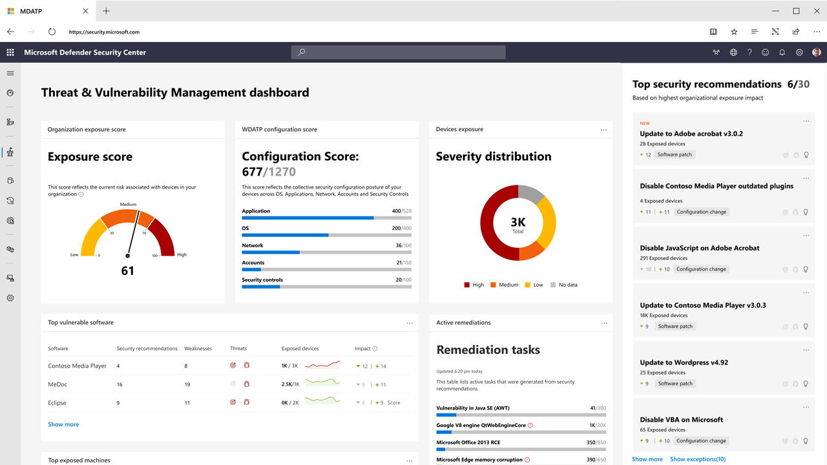
Threat & Vulnerability Management
A risk-based approach to mature your vulnerability management program
Continuous real-time discovery
Context-aware prioritization
Built-in end-to-end remediation process
*Not all capabilities available at time of preview

Slide 6
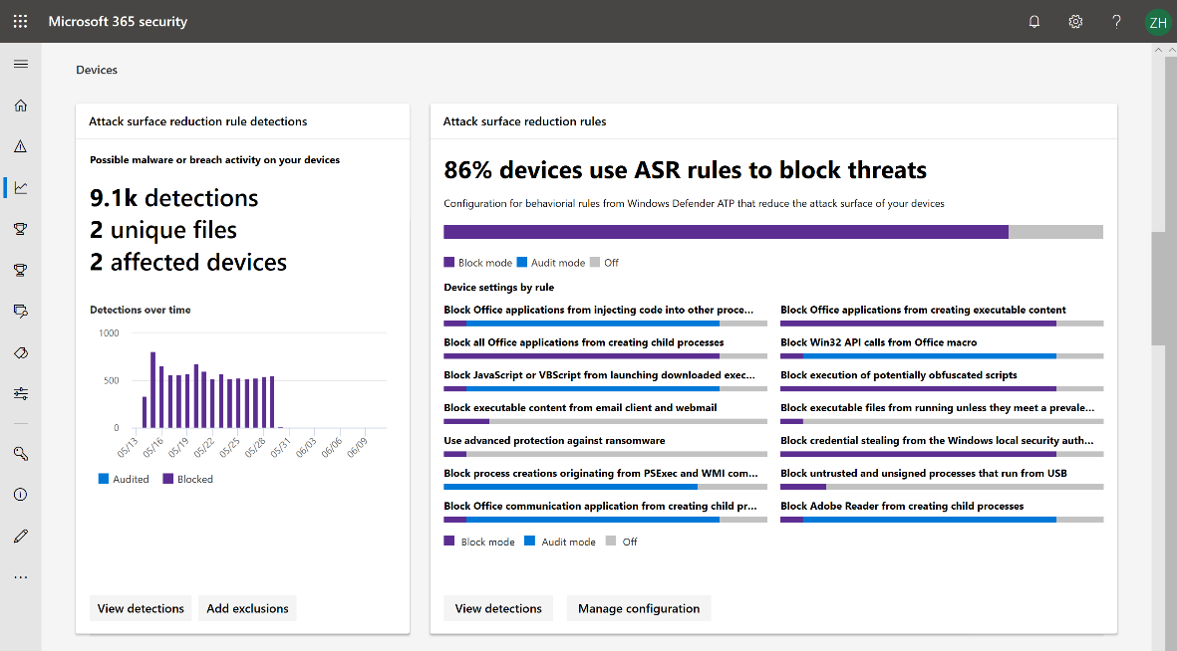
Attack Surface Reduction
Protect against risks by reducing the surface area of attack
System hardening without disruption
Customization that fits your organization
Visualize the impact and simply turn it on
*Not all capabilities available at time of preview

Slide 7
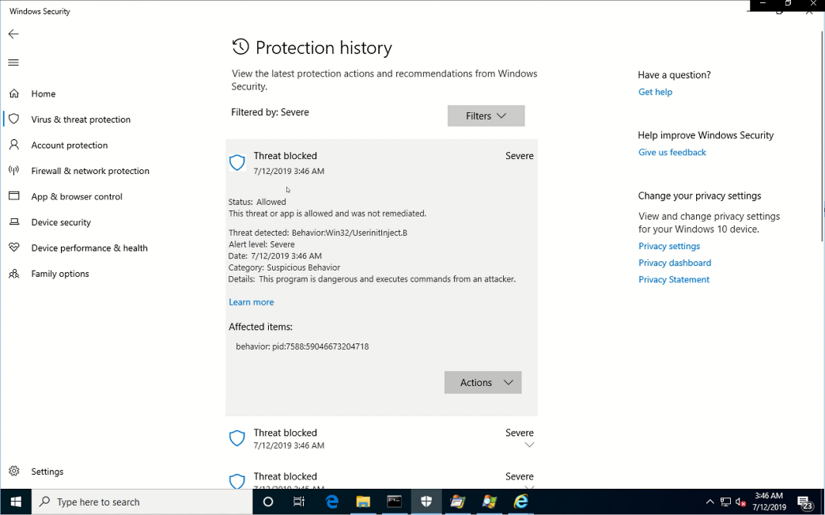
Next Generation Protection
Helps block and tackle sophisticated
threats and malware
Behavioral based real-time protection
Blocks file-based and fileless malware
Stops malicious activity from trusted and
untrusted applications
*Not all capabilities available at time of preview

Slide 8
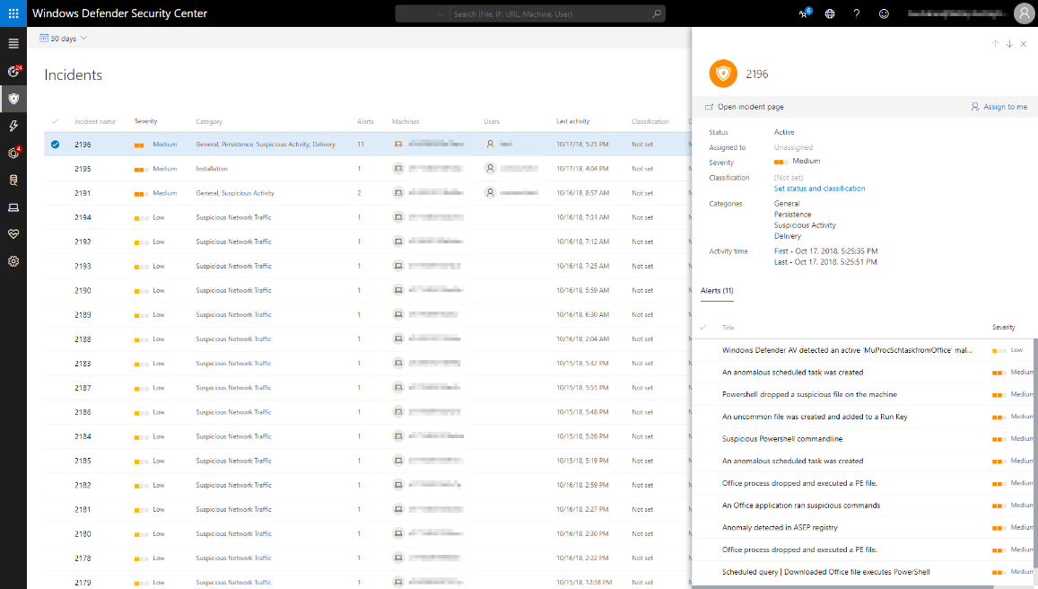
Endpoint Detection & Response
Detect and investigate advanced persistent attacks
Behavioral-based detection
Manual response actions for a device or file
Live response to gain access to devices
*Not all capabilities available at time of preview

Slide 9
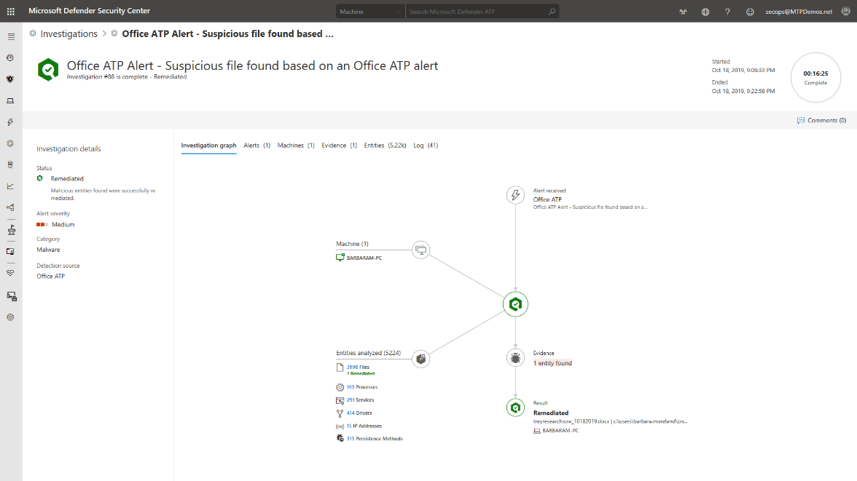
Auto Investigation & Remediation
Automatically investigates alerts and helps to remediate complex threats
Mimics the ideal steps analysts would take
Tackles file or memory-based attacks
Scales security operations with 24x7 automated responses
*Not all capabilities available at time of preview

Slide 10
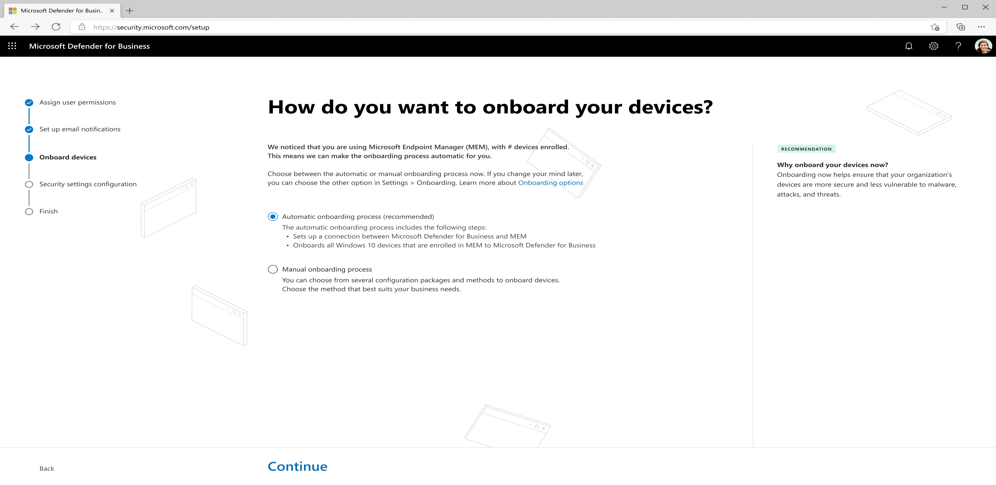
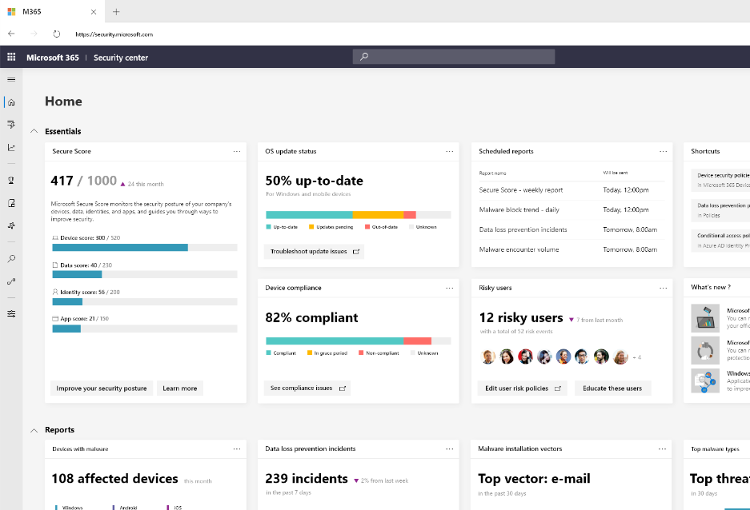
Simplified Onboarding and Administration
Wizard-driven onboarding and easy to use management controls
Onboard new devices in a few simple steps
Recommended security policies activated
out-of-the-box
Action-oriented dashboard help prioritize tasks
*Not all capabilities available at time of preview

Slide 11
APIs - Connecting with the platform
Microsoft Defender for Business
Elevate your security
Threat & Vulnerability Management
Attack Surface
Reduction
Next Generation
Protection
Endpoint Detection
& Response
Auto Investigation
& Remediation
APIs and Integration
Devices
Reporting
Apps
Siem Data
Tools
*Not all capabilities available at time of preview

Slide 12
Microsoft 365 Lighthouse overview
Public Preview
Helps Managed Service Providers to secure devices, data, and users for customers that are using Microsoft 365 Business Premium and Microsoft Defender for Business
Customer management
at scale
Monitor and manage customers centrally to easily identify gaps in end-customer configuration, target improvements, and
drive adoption.
Proactive risk management
Realize efficiencies in customer management to support business scale and growth
Improved
security
Secure and protect devices, data, and users across customer environments using recommended best practices.
Standardize configuration
Benefit from deployment plans to drive standardization, upsell across customer base, and reduce risk

Slide 13
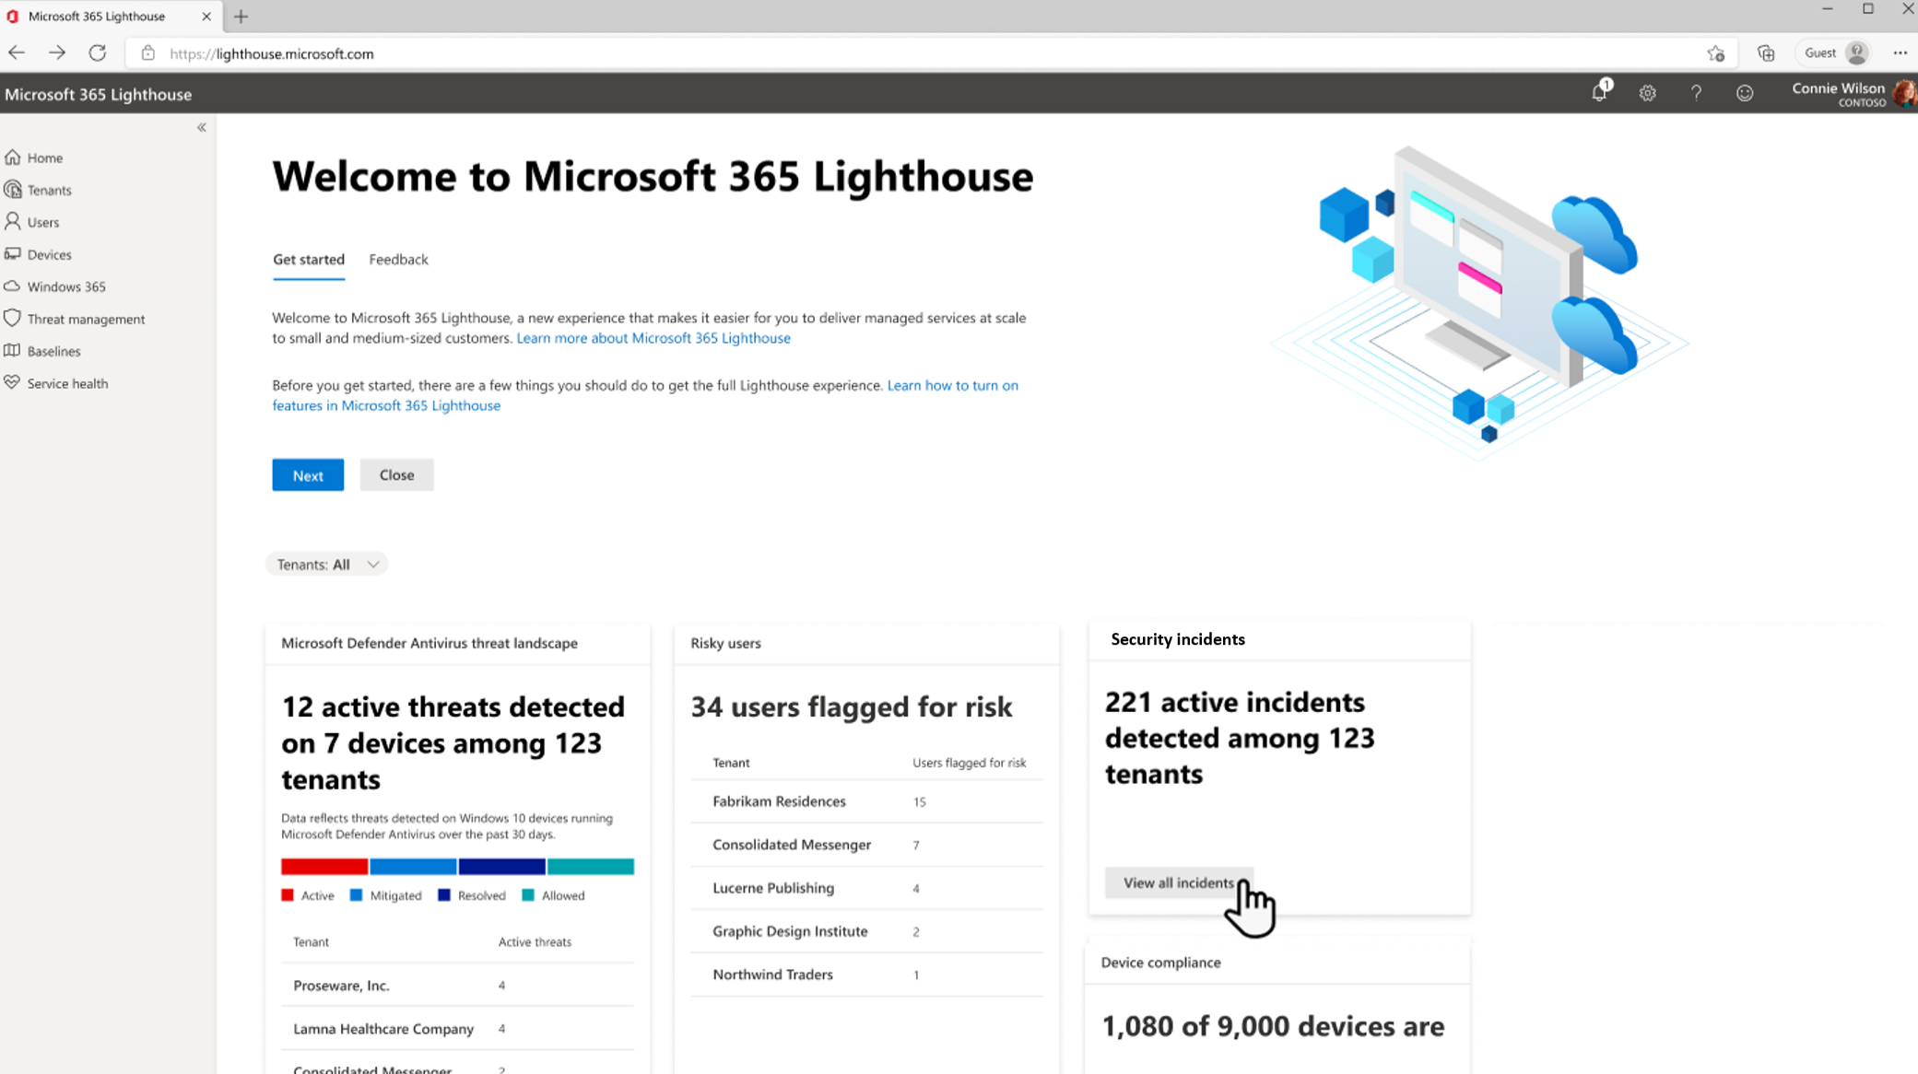
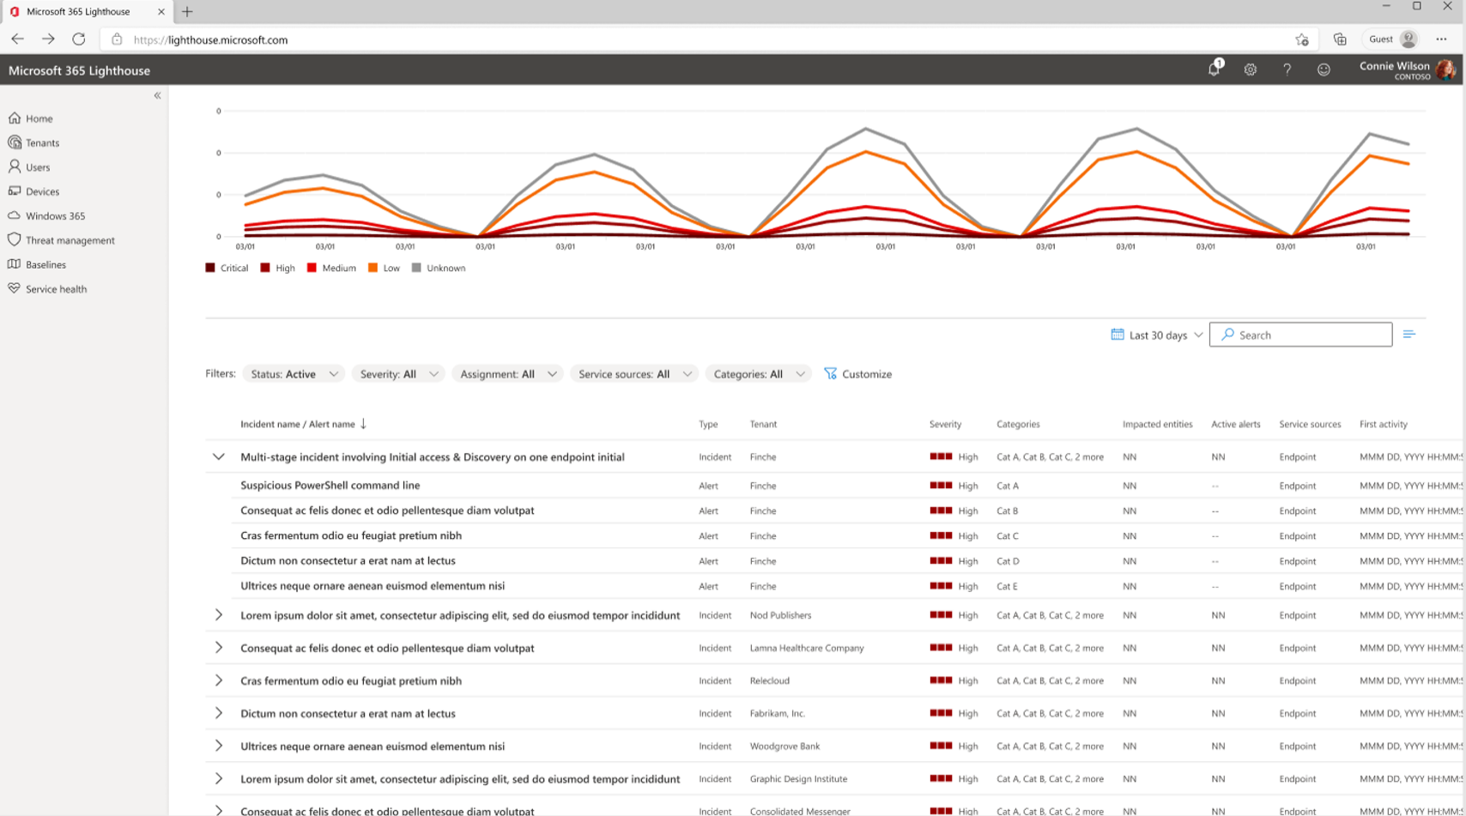
Microsoft 365 Lighthouse with Defender for Business and Microsoft Business Premium
Public Preview
View security incidents and alerts from Defender for Business in the dashboard and get the detail from the Incidents queue. Additional security management capabilities are planned on the roadmap.
Image 1: Security incident summary on the Home dashboard
Image 2: Incident queue highlighting security incidents and alert details
*Not all capabilities available at time of preview

Slide 14




Delivering endpoint security across platforms
Azure Virtual Desktop
Endpoints
Mobile device OS
Virtual desktops
*Not all capabilities available at time of preview

Slide 15
Product comparison
Cross platform and enterprise grade protection with next-gen protection, endpoint detection and response, and threat and vulnerability management
Available as a standalone offering and as part of Microsoft 365 Business Premium
Standalone offering will serve non-Microsoft 365 customers. No licensing prerequisites
Supports multi-customer viewing of security incidents with Microsoft 365 Lighthouse for partners in preview
Customer size | < 300 seats | > 300 seats
Endpoint capabilities\SKU | Microsoft Defender for Business | Microsoft Defender for Endpoint Plan 1 | Microsoft Defender for Endpoint Plan 2
Centralized management |  |  | 
Simplified client configuration | 
Threat and Vulnerability Management |  |  | 
Attack Surface Reduction |  |  | 
Next-Gen Protection |  |  | 
Endpoint Detection and Response | ² |  | 
Automated Investigation and Response | ² |  | 
Threat Hunting and 6-months data retention |  |  | 
Threat Analytics | ² |  | 
Cross platform support for Windows, MacOS, iOS, and Android |  |  | 
Microsoft Threat Experts |  |  | 
Partner APIs |  |  | 
Microsoft 365 Lighthouse for viewing security incidents across customers | ³
*Not all capabilities available at time of preview
¹Limited. ² Optimized for SMB. ³ Additional capabilities planned

Slide 16
Get started with Microsoft Defender for Business
Stay up to date on the latest: https://aka.ms/MDB-Blog

Slide 17
Thank you!

Slide 18
Appendix

Slide 19
Detailed product comparison
Capabilities | MDB | MDE P1 | MDE P2
Threat & Vulnerability
Microsoft secure score | l |  | l
Vulnerability management (visibility into software and vulnerabilities) | l |  | l
Vulnerability remediation based on Intune integration | l |  | l
Attack Surface Reduction
Advanced vulnerability and zero-day exploit mitigations | l | l | l
Attack Surface Reduction rules | l | l | l
Application Control | l | l | l
Network Firewall | l | l | l
Device Control (e.g.: USB) | l | l | l
Network protection | l | l | l
Device-based conditional access | l | l | l
Web Control / Category-based URL Blocking | l | l | l
Ransomware mitigation | l | l | l
Next Gen Protection
Advanced cloud protection (deep inspection and detonation) BAFS | l | l | l
Monitoring, analytics and reporting for Next Generation Protection capabilities | l | l | l
Endpoint Detection and Response
Behavioral-based detection (post-breach) | l |  | l
Rich investigation tools |  |  | l
Custom detections |  |  | l
6-month searchable data per endpoint |  |  | l
Advanced hunting |  |  | l
Evaluation Lab |  |  | l
Manual response actions - (Run AV scan, Machine isolation, File stop and quarantine) | l | l | l
Live response | l |  | l
*Not all capabilities available at time of preview

Slide 20
Detailed product comparison
Capabilities | MDB | MDE P1 | MDE P2
Automatic Investigation and Remediation
Default automation levels | l |  | l
Customized automation levels |  |  | l
Centralized Management
Role-based access control | l | l | l
Simplified client configuration | l
Reporting | l | l | l
API's
SIEM Connector |  | l | l
API's (Response, Data collection) |  | l | l
Partner applications |  | l | l
Threat Intelligence
Threat Analytics | l |  | l
Custom Threat Intelligence | l | l | l
Sandbox |  |  | l
3rd party Threat Intelligence Connector |  |  | l
Partner Support
APIs (For Partners) | l | l | l
RMM Integration | l
​MSP Support (Multi-tenant API, multi tenant authentication) | l | l | l
Microsoft Threat Expert
Targeted attack notification |  |  | l
Collaborate with Experts, on demand |  |  | l
Platform support
Windows Client | l | l | l
MacOS | l | l | l
Mobile (Android, iOS) | l | l | l
*Not all capabilities available at time of preview

