Slide 1
Grow your business by elevating your customers’ security with Microsoft Defender for Business
Name
Date

Slide 2
What we’ll cover:
Top of Mind for SMB customers and partners
Elevating customers’ security with Microsoft Defender for Business
Understanding the Licensing Model at GA
Partner Tools: Microsoft 365 Lighthouse Integration overview
Understanding target audience
Summary of Partner Opportunity
Additional resources
Notes:
In this presentation we’ll introduce Microsoft Defender for Business- which is coming soon in preview and why it’s relevant for customers and partners alike. We’ll go in –depth in product capabilities, licensing model at GA , Lighthouse integration for partners . Plus, we’ll cover the partner opportunity and how you as partners can help attract and serve new types of customers and drive additional revenue with existing customers.

Slide 3
Top of mind for Small and Medium Business (SMB) customers
70% employees want flexible work options to continue¹
238%
Increase in cyberattacks globally²
60%
SMBs lack skills inhouse to deal with cyberattacks³
90%
SMBs would consider hiring a new MSP if they offered the right cybersecurity solution⁴
Sources: 1. 1; The Next Great Disruption Is Hybrid Work—Are We Ready? (microsoft.com)) 2. Why the Hybrid Workplace Is a Cybersecurity Nightmare – WSJ 3. Underserved and Unprepared: The State of SMB Cyber Security in 2019 4. Internal Microsoft Research
Notes:
If we think about the trends shaping the Small and medium business space, there are really three that are top of mind
Customers know that work from anywhere is here to stay, with 70% employees looking for continued flexible and remote work options.
But with it, come increased security risks. There’s hardly a day that goes by without news of a new ransomware or phishing attack. Infact the WEF estimates a 238% increase in cyberattacks from Feb-April last year. So, what customers need is elevated security to deal with increasingly more sophisticated cyberthreats
However, most SMBs are not equipped to handle these security threats inhouse and they’re looking to IT partners like you for help. Infact 90% of SMBs say they would switch IT providers if offered a more comprehensive security solution.

Slide 4
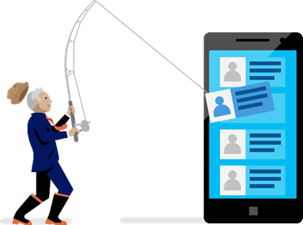
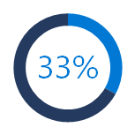
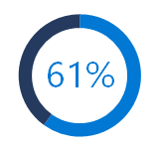
SMBs are increasingly a target of cyberattacks like ransomware
COVID-19 exploited by malicious cyber actors
“…groups and cybercriminals are targeting individuals, small and medium enterprises, and large organizations with COVID-19-related scams and phishing emails.”
Increase in ransomware attacks
“… small businesses comprise approximately one-half to three-quarters of the victims of ransomware," he said. Overall, ransomware attacks have been up almost 300% in the past year, he said. “
Department of Homeland Security, April 8, 2020, CISA Alert (AA20-099A)
Homeland Security Secretary Alejandro Mayorkas, 06 May 2021 ABC report
1/3rd of all cyberattacks are targeted at small businesses.¹
of small businesses that experienced a recent cyberattack were not able to operate.²
$108K
average cost of a SMB data breach.³
Source: 1 Introduction to the 2020 DBIR | Verizon Enterprise Solutions, 2 Microsoft commissioned Forrester Research, 2020, 3 Kaspersky Global Corporate IT Security Risks Survey, 2019
Notes:
To give you more specifics, there has been over 300% increase in ransomware attacks alone in the past year and the economic cost of these for small and medium businesses can be catastrophic with over 60% of small businesses not being able to operate after they’ve experienced a cyberattack

Slide 5
Top of mind for SMB partners
85%
of partners see security as biggest area of growth⁵
How do we expand security services beyond basic AV?
How do we
deliver services at scale?
How do we do so without increasing cost?
Sources: 5. Channel Futures | 2020 MSP 501 Full Report
Notes:
This presents opportunities for you as IT partners to serve these customers by augmenting their security– but the question is – 1) how you transition into security services or expand your existing portfolio of security services beyond AV ) how you standardize these services across all customers and deliver them at scale quickly and easily. C)how do you do so without increasing costs or complexity

Slide 6
Microsoft Defender for Business: Elevate your customers and grow your business

Slide 7
Microsoft Defender for Business
Elevate your security
Elevate your security with enterprise-grade endpoint protection specially built for businesses with up to 300 employees.
Enterprise-grade protection
Security for all your devices with next-gen protection, endpoint detection and response, and threat and vulnerability management.
Easy to use
Streamline onboarding with wizard-driven set up and recommended security policies activated out-of-the-box to quickly secure devices.
Cost-effective
Endpoint security that keeps you productive and works with your IT without compromising budget.
Notes:
I’d like to introduce Microsoft Defender for Business – an enterprise-grade endpoint security to business with up to 300 employees in a simple and cost-effective solution.
You can use Defender for Business to elevate your customers’ security from traditional antivirus to next-gen antivirus protection, endpoint detection and response, and threat and vulnerability management. It offers simplified configuration and management with intelligent automated investigation and response to help protect your endpoints.
Defender for Business brings together additional endpoint security capabilities in one package to remove the need for separate web and network protection, threat, and vulnerability management solutions. It’s proactive automated investigation and response mean that IT administrators can prioritize only on security events that need their attention.
For IT service providers, Microsoft 365 Lighthouse will add alerts and incidents from Defender for Business providing a view of security events across multiple customers, with additional management controls coming.
we also wanted to bring these capabilities in a licensing model that’s cost effective and simple.
Microsoft Defender for Business will be available to customers as a standalone solution, and it will be included within Microsoft 365 Business Premium.
(1 - Microsoft commissioned Forrester Research, 2020)
Enterprise-grade endpoint protection
Security for all your devices with AI-powered automation to rapidly protect, detect, and respond to threats.
Easy to use
Streamlined onboarding and management experiences that provide actionable insights for ease of use
Cost-effective
Endpoint security that keeps you productive and works with your IT without compromising budget.

Slide 8
Microsoft Defender for Business
Microsoft Defender
for Business
Elevate your security
Threat & Vulnerability Management
Attack Surface Reduction
Next Generation Protection
Endpoint Detection & Response
Auto Investigation & Remediation
Simplified Onboarding and Administration
APIs and Integration
Note that not all capabilities may be available in preview.

Slide 9
Delivering endpoint security across platforms
Azure Virtual Desktop
Endpoints
Mobile device OS
Virtual desktops
Note that not all capabilities may be available in preview.
Notes:
Plus you can use it to protect customers across devices , so it’s easy to standardize on 1 endpoint protection solution across your customers
Windows
MacOS
Android
iOS
Virtual Desktops:
Windows 365

Slide 10
How to purchase Microsoft Defender for Business
Microsoft 365 Business Premium
($20pupm)
Comprehensive productivity and security solution
Per user license
Microsoft 365 Business Standard ($12.50) Office apps and services, Teams
Microsoft Defender Business ($3pupm)
Enterprise-grade endpoint security
Microsoft Defender for Business
1) As standalone SKU
Entitlement for use on up to 5 devices
Generally available H1 2022
2) Included as part of Microsoft 365 Business Premium
Microsoft Defender for Business will roll out to new and existing M365 Business Premium customers, post GA
Microsoft Defender for Office 365 Plan 1
Intune
Per user license
Azure AD Premium Plan 1
Next generation protection
Cross Platform support (iOS, Android, Windows, MacOS)
Endpoint Detection and Response
Threat and Vulnerability Management
…and more
Azure Information Protection Premium P1
Exchange Online Archiving
Autopilot
Azure Virtual Desktop license
Windows 10/11 Business
Shared Computer Activation
Note that not all capabilities may be available in preview.
Notes:
Here’s a summary of the licensing model, Post General Availability Microsoft Defender for Business will be available for purchase in two ways
1) As standalone SKU
Generally available H1 2022
2) Included as part of Microsoft 365 Business Premium
MDB will roll out to new and existing M365 Business Premium customers, post GA

Slide 11
Product comparison
Cross platform and enterprise grade protection with next-gen protection, endpoint detection and response, and threat and vulnerability management
Available as a standalone offering and as part of Microsoft 365 Business Premium
Standalone offering will serve non-Microsoft 365 customers. No licensing prerequisites
Supports multi-customer viewing of security incidents with Microsoft 365 Lighthouse for partners in preview
Customer size | < 300 seats | > 300 seats
Endpoint capabilities\SKU | Microsoft Defender for Business | Microsoft Defender for Endpoint Plan 1 | Microsoft Defender for Endpoint Plan 2
Centralized management |  |  | 
Simplified client configuration | 
Threat and Vulnerability Management |  |  | 
Attack Surface Reduction |  |  | 
Next-Gen Protection |  |  | 
Endpoint Detection and Response | ² |  | 
Automated Investigation and Response | ² |  | 
Threat Hunting and 6-months data retention |  |  | 
Threat Analytics | ² |  | 
Cross platform support for Windows, MacOS, iOS, and Android |  |  | 
Microsoft Threat Experts |  |  | 
Partner APIs |  |  | 
Microsoft 365 Lighthouse for viewing security incidents across customers | ³
Note that not all capabilities may be available in preview
¹Limited. ² Optimized for SMB. ³ Additional capabilities planned
Notes:
To end this section, here’s a quick overview of how Defender for Business lines up against our broader portfolio. As you can see, for customers with < 300 employees Microsoft Defender for Business is our key offering for businesses with < 300 employees. It contains most of the capabilities found in MDE P2, with some exceptions like Threat Hunting and some other features have been simplified for ease of management by SMB IT generalists. So we really are bringing enterprise-grade and premium capabilities to SMBs

Slide 12
Partner tools: Manage Defender for Business customers at scale with Microsoft 365 Lighthouse
Notes:
Now let’s talk about the partner tools available to secure customers at scale

Slide 13
Microsoft 365 Lighthouse overview
Public Preview
Helps Managed Service Providers to secure devices, data, and users for customers that are using Microsoft 365 Business Premium and Microsoft Defender for Business
Customer management at scale
Monitor and manage customers centrally to easily identify gaps in end-customer configuration, target improvements, and drive adoption.
Proactive risk management
Realize efficiencies in customer management to support business scale and growth
Improved security
Secure and protect devices, data, and users across customer environments using recommended best practices.
Standardize configuration
Benefit from deployment plans to drive standardization, upsell across customer base, and reduce risk
Note that not all capabilities may be available in preview,
Notes:
We know that in the SMB space, partners play a critical role in managing customers IT environments. That is why we are making Microsoft engineering investments in new partner tools to help you deliver managed services to your customers and accelerate profitability.
At Inspire this year, we launched of Microsoft 365 Lighthouse into public preview.
Microsoft 365 Lighthouse is a unified portal that helps managed service providers secure devices, data, and users at scale for small and medium sized business customers. It simplifies onboarding of tenants by recommending security configuration baselines tailored to SMBs and provides multi-tenant views across all your customer environments.
Let’s talk about what Microsoft 365 Lighthouse is and how it can help you secure and manage your Microsoft Defender for Business and Microsoft 365 Business Premium customers at scale.
Microsoft 365 Lighthouse helps managed service providers (MSPs) to secure devices, data, and users at scale for small and medium sized businesses. It simplifies the onboarding and management of Microsoft 365 Business Premium tenants into a unified portal, provides a view of customer environments, and recommends minimum security configuration baselines. MSPs can drive scale and growth of security managed services with Microsoft 365 Business Premium and Microsoft 365 Lighthouse. You can learn more about growing your managed services business with Microsoft 365 Business Premium and Microsoft 365 Lighthouse at https://aka.ms/M365Lighthouse

Slide 14
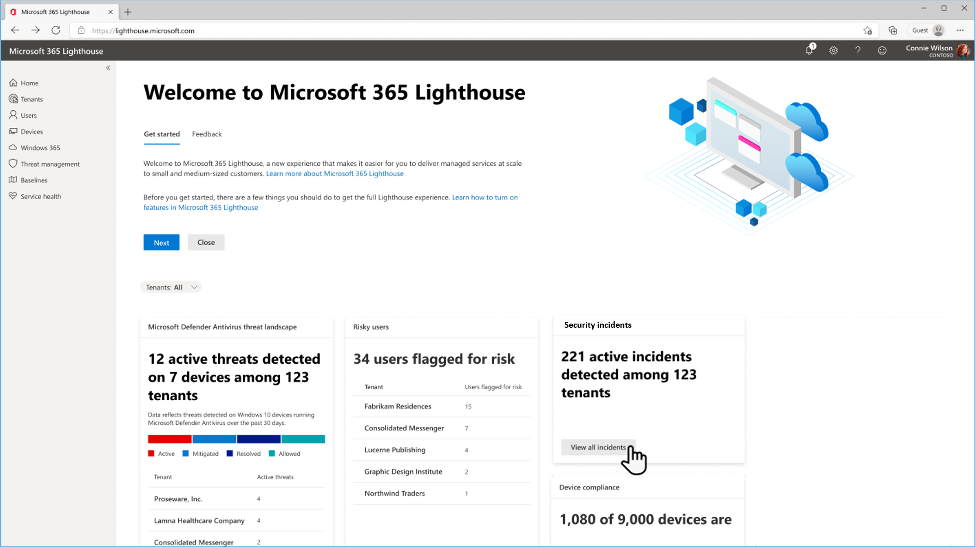
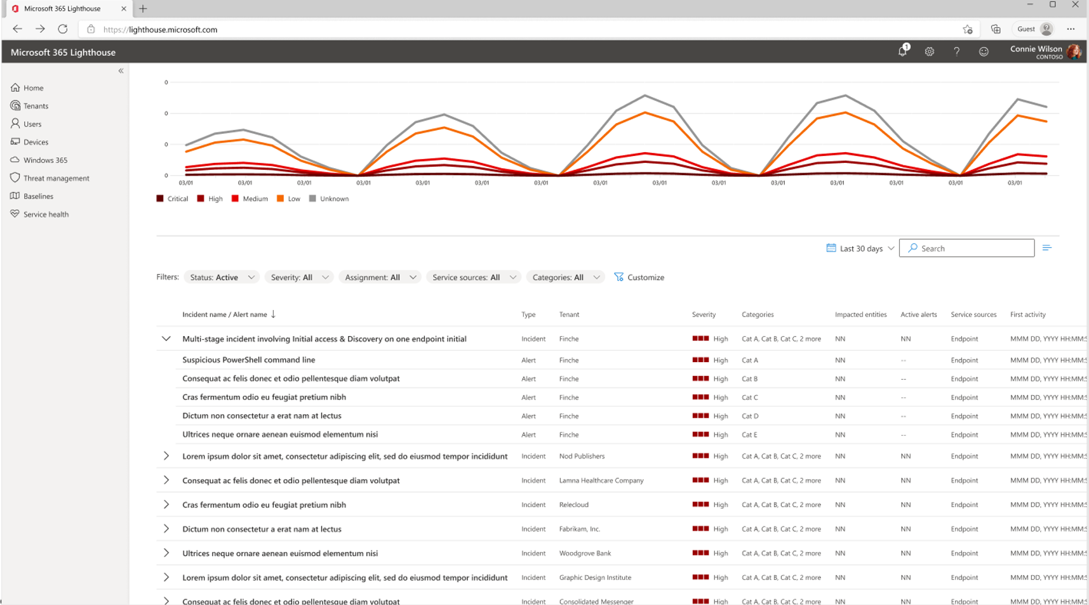
Microsoft 365 Lighthouse with Defender for Business and Microsoft Business Premium
Public Preview
View security incidents and alerts from Defender for Business in the dashboard and get the detail from the Incidents queue. Additional security management capabilities are planned on the roadmap.
Image 1: Security incident summary on the Home dashboard
Image 2: Incident queue highlighting security incidents and alert details
Notes:
Microsoft 365 Lighthouse will add alerts and incidents from Defender for Business in two locations. We’re delivering a multi-customer summary of security events from the home page dashboard, and you can use this card to double-click into the security incidents and alerts queue to see more detail. This capability will be delivered later in preview, with additional security management capabilities planned on the roadmap. There are additional capabilities for Microsoft 365 Business Premium, you can learn more about It at https://aka.ms/M365BPPartnerPlaybook
Microsoft 365 Lighthouse will add alerts and incidents from Defender for Business in two locations. We’re delivering a multi-customer summary of security events from the home page dashboard, and you can use this card to double-click into the security incidents and alerts queue to see more detail. This capability will be delivered later in preview, with additional security management capabilities planned on the roadmap.

Slide 15
Understanding customer and partner Opportunity with Microsoft Defender for Business
Notes:
Now that we’ve reviewed the product capabilities, let’s summarize who the solution is targeted at and what’s the opportunity for you as partners

Slide 16
Onramp new customers and upsell existing
Target customers for Microsoft Defender for Business
Upsell Existing Microsoft 365 customers: Cement Upsell to Microsoft 365 Business Premium by highlighting new value.
Recruit Non-Microsoft 365 Customers, Defender for Business is a great solution for compete and on-premises customers who want additional security but are not yet ready to move full scale to the Microsoft 365 cloud. It offers them enterprise-grade protection that is both cost-effective and easy to use, without requiring additional Microsoft solutions as pre-requisites.
Onramp Cost-conscious customers in emerging markets etc. who don’t yet have the budget to upgrade to Business Premium: Due to economic climate and budget constraints, the customer may be looking for lower priced point security solutions but want a best of breed product.
Elevate security and increase ARPU with existing customers
Recruit new customers (on-premises, compete)
Notes:
Microsoft Defender for Business can help you
Increase ARPU for existing customers by accelerating upsell to BP
Help you onramp and recruit new types of customers
Non Microsoft 365 customers (e.g. on premises, Google Workspace) etc who may yet be ready to shift to MSFT productivity portfolio. Microsoft Defender for Business provides an easy way for them to get enterprise-grade security that works regardless of platform/ device. There will be no other Microsoft pre-requisites required post GA
Onramp Cost-conscious customers in emerging markets etc who don’t yet have the budget to upgrade to BP: Due to economic climate and budget constraints, the customer is looking for lower priced point security solutions but wants a best of breed product.

Slide 17
Partner Opportunity Summary
Elevate your customers’ security and grow your business
Grow your business and reduce risk by enhancing your customers’ security with an enterprise –grade endpoint protection solution that’s easy to manage.
Increase security and reduce risk
Boost security for all your customers and devices - with AI-powered automation to rapidly protect, detect, and respond to threats with advanced technologies like Endpoint Detection and Response and Threat and Vulnerability Management.
Manage all your customers with ease
Secure all your customers from one place with Microsoft 365 Lighthouse. Later in preview, you will be able to view threats for your customers, with additional capabilities coming post GA. Standardize on one solution across customer devices -Windows, iOS, Mac, Android..
Grow revenue & reduce operational costs
Build new higher margin, standardized endpoint security services. Reduce operational costs with a simplified solution, that can be managed by IT generalists and lowers support overhead
Onramp new customers and Upsell to broader Microsoft portfolio
Use Microsoft Defender for Business as an onramp for new customers who you can then upsell to Microsoft’s broader portfolio of SMB offerings like Microsoft 365 Business Premium or add-on additional Azure and Microsoft security solutions.
Note that not all capabilities may be available in preview
Notes:
So to summarize, here are the key opportunities for partners
Boost security for all your customers and devices - with AI-powered automation to rapidly protect, detect, and respond to threats with advanced technologies like Endpoint Detection and Response and Threat and Vulnerability Management.
Secure all your customers from one place with Microsoft 365 Lighthouse. Later in preview, you will be able to view threats for your customers, with additional capabilities coming post GA. Standardize on one solution across customer devices -Windows, iOS, Mac, Android..
Build new higher margin, standardized endpoint security services. Reduce operational costs with a simplified solution, that can be managed by IT generalists and lowers support overhead
Use Microsoft Defender for Business as an onramp for new customers who you can then upsell to Microsoft’s broader portfolio of SMB offerings like Microsoft 365 Business Premium or add-on additional Azure and Microsoft security solutions.

Slide 18
Learn more

Slide 19
Learn more at
Read our Ignite blog: https://aka.ms/MDB-Blog
Join the partner webinar, Nov 18th at 8 am Pacific
Microsoft 365 Business Premium Partner Playbook
Updated Upsell Guides:
Business Standard to Business Premium
Business Basic to Business Premium
Notes:
We hope this has given you a good overview of Microsoft Defender for Business and the partner opportunity. To get started, Here are some resources to learn more. We’ll have more to share when the preview starts later in November.
Read our blog: https://aka.ms/MDB-Blog
Check out the documentation: https://aka.ms/DefenderforBusiness
Join the partner webinar, Nov 18th at 8 am Pacific

Slide 20
Appendix

Slide 21
Detailed product comparison
Capabilities | MDB | MDE P1 | MDE P2
Threat & Vulnerability
Microsoft secure score | l |  | l
Vulnerability management (visibility into software and vulnerabilities) | l |  | l
Vulnerability remediation based on Intune integration | l |  | l
Attack Surface Reduction
Advanced vulnerability and zero-day exploit mitigations | l | l | l
Attack Surface Reduction rules | l | l | l
Application Control | l | l | l
Network Firewall | l | l | l
Device Control (e.g.: USB) | l | l | l
Network protection | l | l | l
Device-based conditional access | l | l | l
Web Control / Category-based URL Blocking | l | l | l
Ransomware mitigation | l | l | l
Next Gen Protection
Advanced cloud protection (deep inspection and detonation) BAFS | l | l | l
Monitoring, analytics and reporting for Next Generation Protection capabilities | l | l | l
Endpoint Detection and Response
Behavioral-based detection (post-breach) | l |  | l
Rich investigation tools |  |  | l
Custom detections |  |  | l
6-month searchable data per endpoint |  |  | l
Advanced hunting |  |  | l
Evaluation Lab |  |  | l
Manual response actions - (Run AV scan, Machine isolation, File stop and quarantine) | l | l | l
Live response | l |  | l

Slide 22
Detailed product comparison
Capabilities | MDB | MDE P1 | MDE P2
Automatic Investigation and Remediation
Default automation levels | l |  | l
Customized automation levels |  |  | l
Centralized Management
Role-based access control | l | l | l
Simplified client configuration | l
Reporting | l | l | l
API's
SIEM Connector |  | l | l
API's (Response, Data collection) |  | l | l
Partner applications |  | l | l
Threat Intelligence
Threat Analytics | l |  | l
Custom Threat Intelligence | l | l | l
Sandbox |  |  | l
3rd party Threat Intelligence Connector |  |  | l
Partner Support
APIs (For Partners) | l | l | l
RMM Integration | l
​MSP Support (Multi-tenant API, multi tenant authentication) | l | l | l
Microsoft Threat Expert
Targeted attack notification |  |  | l
Collaborate with Experts, on demand |  |  | l
Platform support
Windows Client | l | l | l
MacOS | l | l | l
Mobile (Android, iOS) | l | l | l

