Slide 1
ABOUT THIS DECK
“Working from home with children” is a document that Microsoft created to provide employees who are impacted by daycare and school closures due to the COVID-19 outbreak with shared practices, tips, and resources.
As the outbreak continues, employees in more and more organizations are finding themselves at home trying to balance work and childcare. We want to help everyone meet this challenge and are sharing this document for you to share with your employees if you find it helpful. The document can be shared as is or be used as a starting point to which you can add additional company specific information. Please see the Notes section on each slide for suggestions on what to add.
We hope you find this deck helpful, and join the COVID-19 Business Resources Center to reach out with questions, connect with others, and share your experiences.

Slide 2
Working from home with children

Slide 3
Balancing work and childcare
With schools and daycares closed due to COVID-19, many of you are finding yourself at home trying to balance work and childcare.
Working from home with children brings its own set of challenges that can cause increased stress on parents. To help you, we’ve collected shared practices from parents on how to balance work and childcare.
We acknowledge that every family and situation is different, but we hope you’ll find the tips helpful.
Notes:
Additional information that can be added to this page:
Where employees can find information about your company’s response to COVID-19 and support options for families
How to connect with HR

Slide 4
General tips for working from home with children

Slide 5
Put your family and health first
We encourage you to find the right balance in these challenging circumstances.
Put family and health first
Be gentle on yourself and don’t stress over whether you are being perfect during this time. It’s a difficult and new situation for all of us, and it’s important to put your health and family first.
Communicate with your manager
While you should do your best to perform regular work from home, managers should understand that you may not be able to accomplish everything you had expected to. Talk to them about your workload and agree on expectations or changes in priorities.
Notes:
Throughout this deck, you can use the grey bar to surface links and tips specific to your organization. Additional information that can be added to this page:
Internal support options for parents and families during COVID-19
Well-being programs, resources and activities

Slide 6
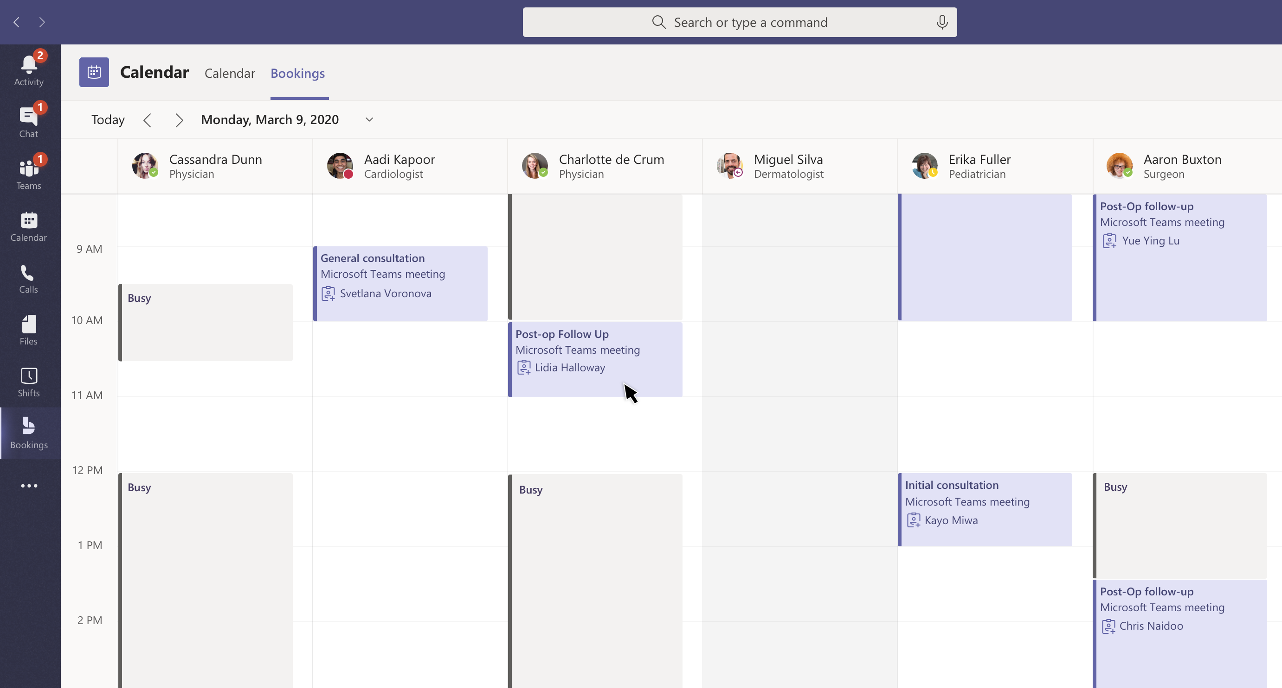
Make a plan with your entire family
Discuss as a family how best to manage schedules.
Share the load
If there are more than one responsible adult, parent, or caregiver in the house, consider dividing the day into shifts. That way, each of you will get a block of time to yourself or to focus on work.
Communicate as a family
Share your calendar with your partner or other family members so you are aware of when there are previously planned meetings or activities. Include time for set aside for household needs, family time, and me time.
Consider a routine
It can help to establish a routine (with room for changes) to set expectations with children and other adults. Don’t forget to carve out breaks to spend time with your entire family, including times for outdoor activities, breaks for meals, and more.
Share your Outlook calendar with other people
Use shared family calendars in Outlook.com to share the schedule with the entire family.

Slide 7
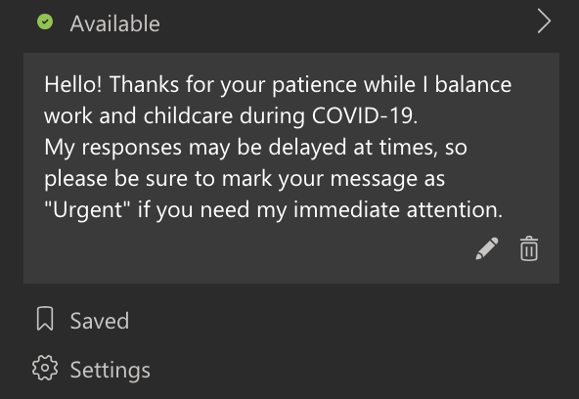
Communicate with your stakeholders
Set expectations with your team and stakeholders on your availability. Don’t feel you need to apologize for your modified hours, this is a unique situation and we’re all doing our best.
Communicate your availability
Communicate availability through i.e. a status message in Microsoft Teams, an OOF message in Outlook, or by blocking offline hours on your calendar. If your schedule changes frequently, let people know that your responses might be delayed and how to reach you with anything urgent or who to contact instead.
Share updates regularly
Communicate any changes to your stakeholders and regularly provide updates on your deliverables so that they can plan work on their side accordingly. Be sure to share only with those who need to know to make it easy for others to prioritize.
Make meetings count
To prioritize your time, ask for a meeting agenda ahead of time, and determine if you are a required or optional attendee. Schedule meetings to conclude five minutes before the end of the hour or half hour to avoid uninterrupted back-to-backs.
Set a status message in Teams and update your calendar to indicate if you are free or busy.
Start using Planner in Teams to organize and prioritize action items across a group of people.

Slide 8
Tips for working from home with newborns and toddlers

Slide 9
Newborns and toddlers
Be flexible about your workspace and explore options to be productive without always having to be in front of your laptop.
Go wireless
Consider wireless headphones so you can join a call hands-free while tending to your baby when needed. This is a great option when you have meetings that don’t require you to be in front of your laptop.
Walking meetings
Try taking a call while going on a stroller walk with your little one. Not only is this a great way for you and your child to get some fresh air, but you also get some physical activity.
Have a baby monitor?
During nap time, leverage a baby monitor to keep track of your children while taking care of some work or other tasks at home.
Please note: These are practices shared by parents at Microsoft. We understand that every family and situation is different and not all may be applicable to you. Please do what works best for your family.
Try Teams Meetings on mobile to conduct check-ins and get outside.

Slide 10
Tips for working from home with elementary-age children and teenagers

Slide 11
Elementary-age children, pre-teens, and teenagers
Engage your children in fun-filled activities and adjust your environment to create focus time.
Communicate with your children
Let your children know that you will be working during certain hours and set boundaries. Develop a signal for them to understand that right now is not a good time and practice it with them.
Try new games and activities
Engage your children in autonomous arts and crafts projects (puzzles, sticky mosaics, Legos) to keep them entertained; set a timer and let them know you’ll discuss what they’ve created once time is up.
Block out background noise
If you are able to trade off childcare with another person, try using noise cancelling headphones, a white noise app/ playlist, etc. to maximize concentration and avoid unintended distraction.
Please note: These are practices shared by parents at Microsoft. We understand that every family and situation is different and not all may be applicable to you. Please do what works best for your family.
In Teams Meetings, try out the background blur option.

Slide 12
Elementary-age children, pre-teens, and teenagers
Encourage autonomous learning and activities, and consider new ways to engage your older children, while checking in often.
Find the right balance
Strike a balance between “screen-off” and “screen-on” time periods. Encourage going outside, reading, or journaling, but realize there is great content to be consumed across devices.
Explore popular virtual experiences
Offer new digital learning experiences, such as virtual museum tours, farms, or the solar system.
Get them moving!
Encourage kids and teenagers to be active by committing to exercise breaks together (i.e., yoga, meditation, moderate circuit training exercises).
Please note: These are practices shared by parents at Microsoft. We understand that every family and situation is different and not all may be applicable to you. Please do what works best for your family.
Schedule breaks in your calendar to check in with your children.
Get to know the Office 365 distance learning tools made to support learners of all ages and abilities, and see how your child’s core subjects and class discussions can happen virtually with support from Microsoft Education.

Slide 13
Resources

Slide 14
Resources for all ages
LinkedIn Live Q&A—working from home with children
Microsoft Family Learning Center—collection of free learning experiences for ages 3 to 12
Microsoft family fun activities—puzzles, drawing challenges, doodling, and more
Activities for all ages (long)—a compilation of various activities across math, reading, history, and more
Free worksheets—printable worksheets for a variety of subjects
Khan Academy—online learning platform with engaging topics for all ages
75 indoor activities—activities for learning, imagining, and exploring with children
Virtual field trips—virtual explorations of zoos, museums, monuments, and more
Online small group classes—over 10,000 online classes ranging from tech to writing
Home management and childcare tips—guidance on managing your home, and resources for additional assistance
Resources for elementary-age children
Learn at home: Pre–K-K, grades 1–2, grades 3–5, grades 6+—educational materials from Scholastic that cover an array of subjects
Arts and crafts and activities for indoor and outdoor entertainment—fun, creative projects that pique new interests
Art projects brought to you by Arts for Kids Hub—fun art activities that engage the artistic side of the brain
Resources for pre-teens and teens
Journaling or guided mediation—Practices to promote self-care and awareness
Virtual museum tours, virtual park tours—tours of museums or national parks right from the living room
Radiolab, Forever Ago, or Science Friday—educational and storytelling podcasts
Kid-friendly documentaries—Science, nature, and history documentaries that you can stream on Netflix
Please note: the resources listed include external links, Microsoft does not own or control the content.

Slide 15
Learn more
Find general tips in the Working From Home Guide
Notes:
Additional information that can be added to this page:
links to additional information and resources

