Slide 1
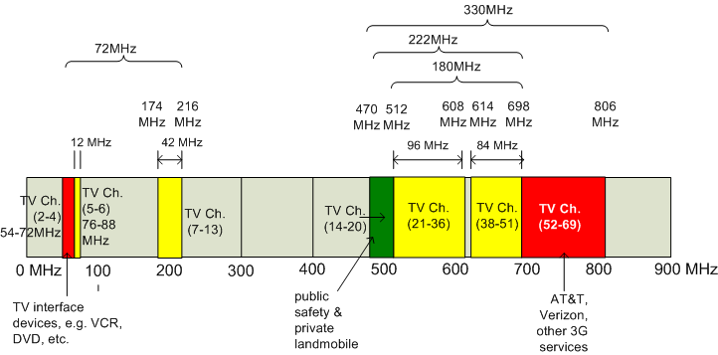


White Space Networking
Status Update
Ranveer Chandra, Thomas Moscibroda, Victor Bahl
WS
August 14, 2010

Slide 2

A Comprehensive Approach
Strategy & Policy
Work with regulators to nail down sensible specifications
Research
Identify & solve technical problems
Business
Product
Gather requirements & nail down specs
Help policy teams with recommendations based on solid science
Identify Applications & Services
Help achieve world-wide harmonization
Engage with silicon vendors & system integrators
Help create industry Standards
Harden research code, develop & test on Windows
Develop business models
Build proof-of-concept prototypes
Build community mindshare
Build alliances for greater connectivity

Slide 3
Microsoft's Cognitive Networking Research Program (2005-…)
Version 1: Ad hoc networking in white spaces
  700 MHz operation, TV sensing capability, one-to-one opportunistic networking, control-channel based MAC, varying channel width operation, multi-radio design, design analysis through simulations
Version 2: Infrastructure based networking (WhiteFi)
  White Space freq. operation, TV sensing Capability, limited microphone sensing, one-to-many opportunistic networking, Wi-Fi MAC, time-domain analysis (SIFT), demo-ed at Microsoft events (e.g. TechFest 2009)
Version 3: Campus-wide backbone network (WhiteFi with Geolocation)
  All of V2 + geolocation DB, Windows network stack improvements, bridging between Wi-Fi and WhiteFi, coverage in MS Shuttles

Slide 4
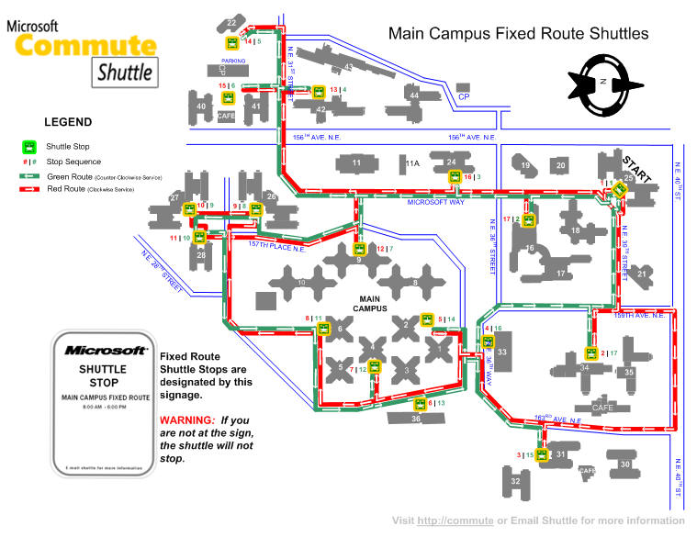
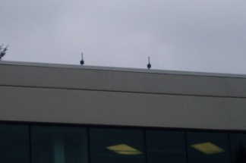
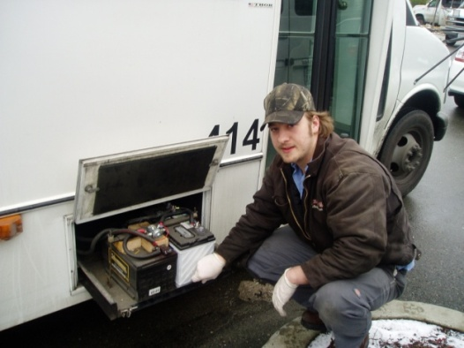
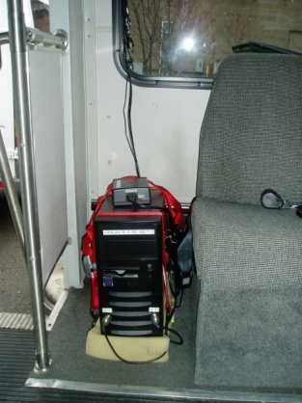
Campus Wide White Space Network (WhiteFi Network)
FCC Experimental License (Granted: July 6, 2009)
Centered at (47.6442N, 122.1330W)
Area of 1 square mile
Perimeter of 4.37 miles
WSD on 5-10 campus buildings
Fixed BS operate at 4 W EIRP
WSD inside shuttles at 100 mW EIRP
Goal: Deploy a white space network that provides corp. net access in Microsoft shuttles
6-2
6-1
1-1
5-3
4-2
4-1
1-2
5-2
5-1
3-2
3-1

Slide 5
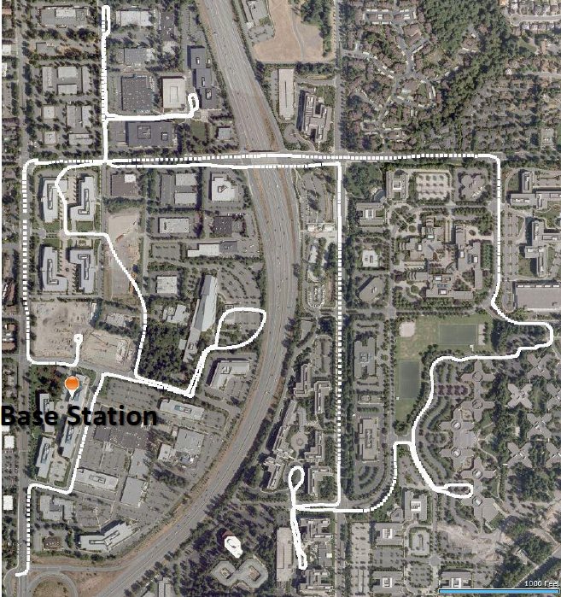
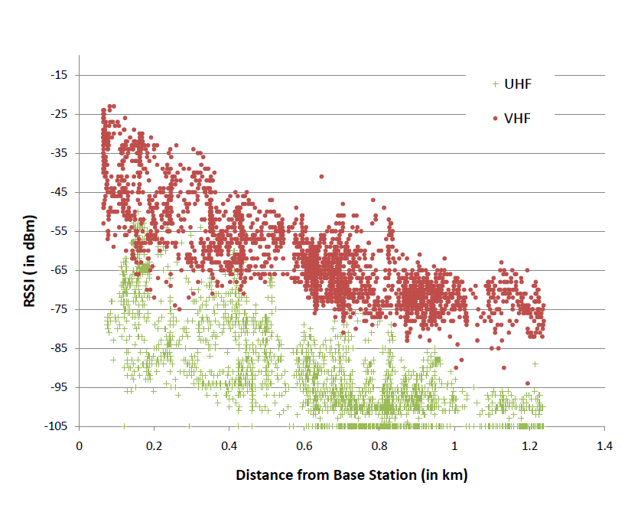
Range Experiments
Raw received power at different
Distances from the transmitter
MSR’s Redmond Campus
Route taken by the shuttle (0.95 miles x 0.75 miles)
~4x range compared to 2.4 GHz (Wi-Fi) with same transmit power and receiver sensitivity

Slide 6




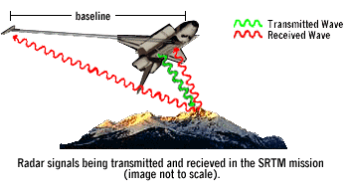

Microsoft’s Database Service
TV/MIC data
(FCC CDBS, others)
Propagation Modeling
Irregular Terrain Model (ITM) Longley-Rice (1968)
20 MHz to 20 GHz
Location
(Latitude, Longitude)
Terrain Data
(Globe, SRTM)
John Egli (1957)
Globe
Shuttle Radar Topography Mission (SRTM)
Joint Project between NASA and NIMA
Notes:
The ITS model of radio propagation for frequencies between 20 MHz and 20 GHz (the Longley-Rice model) (named for Anita Longley & Phil Rice, 1968) is a general purpose model that can be applied to a large variety of engineering problems. The model, which is based on electromagnetic theory and on statistical analyses of both terrain features and radio measurements, predicts the median attenuation of a radio signal as a function of distance and the variability of the signal in time and in space.

Slide 7
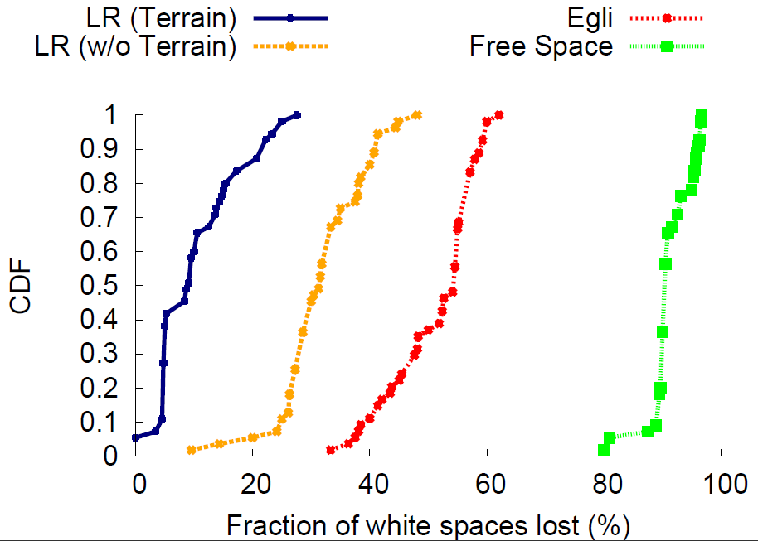
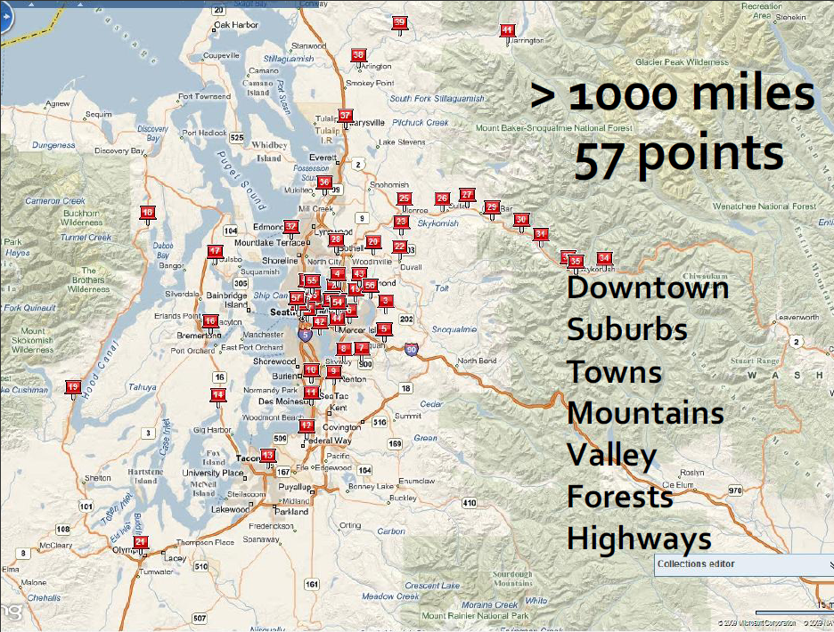
Microsoft’s Database Service
TV/MIC data
(FCC CDBS, others)
Propagation Modeling
Checking for Accuracy
Location
(Latitude, Longitude)
Terrain Data
(Globe, SRTM)
ASP.NET implementation using SOAP extensions
Fewer White Spaces lost with
Longley-Rice + SRTM

Slide 8
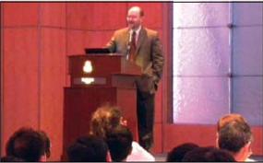

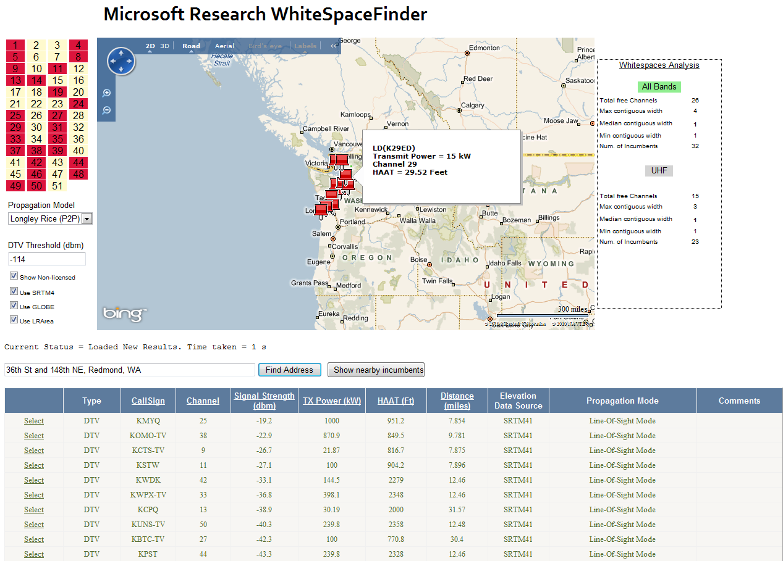




WhiteSpaceFinder Announcement http://whitespaces.msresearch.us
April 7 2010
<primary user[], signal strength[] at location>
Dan Reed, announces availability of MS White Space DB for the research community
Features
Configurable parameters
  Propagation models: L-R, Free Space, Egli
  detection threshold (-114 dBm by default)
Includes analysis of white space availability
(forthcoming) Internationalization of TV tower data
Collaborators

Slide 9
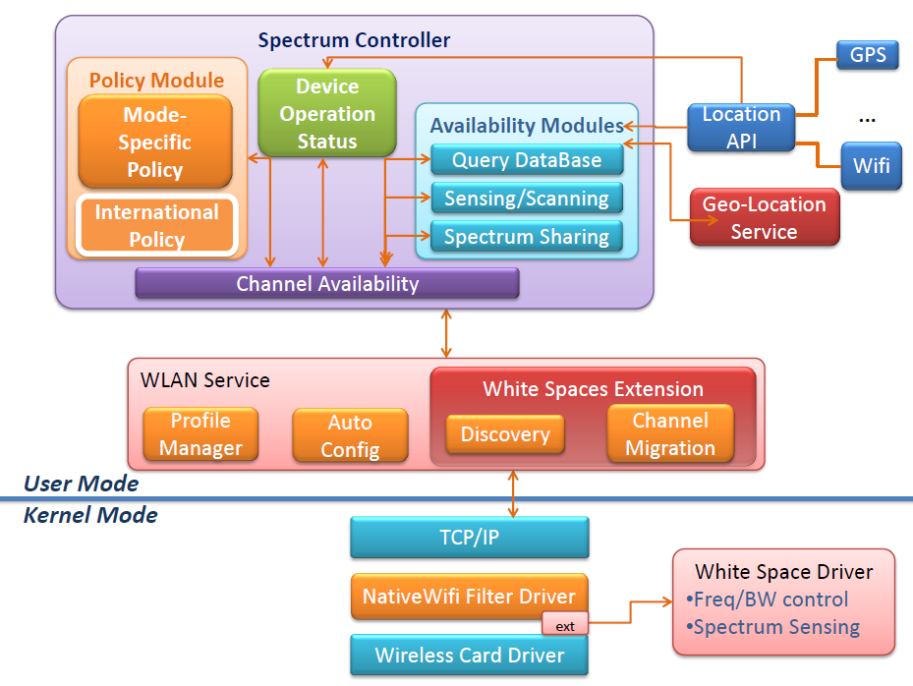
Windows 7 Software Stack Improvements

Slide 10
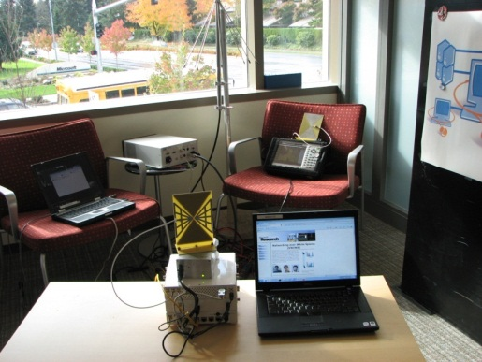
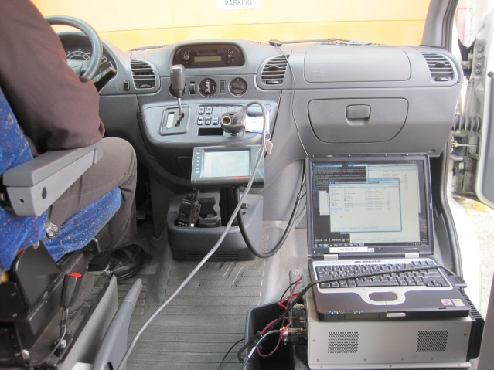
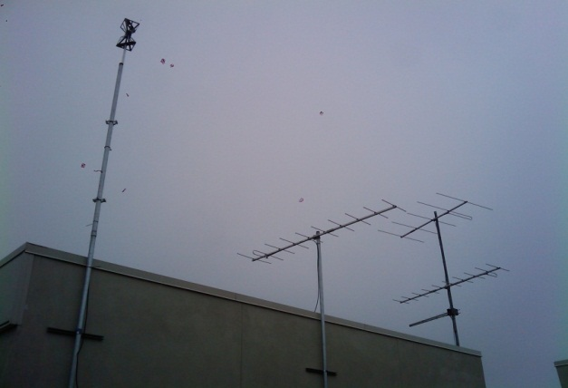
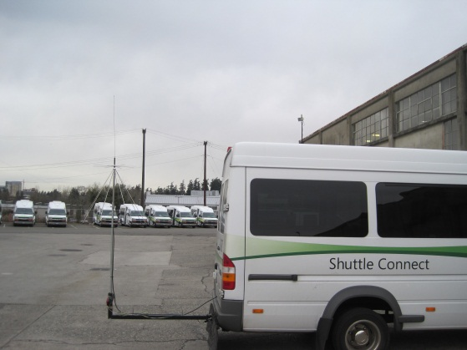
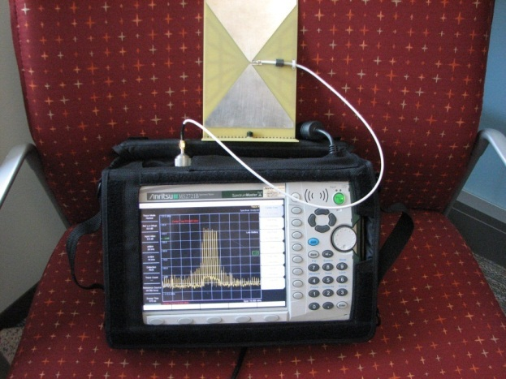
First Urban White Space Network in the World
Oct. 16, 2009
White Space Network Setup
Shuttle Deployment
WS Antenna on Bldg 42
WS Antenna on MS Shuttle
Data packets over UHF

Slide 11







Public Demos & Policy Influence
Office of Communications (UK)
June 10, 2010
India
Oct. 22, 2009
USA
Apr. 28, 2010
China
Jan. 11, 2010
Singapore
Apr. 8, 2010
Brazil
(Feb. 2, 2010)
Industry Partners
Jan. 5, 2010
US Research Funding
Nov. 9 2009
Fisher Communications Inc.
Jan. 14, 2010

Slide 12
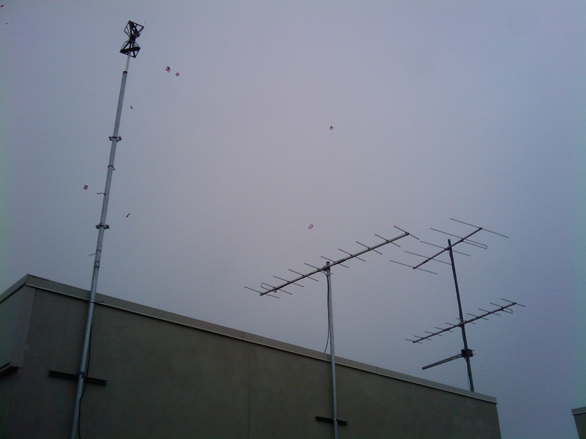
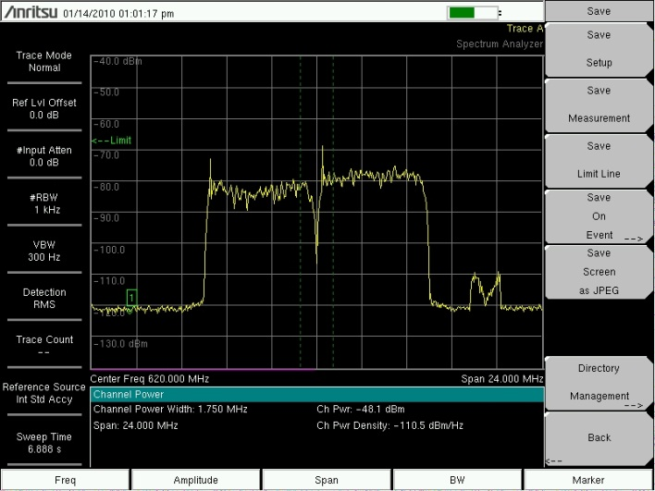
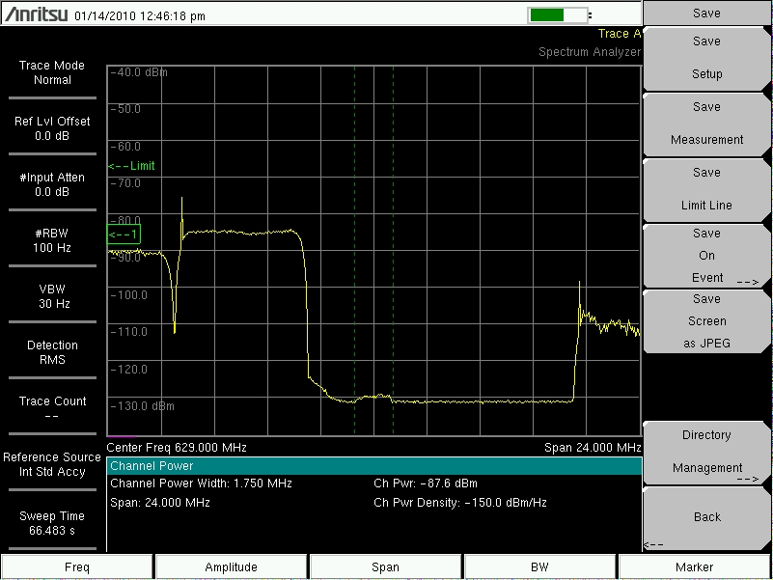
WhiteFi and Broadcast TV
WhiteFi Antenna
TV Antennas
KOMO (Ch. 38)
KIRO (Ch. 39)
WhiteFi (Ch. 40)
Microsoft Campus Redmond (Bldg 41)
WhiteFi transmitting at 40 mW
WhiteFi (Ch. 40)

Slide 13
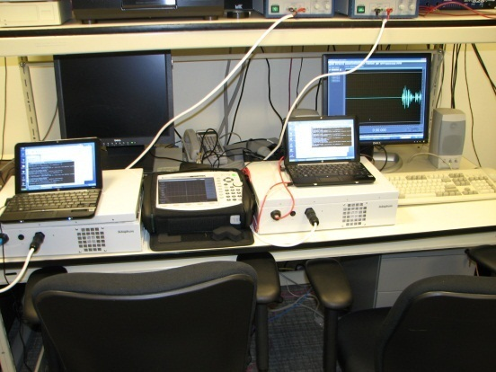
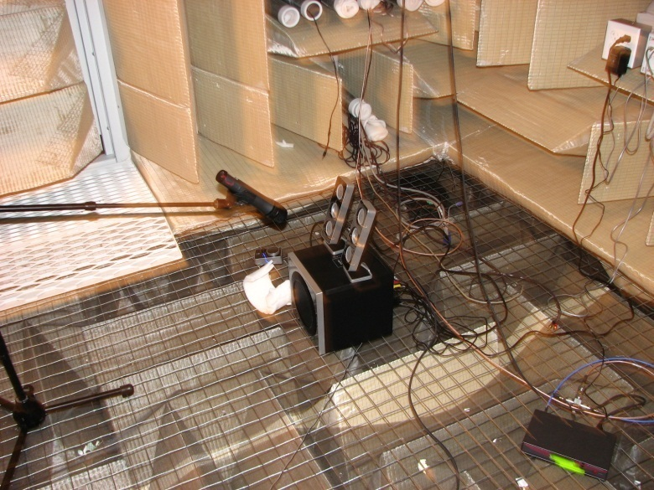
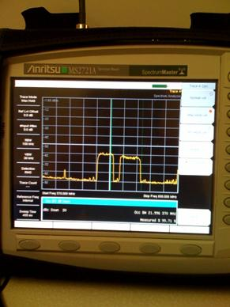

Co-existing with Microphones
Subcarrier Suppression setup
Microphone recording in Anechoic Chamber
Results
Subcarrier
Suppression
Original
Without SCS
With SCS

Slide 14

Looking Internationally (Europe)
Digital Conversion in Europe
  UK: End of 2012 – London region is the last to convert
  Finland – Complete
  Spain – Complete
  Germany – Complete
  France – End of 2011
United Kingdom (OFCOM)
  Geo-location OR sensing permitted.
  Consultations on enabling legislation and
  geolocation-database services expected this fall.
Other Countries
  European Commission’s CEPT SE43 group addressing technical issues.
  Finland’s Ministry of Transport and Communications has invited proposals for white space trials.
  Sweden’s National Post and Telecoms Agency is looking into enabling access to TV white spaces.
Notes:
DTT sensing requirement is -120 dBm

Slide 15

Looking Internationally (Others)
Singapore, IDA
  7 April 2010, IDA announced the 'White Space
  Technology Information Package and Test Plan‘
  July 31, announced white space trials, named Cognitive Radio Venues ("CRAVE")
  Investigating WS applications to show commercial value
Brazil, Ministry of Communications and Anatel
  Considering pilot projects, along the lines of Microsoft’s WhiteFi Campus deployment
Japan, Ministry of Internal Affairs and Communications
  Considering proposals for white spaces trials. 103 proposals received.

Slide 16
Standardization Status
Goal: Align industry towards a commercially feasible solution
    Develop usage models & marketing requirements
    Agree on a technical solution
Participants: Diverse group of network operators, chip vendors, device manufacturers, and others.
Direction
IEEE 802.11af: Task Group Formed
  Define the PHY
  Minimum MAC enhancements
Wi-Fi Alliance: TV White Spaces Marketing Task Group Formed
  Develop roadmap for a certification program
  MAC enhancements + database specifications

Slide 17



Global Standardization Status
ECMA – 392 (CogNEA Group) Edition 1, December 2009
  New MAC and PHY for Operation in TV White Space
  BT, Cambridge Consultants, ETRI, Philips, Samsung Electro-Mechanics, MaxLinear, Georgia Electronic Design Center (GEDC) and Motorola
IEEE 802.22: Wireless Regional Area Network (WRAN) utilizing white spaces
  Point to multi-point operation (star topology)
  Clients are homes equipped with antennas (EIRP @ BS 4W - Range about 30 km)
  Distributed Sensing - CPEs share sensing information with BS
IEEE 802.11af Task Group:
  Want to adapt 802.11 for TV white space
  OFDM PHYs with 5-, 10- and 20-MHz channel widths to specify the basis for a system that the regulators can approve
  Working closely with WS Alliance

Slide 18
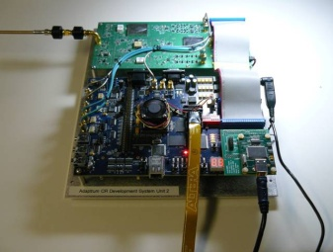
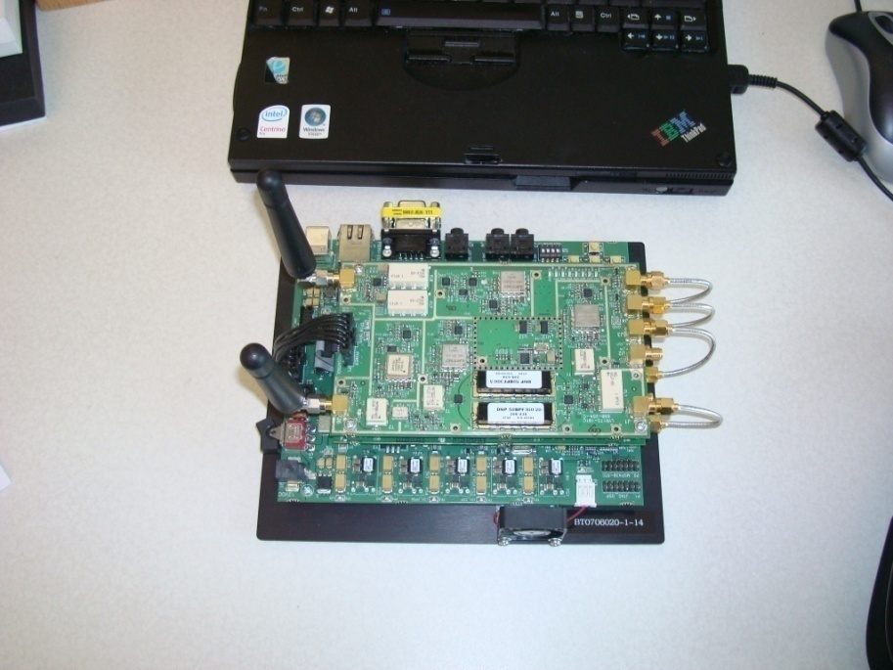
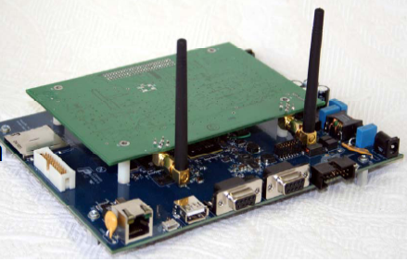
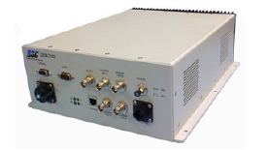
Hardware OEMs
Have some operational hardware
Status of Industry Products
Adaptrum Inc., Shared Spectrum Inc., Cambridge Consultants, Neocific Inc., Ubiquity XR7, TI Lyrtech, …
Shared Spectrum
Adaptrum
Lyrtech
Neocific
Potential Database Providers
Have filed with the FCC
Google, Comsearch, Frequency Finder, KB Enterprises, Neustar, Spectrum Bridge, Telecordia, White Spaces DB, LLC.

Slide 19
Our Contributions to Standards
Best Paper
SIGCOMM 09
Fast discovery mechanism
  Enable clients to quickly discover an AP over all <channel, width> pairs
Fast recovery mechanism on disconnection
  Re-connects quickly on a new available channel upon sensing a primary user on existing channel
Spectrum assignment algorithm
  Enables AP to pick a channel that is free for all clients AND pick the best possible channel width
PC
Raw (I, Q)
WS Radio
SDR
TV/MIC
Detection
FFT
Altera FPGA
UHF Rx Daughterboard
Net
Stack
Temporal Analysis
(SIFT)
(fc, df)
(fc, df)
Serial Control Interface
Connection Manager
Device Driver (Atheros)
Wi-Fi Substrate
UHF
Translator
UHF Transmissions

Slide 20
Our Contributions to the Community (1)
Open about identifying problems and sharing research results
Research Results & Technology | Publication Venue
Co-existence with wireless microphones | In-preparation
Harmonious operation in heterogeneous environment | In-preparation
Enhancements to the software stack | White paper (Tech Report)
Fast discovery & connectivity in ad hoc mode | In-preparation
Secure collaborative sensing | IEEE DySPAN 2010
Temporal analysis (SIFT) & Spectrum assignment for AP Operation (MCham) | ACM SIGCOMM 2009 (Best paper)
Dynamic channel width operation | ACM SIGCOMM 2008
Load aware spectrum distribution | IEEE ICNP 2008
Dynamic time spectrum blocks | ACM MobiHoc 2007
Control channel medium access protocol | IEEE DySPAN 2007
Spectrum leasing | IEEE DySPAN 2006
Separation of control & data | IEEE BroadNets 2006

Slide 21




Our Contributions to the Community (2)
Founding Member & Steering Committee Member IEEE DySPAN (since inception in 2005)
Organizerd MSR Cognitive Wireless Networking Summit 2008, June 2008 (Snoqualmie, WA)
Guest Editor, IEEE Journal on Selected Areas in Communications, Special Issue on Advances in Cognitive Radio Networking and Communications
Tutorial on White Space Networking, Summer School in Networking, Bangalore, India (June 2009)
General Co-Chair of IEEE Workshop on Cognitive Wireless Communications and Networking
General Chair of IEEE DySPAN 2012 (Committed)
Program Committee Member, IEEE DySPAN 2005, 2007, 2008, 2010
Steering Committee
MSR Event
Special Issue Editor

Slide 22





Our Collaborations with Universities
White space mesh networks for rural communities
Chanel occupancy database design & related issues
Harmonization between
heterogeneous white space networks
Security & privacy in white space networks
Smart antennas, interference mitigate & internationalization
The SORA Program

Slide 23
Sharing Vision and Research Directions
Keynotes on WS Networking
The Fifth International Conference on Mobile Computing and Ubiquitous Networking (ICMU 2010), Seattle, Washington, US (April 2010)
The 7th IEEE/IFIP International Conference on Embedded and Ubiquitous Computing (EUC 2009), Vancouver, Canada, August 31, 2009
The Fifth Euro-NGI Conference on Next Generation Internet Networks, July 2, 2009
The Sixth International Conference on Wireless On-demand Network Systems and Services, Salt Lake City, Utah, February 2, 2009
Workshop on Wireless Broadband Access for Communities and Rural Developing Regions, December 11, 2008
Second IFIP International Symposium on Wireless Communications and Information Technology in Developing Countries, October 7, 2008
MSR’s Cognitive Wireless Networking Summit, Snoqualmie, Washington, USA, June 4, 2008
First International Workshop on Cognitive Dynamic Systems and Their Applications, May 27, 2008
Intel's Communications Internal Senior Leadership Conference (ICOMM 2008), April 9, 2008
The Third International Conference on Communication System Software and Middleware (COMSWARE 2008), January 8, 2008
The Ninth International Conference on Distributed Computing and Networking (ICDCN), January 6, 2008

Slide 24
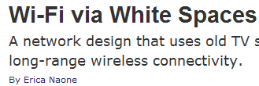


Sample Press
Over 50 articles (that we have tracked)

Slide 25
Accolades from Mainstream Media
The project, dubbed “White Fi,” is one of the most advanced in the field, both dealing with the hardware side but also creating the networking protocols to handle the specific challenges.
    Softpedia (Aug. 19, 2009)
Microsoft researchers have taken a step closer to finally turning unused analogue TV spectrum, known as "white spaces", into unlicensed spectrum that can be used to deliver new wireless broadband service
    CNET.COM (Aug. 19, 2009)
The Microsoft Research team has addressed many of these issues with WhiteFi. —that early promise of "WiFi on steroids" might turn out to be surprisingly accurate, after all.
    Nate Anderson, Ars technica, August 27, 2009
The actual engineering requirements to accomplish this frequency switch are non-trivial. Microsoft Research’s ”KNOWS” project has taken up the task and made some pretty remarkable advances.
    Scott Merrill, Crunchgear, August 28, 2009
One of the best prospects for the future is the opening up of “white spaces,” unused parts of the spectrum. One of the most advanced research projects…..
    Lucian Parfeni, Web News, August 18, 2009
Microsoft researchers have taken the next step toward turning old UHF analog TV spectrum into rural wireless broadband networks that would operate like Wi-Fi but with greater range.
    Simon Juran, GigaOm, August 18, 2009-09-02

Slide 26
To Succeed
Wi-Fi +
WhiteFi
Multimodal radios integrated into devices
Geo-location databases available
Software Support
Industry standards complete
World-wide harmonization progresses
FCC finalizes rules
2-3 SFF hardware devices available

Slide 27

Thanks
http://research.microsoft.com/en-us/projects/knows/

