Slide 1

Low-cost, Long-Range Connectivity over the TV White Spaces
Ranveer Chandra
Collaborators:
Thomas Moscibroda, Victor Bahl, Ivan Tashev
Rohan Murty (Harvard), George Nychis (CMU), Eeyore Wang (CMU)

Slide 2
The Big Spectrum Crunch
FCC Broadband Plan calls it the “Impending Spectrum Crisis”
Limited amount of good spectrum, while demand increasing
  Smartphone growth projected to double by 2014 (iSuppli 2010)
  Increasing demand for media (YouTube, NetFlix)
CTIA has requested for 800 MHz by 2015
FCC promises to provide 500 MHz by that time
“Globally, mobile data traffic is expected to double every year through 2013. Whether an iPhone, a Storm or a Gphone, the world is changing. We’re just starting to scratch the surface of these issues that AT&T is facing.”, Cisco Systems, 2009
“Customers Angered as iPhones Overload AT&T”
Headline in New York Times , 2.Sept 2009
“The industry is quickly approaching the point where consumer demand for mobile broadband data will surpass the telecommunication companies’ abilities to handle the traffic. Something needs to happen soon” De la Vega, chair of CTIA, 2009
“Heaviest Users of Phone Data Will Pay More”
Headline in New York Times , 2.June 2010

Slide 3
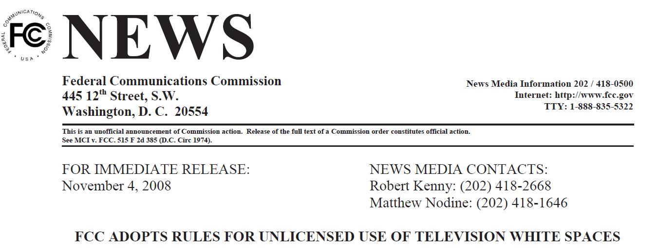
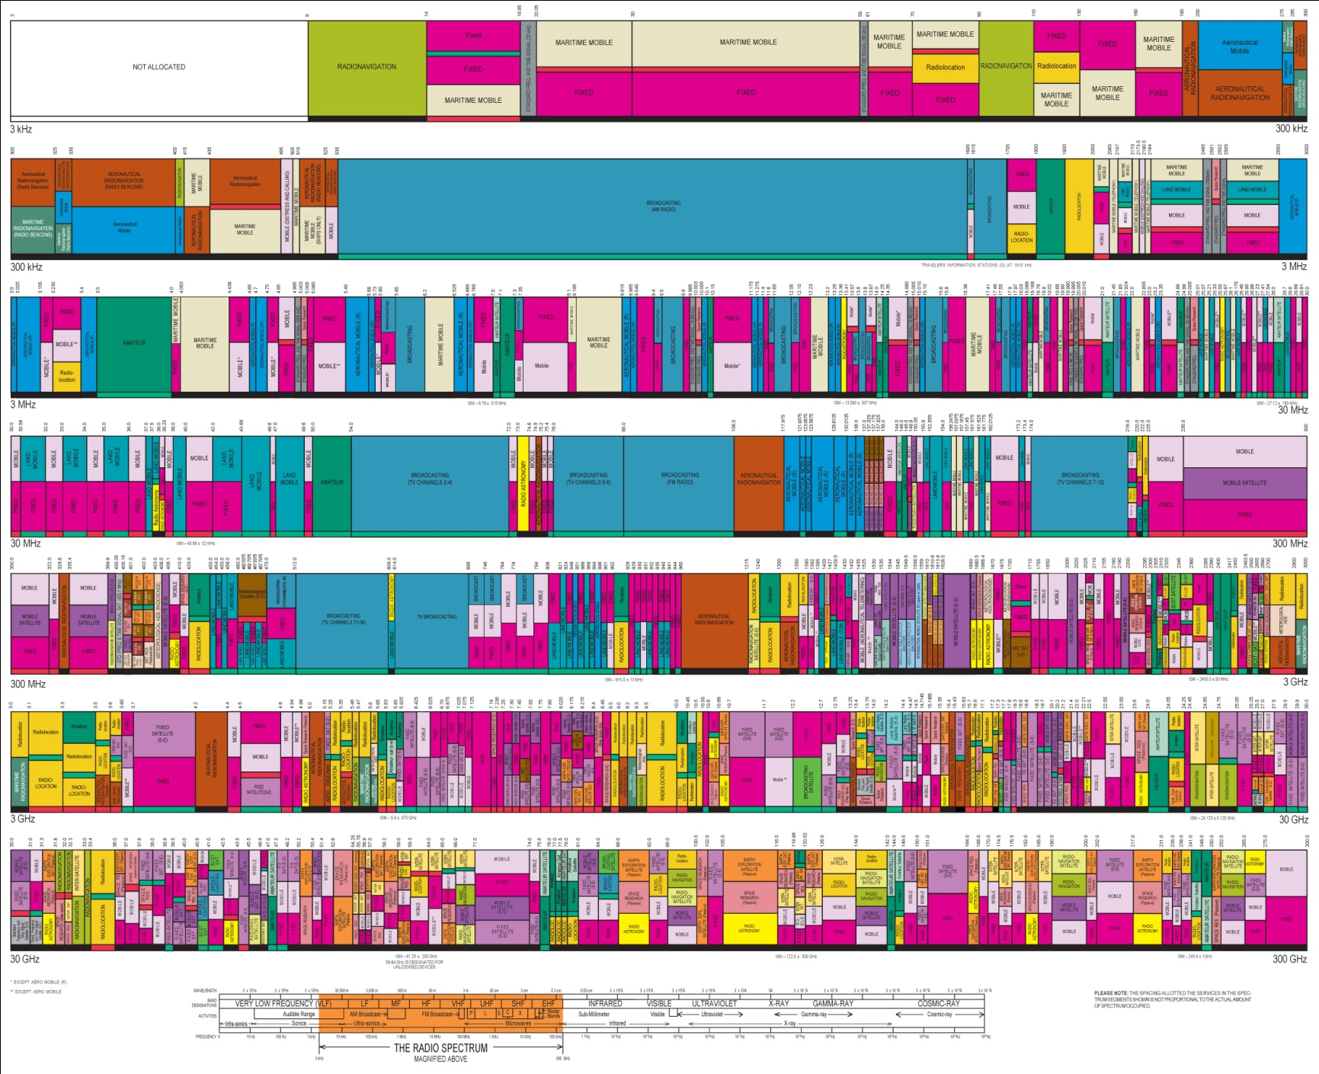



Analog TV → Digital TV
USA (2009)
Japan (2011)
Canada (2011)
UK (2012)
China (2015)
….
….
…..
Higher Frequency
Broadcast TV
Wi-Fi (ISM)

Slide 4


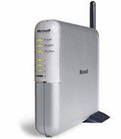
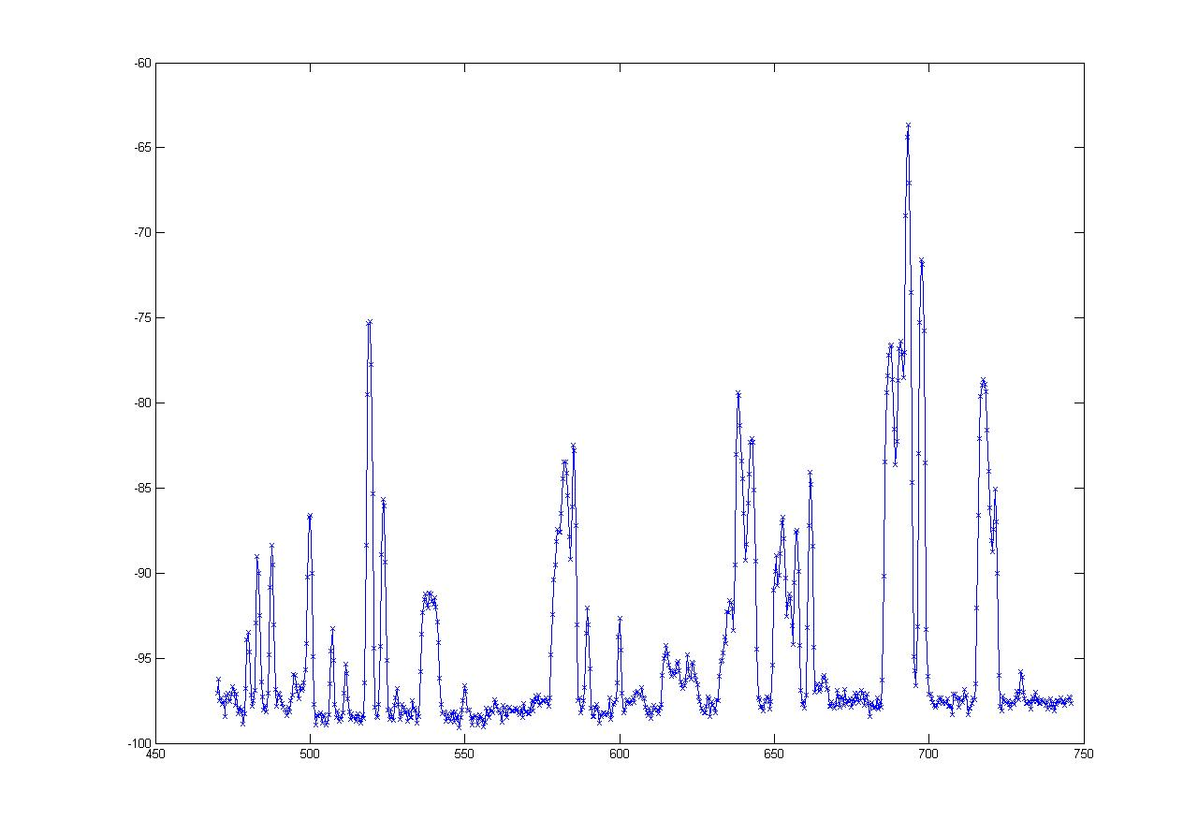
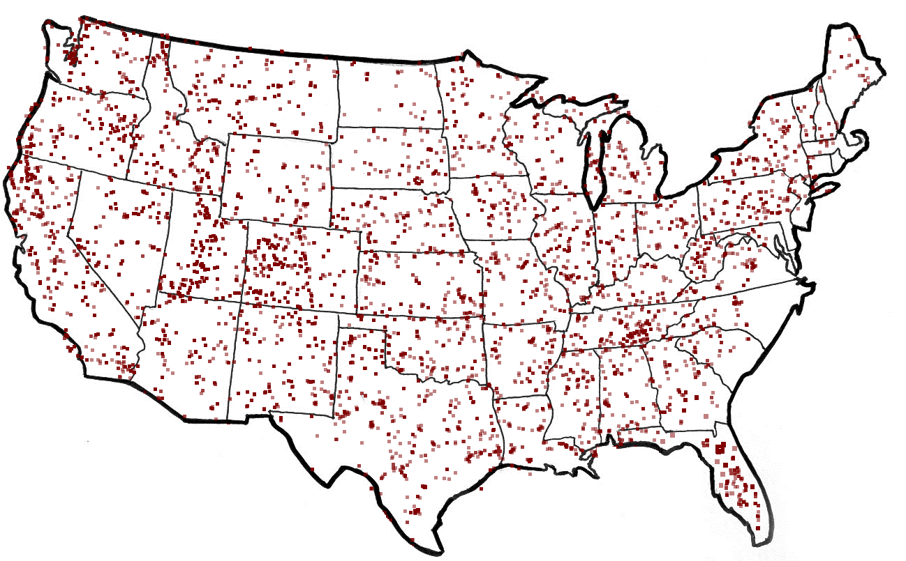
What are White Spaces?
TV
Wireless Mic
ISM (Wi-Fi)
0
MHz
54-88
170-216
470
700
2400
2500
5180
5300
7000
MHz
  50 TV Channels
  Each channel is 6 MHz wide
-60
“White spaces”
dbm
TV Stations in America
-100
470 MHz
Frequency
700 MHz
are Unoccupied TV Channels
White Spaces
Notes:
-Prime real estate like a beach front mansion
-Modern day equivalent of the Airbus 380

Slide 5
Why should we care about White Spaces?

Slide 6
The Promise of White Spaces
TV
Wireless Mic
ISM (Wi-Fi)
0
MHz
470
700
2400
2500
5180
5300
54-90
174-216
7000
MHz
}
Up to 3x of 802.11g
More Spectrum
Potential Applications
Rural wireless broadband
City-wide mesh
Longer Range
……..
……..
at least 3 - 4x of Wi-Fi
Notes:
-Prime real estate like a beach front mansion
-Modern day equivalent of the Airbus 380

Slide 7




Goal: Deploy a Campus-Wide Network
Base Station
(BS)
Good throughput for all nodes
Avoid interfering with incumbents

Slide 8
Why not reuse Wi-Fi based solutions, as is?

Slide 9
White Spaces Spectrum Availability
Differences from ISM(Wi-Fi)
Fragmentation
Variable channel widths
1
2
3
4
5
1
2
3
4
5
Each TV Channel is 6 MHz wide
Spectrum is Fragmented
⇒ Use multiple channels for more bandwidth
Notes:
-DO NOT SAY POPULATION DENSITY IS INVERSELY PROPORTIONAL TO WHITESPACES AVAILABILITY

Slide 10
White Spaces Spectrum Availability
Differences from ISM(Wi-Fi)
Fragmentation
Variable channel widths
Spatial Variation
Cannot assume same
channel free everywhere
1
2
3
4
5
1
2
3
4
5
TV
Tower
Location impacts spectrum availability
⇒ Spectrum exhibits spatial variation

Slide 11


White Spaces Spectrum Availability
Differences from ISM(Wi-Fi)
Fragmentation
Variable channel widths
Spatial Variation
Cannot assume same
channel free everywhere
1
2
3
4
5
Temporal Variation
1
2
3
4
5
Same Channel will
not always be free
Any connection can be
disrupted any time
Incumbents appear/disappear over time
⇒ Must reconfigure after disconnection

Slide 12

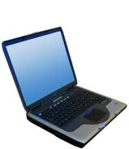
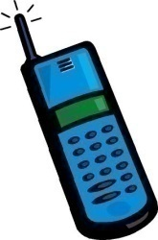
Cognitive (Smart) Radios
Dynamically identify currently unused portions of spectrum
Configure radio to operate in available spectrum band
  → take smart decisions how to share the spectrum
Signal Strength
Signal Strength
Frequency
Frequency

Slide 13
Networking Challenges
The KNOWS Project (Cogntive Radio Networking)
How should nodes connect?
How should they discover
one another?
Which spectrum-band should two
cognitive radios use for transmission?
  Frequency…?
  Channel Width…?
  Duration…?
Need analysis tools to reason about capacity & overall spectrum utilization
Which protocols should we use?

Slide 14
MSR KNOWS Program
Version 1: Ad hoc networking in white spaces
  Capable of sensing TV signals, limited hardware functionality, analysis of design through simulations
Version 2: Infrastructure based networking (WhiteFi)
  Capable of sensing TV signals & microphones, deployed in lab
Version 3: Campus-wide backbone network (WhiteFi + Geolocation)
  Deployed on campus, and provide coverage in MS Shuttles
DySPAN 2007, MobiHoc 2007, LANMAN 2008
SIGCOMM 2008, SIGCOMM 2009 (Best Paper)

Slide 15
Deployment Setup
Goal: Provide Internet connectivity in campus shuttles
  Cover approx. 1 sq. mile
  Support existing Wi-Fi devices in the shuttle
Solution:
  Connect shuttle to base station over white spaces
  Bridge white space to Wi-Fi inside the shuttle
Obtained FCC experimental license to operate over TV bands

Slide 16
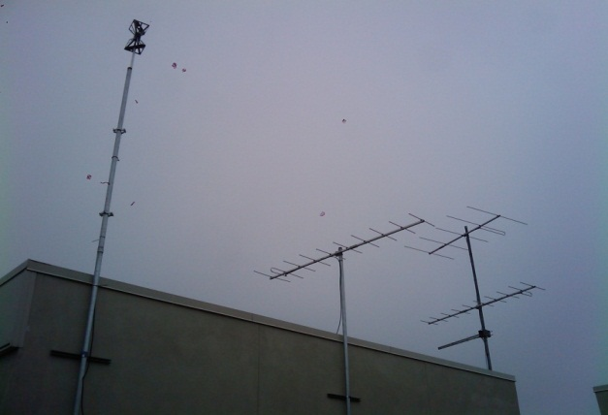
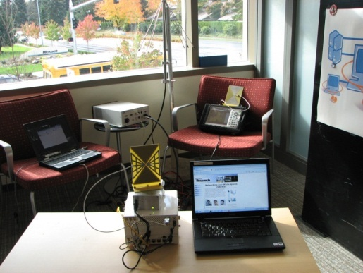
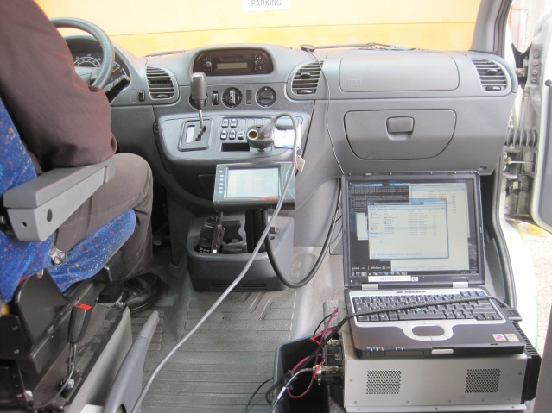
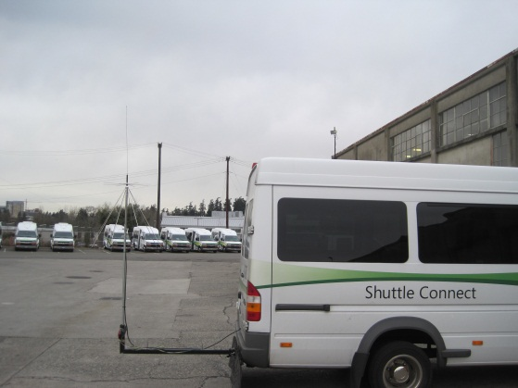
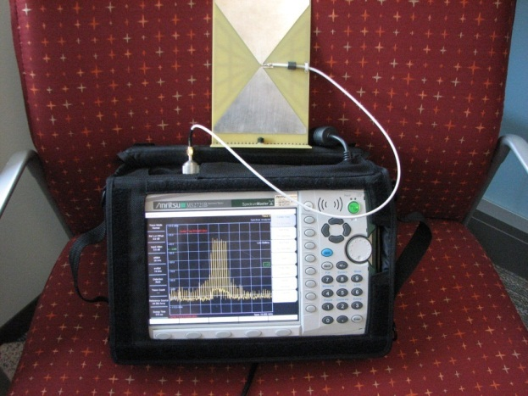
Deployment
Implemented and deployed the world’s first operational white space network on Microsoft Redmond campus (Oct. 16, 2009)
White Space Network Setup
Shuttle Deployment
WS Antenna
WS Antenna on MS Shuttle
Data packets over UHF

Slide 17
System Design
Hardware design
Determining white spaces
Base station placement
Channel assignment
Dealing with wireless mics
Security, discovery, …

Slide 18
Hardware Design
Send high data rate signals in TV bands
  Wi-Fi card + UHF translator
Operate in vacant TV bands
  Detect TV transmissions using a scanner
Avoid hidden terminal problem
  Detect TV transmission much below decode threshold
Signal should fit in TV band (6 MHz)
  Modify Wi-Fi driver to generate 5 MHz signals
Utilize fragments of different widths
  Modify Wi-Fi driver to generate 5-10-20-40 MHz signals

Slide 19
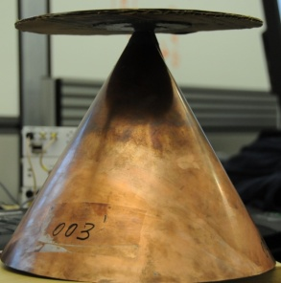
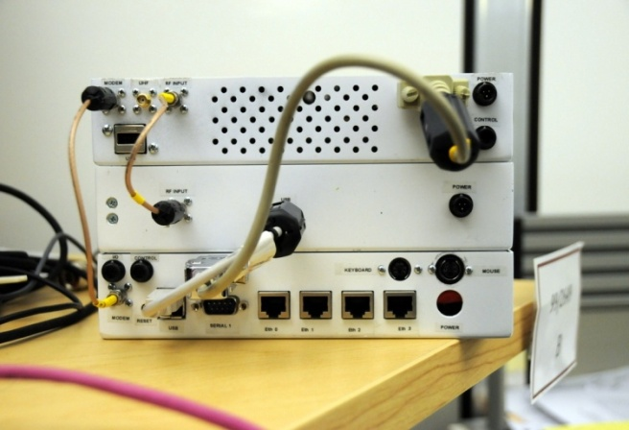
KNOWS White Spaces Platform
Windows PC
Scanner (SDR)
Net
Stack
TV/MIC detection
FFT
FPGA
UHF RX Daughterboard
Whitespace Radio
Connection Manager
Atheros Device Driver
Wi-Fi Card
UHF
Translator
Variable Channel Width Support
Notes:
-Why this architecture? Motivate why we need a scanner?
-Why do we need a translator?

Slide 20
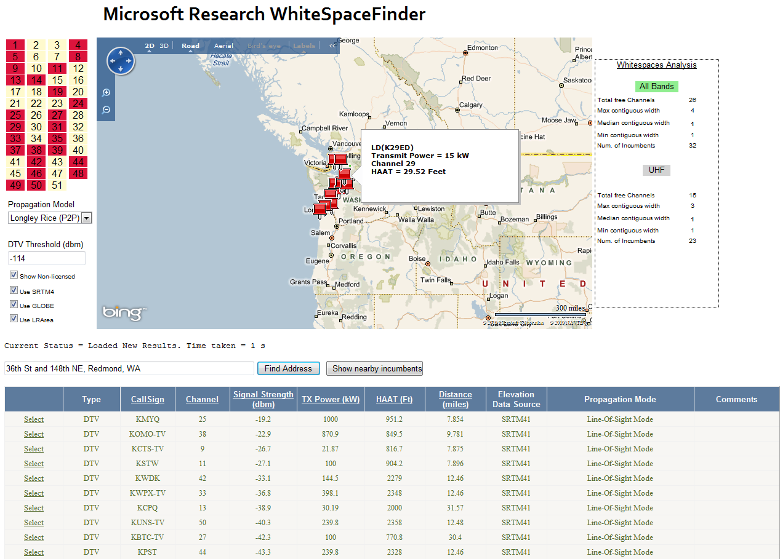
Geo-location Service
(http://whitespaces.msresearch.us)
Use centralized service in addition to sensing
  Returns list of available TV channels at given location
TV/MIC data
(FCC CDBS, others)
Propagation Modeling
<primary user [ ], signal strength [ ] at location>
Location
(Latitude, Longitude)
Terrain Data
(Globe, SRTM)
Features
Can configure various parameters, e.g.
  propagation models: L-R, Free Space, Egli
  detection threshold (-114 dBm by default)
Protection for MICs by adding as primary user
Accuracy:
  combines terrain sources for accurate results
  results validated across1500 miles in WA state
Includes analysis of white space availability
(forthcoming) Internationalization of TV tower data

Slide 21
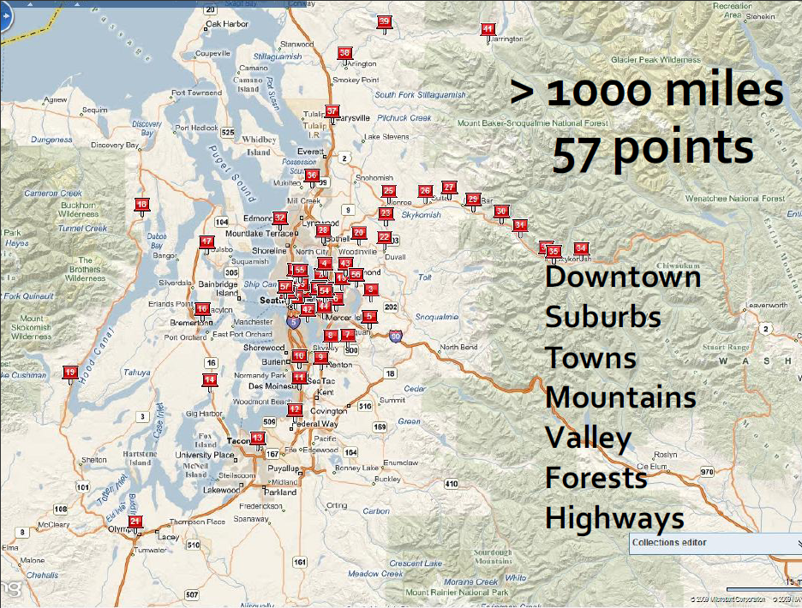
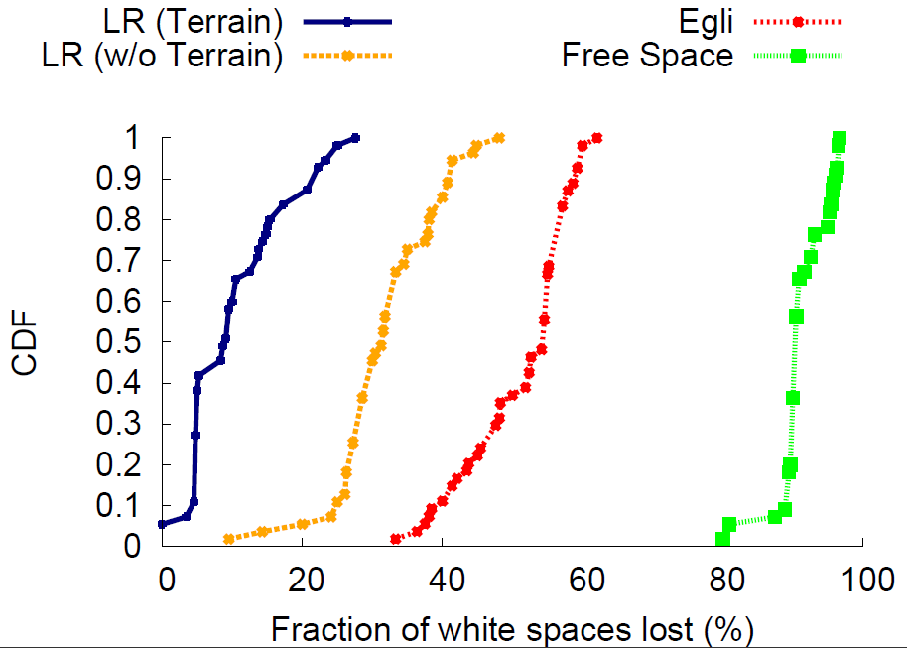
White-Fi: Geo-Location Database
Our geo-location
database
FCC mandated

Slide 22
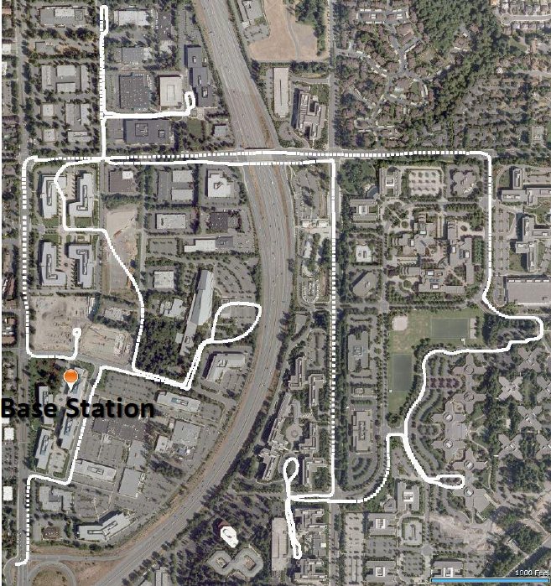
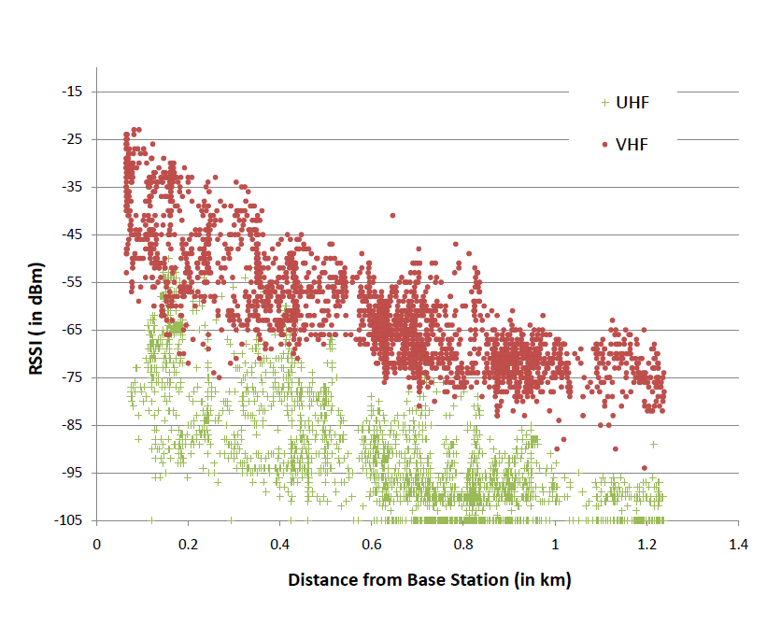
Base Station Placement
Problem: How many base stations do we need?
MSR’s Redmond Campus
Route taken by the shuttle (0.95 miles x 0.75 miles)

Slide 23
System Design
Hardware design
Determining white spaces
Base station placement
Channel assignment
Dealing with wireless mics
Security, discovery, etc.

Slide 24
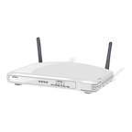
Channel Assignment in Wi-Fi
1
6
11
1
6
11
Fixed Width Channels
⇒ Optimize which channel to use
Notes:
-Well studied problem

Slide 25
Spectrum Assignment in WhiteFi
Spectrum Assignment Problem
Goal
Maximize Throughput
Include
Spectrum at clients
1
2
3
4
5
1
2
3
4
5
Center Channel
Assign
&
Width
Fragmentation
⇒ Optimize for both, center channel and width
Spatial Variation
⇒ BS must use channel iff free at client

Slide 26
Intuition
Intuition
Use widest possible channel
BS
But
Limited by most busy channel
1
2
3
4
5
Carrier Sense Across All Channels
All channels must be free
  ρ_{BS}(2 and 3 are free) = ρ_{BS}(2 is free) x ρ_{BS}(3 is free)
Tradeoff between wider channel widths
and opportunity to transmit on each channel
Notes:
-We use MAX because even when the medium is fully utilized, a node can still get a “FAIR” share of the spectrum.
-Bigger is NOT always better

Slide 27
Multi Channel Airtime Metric (MCham)
BS
MCham_{n} (F, W) =
1
2
3
4
5
Pick (F, W) that maximizes
(N * MCham_{BS} + Σ_{n}MCham_{n})
ρ_{n}(c) = Approx. opportunity node n will
get to transmit on channel c
ρ_{BS}(2) ∝
ρ_{BS}(2) ∝ Free Air Time on Channel 2
ρ_{BS}(2) = Max (Free Air Time on channel 2, 1/Contention)
Notes:
-We use MAX because even when the medium is fully utilized, a node can still get a “FAIR” share of the spectrum.

Slide 28
WhiteFi Prototype Performance
25
26
27
28
29
30
31
32
33
34
35
36
37
38
39
40

Slide 29
Accounting for Spatial Variation
1
2
3
4
5
1
2
3
4
5
1
2
3
4
5
∪
∪
=
1
2
3
4
5
1
2
3
4
5
1
2
3
4
5
1
2
3
4
5

Slide 30
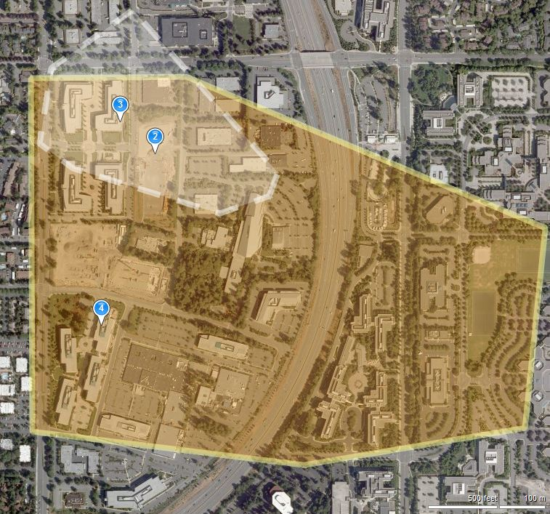
White-Fi: Local Spectrum Asymmetry (LSA)
Indoor MIC usage on campus is problematic
→ prevents clients in local neighborhood from using this channel
Base station and associated clients do not see same spectrum
as being available!

Slide 31
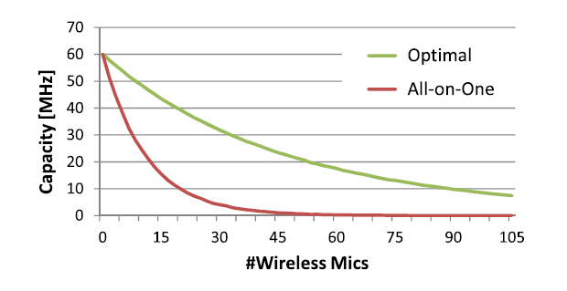
White-Fi: Impact of LSA
All-on-One protocol: All clients associated to same AP must be on same channel (e.g., Wi-Fi)
All-on-One protocols are inherently bad in the face of LSA
White-Fi deployment uses new TDMA-based MAC
  Serve different clients on different channels
  Optimally cluster clients onto few channels to 1) minimize switching cost and 2) maximize spectrum diversity

Slide 32
System Design
Hardware design
Determining white spaces
Base station placement
Channel assignment
Dealing with wireless mics
Security, discovery, …

Slide 33
MIC Protection is Super Conservative
MICs are narrowband devices
However, the FCC and regulations worldwide reserve an entire TV channel for a wireless MIC

Slide 34
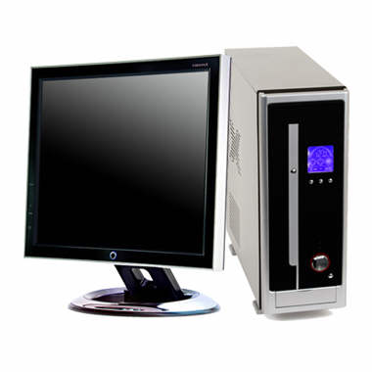

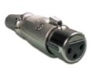
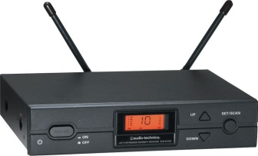
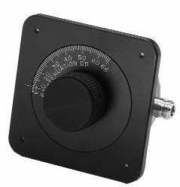
Impact of White Space Interference
Measure PESQ value for recorded speech
Anechoic Chamber
1. PC Output
to Speakers
2. MIC Recording
to Computer
White Space
Device (WSD)
Faraday Cage
3. Control interference
from WSD
Attenuator
MIC Receiver

Slide 35
Some Results
Time: Even short packets (16 µs) every 500 ms cause audible interference
Power: No interference when received power was below squelch tones
Frequency: Number of subcarriers to suppress depends on distance from MIC receiver

Slide 36
Which frequencies to suppress?
Possible Solutions:
  WSDs sense for MICs at very low thresholds
    Extremely difficult to get right, very expensive
  MICs reserve center frequency in the DB
    Will still have to be conservative
Our Approach: New device at MIC receiver signals when receiver is likely to face interference
  When WSD interference is greater than squelch tones

Slide 37
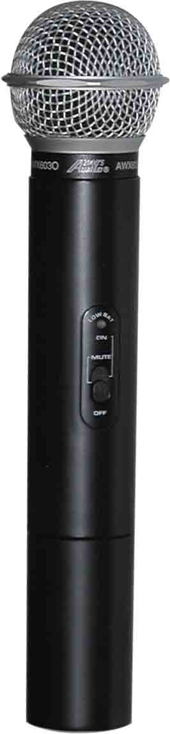
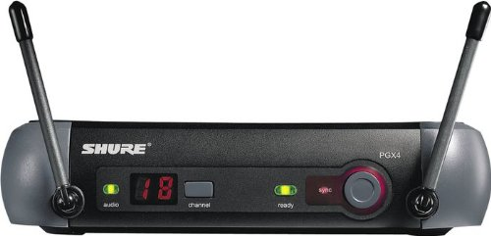
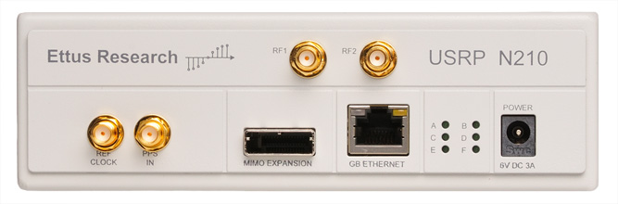
SEISMIC System Overview
MicProtector – placed near mic receiver
  Enables interference detection at the mic receiver
  Notifies WSD of impending disruption to audio
    Leverages understanding gained from measurements
MicProtector
White Space Device
Mic Receiver
Mic

Slide 38
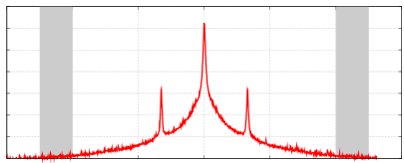
MicProtector Design
Implements three key components:
  Interference Detection: estimated in control bands
  Interference Protection: monitors squelch & noise
  Impending Interference Notification: strobe signals
Control
Strobe
(on-symbol)
Control
Band
Band
Interference
Level
Amplitude
Protection
Threshold
25KHz
Frequency
25KHz

Slide 39
Strobing
Strobes convey: impending audio disruption,
mic operational band & center frequency
Similar to Morse-code and on/off-keying (OOK)
  Quickly introduce/remove power in a pattern
  Only requires simple power generation/detection
Amplitude
Frequency

Slide 40

SEISMIC Protocol
WSD: sends short probes with increasing TX power, suppresses frequency when strobed.
MicProtector: monitors interference and strobes WSD if the power in the band reaches threshold.
Pkts:
Probe
Strobe
MicProtector Strobes the WSD
for interference near threshold
Convergence
To Coexistence
MicProt.
WSD
125
125
Increase in Power
125
25
50
50
75
100
Suppressed Frequency (KHz)
Time

Slide 41
SEISMIC Evaluation

Slide 42
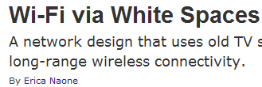


White-Fi: Press

Slide 43







WhiteFi: Impact on Regulatory Bodies
Radiocommunication Sector
India
Oct. 22, 2009
Federal Communications Commission, USA (FCC), Apr. 28 & Aug. 14, 2010
Singapore
Apr. 8, 2010
China
Jan. 11, 2010
Brazil
(Feb. 2, 2010)
Standards
Industry Partners
Jan. 5, 2010
Fisher Communications Inc.
Jan. 14, 2010

Slide 44
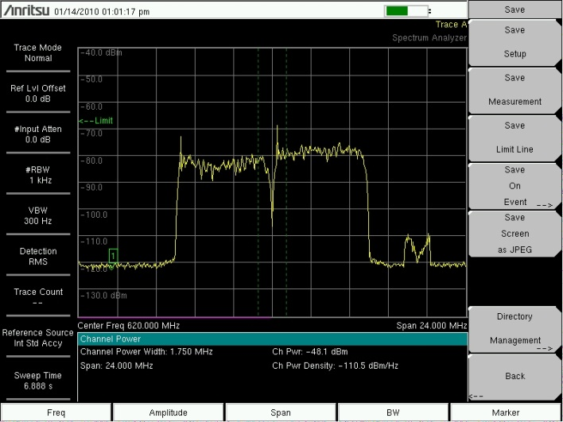
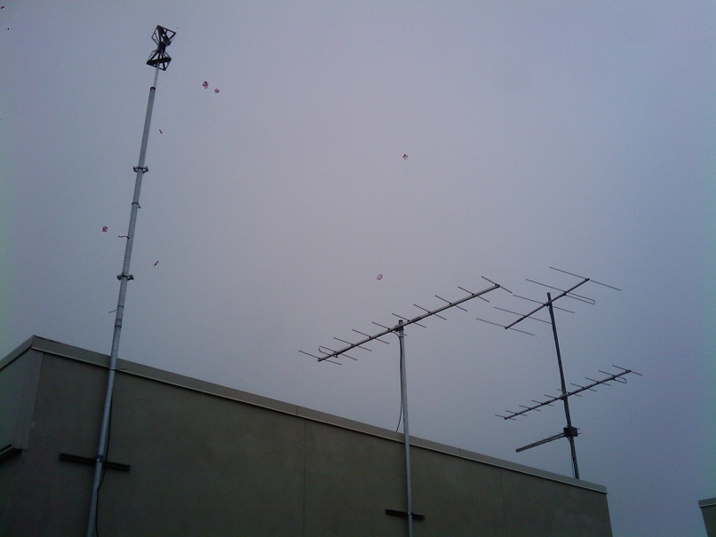
White-Fi & Broadcast TV
TV broadcasters opposed to white space networking
Hillary Clinton lobbying for broadcasters
against White-Fi ☺
Our system demonstrated that we can reuse unused spectrum without hurting broadcasters
KOMO (Ch. 38)
KIRO (Ch. 39)
White-Fi (Ch. 40)

Slide 45
Summary & On-going Work
White Spaces enable new networking scenarios
KNOWS project researched networking problems:
  Spectrum assignment: MCham, LSA
  Spectrum efficiency: MIC Coexistence
  Network Agility: Using geo-location database
Ongoing work:
  MIC sensing, mesh networks, co-existence among white space networks, …

Slide 46
Questions

Slide 48
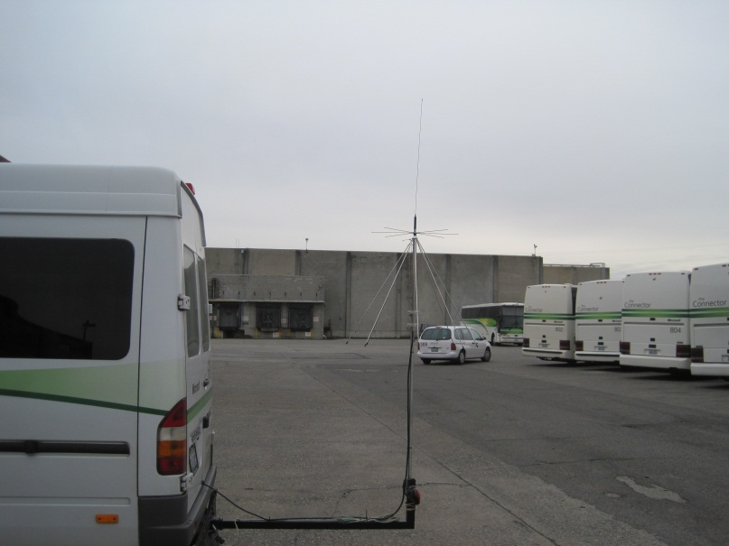

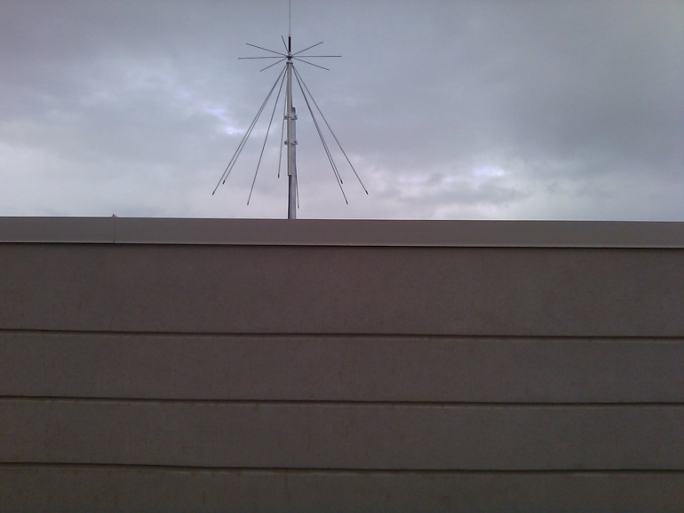
Shuttle Deployment
World’s first urban white space network!
Goal: Provide free Wi-Fi Corpnet access in MS shuttles
  Use white spaces as backhaul, Wi-Fi inside shuttle
  Obtained FCC Experimental license for MS Campus
  Deployed antenna on rooftop, radio in building & shuttle
  Protect TVs and mics using geo-location service & sensing

Slide 49
Outline
Networking in TV Bands
KNOWS Platform – the hardware
CMAC – the MAC protocol
B-SMART – spectrum sharing algorithm
Future directions and conclusions

Slide 50

MAC Layer Challenges
Crucial challenge from networking point of view:
How should nodes share the spectrum?
Which spectrum-band should two
cognitive radios use for transmission?
Channel-width…?
Frequency…?
Duration…?
Determines network
throughput and overall
spectrum utilization!
We need a protocol that efficiently allocates
time-spectrum blocks in the space!

Slide 51
Allocating Time-Spectrum Blocks
View of a node v:
Primary users
Frequency
f+Δf
f
Time
t
t+Δt
Node v’s time-spectrum block
Neighboring nodes’
time-spectrum blocks
Time-Spectrum Block
Within a time-spectrum block,
any MAC and/or communication
protocol can be used
ACK
ACK
ACK

Slide 52
Context and Related Work
Context:
Single-channel → IEEE 802.11 MAC allocates on time blocks
Multi-channel → Time-spectrum blocks have fixed channel-width
Cognitive channels with variable channel-width!
time
Multi-Channel MAC-Protocols:
[SSCH, Mobicom 2004], [MMAC, Mobihoc 2004],
[DCA I-SPAN 2000], [xRDT, SECON 2006], etc…
Existing theoretical or practical work
does not consider channel-width
as a tunable parameter!
MAC-layer protocols for Cognitive Radio Networks:
[Zhao et al, DySpan 2005], [Ma et al, DySpan 2005], etc…
Regulate communication of nodes
on fixed channel widths

Slide 53
CMAC Overview
Use common control channel (CCC) [900 MHz band]
  Contend for spectrum access
  Reserve time-spectrum block
  Exchange spectrum availability information
  (use scanner to listen to CCC while transmitting)
Maintain reserved time-spectrum blocks
  Overhear neighboring node’s control packets
  Generate 2D view of time-spectrum block reservations

Slide 54

CMAC Overview
RTS
  Indicates intention for transmitting
  Contains suggestions for available time-spectrum block (b-SMART)
CTS
  Spectrum selection (received-based)
  (f,Δf, t, Δt) of selected time-spectrum block
DTS
  Data Transmission reServation
  Announces reserved time-spectrum block to neighbors of sender
Sender
RTS
Receiver
CTS
DTS
Waiting Time
t
DATA
ACK
DATA
Time-Spectrum Block
ACK
DATA
ACK
t+Δt

Slide 55
Network Allocation Matrix (NAM)
Nodes record info for reserved time-spectrum blocks
Time-spectrum block
Frequency
Control channel
IEEE 802.11-like
Congestion resolution
Time
The above depicts an ideal scenario
  1) Primary users (fragmentation)
  2) In multi-hop → neighbors have different views

Slide 56
Network Allocation Matrix (NAM)
Nodes record info for reserved time-spectrum blocks
Primary Users
Frequency
Control channel
IEEE 802.11-like
Congestion resolution
Time
The above depicts an ideal scenario
  1) Primary users (fragmentation)
  2) In multi-hop → neighbors have different views

Slide 57
B-SMART
Which time-spectrum block should be reserved…?
  How long…? How wide…?
B-SMART (distributed spectrum allocation over white spaces)
Design Principles
1. Try to assign each flow
blocks of bandwidth B/N
B: Total available spectrum
N: Number of disjoint flows
2. Choose optimal transmission duration Δt
Long blocks:
Higher delay
Short blocks:
More congestion on control channel

Slide 58
B-SMART
Upper bound T_{max}~10ms on maximum block duration
Nodes always try to send for T_{max}
1. Find smallest bandwidth Δb
for which current queue-length
is sufficient to fill block Δb ΔT_{max}
Δb
Δb=⎡B/N⎤
T_{max}
T_{max}
2. If Δb ≥ ⎡B/N⎤ then Δb := ⎡B/N⎤
3. Find placement of ΔbxΔt block
that minimizes finishing time and does
not overlap with any other block
4. If no such block can be placed due
prohibited bands then Δb := Δb/2

Slide 59
Example
Number of valid reservations in NAM → estimate for N
Case study: 8 backlogged single-hop flows
T_{max}
80MHz
2(N=2)
4 (N=4)
8 (N=8)
2 (N=8)
5(N=5)
1 (N=8)
40MHz
3 (N=8)
1 (N=1)
3 (N=3)
7(N=7)
6 (N=6)
1
2
3
4
5
6
7
8
1
2
3
Time

Slide 60
B-SMART
How to select an ideal T_{max}…?
Let Λ be maximum number of disjoint channels
(with minimal channel-width)
We define T_{max}:= Λ⋅ΔT₀
We estimate N by #reservations in NAM
→ based on up-to-date information → adaptive!
We can also handle flows with different demands
(only add queue length to RTS, CTS packets!)
T_{O}: Average time spent on one successful handshake on control channel
Prevents control channel
from becoming a bottleneck!
Nodes return to control
channel slower than
handshakes are completed

Slide 61
Performance Analysis
In the paper only…
Markov-based performance model for CMAC/B-SMART
  Captures randomized back-off on control channel
  B-SMART spectrum allocation
We derive saturation throughput for various parameters
  Does the control channel become a bottleneck…?
  If so, at what number of users…?
  Impact of T_{max} and other protocol parameters
Analytical results closely match simulated results
Even for large number of flows, control channel can be prevented from becoming a bottleneck
Provides strong validation for our choice of T_{max}

Slide 62
Simulation Results - Summary
Simulations in QualNet
Various traffic patterns, mobility models, topologies
B-SMART in fragmented spectrum:
  When #flows small → total throughput increases with #flows
  When #flows large → total throughput degrades very slowly
B-SMART with various traffic patterns:
  Adapts very well to high and moderate load traffic patterns
  With a large number of very low-load flows
  → performance degrades (→ Control channel)

Slide 63
KNOWS in Mesh Networks
More in the paper…
Aggregate Throughput of Disjoint UDP flows
Throughput (Mbps)
b-SMART finds the best allocation!
# of flows

Slide 64
Summary
White Spaces overcome shortcoming of Wi-Fi
Possible to build hardware that does not interfere with TV transmissions
CMAC uses control channel to coordinate among nodes
B-SMART efficiently utilizes available spectrum by using variable channel widths

Slide 65
Future Work & Open Problems
Integrate B-SMART into KNOWS
Address control channel vulnerability
Design AP-based networks
Build, demonstrate large mesh network!

Slide 66
Other Ongoing Projects
Network Management
  DAIR: Managing enterprise wireless networks
  Sherlock: localizing performance failures
  eXpose: mining for communication rules in a packet trace
Green Computing
  Cell2Notify: reducing battery consumption of mobile phones
  Somniloquy: enabling network connectivity to sleeping PCs

Slide 67

WhiteFi System Challenges
Fragmentation | Spatial Variation | Temporal Variation | Impact
Discovery
Spectrum
Assignment
Disconnection
Notes:
-Stress, Wi-Fi load may vary but that is not the same as fragmentation
-I will soon demonstrate to you how these differences raise new challenges

Slide 68
Discovering a Base Station
Discovery Problem
Goal
Quickly find channels BS is using
1
2
3
4
5
1
2
3
4
5
Discovery Time = Ο(B x W)
How does the new client discover channels used by the BS?
Can we optimize this discovery time?
BS and Clients must use same channels
Fragmentation
⇒ Try different center channel and widths
Notes:
-What is the worst case discovery time?

Slide 69
Whitespaces Platform: Adding SIFT
PC
Scanner (SDR)
Net
Stack
TV/MIC detection
FFT
FPGA
UHF RX Daughterboard
Temporal Analysis
(SIFT)
Whitespace Radios
Connection Manager
Atheros Device Driver
Wi-Fi Card
UHF
Translator
SIFT: Signal Interpretation before Fourier Transform

Slide 70
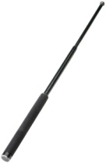
SIFT, by example
10 MHz
5 MHz
ADC
SIFT
SIFT
Data
ACK
Beacon
Beacon
Does not decode packets
Amplitude
SIFS
Pattern match in time domain
Time

Slide 71
BS Discovery: Optimizing with SIFT
1
2
3
4
5
1
2
3
4
5
18 MHz
Matched against 18 MHz packet signature
Amplitude
Time
SIFT enables faster discovery algorithms
Notes:
-SIFT: jump cleverly until we hit the “sweet” spot.

Slide 72
BS Discovery: Optimizing with SIFT
Linear SIFT (L-SIFT)
1
2
3
4
5
Jump SIFT (J-SIFT)
1
2
3
4
5
6
7
8

Slide 73
Discovery: Comparison to Baseline
Baseline =Ο(B x W)
L-SIFT = Ο(B/W)
J-SIFT = Ο(B/W)
2X reduction

Slide 74
WhiteFi System Challenges
Fragmentation | Spatial Variation | Temporal Variation | Impact
Discovery
Spectrum
Assignment
Disconnection
Notes:
-Stress, Wi-Fi load may vary but that is not the same as fragmentation
-I will soon demonstrate to you how these differences raise new challenges

Slide 75
Operating in TV Bands
DSP Routines detect TV presence
Scanner
UHF Translator
Wireless Card
Set channel for data communication
Modify driver to operate in 5-10-20-40 MHz
Transmission in the
TV Band

Slide 76
KNOWS: Salient Features
Prototype has transceiver and scanner
Use scanner as receiver when not scanning
Data Transceiver Antenna
Scanner Antenna

Slide 77
KNOWS Platform: Salient Features
Can dynamically adjust channel-width and center-frequency.
Low time overhead for switching
→ can change at fine-grained time-scale
Transceiver can tune
to contiguous spectrum
bands only!
Frequency

Slide 78
Changing Channel Widths
Scheme 1: Turn off certain subcarriers ~ OFDMA
10 MHz
20 MHz
Issues: Guard band? Pilot tones? Modulation scheme?

Slide 79
Changing Channel Widths
Scheme 2: reduce subcarrier spacing and width!
⇒ Increase symbol interval
10 MHz
20 MHz
Properties: same # of subcarriers, same modulation

Slide 80
Adaptive Channel-Width
20Mhz
5Mhz
Why is this a good thing…?
Fragmentation
→ White spaces may have different sizes
→ Make use of narrow white spaces if necessary
Opportunistic, load-aware channel allocation
→ Few nodes: Give them wider bands!
→ Many nodes: Partition the spectrum in narrower bands
Frequency

Slide 81
Version 2: WhiteFi System
Prototype Hardware Platform
Base Stations and Clients
Algorithms
Discovery
Spectrum Assignment
and Implementation
Handling Disconnections
Evaluation
Deployment of prototype nodes
Simulations
Notes:
-Key point: we have thought through the MAIN issues that arise due to these differences and we address them
-This it the FIRST whitespaces based wirelss network
-We do NOT address sensing. We leverage significant prior work on sensing.

Slide 82
WhiteFi System Challenges
Fragmentation | Spatial Variation | Temporal Variation | Impact
Discovery
Spectrum
Assignment
Disconnection
Notes:
-Stress, Wi-Fi load may vary but that is not the same as fragmentation
-I will soon demonstrate to you how these differences raise new challenges

Slide 83
MSR KNOWS Program
Prototypes
Version 1: Ad hoc networking in white spaces
  Capable of sensing TV signals, limited hardware functionality, analysis of design through simulations
Version 2: Infrastructure based networking (WhiteFi)
  Capable of sensing TV signals & microphones, deployed in lab
Version 3: Campus-wide backbone network (WhiteFi + Geolocation)
  Deployed on campus, and provide coverage in MS Shuttles

Slide 84
White-Fi: Deployment
Implemented and deployed the world’s first operational white space network on Microsoft Redmond campus (Oct. 16, 2009)
White Space Network Setup
Shuttle Deployment
WS Antenna
WS Antenna on MS Shuttle
Data packets over UHF

Slide 85

White-Fi: Deployment
Implemented and deployed the world’s first operational white space network on Microsoft Redmond campus (Oct. 16, 2009)
FCC experimental license
Provide Internet connectivity in shuttle buses
(inside bus, clients can use Wi-Fi, backhaul is White Spaces)
Covering the entire campus with 3 base stations! (>1 square mile)
(compare Wi-Fi: would need 100’s of Aps)
(compare cellular: not free)
Protecting wireless microphones
using a geo-location database
Adaptive channel width
Dynamic channel selection

Slide 86
White-Fi: Deployment
Implemented and deployed the world’s first operational white space network on Microsoft Redmond campus (Oct. 16, 2009)
FCC experimental license
Provide Internet connectivity in shuttle buses
(inside bus, clients can use Wi-Fi, backhaul is White Spaces)
Covering the entire campus with 3 base stations! (>1 square mile)
(compare Wi-Fi: would need 100’s of Aps)
(compare cellular: not free)
Protecting wireless microphones
using a geo-location database
Adaptive channel width
Dynamic channel selection
The first white space network in the world
The first opportunistic (cognitive) network in
the world

