Slide 1


Detecting Collective Anomalies from Multiple Spatio-Temporal Datasets across Different Domains
Yu Zheng
Microsoft Research, Beijing, China
yuzheng@microsoft.com
Released Data & Codes
http://research.microsoft.com/en-us/people/yuzheng/

Slide 2


Existing Anomaly Detection
Detecting anomalies (outliers) is sometimes more useful than regular patterns
Existing research focuses on detecting anomalies based on a single dataset
  May cause some anomalies undetected or very late
  Or over detected when using a sparse dataset (false alerts)
  Reports of sickness in a neighborhood
  <0, 0, 0, 0, 0, 0, 1, 0, 0, 0, 0, 0, 1, 0, 0,…>
  time
$μ→0$, $σ→0$
$$(1−μ)≫3σ$$
An undetected example
A false alert

Slide 3









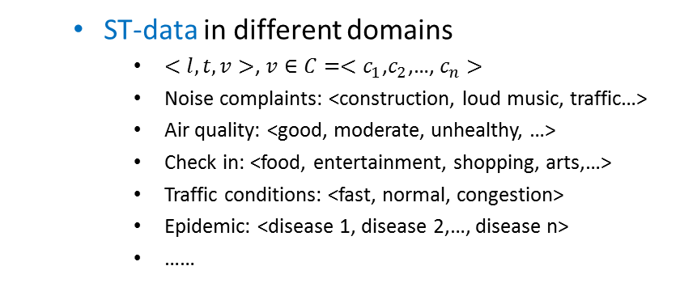
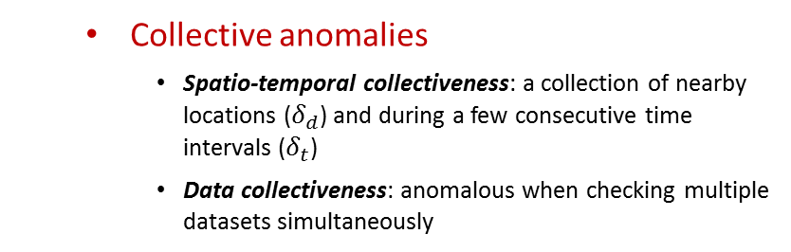
Collective Anomalies
Detect collective anomalies based on multiple Spatio-Temporal (ST) datasets
  ST-data in different domains
    $<l, t, v>$, $v∈C=<c_{1}\text{,}c_{2}$,…, $c_{n}>$
    Noise complaints: <construction, loud music, traffic…>
    Air quality: <good, moderate, unhealthy, …>
    Check in: <food, entertainment, shopping, arts,…>
    Traffic conditions: <fast, normal, congestion>
    Epidemic: <disease 1, disease 2,…, disease n>
    ……
  Collective anomalies
    Spatio-temporal collectiveness: a collection of nearby locations ($δ_{d}$) and during a few consecutive time intervals ($δ_{t}$)
    Data collectiveness: anomalous when checking multi­ple datasets simultaneously

Slide 4

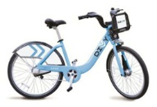


An Example
Eight regions are collectively anomalous in five consecutive hours
in terms of three datasets:
Taxicab, bike-sharing, and 311 complaints,
$$δ_{d}$$
Benefits
Detect an underlying problem
Den­o­te an early stage of an epidemic disease or the beginning of a natural disaster
Provide a panora­mic view of an event
8am
9am
10am
11am
12pm
1pm

Slide 5
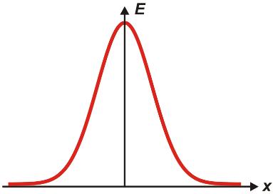
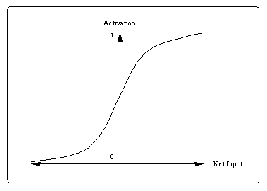
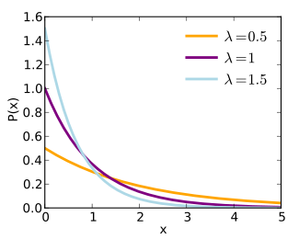
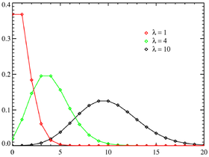
Challenges
Data sparsity and uncertainty
  →Difficult to estimate their true distri­butions based on limited observations
  →Hard to measure the deviation of an instance from its original dis­tri­bution
Different scales and distributions
  → Difficult to aggregate them into an integrate (anomalous) measurement
Many combinations of regions and time intervals
  High computational cost
  Conflicts online detection
  <0, 0, 0, 0, 0, 1, 0, 0, 0, 0, 0, 1, 0, 0,…>
Distribution ?
Aggregation ?
  <1, 0, 0, 0, 0, 0, 0, 1, 0, 0, 0, 0, 0, 0,…>

Slide 6

Methodology
Multiple Sources Latent Topic (MSLT) Model :
  Combine multiple datasets to better estim­ate the underlying distribution of a sparse dataset
  Leading to more accurate anomaly detection
Spatio-Temporal Log-likelihood Ratio Test (ST_LRT)
  Adap­ts Likelihood Ratio Test to a spatio-temporal setting
  Aggregates the information of multiple datasets across multiple regions to detect anomalies
Candidate generation algorithm
  Generate candidates using computational geometry
  Prune unnecessary combinations based on skylines
$$Λ=−2log\frac{likelihood for null model}{likelihood for alternative model}$$

Slide 7

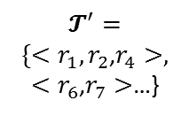







Framework
$S=\{s_{1}\text{,}s_{2}$, …}
$$s_{1}$$
$$s_{2}$$
…
Circel_Based_Spatial_Check
(spatial constraint $δ_{d}$)
Skyline Detection
LRT
$$𝓣^{′}=$$
${\{<r}_{1}, {r_{2}\text{,}r}_{4}>,$
$<r_{6}\text{,}r_{7}>$…}
Learning Distributions
$r=\{r_{1}\text{, }r_{2}$, …$,r_{m}$}
ST_LRT
$(θ$， $φ)$
An entry $<r,t>$
$𝓣={\{<r}_{1}, t_{1}>$,$<r_{2}\text{,}t_{1}>$,…,$<r_{m}\text{,}t_{1}>,<r_{1}\text{,}t_{2}>, <r_{2}\text{,}t_{2}>$…,$<r_{m}\text{,}t_{2}>$,…, ${<r}_{m},t_{t}>\}$
MSLT Model

Slide 8


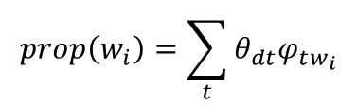

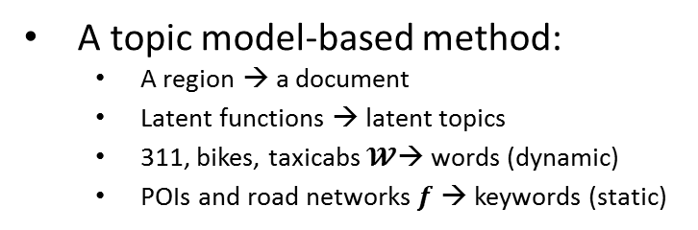
MSLT Model
Combine multiple datasets to discover latent functions of a region
  To better estimate the distribution of a sparse dataset
  Different datasets in a region can mutually reinforce
  A dataset can reference across different regions
A topic model-based method:
  A region → a document
  Latent functions → latent topics
  311, bikes, taxicabs $𝓦$→ words (dynamic)
  POIs and road networks$f$ → keywords (static)
$$s_{1}$$
$$s_{2}$$
$$prop\left(w_{i}\right)=\sum_{t}{θ_{dt}φ_{tw_{i}}}$$

Slide 9
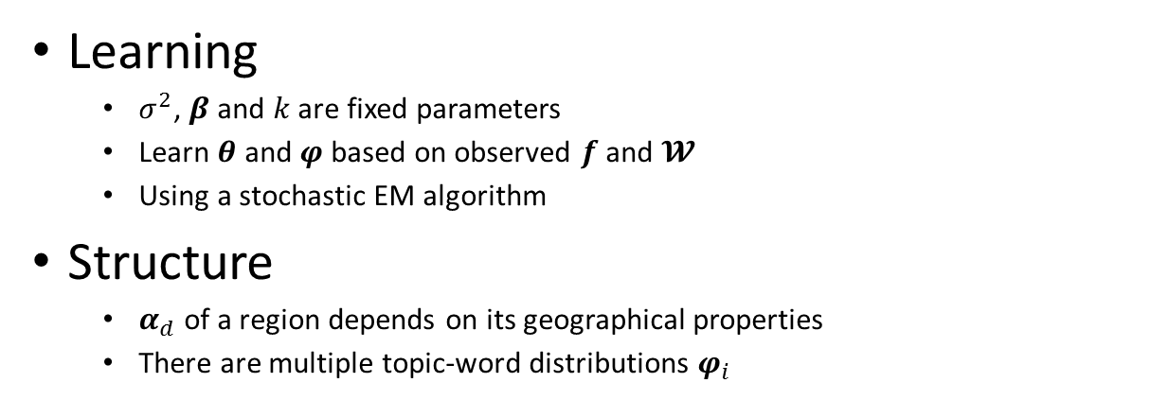
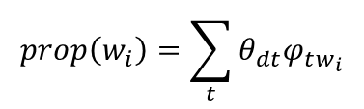
MSLT Model
Learning
  $σ^{2}$, $β$ and $k$ are fixed parameters
  Learn $θ$ and $φ$ based on observed $f$ and $𝓦$
  Using a stochastic EM algorithm
Structure
  $α_{d}$ of a region depends on its geographical pro­­perties
  There are multiple topic-word distributions $φ_{i}$
$$prop\left(w_{i}\right)=\sum_{t}{θ_{dt}φ_{tw_{i}}}$$
Latent Dirichlet Allocation (LDA)
MSLT

Slide 10
ST_LRT
Log-Likelihood Ratio Test (LRT)
Apply LRT to a single (ST) dataset
  in a single region
  in multiple regions
Apply LRT to multiple datasets
  Distribution estimations for different datasets
  Aggregate anomalous degree of multiple datasets

Slide 11
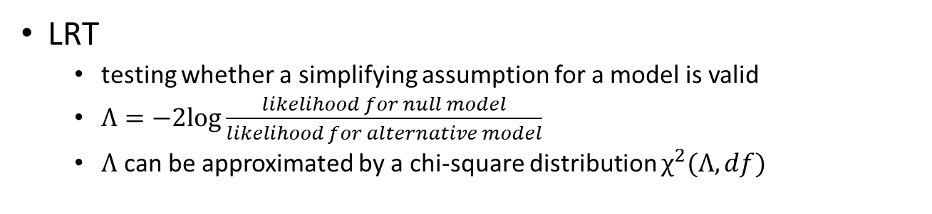



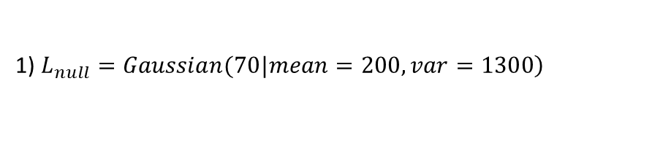

ST_LRT
LRT
  testing whether a simplifying assumption for a model is valid
  $Λ=−2log\frac{likelihood for null model}{likelihood for alternative model}$
  $Λ$ can be approximated by a chi-square distribution $χ^{2}(Λ, df)$
An example for a single region and a single dataset
1) $\left.L_{null}=Gaussian(70|mean=200,var=1300\right)$
2) The maximum likelihood for the alternative model (mean to 70)
$$p=\frac{70}{200}=0.35$$
$mean$= 200$×$0.35=70; $var=$1300$×$0.35=455
$L_{alter}=Gaussian(70|mean=70, var=455)$;
70
200
3) $Λ\left(s\right)=−2\log\left(\frac{L_{null}}{L_{alter}}\right)=14.05$
$od=χ^{2}_cdf(14.05, fd=1)$=0.999
Notes:
a likelihood ratio test is used to compare the fit of two models, one of which (the null model) is a special case of the other (the alternative model).
Each of the two competing models is separately fitted to the data with the log-likelihood recorded.
The test statistic is negative twice the difference in these log-likelihoods.

Slide 12


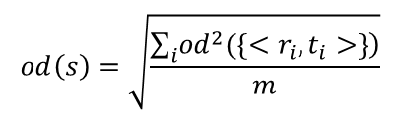

ST_LRT
Apply LRT to multiple regions (or time slots)
A dataset varies in different regions (or time slots) consist­ently
1) $L_{null}=Poi\left(14 | λ_{1}=8\right)×Poi\left(14 | λ_{2}=10\right)×Pois(8|λ_{3}=6)$;
2) Calculate $Θ^{′}=\{{λ^{′}}_{1},{λ^{′}}_{2}, {λ′}_{3}\}$: To maximize the likelihood of the alternative model ($fd$=1)
$p=\frac{14+14+8}{8+10+6}=1.5$
${λ′}_{1}=$8$×$1.5=12, ${λ′}_{2}$=10$×$1.5=15, ${λ′}_{3}$=6$×$1.5=9;
$L_{alter}=Poi\left(14 | {λ′}_{1}\right)×Poi\left(14 | {λ′}_{2}\right)×Pois(8|{λ′}_{3})$;
3) $Λ\left(s\right)=−2\log\left(\frac{L_{null}}{L_{alter}}\right)=$5.19
$$od=χ^{2}_cdf\left(5.19,fd=1\right)=0.978$$
A dataset changes differently in different regi­ons (or slots).
$$od\left(s\right)=\sqrt{\frac{\sum_{i}{\left.{od}^{2}(\left\{{<r}_{i},t_{i}>\right\}\right)}}{m}}$$

Slide 13

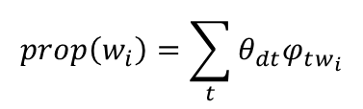







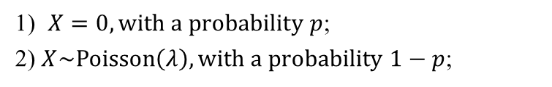

ST_LRT
Deal with multiple datasets
  Dealing with a sparse dataset
    The zero-inflated Poisson (ZIP) model → $λ$
    Using latent topic-word distribution
  $λ$_{2 :}<0, 0, 0, 0, 0, 0, 0, 0, 0, 0, 0, 0, c₂, 0, 0,…>
  $λ$_{1 :}<0, 0, 0, 0, 0, 0, c₁, 0, 0, 0, 0, 0, 0, 0, 0,…>
  $λ$:<0, 0, 0, 0, 0, 0, c₁, 0, 0, 0, 0, 0, c₂, 0, 0,…>
1) $X=0, with a probability p$;
2) $X\sim Poisson\left(λ\right), with a probability 1−p$;
  <0, 0, 0, 0, 0, 0, 1, 0, 0, 0, 0, 0, 1, 0, 0,…>
$X=0, with probability p+\left(1−p\right)e^{−λ}$;
$$ZIP$$
$$X=h, with probability \left(1−p\right)\frac{e^{−λ}λ^{h}}{h!}$$
$$λ$$
$$prop\left(w_{i}\right)=\sum_{t}{θ_{dt}φ_{tw_{i}}}$$
$$λ_{i}=λ×prop\left(w_{i}\right)$$
$$λ_{1}$$
  <0, 0, 0, 0, 0, 0, c₁, 0, 0, 0, 0, 0, 0, 0, 0,…>
$$λ_{2}$$
  <0, 0, 0, 0, 0, 0, 0, 0, 0, 0, 0, 0, c₂, 0, 0,…>
$$LRT$$

Slide 14




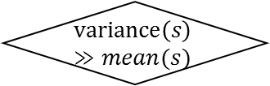




ST_LRT
Estimate distributions for different datasets
s
Sparse?
$$variance\left(s\right)≫mean(s)$$
N
N
$$Y$$
$$Y$$
$$ZIP$$
$Guassian$()
$Poisson$()
$$λ$$
$$λ_{i}=λ×prop\left(w_{i}\right)$$
$$LRT$$

Slide 15











ST_LRT
Aggregate anomalous degrees of multiple datasets
Circel-Based Spatial Check
$δ_{d}$
$δ_{t}$
${\{r}_{1}, {r_{2}\text{,}r}_{4}\},$
${\{<r}_{1},t_{2}{>,<r_{2}\text{,}t}_{1}>,$ $<r_{4}\text{,}t_{1}>\}$
  <${od}_{1},$ ${od}_{2}$,…, ${od}_{s}$>
$$\{r_{6}\text{,}r_{7}\},$$
$${\{<r}_{1},t_{1}{>,{<r}_{1},t_{2}>,<r_{2}\text{,}t}_{1}>,<r_{4}\text{,}t_{2}>\}$$
  <${od′}_{1},$ ${od′}_{2}$,…, ${od′}_{s}$>
…
…
…
…
{$<r_{6}\text{,}t_{2}>,<r_{7}{, t}_{2}>,$
$$\{r_{3}\text{,}r_{5},r_{7}\},$$
…
{$<r_{6}\text{,}t_{2}>,<r_{7}{, t}_{2}>,$
  <${od′′}_{1},$ ${od′′}_{2}$,…, ${od′′}_{s}$>
…
Pruning
Skyline ods
If a set of entries’ upper bound of $od$ is dominated by existing skyline combinations, all the combinations of its subsets will be dominated by the skyline too.

Slide 16
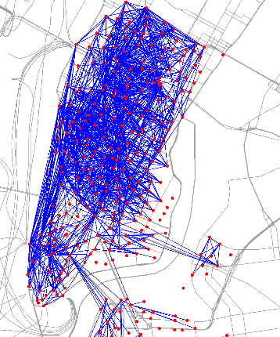
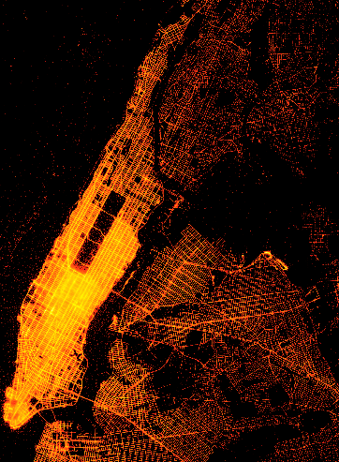
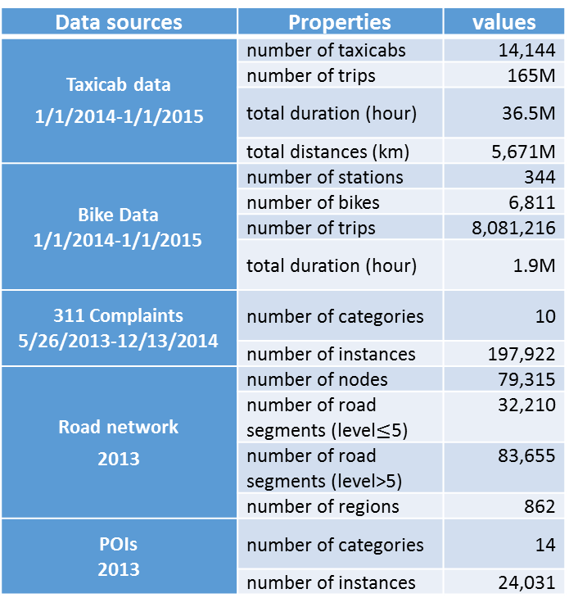
Evaluation
Data Release:
http://research.microsoft.com/pubs/255670/release_data.zip
Datasets
Data sources | Properties | values
Taxicab data 1/1/2014-1/1/2015 | number of taxicabs | 14,144
 | number of trips | 165M
 | total duration (hour) | 36.5M
 | total distances (km) | 5,671M
Bike Data 1/1/2014-1/1/2015 | number of stations | 344
 | number of bikes | 6,811
 | number of trips | 8,081,216
 | total duration (hour) | 1.9M
311 Complaints 5/26/2013-12/13/2014 | number of categories | 10
 | number of instances | 197,922
Road network 2013 | number of nodes | 79,315
 | number of road segments (level$≤$5) | 32,210
 | number of road segments (level>5) | 83,655
 | number of regions | 862
POIs 2013 | number of categories | 14
 | number of instances | 24,031

Slide 17


Evaluation
    Evaluation on MSLT
      Estimating the distribution for 311 data (sparse)
      KL-Divergence between estimations and ground truth
      Down-sampling ground truth
$$r_{1}$$
$$r_{2}$$
A distribution of 311
c₁
c₂
c₃
c₄
c₅

Slide 18
Events were reported by nycinsiderguide.com
 | Event Name | Address | Start Time | End Time
1 | Bowlloween 2014 New York Halloween | 624-660 W 42nd St | 10/31/2014 9PM | 11/1/2014 2AM
2 | Largest Halloween Singles Party in NYC | 247 West 37th Street | 10/31/2014 7AM | 11/1/2014 3AM
3 | Kokun Cashmere Sample and Stock Sale | 237 W 37th Street | 11/5/2014 10:30AM | 11/7/2014 5:45PM
4 | Big Apple Film Festival | 54 Varick St | 11/5/2014 6PM | 11/9/2014 11PM
5 | InterHarmony Concert Series: The Soul of élégiaque | 881 7th Avenue | 11/6/2014 8PM | 11/6/2014 10PM
6 | Hiras Master Tailors New York Trunk Show | 301 Park Avenue | 11/6/2014 9AM | 11/9/2014 1PM
7 | in Collaboration with Carnegie Halls Neighborhood Concerts | 881 Seventh Avenue | 11/7/2014 6PM | 11/7/2014 10PM
8 | Thomas/Ortiz Dance Show | 248 West 60th Street | 11/7/2014 7PM | 11/8/2014 9PM
9 | Rebecca Taylor Sample Sale | 260 5th Ave | 11/11/2014 10AM | 11/15/2014 8PM
10 | The News NYC Sample Sale | 495 Broadway | 11/13/2014 9AM | 11/15/2014 6AM
11 | Giorgio Armani Sample Sale | 317 W 33rd St | 11/15/2014 9:30AM | 11/19/2014 6:30PM
12 | Get Buzzed 4 Good Charity Event NYC | 200 5th Ave | 11/15/2014 1PM | 11/15/2014 4PM
13 | Ment’or Young Chef Competition | 462 Broadway | 11/15/2014 2PM | 11/15/2014 6PM
14 | Gotham Comedy Club | 208 West 23rd Street | 11/17/2014 6PM | 11/17/2014 9PM
15 | Kal Rieman NYC Sample Sale | 265 West 37th Street | 11/18/2014 11AM | 11/20/2014 8PM
16 | Inhabit Cashmere Sample Sale | 250 West 39th St | 11/18/2014 10AM | 11/20/2014 6 PM
17 | Shoshanna NYC Sample Sale | 231 W. 39th St | 11/19/2014 10AM | 11/20/2014 6:30PM
18 | ICB / J. Press NYC Sample Sale | 530 Seventh Avenue | 11/19/2014 12AM | 11/21/2014 12AM
19 | Thanksgiving in New York City 2014 | 1675 Broadway | 11/27/2014 6AM | 11/27/2014 10PM
20 | Thanksgiving Day Dinner at Croton Reservoir Tavern | 108 West 40th St | 11/27/2014 12PM | 11/27/2014 9PM
Nov. 1, 2014 to Nov. 30, 2014
Baselines
 | Taxi Inflow | Taxi Outflow | Bike Inflow | Bike Outflow
Single Dataset | DB-S-Taxi-S: one property |  | DB-S-Bike-S: one property
 | DB-S-Taxi-B: both properties |  | DB-S-Bike-B: both properties
Multi-Datasets | DB-M-One: one of the properties satisfying the 3-time deviation
 | DB-M-ALL: all the properties need to satisfy the 3-time deviation
DB: distance-based methods
Results
Methods | Detected Anomalies/day | Hit Event IDs
DB-S-Taxi-S | 336.3 | 1, 9, 19, 20
DB-S-Bike-B | 25.7 | 9, 19, 20
DB-S-Taxi-S | 18.1 | 4, 19
DB-S-Bike-B | 1.83 | None
DB-M-One | 353.2 | 1, 4, 9, 19, 20
DB-M-ALL | 0.12 | None
ST_LRT | 28.5 | 1, 3, 9, 10, 11, 13, 15, 16, 20
Notes:
We compare our approach with six baselines (shown in Table 3), showing the approach’s advantages beyond distance-based meth­ods and those solely using a single dataset.
In the distance-based (DB) methods, if the distance between an observation and the mean of the data is three times larger than the data’s standard dev­i­a­tion, the observation is regarded as an anom­aly

Slide 19

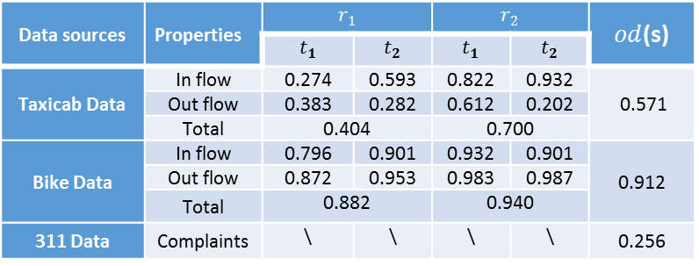
($t_{1}$:18-20, $t_{2}$: 20-22)
Data sources | Properties | $$r_{1}$$ |  | $$r_{2}$$ |  | $od$(s)
 |  | $$t_{1}$$ | $$t_{2}$$ | $$t_{1}$$ | $$t_{2}$$
Taxicab Data | In flow | 0.274 | 0.593 | 0.822 | 0.932 | 0.571
 | Out flow | 0.383 | 0.282 | 0.612 | 0.202
 | Total | 0.404 |  | 0.700
Bike Data | In flow | 0.796 | 0.901 | 0.932 | 0.901 | 0.912
 | Out flow | 0.872 | 0.953 | 0.983 | 0.987
 | Total | 0.882 |  | 0.940
311 Data | Complaints | \ | \ | \ | \ | 0.256
    Beyond distance-based methods
    Beyond a single dataset
    Beyond a single region
Notes:
Figure A) presents a collective anomaly, which is comprised of two regions $r_{1}$ and $r_{2}$ at two successive time intervals ($t_{1}$:18-20, $t_{2}$: 20-22).
We find that this anomaly was caused by the News NYC Sample Sale (the 10th event in Table 2), which is a two-day event occurring at blue point A.
These figures present the in/out-flow of taxicabs and bikes in ($r_{1}$, $r_{2}$) at ($t_{1}$, $t_{2}$), where the vertical gray range at each time interval denotes the 3-time standard deviation of the base distribution (learned from historical data at the interval). The black points standing in the middle of each range are the mean of the base distribution. The red points are the real observations in each data source.
Beyond distance-based methods
This table shows

Slide 20
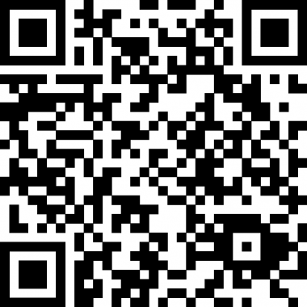

Conclusion
Detect collective anomalies based on multiple datasets
Methodology
  MSLT
  ST_LRT
  Candidate generation and pruning
Evaluated based on five datasets in NYC
Detect all anomalies in NYC in 3 minutes
Thanks!
Yu Zheng
yuzheng@microsoft.com
Released Data & Codes
Homepage

Slide 21
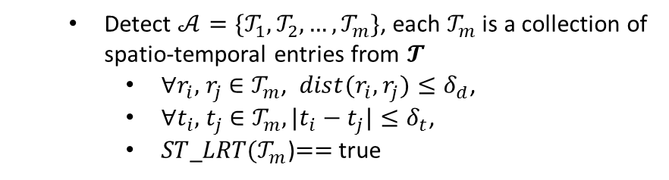
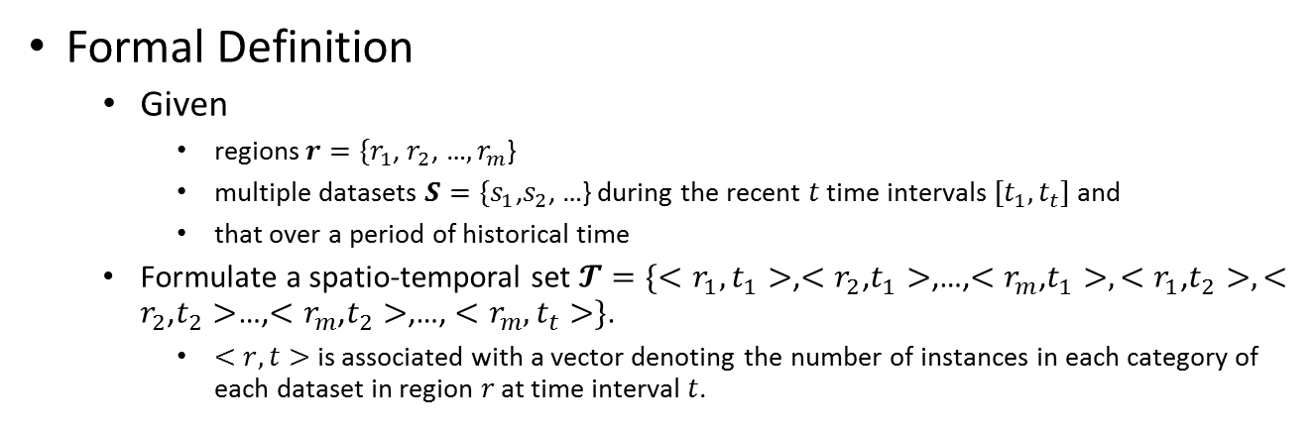
Collective Anomalies
Formal Definition
  Given
    regions$r=\{r_{1}\text{, }r_{2}$, …$,r_{m}$}
    multiple datasets $S=\{s_{1}\text{,}s_{2}$, …} during the recent $t$ time intervals ${[t}_{1},t_{t}]$ and
    that over a period of historical time
  Formulate a spatio-temporal set $𝓣={\{<r}_{1}, t_{1}>$,$<r_{2}\text{,}t_{1}>$,…,$<r_{m}\text{,}t_{1}>,<r_{1}\text{,}t_{2}>, <r_{2}\text{,}t_{2}>$…,$<r_{m}\text{,}t_{2}>$,…, ${<r}_{m},t_{t}>\}$.
    $<r,t>$ is associated with a vector denoting the number of instances in each category of each dataset in region $r$ at time interval $t$.
  Detect $𝒜=\{𝒯_{1},𝒯_{2},…,𝒯_{m}\}$, each $𝒯_{m}$ is a collection of spatio-temporal entries from $𝓣$
    $∀r_{i},$ $r_{j}$ $∈𝒯_{m}$, ${dist(r}_{i},$ $r_{j})≤δ_{d}$,
    $∀t_{i},$ $t_{j}$ $∈𝒯_{m}, |t_{i}−t_{j}|{≤δ}_{t}$,
    $ST$_$LRT(𝒯_{m}$)$==$true

