Slide 1
Privacy and the Participatory Sensor Web
Tarek Abdelzaher, Mike Ward
University of Illinois at Urbana Champaign

Slide 2
SensorMap – the Social Network of Mobile Sensors
WWW → a gathering place for special interest social groups
SensorMap → a gathering place for special interest data pools
  Joggers sharing route and fitness data
  Weight-watchers sharing weight-loss data
  Drivers sharing GPS/speed data
  Environmentalists sharing CO2 measurements
  Biologists sharing instrumented animal biometrics
  Chronic sinus patients sharing allergen counts

Slide 3
SensorMap – the Social Network of Mobile Sensors
WWW → a gathering place for special interest social groups
SensorMap → a gathering place for special interest data pools
  Joggers sharing route and fitness data
  Weight-watchers sharing weight-loss data
  Drivers sharing GPS/speed data
  Environmentalists sharing CO2 measurements
  Biologists sharing instrumented animal biometrics
  Chronic sinus patients sharing allergen counts
  A Sensor Web is a Social Network

Slide 4
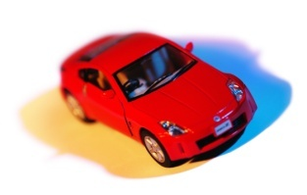
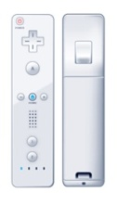


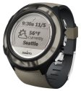

Information Distillation
Services
Information Distillation Layer
Privacy Layer
Privacy
Firewall
Storage Layer
GET
Sensor Layer
POST
Custom
Local Sensors
User Application
Private Storage
Server
Custom
Protocols
PUT
Internet-Ready Sensors
and Data Gateways

Slide 5
Information Distillation
Services
Has home on
SensorMap
(Publicly
Viewable)
Information Distillation Layer
Privacy Layer
Perturbation
Privacy
Firewall
Storage Layer
GET
Has home on
SensorMap
(Viewable by
“Buddy list”)
Sensor Layer
POST
Custom
Local Sensors
User Application
Private Storage
Server
Custom
Protocols
PUT
Internet-Ready Sensors
and Data Gateways

Slide 6
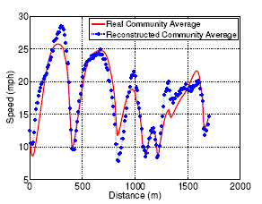
Application: Traffic Monitoring at UIUC
Demo link:
http://corie.cs.uiuc.edu/green_speed.php
On SensorMap: http://atom.research.microsoft.com/sensormap/
Real speed data, noise added,
and perturbed data of a single user
Real versus reconstructed
Community statistics
Raghu Kiran, Nam Pham, Tarek Abdelzaher, “PoolView: Stream Privacy for
Grassroots Participatory Sensing,” Sensys 2008.

Slide 7
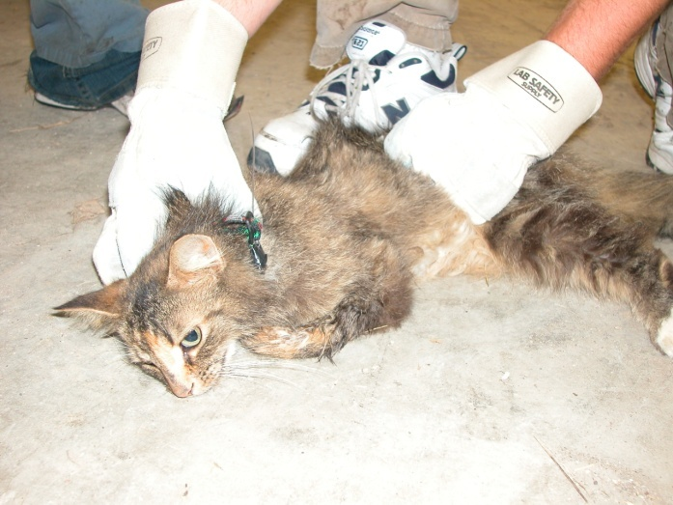
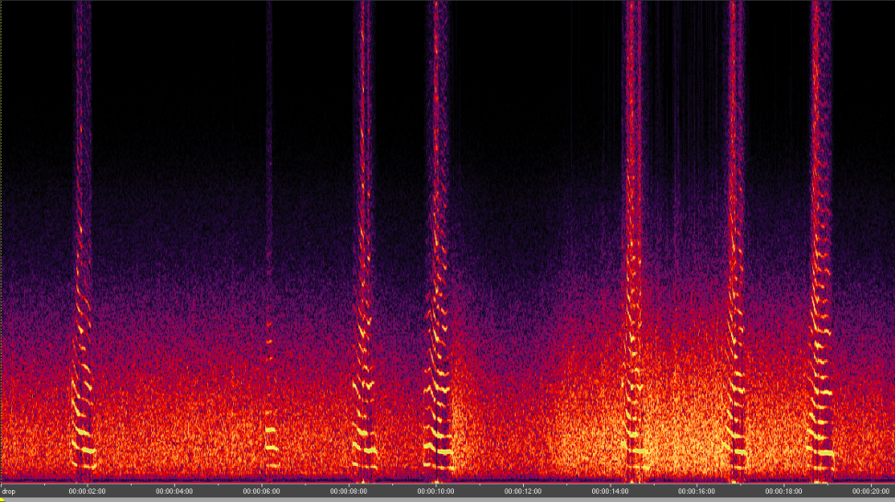
Application: Animal Tracking
(by Mike Ward, UIUC)
Continuous recordings of an animal’s vocalizations
No effect of a person stalking the animal with a microphone
Can be tracking using the Automated tracking system to determine its locations
1.3 gram continuous transmitters lasts 28 days
Developing software radios to record signals from multiple sources simultaneously.
Enormous amounts of data
Microphone recording
Used on feral cats to determine what they are eating from the “death screams” of their prey

Slide 8
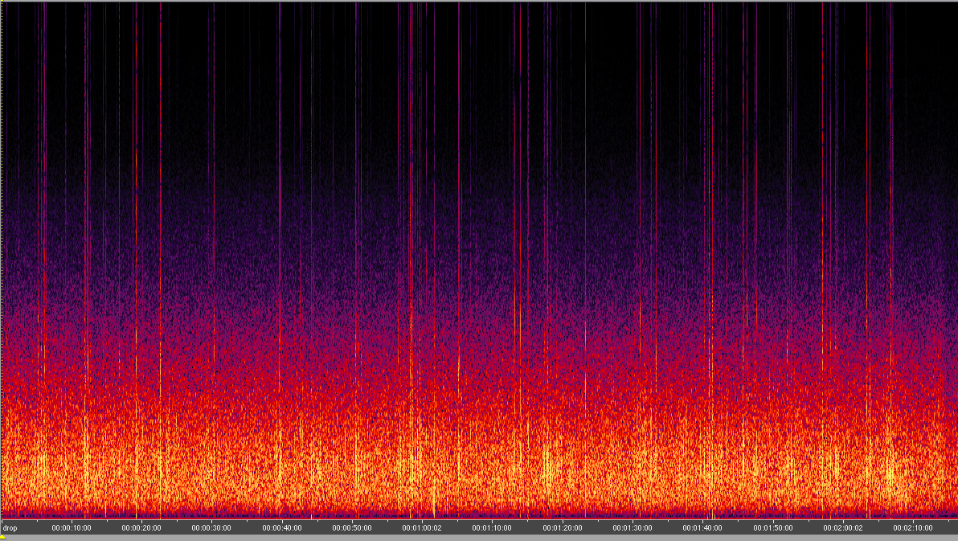
Feral cat eating dry cat food??
Most “feral cats” live closely with humans and some receive occasional food.

