Slide 1
Toward Situated Interaction
in collaboration with:
Eric Horvitz, ASI
Zicheng Liu, CCS
Cha Zhang, CCS
George Chrysanthakopoulos, Robotics
Tim Paek, MLAS
Dan Bohus
Researcher
Microsoft Research

Slide 2
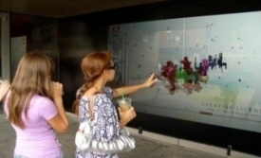

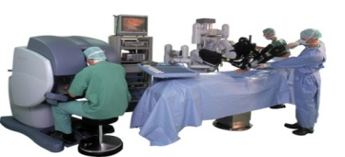
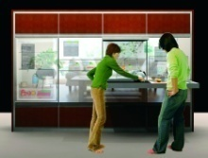
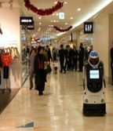

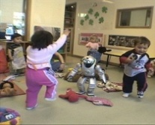
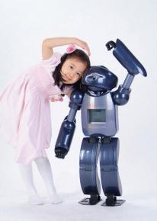
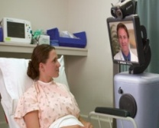
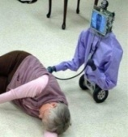
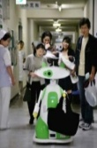
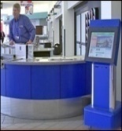

Situated Interaction
Examples
Long term goal
Embed interaction and computation deeply into the flow of everyday situations, tasks, and collaborations
Interactive billboards

Slide 3

Situated Interaction
Examples
Long term goal
Embed interaction and computation deeply into the flow of everyday situations, tasks, and collaborations
Computation and team coordination

Slide 4
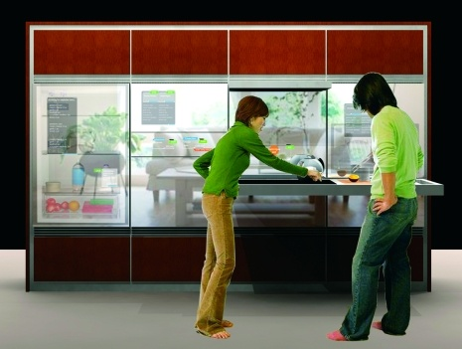
Situated Interaction
Examples
Long term goal
Embed interaction and computation deeply into the flow of everyday situations, tasks, and collaborations
Live guidance and assistance

Slide 5
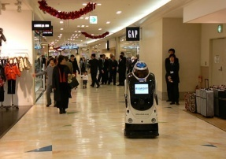
Situated Interaction
Examples
Long term goal
Embed interaction and computation deeply into the flow of everyday situations, tasks, and collaborations
Robots on the way …
What are you
looking for?
Well, I need this
in size 8…
Right… that’s over
this way

Slide 6
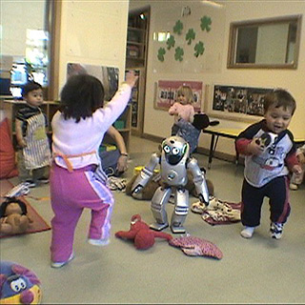
Situated Interaction
Examples
Long term goal
Embed interaction and computation deeply into the flow of everyday situations, tasks, and collaborations
Monitoring and care-taking

Slide 7
Situated Interaction
Examples
Long term goal
Embed interaction and computation deeply into the flow of everyday situations, tasks, and collaborations

Slide 8
Situated Interaction
Examples
Long term goal
Embed interaction and computation deeply into the flow of everyday situations, tasks, and collaborations
Research challenges
Situational awareness
  multimodal sensing and inferences about surrounding environment
Natural interaction
  language and non-verbal behaviors; socially-integrated
Collaborative intelligence
  mixed-initiative, multi-participant interaction and problem-solving
Life-long learning and adaptation
  continuous knowledge acquisition and sharing

Slide 9
Sample challenge
Initial challenge
Develop a situated conversational agent that
can act as a Microsoft front-desk receptionist
Current research focus
Multi-participant engagement and interaction

Slide 10
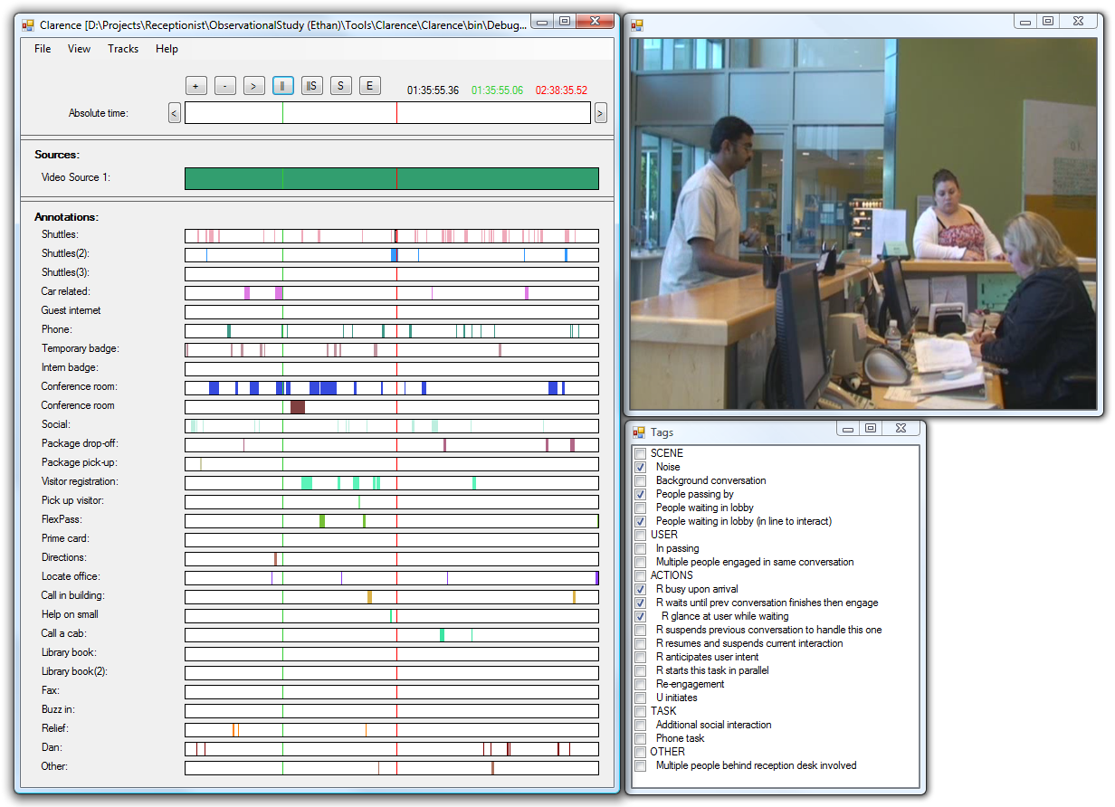
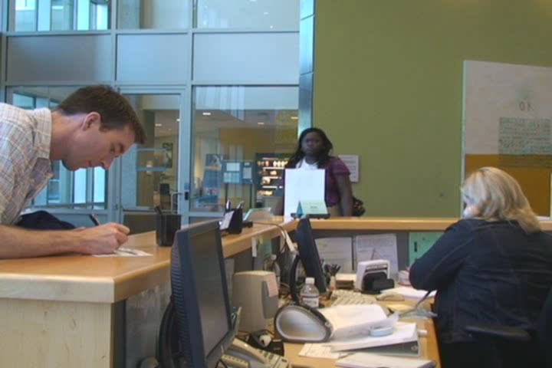
Human receptionist

Slide 11
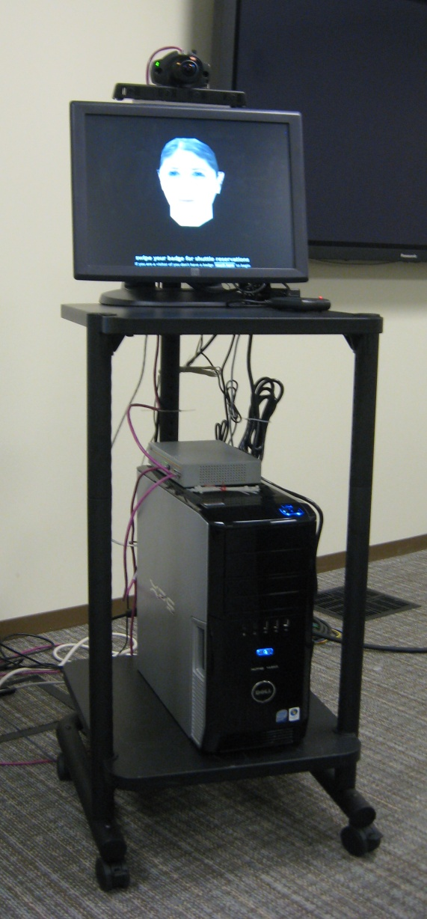
Next …
Prototype
Sample videos
Moving forward

Slide 12
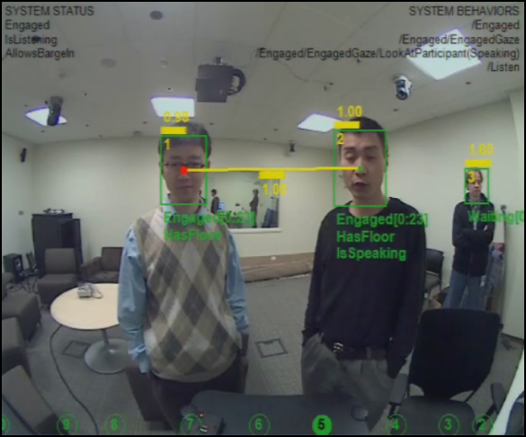
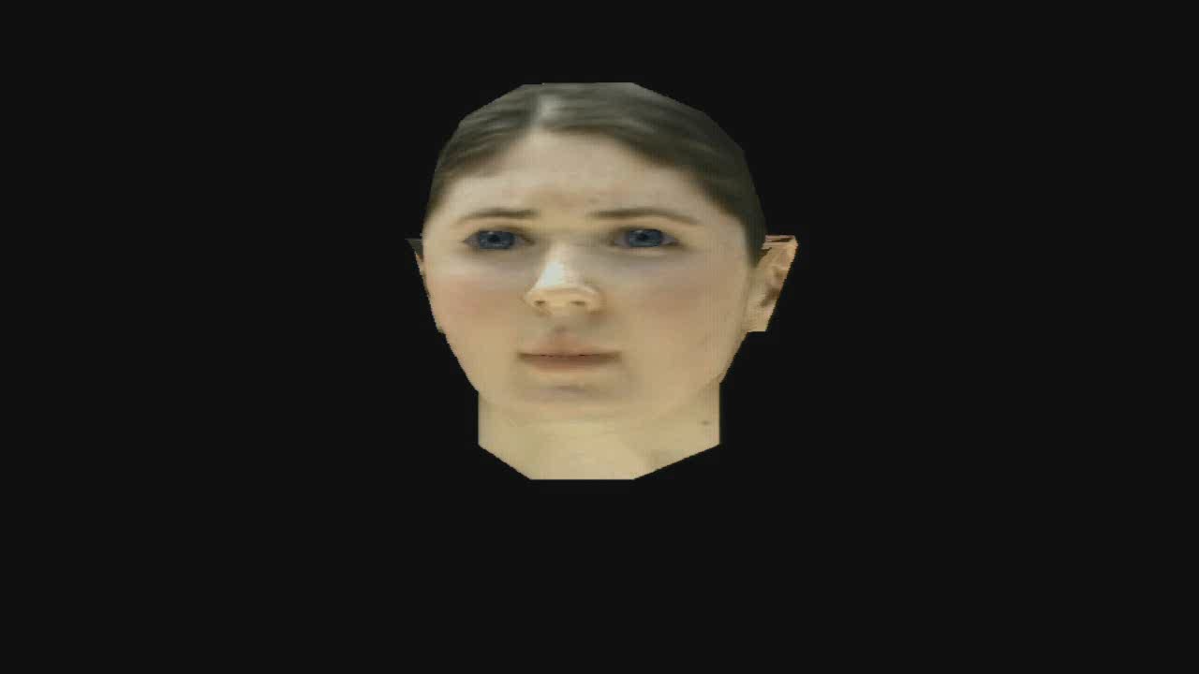
Prototype
wide-angle camera
4-element microphone array
touch screen
card reader
speakers
Speech
Synthesis
Avatar
Synthesis
Speech
Recognition
Tracker
Output
Management
Conversational
Scene
Analysis
Behavioral control
quad core PC
Dialog management &
Interaction Planning
Microsoft Robotics Studio
[Concurrency, Coordination and Distributed Services]

Slide 13
Next …
Sample videos

Slide 14
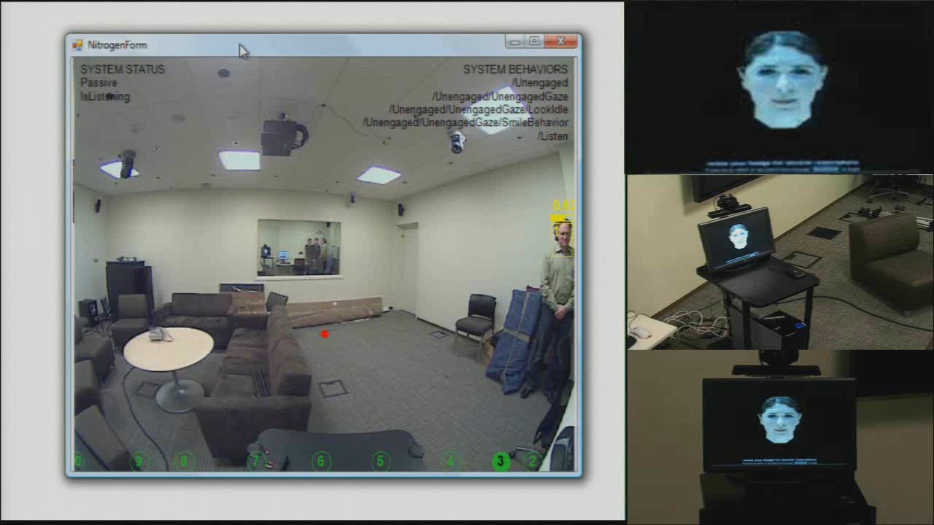
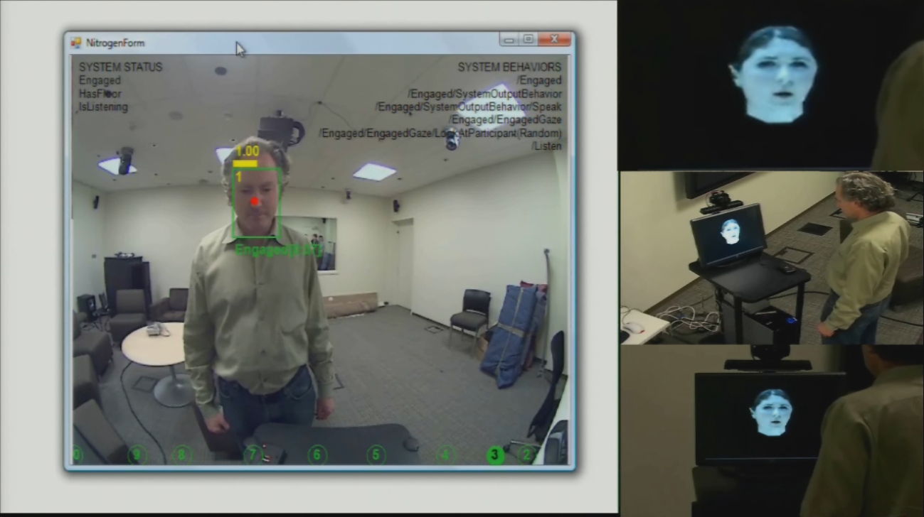
Single-participant interaction
system display
face detection and tracking
microphone array sound
source localization
overhead shots
conversational
scene analysis
avatar’s gaze

Slide 15
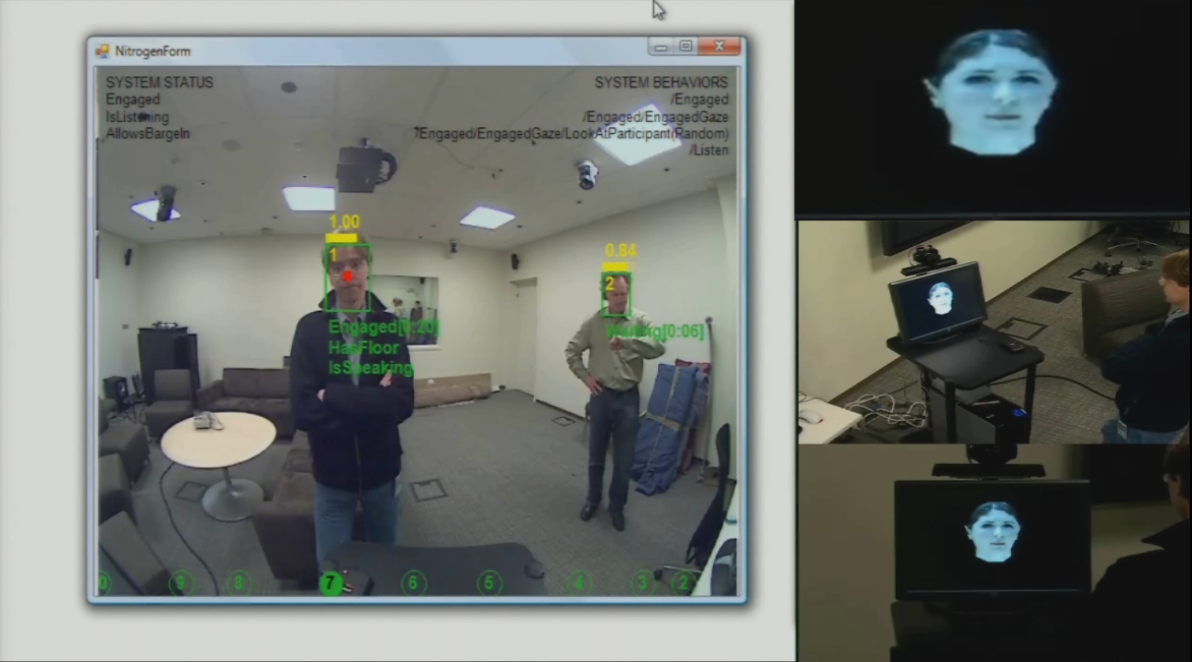
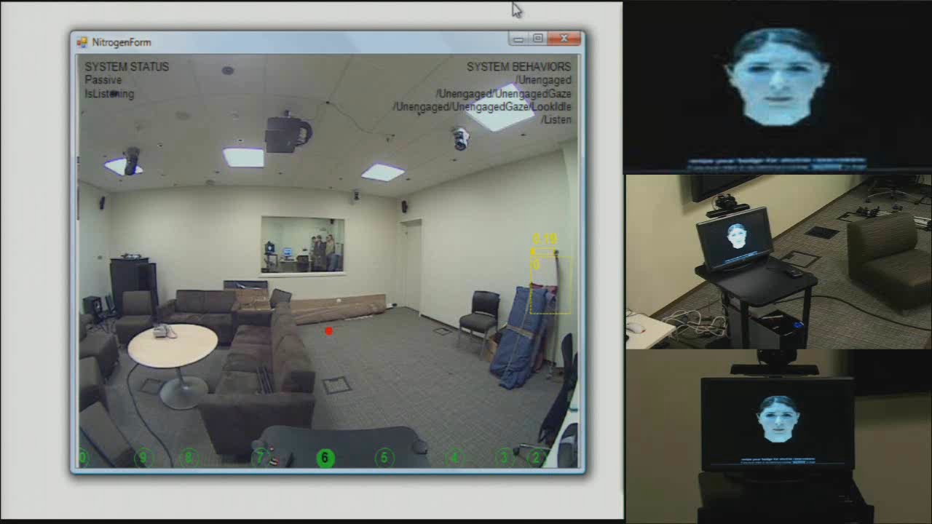
Handling participants waiting in line
detect and track multiple
participants
infer roles and needs
infer and track current speaker
and the conversational floor
maintain engagement with both
participants via gaze and direct
interaction
inference about goals (number
of people) from vision signals

Slide 16
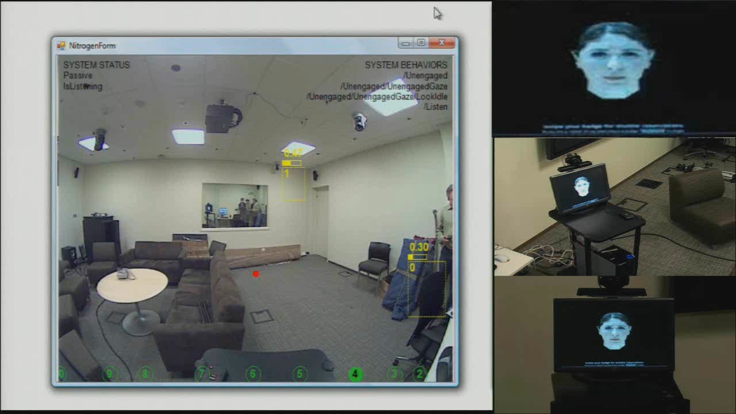
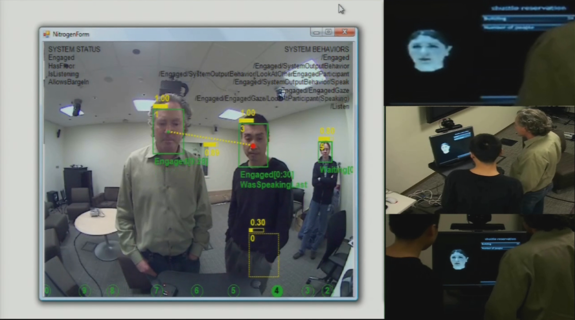
Multi-participant interaction
infer, track and verify group
relationships
behavioral model for gaze is
informed by both current
speaker and addressee(s)

Slide 17
Next …
Moving forward …
Decision-theoretic engagement models
  Balancing costs for waiting, interacting, frustrations
Conversational scene analysis
  Spatio-temporal trajectory reasoning, intention recognition
Natural behavioral models
  Coordinated and scene-driven models for pose, gesture, gaze
Social interaction skills
  Balancing chit-chat and task-oriented dialog
Life-long learning and adaptation

Slide 18

© 2008 Microsoft Corporation. All rights reserved. Microsoft, Windows, Windows Vista and other product names are or may be registered trademarks and/or trademarks in the U.S. and/or other countries. The information herein is for informational purposes only and represents the current view of Microsoft Corporation as of the date of this presentation. Because Microsoft must respond to changing market conditions, it should not be interpreted to be a commitment on the part of Microsoft, and Microsoft cannot guarantee the accuracy of any information provided after the date of this presentation. MICROSOFT MAKES NO WARRANTIES, EXPRESS, IMPLIED OR STATUTORY, AS TO THE INFORMATION IN THIS PRESENTATION.

