Slide 1
AI, Sensing, and Optimized Information Gathering:
Trends and Directions
Carlos Guestrin
joint work with:
and:
Anupam Gupta, Jon Kleinberg,
Brendan McMahan, Ajit Singh, and others…

Slide 2
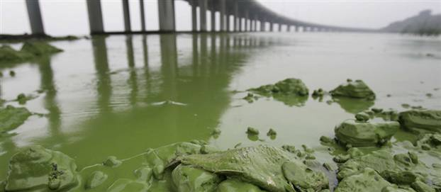
Monitoring algal blooms
Algal blooms threaten freshwater
  4 million people without water
  1300 factories shut down
  $14.5 billion to clean up
  Other occurrences in Australia, Japan, Canada,
  Brazil, Mexico, Great Britain, Portugal, Germany …
Growth processes still unclear [Carmichael]
  Need to characterize growth in the lakes, not in the lab!
Tai Lake China
10/07 MSNBC

Slide 3
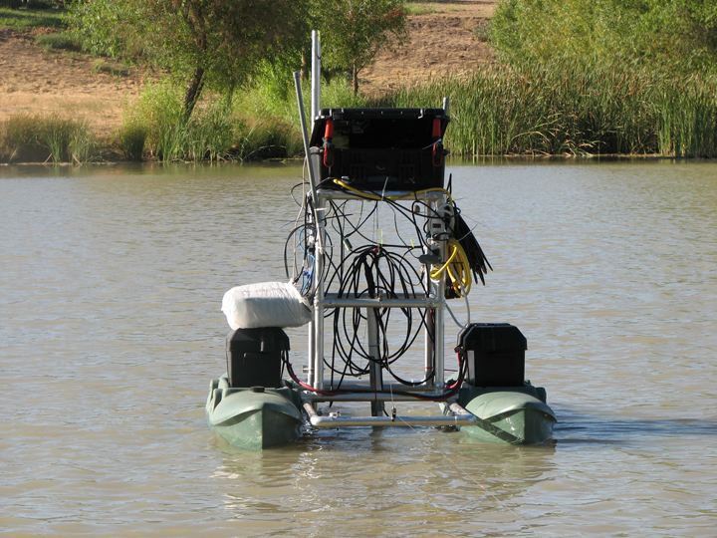
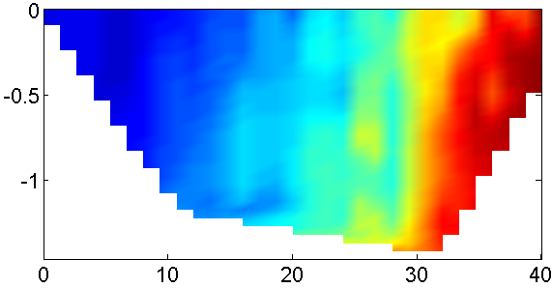
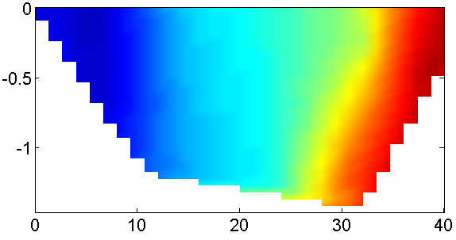
Monitoring rivers and lakes
[Singh, Krause, G., Kaiser ‘07]
Need to monitor large spatial phenomena
  Temperature, nutrient distribution, fluorescence, …
Use robotic sensors to
cover large areas
NIMS
Kaiser
et.al.
(UCLA)
Can only make a limited number of measurements!
Color indicates
actual temperature
Predicted temperature
Depth
Predict at
unobserved
locations
Location across lake
Where should we sense to get most accurate predictions?

Slide 4
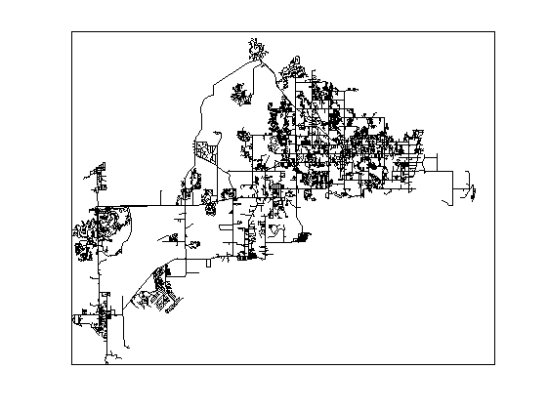
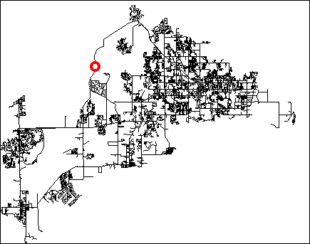




Water distribution networks
Chlorine
ATTACK!
could deliberately
introduce pathogen
Water distribution in a city →
very complex system
Pathogens in water can affect thousands (or millions) of people
Currently: Add chlorine to the
source and hope for the best
Simulator from EPA

Slide 5
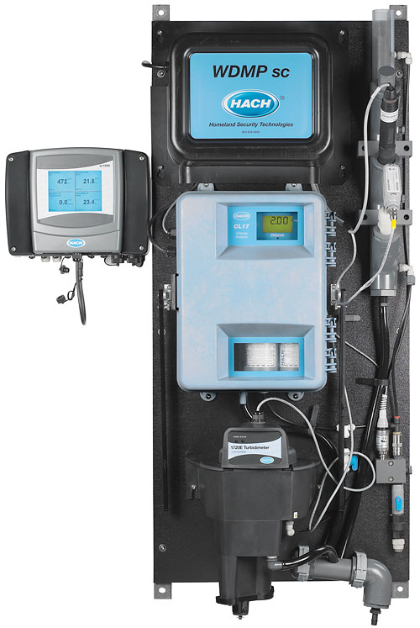
Monitoring water networks
[Krause, Leskovec, G., Faloutsos, VanBriesen ‘08]
Contamination of drinking water
could affect millions of people
Sensors
Simulator from EPA
Hach Sensor
Place sensors to detect contaminations
“Battle of the Water Sensor Networks” competition
~$14K
Where should we place sensors
to detect contaminations quickly ?

Slide 6
Sensing problems
Want to learn something about the state of the world
  Detect outbreaks, predict algal blooms …
We can choose (partial) observations…
  Place sensors, make measurements, …
… but they are expensive / limited
  hardware cost, power consumption, measurement time …
Want cost-effectively get most useful information!
Fundamental problem:
What information should I use to learn ?

Slide 7
Related work
Sensing problems considered in
  Experimental design (Lindley ’56, Robbins ’52…), Spatial statistics
  (Cressie ’91, …), Machine Learning (MacKay ’92, …), Robotics (Sim&Roy ’05, …), Sensor Networks (Zhao et al ’04, …), Operations Research (Nemhauser ’78, …)
Existing algorithms typically
  Heuristics: No guarantees! Can do arbitrarily badly.
  Find optimal solutions (Mixed integer programming, POMDPs):Very difficult to scale to bigger problems.

Slide 8
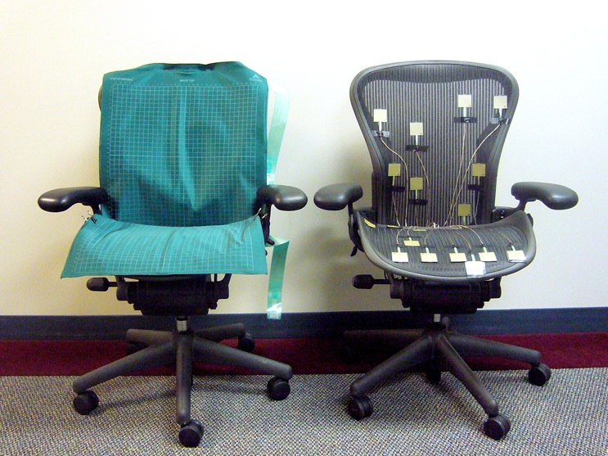
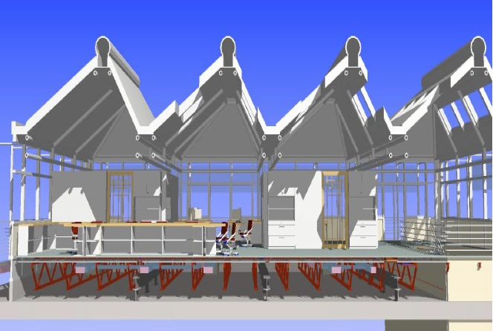

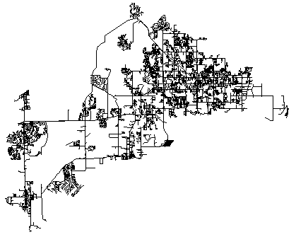

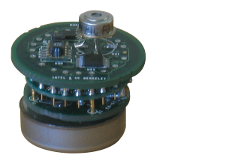



This talk
Theoretical:
Approximation algorithms that have
theoretical guarantees and scale to large problems
Applied:
Empirical studies with real deployments
and large datasets

Slide 9
Model-based sensing
Model predicts impact of contaminations
  For water networks: Water flow simulator from EPA
  For lake monitoring: Learn probabilistic models from data (later)
For each subset A⊆V compute “sensing quality” F(A)
Model predicts
High impact
Lowimpact
location
Contamination
Medium impact
location
S3
S1
S2
S3
S1
S4
Sensor reduces
impact through
early detection!
S2
S4
Set V of all
network junctions
S1
High sensing quality F(A) = 0.9
Low sensing quality F(A)=0.01

Slide 10
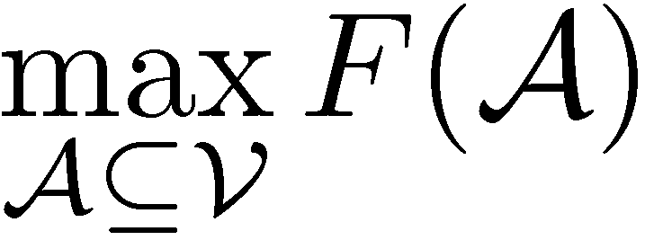
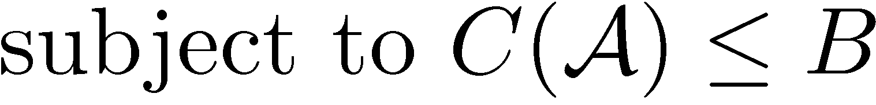
Optimizing sensing / Outline
Sensing quality
Sensing locations
Sensing cost
Sensing budget
Sensor placement
Robust sensing
Complex constraints
Sequential sensing

Slide 11
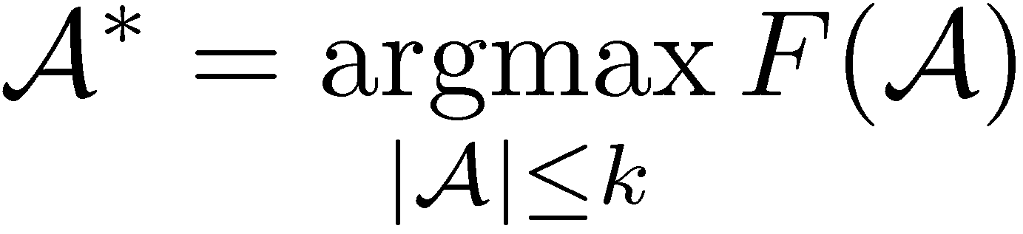
Sensor placement
Given: finite set V of locations, sensing quality F
Want: A*⊆ V such that
Typically NP-hard!
How well can this simple heuristic do?
S3
S1
S5
S2
Greedy algorithm:
  Start with A =Ø ;
  For i = 1 to k
    s* := argmax_{s} F(A ∪ {s})
    A := A ∪{s*}
S4
S6

Slide 12
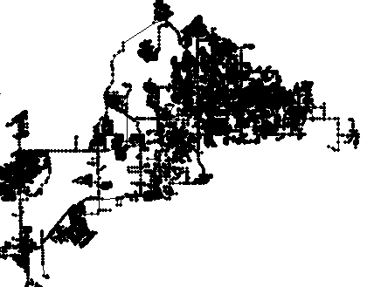
Performance of greedy algorithm
Optimal
Greedy
Population protected
(higher is better)
Small subset of
Water networks
data
Number of sensors placed
Greedy score empirically close to optimal. Why?

Slide 13
Key property: Diminishing returns
Placement A = {S₁, S₂}
Placement B = {S₁, S₂, S₃, S₄}
S2
S3
S2
S1
S1
S4
Theorem [Krause, Leskovec, G., Faloutsos, VanBriesen ’08]:
Sensing quality F(A) in water networks is submodular!
Adding S’
will help a lot!
Adding S’
doesn’t help much
S’
New
sensor S’
B . . . . .
+
S’
Large improvement
Submodularity:
A
+
S’
Small improvement
For A⊆B, F(A ∪ {S’}) – F(A) ≥ F(B ∪ {S’}) – F(B)

Slide 14
One reason submodularity is useful
Theorem[Nemhauser et al ‘78]
Greedy algorithm gives constant factor approximation
F(A_{greedy})≥ (1-1/e) F(A_{opt})
Greedy algorithm gives near-optimal solution!
Guarantees best possible unless P = NP!
Many more reasons, sit back and relax…
~63%

Slide 15

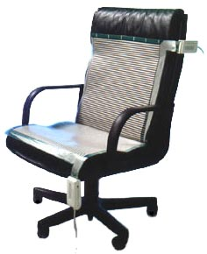
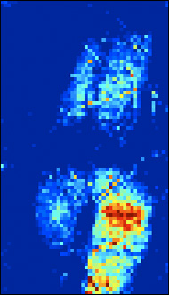
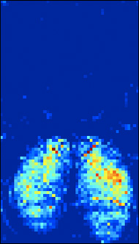
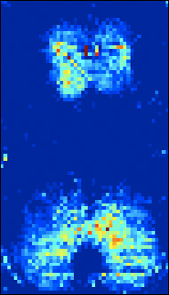
Building a Sensing Chair
[Mutlu, Krause, Forlizzi, G., Hodgins ‘07]
People sit a lot
Activity recognition in
assistive technologies
Seating pressure as
user interface
Equipped with
1 sensor per cm²!
Costs $16,000! ☹
Lean
left
Lean
forward
Slouch
Can we get similar
accuracy with fewer,
cheaper sensors?
82% accuracy on
10 postures! [Zhu et al]

Slide 16
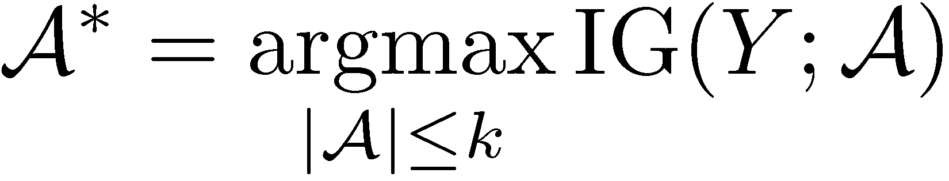
How to place sensors on a chair?
Sensor readings at locations V as random variables
Predict posture Y using probabilistic model P(Y,V)
Pick sensor locations A*⊆V to minimize entropy:
Possible locations V
Placed sensors, did a user study:
Theorem: Information gain
is submodular!*[UAI’05]
 | Accuracy | Cost
Before | 82% | $16,000 ☹
After | 79% | $100 ☺
Similar accuracy at <1% of cost!
*See store for details

Slide 17
Battle of the Water Sensor Networks Competition
Real metropolitan area network (12,527 nodes)
Water flow simulator provided by EPA
3.6 million contamination events
Multiple objectives: Detection time, affected population, …
Place sensors that detect well “on average”

Slide 18
BWSN Competition results
13 participants
Performance measured in 30 different criteria
G: Genetic algorithm
D: Domain knowledge
H: Other heuristic
E: “Exact” method (MIP)
30
G
H
E
25
G
20
E
Total Score
Higher is better
H
15
G
10
H
D
D
G
G
5
0
Gueli
Trachtman
Guan et. al.
Wu & Walski
Dorini et. al.
Berry et. al.
Preis & Ostfeld
Huang et. al.
Propato & Piller
Ghimire & Barkdoll
Eliades & Polycarpou
Ostfeld & Salomons
Our approach
24% better performance than runner-up! ☺

Slide 19

, 16 GB in main memory (compressed)
What was the trick?
Simulated all on 2 weeks / 40 processors
152 GB data on disk
➔ Very accurate sensing quality ☺
3.6M contaminations
Very slow evaluation of F(A) ☹
30 hours/20 sensors
300
6 weeks for all
30 settings ☹
Exhaustive search
(All subsets)
200
Lower is better
Naive
Running time (minutes)
Greedy
ubmodularity
to the rescue:
100
Fast Greedy
0
Using “lazy evaluations”:
1 hour/20 sensors
Done after 2 days! ☺
1
2
3
4
5
6
7
8
9
10
Number of sensors selected
Advantage through theory and engineering!

Slide 20
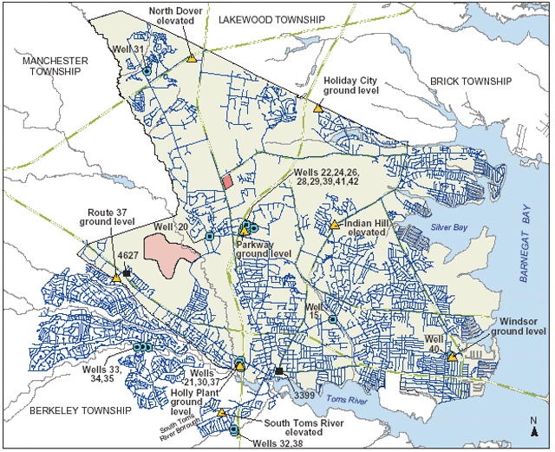
Robustness against adversaries
[Krause, McMahan, G., Gupta ‘07]
If sensor locations are known,
attack vulnerable locations
Unified view
  Robustness to change in parameters
  Robust experimental design
  Robustness to adversaries
SATURATE: A simple, but very effective algorithm for robust sensor placement

Slide 21
What about worst-case?
Knowing the sensor locations, an
adversary contaminates here!
S3
S2
S3
S1
S4
S2
S4
S1
Placement detects
well on “average-case”
(accidental) contamination
Very different average-case score,
Same worst-case score
Where should we place sensors to quickly detect in the worst case?

Slide 22
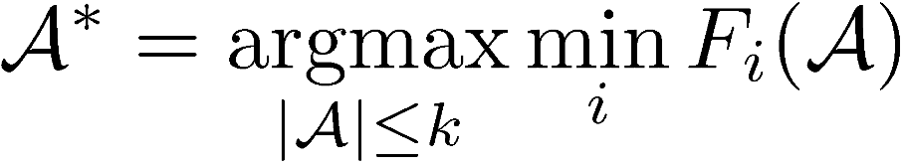
Optimizing for the worst case
Separate utility function F_{i} with each contamination i
F_{i}(A) = impact reduction by sensors A for contamination i
Want to solve
Each of the F_{i} is submodular
Unfortunately, min_{i} F_{i}
not submodular!
How can we solve this robust sensing problem?
Contamination
at node s
Sensors A
F_{s}(C) is high
F_{s}(B) is low
F_{s}(A) is high
Sensors C
Sensors B
Contamination
at node r
F_{r}(A) is low
F_{r}(B) is high
F_{r}(C) is high

Slide 23
How does the greedy algorithm do?
V={ , , }
Can only buy k=2
Set A | F₁ | F₂ | min_{i} F_{i}
 | 1 | 0 | 0
 | 0 | 2 | 0
 | ε | ε | ε
 | 1 | ε | ε
 | ε | 2 | ε
 | 1 | 2 | 1
Greedy picks
first
Hence we can’t find any approximation algorithm.
Optimal
solution
Then, can
choose only
or
Or can we?
Optimal score: 1
Greedy score:ε
➔ Greedy does arbitrarily badly. Is there something better?
Theorem [NIPS ’07]: The problem max_{|A|≤ k} min_{i} F_{i}(A)
does not admit any approximation unless P=NP

Slide 24
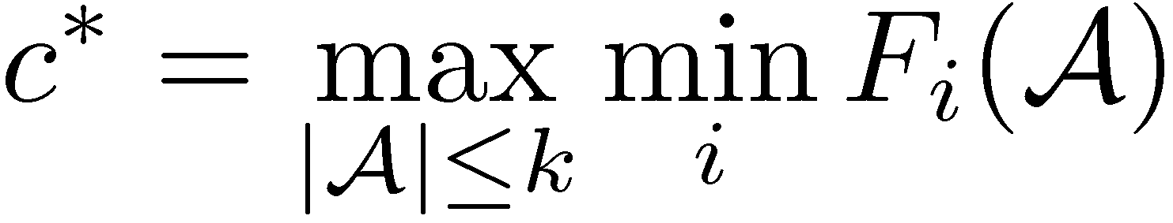
Alternative formulation
If somebody told us the optimal value,
can we recover the optimal solution A*?
Need to find
Is this any easier?
Yes, if we relax the constraint |A| ≤ k

Slide 25
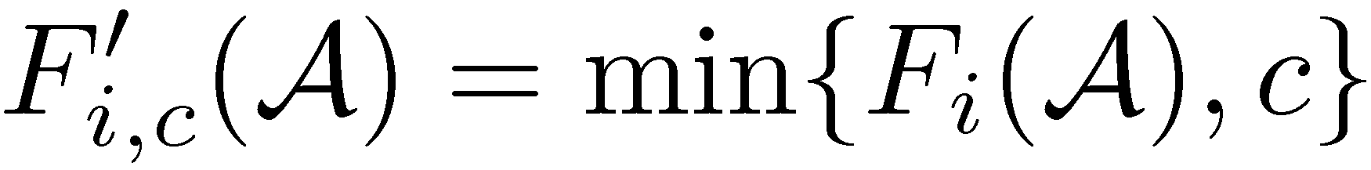
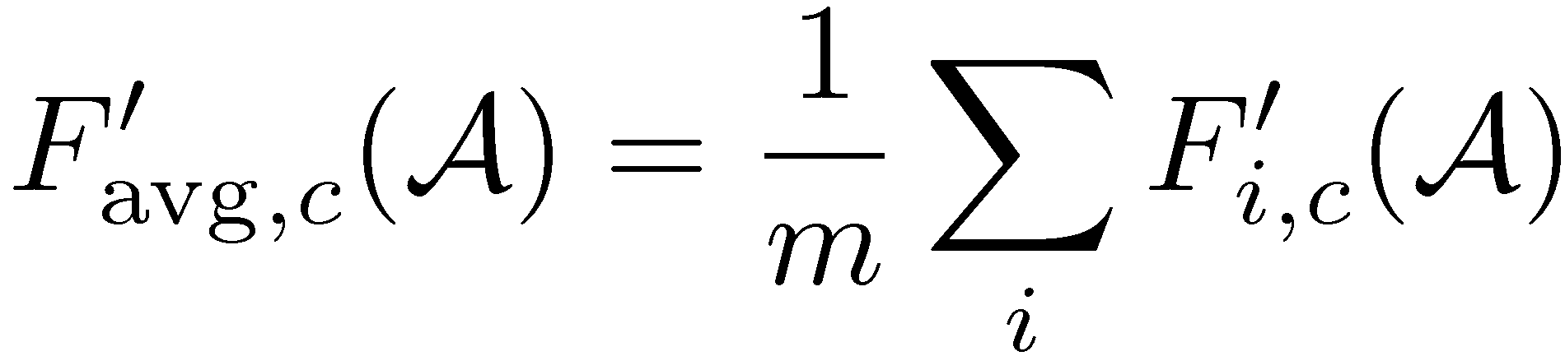
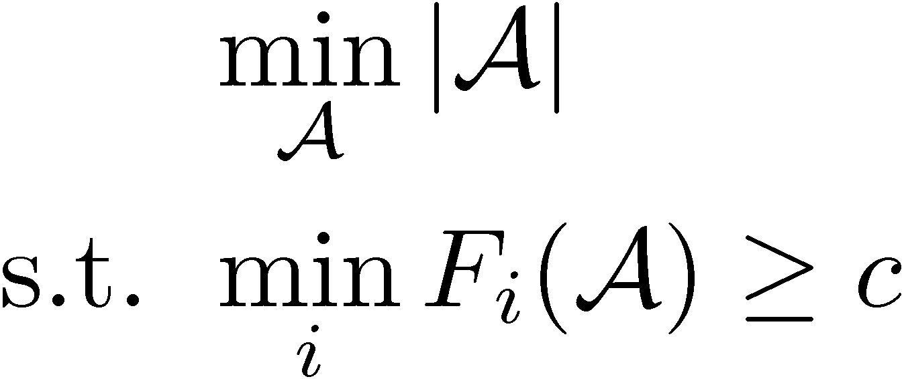
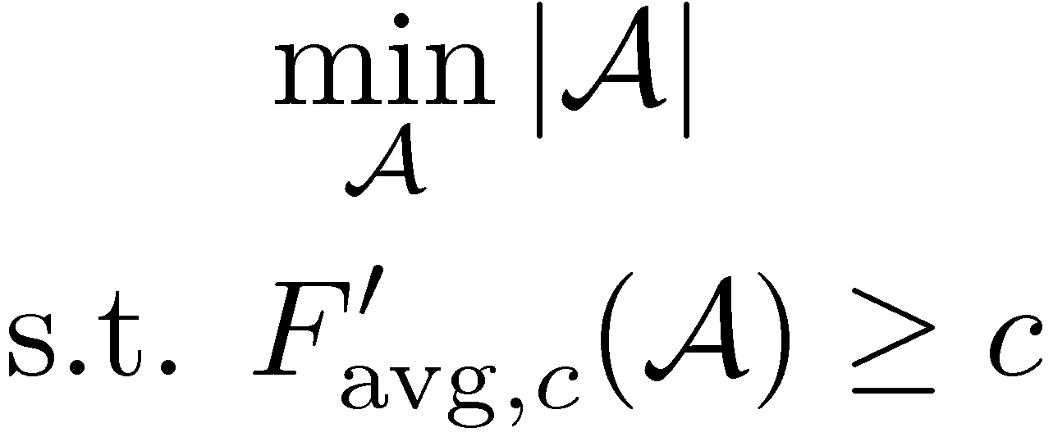
Solving the alternative problem
Trick: For each F_{i} and c, define truncation
F_{i}(A)
c
F’_{i,c}(A)
|A|
Problem 1 (last slide)
Problem 2
Non-submodular ☹
Don’t know how to solve
Same optimal solutions!
Solving one solves the other
Submodular!
Can use greedy! ☺

Slide 26
Back to our example
Guess c=1
First pick
Then pick
➔ Optimal solution!
How do we find c?
Do binary search!
Set A | F₁ | F₂ | min_{i} F_{i} | F’_{avg,1}
 | 1 | 0 | 0 | ½
 | 0 | 2 | 0 | ½
 | ε | ε | ε | ε
 | 1 | ε | ε | (1+ε)/2
 | ε | 2 | ε | (1+ε)/2
 | 1 | 2 | 1 | 1

Slide 27
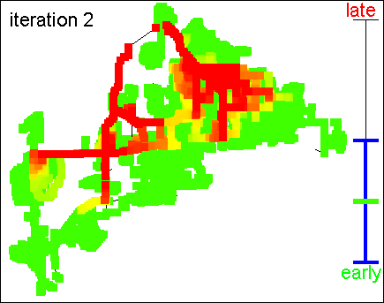
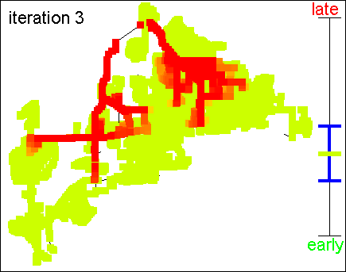
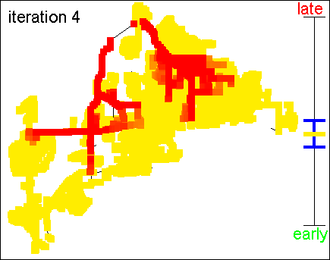
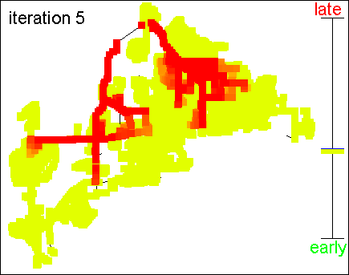
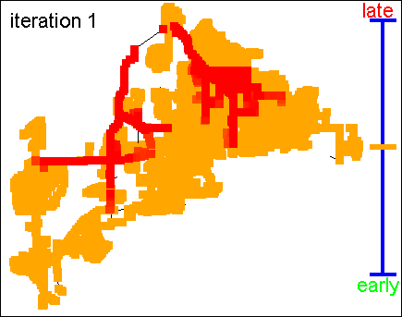

Saturate Algorithm [NIPS ‘07]
Given: set V, integer k and submodular functions F₁,…,F_{m}
Initialize c_{min}=0, c_{max} = min_{i} F_{i}(V)
Do binary search: c = (c_{min}+c_{max})/2
  Greedily find A_{G} such that F’_{avg,c}(A_{G}) = c
  If |A_{G}| ≤α k: increase c_{min}
  If |A_{G}| >α k: decrease c_{max}
until convergence
Truncation
threshold
(color)

Slide 28
Theoretical guarantees
Theorem: The problem max_{|A|≤ k} min_{i} F_{i}(A)
does not admit any approximation unless P=NP ☹
Theorem: Saturate finds a solution A_{S} such that
min_{i} F_{i}(A_{S}) ≥ OPT_{k} and |A_{S}| ≤α k
where OPT_{k} = max_{|A|≤k} min_{i} F_{i}(A)
α = 1 + log max_{s}∑_{i} F_{i}({s})
Theorem:
If there were polytime algorithm with better factor β<α, then NP ⊆ DTIME(n^{log log n})

Slide 29
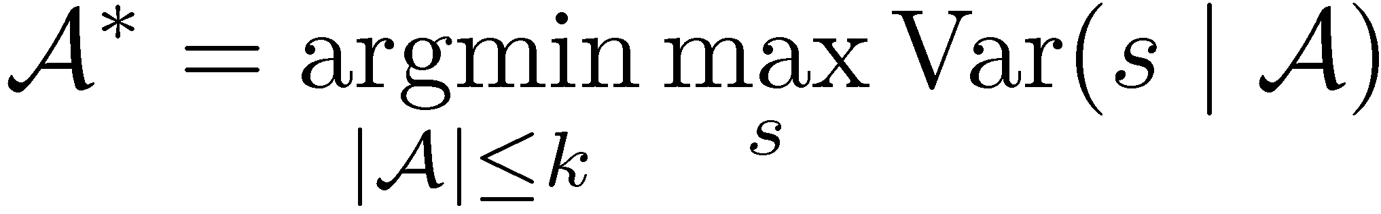
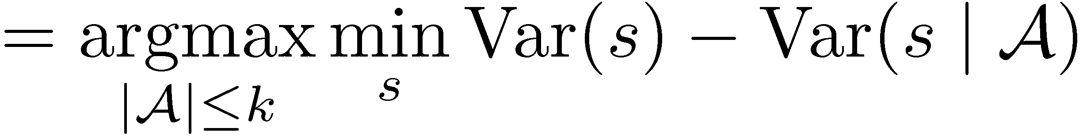
Example: Lake monitoring
Monitor pH values using robotic sensor
transect
Prediction at unobserved
locations
Observations A
True (hidden) pH values
pH value
Var(s | A)
Use probabilistic model
(Gaussian processes)
to estimate prediction error
Position s along transect
Where should we sense to minimize our maximum error?
➔ Robust sensing problem!
(often) submodular
[Das & Kempe ’08]

Slide 30
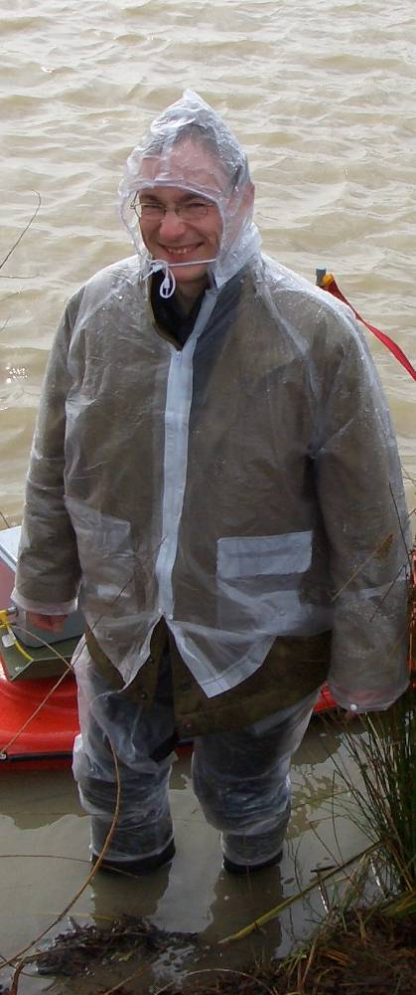
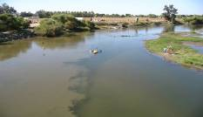
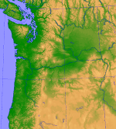
Comparison with state of the art
Algorithm used in geostatistics: Simulated Annealing
  [Sacks & Schiller ’88, van Groeningen & Stein ’98, Wiens ’05,…]
  7 parameters that need to be fine-tuned
2.5
2
Greedy
better
Maximum marginal variance
1.5
Simulated
Annealing
1
Saturate
0.5
0
20
40
60
80
100
Number of sensors
Saturate is competitive & 10x faster
No parameters to tune!
Environmental monitoring
Precipitation data

Slide 31
Results on water networks
3000
No decrease
until all
contaminations
detected!
2500
Greedy
2000
Simulated
Maximum detection time (minutes)
1500
Lower is better
Annealing
1000
500
Saturate
0
Water networks
0
10
20
Number of sensors
60% lower worst-case detection time!

Slide 32
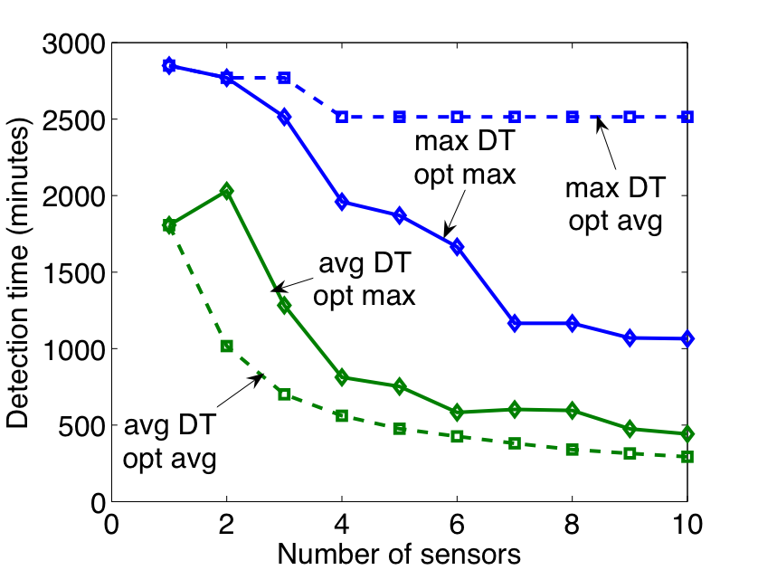
Is optimizing for the worst case too conservative?
(on water competition data)
max
min
max
avg
worst
attack
max
min
max
avg
average
attack
SATURATE:
  significantly better worst-case performance
  good average performance

Slide 33
Trading off average-case performance and robustness
Worst-case may be too conservative
Maximize average
  Subject to worst-case ≥ c_{adv}
Hard constrained optimization problem
  submodular optimization with minimax constraint
Extension of SATURATE
  approximation algorithm with similar guarantees
3000
2500
2000
Adversarial score
k=10
1500
k=5
1000
500
k=20
k=15
0
0
200
400
600
800
Expected score

Slide 34
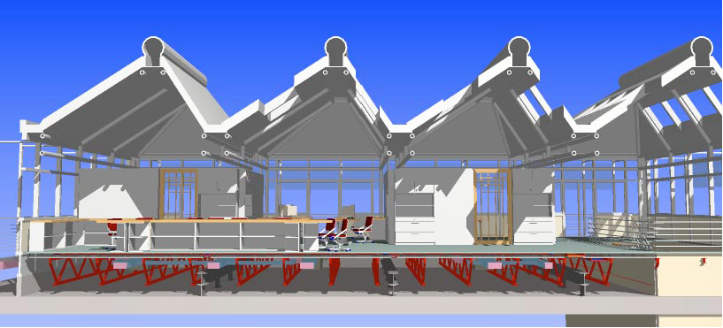
Summary so far
All these applications involve physical sensing
Now for something completely different
Let’s jump from water…
Submodularity in
sensing optimization
Greedy is near-optimal
Robust sensing
Greedy fails badly
Saturate is near-optimal
Path planning
Communication constraints
Constrained submodular optimization
pSPIEL gives strong guarantees
Sequential sensing
Exploration Exploitation Analysis

Slide 35
… to the Web!
You have 10 minutes each day for
reading blogs / news.
Which of the million blogs should you read?

Slide 36



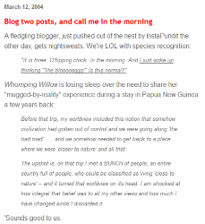

Information Cascades
[Leskovec, Krause, G., Faloutsos, VanBriesen ‘07]
Time
Learn about
story after us!
Information cascade
Which blogs should we read to learn about big cascades early?
Notes:
36

Slide 37


Water vs. Web
Placing sensors in
water networks
Selecting
informative blogs
vs.
In both problems we are given
  Graph with nodes (junctions / blogs) and edges (pipes / links)
  Cascades spreading dynamically over the graph (contamination / citations)
Want to pick nodes to detect big cascades early
In both applications, utility functions submodular ☺

Slide 38
Performance on Blog selection
0.7
400
Greedy
0.6
Exhaustive search
300
(All subsets)
0.5
0.4
Lower is better
Naive
Higher is better
Running time (seconds)
Cascades captured
In-links
200
greedy
0.3
All outlinks
0.2
# Posts
100
Fast greedy
0.1
Random
0
0
0
20
40
60
80
100
1
2
3
4
5
6
7
8
9
10
Number of blogs
Number of blogs selected
Blog selection
~45k blogs
Blog selection
Outperforms state-of-the-art heuristics
700x speedup using submodularity!

Slide 39
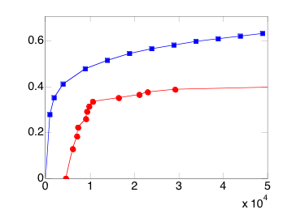
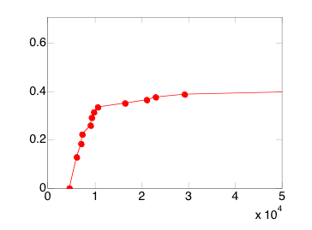
Taking “attention” into account
Naïve approach: Just pick 10 best blogs
Selects big, well known blogs (Instapundit, etc.)
These contain many posts, take long to read!
Cost/benefit
analysis
Cascades captured
Ignoring cost
x 10⁴
Number of posts (time) allowed
Cost-benefit optimization picks summarizer blogs!

Slide 40
Predicting the “hot” blogs
Want blogs that will be informative in the future
Split data set; train on historic, test on future
Detects on training set
0.25
Greedy on future
Test on future
0.2
“Cheating”
0.15
Cascades captured
0.1
Greedy on historic
Blog selection “overfits”
to training data!
Test on future
Detect well
here!
Detect poorly
here!
0.05
0
Poor generalization!
Why’s that?
0
1000
2000
3000
4000
Number of posts (time) allowed
Want blogs that
continue to do well!
Let’s see what
goes wrong here.

Slide 41
Robust optimization
“Overfit” blog
selection A
F_{i}(A) = detections
in interval i
F₁(A)=.5
F₃ (A)=.6
F₅ (A)=.02
F₂ (A)=.8
F₄(A)=.01
Optimize
worst-case
Detections using Saturate
“Robust” blog
selection A*
Robust optimization ⬄ Regularization!

Slide 42
Predicting the “hot” blogs
0.25
Greedy on future
Test on future
Robust solution
0.2
“Cheating”
Test on future
0.15
Sensing quality
0.1
Greedy on historic
Test on future
0.05
0
0
1000
2000
3000
4000
Number of posts (time) allowed
50% better generalization!

Slide 43
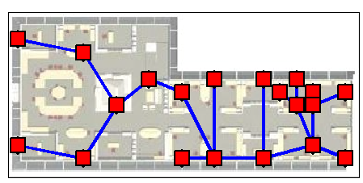
Summary
Submodularity in
sensing optimization
Greedy is near-optimal
Path planning
Communication constraints
Constrained submodular optimization
pSPIEL gives strong guarantees
Robust sensing
Greedy fails badly
Saturate is near-optimal
Robust optimization
➔ better generalization
Constrained optimization
➔ better use of “attention”
Sequential sensing
Exploration Exploitation Analysis

Slide 44
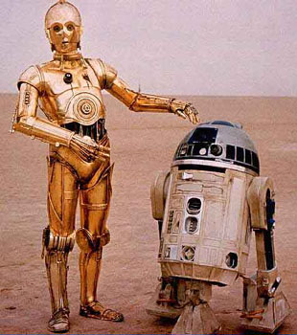
AI-complete dream
Robot that saves the world
  Robot that cleans your room
But…
  It’s definitely useful, but…
    Really narrow
  Hardware is a real issue
    Will take a while
What’s an “AI-complete” problem that will be useful to a huge number of people in the next 5-10 years?
What’s a problem accessible to a large part of AI community?

Slide 45
What makes a good AI-complete problem?
A complete AI-system:
  Sensing: gathering information from the world
  Reasoning: making high-level conclusions from information
  Acting: making decisions that affect the dynamics of the world and/or the interaction with the user
But also
  Hugely complex
  Can get access to real data
  Can scale up and layer up
  Can make progress
  Very cool and exciting
Data gathering can lead to good, accessible and cool AI-complete problems

Slide 46
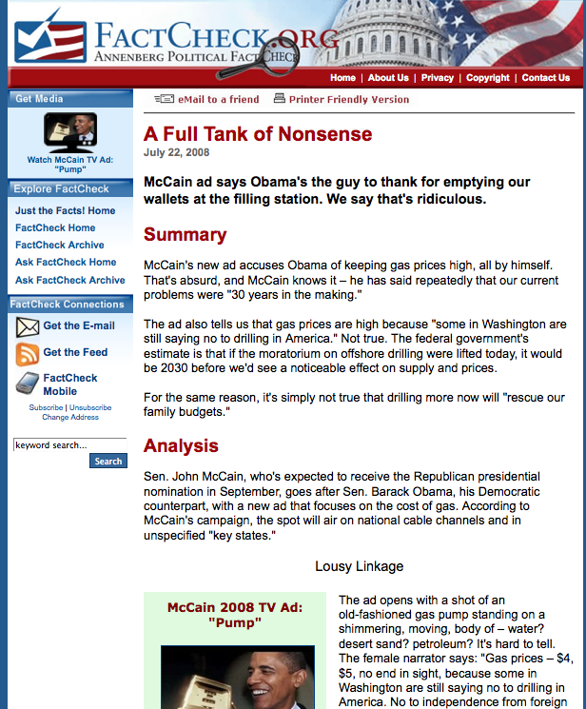
Factcheck.org
Take a statement
Collect information from multiple sources
Evaluate quality of sources
Connect them
Make a conclusion AND provide an analysis

Slide 47
Automated fact checking
Query
Fact or Fiction?
Can lead to very cool “AI-complete” problem, useful, and
can make progress in short term!
Web
Models
Inference
Conclusion and Justification
Active user feedback on sources and proof

Slide 48
Conclusions
Sensing and information acquisition problems are important and ubiquitous
Can exploit structure to find provably good solutions
Obtain algorithms with strong guarantees
Perform well on real world problems
Could help focus on a
cool “AI-complete” problem

