Slide 1
Contexts in Computer Science Education
Mark Guzdial
Professor
Georgia Institute of Technology (Georgia Tech)

Slide 2
Story
Beyond teaching computing to more,
teaching computing to everyone.
Computing for All at Georgia Tech
  1999-2003: One course for all
  2003-2008: Contextualized Computing Education
    Margolis and Fisher’s “Alternative Paths”
Evaluation Results: Different contexts, at different schools
  Media Computation, Engineering, Robotics, Games
  Beyond CS1: Media Computation CS2, Gameboy for
  Computer Organization

Slide 3
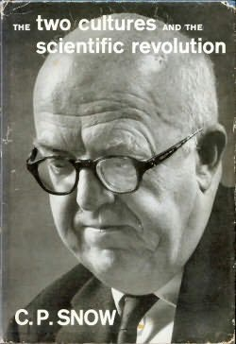
The Two Cultures

Slide 4
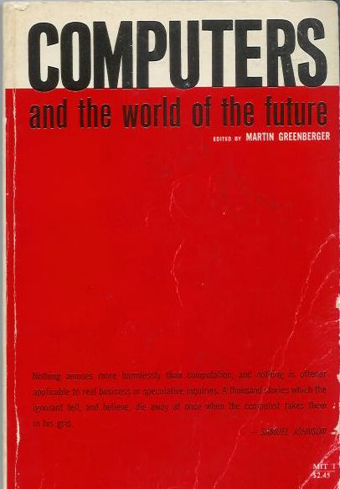
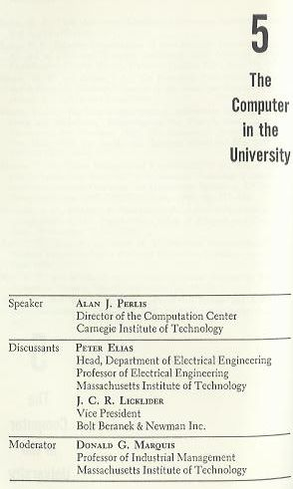
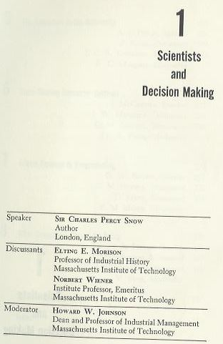
1961 MIT Sloan School Symposium

Slide 5
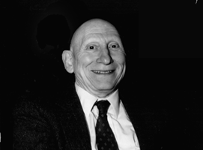
Learn Programming
To re-think process everywhere
Alan Perlis argued that computer science should be part of a liberal education
  Explicitly, he argued that all students should learn to program
Why?
  Because Computer Science is the study of process
  Automated execution of process changes everything
    Including how we think about things

Slide 6
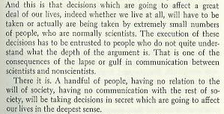
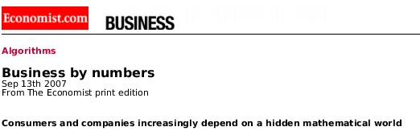
The Power and Fear of Algorithms
The Economist (Sept., 2007) spoke to the algorithms that control us, yet we don’t understand.
  Credit Ratings, Adjustable Rate Mortgages, Search Rankings
C.P. Snow foresaw this in 1961.
  Those who don’t understand algorithms, can’t understand how the decisions are made
“A handful of people, having no relation to the will of society, having no communication with the rest of society, will be taking decisions in secret which are going to affect our lives in the deepest sense.”

Slide 7
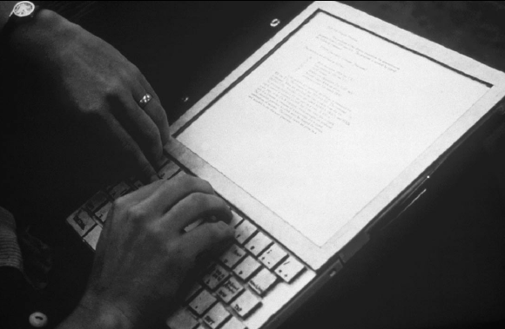
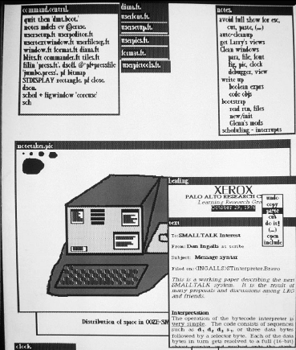
1970- : Alan Kay’s Dynabook
Alan Kay (2004 ACM Turing Awardee)sees the Computer as humanity’s first metamedium
  A medium that can represent
  all other media
  Programming as an important new medium
The computer-as-Dynabook is for creative metamedia exploration and reading

Slide 8
Fall 1999: Georgia Tech
Fall 1999
All students at Georgia Tech must take a course in
computer science
  Considered part of General Education, like mathematics,
  social science, humanities…
Why did Georgia Tech make that decision?
  Computing was a College
    Solved a problem for Engineering
  Making a competitive distinction for Liberal Arts

Slide 9
Computing for Everyone Already Happening:
Computational Thinking
Computing is already cross-campus
  Bio2010 (NRC) calls for programming for mathematical and
  computational models.
  Physics teaches VPython for labs where they solve three-body problems.
Computer science provides the tools and metaphors for understanding our world
  Jeanette Wing’s “Computational Thinking”
Scientists and engineers use computing to model,
simulate, and understand.
  Why shouldn’t students?

Slide 10
Richard Dawkins on Fresh Aire
GROSS: You close your book saying, "I am thrilled to be alive
at a time when humanity is pushing against the limits of understanding." How do you think that's happening in your
field of evolutionary biology?
Mr. DAWKINS: Well, it's the most exciting time to be a biologist… Since Watson and Crick in 1953, biology has become a sort of
branch of computer science. I mean, genes are just long computer tapes, and they use a code which is just another kind of computer code. It's quaternary rather than binary, but it's read in a sequential way just like a computer tape. It's transcribed. It's copied and
pasted. All the familiar metaphors from computer science fit.

Slide 11
Computer Science = = Computer Science
Key Point: Only one course met the requirement:
CS1321 Introduction to Computing
  Shackelford’s pseudocode approach in 1999
  Later Scheme: How to Design Programs (MIT Press)
Why only one?
  It’s all the same computer science.
  Resource issues
  “Service Ghetto”
  Sealed the deal: The offer to help them do their own

Slide 12
One-class CS1: Pass (A, B, or C) vs. WDF
(Withdrawal, D or F)
Success Rates in CS1 from Fall 1999 to Spring 2002
Architecture | 46.7%
Biology | 64.4%
Economics | 53.5%
History | 46.5%
Management | 48.5%
Public Policy | 47.9%

Slide 13
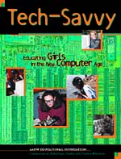
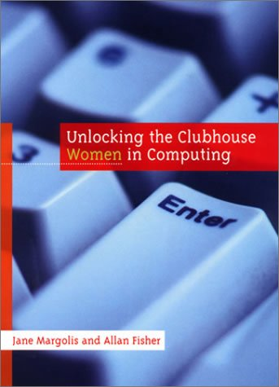
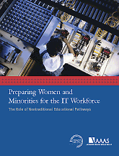
Contextualized Computing Education
What’s going on?
  Research results: Computing is “tedious,
  boring, irrelevant”
Since Spring 2003, Georgia Tech teaches
three introductory CS courses
  Based on Margolis and Fisher’s “alternative paths”
Each course introduces computing using a context (examples, homework assignments, lecture discussion) relevant to majors
  Make computing relevant by teaching it in
  terms of what computers are good for
  (from the students’ perspective)

Slide 14
Contexts, Results, and Themes
Media Computation
Computing for Engineers (MATLAB)
Robotics for CS1
  Institute for Personal Robotics in Education
Gaming
Beyond CS1
  Impact on CS2
  Gameboy programming for Computer Organization

Slide 15
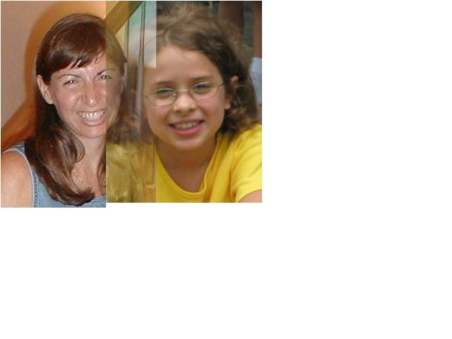

Media Computation
Teaching in a relevant context
Presenting CS topics with media projects and examples
  Iteration as creating negative and grayscale images
  Indexing in a range as removing redeye
  Algorithms for blending both images and sounds
  Linked lists as song fragments woven to make music
  Information encodings as sound visualizations

Slide 16
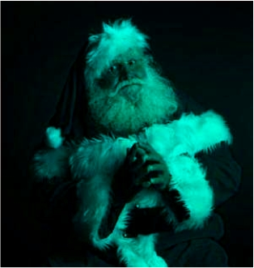


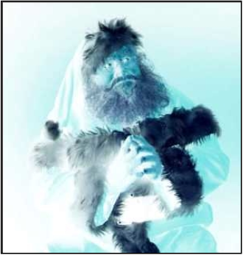
def clearRed(picture):
for pixel in getPixels(picture):
setRed(pixel,0)
def greyscale(picture):
for p in getPixels(picture):
redness=getRed(p)
greenness=getGreen(p)
blueness=getBlue(p)
luminance=(redness+blueness+greenness)/3
setColor(p, makeColor(luminance,luminance,luminance))
def negative(picture):
for px in getPixels(picture):
red=getRed(px)
green=getGreen(px)
blue=getBlue(px)
negColor=makeColor(255-red,255-green,255-blue)
setColor(px,negColor)

Slide 17
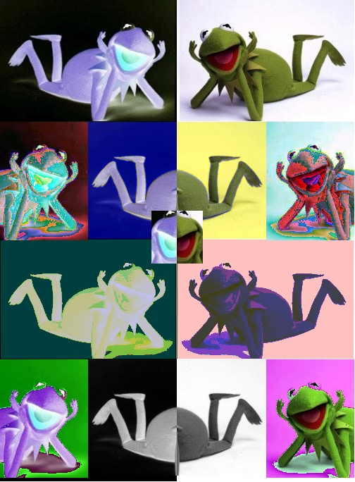
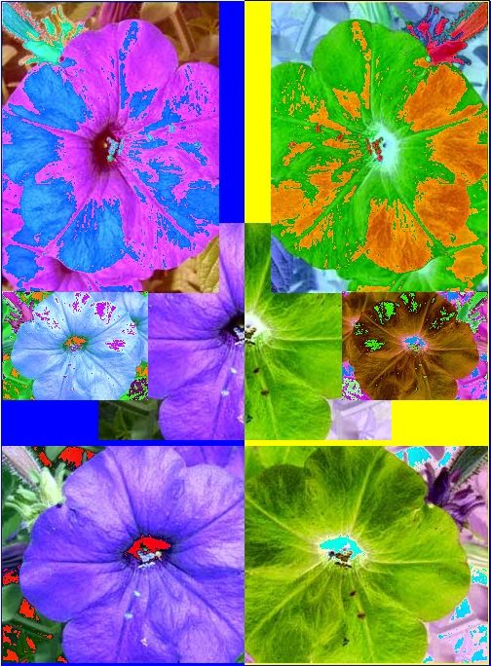
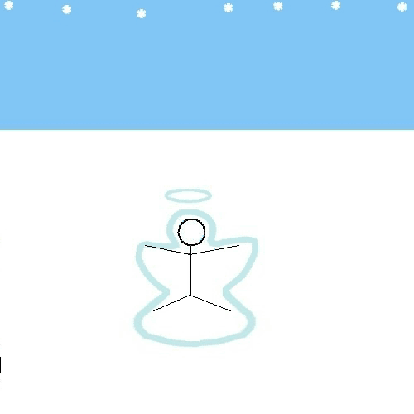
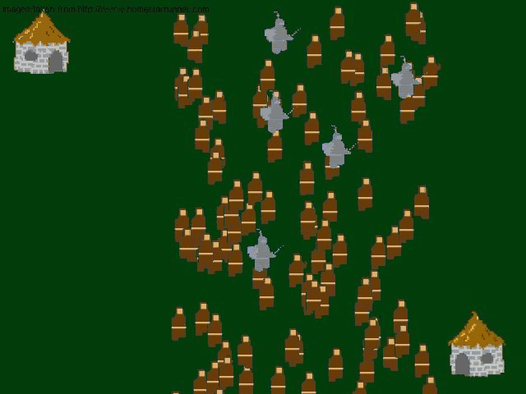
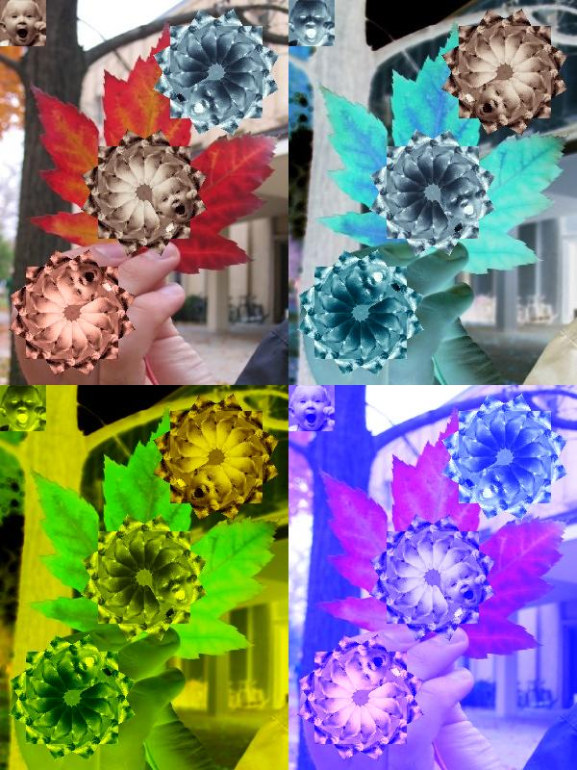
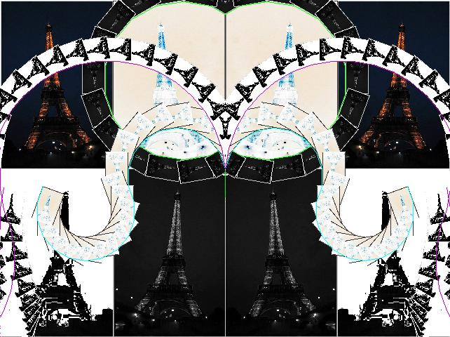

Open-ended, Contextualized Homework
Sound collage
Music

Slide 18
Results: CS1“Media Computation”
Change in Success rates in CS1 “Media Computation” from Spring 2003 to Fall 2005
Architecture | 46.7% | 85.7%
Biology | 64.4% | 90.4%
Economics | 54.5% | 92.0%
History | 46.5% | 67.6%
Management | 48.5% | 87.8%
Public Policy | 47.9% | 85.4%

Slide 19
Voices From Media Computation Students
Intl Affairs student (female): “I just wish I had more time to play around with that and make neat effects. But JES [IDE for class] will be on my computer forever, so… that’s the nice thing about this class is that you could go as deep into the homework as you wanted. So, I’d turn it in and then me and my roommate would do more after to see what we could do with it.”
Results from a survey a year later
  19% of respondents had programmed since class ended
  “Did the class change how you interact with computers?”
  80% say “Yes”
    “Definitely makes me think of what is going on behind the scenes of such programs
    like Photoshop and Illustrator.”

Slide 20
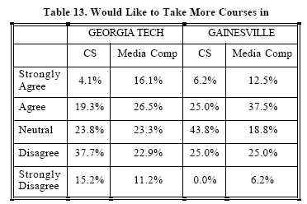
Results at Gainesville College
(Tew, Fowler, Guzdial, SIGCSE 2005)

Slide 21
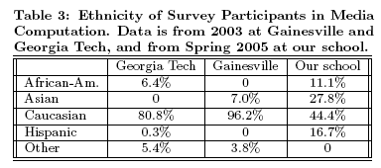
Results at U. Illinois-Chicago
(Sloan and Troy,
SIGCSE 2008)

Slide 22
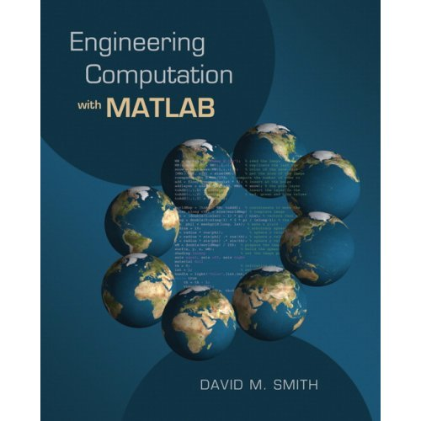
Introducing Computing in an
Engineering Context
Developed in collaboration with Civil, Mechanical, and Aerospace Engineering
Uses Engineering problems
and MATLAB
Covers traditional CS1 topics
These are the first students to program outside of class.

Slide 23
Results: CS1 for Engineering

Slide 24
Side Trip: How about CS?

Slide 25
Comparing Spring 2004

Slide 26
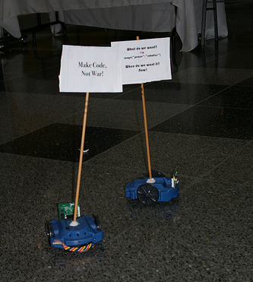
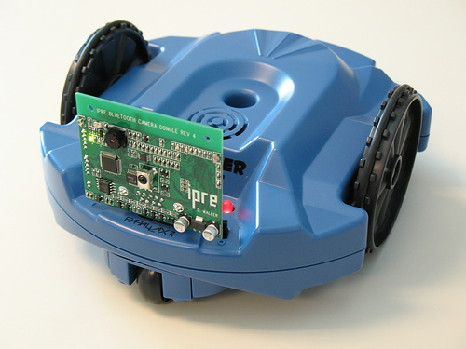
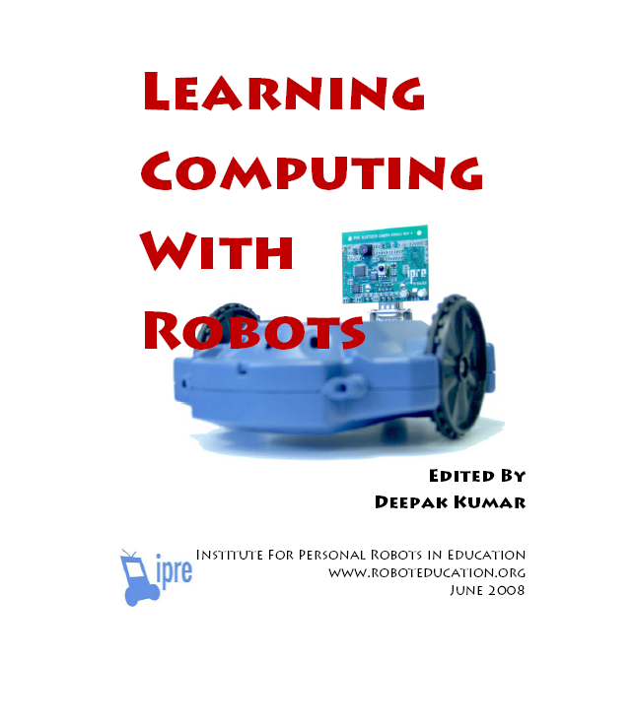
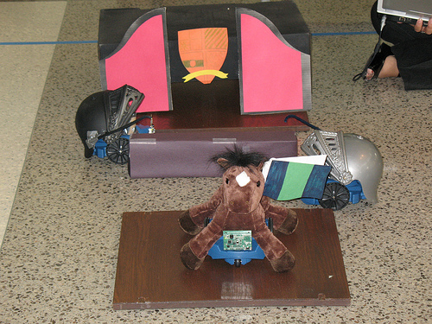
A Context For CS1 For CS Majors
Robotics
Microsoft Research has funded the Institute for Personal Robotics in Education
  Tucker Balch, Deepak Kumar,
  Doug Blank
  Joint between Bryn Mawr and Georgia Tech
  http://www.roboteducation.org
Goal is to develop a CS1 with robotics as the context
  Includes a camera and media computation functions

Slide 27
Robot Movies
Wonderful project by Jay Sumet
Creative and Collaborative – and Distributed/Parallel!
  Robots are characters
  Multiple characters mean multiple students with multiple robots
  One robot is camera
    How do you zoom?
    Aim and go forward!
  Challenges
  How do you know when your actors are in their places?
  How do you “cue” the others?
  Post-processing media computation for eerie
  disappearing effects

Slide 28

Example Movie

Slide 29
IPRE Assessment Results
Two main trials so-far
  Spring 2007
  Attitudes in robot (GT and Bryn Mawr) and in non-robot (GT)‏
    Interviews to establish themes
    Surveys to test themes across whole class
  Fall 2007: More careful testing of learning, same groupings
  Average success rate: 90.87%
Notes:
29
© 2007 Microsoft Corporation. All rights reserved. Microsoft, Windows, Windows Vista and other product names are or may be registered trademarks and/or trademarks in the U.S. and/or other countries. The information herein is for informational purposes only and represents the current view of Microsoft Corporation as of the date of this presentation. Because Microsoft must respond to changing market conditions, it should not be interpreted to be a commitment on the part of Microsoft, and Microsoft cannot guarantee the accuracy of any information provided after the date of this presentation. MICROSOFT MAKES NO WARRANTIES, EXPRESS, IMPLIED OR STATUTORY, AS TO THE INFORMATION IN THIS PRESENTATION.
01/09/08 16:37

Slide 30
Attitudes in Spring 2007
All students enjoyed the robot, were comfortable with it, and found it easy to get working
  Personalizing the robot improved the course,
  in students’ opinion
Reported that the class was about computer science
Found homework challenging
Notes:
30
© 2007 Microsoft Corporation. All rights reserved. Microsoft, Windows, Windows Vista and other product names are or may be registered trademarks and/or trademarks in the U.S. and/or other countries. The information herein is for informational purposes only and represents the current view of Microsoft Corporation as of the date of this presentation. Because Microsoft must respond to changing market conditions, it should not be interpreted to be a commitment on the part of Microsoft, and Microsoft cannot guarantee the accuracy of any information provided after the date of this presentation. MICROSOFT MAKES NO WARRANTIES, EXPRESS, IMPLIED OR STATUTORY, AS TO THE INFORMATION IN THIS PRESENTATION.
01/09/08 16:37

Slide 31
Differences in Attitudes
Spring 2007
BMC students did more on homework “because it was cool.”
BMC students were undeclared majors
  Reported being more excited about CS afterward
GT students were already declared majors
  Less excited about robots overall,
  but more interested than BMC in more courses
  in computer science
Notes:
31
© 2007 Microsoft Corporation. All rights reserved. Microsoft, Windows, Windows Vista and other product names are or may be registered trademarks and/or trademarks in the U.S. and/or other countries. The information herein is for informational purposes only and represents the current view of Microsoft Corporation as of the date of this presentation. Because Microsoft must respond to changing market conditions, it should not be interpreted to be a commitment on the part of Microsoft, and Microsoft cannot guarantee the accuracy of any information provided after the date of this presentation. MICROSOFT MAKES NO WARRANTIES, EXPRESS, IMPLIED OR STATUTORY, AS TO THE INFORMATION IN THIS PRESENTATION.
01/09/08 16:37

Slide 32
Fall 2007:
Final exam comparison at GT

Slide 33
Statistically Significant p <= 0.015
Ignore the Tracing Question

Slide 34
Confound: Differences in Class Demographics
Due to the laptop requirement, advisors steered students who were declared as CS majors into the robots class,
and other students into the non-robots class
4% CS/Computation Majors in the Non-Robots class
81% CS/Computation majors in Instructor B's Robots class

Slide 35
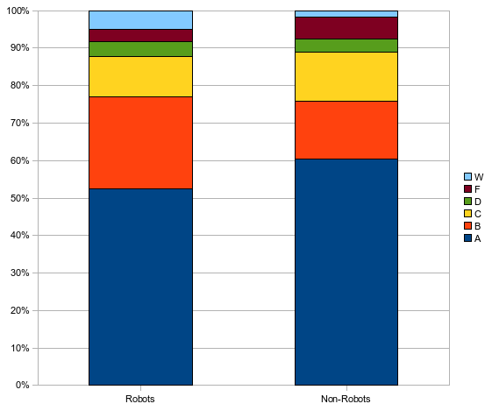
W’s vs. F’s,
Statistically significant
Notes:
35
© 2007 Microsoft Corporation. All rights reserved. Microsoft, Windows, Windows Vista and other product names are or may be registered trademarks and/or trademarks in the U.S. and/or other countries. The information herein is for informational purposes only and represents the current view of Microsoft Corporation as of the date of this presentation. Because Microsoft must respond to changing market conditions, it should not be interpreted to be a commitment on the part of Microsoft, and Microsoft cannot guarantee the accuracy of any information provided after the date of this presentation. MICROSOFT MAKES NO WARRANTIES, EXPRESS, IMPLIED OR STATUTORY, AS TO THE INFORMATION IN THIS PRESENTATION.
01/09/08 16:37

Slide 36
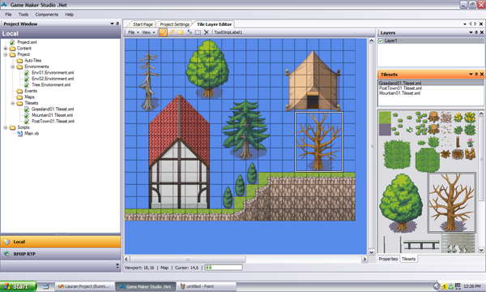
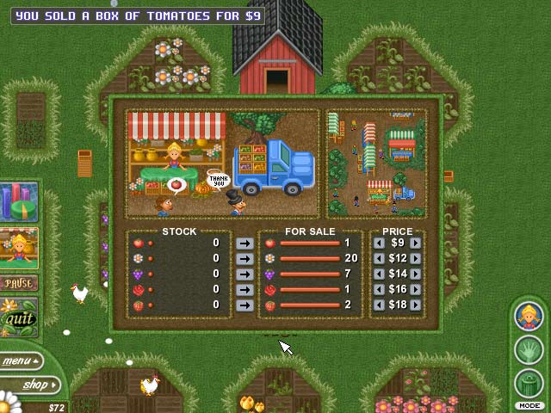
Gaming as a Context for CS1
Most households in the US today play computer games
  It is relevant
Games programs are popular and draw in students.
Draws mostly male
  CS1-3 sequence for games at RIT: 95% male (Bayliss, 2008)
  Made the games course “GenEd” to draw more students: Still only 20% female (Whitehead, 2008)

Slide 37
Challenge of Gaming Context: Infrastructure
Computer gaming courses in College of Computing are predominantly male
  Advanced course on game implementation.
BS in Computational Media degree: 27% female
  ½ the students want to build video games
  All the women are in the other half
Report from Bryn Mawr (Dianna Xu, Doug Blank, Deepak Kumar)
  Introducing gaming into the curriculum has a real danger of discouraging female enrollment
  Significant student frustration over tools and textbook
  Can’t succeed at making the context work without support

Slide 38
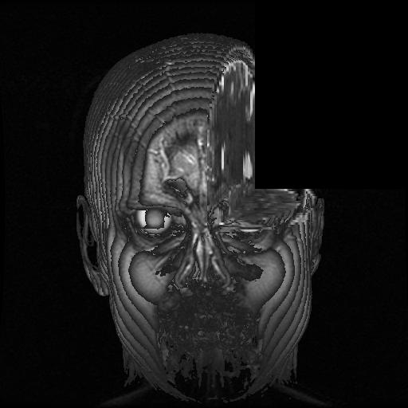
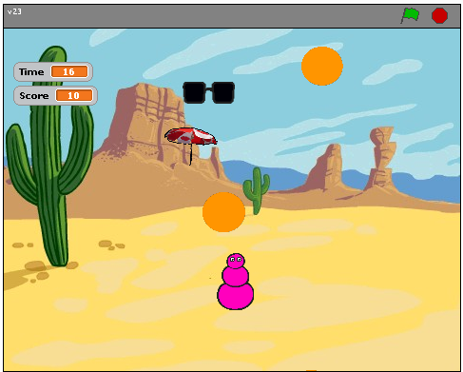
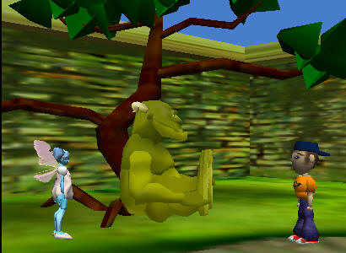
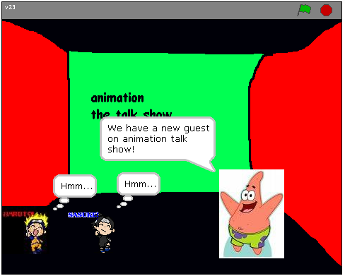
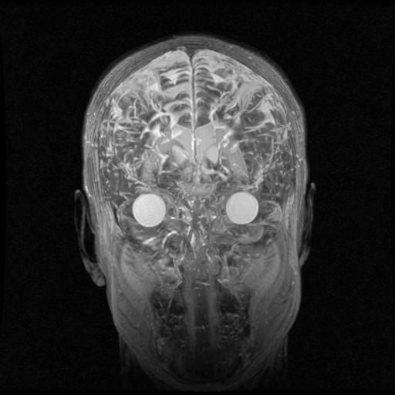
Others: Storytelling, Music Video, Analysis

Slide 39
What About Beyond CS1?
If students get context in CS1, how do they do
in a context-free CS2?
Are students as well-prepared in CS2 after
a contextualized CS1?
Is context useful in CS2 and beyond?

Slide 40
The Impact of Contextualized CS1 on CS2
Bryn Mawr College Data for 12 years of CS2
CS2 Data Structures Enrolment
Notes:
40
© 2007 Microsoft Corporation. All rights reserved. Microsoft, Windows, Windows Vista and other product names are or may be registered trademarks and/or trademarks in the U.S. and/or other countries. The information herein is for informational purposes only and represents the current view of Microsoft Corporation as of the date of this presentation. Because Microsoft must respond to changing market conditions, it should not be interpreted to be a commitment on the part of Microsoft, and Microsoft cannot guarantee the accuracy of any information provided after the date of this presentation. MICROSOFT MAKES NO WARRANTIES, EXPRESS, IMPLIED OR STATUTORY, AS TO THE INFORMATION IN THIS PRESENTATION.
01/09/08 16:37

Slide 41
Including Last Two Years (Since Robots)
CS2 Data Structures Enrolment
Notes:
41
© 2007 Microsoft Corporation. All rights reserved. Microsoft, Windows, Windows Vista and other product names are or may be registered trademarks and/or trademarks in the U.S. and/or other countries. The information herein is for informational purposes only and represents the current view of Microsoft Corporation as of the date of this presentation. Because Microsoft must respond to changing market conditions, it should not be interpreted to be a commitment on the part of Microsoft, and Microsoft cannot guarantee the accuracy of any information provided after the date of this presentation. MICROSOFT MAKES NO WARRANTIES, EXPRESS, IMPLIED OR STATUTORY, AS TO THE INFORMATION IN THIS PRESENTATION.
01/09/08 16:37

Slide 42
Media Computation Impact On CS2
Trial at Columbus State University
Fall 2007, 3 sections of CS1 for Majors
Media Computation Java versus traditional
From Wayne Summers (Dept Chair)
  We also taught two other CS1 sections without the Media Computation focus (using the Lewis/Loftus book) and are assessing the difference. The Media Computation class had a significantly higher completion and pass
  rate and appears to have a higher student satisfaction rate. We will be
  able to better compare the two methods after this semester. Students
  from both groups are taking the same CS2 class
Spring 2008: Same CS2 for all 3 sections
Results
  No difference on retention rates, midterm exam grades, final exam grades

Slide 43
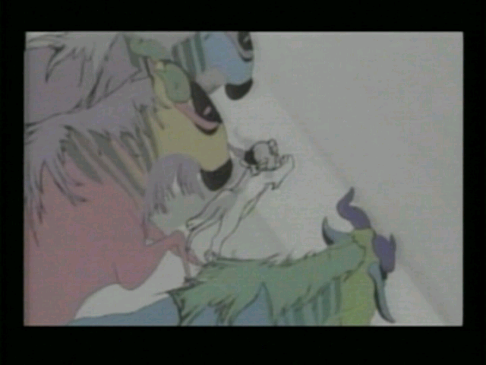
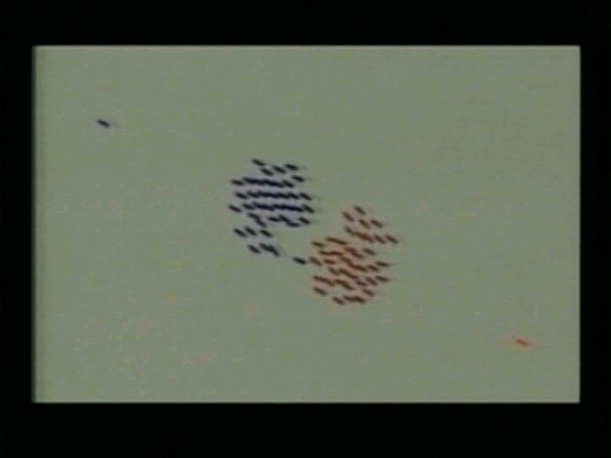
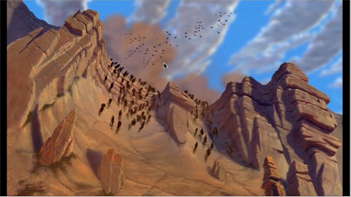
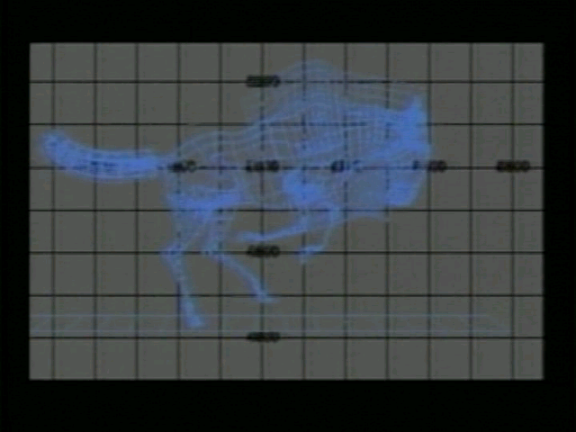
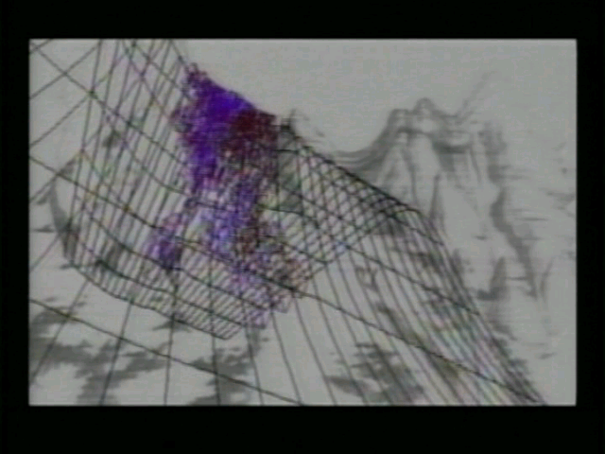
Building A Contextualized CS2:
Media computation data structures
How did the wildebeests charge over the ridge
in Disney's “The Lion King"?

Slide 44
Research Question:
Is context still useful in a second course?
11% agreed with “Working with media is a waste of time that
could be used to learn the material in greater depth.”
  “I didn’t take this class to learn how to make pretty pictures.”
A majority of the class (70%) agreed or strongly agreed that
working with media makes the class more interesting.
67% of the students agreed or strongly agreed that they were
really excited by at least one class project
66% reported doing extra work on projects to make the
outcome look “cool.”
(Yarosh and Guzdial, JERIC, Jan 2008)

Slide 45
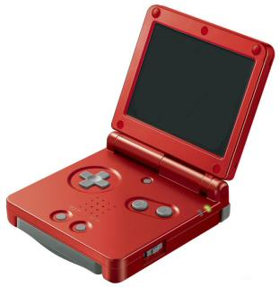
Context: Programming a Gameboy
Traditional Computer Organization (Patt and Patel) using an imaginary processor, versus
Computer Organization using a Gameboy
  Not all the same topics
  (e.g., Gameboy graphics modes)
  Common focus on C programming, bit manipulations, model of the computer (including memory and I/O)
Post-class survey comparison
No significant difference
  100% of students in Gameboy class did extra on at least one homework, because it was fun.
  30% of traditional students never put any extra
  effort in (p=0.046)
(Tew, Dorn, Leahy, Guzdial, JERIC, to appear)

Slide 46
Summary:
What do we know about contexts for CS Ed?
Including context has led to evaluation reports of:
  Increased retention (in CS1, across multiple schools, with both majors and non-CS majors, across genders and ethnicities),
  Some evidence of retention into CS2, and
  Student reports of increased time-on-task, even beyond CS1.
Not all contexts work for all students.
  Some students do just fine with computing Fibonacci numbers
  Therefore, we need to offer multiple contexts, to draw all “cultures”

Slide 47
What Don't we KInow About Context?
What is a context?
What do students perceive as a relevant context?
When do contexts work? For how long? For whom?
Do contexts help with learning?
What are the contexts that draw middle school girls and under-represented minorities?
When the context is fixed (e.g., professional graphics designers), how do you teach within that context?
What is needed for teachers to succeed with a context?

Slide 48
Conclusions
Computing is important for everyone,
We should aim to be able to teach computing to everyone.
Contextualized Computing Education has great promise for achieving the goal of teaching everyone about computing
We have little data on these contexts.
We need support to make the more promising contexts more successful

Slide 49
With Thanks to Our Funding Supporters
National Science Foundation
  Statewide BPC Alliance: Project “Georgia Computes!” http://www.gacomputes.org
  CCLI Grant
Microsoft Research
Georgia Tech's College of Computing
Georgia’s Department of Education
GVU Center,
Al West Fund,
President's Undergraduate Research Award,
Toyota Foundation

Slide 50
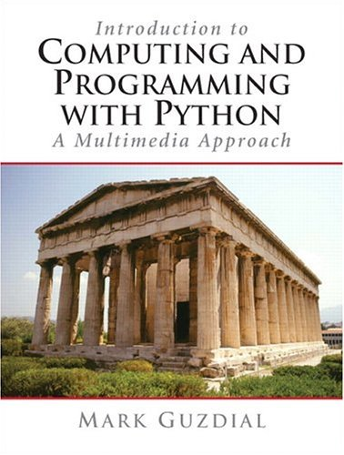
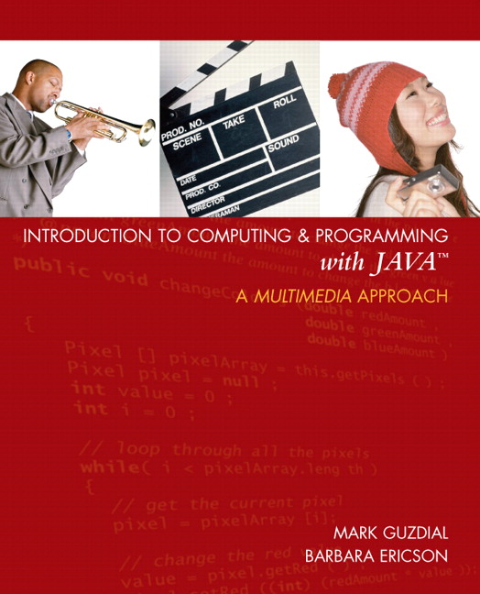
Thank You!
http://www.cc.gatech.edu/~mark.guzdial
http://home.cc.gatech.edu/csl
For more on MediaComp approach (including papers, software, and slides and workshops):
http://coweb.cc.gatech.edu/mediaComp-plan
Media Computation Teachers’ Site:
http://coweb.cc.gatech.edu/mediaComp-teach

