Slide 2
Microsoft Research Asia Overview
Dr. Hsiao-Wuen Hon
Managing Director
Microsoft Research Asia

Slide 3




MSRA 10th Anniversary

Slide 4
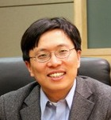
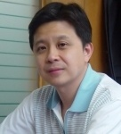
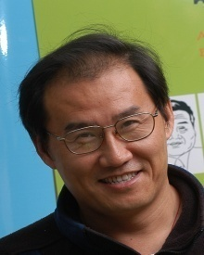


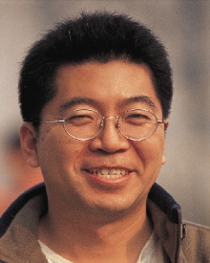
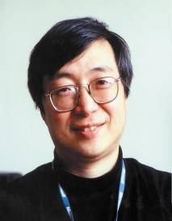
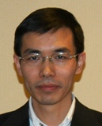
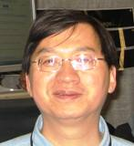
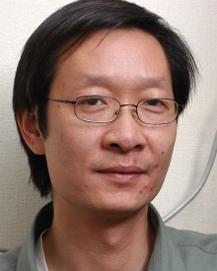
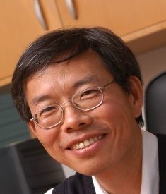
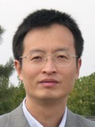
Microsoft Research Asia
Founded on Nov. 5, 1998
380+ people and 350 interns
20 research groups
1500+ papers published
200+ technologies transferred to MS products
16+ technologies licensed to other companies
Notes:
Largest int’l lab at MSR. 70 people joined from overseas

Slide 5
Research Groups
Research Group | Research Manager
User Interface | Dongmei Zhang
Natural Language Computing | Ming Zhou
Speech | Frank Soong
Interaction Design | Jian Wang
Internet Media | Shipeng Li
Media Communication | Jiang Li
Internet Graphics | Baining Guo
Visual Computing | Shipeng Li
System | Zheng Zhang
Wireless and Networking | Yongguang Zhang
Platform and Devices | CB Hsu
Web Search and Mining | Wei-Ying Ma
Data Intelligence & Tools | Jiang Wang
Web Data Management | Ji-Rong Wen
Information Retrieval & Mining | Hang Li
Machine Learning | Zheng Chen
Theory | Baining Guo

Slide 6
Research Impact
Extensive publication & conference publication: over 1500 publications to date
  CVPR 2008/7/6/5 20/16/15/17 papers from MSRA
  SIGIR 2008/7/6/5 8/7/6/13 papers from MSRA
  SIGGRAPH 2008/7/6/5 8/7/7/9 papers from MSRA
  WWW 2008/7/6/5 8/6/4/4 papers from MSRA
  ACM Multimedia 2008/7/6 8/8/4 papers from MSRA
  ICASSP 2008/7/6 14/10/12 papers from MSRA
  ACL 2008/7/6 5/4/4 papers from MSRA
Best Paper/Demo Awards
  EuroSys’08, ACM SenSys’07 ,ACM MobiSys’07, VCIP’07,
  ACM MM’07(2), WWW’06, VCIP’05, IEEE T-CSVT’01
Community Leadership
  Extensive visitor and speaker program
  Professional Services: TVCG, PCM, WWW …

Slide 7
Product Collaboration
Together, we create great technologies to
  Change the world
  Benefit the user
Different collaboration models
  Ideas/papers/prototypes/codes → product teams
  Dedicated development group (IEG/TTG) to deliver components/libraries
  Incubated ATC (Advanced Technology Center)
    over 200 FTE’s today
  Special centers (STC) to own key product initiatives
  Incubation teams (e.g., adLabs) to build new technologies for emerging business

Slide 8
Research Areas
Natural User Interface
Multimedia
Search & Online Ads
Data-Intensive Computing
Fundamentals

Slide 9










Product Transfer Results
Technology Transfer Group
  Mission: the & in R & D!
  Understand MS technology and customer needs
  Work closely with researchers and product groups
Over 200 product transfers to date
Notes:
Win XP: Speech, AutoMovie, …
Win XP Tablet PC: Digital Ink, …
Win XP MC: Image/video Experience, …
Office 2003: Cartoon, Speech, Ink, IME, …
MSN: Photo processing and search, …
Xbox: Realistic Rendering, …
Vista Shell: Photo/video Experience, …
Vista: E2E Mobility, Text-to-Speech, Codecs, …

Slide 10
Industry Impact
Standardization contributions
  ISO MPEG Standard
  China AVS
Technology licensing
  16+ lP license deals from MSR Asia
  LazySnapping, Portrait Video, Cartoon Wizard, & Mobile Picture, …

Slide 11
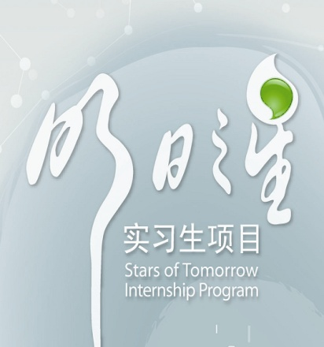
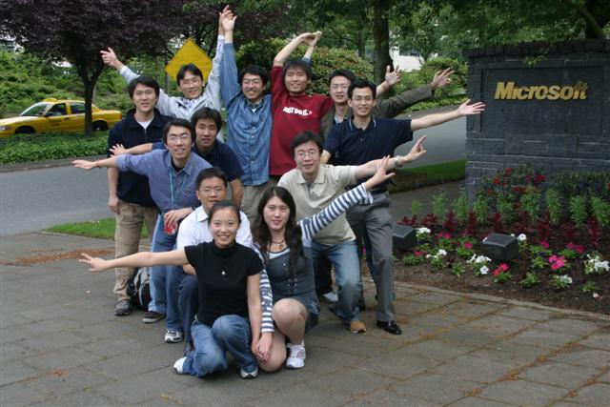
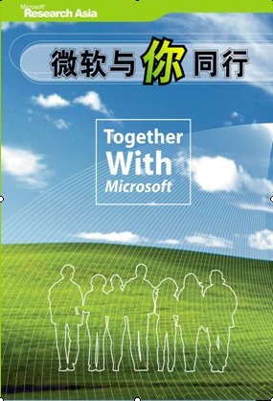

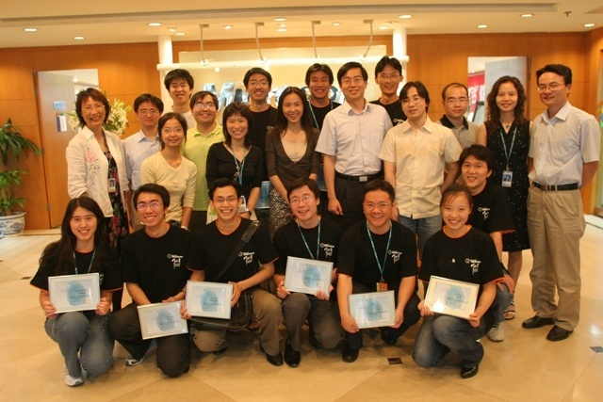
Cultivating New Talents
2500+ students went through MSRA internship
Interns from China, Korea, Japan, U.S., Canada, Europe
  Joint program with China/Korea MOE
Many joint publications together
Notes:
We always consider cultivating new talent as our responsibility to academic community.
In the last seven years, more than 2200 students went through our internship program called “Stars of Tomorrow”.
In 2006, we started a new joint program with Korea Ministry of Education. After a very competitive selection process, 9 Korean interns are doing internship program at MSRA.

Slide 12
UR As a Bridge
Bridge between MSRA & universities:
  Research Collaboration
  Curriculum Innovation
  Talent Development
  Academic Exchange
MSRA
Asia Pacific
Academia
UR

Slide 13
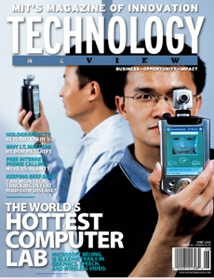
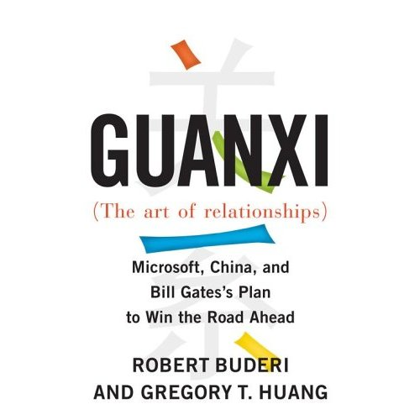



The World's Hottest Computer Lab
“Microsoft Research Asia has become a powerhouse of infotech R&D.”
“It is no surprise that Microsoft Research Asia has such popular appeal.”

Slide 14
Introduction to Academic Collaborations in the Asia Pacific Region
Lolan Song
Senior Director
University Relations, Microsoft Research Asia

Slide 15
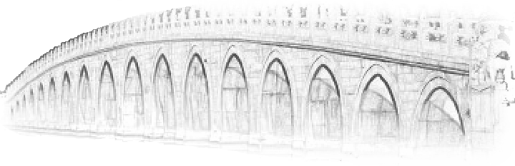
The Mission of University Relations
Mission
  To build long-term, in-depth, mutually beneficial collaboration with academia in Asia Pacific.
Role – UR as a Bridge
  between Microsoft Research & academia in Asia Pacific through
  Research Collaboration
  Curriculum Innovation
  Talent Development
  Academic Exchanges

Slide 16
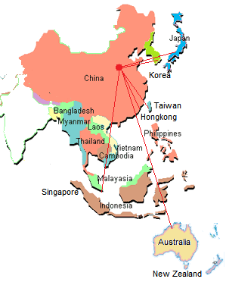
History & Quick Facts about MSRA UR
History
  UR was one of the first groups established in Nov 1998
  Working with more than 50 leading universities in 8 countries and regions in the Asia Pacific
    Mainland China, Hong Kong, Taiwan, Japan, Korea, Australia, Singapore, New Zealand, and other countries in Southeast Asia

Slide 17
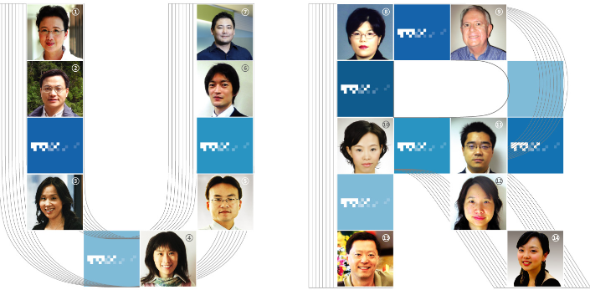
UR Team
Geo locations
  Director: Lolan Song
  China & region: Gao Zhang, Xin Ma, Bei Li, Gang Guan, Lihua Tang, Wen Chen, Xiangwen Liu (based in Beijing)
  ANZ & SEA: John Warren (based in Sydney)
  Korea: Miran Lee (based in Seoul)
  Japan: Sean Kuno (based in Tokyo)
  Taiwan & Hong Kong: Joseph Shih (based in Taipei)
  Regional programs: Bill Luan (based in Redmond)

Slide 18
Pilars of UR Programs
UR Programs are based on four pillars
Research Collaborations
Curriculum Innovation
Talent Development
Academic Exchange

Slide 19
Research Collabrations
Goal
  To advance state of the art in research through collaborations.
Programs and Initiatives
  Regional research theme projects
  Subsidiary faculty-specific collaboration projects
  Joint labs and virtual institute
  Joint research funding with government agencies

Slide 20
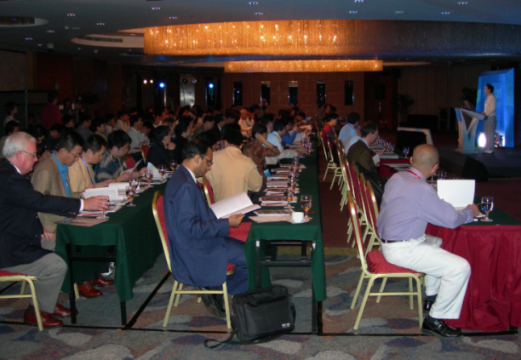
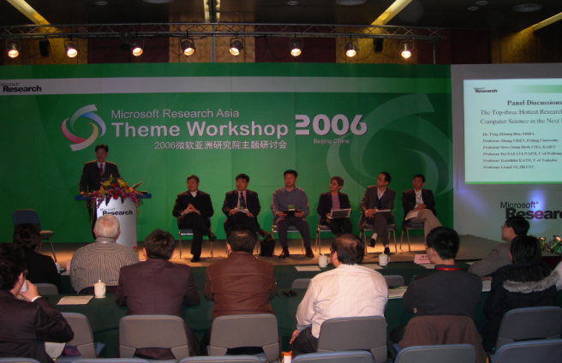
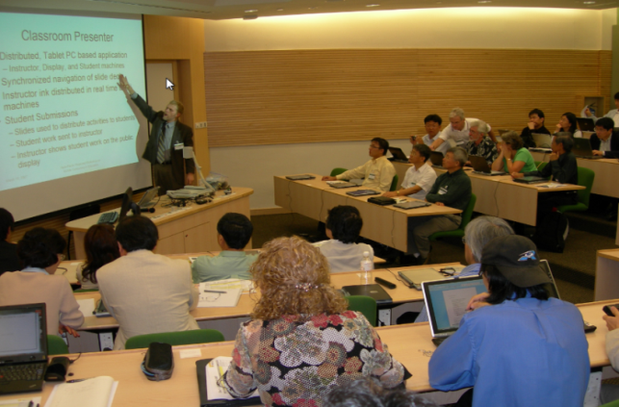
Regional Theme Projects
Characteristics of Theme Projects
  Important research topics in industry
  Highly interesting to academia
  Closely related to local economy
  Related to MSRA research areas
  Offer good opportunities for collaborations between MSR and academia in Asia
Theme Workshops promote knowledge sharing and community building

Slide 21
Research Theme Projects History
Theme Projects Undertaken by UR
2004
2005
2006
2007
2008
2009
Trust Worthy Computing
Wed-based NLP
Gaming & Graphics
Windows CE & Embedded
Internet Service
Windows Core (Curriculum)
Mobile Computing for Education
eHeritage

Slide 22



Support Innovative Research
In 2007, we funded total about 90 research projects, covering close to 50 universities in the Asia-Pacific region.
Australia: In multimodal devices project at Queensland University of Technology - every $1 from MSRA became $3+ for university.
Singapore: $35K MS seed fund to Nanyang Technological University in Singapore became $270K research project.
Japan: UR-funded project at University of Tokyo sets Internet2 land speed record.
Notes:
As a Microsoft main research arm in Asia, one of the major functions of UR is to support innovative research.
In FY06, our last fiscal year, we totally funded 78 research projects covering 42 universities in the region.
We are specially proud that our seed funds have helped faculties to receive much bigger support from the government and other sources and generated some exciting results.
For example, a project at Queensland University of Technology in Australia, for every dollar from MSRA, it became $3+ for the university.
A $35 thousands dollar Microsoft-funded project at the National University of Singapore became a $270 thousands dollar research project based on government fund.
A UR-funded project at University of Tokyo sets Internet2 land speed record.

Slide 23
Curriculum Innovations
Goal
  To create new curriculums or to enhance existing curriculums with new techniques in computer science & engineering related subjects.
Results
  Supported over 100 curriculum projects
  Covered 40 universities in 5 countries or areas

Slide 24
Curriculum Innovations
Program implementation
New curriculum creation
(e.g. search, gaming)
Courses taught by MSRA researchers
(e.g. at Tsinghua, Peking Univ.)
Faculty curriculum workshops
(e.g. embedded @ Tongji Univ,)
Seeding Textbook Projects
(e.g. support China MOE精品课程)

Slide 25

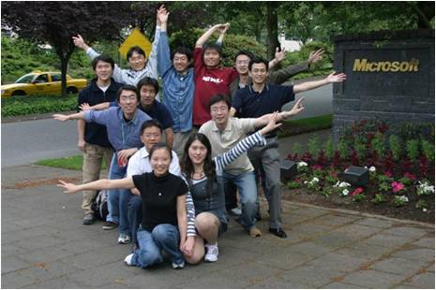
Young Talent Development
Goal
  To foster high-quality talents for global research community
UR Program Content
  New Faculty Award
  Internship
  Fellowship
  Other Talent Development programs

Slide 26

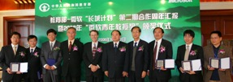
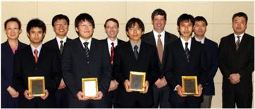
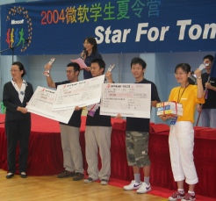

Young Talent Development
Talent Program Model
New
Faculty
Internship
Fellowship/Young Fellowship
Support Student Technical Community

Slide 27
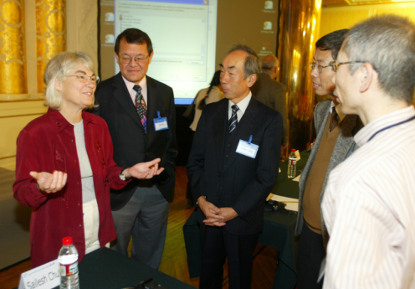
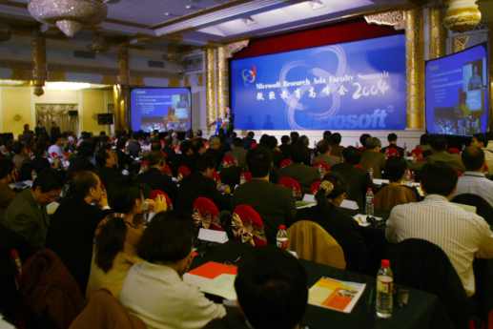
Academic Exchange
Goal
  To share creative ideas and promote collaboration among MSR researchers and academician in mutually interested areas.
UR Academic Exchange Programs
  Guest Professorship for MSRA researchers
  Campus Visit by MSRA
  MSR Asia Faculty Summits
  Conference on Computing in 21st Century
  Cross Region Exchanges: TechFest

Slide 28
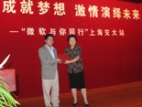
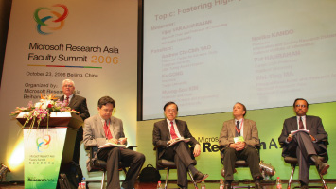
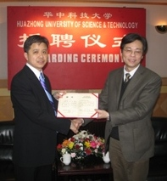
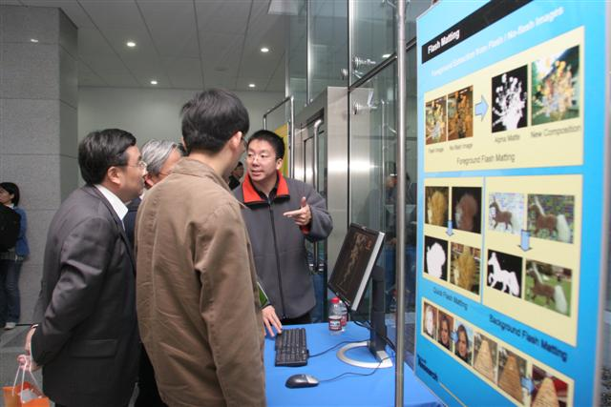
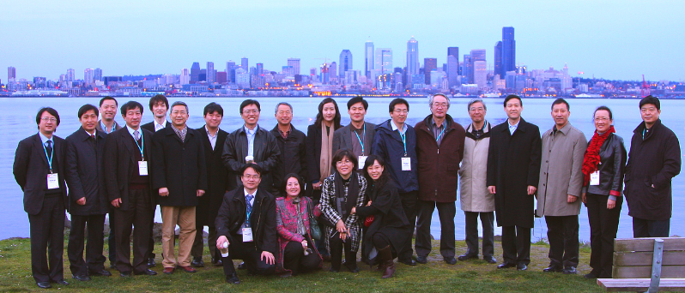
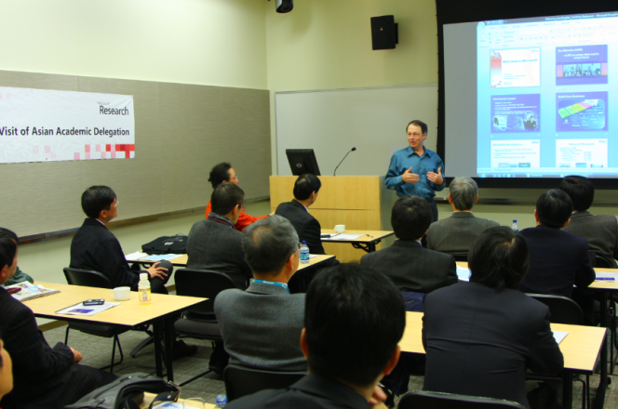
Academic Exchange
Examples of academic exchanges
Guest Professorship
AP Faculties attending Faculty Summit
AP academic leaders attending TechFest & visit Seattle

Slide 29
2007-2008 Events Participations
Country/Area | # of Professors participated in | # of Institutions
Australia | 57 | 17
China | 617 | 51
Hong Kong | 53 | 6
Taiwan | 97 | 16
India | 2 | 1
Indonesia | 9 | 7
Japan | 136 | 29
Korea (Republic of) | 88 | 10
Malaysia | 9 | 7
New Zealand | 15 | 7
Singapore | 52 | 8
Sri Lanka | 3 | 3
Thailand | 3 | 3
United States | 7 | 2
Vietnam | 3 | 3
Total | 1151 | 162

Slide 30
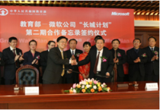
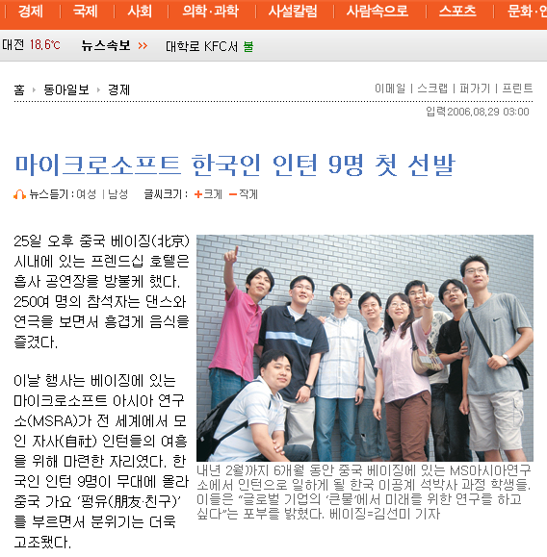
Diversified Local Programs
China
  Great Wall Plan with Ministry of Education (MoE)
    2 phases completed in past 6 years
Japan
  MSR virtual presence: Institute for Japanese Academic Research Collaboration (IJARC)
Korea
  Special Internship program with MOE running for 3 years

Slide 31



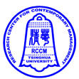





Joint Programs with US Universities
Shanghai Jiaotong University, CMU, and MSRA joint program
Tsinghua University, Stanford University, and MSRA internship program
Beihang University, University of Washington, and MSRA CS course
UCLA and MSRA joint student summer program
Korea University, Georgia Tech and MSRA joint program
Participate in MIT VI-A program
Notes:
As more and more American universities are interested in developing new programs with Chinese universities, and vice verse, UR is taking part in several joint programs.
For example, a couple of months ago, Shanghai Jiaotong University, CMU, and MSRA announced a joint program.
Last summer, we started a pilot program with Tsinghua and Stanford to accept interns at MSRA. We will continue the program next year.
With President Li Wei and Dr. Harry Shum support, we are supporting a CS course offered by a professor of University of Washington at Beihang. This is a first core CS course offered to Chinese students by an American professor cross the pacific ocean using tablet PC in the classroom to facilitate teacher-student interaction.
We are working on more joint programs with the American universities and Chinese universities.

Slide 32
Summary
Academic collaboration contributed to MSRA’s initial success in the last 10 years
Academic collaboration will continue to be an integral part of MSR Asia business
Look for more opportunities to collaborate in the Asia-Pacific region

Slide 33

© 2008 Microsoft Corporation. All rights reserved. Microsoft, Windows, Windows Vista and other product names are or may be registered trademarks and/or trademarks in the U.S. and/or other countries. The information herein is for informational purposes only and represents the current view of Microsoft Corporation as of the date of this presentation. Because Microsoft must respond to changing market conditions, it should not be interpreted to be a commitment on the part of Microsoft, and Microsoft cannot guarantee the accuracy of any information provided after the date of this presentation. MICROSOFT MAKES NO WARRANTIES, EXPRESS, IMPLIED OR STATUTORY, AS TO THE INFORMATION IN THIS PRESENTATION.

Slide 34
Appendix

Slide 35
SPEAKER COMMENT SLIDE (hidden slide):
Speakers, please read the previous two slides and in the box below list any special formatting or archiving instructions you want followed.
(Add your special instructions here, if you have any.)

