Slide 1
Social Networking and Semantics
Marc Smith
Microsoft Live Community Research
masmith@microsoft.com

Slide 2
What is social media?
A Sociological Frame:
Collective Goods produced through Computer-Mediated Collective Action

Slide 3
Collective Action Dilemma Theory
Central tenet
Individual rationality leads to collective disaster
Phenomena of interest
Provision and/or sustainable consumption of collective resources
Public Goods, Common Property, "Free Rider” Problems, Tragedies
Signaling intent
Methods
Surveys, interviews, participant observation, log file analysis, computer modeling
(Axelrod, 1984; Hess, 1995; Kollock & Smith, 1996)
Community Computer Mediated Collective Action

Slide 4
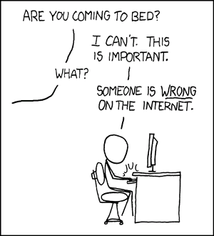
Motivations for contribution to computer mediated public goods
Source: xkcd, http://xkcd.com/386/

Slide 5
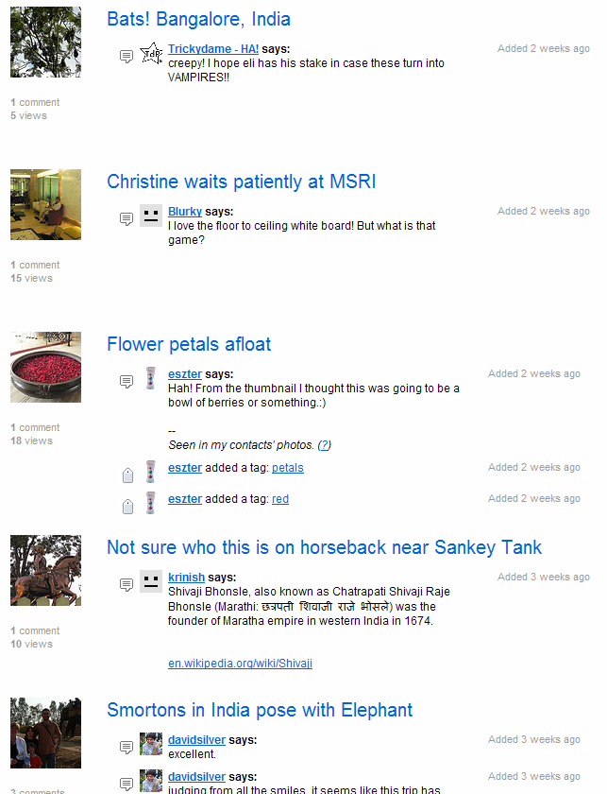
Seeing that my pictures get seen by family and friends
Colleague adds better tags to my photos!
Stranger translates foreign (to me) content in my public photos!

Slide 6
Some Dimensions of Social Media
How large are the social groups producing and consuming social media?
How large and interactive are the objects produced and consumed?
What does it mean to own a social media object?

Slide 7
Producers
Individuals
Small Groups
How large are the social groups producing and consuming social media?
Consumers
Large Groups
Individuals
Dyadic exchanges. Email to named individual(s) | Committee reports to a decision maker/reviewer | Professional services reports for decision makers
Local email list “Social” blogs Personal social network profile page | Multiple authored specialty publications Group blogs. Personal social networks | Professional reports to specialty groups Value added economic data Bloomberg
Messages to discussion groups/web board Sole authored source code Popular blogs Novels | Multiple authored popular media, software Journalism Wikipedia Pages Popular group blogs | Collective search engine users Market behavior Query log optimizations Market analysis
Small Groups
Large Groups

Slide 8
Dimensions of Social Media: How large are the pieces of social media? How interactive is the rate of exchange?
 | Digital Object Editing Granularity | Fine (Character/Pixel/Byte) | Medium (Object/Attribute/Track/Player) | Coarse (Document/Message/Blog Post/Photo)
Digital Object Editing Synchronicity |  | Each user can directly control smallest units of content. | Each user controls medium sized blocks of content that can only indirectly alter or be altered by other user’s content in a larger shared data structure. | Each user controls a block of content, rarely edited or modified by others with only associative linkages.
 | Synchronous | Real time Shared canvas | Virtual Worlds Multiplayer Games Real-time networked musical jamming | Chat, IM, Twitter
 | Asynchronous | Shared docs, images, video, audio Source code Wikipedia | Contribution to collected works (album, anthology, report section, discussion group, photosets and other collections). | Email Blog posts Link sharing Photo sharing Document sharing Turn based games

Slide 9
Types of property rights “What does it mean to own social media content?”
Create?
Copy/Paste?
Edit/Delete?
Limit access?
Revoke access?
Monitor access?
Transfer to new host?
Transfer rights to others?
Commercial exploitation?
Adjoining display rights? (can I put ads near your content when I show it to other people)?
Aggregation and secondary analysis rights?
Who owns social media content?
Author | Group of authors | Recipients | Observers | Host | Public Domain
Dimensions of Social Media:
Who can exercise what property rights over social media?

Slide 10
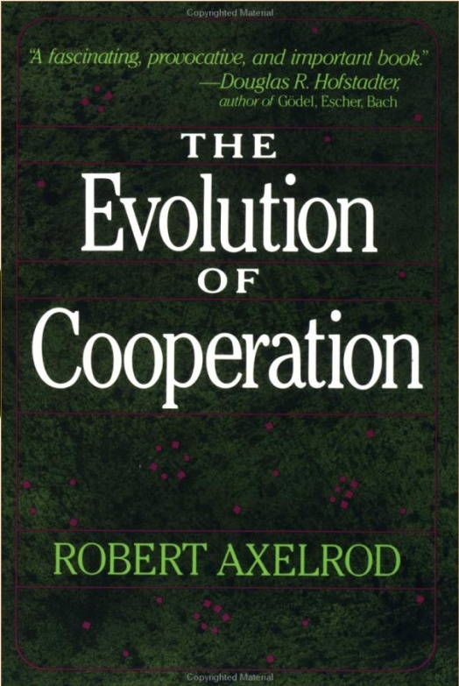
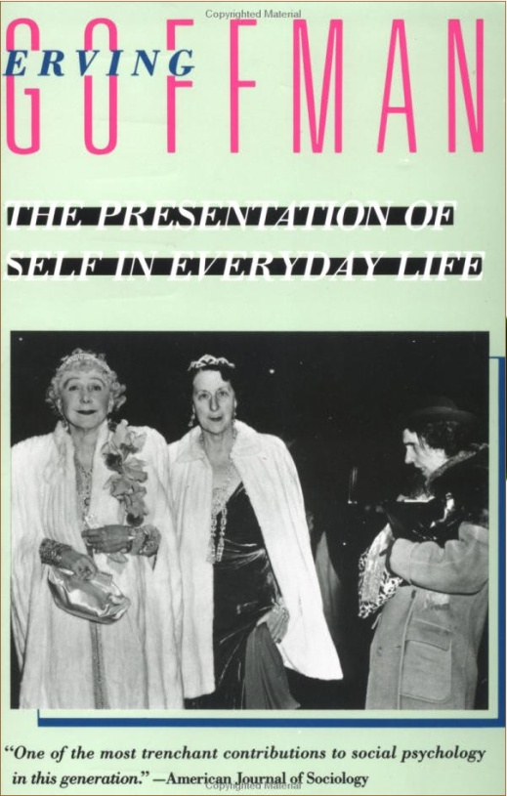
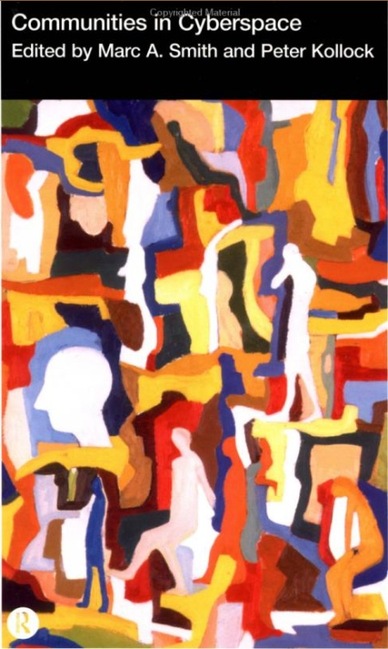
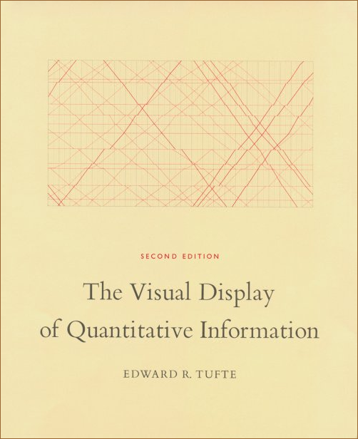
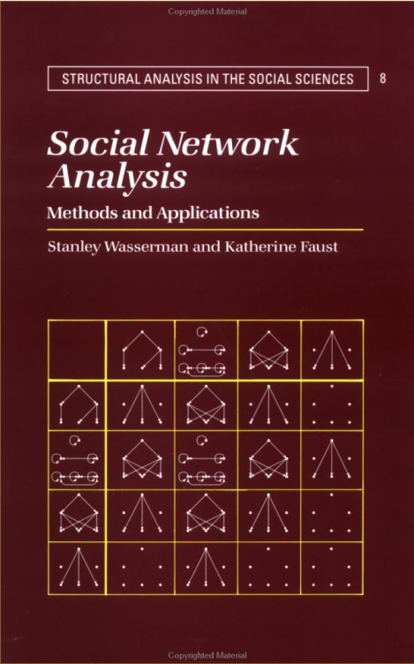
Hardin, Garrett. 1968/1977. “The tragedy of the commons.” Science 162: 1243-48. Pp. 16-30 in Managing the Commons, edited by G. Hardin and J. Baden. San Francisco: Freeman.
Wellman, Barry. 1997. “An electronic group is virtually a social network.” In S. Kiesler (Ed.), The Culture of the Internet. Hillsdale, NJ: Lawrence Erlbaum.

Slide 11
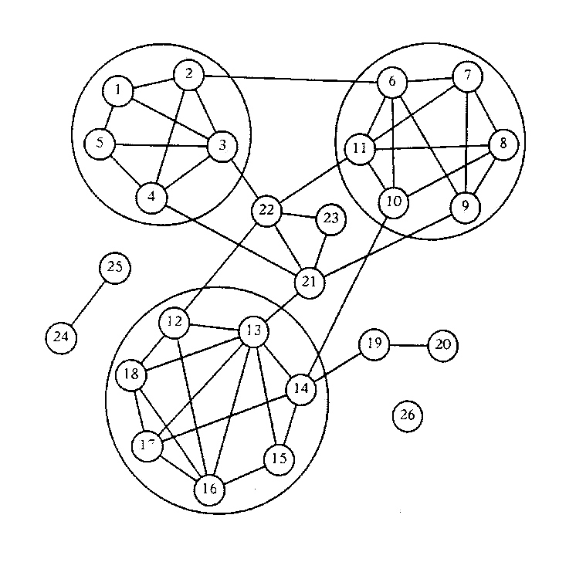
Social Network Theory
Central tenet
Social structure emerges from the aggregate of relationships (ties) among members of a population
Phenomena of interest
Emergence of cliques and clusters from patterns of relationships
Centrality (core), periphery (isolates), betweenness
Methods
Surveys, interviews, observations, log file analysis, computational analysis of matrices
(Hampton &Wellman, 1999; Paolillo, 2001; Wellman, 2001)
Source: Richards, W. (1986). The NEGOPY network analysis program. Burnaby, BC: Department of Communication, Simon Fraser University. pp.7-16

Slide 12
Problem: No network chart in Excel

Slide 13
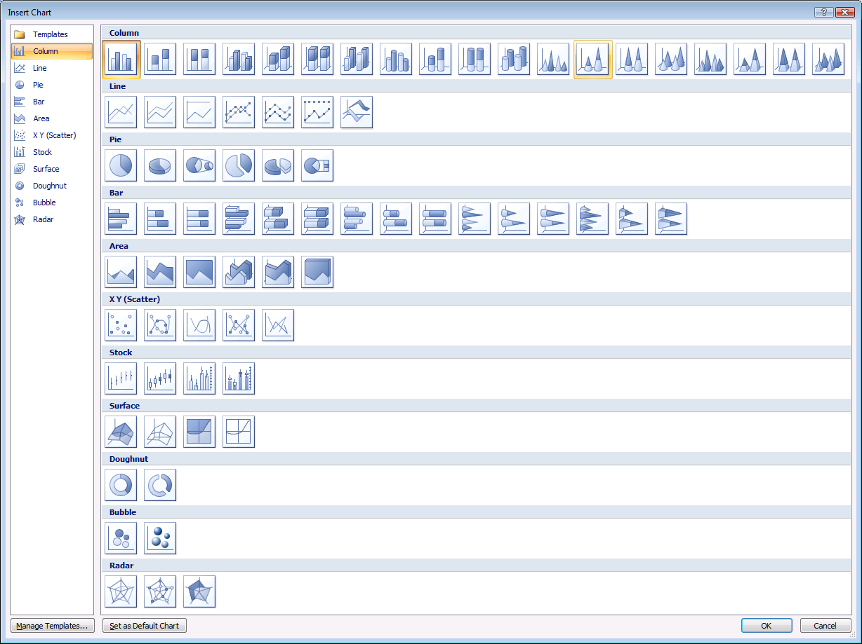
Problem: No network chart in Excel

Slide 14
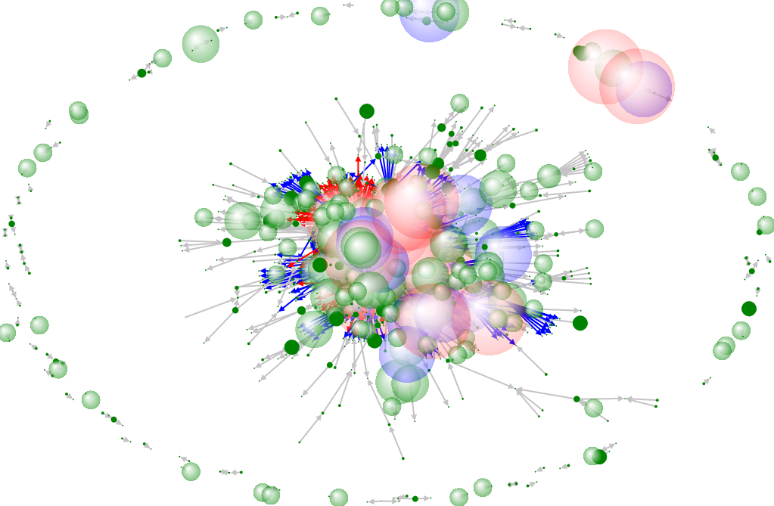
Excel .NetMap
Add-in: http://cid-ae935b3cde8015dd.skydrive.live.com/browse.aspx/Excel%20.NetMap%20|5formerly%20C|3UNG|6%20drops

Slide 15
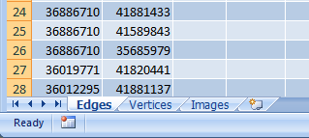
Excel .NetMap
Add-in: http://cid-ae935b3cde8015dd.skydrive.live.com/browse.aspx/Excel%20.NetMap%20|5formerly%20C|3UNG|6%20drops

Slide 16
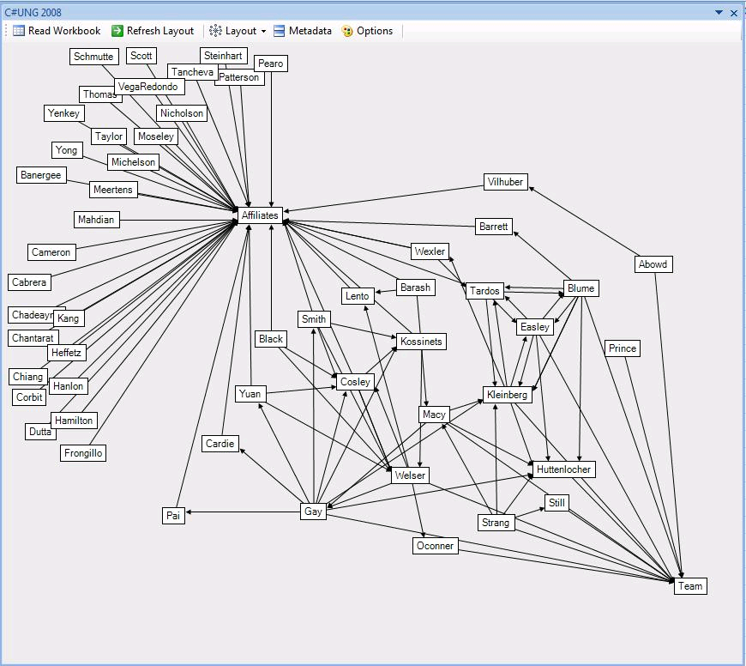
Excel .NetMap
Add-in: http://www.codeplex.com/netmap

Slide 17
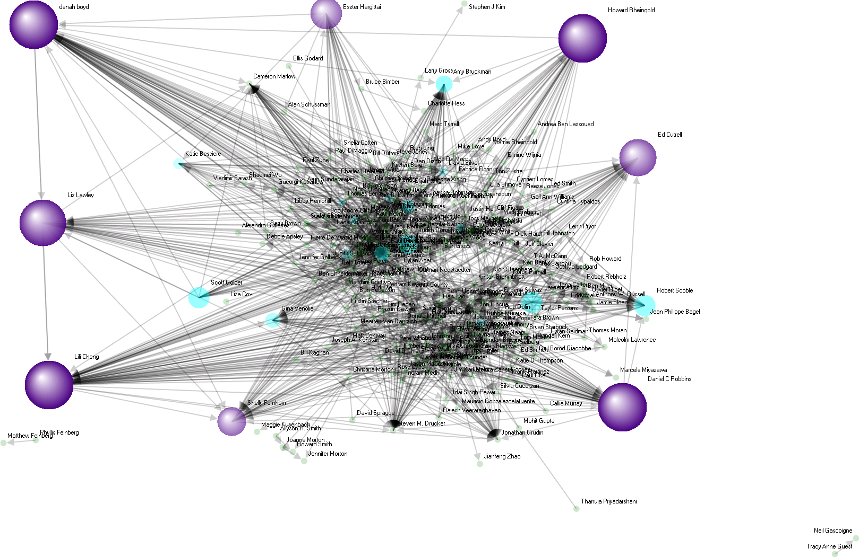
Marc’s Facebook Graph

Slide 18
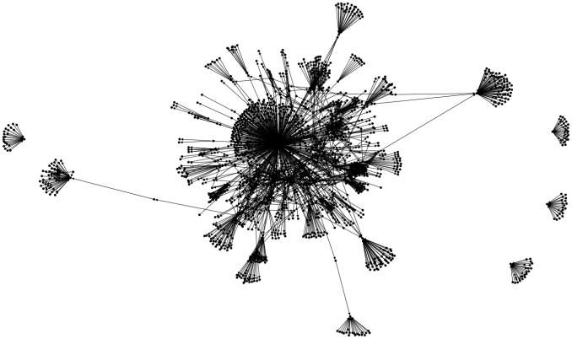
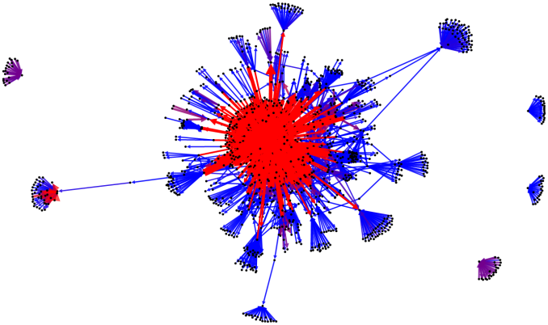
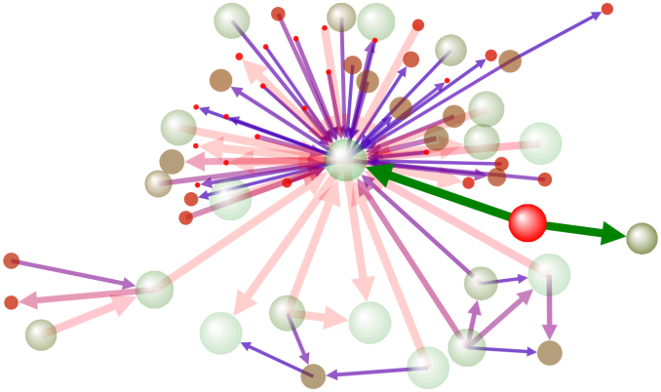
Personal email social networks
Strong-tie inner cores of email social networks

Slide 19
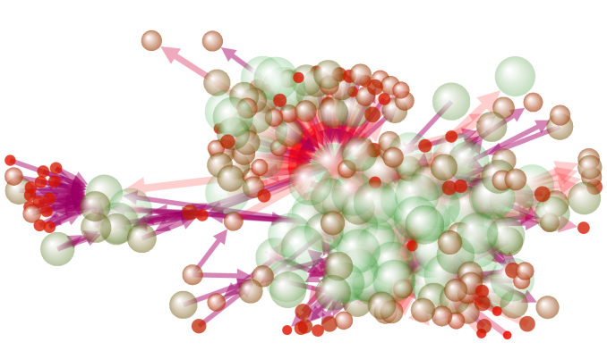
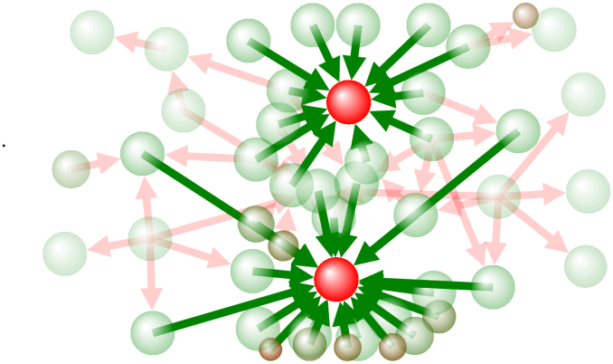
Email List social networks
Strong Tie Core of an Email List

Slide 20
Goal: Make SNA easier
Existing Social Network Tools are challenging for many novice users
Tools like Excel are widely used
Leveraging a spreadsheet as a host for SNA lowers barriers to network data analysis and display

Slide 21
Social Network Science of Science Study social network structure of email and web boards of different scientific communities
Sociologist
“What are the structures of communication in scientific discussions?”
User Experience Information Visualization
“What are the best UI/UX workflows for network analysis tools?”
Computer Scientist Algorithmicist for Social Network Measures
“What are the measures and algorithms needed for understanding networks?”

Slide 22
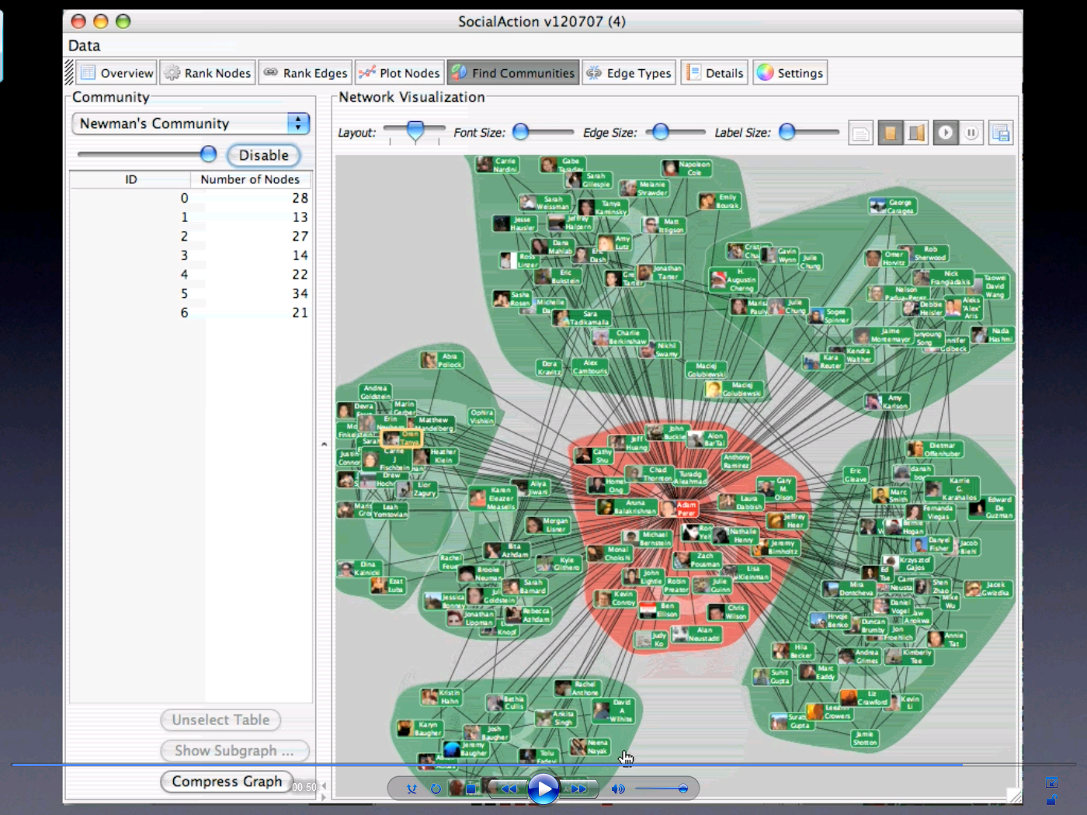
Social Action – Adam Perer

Slide 23
Social Network Tools for Excel (Excel) .NetMap
http://www.codeplex.com/netmap
masmith@microsoft.com

Slide 24
© 2008 Microsoft Corporation. All rights reserved. Microsoft, Windows, Windows Vista and other product names are or may be registered trademarks and/or trademarks in the U.S. and/or other countries. The information herein is for informational purposes only and represents the current view of Microsoft Corporation as of the date of this presentation. Because Microsoft must respond to changing market conditions, it should not be interpreted to be a commitment on the part of Microsoft, and Microsoft cannot guarantee the accuracy of any information provided after the date of this presentation. MICROSOFT MAKES NO WARRANTIES, EXPRESS, IMPLIED OR STATUTORY, AS TO THE INFORMATION IN THIS PRESENTATION.

