Slide 1
Virtual Earth™ Academic Research Collaboration 2007 RFP
Evelyne Viegas
Senior Research Program Manager
Microsoft Research
Dr. Bill Chen
Researcher
Virtual Earth

Slide 2
Microsoft Virtual Earth RFP 2007
Virtual Earth™ Academic Research Collaboration
Topics: Image processing; Computer vision 3D; Geo-mapping; Communities; Economics; UI
Data, data, data: Microsoft made available street imagery data from one residential area, and the downtown area of San Francisco including
color satellite imagery that covers the area
street-side images with their estimated position and orientation accumulated in 4m intervals
models of the houses in the area, with some textured buildings

Slide 3
Microsoft Virtual Earth RFP 2007
Semantic Enrichment of Street Side Imagery, Horst Bischof, Graz University of Technology, Austria
City Capture, Frank Dellaert, Irfan Essa, Georgia Institute of Technology, U.S.
Efficient Image Correspondence and Indexing Methods for Urban Scene and Object Recognition, Kristen Grauman, Trevor Darrell, University of Texas at Austin, U.S.; Massachusetts Institute of Technology, U.S.
Local Search for Hotel and Restaurants Using Econometrics Spatial Data and Image Classification, Panagiotis Ipeirotis, Anindya Ghose, New York University, U.S.
Integrating Online Maps with Aerial Imagery, Craig Knoblock, University of Southern California, U.S.
A New View on NEWS, Hanan Samet, University of Maryland, U.S.
Towards Reconstructing the World from Photos on the Internet, Steven Seitz, Brian Curless, University of Washington, U.S.
On Testing Non-Testable Information Retrieval Systems with Geographic Components on the Web, Zhi Quan Zhou, University of Wollongong, Australia; T.H. Tse, The University of Hong Kong, China; Kai-Yuan Cai, Beijing University of Aeronautics and Astronautics, China; F.-C. Kuo Swinburne University of Technology, Australia
Enhancement of Photographs Using Virtual Earth, Oliver Deussen, University of Konstanz, Germany
Techniques for Rendering Effective Tourist Maps, Maneesh Agrawala, University of California, U.S.
Virtual Earth Awards
Virtual Earth and Location Summit 2008

Slide 4
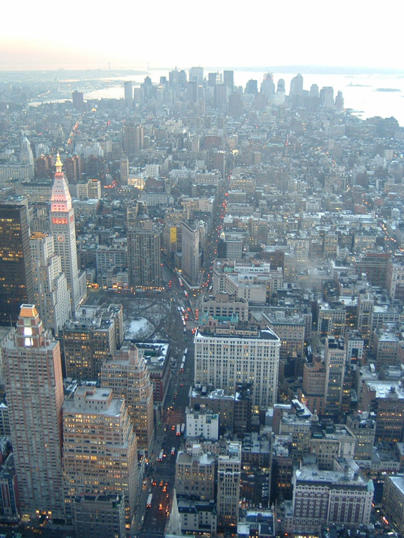
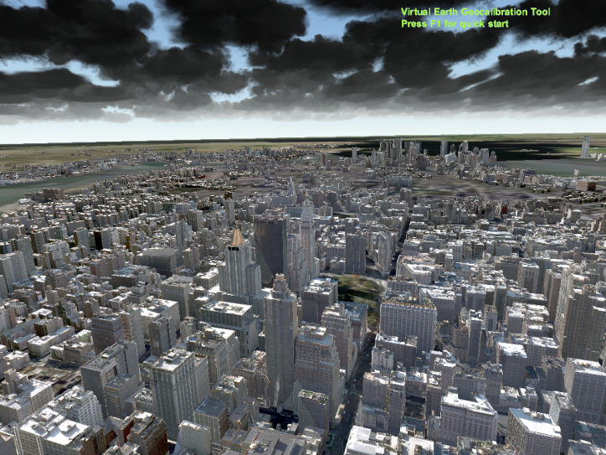
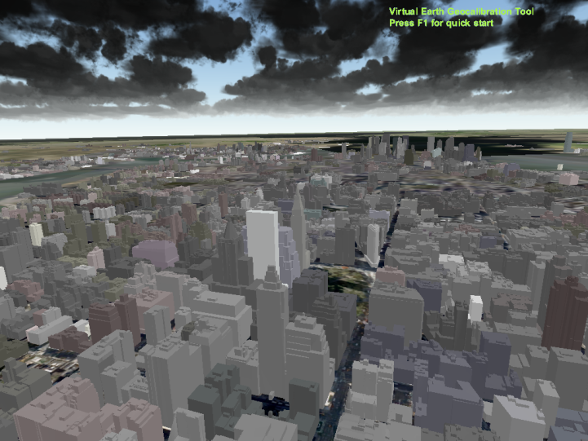
Enhancement of Photographs Using Virtual Earth

Slide 5
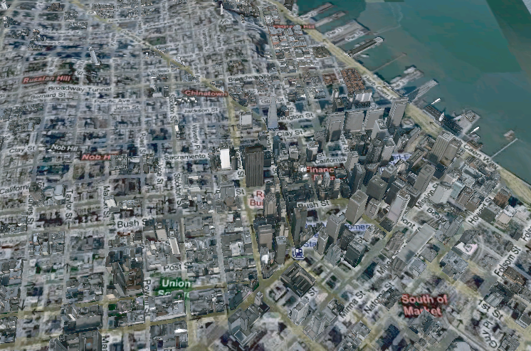
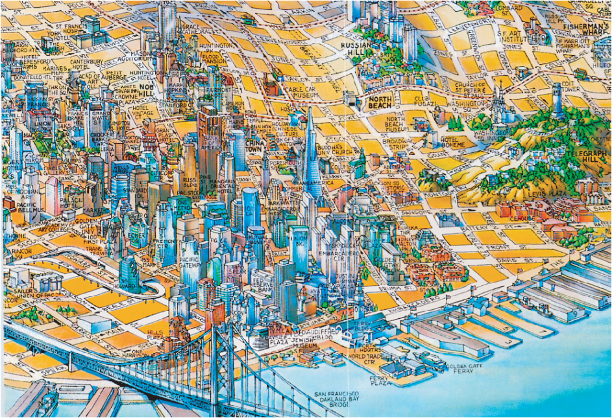
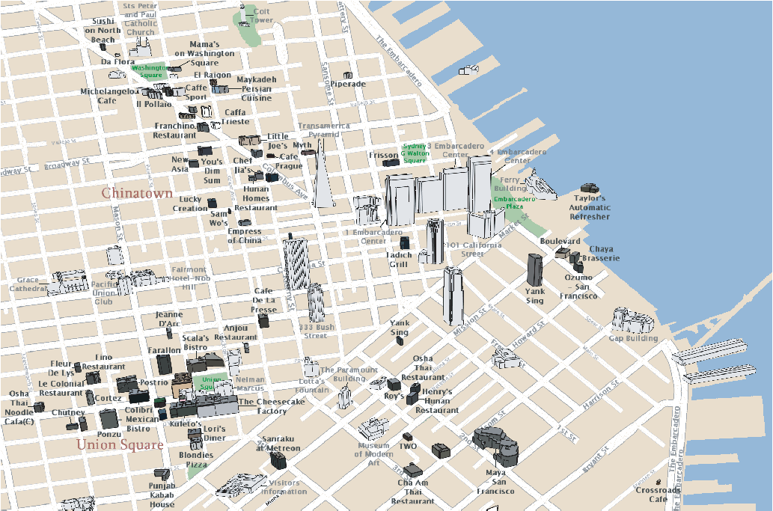
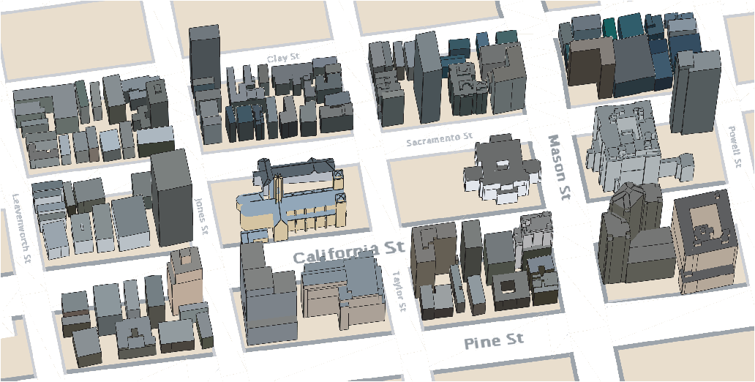
Techniques for Rendering Effective Tourist Maps
mental model of a city: landmarks, paths
districts, nodes, edges
multiperspective rendering
catographic generalization: simplification, displacement, deformation, removal

Slide 6
Real-time sensory data in Virtual Earth
Mobile phone GPS
Photos, video, audio, text into Virtual Earth

Slide 7
© 2008 Microsoft Corporation. All rights reserved. Microsoft, Windows, Windows Vista and other product names are or may be registered trademarks and/or trademarks in the U.S. and/or other countries. The information herein is for informational purposes only and represents the current view of Microsoft Corporation as of the date of this presentation. Because Microsoft must respond to changing market conditions, it should not be interpreted to be a commitment on the part of Microsoft, and Microsoft cannot guarantee the accuracy of any information provided after the date of this presentation. MICROSOFT MAKES NO WARRANTIES, EXPRESS, IMPLIED OR STATUTORY, AS TO THE INFORMATION IN THIS PRESENTATION.

