Slide 2
The CARMEN Science Cloud & Beyond
Paul Watson
Professor of Computer Science
Newcastle University, UK

Slide 3
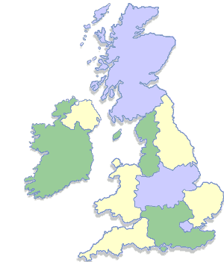
CARMEN Project building a science cloud for neuroscientists
UK EPRSC e-Science Pilot
$9M (2006-10)
20 Investigators
Stirling
St. Andrews
Newcastle
Manchester
York
Sheffield
Leicester
Warwick
Cambridge
Plymouth
Imperial

Slide 4
Research Challenge
Understanding the brain is the greatest informatics challenge
Enormous implications for science:
Medicine
Biology
Computer Science
100,000 scientists are working on this

Slide 5
Neuroinformatics Problems
Data is
expensive to collect but rarely shared
in proprietary formats & locally described
The result is
a shortage of analysis techniques that can be applied across neuronal systems
limited interaction between research centres with complementary expertise

Slide 6
Epilepsy Exemplar
Data analysis guides surgeon during operation
Data stored for further analysis
WARNING!
The next 2 Slides show an exposed human brain

Slide 7
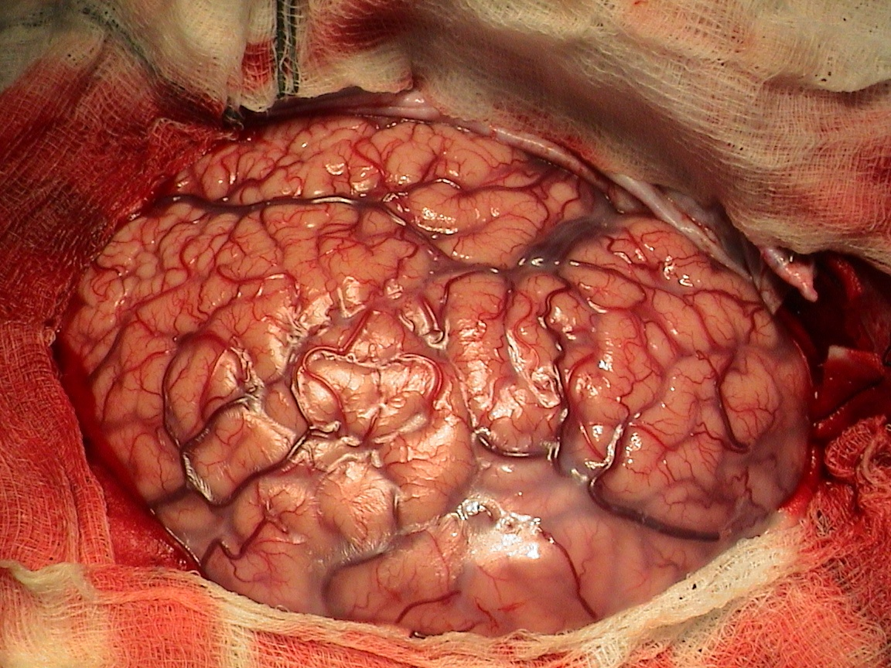

Slide 8
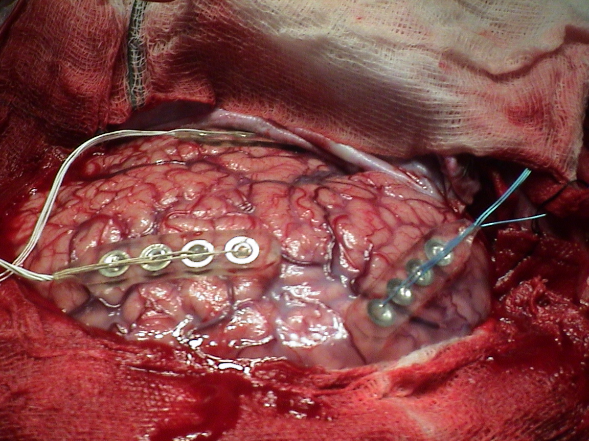

Slide 9
CARMEN e-Science Requirements Summary
Sharing
data
code
Capacity
huge data storage
(100TB+)
support data intensive analysis

Slide 10
CARMEN Cloud Architecture
User access over Internet
(typically via browser)
Users upload data & services
Data storage
and
analysis
Users run analyses

Slide 11
Science Cloud Design Options
Science
App 1
Science
App n
....
Science Cloud Platform
Science
App 1
Science
App n
....
Cloud Infrastructure:
Storage & Compute
Cloud Infrastructure: Storage & Compute

Slide 12
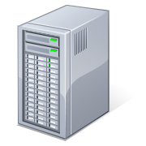
CARMEN Science Cloud Platform
Filestore with Pattern
Search
Workflow
Database
Security
Workflow
Enactment
Metadata
Service
Repository
Browsers &
Rich Clients
Processing

Slide 13
Re-using e-Science technologies
SRB & Aura
Filestore with Pattern
Search
Workflow
SDE
Database
SQL Server
Security
Taverna
Workflow
Enactment
Gold
Metadata
Symba
Service
Repository
Browsers &
Rich Clients
Dynasoar
Processing

Slide 14
Example: Running a Workflow

Slide 15
Conclusions and Current Directions
CARMEN is delivering a scalable Science Cloud Platform that can be applied across a diverse range of sciences
e-Science Central (One NorthEast)
piloting a science cloud for a range of academic and industrial scientists across the North East of England

Slide 16
Sustainability
Sustainability is a problem for e-science projects
cost of managing & maintaining h/w & s/w
academics are funded to do research, not run a service

Slide 17
Commercial Clouds to the Rescue?
Are Commercial Clouds the solution?
e.g. “Pay-as-You-Go” Amazon EC2 & S3
focus is currently on infrastructure: storage & processing
But, this is only part of the stack
what about the cloud middleware?
Can we have pay-as-you-go Science Cloud Platforms?

Slide 18
A Commercial Science Cloud Platform?
Where scientists
should focus
Science
App 1
Science
App n
....
Science Cloud Platform
?
Current gap
Existing
Commercial
Clouds
✓
Storage & Compute

Slide 19
Reasons to be optimistic
CARMEN Science Cloud Platform services are also needed by commercial applications:
Filestore, Databases & Metadata
Dynamic Service Provisioning, Workflow
Security
Science Cloud Platforms should be able to leverage commercial cloud platforms
allowing scientists to focus on the domain-specific science applications

