Slide 1
Forza, Halo, Xbox Live The Magic of Research in Microsoft Products
Ralf Herbrich
Applied Games Group
Microsoft Research Cambridge

Slide 2
Microsoft Research
1997
1991
2008
2001
1998
2005

Slide 3
Overview
Why Machine Learning and Games?
Machine Learning in Video Games
Drivatars™
Reinforcement Learning
Machine Learning in Online Games
TrueSkill™
Halo 3
History of Chess
Conclusions

Slide 4
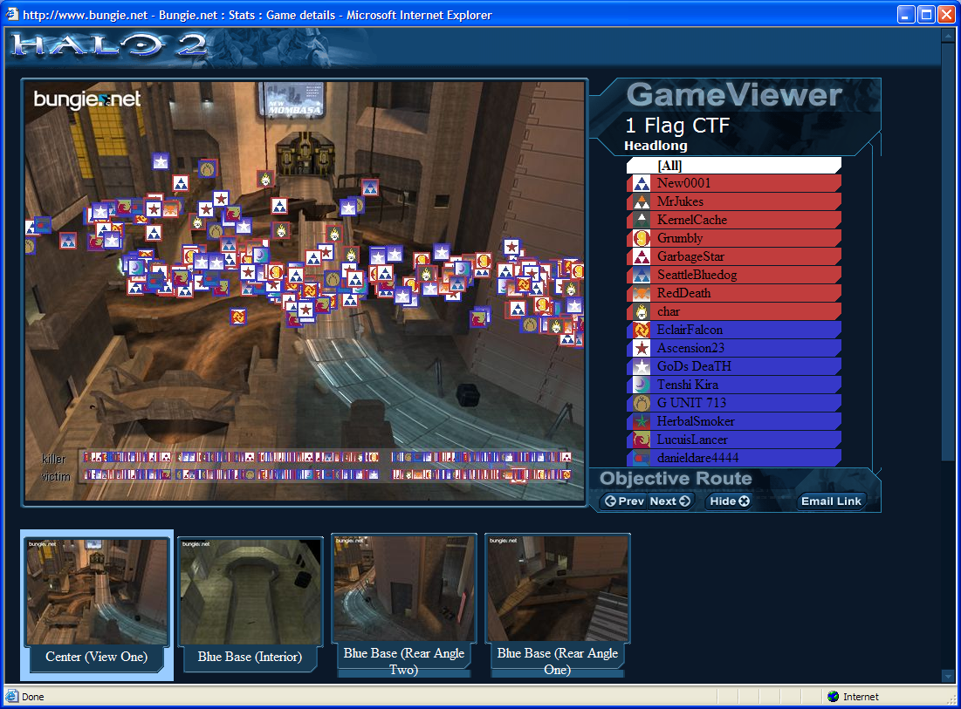
Why Machine Learning and Games?
Test Beds for Machine Learning
Perfect instrumentation and measurements
Perfect control and manipulation
Reduced cost
Great way to showcase algorithms
Improve User Experience
Create adaptive, believable game AI
Compose great multiplayer matches based on skill and social criteria
Mitigate Network latency using prediction
Create realistic character movement
Reduced risk

Slide 5
Games can be very hard!
Partially observable stochastic games
States only partially observed
Multiple agents choose actions
Stochastic pay-offs and state transitions depend on state and all the other agents’ actions
Goal: Optimise long term pay-off (reward)
Just like life: complex, adversarial, uncertain, and we are in it for the long run!

Slide 6
Approximations
From single player’s perspective
Partially Observable Markov Decision Process (POMDP)
Approximate Solutions
Reinforcement Learning
Unsupervised Learning
Supervised Learning
What is the best AI?
Always takes optimal actions
Delivers best entertainment value

Slide 7
Games Industry Surpasses Hollywood!
World Box Office Sales(2007)

Slide 8
Overview
Why Machine Learning and Games?
Machine Learning in Video Games
Drivatars™
Reinforcement Learning
Machine Learning in Online Games
TrueSkill™
Halo 3
History of Chess
Conclusions

Slide 9
Drivatar™
Adaptive avatar for driving
Separate game mode
Basis of all in-game AI
Basis of “dynamic” racing line

Slide 10
Forza Motorsport Demo
XBOX Game
Learning a Drivatar
Using a Drivatar
Dynamic Racing Line
Notes:
RL has learnt what to maximize, rather than copying the priming lap

Slide 11
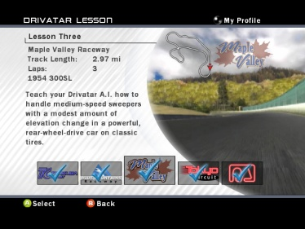
Drivatars Unplugged
Drivatar Learning System
“Built-In” AI Behaviour Development Tool
Drivatar Racing Line Behaviour Model
Vehicle Interaction and Racing Strategy
Recorded Player Driving
Controller
Car Behaviour
Drivatar AI Driving

Slide 12
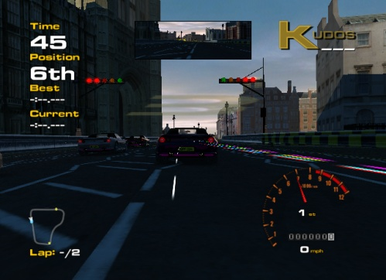
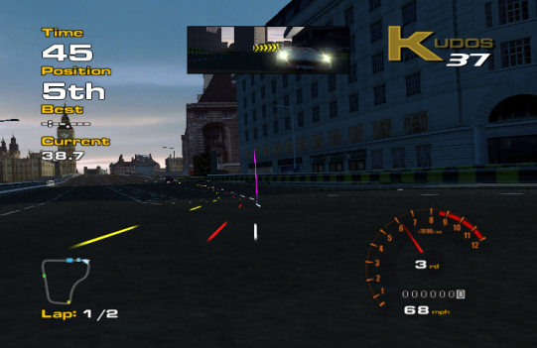
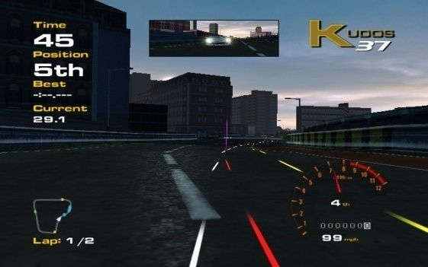
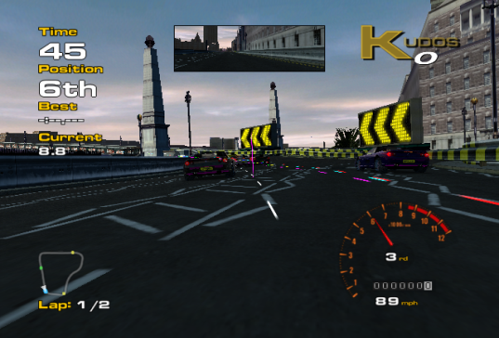
The Racing Line Model

Slide 13
Drivatars: Main Idea
Two phase process:
Pre-generate possible racing lines prior to the race from a (compressed) racing table.
Switch the lines during the race to add variability.
Compression reduces the memory needs per racing line segment
Switching makes smoother racing lines.
Notes:
“Constrained switching makes …” perhaps?
Is the thinking also that the mechanism of switching will also fit in well with our current ideas re a passing model?

Slide 14
Racing Tables
Segments
a₁
a₂
a₃
a₄

Slide 15
Minimal Curvature Lines

Slide 16
Forza Motorsport 3

Slide 17
Vehicle Control as an Inverse Problem
Car Position and Speed at time t
Physics (“causal”)
Static Car Properties
Physics Simulation System
Car Position and Speed at time t+1
Car Controls
Control (“inverse”)
Desired Pos. and Speed at time t+1
Controller

Slide 18
Overview
Why Machine Learning and Games?
Machine Learning in Video Games
Drivatars™
Reinforcement Learning
Machine Learning in Online Games
TrueSkill™
Halo 3
History of Chess
Conclusions

Slide 19
Reinforcement Learning
Agent
game state
parameter update
action
Learning Algorithm
reward / punishment
game state
Game
action

Slide 20
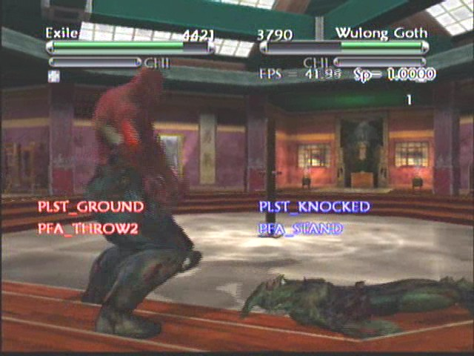
Tabular Q-Learning
+10.0
actions
Q-Table | THROW | KICK | STAND
1ft / GROUND
2ft / GROUND
3ft / GROUND
4ft / GROUND
5ft / GROUND
6ft / GROUND
1ft / KNOCKED
2ft / KNOCKED
3ft / KNOCKED
4ft / KNOCKED
5ft / KNOCKED
6ft / KNOCKED
13.2
10.2
-1.3
3 ft
game states
5 ft
3.2
6.0
4.0
Notes:
sequence: FORWARD – JUMP – KICK – BLOCK
Insert TaoFeng pictures

Slide 21
Results
Game state features
Separation (5 binned ranges)
Last action (6 categories)
Mode (ground, air, knocked)
Proximity to obstacle
Available Actions
19 aggressive (kick, punch)
10 defensive (block, lunge)
8 neutral (run)
Q-Function Representation
One layer neural net (tanh)
Reinforcement Learner
In-Game AI Code

Slide 22
Learning Aggressive Fighting
Reward for decrease in Wulong Goth’s health
Early in the learning process …
… after 15 minutes of learning
Notes:
Explain health bar

Slide 23
Learning “Aikido” Style Fighting
Punishment for decrease in either player’s health
Early in the learning process …
… after 15 minutes of learning
Notes:
DO NOT SHOW the first video (unless queried by the audience)
Explain the EXPLORE-EXPLOIT situation after the random move at the end of the second video

Slide 24
Overview
Why Machine Learning and Games?
Machine Learning in Video Games
Drivatars™
Reinforcement Learning
Machine Learning in Online Games
TrueSkill™
Halo 3
History of Chess
Conclusions

Slide 25
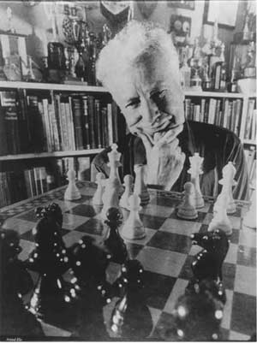
Motivation
Competition is central to our lives
Innate biological trait
Driving principle of many sports
Chess Rating for fair competition
ELO: Developed in 1960 by Árpád Imre Élő
Matchmaking system for tournaments
Challenges of online gaming
Learn from few match outcomes efficiently
Support multiple teams and multiple players per team

Slide 26
The Skill Rating Problem
Given:
Match outcomes: Orderings among k teams consisting of n₁, n₂ , ..., n_{k} players, respectively
Questions:
Skill s_{i} for each player such that
Global ranking among all players
Fair matches between teams of players

Slide 27
Two Player Match Outcome Model
Latent Gaussian performance model for fixed skills
Possible outcomes: Player 1 wins over 2 (and vice versa)
s₁
s₂
p₁
p₂
y₁₂

Slide 28
Two Team Match Outcome Model
Skill of a team is the sum of the skills of its members
s₁
s₂
s₃
s₄
t₁
t₂
y₁₂

Slide 29
Multiple Team Match Outcome Model
Possible outcomes: Permutations of the teams
s₁
s₂
s₃
s₄
The total order relation among the teams is not reflected in the graph structure!
t₁
t₂
t₃
y

Slide 30
Multiple Team Match Outcome Model
But we are interested in the (Gaussian) posterior!
s₁
s₂
s₃
s₄
t₁
t₂
t₃
y₁₂
y₂₃

Slide 31
Efficient Approximate Inference
Gaussian Prior Factors
s₁
s₂
s₃
s₄
Ranking Likelihood Factors
Fast and efficient approximate message passing using Expectation Propagation
t₁
t₂
t₃
y₁₂
y₂₃

Slide 32
Applications to Online Gaming
Leaderboard
Global ranking of all players
Matchmaking
For gamers: Most uncertain outcome
For inference: Most informative
Both are equivalent!

Slide 33
Experimental Setup
Data Set: Halo 2 Beta
3 game modes
Free-for-All
Two Teams
1 vs. 1
> 60,000 match outcomes
≈ 6,000 players
6 weeks of game play
Publically available

Slide 34
Convergence Speed
40
35
30
25
Level
20
15
char (TrueSkill™)
10
SQLWildman (TrueSkill™)
5
char (Halo 2 rank)
SQLWildman (Halo 2 rank)
0
0
100
200
300
400
Number of Games

Slide 35
Convergence Speed (ctd.)
100%
char wins
SQLWildman wins
80%
Both players draw
60%
Winning probability
40%
20%
5/8 games won by char
0%
0
100
200
300
400
500
Number of games played

Slide 36
Overview
Why Machine Learning and Games?
Machine Learning in Video Games
Drivatars™
Reinforcement Learning
Machine Learning in Online Games
TrueSkill™
Halo 3
History of Chess
Conclusions

Slide 37
Xbox 360 & Halo 3
Xbox 360 Live
Launched in September 2005
Every game uses TrueSkill™ to match players
> 12 million players
> 2 million matches per day
> 2 billion hours of gameplay
Halo 3
Launched on 25th September 2007
Largest entertainment launch in history
> 200,000 player concurrently (peak: 1,000,000)

Slide 38
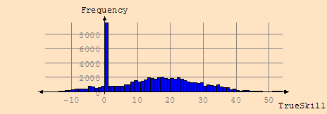
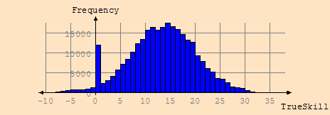
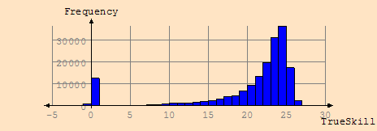
Skill Distributions of Online Games
Golf (18 holes): 60 levels
Car racing (3-4 laps): 40 levels
UNO (chance game): 10 levels

Slide 39
Halo 3 Demo
Halo 3 Game
Skill Stats
Tight Matches
Matchmaking
Notes:
RL has learnt what to maximize, rather than copying the priming lap

Slide 40
Halo 3 in Action
Notes:
RL has learnt what to maximize, rather than copying the priming lap

Slide 41
Halo 3 Public Beta Analysis

Slide 42
Overview
Why Machine Learning and Games?
Machine Learning in Video Games
Drivatars™
Reinforcement Learning
Machine Learning in Online Games
TrueSkill™
Halo 3
History of Chess
Conclusions

Slide 43
TrueSkillTM Through Time: Chess
Model time-series of skills by smoothing across time
History of Chess
3.5M game outcomes (ChessBase)
20 million variables (each of 200,000 players in each year of lifetime + latent variables)
40 million factors
p_{t,i}
p_{t,j}
s_{t,i}
s_{t,j}
p_{t,i}
p_{t,j}
p_{t+1,i}
p_{t+1,j}
s_{t+1, i}
s_{t+1, j}
p_{t+1,i}
p_{t+1,j}

Slide 44
ChessBase Analysis: 1850 - 2006
Garry Kasparov
3000
2800
Robert James Fischer
Anatoly Karpov
2600
Mikhail Botvinnik
2400
Paul Morphy
Skill estimate
Whilhelm Steinitz
2200
Boris V Spassky
2000
Emanuel Lasker
1800
Jose Raul Capablanca
1600
Adolf Anderssen
1400
1850
1858
1866
1875
1883
1891
1899
1907
1916
1924
1932
1940
1949
1957
1965
1973
1981
1990
1998
2006
Year

Slide 45
Overview
Why Machine Learning and Games?
Machine Learning in Video Games
Drivatars™
Reinforcement Learning
Machine Learning in Online Games
TrueSkill™
Halo 3
History of Chess
Conclusions

Slide 46
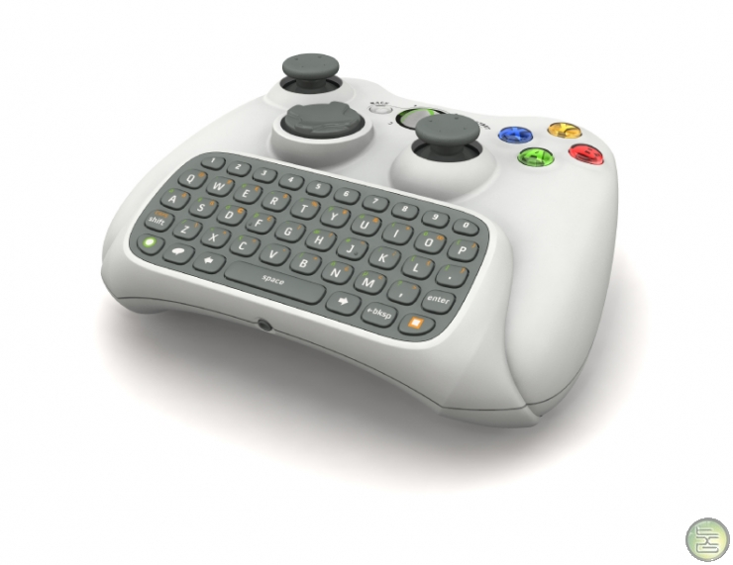
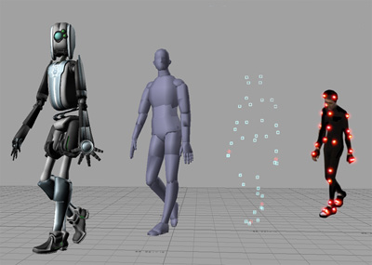
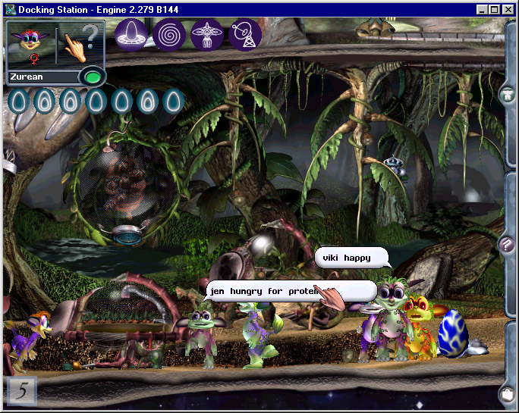
Future Challenges for Machine Learning in Games
Mentioned in this talk
Adaptive and Learning Game AI
Online Gaming Interactions
Not mentioned in this talk
Adaptive Input Devices
Dialogue Generation
Realistic Physical Movement
Computer Vision
New Game Genres based on Machine Learning

Slide 47
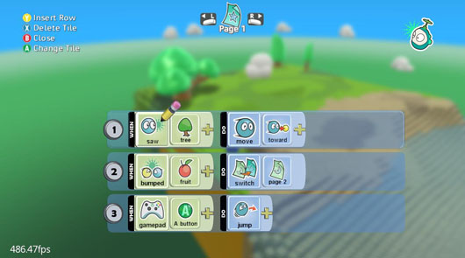
Conclusions
Computer games can be used as test beds for research.
Machine learning can be used to improve the user experience in computer games.
Both research and applications are in their infancy and there are many open questions.
XNA framework exists to plug in machine learning algorithms.
For more question, please drop us a line
Ralf Herbrich, Thore Graepel, Joaquin Quiñonero Candela
Online Services and Advertising Group

