Slide 1
Privacy of Location Trajectory
Chi-Yin Chow
Department of Computer Science
City University of Hong Kong
Mohamed F. Mokbel
Department of Computer Science and Engineering
University of Minnesota

Slide 2
Outline
Introduction
Protecting Trajectory Privacy in Location-based Services
Protecting Privacy in Trajectory Publication
Future Research Directions

Slide 3
Data Privacy
Example: Hospitals want to publish medical records for public health research
  Contain personal sensitive information
  Natural way: remove known identifiers (de-identify)

Slide 4
Is De-identification Enough?

Slide 5
Is De-identification Enough?

Slide 6
Data Privacy-Preserving Techniques
k-anonymity (Sweeney, IJUFKS’02)
  Indistinguishable among at least k records
l-diversity (Machanavajjhala et al., TKDD’07)
  At least l values for sensitive attributes
t-closeness (Li et al., TKDE’10)
  Distribution of sensitive attributes
    (in equivalence class vs in entire data set)

Slide 7
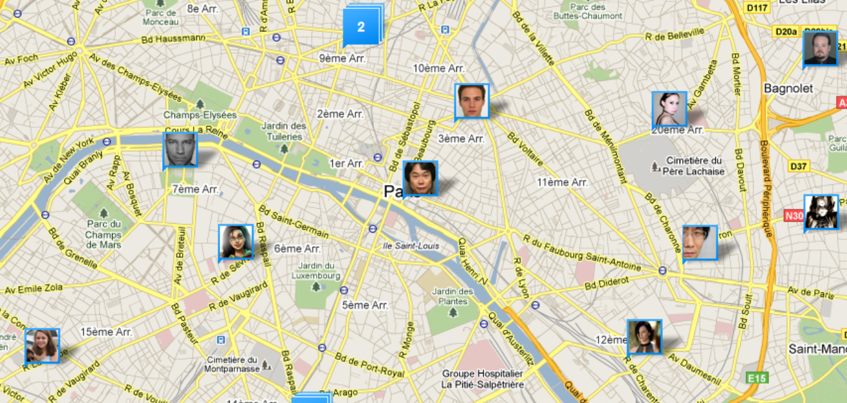
Location Privacy
Location-Based Services (LBS)
  Untrustable LBS Service Provider – Location Privacy Leakage

Slide 8
Location Privacy-Preserving Techniques
False Location
  Users generate fake locations
Space Transformation
  Transform into another space
Spatial Cloaking
  Blur user’s location into cloaked region

Slide 9
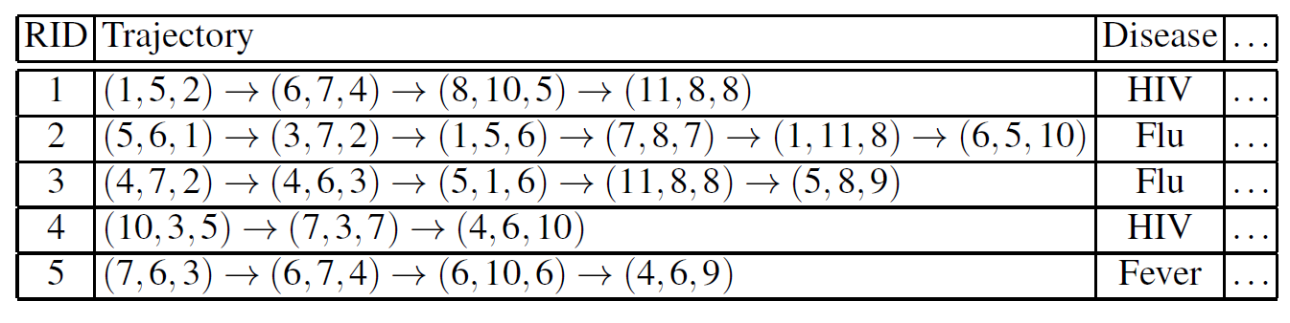
More Challenging: Trajectory Privacy
The hospital example
  Suppose the trajectories of patients should be published
    Trajectory T:
  De-identified
Suppose adversary know a patient visited (1, 5) and (8, 10) at timestamps 2 and 5, respectively
Sensitive Attribute
He has a disease of HIV!
Powerful quasi-identifiers!

Slide 10
Two Kinds of Trajectory
Real-time Trajectory -- Continuous LBS
  “Continuously inform me the traffic condition within 1 mile from my vehicle”
  “Let me know my friends’ locations if they are within 2km from my location”
Off-line Trajectory -- Historical Trajectory
  Publish trajectory data for public research
  Answer spatio-temporal range queries

Slide 11
Continuous Location-based Services vs. Trajectory Publication
Scalability Requirement
  Continuous LBS: Real-time
  Historical Trajectory: Off-line
Applicability of Global Optimization
  Continuous LBS: Dynamic, Uncertain
  Historical Trajectory: Static

Slide 12
Outline
Introduction
Protecting Trajectory Privacy in Location-based Services
Protecting Privacy in Trajectory Publication
Future Research Directions

Slide 13
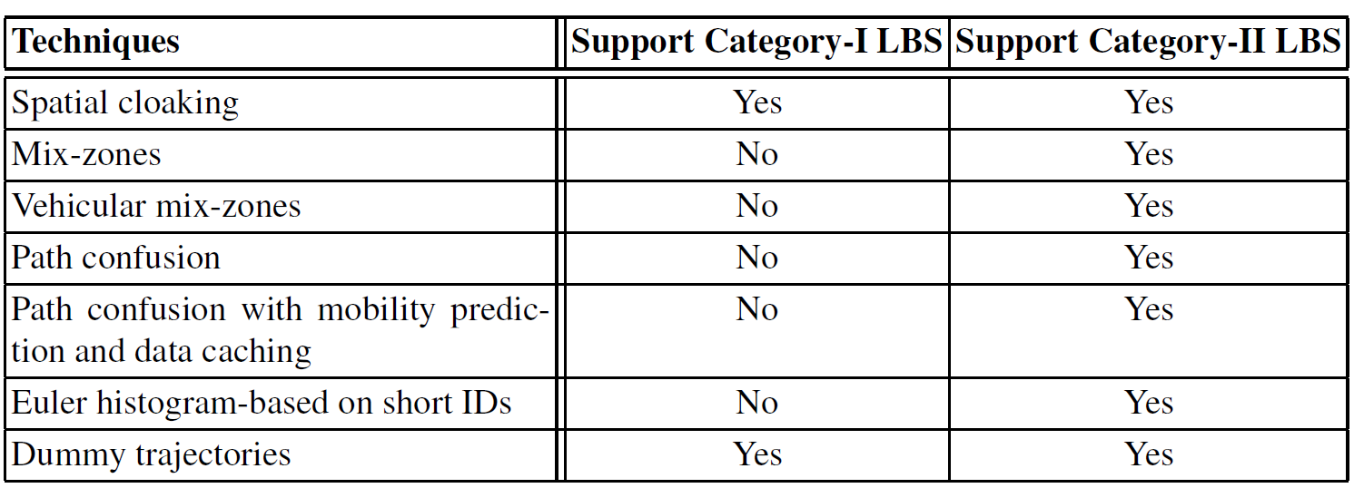
Protecting Trajectory Privacy in LBS
Category-I LBS: Require consistent user identities.
  “Let me know my friends’ locations if they are within 2km from my location”
Category-II LBS: Do not require consistent user identities.
  “Send e-coupons to users within 1km from my coffee shop”

Slide 14
Protecting Trajectory Privacy in LBS
Spatial cloaking
Mix-zones
Vehicular mix-zones
Path confusion
Path confusion with mobility prediction and data caching
Euler histogram-based on short IDs
Dummy trajectories

Slide 15
Spatial Cloaking
  Main Idea: Blur user’s location into cloaked region
    k-anonymity
Challenge: From snapshot location to continuous trajectory
  Trajectory tracing attack
  Anonymity-set tracing attack
Support consistent user identity

Slide 16
Trajectory Tracing Attack (1/2)
Suppose R₁ and R₂ are two cloaked regions for user U at t₁ and t₂, respectively.
Suppose attacker knows U’s maximum speed.

Slide 17
Trajectory Tracing Attack (2/2)
Attacker could infer which user is U! (Here it is C)

Slide 18
Trajectory Tracing Attack: Solution
Patching Technique
Delaying Technique
(Cheng et al., PETS’06)

Slide 19
Anonymity-set Tracing Attack
At time t₁
At time t₂

Slide 20
Anonymity-set Tracing Attack: Solution
Solution 1: Group-based Approach
Solution 2: Distortion-based Approach
Solution 3: Prediction-based Approach

Slide 21
Solution 1: Group-based Approach
At time t₁
At time t₂
At time t₃
Group members are fixed
  All members need to report their locations to the anonymizer server periodically
(Chow et al., SSTD’07)

Slide 22
Solution 2: Distortion-based Approach
At time t₁
At time t_{i}
Do not need other members to report their locations periodically
  Use their initial directions and velocities to calculate distortion regions
  Use distortion regions as new cloaked regions
(Pan et al., SIGSPATIAL’09)

Slide 23
Solution 3: Prediction-based Approach
Predict user’s trajectory
Cloak it with other users’ historical trajectories
(Xu et al., INFOCOM’08)

Slide 24
Protecting Trajectory Privacy in LBS
Spatial cloaking
Mix-zones
Vehicular mix-zones
Path confusion
Path confusion with mobility prediction and data caching
Euler histogram-based on short IDs
Dummy trajectories

Slide 25
Mix-Zones (1/2)
  Main Idea:
    Users change pseudonyms when entering mix-zones
    Do not reveal their location when they are in mix-zones
    k-anonymity
Not support consistent user identity

Slide 26
Mix-Zones (2/2)
(Freudiger et al., PETS’09)
  Ensuring k-anonymity
    At least k users in mix-zone at a certain time point
    Each user spends a completely random duration of time in the mix-zone
    Each user is equally likely to exit in any exit points no matter entering through any entry points

Slide 27
Vehicular Mix-Zones (1/2)
  Mix-zone designed for Euclidean space not secure enough when it comes to vehicle movements
    Physical roads
    Vehicle directions
    Speed limits
    Traffic conditions
    Road conditions

Slide 28
Vehicular Mix-Zones (2/2)
  Adaptive mix-zones:
    Road intersection, together with outgoing road segments
(Palanisamy et al., ICDE’11)

Slide 29
Protecting Trajectory Privacy in LBS
Spatial cloaking
Mix-zones
Vehicular mix-zones
Path confusion
Path confusion with mobility prediction and data caching
Euler histogram-based on short IDs
Dummy trajectories

Slide 30
Path Confusion
  Goal: Avoid linking consecutive location samples to individual vehicles
  Main Idea: A central server controls the release of location data to satisfy “time-to-confusion”
Not support consistent user identity
(Gruteser et al., MobiSys’03)

Slide 31
Path Confusion with Mobility Prediction and Data Caching
  Main Idea: The location anonymizer predicts vehicular movement paths, pre-fetches the spatial data on predicted paths, stores the data in a cache
    Service provider can only see queries for a series of interweaving paths
(Meyerowitz et al., MobiCom’09)

Slide 32
Protecting Trajectory Privacy in LBS
Spatial cloaking
Mix-zones
Vehicular mix-zones
Path confusion
Path confusion with mobility prediction and data caching
Euler histogram-based on short IDs
Dummy trajectories

Slide 33
Euler Histogram-based on Short IDs (EHSID)
  Goal: Privacy-aware Traffic Monitoring (answering aggregate queries of a given region)
    ID-based query (count of unique vehicles) (need ID?)
    Entry-based query (count of entries)
  Short ID: Partial ID information about objects
    Full ID: 1 1 0 1 1 1 0 1 1
    Bit Pattern: 1, 3, 4, 7
    Short ID: 1 0 1 0
  Euler Histogram: Answer aggregate queries
Not support consistent user identity
(Xie et al., IEEE Trans. ITS’10)

Slide 34

Euler Histogram
  Use an Euler histogram to count distinct rectangles in a query region R
    F is the sum of face counts inside R
    V is the sum of vertex counts inside R (excluding its boundary)
    E is the sum of edge counts inside R (excluding its boundary)
= 6 + 1 – 5 = 2
Query region
F = 1+2+1+2 = 6
V = 1
E = 1+1+1+2 = 5

Slide 35
Euler Histogram-based on Short IDs (EHSID)
  Answering four types of queries
    ID-based cross-border
    ID-based distinct-objects
    Entry-based cross-border
    Entry-based distinct-objects
  How to calculate these answers using Euler Histogram?

Slide 36
Define Four Types of Vertices
Query Region
Road Segment
Two Trajectories

Slide 37
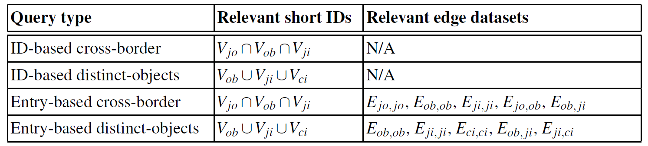
Euler Histogram-based on Short IDs (EHSID)
Query Region
Road Segment
Two Trajectories

Slide 38
Protecting Trajectory Privacy in LBS
Spatial cloaking
Mix-zones
Vehicular mix-zones
Path confusion
Path confusion with mobility prediction and data caching
Euler histogram-based on short IDs
Dummy trajectories

Slide 39
Dummy Trajectories
  Main Idea: User generate fake location trajectories
    How to choose dummy trajectories?
    How to measure the degree of privacy protection?
Support consistent user identity
(You et al., PALMS’07)

Slide 40
How to Choose Dummy Trajectories
  Snapshot disclosure (SD): Average probability of successfully inferring each true location
  Trajectory disclosure (TD): Probability of successfully identifying the true trajectory among all possible trajectories
  Distance deviation (DD): Average distance between the i^{th} location samples of real trajectory and each dummy trajectory

Slide 41
Outline
Introduction
Protecting Trajectory Privacy in Location-based Services
Protecting Privacy in Trajectory Publication
Future Research Directions

Slide 42
Protecting Privacy in Trajectory Publication
Clustering-based Anonymization Approach
Generalization-based Anonymization Approach
Suppression-based Anonymization Approach
Grid-based Anonymization Approach

Slide 43
Clustering-based Anonymization Approach
  Main Idea: Group k co-localized trajectories within the same time period to form a k-anonymized aggregate trajectory.
    Trajectory Uncertainty Model
(Abul et al., ICDE’08)

Slide 44
Clustering-based Anonymization Approach
  Aggregate trajectory of a set of 2-anonymized co-localized trajectories

Slide 45
Protecting Privacy in Trajectory Publication
Clustering-based Anonymization Approach
Generalization-based Anonymization Approach
Suppression-based Anonymization Approach
Grid-based Anonymization Approach

Slide 46
Generalization-based Anonymization Approach
  Main Idea:
    Step1: Generalize a trajectory data set into a sequence of k-anonymized regions
    Step2: Uniformly select k atomic points from each anonymized region and reconstruct k trajectories
(Nergiz et al., TDP’09)

Slide 49
Protecting Privacy in Trajectory Publication
Clustering-based Anonymization Approach
Generalization-based Anonymization Approach
Suppression-based Anonymization Approach
Grid-based Anonymization Approach

Slide 50
Suppression-based Anonymization Approach
  Main Idea: Iteratively suppress locations until the privacy constraint is met
    Privacy constraint
    Difference between transformed trajectories and original ones
(Terrovitis et al., MDM’08)
Suppress location a₁

Slide 51

Suppression-based Anonymization Approach
  The probability adversary can identify the actual user of any location p_{i}
Suppress location a₁

Slide 52



Suppression-based Anonymization Approach
Calculate difference between transformed trajectory and the original

Slide 53
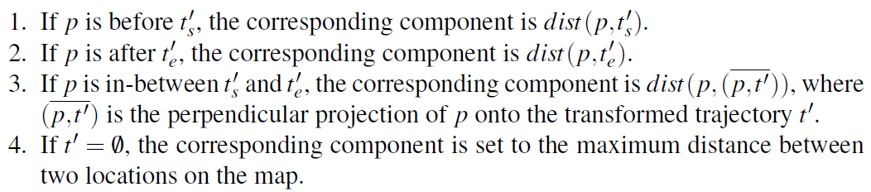
Suppression-based Anonymization Approach

Slide 54
Protecting Privacy in Trajectory Publication
Clustering-based Anonymization Approach
Generalization-based Anonymization Approach
Suppression-based Anonymization Approach
Grid-based Anonymization Approach

Slide 55

Grid-based Anonymization Approach
  Main Idea: Replace locations with grids (could have different resolutions)
(Gidofalvi et al., MDM’07)

Slide 56
Outline
Introduction
Protecting Trajectory Privacy in Location-based Services
Protecting Privacy in Trajectory Publication
Future Research Directions

Slide 57
Future Directions
Personalized LBS (require more user semantics)
  User preferences and background information could be used as quasi-identifiers
Trajectory publication supporting more complex queries
  Spatio-temporal queries
  Spatio-temporal data analysis

