Slide 1

An Interactive-Voting Based
Map Matching Algorithm
Jing Yuan¹, Yu Zheng², Chengyang Zhang³, Xing Xie² and Guangzhong Sun¹
¹University of Science and Technology of China
²Microsoft Research Asia
³University of North Texas

Slide 2
Outline
Introduction
Our Contributions
Related Work
Interactive-Voting Algorithm
Evaluation
Conclusion and Future Work

Slide 3
Introduction
Popular GPS-enabled devices enable us to collect large amount of GPS trajectory data

Slide 4
Introduction
These data are often not precise
  Measurement error: caused by limitation of devices
  Sampling error: uncertainty introduced by sampling
  It is desirable to match GPS points with road segments on the map

Slide 5
Introduction
In practice there exists large amount of low-sampling-rate GPS trajectories
Distribution of sampling intervals of Beijing taxi dataset

Slide 6
Outline
Introduction
Our Contributions
Related Work
Interactive-Voting Algorithm
Evaluation
Conclusion and Future Work

Slide 7
Our Contributions
We study the interactive influence of the GPS points and propose a novel voting-based IVMM algorithm
Extensive experiments are conducted on real datasets
The evaluation results demonstrate the effectiveness and efficiency of our approach for map-matching of low-sampling rate GPS trajectories

Slide 8
Outline
Introduction
Our Contributions
Related Work
Interactive-Voting Algorithm
Evaluation
Conclusion and Future Work

Slide 9
Related Work
Information utilized in the input data
  Geometric, topological, probabilistic, …
  Usually performs poor for low-sampling rate trajectories
Range of sampling points considered
  Incremental/Local algorithms
  Global algorithms
A screen shot of ST-Matching result (green pushpins are the matched points of the red trace)

Slide 10
Related Work
Sampling density of the tracking data
  Dense-sampling-rate approach
  Low-sampling-rate approach
A screen shot of ST-Matching result
(green pushpins are the matched points of the red trace)

Slide 11
Related Work
Problem with ST-Matching
  The similarity function only considers two adjacent candidate points
  The influence of points is not weighted
  The mutual influence is not considered

Slide 12
Outline
Introduction
Our Contributions
Related Work
Interactive-Voting Algorithm
Evaluation
Conclusion and Future Work

Slide 13
Problem Definition
Given a low-sampling rate GPS trajectory T and a road network G(V,E), find the path P from G that matches T with its real path.

Slide 14
Key Insights
Position context influence
Mutual influence
Weighted influence

Slide 15
System Overview

Slide 16
Step 1: Candidate Preparation
Candidate Road Segments (CRS)
Candidate Points (CP)
Candidate Graph G’=(V’,E’)

Slide 17
Step 2: Position Context Analysis
Spatial Analysis
  Measure the similarity between the candidate paths with the shortest path of two adjacent candidate points

Slide 18
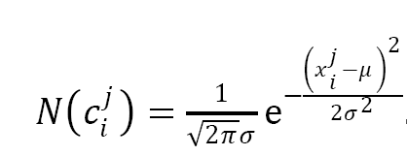
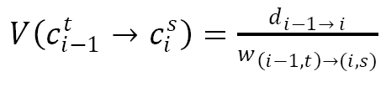
Step 2: Position Context Analysis
Spatial Analysis

Slide 19
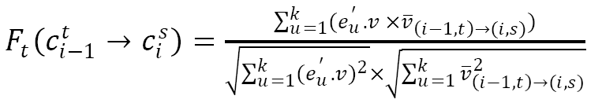

Step 2: Position Context Analysis
Temporal Analysis
  Considers the speed constraints of the road segment
Spatial Temporal Function

Slide 20
Step 3: Mutual Influence Modeling
Static Score Matrix
  represents the probability of candidate points to be correct when only considering two consecutive points
  e.g.

Slide 21

Step 3: Mutual Influence Modeling
Distance Weight Matrix
  a (n-1) dimensional diagonal matrix for each sampling point
  The value of each element is determined by a distance-based function f
  e.g.
    w₁=diag{1/2,1/4,1/8}

Slide 22
Step 3: Mutual Influence Modeling
Weighted Score Matrix
  probability when remote points are also considered
  e.g.

Slide 23
Step 4: Interactive Voting
Interactive Voting Scheme
  Each candidate point determines an optimal path based on weighted score matrix
  Each point on the best path gets a vote from that candidate point
  The points with most votes are selected
  Can be processed in parallel

Slide 24
Step 4: Interactive Voting
Find optimal path for one candidate point
  The path with largest weighted score summation
  Dynamic programming
  A value is obtained to break the tie of voting

Slide 25
Step 4: Interactive Voting
Find Optimal Path
Voting results
Matching result

Slide 26
Outline
Introduction
Our Contributions
Related Work
Interactive-Voting Algorithm
Evaluation
Conclusion and Future Work

Slide 27
Evaluation
Dataset
  Beijing road network
  26 GPS traces from Geolife System
Evaluation approach (Correct Matching Percentage)

Slide 28
Evaluation Results
Visualized results
ST
IVMM
IVMM
ST

Slide 29
Evaluation Results
Accuracy

Slide 30
Evaluation Results
Running time

Slide 31
Evaluation Results
Impact of different distance weight functions

Slide 32
Outline
Introduction
Our Contributions
Related Work
Interactive-Voting Algorithm
Evaluation
Conclusion and Future Work

Slide 33
Conclusion and Future Work
Conclusion
  Modeling the mutual influence of the GPS sampling points
  A voting-based approach for map matching low-sampling-rate GPS traces
  Evaluation with real world GPS traces
Future Work
  The mutual influence related with the topology of the road network
  Combination with other statistical methods, e.g., HMM and CRF models

Slide 34
Thank You!

