Slide 1
Detecting Nearly Duplicated Records in Location Datasets
Yu Zheng
Xing Xie, Shuang Peng, James Fu
Microsoft Research Asia
Search Technology Center

Slide 2
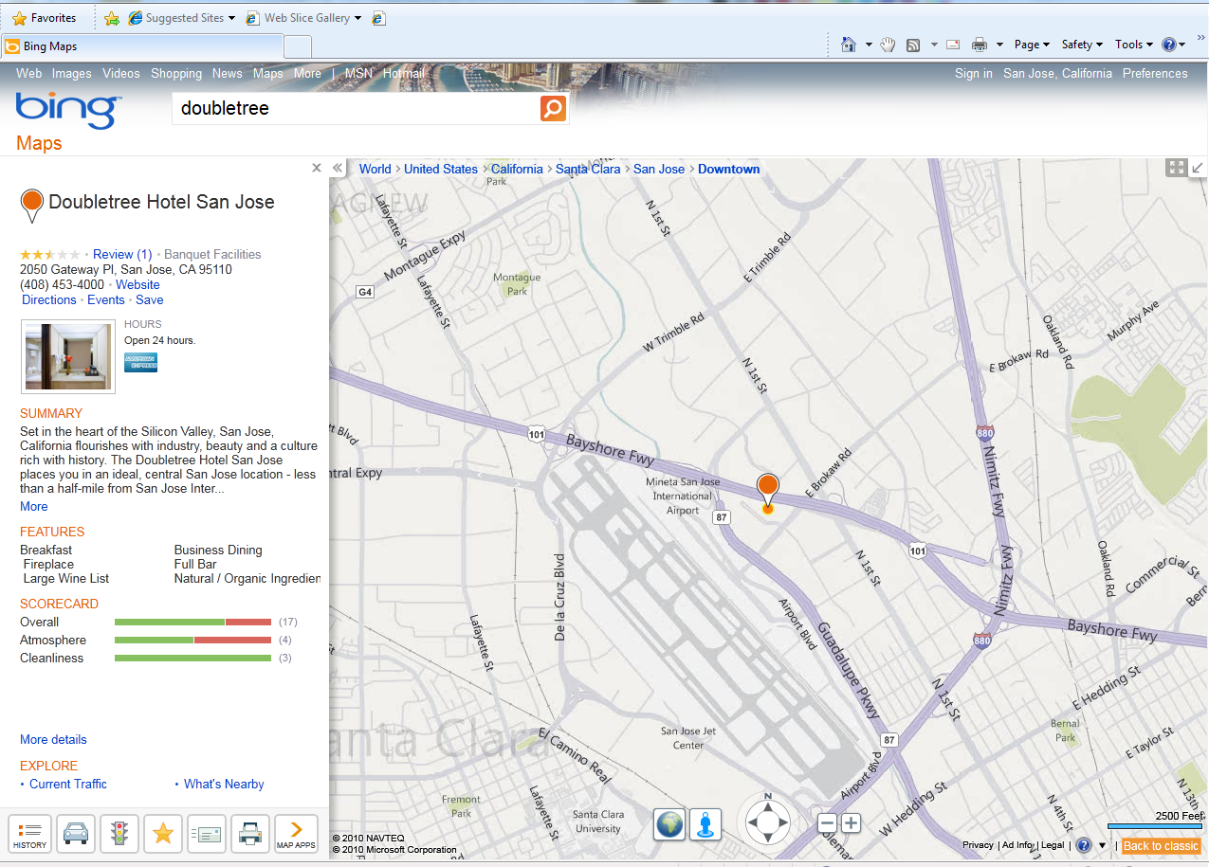
Background
Web maps and local search engines are frequently-used
The quality of the services depends on geographic data

Slide 3
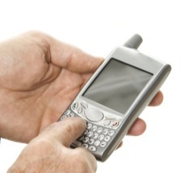


Background
Point of interests
  Collected by people holding GPS-enabled devices in the physical world
  Accurate GPS coordinates
  Less accurate address
Yellow page
  Inputted by people in a cyber environment, e.g., online
  Accurate address
  Inaccurate GPS coordinates (translated by geocoding)
Name | Address | GPS Position | Phone Num. | Category | Type
The Matt’s Bar | 701 5th Ave Seattle, WA | 116.325, 35.364 | 1-56987452 | Café | YP
Silver Cloud Inn | 314 7th Ave Redmond, WA | 116.451, 35.209 | 1-25698716 | Hotel | POI

Slide 4
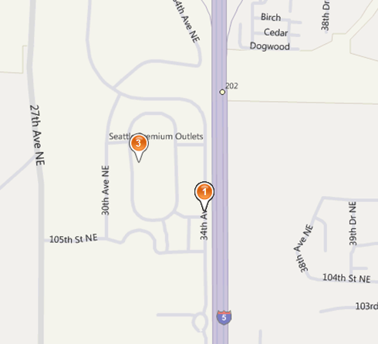
Problem
Nearly duplicated POIs
  The same entity in the physical world
  With slightly different presentations of name, address,
Caused by multiple resources
  Different vendors and channels
  Different types: POI and YP
Results
  Bring trouble to data management
  Confuse users
  Example:
  Seattle Premier Outlet Mall
  Seattle Premium Outlet

Slide 5
What we do
Infer the similarity between two location entities
  Based on a machine learning based approach
  Consider multiple fields: name, address, coordinates, categories
Identify some useful features
Evaluate our method using real datasets

Slide 6
Methodology
Similarities between two entities
  Name similarity
  Address similarity
  Category similarity
Train a inference model
  Using these similarities as features
  A small human label training set
  Apply to a large scale dataset

Slide 7


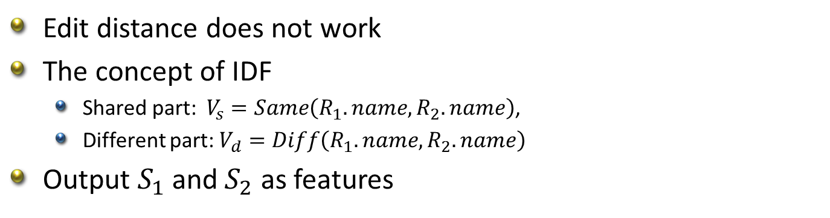

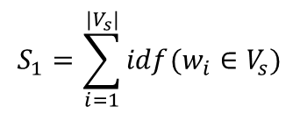

Name similarity
Edit distance does not work
The concept of IDF
  Shared part: $V_{s}=Same\left(R_{1}.name, R_{2}.name\right)$,
  Different part: $V_{d}=Diff\left(R_{1}.name, R_{2}.name\right)$
Output $S_{1}$ and $S_{2}$ as features
$$V_{s}=〈w_{1},w_{2},…,w_{i}〉$$
$$V_{d}=〈{w′}_{1},{w′}_{2},…,{w′}_{i}〉$$
$$S_{1}=\sum_{i=1}^{|V_{s}|}{idf(w_{i}∈V_{s})}$$
$$S_{2}=\max_{w_{i}∈V_{d}}⁡idf(w_{i})$$
$idf\left(w_{i}\right)=\log{\frac{N}{|\{R_{j},w_{i}∈R_{j}.Name\}|}}$

Slide 8
Address similarity
Example: The same building having two different address presentation
79 Beaver St, New York, NY 10005-2812
92 Water St, New York, NY 10005-3511
the geospatially closer two records are located, the higher the probability these two records might be nearly duplicated
City structure

Slide 9
Address similarity
Insert YP data into the city structure according to their address
Calculate the mean coordinates of each leaf node
Insert POI data into the city structure in terms of their coordinates
Find out the co-parent node in the structure

Slide 10
Category similarity
Map each entity to a category hierarchy
Find the co-parent node of two entities
The lower lever the co-parent is on the high similar
E.g., some shops usually provide coffee, lunch and wine simultaneously. Therefore, different people would classify these shops into different categories

Slide 11
Experiments- Settings
Beijing Dataset
  In total 0.7 million entities
  0.3m POIs and 0.4m YPs
Human labeled
Decision tree + Bagging
Baselines
  Exact match
  Rule-based: edit distance and geo-distance
Datasets | Training Set | Test Set | Total
D1 | 200 | 200 | 400
D2 | 400 | 400 | 800
D3 | 600 | 600 | 1200
D4 | 800 | 800 | 1600

Slide 12
Experiments - Results
Single feature study
  S1 and S2 are name similarity
  S3 denotes address similarity
  S4 represents category similarity

Slide 13
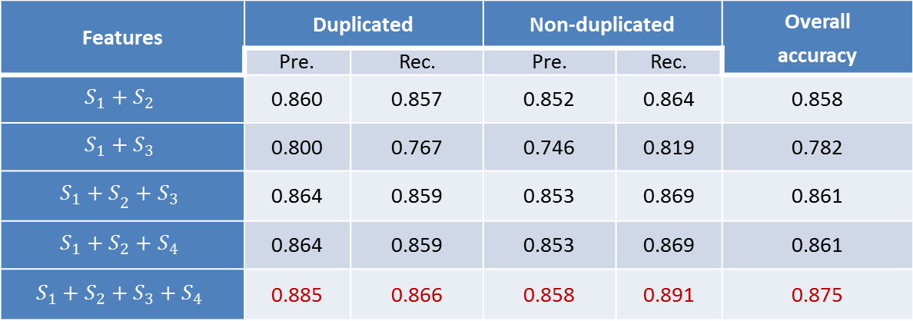
Experiments - Results
Feature combination
Features | Duplicated |  | Non-duplicated |  | Overall accuracy
 | Pre. | Rec. | Pre. | Rec.
$$S_{1}+S_{2}$$ | 0.860 | 0.857 | 0.852 | 0.864 | 0.858
$$S_{1}+S_{3}$$ | 0.800 | 0.767 | 0.746 | 0.819 | 0.782
$${S_{1}+S}_{2}+S_{3}$$ | 0.864 | 0.859 | 0.853 | 0.869 | 0.861
$$S_{1}+S_{2}+S_{4}$$ | 0.864 | 0.859 | 0.853 | 0.869 | 0.861
$$S_{1}+S_{2}+S_{3}+S_{4}$$ | 0.885 | 0.866 | 0.858 | 0.891 | 0.875

Slide 14
Experiments- results
Features | Duplicated |  | Non-duplicated |  | Overall accuracy
 | Pre. | Rec. | Pre. | Rec.
Exact Match | 1 | 0.183 | 0.558 | 0.100 | 0.598
Rule-based method | 0.780 | 0.701 | 0.736 | 0.808 | 0.755
Our approach | 0.885 | 0.866 | 0.858 | 0.891 | 0.875

Slide 15
Conclusion
A classification model using
  Name similarity
  Address similarity
  Category similarity
Determine the nearly duplicated location data
  With a overall accuracy of 0.89

Slide 16

Thanks!
Yu Zheng
Microsoft Research Asia
yuzheng@microsoft.com
Notes:
Thanks!

