Slide 1
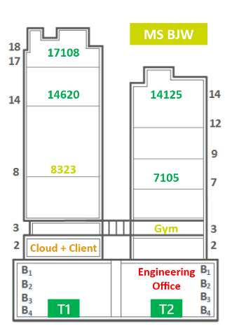
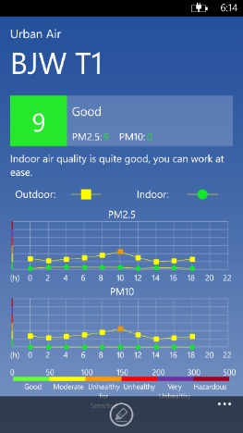
Indoor Air Quality Monitoring System for Smart Buildings
Yu Zheng
Microsoft Research

Slide 2
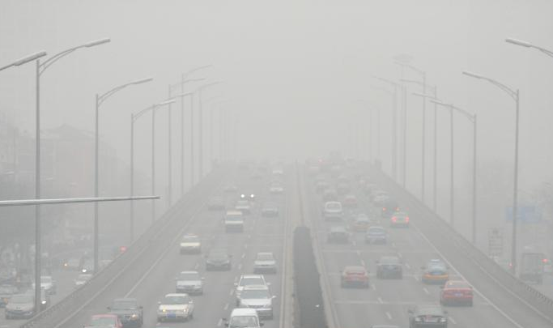
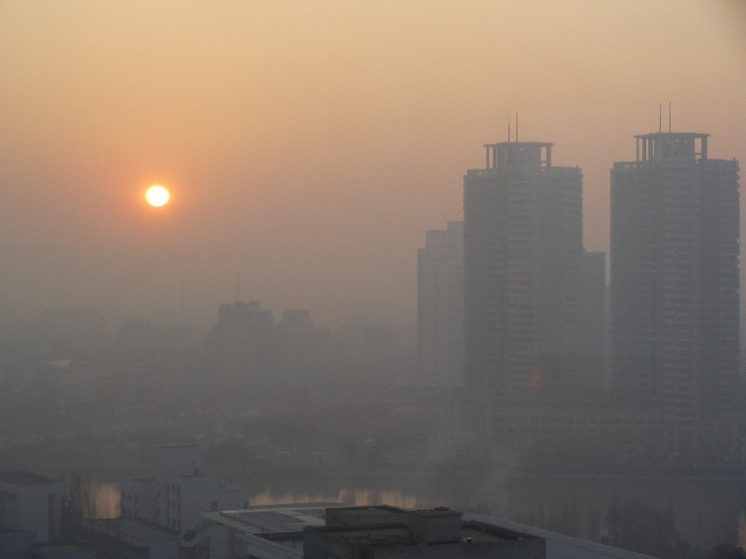
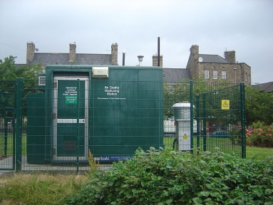
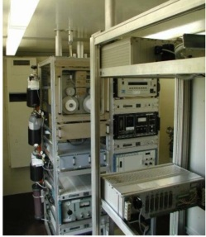
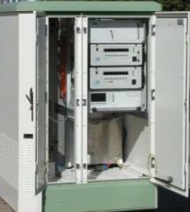
Outdoor Air Quality
Air quality monitor station
50kmx40km
Notes:
Air pollution is now a global concern, especially in developing countries like China. Many cities have built air quality monitoring stations in public areas to inform people the outdoor air quality every hour. However, the air quality of the indoor environment, where people spend the majority of time of day, has not been well monitored yet.

Slide 3
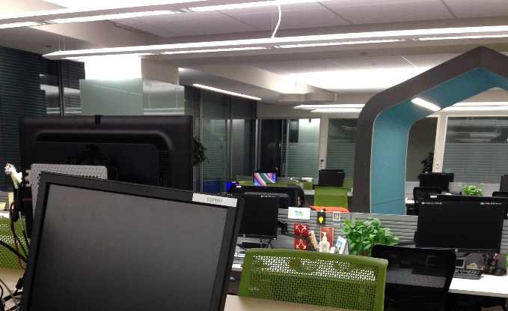
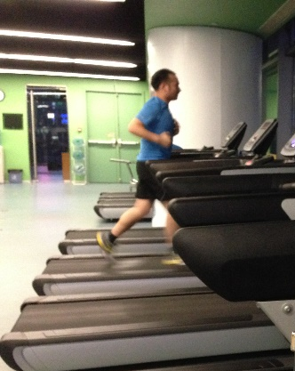
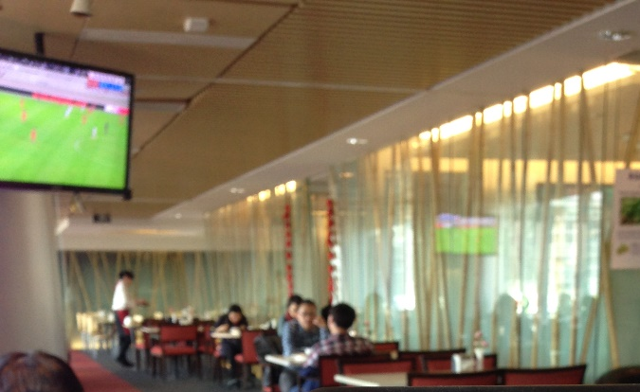
Indoor Air Quality
PM2.5 has NOT been monitored and dealt with
PM2.5 is NOT considered as a factor by HVAC
PM2.5: Particulate matter with a diameter < 2.5$μm$
HVAC: Heating, Ventilation, and Air Conditioning
Problems!
Notes:
Especially the PM2.5, a kind of particle with a diameter smaller than 2.5 micro meter, which adversely affects human health.
Many buildings now have been equipped with a HVAC. But, PM2.5 is not considered as a factor when an HVAC system circulates fresh air from outside into the building.
As shown the middle figure, the guy came to the gym in our building very early, and started working out very hardly without noticing the air quality in the gym. But, as the HVAC system has not turned on or just turned on, the air quality in the gym is not very good. It does not make sense to work out in such a bad environment.
Another example, the air quality of a dinning room in a building is more easily to become bad than other working areas, due to the cooking oil fumes. So, we need to replace the air purify filter for the particular area more frequently than other places. Otherwise, eating in such a dinning room is kind of suicide.

Slide 4
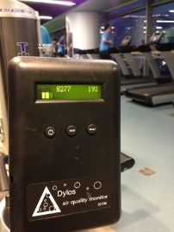

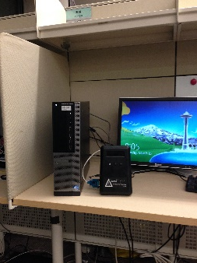
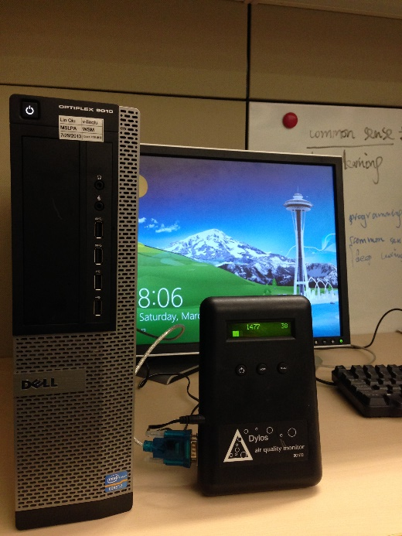
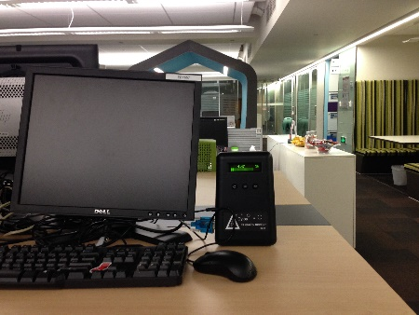
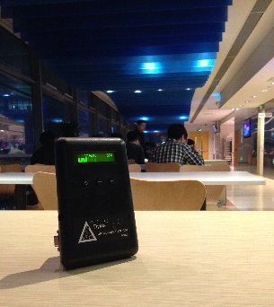
What We Do
Monitor indoor PM2.5 and PM10
  In 5 Microsoft Campuses in China
  Deploy sensors on different floor of a building
Notes:
We monitor the indoor PM2.5 and PM10 in five MS campuses in China, by deploying sensors on different floors, including gym, garages, and restaurant.
The sensor is a kind of an aerosol particle counter (Dylos DC1700) which measures the number of particles with a size (bigger than 0.5$μm$ but) smaller than 2.5$μm$ in each cube centimeter by using X-ray laser. The particle counter is connected to a local server via an USB-to-Com port adapter, streaming out the number of particles every minute

Slide 5
What We Do
Cloud + Client system
Notes:
The local server then converts the received number into a concentration of PM2.5 ($μg/m^{3}$) through an empirical formula and submits the average concentration of every 10 minutes to the cloud.
The cloud stores the air quality data received from different monitors in a cloud database, which will be enquired by end users through a mobile client and a website.

Slide 6

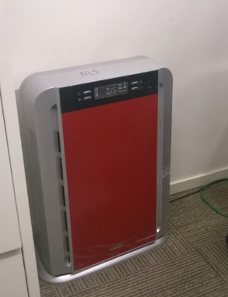

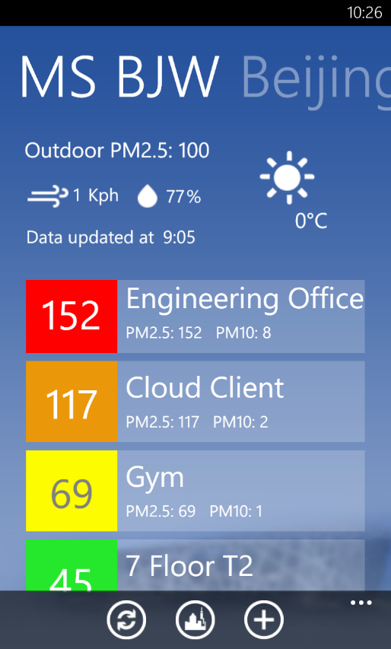

Client
Urban Air
Check air quality anytime
Inform people’s decision making
45
Notes:
These figures show the mobile client that allows people to check the air quality anytime.
In the most right figure, the numbers denote the locations where we deployed the monitors, and the color means the level of air quality.
You can add a venue into a watch list by clicking on the venue. And so on so forth.
After further clicking on a venue, we can see the air quality index of pm2.5 and pm10 in both outdoor and indoor environments.
How effective the HVAC system is working?
when to work out in a gym or whether turning on an additional air filter in her own office.
Download the app from windows phone app store by searching urban air.
Having the data over a long period, we can do more. For instance, predict the purification time.

Slide 7



Suggestion to HVAC
Purification Time (PT)
$${PT=t}_{1}−t_{0}$$
    1.5h
    0.5h
    6:30am
    7am
    8am
Notes:
To save energy in a building, an HVAC system is usually turned off (or partially turned down) during night and turned on in the morning shortly before people start working in the building.
After being turned on, an HVAC system needs a time period to reduce indoor PM2.5 under a safe situation.
Shown in this figure, the HVAC starts at t0, reducing the indoor PM2.5 under a safe level until t1. so, the purification time is t1-t0.
Suppose people arrive at office around 8am and an HVAC system is scheduled to be turned on at 7am. i.e. there is one hour buffer time to purify the indoor air quality.
If today is a good day, the purification time to reduce the indoor PM2.5 to under a safe level is half hour. Then, We do not need to anything.
if it is a pretty bad day, the purification time could be 1 and half hour. we need to turn on the HVAC system 30 minutes ahead of its original schedule.
Note that we do not change the way how an HVAC is functional? We just predict whether we should turn it on ahead of its original schedule and how long is ahead of the schedule.
This can provide a healthy working environment to employees while saving energy.

Slide 8
Depends on many factors
  Outdoor/indoor air quality
  Meteorological data
Notes:
Predicting PT is not a simple task, as it depends on multiple factors, such as,…
We did a simple study on the correlation between pt and these factors.
As shown in this figure, each column stands…

Slide 9
Suggestion to HVAC
Learn the purification time from historical data
  hourly outdoor air quality data
  Hourly meteorological data
Notes:
To be able to predict the purification time, we collect the outdoor air quality every hour from the air quality monitoring station that is the closest to the building.
Meteorological data from official website.
By mining the three databases, we can train a neuro network to predict the purification time.

Slide 10
Suggestion to HVAC
Predict the purification time based on ANN
Notes:
Continuous value. Non-linear relationship.
why
The system performs the PTI model every 10 minutes for each venue where we have deployed the monitor.
notifies a building’s operation team if the gap between the current time and people’s arrival time is close to the inferred PT.

Slide 11
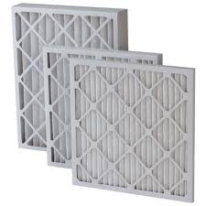
Suggestion to HVAC
Replace HVAC’s filter sheet
Gap between the inferred and real PTs
Notes:
Figure 7 shows the real and inferred PTs of a floor in Beijing campus from 1/10/2014 to 3/10/2014. There was a significant gap between the real and inferred PTs around 2/21/2014. An inspection on the floor’s HVAC found the filter sheets were very dirty and needed to be replaced. After the replacement, the gap is disappeared.

Slide 12
Evaluation
Data
  A real dataset of 150 workdays from 12/23/2013 to 5/9/2014 generated in Beijing campus
    Indoor air quality (every 10 minutes)
    Hourly outdoor air quality from a monitoring station
    Hourly meteorological data
Baseline
  Default: Historical longest time
  Average
  Linear Regression
  ANN: without considering the meteorological data
Data is publicly available

Slide 13
Evaluation
Results

Slide 14

Conclusion
Deployed a real system in 5 MS campuses
Cloud + Client system
  Inform people’s decision making
  Suggestion to the operation of HVAC systems
Data, models and mobile client are publicly available !
Yu Zheng
Microsoft Research
yuzheng@microsoft.com
Urban Air

