Slide 1
Mining Individual Life Pattern Based on Location History: A Paradigm and Framework
Yu Zheng @ Microsoft Research Asia
On behalf of Ye Yang
March 16, 2009

Slide 2
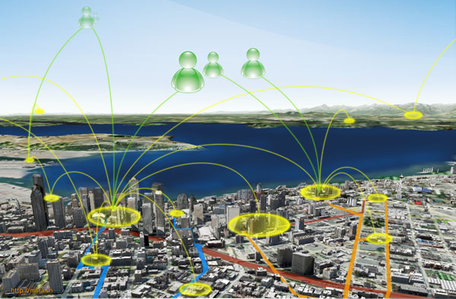
Background
GPS-enabled devices have become prevalent
These devices enable us to record our location history with GPS trajectories
Human location history is a big cake given the large number of GPS phones

Slide 3
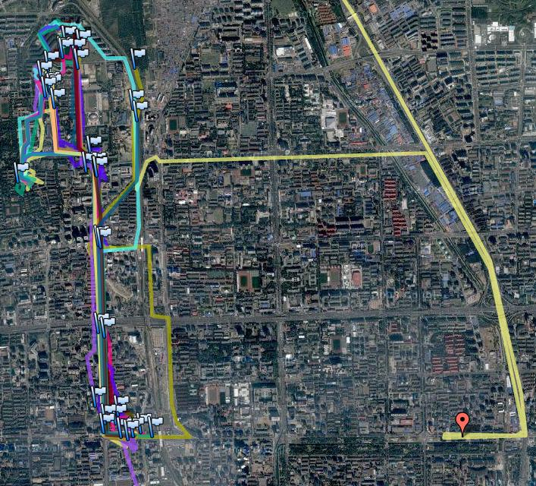
Motivation
Human location history
  does not only represent an individual’s life regularity
  but also imply the tastes/preferences of a person
University
Movie center
Super-market
Microsoft

Slide 4

Motivation
An individual’s life pattern
  can be used to model and predict a person’s behaviors/preferences
  and enable valuable applications
    context-aware computing
    personalized recommendation

Slide 5
Challenges
How to model an individual’s location history
Life Pattern could have multiple representation/definitions
  E.g., John typically leaves home at 8:30 am
  E.g., Matt usually goes to a cinema once a month
  E.g., Marry goes shopping after visiting a Starbucks
Different applications need different patterns
  Many mining algorithms
  Duplicated effort

Slide 6
What we do
Propose a model representing an individual’s location history
Define the paradigm of individual life patterns
Present a framework for mining individual life pattern

Slide 7
1: Modeling Location History
GPS logs P and GPS trajectory
Stay points S={s1, s2,…, sn}.
  Stands for a geo-region where a user has stayed for a while
  Carry a semantic meaning beyond a raw GPS point

Slide 8
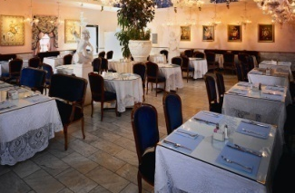
1: Modeling Location History
Location history:
  represented by a sequence of stay points
  with transition intervals
Day 1: S1→S2→S3→S4
Restaurant
C4
Day 2: S4→S5→S7→S7
S6
S9
S10
Day 3: S7→S8→S9→S10
S7
S8
S1
Day 1: C1→ C3 → C2 → C1
Home
S5
S2
S4
C3
Company
Day 2: C1 → C2 →C4→ C1
C1
C2
Day 3: C1 → C3 →C4→ C3
S3
Supermarket

Slide 9
1: Modeling Location History
A
B
Considering the scale of a location
C1
C2
C3
C4
S1
S4
S7
S5
S3
S2
S8
S10
S6
S9
Restaurant
A
C4
Day 1: C1→ C3 → C2 → C1
S6
S9
S10
Day 2: C1 → C2 →C4→ C1
S7
S8
Day 3: C1 → C3 →C4→ C3
S1
Home
S5
S2
C3
C1
S4
B
Company
Day 1: A→ B → A→ A
C2
S3
Day 2: A→ A →B→A
Supermarket
Day 3: A→ B→B→ B

Slide 10
1: Modeling Location History
Build a tree using a hierarchical clustering algorithm
Each node represents a cluster of stay points
Different levels denote different geospatial granularity
City 1
City i
City n
Community A
Community B
Supermarket
Home
Company
Restaurant

Slide 11
1: Modeling Location History
An individual’s location history can be represented by a sequence of stay point clusters with transition time between two clusters on different geospatial scales.
A
S6
S9
S10
Day 1: A→ B → A→ A
S7
S8
Day 2: A→ A →B→A
S1
Day 3: A→ B→B→ B
S2
S4
S5
B
S3
Restaurant
C4
S9
Day 1: C1→ C3 → C2 → C1
S6
Company
S10
Day 2: C1 → C2 →C4→ C1
S7
S8
Day 3: C1 → C3 →C4→ C3
S1
Home
S5
S2
S4
C3
Day 1: S1→S2→S3→S4
C1
Day 2: S4→S5→S7→S7
C2
S3
Supermarket
Day 3: S7→S8→S9→S10

Slide 12

2: The Paradigm of Life Pattern
Location dimension: City, Community, Restaurants
Time dimension: Year, Month, Week, Day

Slide 13
2: The Paradigm of Life Pattern
Atomic life pattern
E.g., Marry typically arrives at the “Starbucks” between 2 and 3 pm.
E.g., Marry typically stays in the “Starbucks” for 1 to 1.5 hours
E.g., Marry typically arrives at the “Starbucks” between 2 and 3 pm, and stays there for 1 to 1.5 hours
Non-sequential life pattern
E.g., Typically, Marry leaves home around 9 am.
E.g., Typically, Marry leaves around 9 am and comes back around 7 pm
Sequential life pattern
E.g., John usually goes to a Starbucks café after shopping in a Outlets (Outlets→ Starbucks)
E.g., John usually visits Outlets→ Starbucks→ restaurants

Slide 14
3: The Framework for Life Pattern Mining

Slide 15
3: The Framework for Life Pattern Mining
Mining Atomic life patterns
  A user need to specify
    the geo-region that interest them (location condition)
    the time span and/or temporal type they concern (Temporal condition)
    A suggested support value (S)
    E.g., show me my life patterns about Sigma building in the weekends of the last year
    E.g., show me my life patterns on Friday during 2008 in Beijing
  Algorithms like FP-growth, MAFIA, CHARM and Closet+ can be used here
  Possible results
    1. In the last year, you typically arrive at Sigma around 10~11 am, and stay 4-6 hours;
    you visited Sigma building every two weekends.
    ……
    2. In 2008, you went to Xidan once a month.
    you visit there in the evening.
    Typically, you spent 2-3 hours in Xidan;
    you went to a Movie center every three weeks.

Slide 16
3: The Framework for Life Pattern Mining
Mining non-conditioned life patterns based on atomic patterns
  Combine atomic patterns
  E.g., In the last year, you went to Xidan once a month; in most case, you visited there in the evening of weekend and spent 2-3 hours there.
  Mining sequential life patterns
    Algorithms like CloSpan, etc.
  E.g., In 2008, you typically travel to Xidan from Sigma building in the weekend.
  More specifically, you usually leave Sigam building around 7 pm and spent 30 to 50 minutes on the way.
  30-50min
  Sigma building ----------------> Xidan

Slide 17
3: The Framework for Life Pattern Mining
Mining conditional life patterns
One or two conditions would be more useful
E.g., typically, you will go to Zhongguanchun movie center if you leave Sigma building before 4 pm in weekends.
If you leave Sigma building after 7 pm in the weekends, you usually visit Xidan.
If stayed in Xidan more than 3 hours, you went to a Thai-food restaurant.

Slide 18
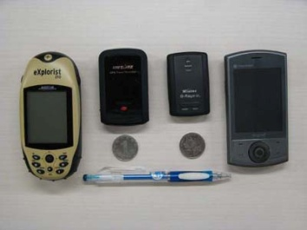
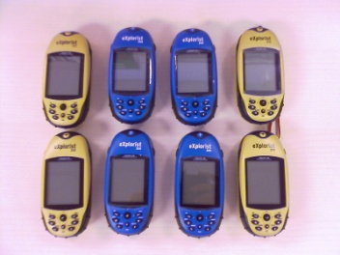
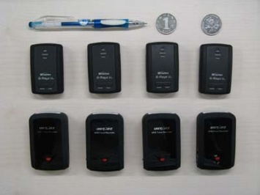
Experiements
60 Devices and 138 users
From May 2007 ~ present

Slide 19
Experiments
Select 10 volunteers out of the 138 users
Partition their location histories into two parts
Mine patterns separately
Investigate the predictability of the detected life patterns

Slide 20
Experiments
The predictability of life patterns

Slide 21
Experiment
A case study on non-conditioned patterns
  One-year GPS logs of each volunteer

Slide 22
Experiments
A case study on conditioned patterns
  Condition 1:not visiting the most frequent place;
  Condition 2: visiting the second frequent place;
  Condition 3: visiting the second frequent place while not visiting the most frequent place.

Slide 23
Conclusion
Propose a model representing an individual’s location history
Define the paradigm of individual life patterns
Present a framework for mining individual life pattern

Slide 24
Thanks!
yuzheng@microsoft.com

