Slide 1
Sensing the Pulse of Urban Refueling Behavior
Fuzheng Zhang, David Wilkie, Yu Zheng, Xing Xie
Microsoft Research Asia

Slide 2

Questions
How many liters of gas have been consumed in the past 1 hour in NYC?
Which gas station in 3 miles has the shortest queue?

Slide 3
Goal
Use GPS-equipped taxicabs as a sensor to capture both
  Waiting time at a gas station
  City-wide petrol consumption
Waiting time of taxis in a gas station
City-scale Gas consumption

Slide 4

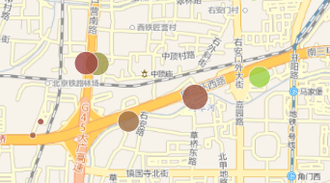
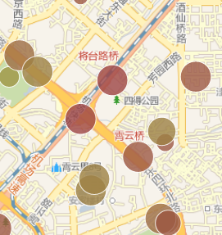
Motivation
Gas stations are owned by competing organizations
  Do not want to make data available to competitors
  There is a cost but no benefit for them
Benefits
  Gas station recommendation
  Support the planning and operation of gas stations
  Monitoring real-time city-scale energy consumption

Slide 5
Methodology Overview
Spatio-temporal clustering and classification
Tensor Decomposition
Queue theory
1. Refueling event detection in a gas station
2. Waiting time inference across different stations
3. Estimation number of vehicles in a station

Slide 6
Refueling Event Detection
Candidate Extraction
Filtering
  Train a classification model with human labeled data
  Spatial-Temporal features:
    Encompassment
    Gas Station Distance.
    Distance To Road.
    Minimum Bounding Box Ratio.
    Duration.
  POI features including:
    Neighbor Count.
    Distance To POI.

Slide 7
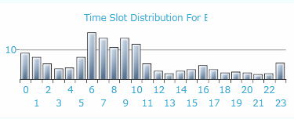
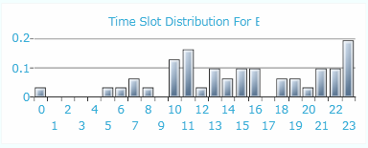
Expected Duration Learning
Infer the waiting time of each gas station
  Data sparsity problem
  Model the data as a tensor
  Tensor decomposition with contexts

Slide 8











Expected Duration Learning
Tensor decomposition
  Approximate a tensor with the multiplication of three (low-rank) matrices and a core tensor
  High order singular value decomposition (HOSVD)
  Find out the three attributes’ latent connections in subspaces through what we have already observe
Neglecting other context of a station!
$$F_{ijk}=S×_{H}H_{}×_{G}G_{}×_{D}D_{}≈S×_{H}H_{i∗}×_{G}G_{j∗}×_{D}D_{k∗}$$
$$H$$
$$H_{i∗}$$
$$G$$
$$D$$
$$S$$
$$D_{k∗}$$
$$D$$
$$G_{j∗}$$
$$F$$
$$H$$
$$G$$

Slide 9
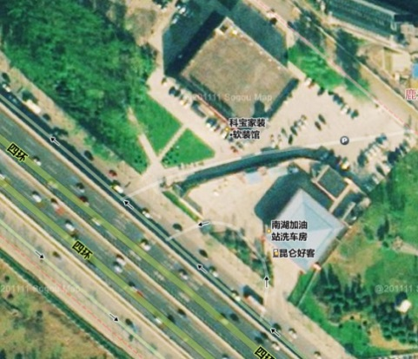
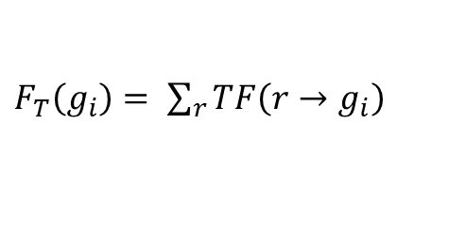
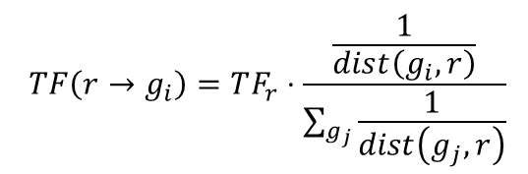

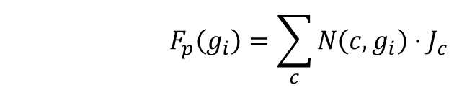

Expected Duration Learning
  Stations with similar contextual features tend to have a similar duration
The context of a station
  POI feature $F_{P}$
  Traffic feature $F_{T}$
  Area feature $F_{A}$
$${ F}_{p}\left(g_{i}\right)=\sum_{c}{N\left(c,g_{i}\right)⋅J_{c}}$$
$J_{c}=\frac{\#co_location\left(c,g\right)}{\#c}$
$F_{T}\left(g_{i}\right)= \sum_{r}{TF\left(r→g_{i}\right)}$
$$TF\left(r→g_{i}\right)=TF_{r}⋅\frac{\frac{1}{dist\left(g_{i},r\right)}}{\sum_{g_{j}}{\frac{1}{dist\left(g_{j},r\right)}}}$$

Slide 10



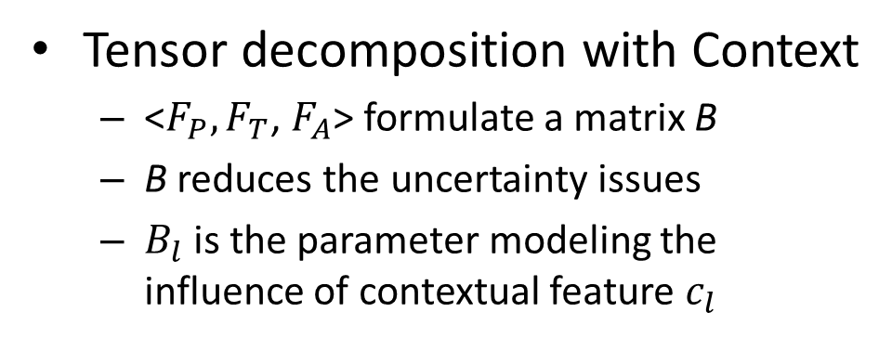
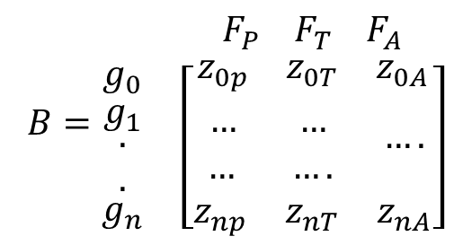
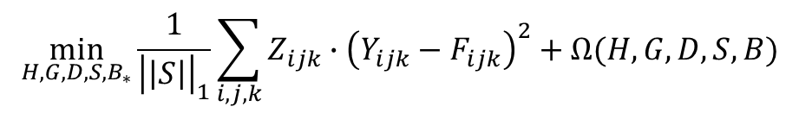


Expected Duration Learning
Tensor decomposition with Context
  <$F_{P}, F_{T}$, $F_{A}$> formulate a matrix B
  B reduces the uncertainty issues
  $B_{l}$is the parameter modeling the influence of contextual feature $c_{l}$
$$B=\begin{matrix} & F_{P}{ F}_{T}{ F}_{A} \\ \begin{matrix}g_{0} \\ \begin{matrix}g_{1} \\ \begin{aligned}. \\ .\end{aligned}\end{matrix} \\ g_{n}\end{matrix} & \left[\begin{aligned}\begin{matrix}z_{0p} & z_{0T} & z_{0A} \\ … & … & \end{matrix} \\ \begin{matrix}… & …. & \begin{aligned}…. \\ \end{aligned} \\ z_{np} & z_{nT} & z_{nA}\end{matrix}\end{aligned}\right]\end{matrix}$$
$$F_{ijk}=S×_{H}H_{i∗}×_{G}G_{j∗}×_{D}D_{k∗}+\sum_{l=1}^{L}{B_{l}}$$
$$D$$
$$\min_{H,G,D,S,B_{∗}}\frac{1}{{\left|\left|S\right|\right|}_{1}}\sum_{i,j,k}{Z_{ijk}∙{\left(Y_{ijk}−F_{ijk}\right)}^{2}}+Ω(H,G,D,S,B)$$
$$H$$
$$F$$
$$G$$
$Ω\left(H,G,D,S,B\right)=\frac{1}{2}λ×({\left|\left|H\right|\right|}_{F}^{2}+{\left|\left|G\right|\right|}_{F}^{2}+{\left|\left|D\right|\right|}_{F}^{2}+{\left|\left|S\right|\right|}_{F}^{2}+{\left|\left|B\right|\right|}_{F}^{2})$
L. Baltrunas, B. Ludwig, and F. Ricci, “Matrix Factorization Techniques for Context Aware,” pp. 301–304.

Slide 11

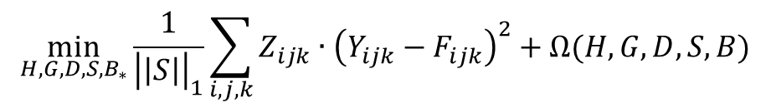

Expected Duration Learning
  Tensor decomposition with contexts
    An item’s contextual features are often modeled in collaborative filtering to help reduce uncertainty issues
    Context features: <$F_{P}, F_{T}$, $F_{A}$>
    $B_{l}$is the parameter modeling the influence of contextual feature $c_{l}$
$$F_{ijk}=S×_{H}H_{i∗}×_{G}G_{j∗}×_{D}D_{k∗}+\sum_{l=1}^{L}{B_{l}}$$
$$D$$
$$\min_{H,G,D,S,B_{∗}}\frac{1}{{\left|\left|S\right|\right|}_{1}}\sum_{i,j,k}{Z_{ijk}∙{\left(Y_{ijk}−F_{ijk}\right)}^{2}}+Ω(H,G,D,S,B)$$
$$H$$
$$F$$
$$G$$
$Ω\left(H,G,D,S,B\right)=\frac{1}{2}λ×({\left|\left|H\right|\right|}_{Frob}^{2}+{\left|\left|G\right|\right|}_{Frob}^{2}+{\left|\left|D\right|\right|}_{Frob}^{2}+{\left|\left|S\right|\right|}_{Frob}^{2}+{\left|\left|B\right|\right|}_{Frob}^{2})$
L. Baltrunas, B. Ludwig, and F. Ricci, “Matrix Factorization Techniques for Context Aware,” pp. 301–304.
Notes:
where $Z∈{\left\{0,1\right\}}^{h×g×d}$ is a binary tensor with nonzero entries $Z_{ijk}$ whenever $Y_{ijk}$ is observed

Slide 12
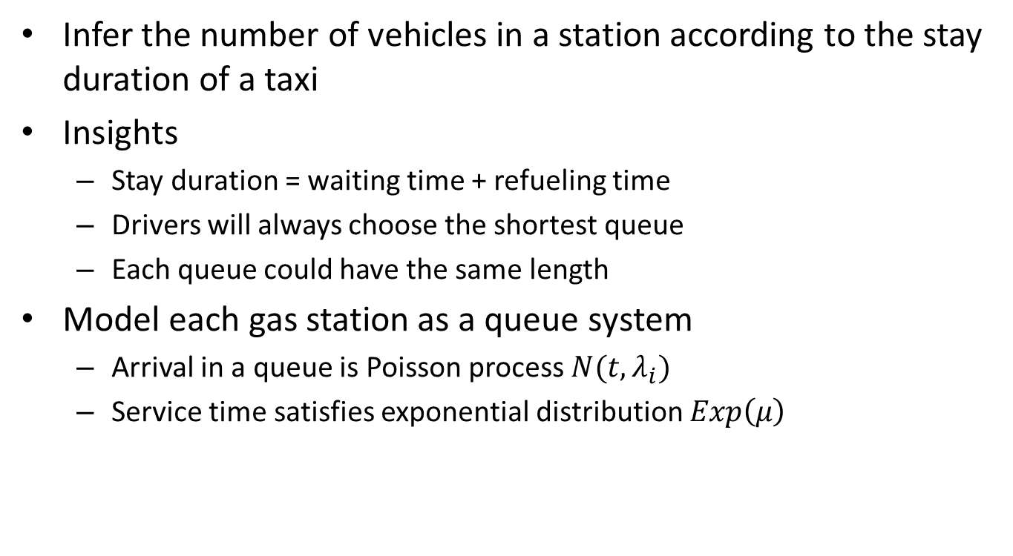
Arrival Rate Calculation
  Infer the number of vehicles in a station according to the stay duration of a taxi
Insights
  Stay duration = waiting time + refueling time
  Drivers will always choose the shortest queue
  Each queue could have the same length
Model each gas station as a queue system
  Arrival in a queue is Poisson process $N(t,λ_{i})$
  Service time satisfies exponential distribution $Exp\left(μ\right)$

Slide 13
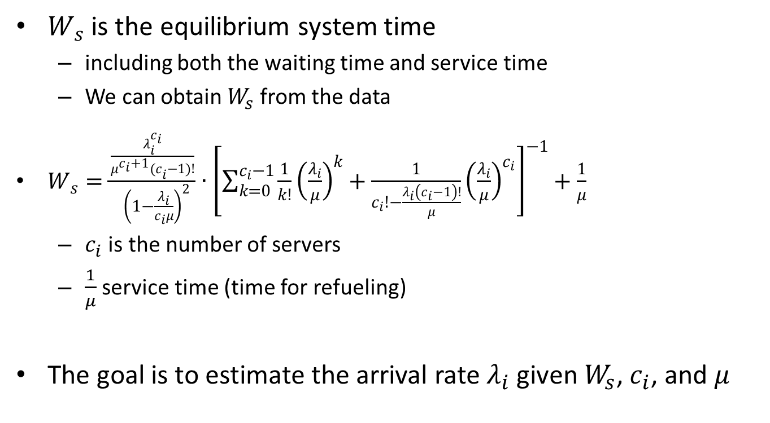
Arrival Rate Calculation
$W_{s}$ is the equilibrium system time
  including both the waiting time and service time
  We can obtain $W_{s}$ from the data
$W_{s}=\frac{\frac{λ_{i}^{c_{i}}}{{μ^{c_{i}+1}(c}_{i}−1)!}}{ {\left(1−\frac{λ_{i}}{c_{i}μ}\right)}^{2}}∙{\left[\sum_{k=0}^{c_{i}−1}{\frac{1}{k!}{\left(\frac{λ_{i}}{μ}\right)}^{k}}+\frac{1}{c_{i}!−\frac{λ_{i}\left(c_{i}−1\right)!}{μ}}{\left(\frac{λ_{i}}{μ}\right)}^{c_{i}}\right]}^{−1}+\frac{1}{μ}$
  $c_{i}$ is the number of servers
  $\frac{1}{μ}$ service time (time for refueling)
The goal is to estimate the arrival rate $λ_{i}$ given $W_{s}$, $c_{i}$, and $μ$

Slide 14
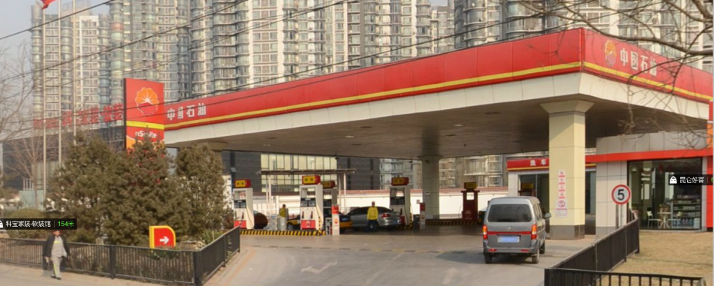
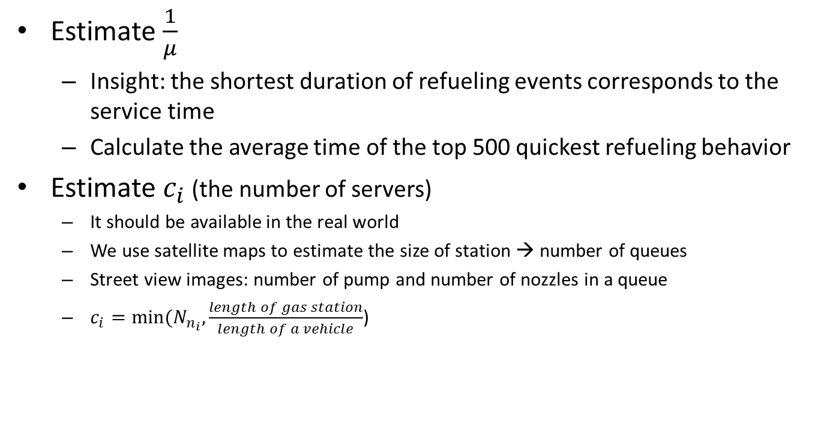
Arrival Rate Calculation
Estimate $\frac{1}{μ}$
  Insight: the shortest duration of refueling events corresponds to the service time
  Calculate the average time of the top 500 quickest refueling behavior
Estimate $c_{i}$ (the number of servers)
  It should be available in the real world
  We use satellite maps to estimate the size of station → number of queues
  Street view images: number of pump and number of nozzles in a queue
  $c_{i}=min⁡(N_{n_{i}},\frac{length of gas station}{length of a vehicle}$)

Slide 15
Evaluation
Raw Trajectories | Total Taxi Count | 32476
 | Duration | 54 day
 | Ave Distance By Day | 226.76 km
 | Ave Sampling Interval | 1.02 minute
Detected REs | Total Count | 638,645
 | Average Temporal Interval | 1.84 day
 | Average Distance Interval | 378.61 km
 | Average Duration | 10.53 minute
 | Minimal Duration | 3.74 minute
 | Maximal Duration | 42.72 minute

Slide 16
Evaluation
Manually labeled datasets
  DS1: 250 real refueling events (200 for training and 50 for testing)
  DS2: 2,000 candidates with noisy (True/False)
In the field study
  DS3:
    Two real users: GPS trajectories + Credit card transactions in gas station
    33 records in total
  DS4:
    Sent students to two stations to observe the queues
    Oct.17 to Nov.15 in 2012, 5:00pm to 6:00pm.

Slide 17
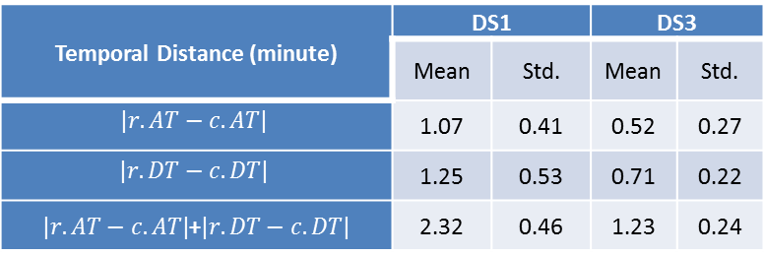
Results
Refueling event detection
  Candidate detection
  Filtering
Temporal Distance (minute) | DS1 |  | DS3
 | Mean | Std. | Mean | Std.
$$|r.AT−c.AT|$$ | 1.07 | 0.41 | 0.52 | 0.27
$$|r.DT−c.DT|$$ | 1.25 | 0.53 | 0.71 | 0.22
$|r.AT−c.AT|$+$|r.DT−c.DT|$ | 2.32 | 0.46 | 1.23 | 0.24
 | Features | Precision | Recall
DS2 | Non-Filtering | 0.464 | 1.0
 | Spatial | 0.623 | 0.73
 | Spatial+Temporal | 0.891 | 0.862
 | Spatial+Temporal+POIs | 0.915 | 0.907
DS3 | Non-Filtering | 0.825 | 1.0
 | Spatial | 0.875 | 0.848
 | Spatial+Temporal | 0.941 | 0.969
 | Spatial+Temporal+POIs | 0.941 | 0.969

Slide 18
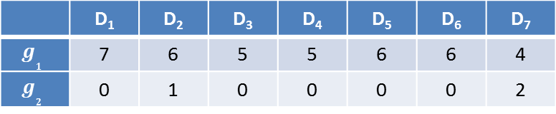
Evaluation
Expected Duration Learning
  Refueling events detected using our method
 | D₁ | D₂ | D₃ | D₄ | D₅ | D₆ | D₇
$$g_{1}$$ | 7 | 6 | 5 | 5 | 6 | 6 | 4
$$g_{2}$$ | 0 | 1 | 0 | 0 | 0 | 0 | 2

Slide 19
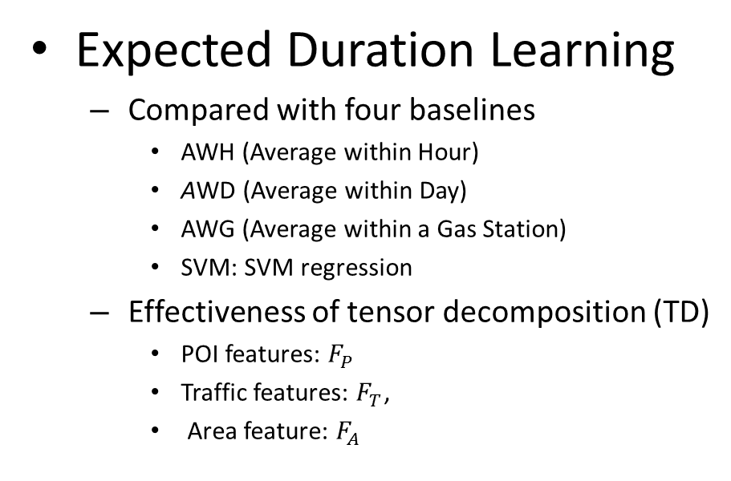
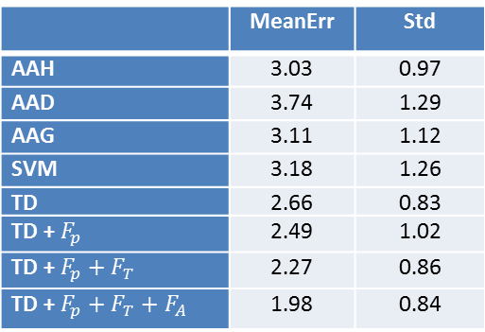
Evaluation
Expected Duration Learning
  Compared with four baselines
    AWH (Average within Hour)
    AWD (Average within Day)
    AWG (Average within a Gas Station)
    SVM: SVM regression
  Effectiveness of tensor decomposition (TD)
    POI features: $F_{P}$
    Traffic features: $F_{T}$,
    Area feature: $F_{A}$
 | MeanErr | Std
AAH | 3.03 | 0.97
AAD | 3.74 | 1.29
AAG | 3.11 | 1.12
SVM | 3.18 | 1.26
TD | 2.66 | 0.83
TD + $F_{p}$ | 2.49 | 1.02
TD + $F_{p}+F_{T}$ | 2.27 | 0.86
TD + $F_{p}+F_{T}+F_{A}$ | 1.98 | 0.84

Slide 20
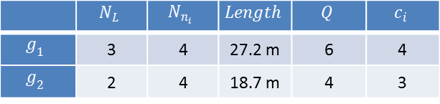
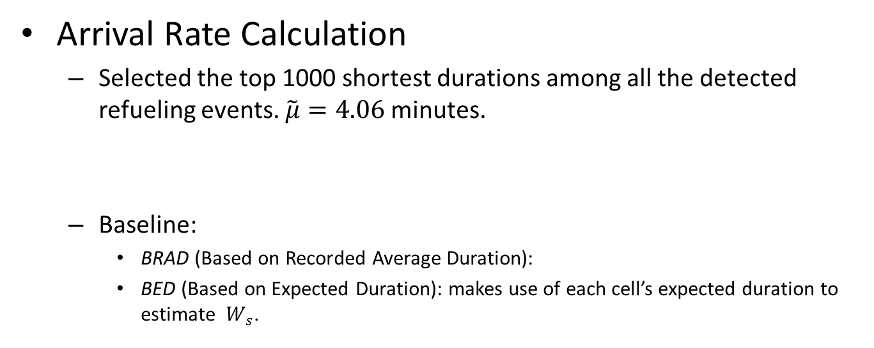

Evaluation
Arrival Rate Calculation
  Selected the top 1000 shortest durations among all the detected refueling events. $\tilde{μ}=4.06$ minutes.
  Baseline:
    BRAD (Based on Recorded Average Duration):
    BED (Based on Expected Duration): makes use of each cell’s expected duration to estimate $W_{s}$.
 | $$N_{L}$$ | $$N_{n_{i}}$$ | $$Length$$ | $$Q$$ | $$c_{i}$$
$$g_{1}$$ | 3 | 4 | 27.2 m | 6 | 4
$$g_{2}$$ | 2 | 4 | 18.7 m | 4 | 3
(a) $g_{1}$ (b) $g_{2}$

Slide 21
Visualization
Geographic View (689 gas stations)

Slide 22
Visualization
Temporal View
(a) Taxis’ time spent (b) taxis’ visits
(c) Urban’s time spent (d) Urban’s visits

Slide 23
Conclusion
From waiting time to energy consumption
Test with Beijing data
Discoveries can help understand urban gas consumption and improve energy infrastructures

Slide 24
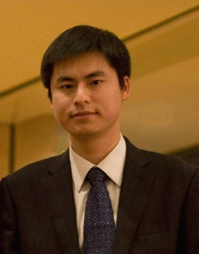
Thanks!
Yu Zheng
yuzheng@microsoft.com
Homepage

