Slide 1
Transaction Processing on Confidential Data using Cipherbase
Arvind Arasu, Ken Eguro, Manas Joglekar*
Raghav Kaushik, Donald Kossmann, Ravi Ramamurthy
Microsoft Research
Stanford University*
Notes:
Good morning: I am Arvind, and I will be talking about a system called Cipherbase that a bunch of us listed here built at Microsoft research.
Cipherbase is a database system designed for data confidentiality using encryption and today I will be talking about the overall system design, and specific optimizations related to transaction processing.

Slide 2
Cloud Data Security Concerns
Data in the cloud vulnerable to:
Snooping administrators
Hackers with illegal access
Compromised servers
Notes:
Motivation for data confidentiality: arises from data security concerns in the cloud
As a customer, I don’t control the people who manage the cloud
How do I know that some rogue admin is not snooping and selling my sensitive data
How do I know that cloud servers are not compromised allowing some hacker to run away with my data

Slide 3
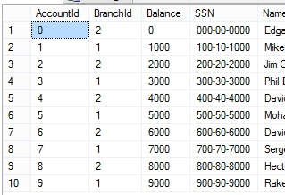
Database Encryption
Client App
Notes:
As a cloud provider, one way of addressing these concerns is through encryption
Cloud provider can then say – your data encrypted, encryption is key is not accessible to admins, so there is no way for them to get to your data.
This is the motivation for encryption,
Let us understand: What does it mean for database system to support encryption:
General idea: data remains encrypted at all times
For contrast: this is what the current world looks like:
Plaintext database, queries with constants exposed, plaintext results

Slide 4
Database Encryption
Client App
Notes:
Database: stored encrypted
Queries constants: encrypted
Results: encrypted
Data remains encrypted at all parts of the qp stack

Slide 5
Cipherbase Summary
Data Confidentiality:
Strong column-level encryption
Decoupled from functionality
*Lightweight “trusted module” in secure hardware
Functionality:
Industrial Strength Database system (SQL Server)
Concurrency, Recovery, Stored Procedures.
Performance on TPCC
85% of plaintext for typical encryption
40% of plaintext for “worst case” encryption
No prior work with this {Confidentiality, Functionality, Performance}
characteristics
Notes:
This is the takeaway slide:
As I mentioned earlier, we have built a system called Cipherbase that comes very close to providing this functionality and security
We can encrypt the data using the strongest encryption schemes crypto community has designed
Small fineprint which I will talk about shortly
Otherwise, it is like any other database system
In fact, Cipherbase is modified SQL Server - full functionality of an industrial strength database system, including concurrency, recovery, and stored procedures
Performance overhead acceptable – 100 xacts, we can do 85 on typical encryption settings
No prior work comes close to matching our S,F,P characteristics (or even two of the three)
I hope to convince you that fundamental systems work is required to achieve this

Slide 6
Organization
Introduction
Solution Landscape & Design Choices
Cipherbase Design & Engineering
Evaluation
Notes:
Organization for the rest of the talk:
I will start by discussing the spectrum of solution approaches and where we fall in the spectrum
Then present Cipherbase details and finally evaluation of our system

Slide 7
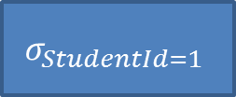
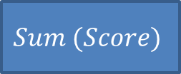
What Makes Encryption Challenging?
$$Sum (Score)$$
Select Sum (Score)
From Assignment
Where StudentId = 1
$$σ_{StudentId=1}$$
Assignment
a7be1a6997ad739bd8c9ca451f618b61
b6ff744ed2c2c9bf6c590cbf0469bf41
47f7f7bc95353e03f96c32bcfd8058df
Notes:
What makes encryption challenging?
Encryption “hides” data, so traditional query processing does not work in an obvious way
I don’t know which records have student id 1, if their scores are encrypted, I don’t know how to add them ..

Slide 8
Solution Landscape
Two fundamental techniques
Directly compute over encrypted data
Special homomorphic encryption schemes
Challenge: limited class of computations
Use a “secure” location
Computations on plaintext
Challenge: Expensive
Notes:
There are two fundamental techniques we can use to address this challenge
1. First technique relies on crypto magic

Slide 9
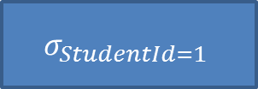
Deterministic Encryption
select *
from assignment
where studentid = 1
$$σ_{StudentId=1}$$
StudentId | AssignId | Score
1 | 1 | 68
1 | 2 | 71
3 | 4 | 99
… | … | …
Notes:
Simplest “homomorphic encryption” scheme is deterministic encryption.
A value every time it is encrypted deterministically produces the same ciphertext

Slide 10
Deterministic Encryption
select *
from assignment
where studentid_det = bd6e7c3df2b5779e0b61216e8b10b689
$$σ_{StudentId_det=bd6…}$$
StudentId_DET | AssignId | Score
bd6e7c3df2b5779e0b61216e8b10b689 | 1 | 68
bd6e7c3df2b5779e0b61216e8b10b689 | 2 | 71
7ad5fda789ef4e272bca100b3d9ff59f | 4 | 99
… | … | …
Notes:
Here, 1 is encrypted the same way, allowing for this query rewrite

Slide 11
Homomorphic Encryption Schemes
Impractical
Fully Homomorphic Encryption
(Any function)
[G09, G10]
Partial Homomorphic Encryption
Order-Preserving Encryption
$$(≤)$$
[BCN11, PLZ13]
Paillier Cryptosystem
$$(+)$$
ElGamal Cryptosystem
$$(×)$$
Partial Homomorphic Encryption (PHE)
[E84]
[P99]
Deterministic Encryption
$$(==)$$
Expensive
Non-Deterministic Encryption
$$(∅)$$
Practical
Notes:
There are several homomorphic encryption schemes

Slide 12
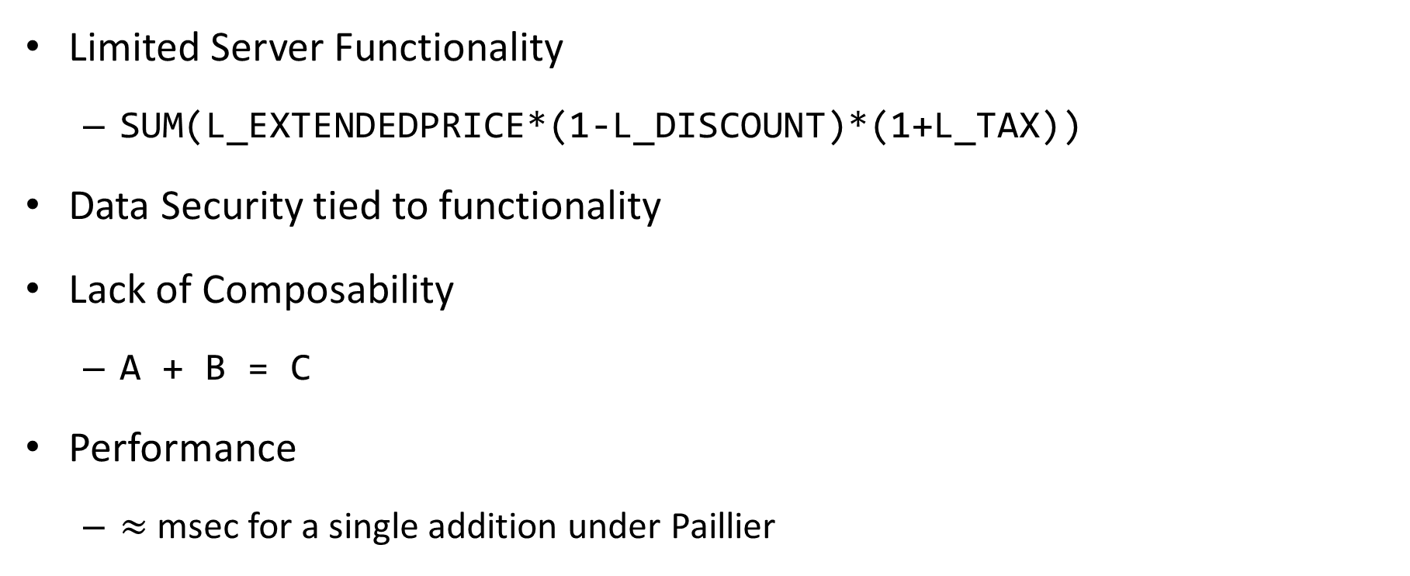
PHE Limitations
Limited Server Functionality
SUM(L_EXTENDEDPRICE*(1-L_DISCOUNT)*(1+L_TAX))
Data Security tied to functionality
Lack of Composability
A + B = C
Performance
$≈$msec for a single addition under Paillier
CryptDB [PRZ+11], Monomi [TFM 13], [HMH08]
Notes:
A whole bunch of systems that either rely solely on PHE, or partially on PHE.
They all inherit have the above limitations:
1. They have limited server functionality because current encryption schemes
2. If there is some chance I need to equality on a column I need to keep it deterministically encrypted –
3. I cant compose – encryption scheme that works for addition does not work for equality
4.

Slide 13
Solution Landscape
Two fundamental techniques
Directly compute over encrypted data
Special homomorphic encryption schemes
Challenge: limited class of computations
Challenge: Not composable
Use a “secure” location
Hardware provisioned isolation and protection
Computations on plaintext
Challenge: Expensive
Notes:
We, and a few other related work, has focused on a second approach that does not rely on cryptography, but instead on hardware provisioned isolation

Slide 14
Secure Location
Inaccessible
Notes:
Vision: cloud servers would provisioned with special purpose “secure” hardware
Secure Hardware would be inaccessible to the adversary, so we keep the key there and do computations in plaintext as long as we are within it
Slight relaxation of our original goal

Slide 15
Secure Hardware Landscape
Long history
Banking, Defense Applications
Becoming mainstream and commoditized
Players:
Crypto co-processors
FPGAs
Intel SGX
TPM, HSM
Notes:
While there has been a long history of using hardware to solve security problems –
All your laptops, e.g., come with TPM chips that can be used for disk encryption
Important factoid: becoming mainstream and commoditized

Slide 16
Intel Software Guard Extensions
Extensions to Intel Architecture
Isolation to code + data within a designated region called enclave
Confidentiality
Integrity
Virtual Addr Space
Enclave
Physical Memory
code/data
Encrypted & Integrity Protected
Ack: Andrew Baumann
[MAB+ 13, AGJ+ 13, HLP+ 13]
Notes:
Example of secure h/w becoming mainstream: Intel SGX
Particular mode that will become available on a commodity intel chip that will allow secure execution

Slide 17
Design Choice: Trusted Functionality
Larger Trusted Computing Base (TCB)
Smaller TCB
DBMS
DBMS
OS
DBMS
OS
OS
DBMS
Library OS
Embedded OS
Expr Eval
Commodity h/w
Secure h/w
Commodity h/w
Secure h/w
Commodity h/w
Secure h/w
Haven [MPH14]
TrustedDB [BS11]
Cipherbase
Notes:
Secure h/w raises an interesting design question: “What is the functionality that runs on secure hardware?”
At one extreme: Put the entire database inside the secure hardware
Other extreme: Put the smallest amount of functionality required to operate on encrypted data on secure hardware
Hybrid designs in between
Design choice exposes high-level tradeoffs:
Code that runs in the secure hardware – trusted computing base.
If there are bugs in this code – this module could be compromised and we will be back to square one
Security: it is important to keep this simple
Software engineering

Slide 18
Design Choice: Trusted Functionality
Less secure
More secure
DBMS
DBMS
OS
DBMS
OS
OS
DBMS
Library OS
Embedded OS
Expr Eval
Commodity h/w
Secure h/w
Commodity h/w
Secure h/w
Commodity h/w
Secure h/w
Haven [MPH14]
TrustedDB [BS11]
Cipherbase

Slide 19
Design Choice: Trusted Functionality
Minimal software engg.
DBMS
DBMS
OS
DBMS
OS
OS
DBMS
Library OS
Embedded OS
Expr Eval
Commodity h/w
Secure h/w
Commodity h/w
Secure h/w
Commodity h/w
Secure h/w
Haven [MPH14]
TrustedDB [BS11]
Cipherbase
Notes:
Other tradeoffs as well
Jury is still out which is the best design

Slide 20
Organization
Introduction
Solution Landscape & Design Choices
Cipherbase Design & Engineering
Evaluation

Slide 21
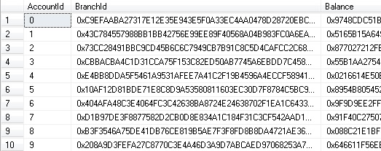
Life of a Query in Cipherbase I
Cipherbase Server
Insecure (x86)
FPGA
App
PCIe
Stack Machine (Expression Evaluation)
Cipherbase Client Lib
Modified SQL Server
(stateless*)
Encryption
Config
5
push $1
decrypt
push 10
add
encrypt
out
AccountId: Plaintext
BranchId: AES-CBC
Balance: AES-CBC
…
Notes:
Points to note:
Secure hardware: FPGA connected through PCIe,
Most functionality implemented on insecure x86 servers
Column-level encryption
Encrypted data sits in untrusted part
Encryption transparent to the app
Interacts through the library which hides all encryption details
FPGA designed as a stack machine to evaluate expressions
Knowns nothing about database processing
Example query: client generates a program that takes one encrypted parameter, adds 10, and returns the encrypted result
Rewrites the query to reference this program
Most of the query processing – indexing, locking, buffering, happen on untrusted machine using regular sql server code

Slide 22
Life of a Query in Cipherbase II
Cipherbase Server
Insecure (x86)
FPGA
App
PCIe
Stack Machine (Expression Evaluation)
Cipherbase Client Lib
Modified SQL Server
Encryption
Config
PK:
AccountId: AES-CBC
BranchId: AES-CBC
Balance: AES-CBC
…
Notes:
Previous example, we made our life easier by keeping the primary key column which had an index in plaintext
What if we want to encrypt it?
Cipherbase supports indexes over encrypted columns

Slide 23
B+-Tree Indexes over Encrypted Data
6
…
…
0A183E
…
…
…
0
1
2
3
4
5
6
7
8
9
FC46B0
…
4F3618
…
20B9D4
…
AC2DB0
4F3618
…
0A183E
C9B7F9
6C2AB4
1DA6B5
BF48BC
DF60B9
0A183E
C9B7F9
1DA6B5
Notes:
How does an index over encrypted column look:
Pretty much like any other b+ index on binary values
Except that keys appear random and not sorted
This is because the sort ordering is based on the plaintext values
If we were to magically decrypt the encrypted values, the B=tree would look like this

Slide 24
B+-Tree Indexes over Encrypted Data
…
…
0A183E
…
…
…
FC46B0
…
4F3618
…
20B9D4
…
AC2DB0
4F3618
…
0A183E
C9B7F9
6C2AB4
1DA6B5
BF48BC
DF60B9
0A183E
C9B7F9
1DA6B5
Notes:
Of course, the encryption key is not in the untrusted system,
So adversary sees only random values

Slide 25
Life of a Query in Cipherbase II
Cipherbase Server
Insecure (x86)
FPGA
App
PCIe
Stack Machine (Expression Evaluation)
Cipherbase Client Lib
Modified SQL Server
Encryption
Config
6
push $1
decr
push $2
decr
compare
out
PK:
AccountId: AES-CBC
BranchId: AES-CBC
Balance: AES-CBC
…
Notes:
To see how the index is used, consider the same query
Now we need another program in FPGA – comparing two encrypted values
Original query is rewritten as follows:
Note: encryption is non-deterministic
FPGA has a program to compare two encrypted values

Slide 26
B+-Tree Indexes over Encrypted Data
Search key:
8DE526
FPGA
…
…
comp(8DE526,0A183E)
0A183E
…
…
…
<
FC46B0
…
4F3618
…
20B9D4
…
AC2DB0
4F3618
…
0A183E
C9B7F9
6C2AB4
1DA6B5
BF48BC
DF60B9
0A183E
C9B7F9
1DA6B5
Notes:
Binary search as before, except that all comparisons for the binary search go through the FPGA

Slide 27
B+-Tree Indexes over Encrypted Data
Search key:
8DE526
FPGA
…
…
comp(8DE526,0A183E)
0A183E
…
…
…
<
FC46B0
…
4F3618
…
20B9D4
…
AC2DB0
4F3618
…
0A183E
C9B7F9
6C2AB4
1DA6B5
BF48BC
DF60B9
0A183E
C9B7F9
1DA6B5
Notes:
Example comparison and the page traversal induced by its result

Slide 28
Life of a Query in Cipherbase II
Cipherbase Server
Insecure (x86)
FPGA
App
PCIe
Stack Machine (Expression Evaluation)
Cipherbase Client Lib
Modified SQL Server
Encryption
Config
PK:
AccountId: AES-CBC
BranchId: AES-CBC
Balance: AES-CBC
…
Notes:
Wrap up:

Slide 29
Operational Security
Operation | Adversary Learns
$σ_{A=5}$(R) | Unknown predicate p(A) over R tuples
$R ⋈_{A}S$ (hash-based) | The join graph and the equivalence relation over R(A) and S(A) for joining A values
$$π_{A+B}(R)$$ | Nothing
$${Groupby}_{A}^{SUM(B)} (R)$$ | The equivalence relation over R(A)
Data Security depends on the operations performed
Notes:
One subtlety: FPGA programs invoked – their input and output – adversary can learn something
Characterize data security: operational – meaning the final security that you get is a function of the operations that you perform
Is this good, bad, acceptable?
Requires a really strong adversary
At any rate: stronger or comparable to prior systems

Slide 30
Transaction Processing Performance Challenges
Life of a transaction
TPCC New Order:
1M instrs
parsing, compilation, buffering, latching, locking, commit, …
x86
FPGA
$≈$ 10 instrs x 300
Expression evaluation
Time/progress
$≈μ$sec
Notes:
Naïve TPCC New Order: 300 roundtrips, each few micro-seconds. Kill performance

Slide 31
Summary of Performance Optimizations
Multiple FPGA cores
Parallelism
More FPGA compute
Batch FPGA work
Amortize communication latency
Core 1
Plaintext Data Cache
Cipherbase Client Lib
Modified SQL Server
Core 2
Core 3
Core 4
Expression folding
Minimize FPGA roundtrips
Plaintext Data Caches
Minimize network comm.
Reduce decryption
Vectorize index comparisons
Minimize FPGA roundtrips

Slide 32
Organization
Introduction
Solution Landscape & Design Choices
Cipherbase Design & Engineering
Evaluation

Slide 33
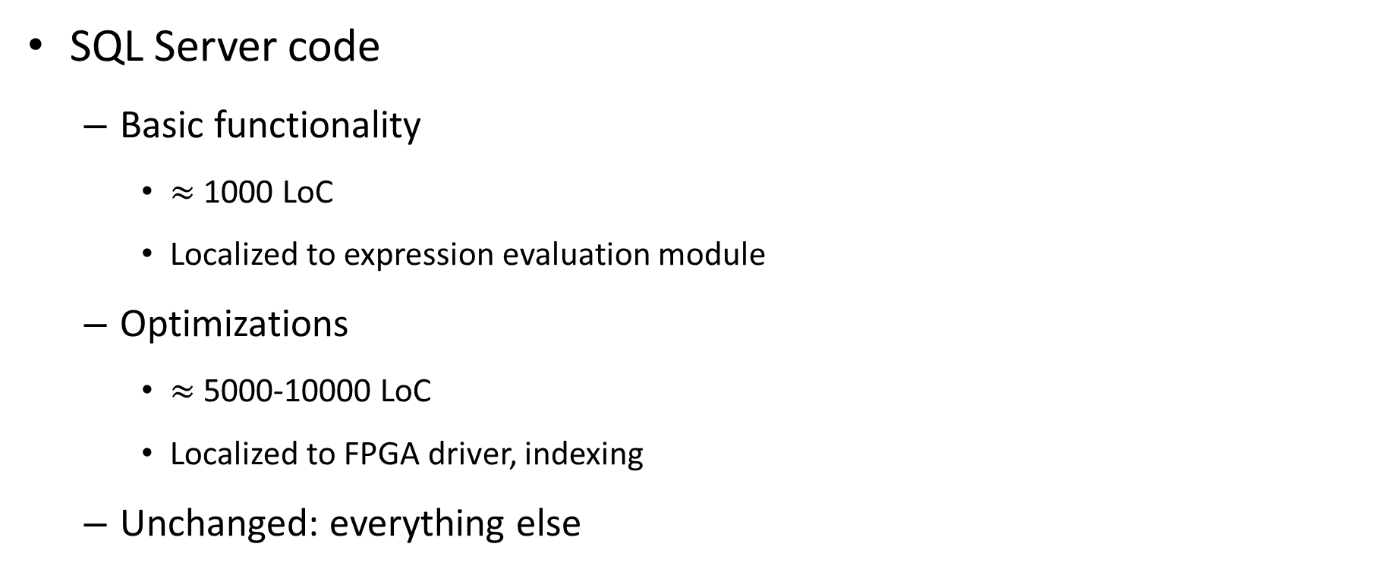
Cipherbase Prototype
SQL Server code
Basic functionality
$≈$ 1000 LoC
Localized to expression evaluation module
Optimizations
$≈$5000-10000 LoC
Localized to FPGA driver, indexing
Unchanged: everything else

Slide 34
Performance on TPCC
Encryption schemes:
Customer: Customer PII data strongly encrypted
Strong/Weak: Index columns deterministic, all others strongly encrypted
Strong/Strong: All columns strongly encrypted
Transactions per sec (relative to SQL Server)
Increasing strength of encryption

Slide 35
Cipherbase Summary
Security:
Strong encryption
Decoupled from functionality
Functionality:
Industrial Strength Database system (SQL Server)
Transaction Processing
Performance on TPCC
85% of plaintext for typical encryption
40% of plaintext for “worst case” encryption
Lightweight “trusted module” in secure hardware
Notes:
Summary of this talk: we have built a system called Cipherbase that …

Slide 36
http://research.microsoft.com/en-us/projects/cipherbase/

