Slide 1
e-Infrastructures for Research and Education:
in the context of the European Capacities Programme
(*) Presentation at the PhD student event, Cambridge 30 June 2009.
Carlos Morais Pires
European Commission - DG INFSO
GÉANT and e-Infrastructures
“The views expressed in this presentation are those of the author and do not necessarily reflect the views of the European Commission”
Notes:
1

Slide 2
Science and ICT
Scientific advances more important than ever
  Global challenges with high societal impact
  Innovation and economic development
Adoption of ICT changes the scientific discovery process
  Computing, simulation and data
  Tackling the very small, the very big and the very complex
  Cost efficiency
  Open, cross-border and cross-discipline collaboration
e-Science
computational science
theoretical
experimental
empirical
e-Infrastructures changing Science, Science changing e-infrastructures
Notes:
2

Slide 3
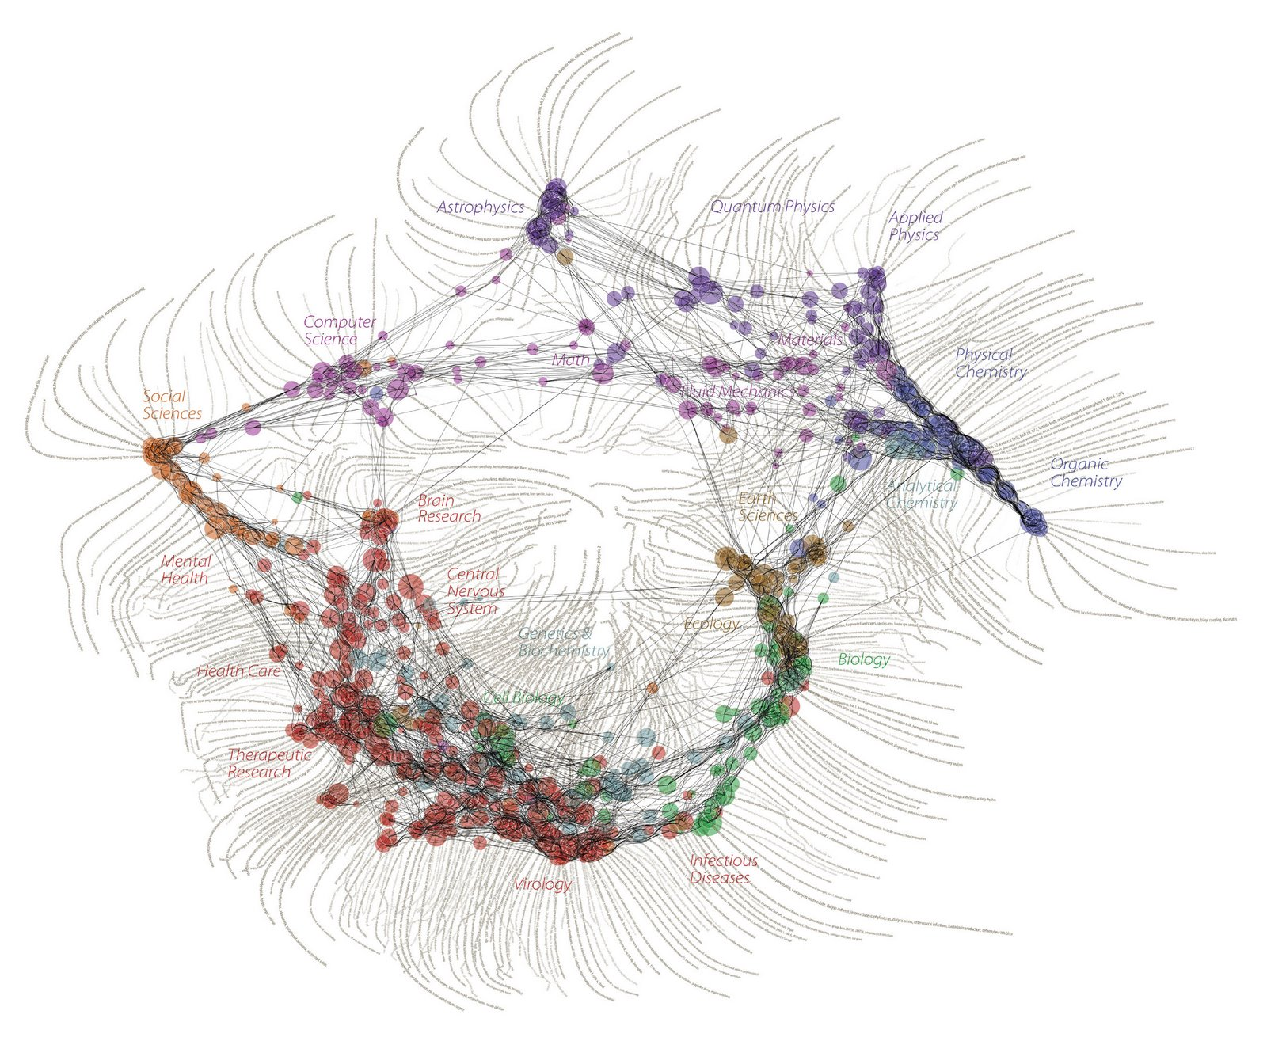
The ‘map of science’
Journal Nature (Dec 2006): This map was constructed by sorting roughly 800,000 published papers into 776 different scientific paradigms (shown as pale circular nodes) based on how often the papers were cited together by authors of other papers. […]

Slide 4





What can we do for Science…
To facilitate a rapid transition to e-Science, the European Commission and Member States have made significant investments in e-Infrastructures…
Innovating the scientific process:
global virtual research communities
Accessing knowledge:
scientific data
Experimenting in silico:
Simulation and visualisation
Sharing the best computational resources:
E-Science grid and high performance computing
Linking the ideas at the speed of the light:
GÉANT
Notes:
4

Slide 5

e-Infrastructures supporting
Global Virtual research Communities
Data/Visualisation
e-Science
Workspace
e-Science
Workspace
e-Science
Workspace
Database
Database
Computer/Simulation
Laboratory
Laboratory
Library
Library
Computer
Computer
Efficiency
Gains
Economies
of Scale
Networking
Networking
Networking/Connectivity
Notes:
5

Slide 6









Examples of projects
IMPACT
METAFOR
EuroVO-AIDA
GENESI-DR
DRIVER
neuGRID
EUFORIA
D4SCIENCE
ETSF
EGEE
DEISA
network computing data
FEDERICA
EVALSO
GÉANT
generic e-Infrastructure… user communities involvement

Slide 7
Budget Overview
(FP7: 2007 -3013)
JRC
Euratom
Cooperation
1751 M€
4062 M€
32413 M€
Capacities
4097 M€
People
4750 M€
Ideas
7510 M€
Research Infrastructures
Dev. of policies
42% - 1715 M€
INCO
e-Infrastructures
(ICT for Science)
572 M€
Science
in Society
SMEs
Regions of Knowledge
Research Potential

Slide 8
Planned Call
Publication: 30/07/2009 / Deadline: 24/11/2009
DRAFT
€10M
biology
Social Sciences
climatology
astronomy
geosciences
physics
fusion
environment
spectroscopy
medical
ICT
…
€23M
Virtual
Research
Communities
Support actions
€12M
User Communities
Data layer
DCI €50M
PRACE €20M
Simulation software & services layer
Computing layer: Distributed Computing & PRACE
Network layer

Slide 9
INFRASTRUCTURES-2010-1.2.1
Distributed Computing Infrastructure
1.2.1.1– European Grid Initiative (EGI)
Set up organisation for sustainable grid services provision including user support & SW/middleware repository maintenance, operation & certification; Plan and prepare future service evolution of grids; Stakeholders: National Grid Initiatives (NGIs); possibly other entities; Seamless progressive transition to new EGI scheme is required
1.2.1.2 – Service deployment
Services for user communities that are heavy users of DCIs and have multi-national dimension (activities expected to be articulated with EGI)
1.2.1.3 – Middleware and repositories
Further develop quality middleware; Create SW-component repositories to complement middleware-services; maintenance to be ensured later by EGI
1.2.1.4 – Access to DCI platforms
Easier access to DCIs through science gateways for computing and data service; support workflows combining capacity & capability computing and access to data & networks
1.2.1.5 – Extension of DCI platforms
Extend existing DCIs to incorporate remote operation of scientific instruments (e.g. in context of ESFRI roadmap projects)
Notes:
9

Slide 10
INFRASTRUCTURES-2010-1.2.2
Simulation software & services
General objectives:
Multi-disciplinary and multi-scale "in silico" experimentation and simulation, ensuring the ability to fully and timely exploit high- performance and distributed computing capabilities
Integrating scientific application software in the European e-Infrastructure
More specifically:
Development, adaptation and maintenance of scientific software on dynamically evolving hardware platforms
Deployment of a computational science infrastructure through models, tools, algorithms and simulation and visualisation techniques
Notes:
10

Slide 11
INFRASTRUCTURES-2010-1.2.3
Virtual Research Communities
General objectives:
Enable users from all disciplines to access, share and use e-Infrastructures
Remove constraints of distance, access and usability
Remove barriers between disciplines for a more effective scientific collaboration and innovation
More specifically:
Deployment of e-Infrastructures in research communities to enable multi- disciplinary collaboration
Build user-configured virtual research facilities and test-beds from collection of diverse resources
Standards for scalability, evolution and interoperation of sw components
Notes:
11

Slide 12
INFRASTRUCTURES-2010-2.3.1
First implementation phase of HPC service
(PRACE)
General objective:
Deploy new ecosystem of computational resources to address the needs of advanced science & engineering; build on PRACE and integrate DEISA resources and services
More specifically:
set up & operation of a new organisational structure
development, adaptation and maintenance of SW
technology and system evaluations to ensure deployment of leading edge technology
mechanisms for industry involvement as partners (users, vendors, providers)
training and sharing of best practices
Notes:
12

Slide 13
INFRASTRUCTURES-2010-3.3
Support to policy development and programme implementation
Objectives
Specific studies on e-Infrastructure related topics
Enhance coordination between national and pan-European e-Infrastructure initiatives and programmes
Strengthen the innovation potential and impact of e-Infrastructures
Establish a new scientific software strategy to reinforce the global position of Europe in scientific software development, deployment and use
Coordinate a European eco-system of scientific data repositories for preservation and sharing of scientific information
Dissemination of e-Infrastructure programme and projects
International cooperation, including:
  e-Infrastructures and International Cooperation Partner countries (ICPC)
  interoperation between similar infrastructures on the global scale
Notes:
13

Slide 14
WP2010 (e-Infastructures)
Publication: 30/07/2009 / Deadline: 24/11/2009
Call for proposals: FP7-INFRASTRUCTURES-2010-2
Support to existing research infrastructures
INFRASTRUCTURES-2010-1.2.1 Distributed Computing Infrastructure | 50 M€
INFRASTRUCTURES-2010-1.2.2 Simulation softwares & services | 12 M€
INFRASTRUCTURES-2010-1.2.3 Virtual Research Communities | 23 M€
Support to new research infrastructures
INFRASTRUCTURES-2010-2.3.1 Construction of new infrastructures (PRACE first phase) | 20 M€
INFRASTRUCTURES-2010-3.3 Support to policy development and programme implementation | 10 M€
Notes:
14

Slide 15
Last thoughts…
Developing world-class e-Infrastructures is necessary for Europe to become a hub of excellence in e-Science
Multi-disciplinary approaches, new participative paradigms and global research communities are an essential part of the European strategy… but organisational, governance and financing models need reconsideration, informed by sociological and cultural considerations
Upcoming 7th Call of Research Infrastructures programme to provide support to the e-Science transition
Notes:
15

