Slide 1
Internships uncovered
Peter Key
MSR Cambridge

Slide 2
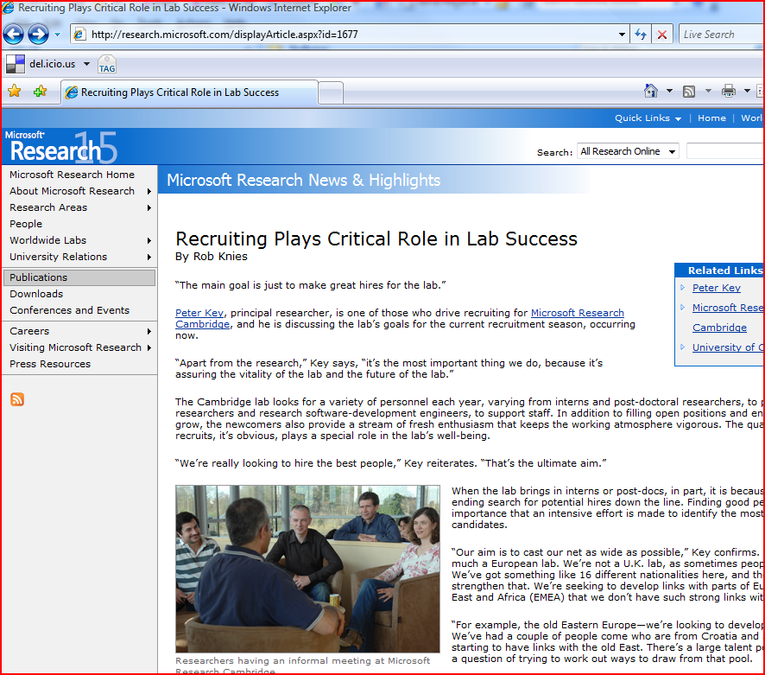

Slide 3
Why and who?
Apart from Research, recruiting is the most important thing we do!
  Vitality
  The future ....
Who?
  The best people
  Researchers (Scientists), RSDEs, SDEs, Support staff
  Post-docs, Interns

Slide 4
Where?
Into the all the 5 main research areas
  Computer-Mediated Living
  Machine Learning and Perception
    & Online Services and Advertising
  Programming, Principles, and Tools
    & security
  Systems and Networking
    & Constraint Reasoning
  Computational Science

Slide 5
What/Why?
Ideally mid-PhD
Given the same responsibilities as a full-time researcher
Work on real projects with research content
Encourage to publish – ideal outcome is a paper or equivalent
Work-alongside a Researcher, who acts as a Mentor
Symbiosis!
Some of our most successful interns now Researchers

Slide 6
Basics info
All year round
  But most in the summer
  Summer applicants decided in February March
On-line application
  https://research.microsoft.com/apps/tools/jobs/intern.aspx
Typically 12 weeks
We pay!
  Salary
  Free Gym membership, bike rental, discounted MS s/w and h/w
  Unlimited sugar, caffeine and water ....
  Travel costs
It’s competitive (supply >> demand (accommodation)

Slide 7
Last year (FY09)
104 interns
  More than 50% from EMEA or EMEA institutions
  The peak is in the summer (end-feb application deadline)

Slide 8
“Microsoft provided everything I needed to work effectively, and as a result, I accomplished more than I ever thought I could in a period of 3 months”
Mike Massimi , Intern 2007, Microsoft Research Cambridge

Slide 9
Examples ...

Slide 10
In Programming Languages area
On the Glasgow Haskell Compiler (with Simon P–J & Simon Marlowe)
  [2008] Jost Berthold worked on parallel evaluation
  [2007] Dan Licata implemented view patterns
  [2007] Peng Li worked on a new concurrency substrate for GHC
  [2007] Michael Adams worked on refactoring the code generator, and [2008] John Dias took the same ideas much further.
  [2007] Bernie Pope implemented the GHCi debugger
  [2006] Kevin Donnelly changed GHC's intermediateDimitrios Vitytonis worked on type inference for impredicative polymorphism
  Krasimir Angelov completed and released Visual Haskell
  Roshan James wrote a parallel garbage collector

Slide 11
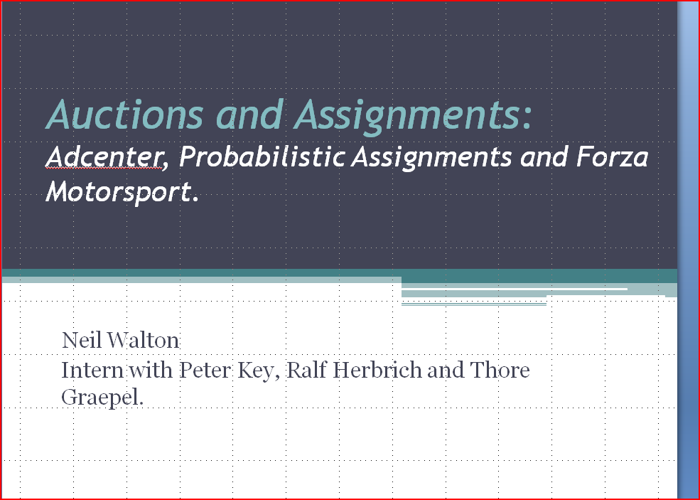
In S&N /OSA

Slide 12
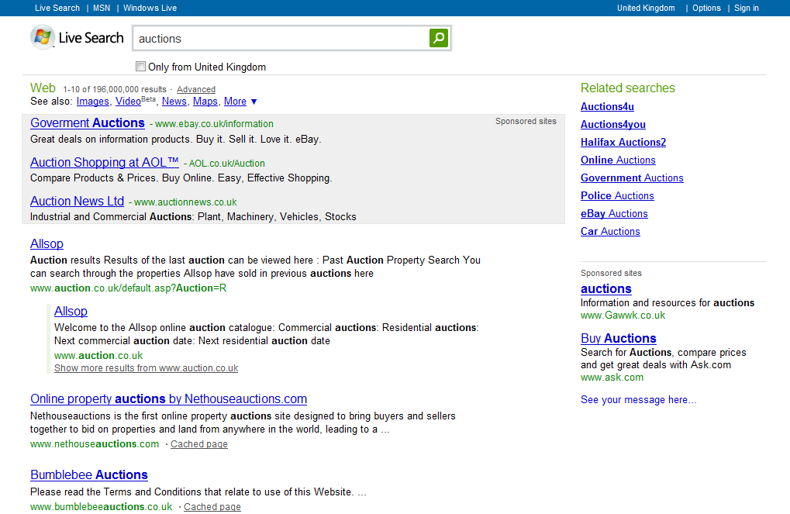
Live Search Auctions

Slide 13
How an AdAuction Works.
Advertisers bid for keywords.
is bid of Advertiser i
We assume,

Slide 14
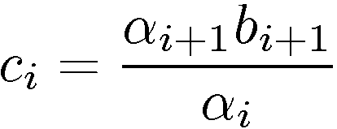
How an AdAuction Works. (ctd.)
Advertisers are ordered,
Advertiser i is charged the minimum bid required to be positioned in i, that is
This auction is called a (weighted) generalized second price auction.

Slide 15
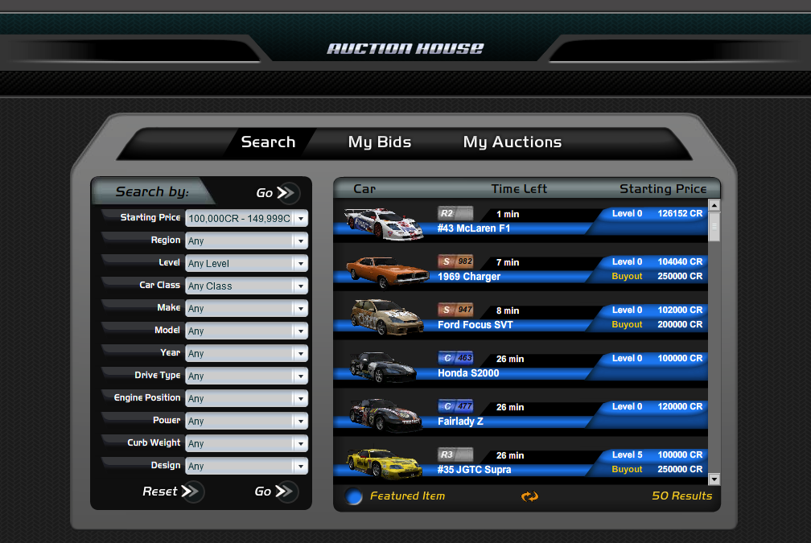
Microsoft Forza Auctions
Neil Walton, Ralf Herbrich, Thore Graepel, Peter Key
Applied Games Group, Microsoft Research Ltd.

Slide 16
What are the Auctions?
Users get money for winning races.
They can buy and sell cars in `Auction House’.
Auctions highest bid wins i.e. English Auction.
Sellers can set a reserve price and a buyout price.
O(10⁵) users

Slide 17
Average Auction Price
People do not have enough money to pay for auctions.
People have money to pay for auctions. Auction price close to buyout
People get rich and sell expensive, most likely modified cars.

Slide 18
Success of Transactions
The large proportion of unsuccessful auctions suggests that there are more users wanting to sell cars than users wanting to buy cars.

Slide 19
A Table of Averages
 | Successful Transaction |  |  | Unsuccessful Transaction
 | Buyout | Auction
 | Buyout set | Buyout set | No Buyout set | Buyout set | No Buyout set
Percentage of Auctions | 25% | 9% | 8% | 42% | 16%
Percentage of wealth | 63% | 4% | 33%
Average Price | .75 | .12 | 1.2
Buyouts transactions being most popular account for the most money spent.
But successful auctions win more money.

Slide 20
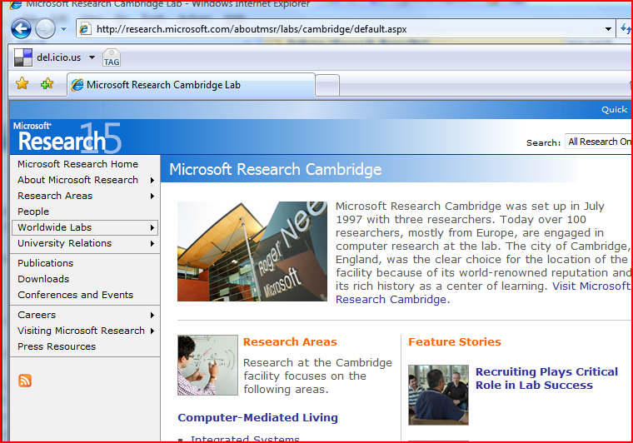
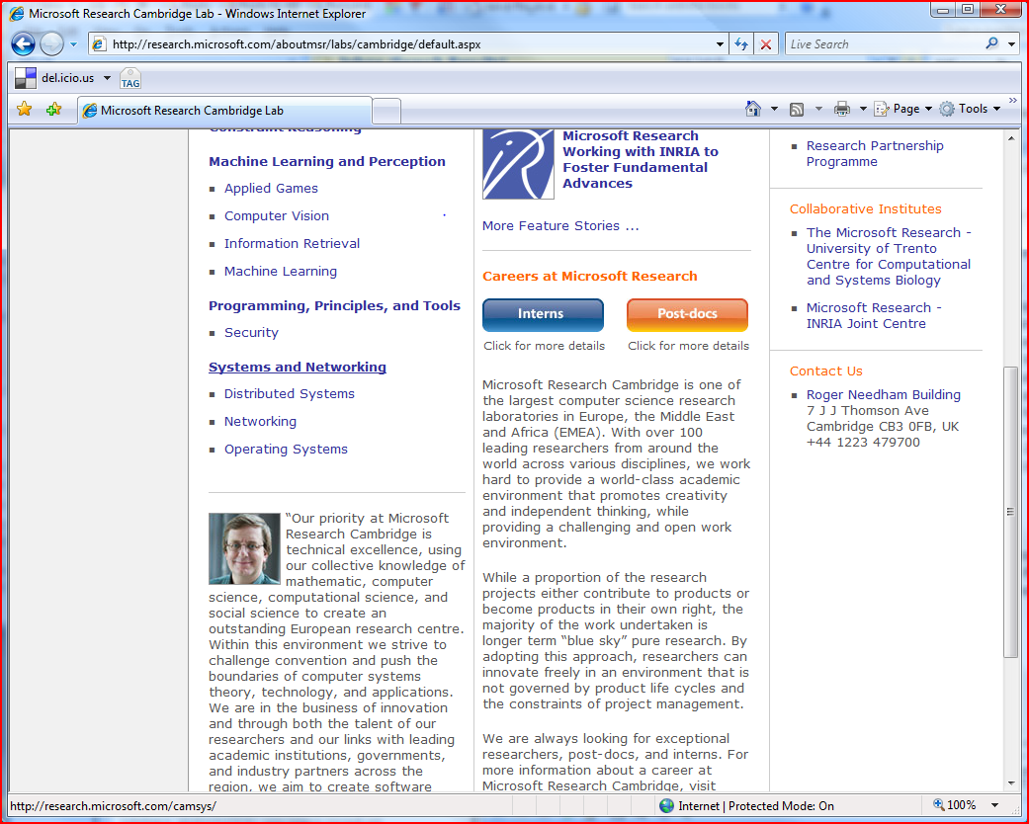
Some links
http://research.microsoft.com/aboutmsr/labs/cambridge/default.aspx
http://research.microsoft.com/displayArticle.aspx?id=1677

Slide 21
Questions?

