Slide 1
How to give a great research talk
Simon Peyton Jones
Microsoft Research, Cambridge
1993 paper joint with
John Hughes (Chalmers),
John Launchbury (Galois)

Slide 2
Giving a good talk
This presentation is about how to give a good research talk
What your talk is for
What to put in it (and what not to)
How to present it

Slide 3
Why you should listen to this talk
Because many research talks are poor...
...and quite simple things can make your talks much better
Because everyone benefits from good talks
  Your audience benefits from your hard-won insights
  You benefit from their informed feedback
Because a research talk gives you access to the world’s most priceless commodity: the time and attention of other people. Don’t waste it!

Slide 4
The purpose of your talk…
The purpose of your talk is not:
To impress your audience with your brainpower
To tell them everything you know about your topic
To present all the technical details

Slide 5
The purpose of your talk…
The purpose of your talk is:
To give your audience an intuitive feel for your idea
To make them foam at the mouth with eagerness to read your paper
To engage, excite, provoke them
To make them glad they came

Slide 6
Your audience…
The audience you would like
Have read all your earlier papers
Thoroughly understand all the relevant theory of cartesian closed endomorphic bifunctors
Are all agog to hear about the latest developments in your work
Are fresh, alert, and ready for action

Slide 7
Your actual audience…
The audience you get
Have never heard of you
Have heard of bifunctors, but wish they hadn’t
Have just had lunch and are ready for a doze
Your mission is to
WAKE THEM UP
And make them glad they did

Slide 8
What to put in

Slide 9
What to put in
Motivation (20%)
Your key idea (80%)
There is no 3

Slide 10
Motivation
You have 2 minutes
to engage your audience before they start to doze
They are thinking...
Why should I tune into this talk?
What is the problem?
Why is it an interesting problem?
Does this talk describe a worthwhile advance?

Slide 11
Motivation
You have 2 mins to answer these questions. Don’t waste those 2 mins.
Example: Java class files are large (brief figures), and get sent over the network. Can we use language-aware compression to shrink them? Yes, and I’m going to show you how we can do 50% better than the best generic zipping technology
Example: Synchronisation errors in concurrent programs are a nightmare to find. I’m going to show you a type system that finds many such errors at compile time.

Slide 12
Your key idea
If the audience remembers only one thing from your talk, what should it be?
You must identify a key idea. “What I did this summer” is No Good.
Be specific. Don’t leave your audience to figure it out for themselves.
Be absolutely specific. Say “If you remember nothing else, remember this.”
Organise your talk around this specific goal. Ruthlessly prune material that is irrelevant to this goal.

Slide 13
Narrow, deep beats wide, shallow
No
Yes
Avoid shallow overviews at all costs
Cut to the chase: the technical “meat”
It’s ok to cover only part of your paper

Slide 14
Your main weapon
Examples are your main weapon
To motivate the work
To convey the basic intuition
To illustrate The Idea in action
To show extreme cases
To highlight shortcomings
When time is short, omit the general case,
not the example

Slide 15
Exceptions in Haskell?
Exceptions are to do with control flow
There is no control flow in a lazy functional program
Solution 1: use data values to carry exceptions
data Maybe a = Nothing
| Just a
lookup :: Name -> Dictionary -> Maybe Address
Often this is Just The Right Thing
[Spivey 1990, Wadler “list of successes”]

Slide 16
What to leave out

Slide 17
Outline of my talk
Background
The FLUGOL system
Shortcomings of FLUGOL
Overview of synthetic epimorphisms
π-reducible decidability of the pseudo-curried fragment under the Snezkovwski invariant in FLUGOL
Benchmark results
Related work
Conclusions and further work

Slide 18
No outline!
“Outline of my talk”: conveys near zero information at the start of your talk
Worse, since your audience only gives you 2 minutes before dozing, you’ve just lost them
  But maybe put up an outline for orientation after your motivation
  …and signposts at pause points during the talk

Slide 19
Related work
[PMW83] The seminal paper
[SPZ88] First use of epimorphisms
[PN93] Application of epimorphisms to wibblification
[BXX98] Lacks full abstraction
[XXB99] Only runs on Sparc, no integration with GUI

Slide 20
Do not present related work
But
You absolutely must know the related work; respond readily to questions
Acknowledge co-authors (title slide), and pre-cursors (as you go along)
Praise the opposition
  “X’s very interesting work does Y; I have extended it to do Z”

Slide 21
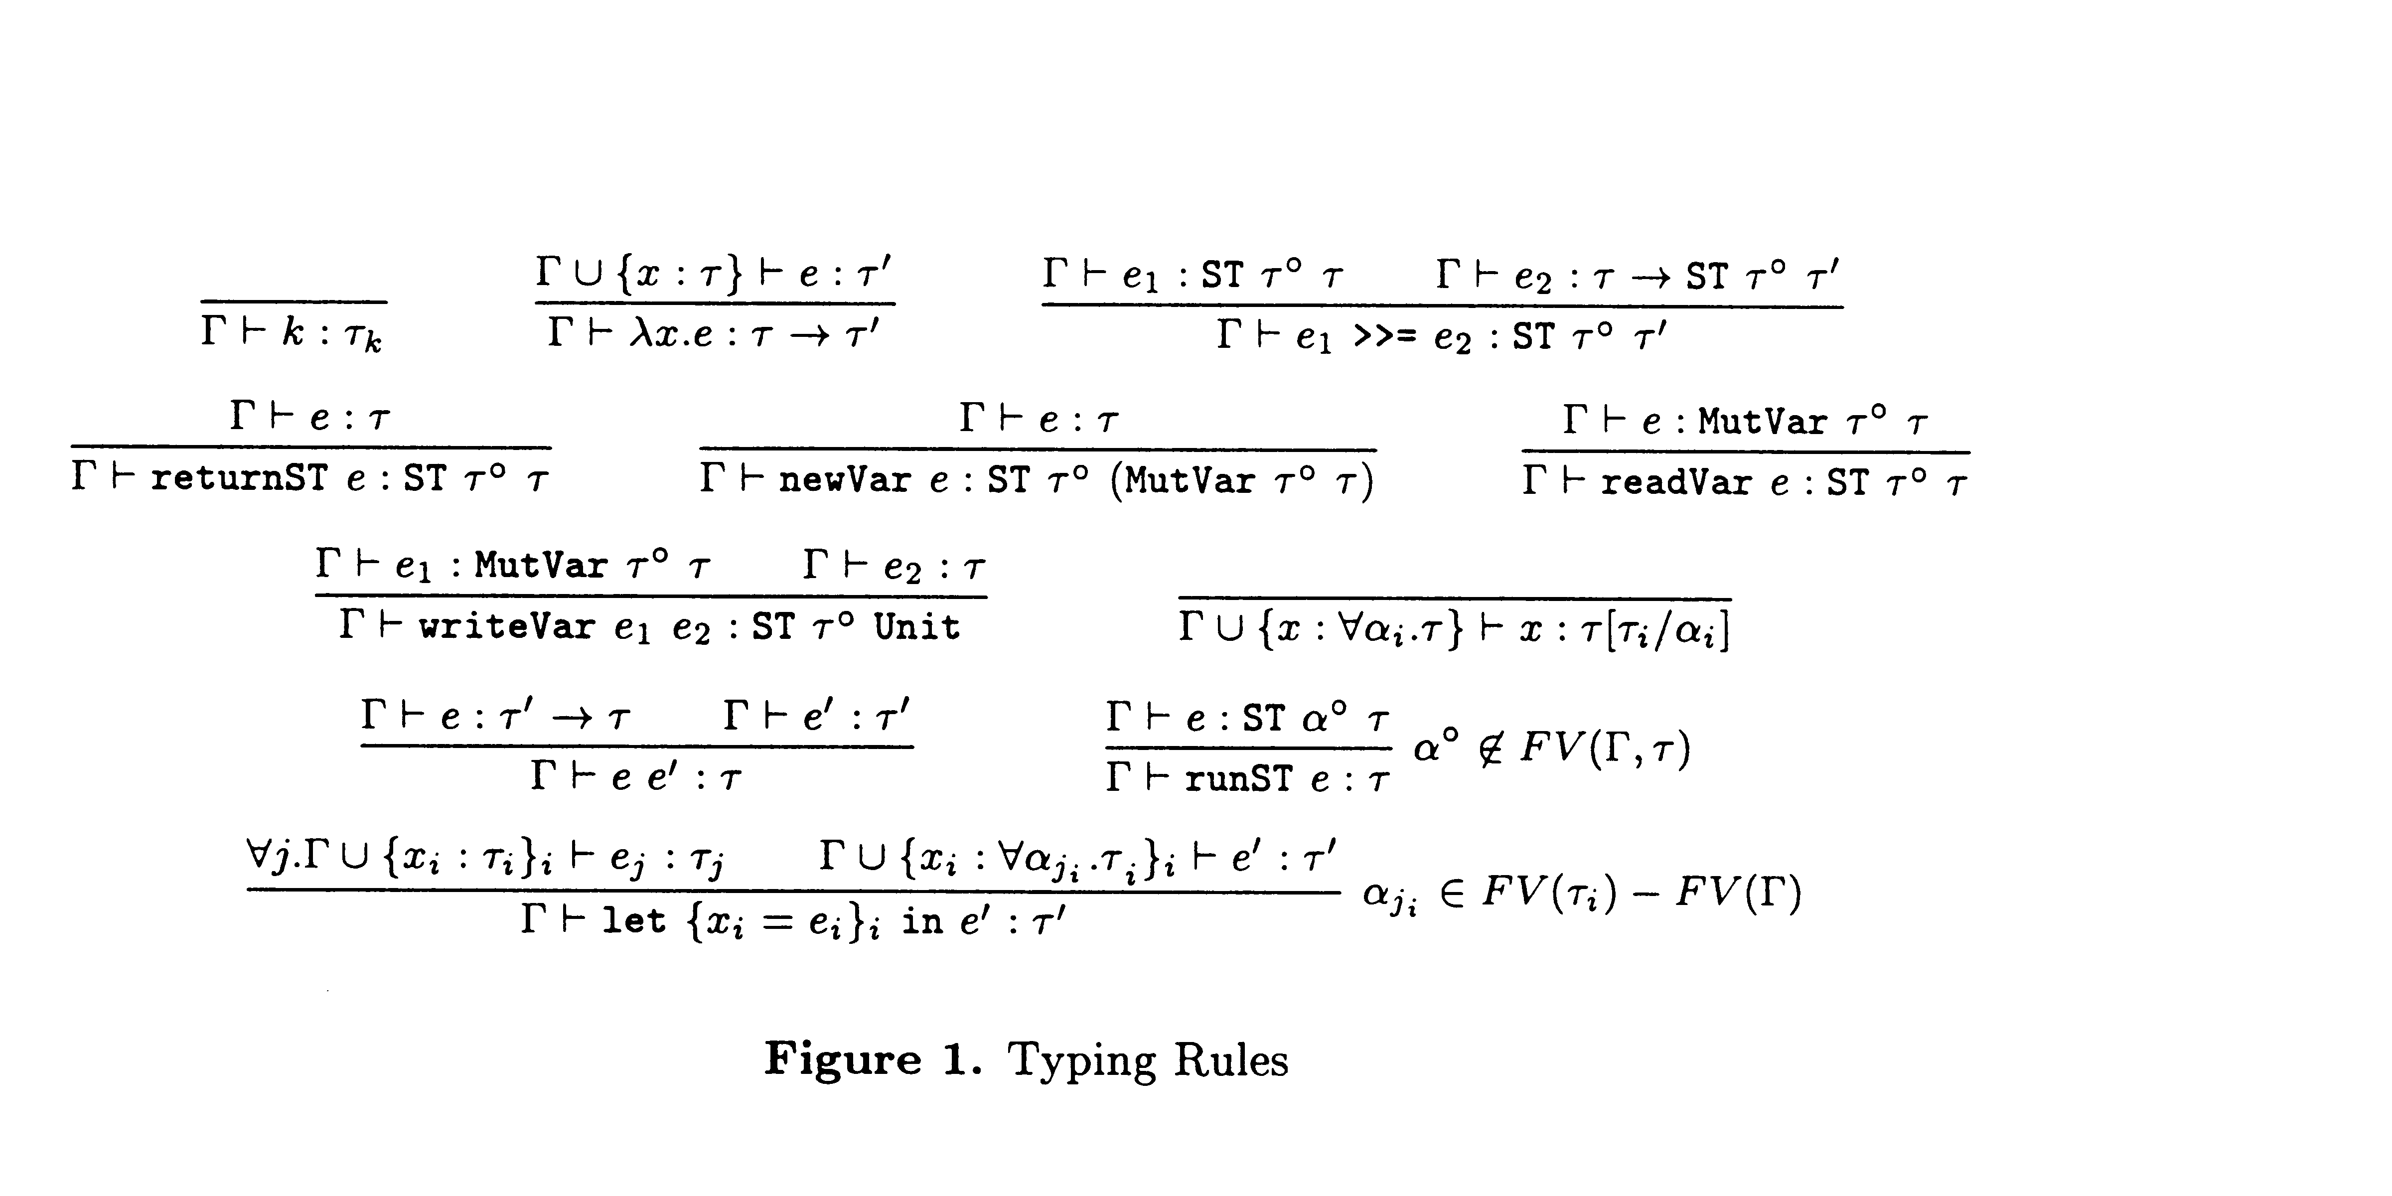
Technical detail

Slide 22
Omit technical details
Even though every line is drenched in your blood and sweat, dense clouds of notation will send your audience to sleep
Present specific aspects only;
refer to the paper for the
details
By all means have backup slides to use in response to questions

Slide 23
Presenting your talk

Slide 24
How to present your talk
Your most potent weapon, by far, is your
enthusiasm

Slide 25
Enthusiasm
If you do not seem excited by your idea, why should the audience be?
It wakes ‘em up
Enthusiasm makes people dramatically more receptive
It gets you loosened up, breathing, moving around

Slide 26
Write your slides the night before
(…or at least, polish it then)
Your talk absolutely must be fresh in your mind
Ideas will occur to you during the conference, as you obsess on your talk during other people’s presentations

Slide 27
Do not apologise
“I didn’t have time to prepare this talk properly”
“My computer broke down, so I don’t have the results I expected”
“I don’t have time to tell you about this”
“I don’t feel qualified to address this audience”

Slide 28
The jelly effect
If you are anything like me, you will experience apparently-severe pre-talk symptoms
Inability to breathe
Inability to stand up (legs give way)
Inability to operate brain

Slide 29
What to do about it
Deep breathing during previous talk
Script your first few sentences precisely
(=> no brain required)
Move around a lot, use large gestures, wave your arms, stand on chairs
Go to the loo first
You are not a wimp.
Everyone feels this way.

Slide 30
Being seen, being heard
Face the audience, not the screen
  Know your material
  Put your laptop in front of you, screen towards you
Don’t point much, but when you do, point at the screen, not at your laptop
Speak to someone at the back of the room, even if you have a microphone on
Make eye contact; identify a nodder, and speak to him or her (better still, more than one)
Watch audience for questions…

Slide 31
Questions
Questions are not a problem
Specifically encourage questions during your talk: pause briefly now and then, ask for questions
Be prepared to truncate your talk if you run out of time. Better to connect, and not to present all your material
Questions are a golden golden golden opportunity to connect with your audience

Slide 32
Presenting your slides
Use a wireless presenter gizmo
Test that your laptop works with the projector, in advance
Laptops break: leave a backup copy on the web; bring a backup copy on a disk or USB key

Slide 33
Presenting your slides
A very annoying technique
is to reveal
your points
one
by one
by one, unless…
there is a punch line

Slide 34
Presenting your slides
Use animation effects
very
very
very
very
very
very
very
sparingly

Slide 35
Finishing
Absolutely without fail,
finish on time
Audiences get restive and essentially stop listening when your time is up. Continuing is very counter productive
Simply truncate and conclude
Do not say “would you like me to go on?” (it’s hard to say “no thanks”)

Slide 36
Conclusion: there is hope
The general standard is often low.
You don’t have to be outstanding to stand out
You will attend 50x as many talks as you give. Watch other people’s talks intelligently, and pick up ideas for what to do and what to avoid.
http://research.microsoft.com/~simonpj

Slide 37
What your talk is for
Your paper = The beef
Your talk = The beef advertisment
Do not confuse the two

Slide 38
Do it! Do it! Do it!
Good papers and talks are a fundamental part of research excellence
Invest time
Learn skills
Practice
Write a paper, and give a talk, about
any idea,
no matter how weedy and insignificant it may seem to you

Slide 39
Research is communication
The greatest ideas are worthless if you keep them to yourself
Your papers and talks
Crystalise your ideas
Communicate them to others
Get feedback
Build relationships
(And garner research brownie points)

