Slide 1
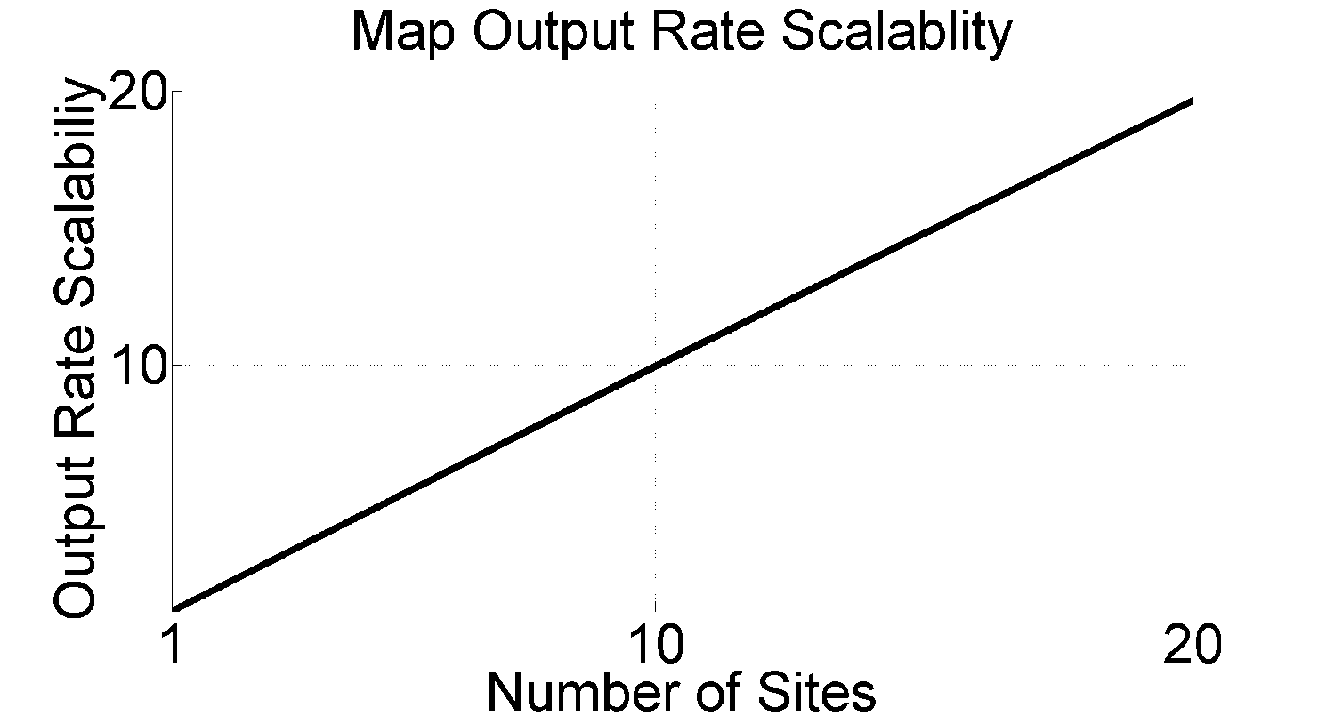
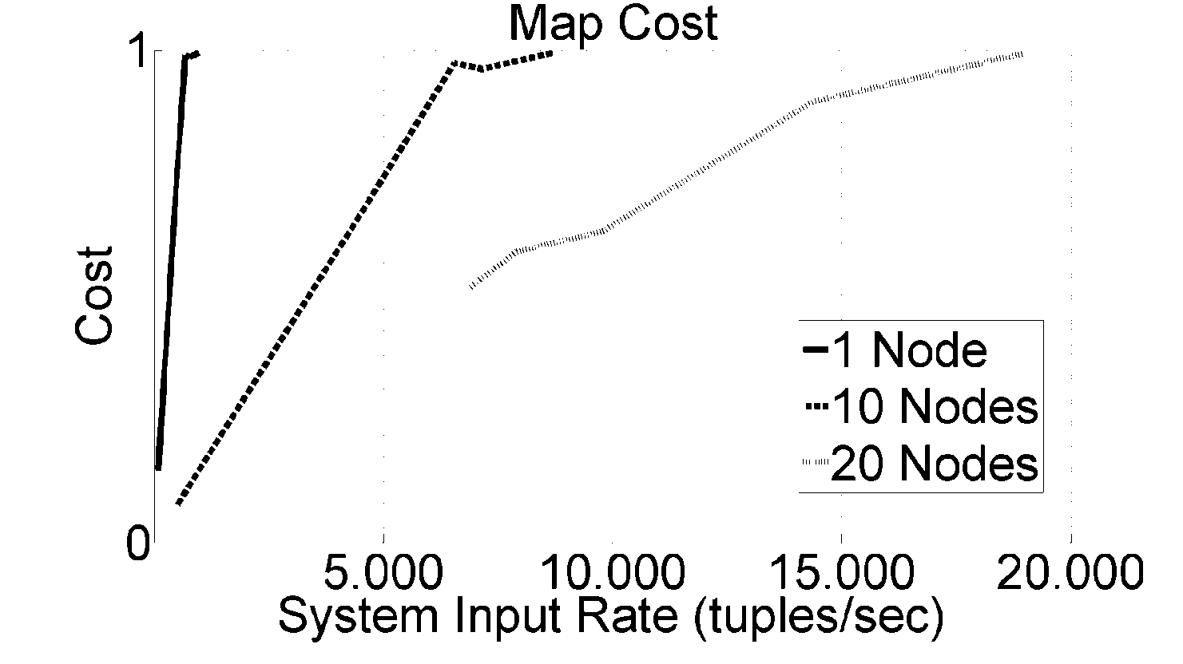
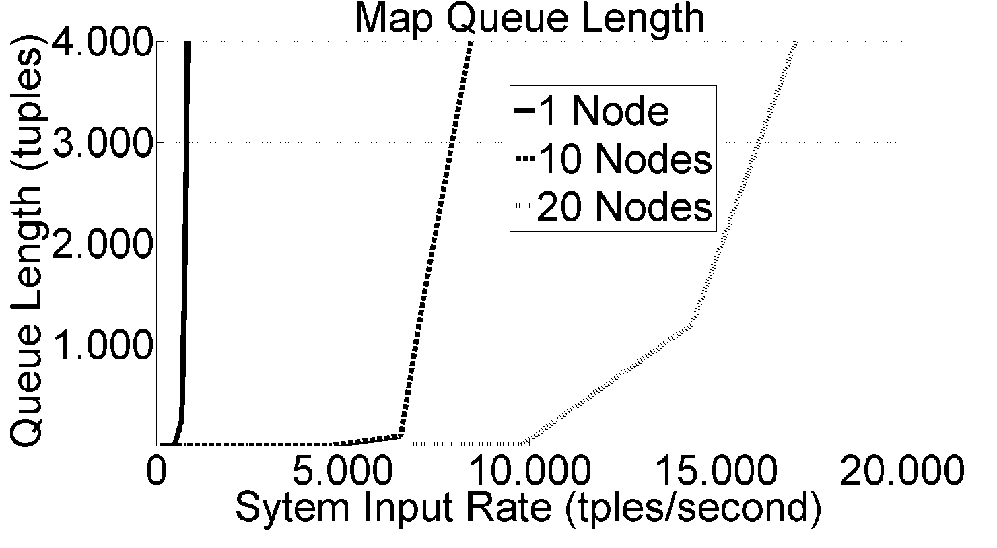
Highly Scalable Platform for Data Streaming
Vincenzo Massimiliano Gulisano Prof: Ricardo Jimenez-Peris {vgulisano, rjimenez}@fi.upm.es
Background & Challenges
Data Streaming: Paradigm for querying in real-time continuous massive flows of data. Queries are
composed by Operators (filters, maps, aggregates, joins) on continuous Flows.
Queries are used to manipulate incoming data and extract desired information.
Possible applications are Sensor Networks, Network traffic Analysis and
Real-Time Financial Applications.
SOTA: Scales on number of queries but not on data stream volume. Each operator is allocated
to a single node; system capacity is then limited to the volume it can process.
Challenge: Scale to massive data streams by allocating individual operators to computing clouds.
Research
Operator 2
How To: - “Cloudify” operators.
- Interconnect scalably / consistently. cloudified operators.
- Provide elastic computing for massive data streams.
Operator 1
Data
Outcome
Operator 3
Data Stream Cloud Platform
Highly Scalable: Able to use 10s of sites for each individual operator.
Elastic: Self Provisioning & Decommissioning nodes as needed depending on the workload.
Self-Optimizing: Non-intrusive dynamic load balancing – dynamic optimization of full queries cloudification.
Self-Healing: Tolerating failures without losing data.
Current Status
Cloudification of: - Stateless Operators (Map, Filter, Union) - Stateful Operators (Join, Equi-Join, Aggregate)
Distributed Load Injector.
Distributed Load Monitor.
First prototype for Self-Provisioning.
Compiler from Abstract Queries to Cloudified Concrete Deployments.
Preliminary evaluation showing close to linear scalability.
Conclusions & Next Steps
Architecture & Algorithms
Framework Preliminary Evaluation
Autonomic Behavior & Evaluation
Preliminary evaluation demonstrates our vision is possible.
Our approach enables to scale 2 orders of magnitude beyond current SOTA.
Next steps will focus on full implementation of elasticity and other essential autonomic capabilities.
Lsd
Distributed
Systems
Laboratory
School of Computer Science
UNIVERSIDAD POLITECNICA DE MADRID
Spain

