Slide 1













Multiworld Testing
Machine Learning for Contextual Decision-Making
Microsoft Confidential

Slide 2



Contextual Decision-Making
User Profile
Demographics
Location
Past Behavior
User Clicks Story
User Reads Story
User Returns More
Service Makes Money
?

Slide 3
ML for Contextual Decision-Making
Given a particular context, select an action that optimizes the reward observed
Great for personalization or situational decisions
  personalized news
  content-based interruptions for email
  OS scheduling
  wellness interventions

Slide 4

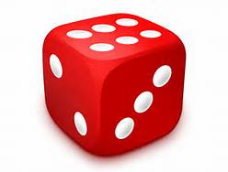
Experimentation
Recommender
Read
Recommender
Ignored
Multiworld testing: Get the right data first, then experiment offline like crazy
  Statistically: 1 billion experiments, for the cost of 21 A/B tests
Multiworld Testing
A/B Testing

Slide 5
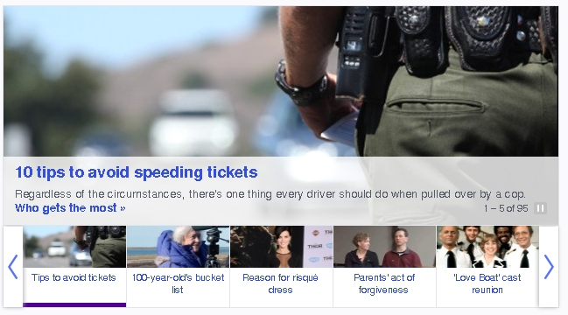
Results: Personalized News @Yahoo!
>30% lift over editorial
Notes:
We have finished several prototype applications of multiworld testing. One of these was at Yahoo!, were personalized news recommendation gave a >30% lift over editorially chosen news stories.
It’s interesting to guess my personal preferences from my personalized news stories ☺

Slide 6
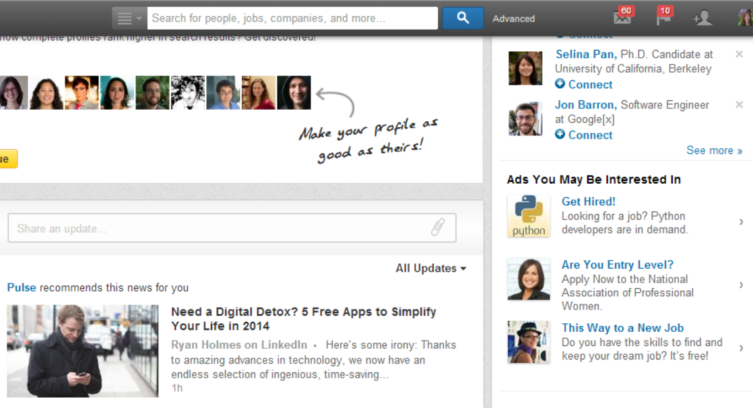
Results: Ads @LinkedIn
>15% revenue improvement*
*Deepak Agarwal @ large scale learning workshop
Notes:
Deepak Agarwal was one of the people working on personalized news recommendation. After things went down at Yahoo!, he moved to LinkedIn. I was pleased to discover that he used multiworld testing to get a healthy bump in revenue over an existing machine learned system.

Slide 7
Multiworld Testing Decision Service
any part of
Explore
Log
Deploy
Learn
Goal: Make this easy, fast, automated
Modular
Supports cycle times from 2 minutes to 2 months
Response times fast enough for any application
∧

Slide 8
Decision Service
Exploration

Slide 9
Client Library
Makes decisions
  Located within the application for extremely low latency
  Supports VW models or generic user-defined functions
Performs exploration
  Several exploration algorithms available
    ɛ-greedy
    Softmax
    Bootstrap
    Generic
Sends data to join service for logging
  Provides compression for feature vectors

Slide 10
Decision Service
Logging

Slide 11
Join Service
Joins together all data with the same key that arrives within the specified time window
  Decision data
  Observation data
  Other data to log
Two versions available
  Azure ML Microservice
  Azure Stream Analytics

Slide 12
Semantics
Azure Storage
duration
duration
9
:
00
10
:
00
11
:
00
Events Key₁
Events Key₂

Slide 13
Decision Service
Learning

Slide 14
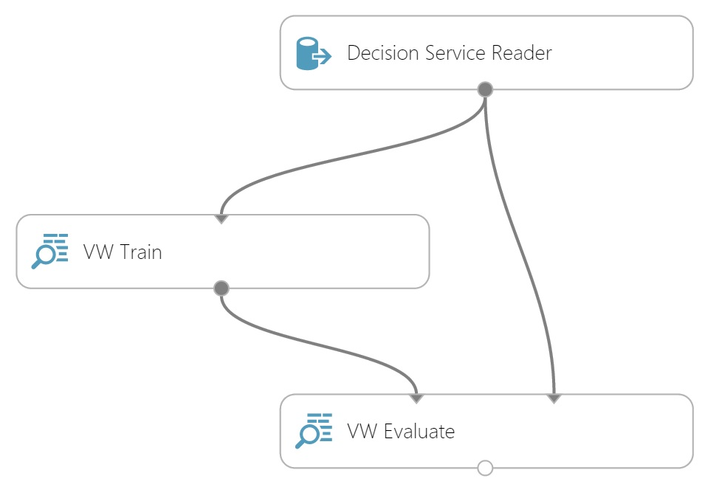
Azure ML
Azure Storage
Graphical framework to perform offline evaluation or optimization
Reader supports
  reading data from Azure Storage
  Custom reward functions
VW training
  generates models
  Adds new data to an existing vw model
VW evaluate
  Evaluates the effect a model would have had based on exploration data
  Supports vw models or custom user-defined functions
data
model

Slide 15
Decision Service
Deploy

Slide 16
Command Center
Controls high-level settings for applications
  Register applications
  Change exploration settings
  Specify new models to deploy

Slide 17
Summary
Multiworld Testing is an efficient approach to finding the optimal policies for contextual decision-making
MWT Decision Service is a powerful, modular service designed to make it easy to deploy MWT in many applications
http://aka.ms/mwt

