Slide 1
Trill: A High-Performance Incremental Query Processor for Diverse Analytics
Badrish Chandramouli, Jonathan Goldstein, Mike Barnett, Rob DeLine,
Danyel Fisher, John C. Platt*, James F. Terwilliger, John Wernsing
Microsoft Research
Contact: badrishc@microsoft.com Twitter: @badrishc
*Current affiliation: Google. This work was performed at Microsoft Research.

Slide 2
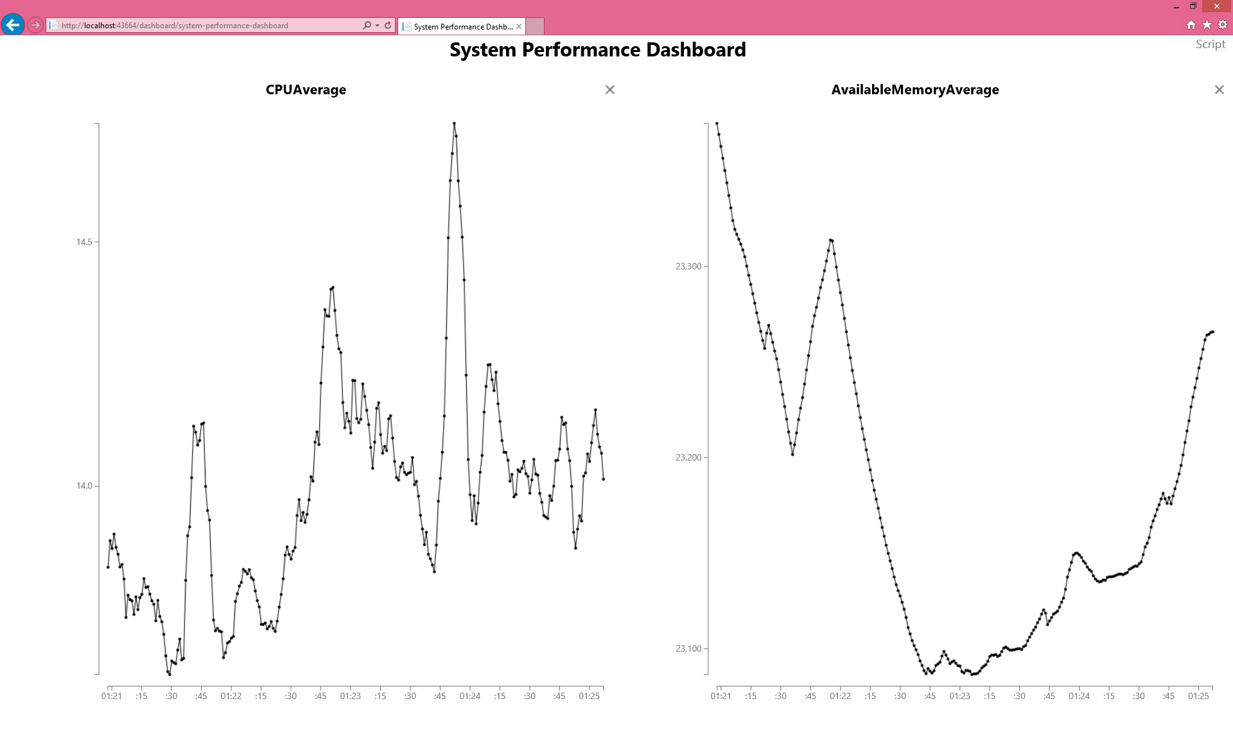



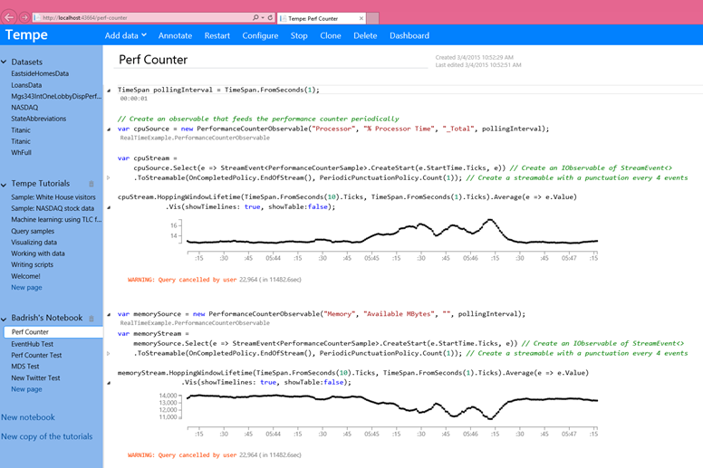
Diverse Scenarios for Analytics
Real-time
  Monitor app telemetry (e.g., ad clicks) &
  raise alerts when problems are detected
Real-time with historical
  Correlate live data stream with historical
  activity (e.g., from 1 week back)
Offline
  Develop initial monitoring query using logs
  Back-test monitoring query over historical logs
Progressive
  Non-temporal analysis (e.g., BI) over large dataset,
  stream data, get quick approximate results
Real-Time Dashboard
Engine
+ Fabric
Interactive
Query Authoring

Slide 3
Three Key Requirements
Performance
  High throughput: critical for large offline datasets
  Low latency & overhead: Important for real time monitoring
Fabric & language integration
  Cloud app/service acts as driver, uses the analytics engine
  Need rich data-types, integrate custom logic seamlessly
Query model
  Need to support real-time and offline data, temporal and
  relational queries, early results for exploratory offline queries
Scenarios
monitor telemetry & raise alerts
correlate real-time with logs
develop initial
monitoring query
back-test over historical logs
offline analysis (BI) with early results

Slide 4
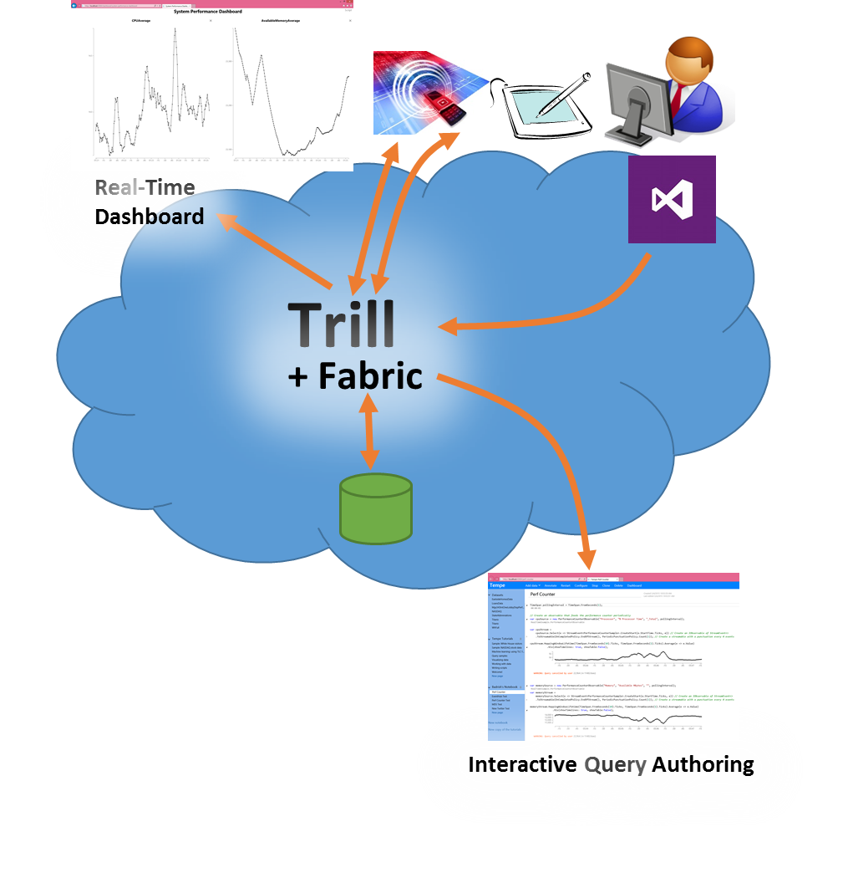
Trill: Fast Streaming Analytics Library
Performance
  2-4 orders of magnitude faster than traditional SPEs
  For relational queries, comparable to best DBMS
  User-controlled latency specification
    explicit latency vs. throughput tradeoff
Fabric & language integration
  Built as high-level language (HLL) library component
  Works with arbitrary HLL data-types & libraries
Query model
  Extended LINQ syntax based on tempo-relational query model
  Supports broad & rich analytics scenarios (relational, progressive, time-based)

Slide 5
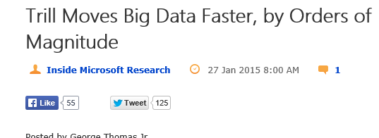
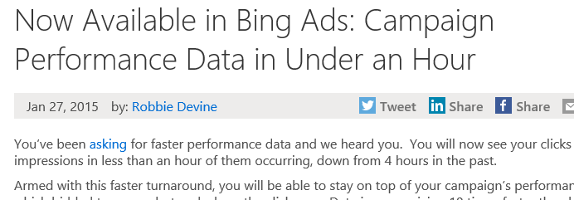
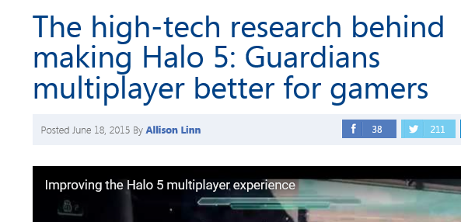

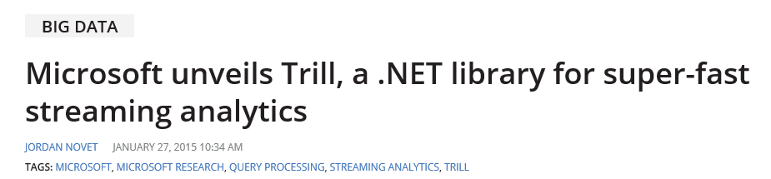
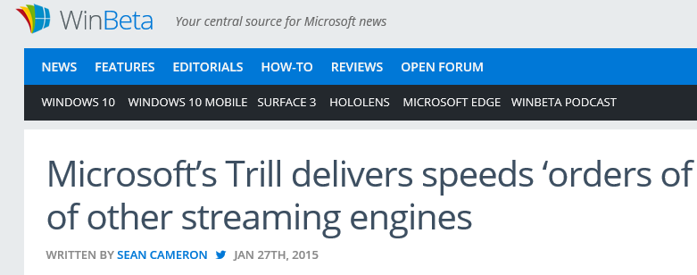

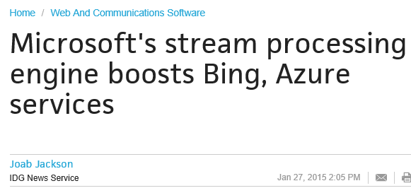
Trill’s Use Cases
Azure Stream Analytics
Cloud service
With Scope for Bing Ads
With Orleans for Halo game monitoring & debugging
…
Key enabler: performance +
fabric & language integration + query model

Slide 6
Example (simplified)
Define event data-type in C#
struct ClickEvent { long ClickTime; long User; long AdId; }
Define ingress
var str = Network.ToStream(e => e.ClickTime, Latency(10secs));
Write query (in C# app)
var query =
str.Where(e => e.User % 100 < 5)
.Select(e => { e.AdId })
.GroupApply( e => e.AdId,
s => s.Window(5min).Aggregate(w => w.Count()));
Subscribe to results
query.Subscribe(e => Console.Write(e)); // write results to console
Application time
Latency specification
Lambda expression
Grouping key selector
Operator
Grouped sub-query

Slide 7


Latency-Throughput Spectrum
Data organized as stream of batches
  Purely physical (no impact on query results)
Users specify latency constraint
(10 secs)
  Batch up to 10 secs of data
  Small batches → low latency
  Large batches → high throughput
  More load → larger batches → better throughput
…
$$op_{2}$$
$$op_{1}$$
…
…

Slide 8


+ Columnar
Columnar format within each batch
  Timestamps as arrays
  Bitvector to indicate row absence
class DataBatch {
long[] SyncTime;
...
Bitvector BV;
}
  One array per payload field
class UserData_Gen : DataBatch {
long[] c_ClickTime;
long[] c_User;
long[] c_AdId;
}
  Batch classes are generated & compiled on-the-fly (under the hood)
  Enables efficient QP & serialization
…
$$op_{2}$$
$$op_{1}$$
…
…
timestamp
payload columns
bitvector

Slide 9
+ Fabric & Language Integration
Application
But, user view is row-oriented
  Dynamically generate and compile HLL code for operators
Our example: filter (where)
  User writes str.Where(e => e.User % 100 < 5)
General technique
  Generate tight loops over batches, with inlined expressions (done using reflection)
  Avoid method calls within loops
  Timestamps are columns – accessed only if needed
    Pointer-swing where possible
Receive(results)
Trill
On(Batch b) {
for i = 0 to b.Size {
if !(b.c_User[i]%100 < 5)
set b.bitvector[i]
}
next-operator.On(b)
}
Send(events)
...
str.Where(e => e.User % 100<5);

Slide 10
See Paper …
Property-based operator codegen specialization
Grouped & batched operator algorithms
Library-mode & multi-core scheduler
Efficient serialization & string support
Rich query language
  SQL queries with progressive (early) results
  Temporal queries
    Sliding, hopping, tumbling, data-dependent session windows
    Temporal joins, set difference
    Powerful high-perf expression-based user-defined aggregate framework

Slide 11
Evaluation (sample)
Pre-loaded datasets in main memory
16-core machine
Streaming filter

Slide 12
Evaluation (sample)
Pre-loaded datasets in main memory
16-core machine
Relational queries

Slide 13
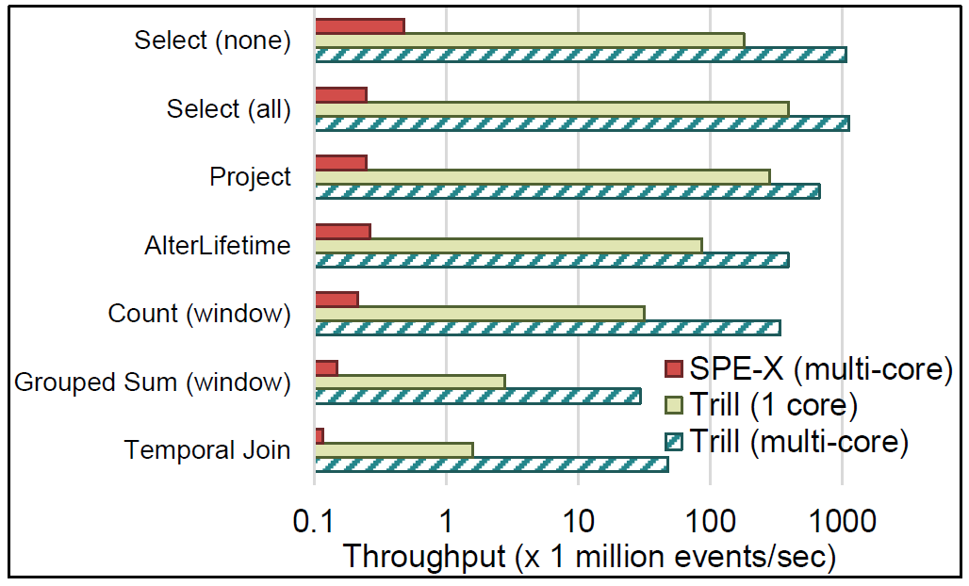
Evaluation (sample)
Pre-loaded datasets in main memory
16-core machine
Temporal queries

Slide 14
Conclusions
Trill is a fast & expressive library for analytics
  2-4 orders-of-magnitude faster than traditional streaming engines
  Comparable to columnar databases for offline SQL queries
    But with progressive (early result) support
  Expressive query language and support for HLL type-system & code
  Library that can be easily embedded in a variety of settings (distributed fabrics, servers, Cloud applications, devices, …)
Trill is being used across diverse analytics scenarios
More info @ http://aka.ms/trill

Slide 15

© 2013 Microsoft Corporation. All rights reserved. Microsoft, Windows, Windows Vista and other product names are or may be registered trademarks and/or trademarks in the U.S. and/or other countries.
The information herein is for informational purposes only and represents the current view of Microsoft Corporation as of the date of this presentation. Because Microsoft must respond to changing market conditions, it should not be interpreted to be a commitment on the part of Microsoft, and Microsoft cannot guarantee the accuracy of any information provided after the date of this presentation. MICROSOFT MAKES NO WARRANTIES, EXPRESS, IMPLIED OR STATUTORY, AS TO THE INFORMATION IN THIS PRESENTATION.

