Slide 1



Urban Water Quality Prediction based on
Multi-task Multi-view Learning
Ye Liu, Yu Zheng, Yuxuan Liang,
Shuming Liu, David S. Rosenblum
https://www.microsoft.com/en-us/research/publication/urban-water-quality-prediction-based-multi-task-multi-view-learning-2/

Slide 2
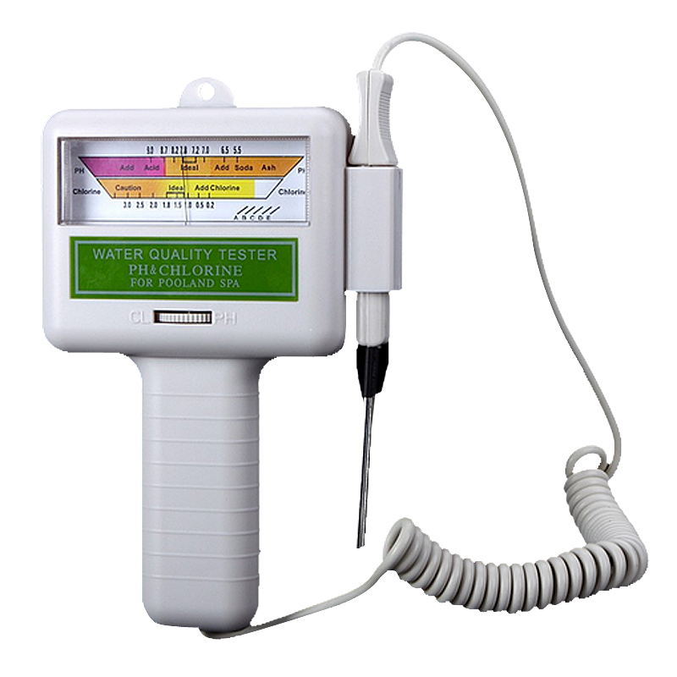
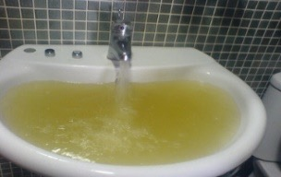
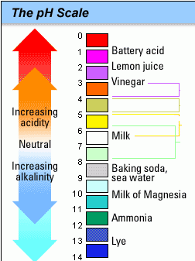
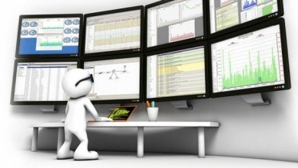

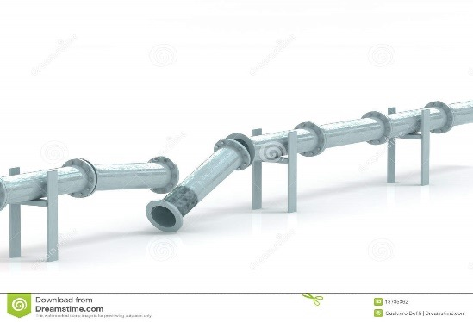
Urban Water Quality
Urban Water quality is crucial to our life
  quality index
    Residual Chlorine (RC)
    Turbidity
    pH
Predicting urban water quality is of great importance to us
Applications
Real-time monitoring
water pollution alarming
Suggestions for replacements

Slide 3


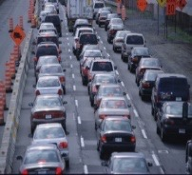



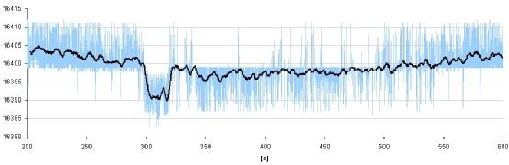
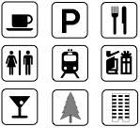
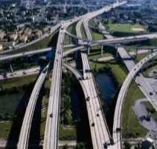
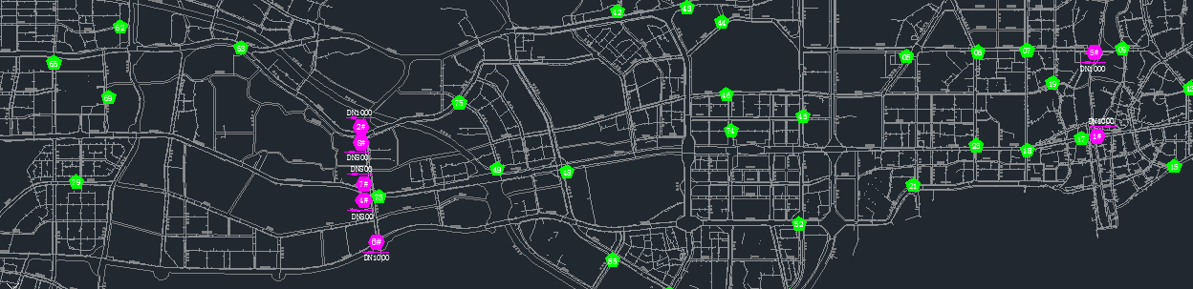
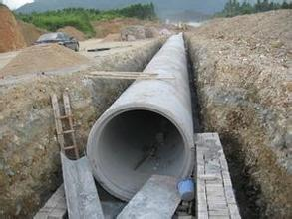
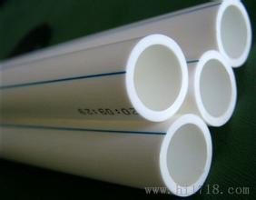
Urban Water Quality
Predicting the Urban Water Quality from Multi-sources Urban Data
Water quality data
pH
residual chlorine
turbidity
Meteorology
Traffic
Hydraulic condition data
flow
pressure
Map data
CAD
GIS
POIs
Road networks
Pipeline attribute data
length
material
pipe age

Slide 4
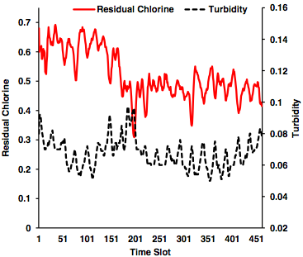
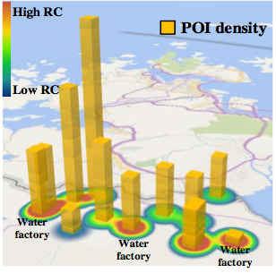
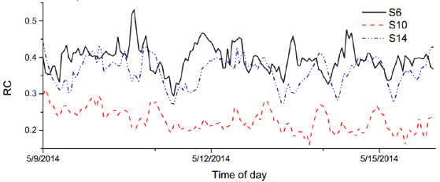
Challenges
Unknown influential factors that affect water quality
  Turbidity
  Flow
  POIs
  …….
RC - Turbidity
RC - POIs
Water quality various over time and location non-linearly

Slide 5
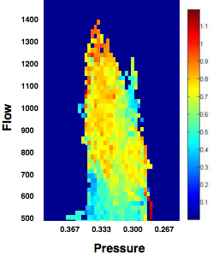
Solutions
Identifying influencing factors
  Flow, turbidity, pH, etc.
Approaching from spatial and temporal perspectives
  Multi-views: each station has two views:
    spatial view and temporal view
  Capturing local information of each station
Approaching from local and global perspectives
  Multi-tasks: water quality prediction at each station
  Capturing the global correlations among stations

Slide 6
Insight
The urban water is influenced by various factors
  direct factors, e.g., usage patterns, pipe structures
  indirect factors, e.g., POIs, time
RC - POIs
RC - Turbidity

Slide 7
Overview
The system consists of:
  Feature extraction and view construction
  Multi-view based prediction (for each station)
  Multi-task based prediction (all stations)

Slide 8
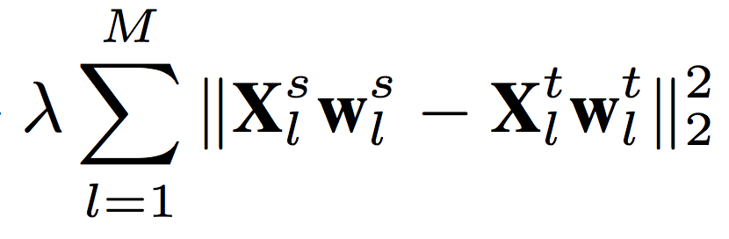
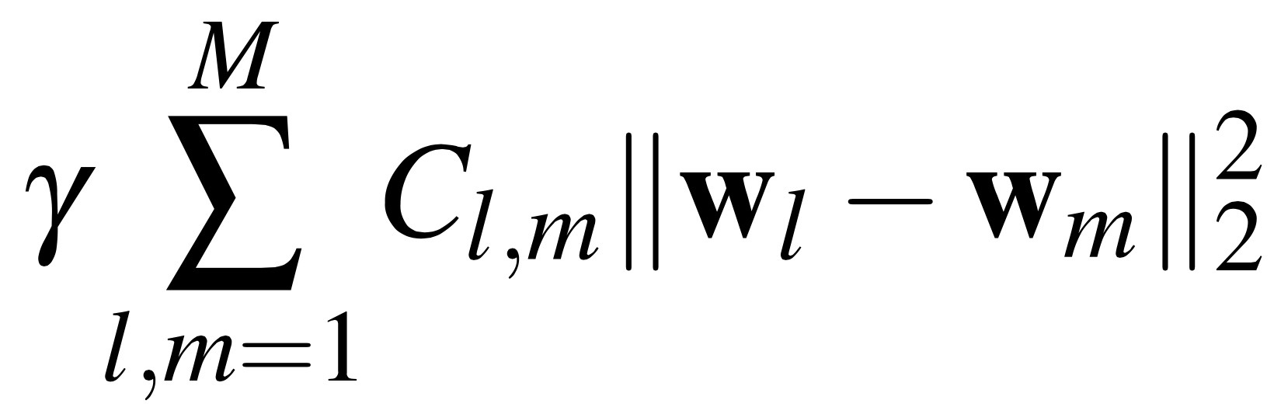
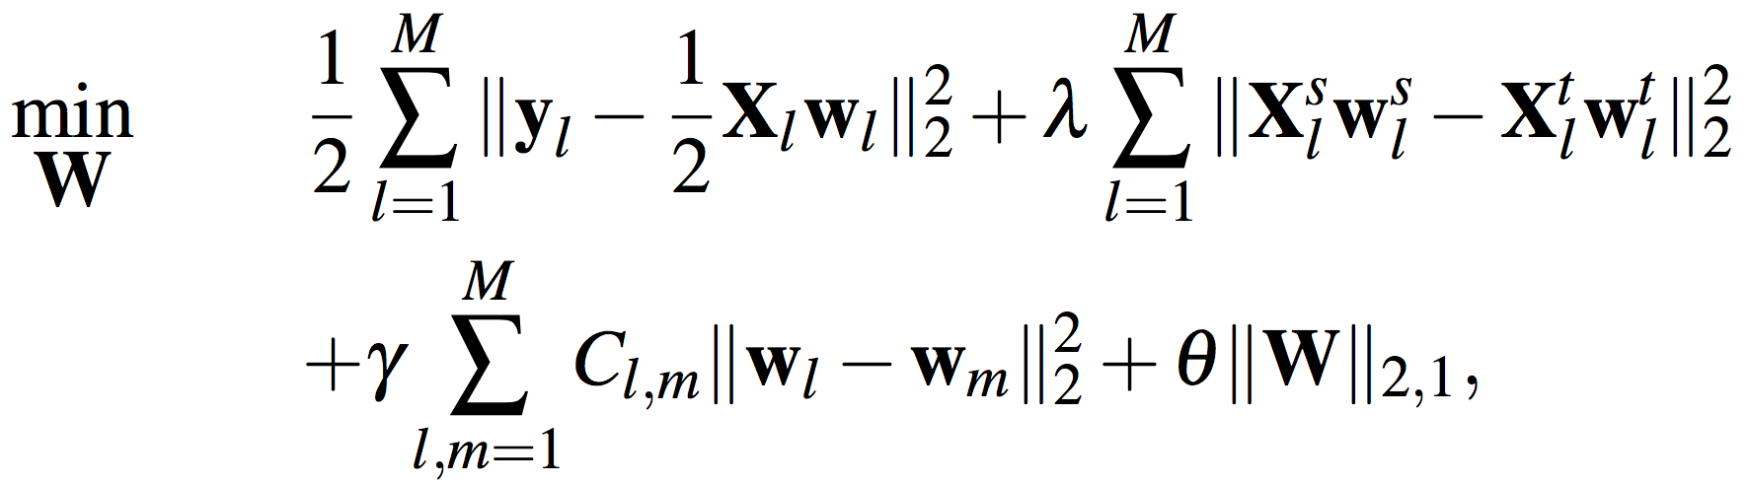
Methodology
Multi-task Multi-view Learning
  Multi-Views: For each station, there are two views
    Spatial view: predictions based on its neighbors
    Temporal view: predictions based on its own history
    Alignment between two views
  Multi-Tasks:
    The prediction at each station is a task
    All stations do the co-prediction
    Alignments among multiple tasks
  Formulations:

Slide 9

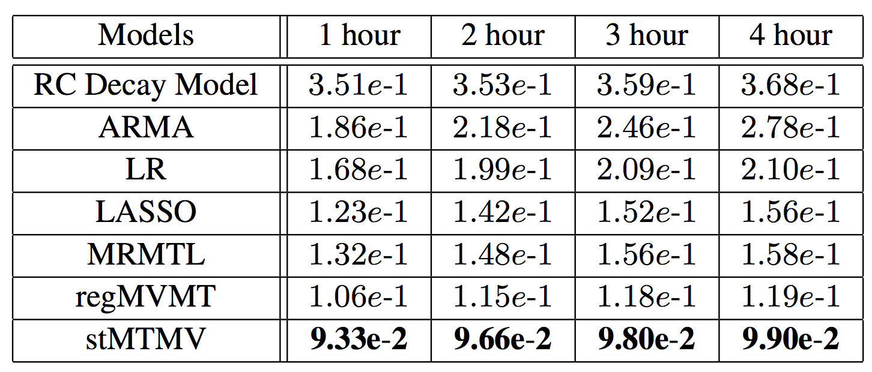
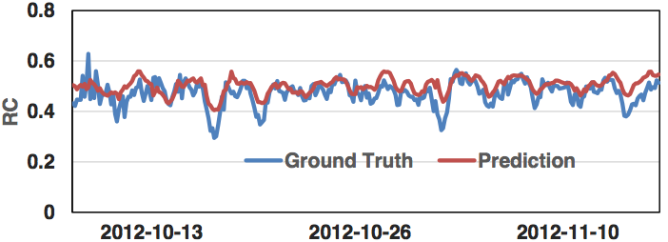
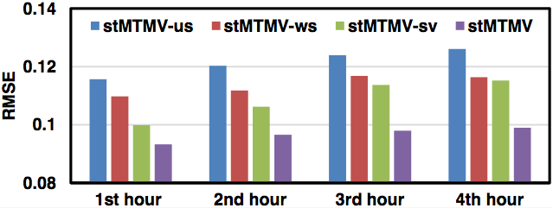
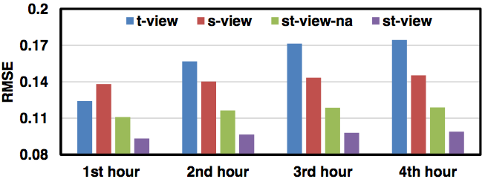
Evaluations
Code Released
Performance comparison among various approaches
Predictive Performance
Model components comparison
Views comparison

Slide 10

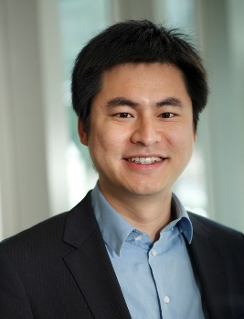
Search for “Urban Computing”
搜索“城市计算”
Thanks!
Yu Zheng
yuzheng@microsoft.com
Download Urban Air Apps
Homepage
Zheng, Y., et al. Urban Computing: concepts, methodologies, and applications. ACM transactions on Intelligent Systems and Technology.
郑宇. 城市计算概述，武汉大学学报. 2015年1月，40卷第一期
Yu Zheng. Methodologies for Cross-Domain Data Fusion: An Overview. IEEE Transactions on Big Data, 1, 1, 2015.

