Slide 1


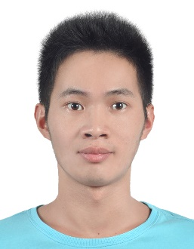
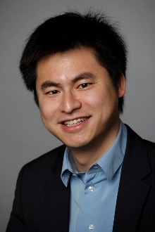

Urban Sensing Based on Human Mobility
Shenggong Ji, Yu Zheng, Tianrui Li
Southwest Jiaotong University, Chengdu, Sichuan, China
Microsoft Research Asia, Beijing, China
Notes:
Microsoft Research Asia
Southwest Jiaotong University

Slide 2
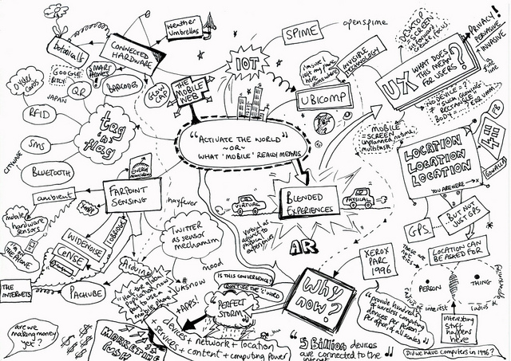


Urban Sensing
Collecting urban data
  Noise, temperature, air quality, …
  Human as a sensor
Brings challenges to
  City-scale real-time monitoring
  Further data analytics
Skewed human mobility
Imbalanced data coverage
?
?
?
?
?
?
?
?
?
?
?
Notes:
Skewed and uncertain human mobility limit the performance of urban sensing. This is our motivation.
Balanced data coverage is a goal for most urban sensing system.

Slide 3

An Urban Sensing Framework
Consider real-world human mobility
Maximize the amount and balance of collected data
Given a limited budget
Unit reward for each hour
Notes:
Human mobility
task

Slide 4
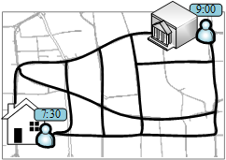
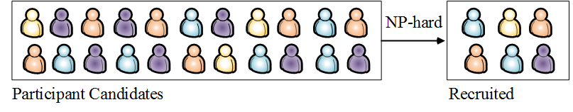
Challenges
  Measure data balance: different spatio-temporal granularities
  High computational cost
Task design for a participant (routing planning)
Recruiting participants from many candidates
Notes:
Spatio-temporal space is a 3-D space. Data in such a 3-D space will present different distributions when the space is partitioned by different granularities.

Slide 5
Framework
A participant recruitment mechanism
  random recruitment
  replacement-based refinement
A task design algorithm
A hierarchical entropy-based objective function
Notes:
Participant Recruitment: Two Steps – Random Recruitment and Replacement-based Refinement

Slide 6
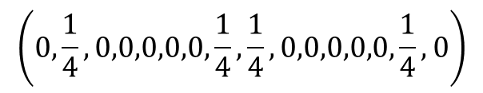

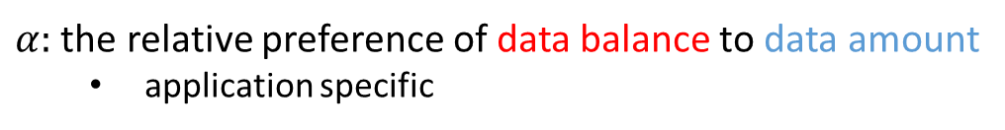
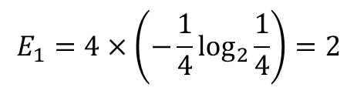
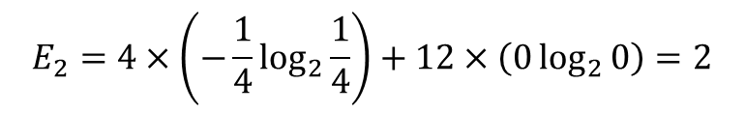
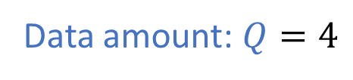
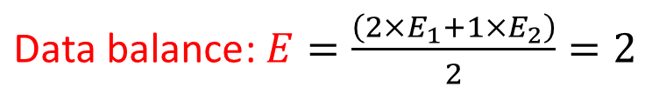
Hierarchical Entropy-based Objective Function
Data amount: $Q=4$
$$\max{φ=α×E+\left(1−α\right)×\log_{2}{Q}}$$
$$\left(\frac{1}{4},\frac{1}{4},\frac{1}{4},\frac{1}{4}\right)$$
$$E_{1}=4×\left(−\frac{1}{4}\log_{2}{\frac{1}{4}}\right)=2$$
$α:$ the relative preference of data balance to data amount
  application specific
$$\left(0,\frac{1}{4},0,0,0,0,0,\frac{1}{4},\frac{1}{4},0,0,0,0,0,\frac{1}{4},0\right)$$
$$E_{2}=4×\left(−\frac{1}{4}\log_{2}{\frac{1}{4}}\right)+12×\left(0\log_{2}{0}\right)=2$$
Coarse-grained
Fine-grained
$\text{Data} \text{balance}$: $E=\frac{\left(2×E_{1}+1×E_{2}\right)}{2}=2$
Coarse-grained partition
Fine-grained partition

Slide 7
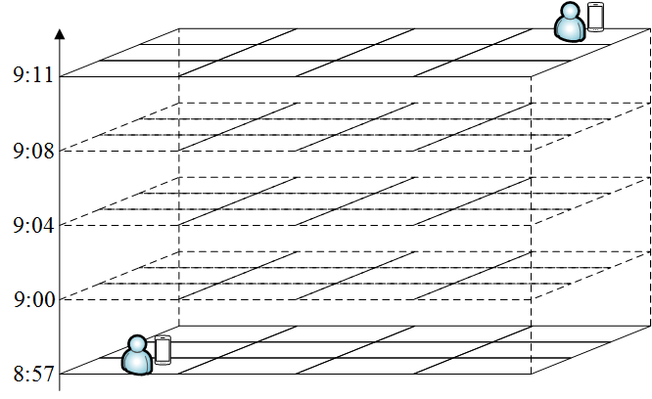
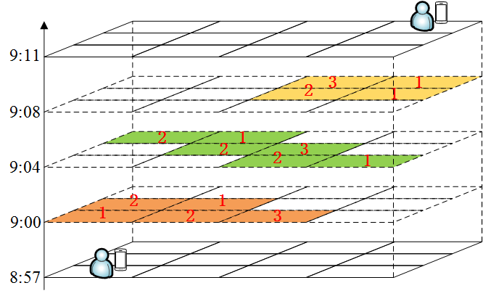

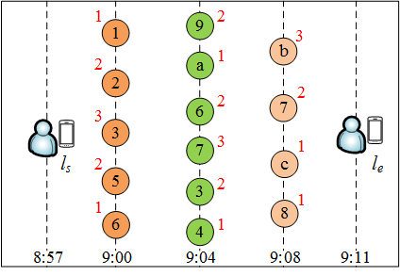

Task Design
Designed Task: $\left(9:00,3\right)→\left(9:04,6\right)→\left(9:08,7\right)$

Slide 8
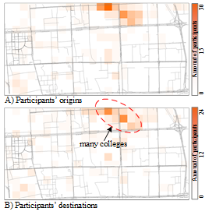
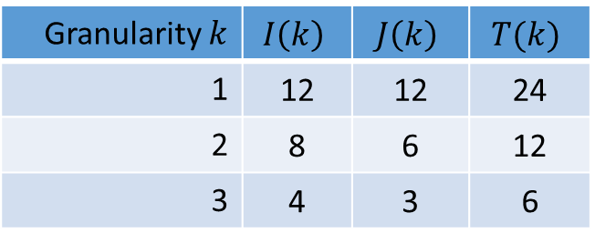

Evaluation
Datasets
  Human mobility dataset from a real-world noise sensing experiment
    Sensing region: 6.6km $×$ 3.3km
    Sensing time interval: 6:00 am ~ 22:00 pm
  244 participant candidates with mobility information
Settings
  Hierarchical partitions for data coverage
    $I\left(k\right)×J\left(k\right):$ spatial partition
    $T\left(k\right)$: temporal partition
Granularity $k$ | $$I\left(k\right)$$ | $$J\left(k\right)$$ | $$T(k)$$
1 | 12 | 12 | 24
2 | 8 | 6 | 12
3 | 4 | 3 | 6

Slide 9
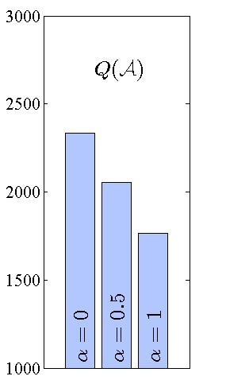
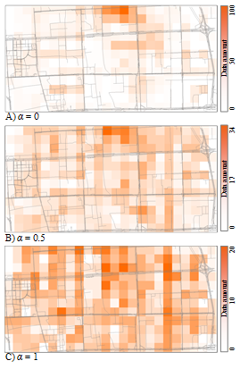

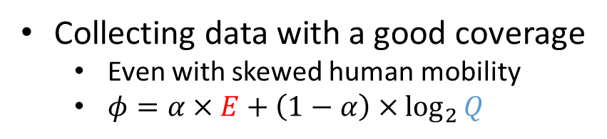


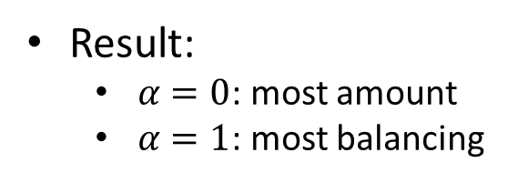
Evaluation
Collecting data with a good coverage
  Even with skewed human mobility
  $φ=α×E+\left(1−α\right)×\log_{2}{Q}$
Result:
  $α=0$: most amount
  $α=1$: most balancing
$$α=0$$
$$α=0.5$$
$$α=1$$

Slide 10
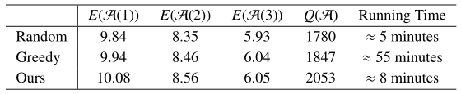
Evaluation
Participant recruitment mechanism
  Ours: Random recruitment + Replacement-based refinement
  Two baselines for comparison
    Random recruitment
    Greedy recruitment
Results
  Data coverage: best performance
  Running time: very efficient

Slide 11
Conclusion
  We proposed a novel urban sensing framework
  Methodology
    A participant recruitment mechanism
    A hierarchical entropy-based objective function
    A graph-based task design algorithm
Extensive experiments using real-world human mobility
Collecting data with better (more balanced) coverage
Data Released:
https://www.microsoft.com/en-us/research/publication/urban-sensing-based-human-mobility/

Slide 12

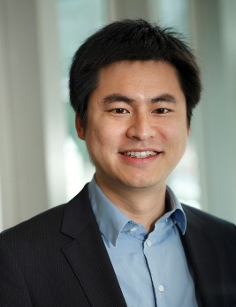
Search for “Urban Computing”
Thanks!
Yu Zheng
yuzheng@microsoft.com
Download Urban Air Apps
Homepage
Zheng, Y., et al. Urban Computing: concepts, methodologies, and applications. ACM transactions on Intelligent Systems and Technology.
Yu Zheng. Methodologies for Cross-Domain Data Fusion: An Overview. IEEE Transactions on Big Data, 1, 1, 2015.

