Slide 1
Blind Seer: Scalable Private DB Querying Columbia-Bell Labs work on IARPA SPAR project
Vladimir Kolesnikov (Bell Labs), Tal Malkin (Columbia)
Steve Bellovin, Seung Geol Choi, Ben Fisch, Angelos Keromytis, Fernando Krell,
Vasilis Pappas and Binh Vo (Columbia)
Wesley George (UToronto), Abishek Kumarasubramanian (UCLA)
Applied MPC Workshop MSR Redmond

Slide 2
Outline
Project
Basic system architecture (Tal)
Basic approach (Tal)
Additional features
Protection against malicious players
Other interesting issues/solutions

Slide 3
IARPA SPAR Program
Tim Edgar mentioned the origins of IARPA SPAR
Result of ODNI asking itself the question of privacy?
There exists Deputy for Civil Liberties for the Director of National Intelligence

Slide 4
This Project
Solves specific problem
Improves/clarifies state of the art of large GC-based SFE.
Basic approach to appear in Oakland 2014
Pappas, Krell, Vo, Kolesnikov, Malkin, George, Keromytis, Bellovin, “Blind Seer: A Scalable Private DBMS”

Slide 5
Required features
100M records, 10TB DB
Preserve query and data privacy
Robust query support:
select * where NAME=Bob AND AGE >20
Boolean query expressions (including at least three conjunctions)
Range queries and inequalities for integer numeric, date/time, etc
Matching of keywords ―close to a specified value (stemming)
Text fields with many keywords (e.g. 100’s)
Matching of values with wildcards
Matching of values with a specified subsequence
m-of-n conjunctions
Ranking of results
…
Allowed up to 2-10x overhead compared to MySQL

Slide 6
Blind Seer: The Basics
Requirements are very hard to achieve securely (impossible…?)
must relax security guarantees
Challenge: How? Find a right TRADEOFF
meaningful, reasonable, provable security (controlled leakage)
Lots of interesting research to be done…
How much leakage is too much? How do you evaluate the damage of a certain leakage profile? How do you qualify/quantify how good your tradeoff is? Application specific? Is there a formal way to do so?
I will describe Our basic system and approach:
Touch upon some of our tradeoffs
Focus on Boolean queries, semi-honest parties
Skip a whole lot… (Vlad will touch on some of it)
Notes:
Deterministic encryption
Because of scale, comparison of encrypted values used in search must be very fast. Not clear how to approach with probabilistic encryption
Access patterns
Clearly not a bad leakage. Seems quite expensive to avoid, so natural to live with it.

Slide 7
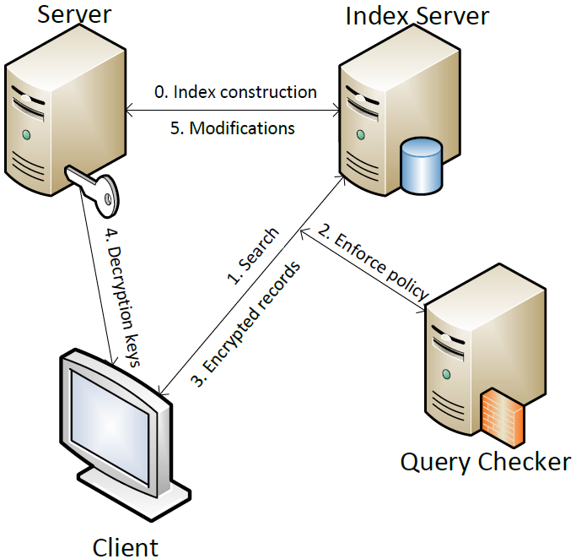
System Architecture
Notes:
Note: 4th party is logical, can be co-located with Server.
Third party (IS) is indeed already one big tradeoff represented. Not trusted with data or with query, but trusted not to collaborate with others.

Slide 8
Secure Computation: Yao’s GC
AND
AND
NOT
Alice’s inputs
Bob’s inputs
AND
OR
OR
Very fast for small problems, but doesn’t scale to large circuits
How to scale?
Identify privacy-critical subroutines and implement securely
Insecure implementation of the rest
Challenge: Understand and formalize security guarantees (hard problem)

Slide 9
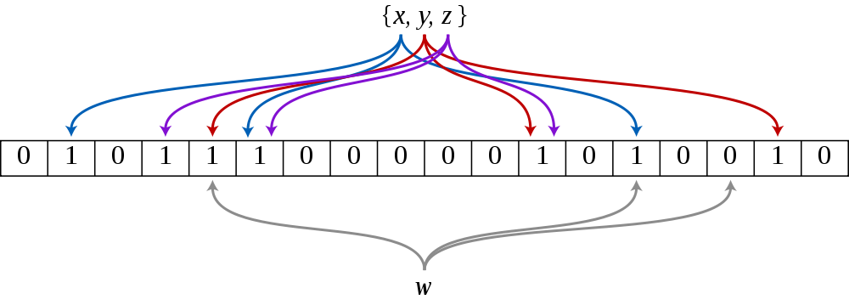
Bloom Filter
Constant-time querying
Efficient storage (ca 10 bits per keyword)
Fixed access pattern (same for both match and non-match)
Encrypted BF:
Same as BF, but objects are encrypted – need deterministic encryption

Slide 10
Occluded BF
Query: C sends Enc(kw), S computes match
OK for single keyword searches
For formulas, need to hide terms matching
Idea:
Mask BF with a (pseudo-)random pad
Let Client know the pad (via seed)
Then Client and Server run SFE for computing match, where C inputs pad.
GC is very efficient: 10-20 gates per term, plus gates to implement formula.
Notes:
Here important to note that they do NOT comptue Yao on the whole length of the BF, but just on the required indices. That’s why need to hide it…)

Slide 11
Search Tree
DB records
2
1,4
3
4
1,8
5
5
5
5,6
6
6
6
5,8
7,8
7
7
7
8
8
8

Slide 12
Search Example
DB records
2
1,4
3
YES
4
1,8
5
5
5
5,6
6
6
6
5,8
7,8
7
7
7
8
8
8

Slide 13
Search Example
DB records
2
YES
1,4
3
YES
4
1,8
5
5
5
5,6
6
6
6
5,8
NO
7,8
7
7
7
8
8
8

Slide 14
Search Example
DB records
2
YES
1,4
3
YES
4
1,8
5
5
5
5,6
6
6
6
5,8
NO
7,8
7
7
7
8
8
8

Slide 15
Search Example
DB records
NO
2
YES
1,4
3
YES
YES
4
1,8
5
5
5
5,6
6
6
6
5,8
NO
7,8
7
7
7
8
8
8

Slide 16
Search Example
DB records
NO
2
YES
YES
1,4
3
YES
YES
3
YES
1,8
5
5
5
5,6
6
6
6
5,8
NO
7,8
7
7
7
8
8
8

Slide 17
What is Leaked ?
Query Pattern (e.g., S can distinguish between simple and complex queries, may learn about repeated terms in different queries)
Returned Records Access Pattern
Tree search pattern of each query:
Notes:
(focus on leakage to IS here)
Recall tree is randomized (order of leaves)
Above types of leakage seem necessary to achieve efficient sublinear performance.

Slide 18
What is Leaked ?
Query Pattern (e.g., S can distinguish between simple and complex queries, may learn about repeated terms in different queries)
Returned Records Access Pattern
Tree search pattern of each query:
1-8
1-4
5-8
1-2
3-4
5-6
7-8
1
2
3
4
5
6
7
8

Slide 19
What does this mean?
OR queries:
Only leakage is access patterns (tree traversal can be simulated, no leakage on individual terms)
Efficiency proportional to number of results (asymptotically optimal)
AND queries:
Tree search pattern reveals more: also abandoned paths
Efficiency: at most proportional to number of matches for best term (asymptotically optimal??)
Similar to MySQL, but don’t need to know which term is best
Abandoned paths (leakage, run time) depend on data and query (and randomness of tree construction).
Seems inherent for sublinear computation (work in progress)
Notes:
OR: note that first OR query reveals *only* number of answers. Future queries help build access patterns.
And: (abandoned path: as in example below)
Seems inherent: imagine a case with n answers for each term, and 0 answers for the intersection. Then there should be databases and queries that will run linear time for A and B. So leak some info

Slide 20
Arbitrary Boolean Formulas
Efficiency: at most proportional to number of matches of BEST term in CNF decomposition of formula
(don’t need to know it)
Leakage: access pattern and tree search pattern
Hard to quantify but “much less” than giving information on patterns of individual terms in the formula
(no information on plaintext beyond patterns)

Slide 21
0-1 Result Set Size Indistinguishability
Goal: hide from S whether there was a 0 or 1 match.
S is an airline and C is gov’t querying for POI. Expect 0 hits
S learning of a match can cause panic.
Def 1: Consider probability of bad event, prove it’s small
Def 2: If distinguishable, guarantee that D’s confidence is not very high

Slide 22
0-1 Result Set Size Indistinguishability
Goal: hide from S whether there was a 0 or 1 match.
Def 2: If distinguishable, guarantee that D’s confidence is not very high
if the a-priori probability of a 1-case is $δ$, then conditioned on any possible view, the a-posteriori probability of a 1-case is at most $(1+ε)δ$).
Solution: C adds p of fake tree-traversal paths. p is a random variable drawn from distribution like this
N paths
Theorem: Above solution satisfies Def. 2 with $ε$=1

Slide 23
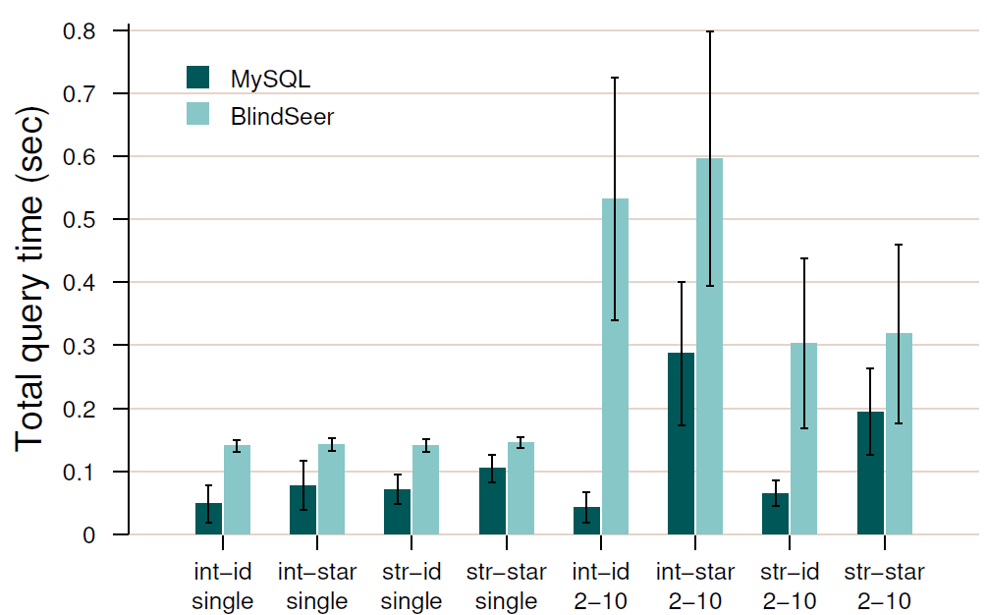
MySQL comparison

Slide 24
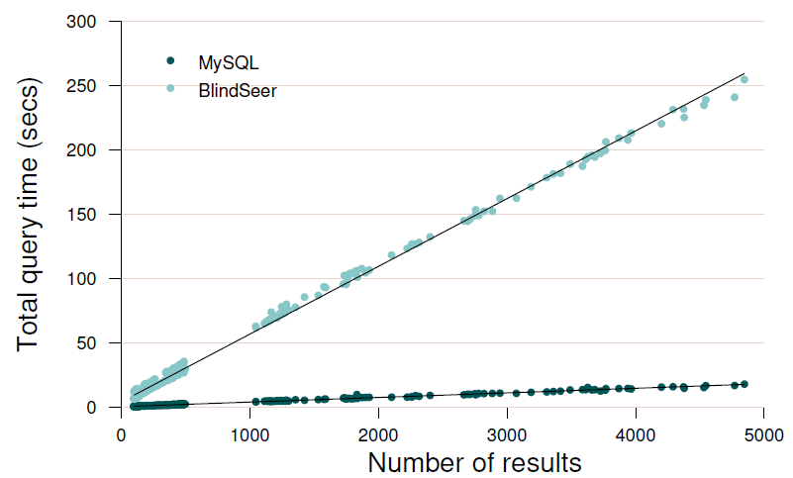
Result set scaling

Slide 25
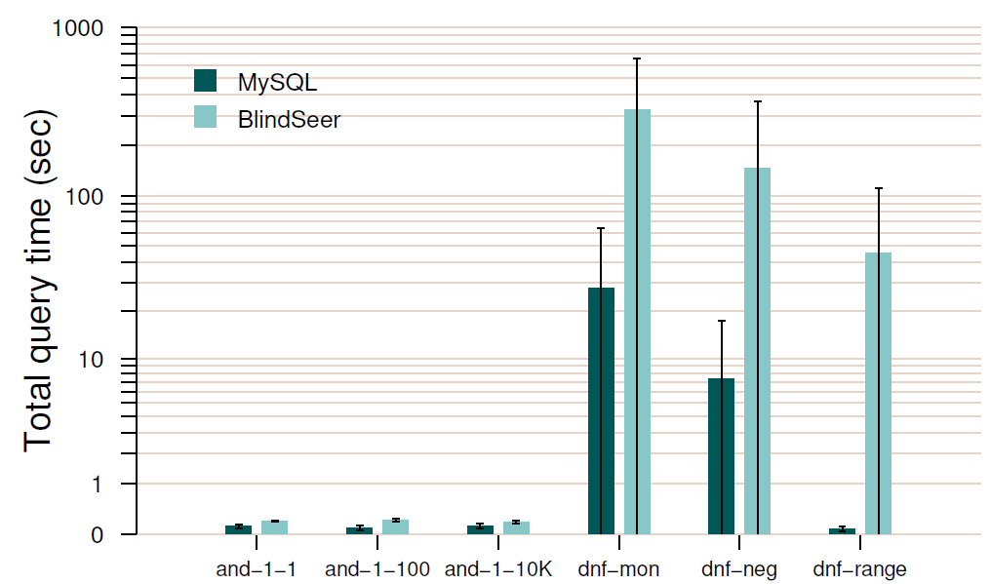
Boolean query performance

Slide 26
Optimizations, Advanced Features, And More

Slide 27
Optimizations
Parallelization
Naïve parallelizing multiple queries
Demonstrated up to 5x throughput benefit
More intelligent speedup intra-query
Tree traversal is the most expensive step
Node visits are mostly independent, and thus highly amenable to parallelization
In 16-core setup observed 16x improvement for traversal.

Slide 28
Optimizations
Better BF analysis
Currently 10^-6 false positive rate in all tree nodes
Much smaller FP rate is sufficient to achieve total 10^-6
BF FP are good for security:
Creates noise in tree traversal patterns
With 10^-3 FP, # circuit inputs is cut in half, and hence expect approx factor 2 performance improvement.
Observed about 50% improvement

Slide 29
Optimizations
Faster secure computation with GESS (vs garbled circuit)
Kolesnikov-Kumaresan (SCN 2012)
Approx 3x improvement in bandwidth vs best GC
Greatly improves performance on narrow channels
Working on translating this into speed improvement on fast LAN.
Observed about 50% improvement in experiments
Did not integrate into current code so far

Slide 30
Optimizations
Code optimization
Possibly most important for performance but effort-intensive
Interplay of LAN, caching, threads, RAM access
Plugging in improved OT extension code of ALSZ13 (CCS 2013) and Kolesnikov-Kumaresan13 (Crypto 2013)
Factor 3 improvement in OT => factor 1.5-2 overall (?)
Conflicted with the multithreaded libraries we used;
Did not integrate in our code

Slide 31
Privacy improvement: Search Tree Rebuilding

Slide 32
Why Rebuilding – Resource utilization (preprocessing phase)

Slide 33
Why Rebuilding – Resource utilization (query phase)

Slide 34
Search Tree Rebuilding
Use two Index Server boxes and switch between them
Algorithm
Same as preprocessing algorithm with fresh randomness
No re encryption of records needed – Really fast
RAM-only computation
Efficiency
Only the bloom filter index tree is rebuilt
Takes about 20 min to generate and transfer (vs 1-3 days of full DB init)
Security across rebuilds
Tree traversal information learnt by the client/IS is much less useful.
IS now sees new BFs with new hash fcns.

Slide 35
Policy Compliance
GC is strategically at the center of our approach because easy to compose.
Requirement: secure policy checking:
Policy rejection should look like a query no-match to C and S
implement policy as a GC computation whose output is an input to BF tree node GC computation.

Slide 36
Malicious Client Protection
Guarantee (roughly):
Actively cheating client cannot receive DB rows if the query is unauthorized.
Idea:
GC is secure against malicious evaluator.
Have IS generate the garbled circuit

Slide 37
Malicious Client
Secure policy enforcement and database privacy against maliciously behaving clients who may arbitrarily deviate from protocol
Why malicious? So far,
Query sent to the Query Checker which enforces policy can be completely different from the query sent to the Index Server
Client can change his decryption mask at will

Slide 38
Client Changing his mask
Recall:
We have Encrypted BF
Decryption Key is with the client – What if a Client changes it?

Slide 39
Client changing his mask
We provide analysis that asymptotically, a client changing his mask is not likely to succeed with sufficiently small probability
BF uses 30 bits per keyword and 20 hash functions
The average density of a bloom filter is about 1/2 with the false positive rate of 10^-6. There are tons of zeros when a keyword does not match
Flipping a random false negative involves correctly identifying a subset of size some c fraction (with c > 0 a constant) to flip. -> negligible probability (in number of BF bits used)

Slide 40
Malicious behavior in OT/Circuit generation
Index
Server
Big potential
for cheating
Client Query
For results
Client Query For Check
Query
Checker
Client

Slide 41
Malicious behavior in OT/Circuit generation
Index
Server
Client does not learn the
output of either the policy
Or the result. Learns only
garbled output
Garbled Universal
Circuit
(KS08)
Information to
Synchronize keys
Query
Checker
Garbled Query Check Circuit
Client

Slide 42
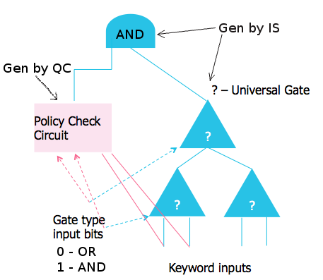
(Malicious.. ) Universal Circuit
IS generates universal circuit which evaluates any circuit on any input.
Circuit has a fixed tree pattern. The gates and inputs are unknown and provided by the client and IS
AND of policy check circuit and universal circuit performed
Inputs to PC and Evalualtion Circuits are cryptographically binded.

Slide 43
(Malicious.. ) Universal Circuit
IS generates universal circuit which evaluates any circuit on any input.
Circuit has a fixed tree pattern. The gates and inputs are unknown and provided by the client and IS
AND of policy check circuit and universal circuit performed
C’s input:
Gate type
?
?
?
Query Check
Circuit
? – Universal Gate

Slide 44
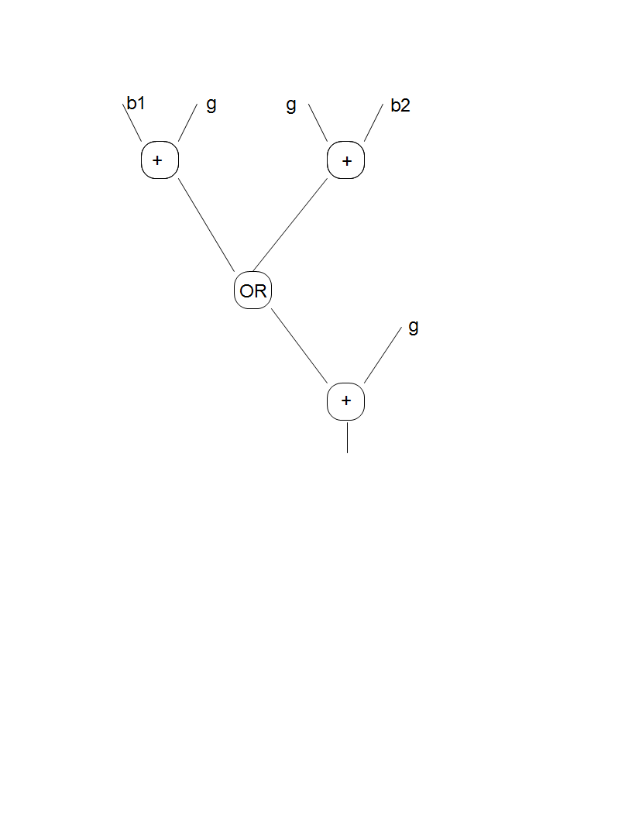
UC is cheap
If g is 0 (OR gate). then you have b_1 OR b_2
If g is 1 (AND gate), then you have NOT(NOT b_1 OR NOT b_2) = b_1 AND b_2
One non-XOR gate! (XOR gates are free KS08a)

Slide 45
Audits
With the client’s help
Client can reveal his query and entire randomness
Client cannot fool an auditor by revealing “wrong” randomness
Without the client’s help
Combine transcripts of S/IS/QC reveal most or all of client’s query
Bloom filter indices are derived based on “hash” values of the client query
Can convert hash value to an AES encryption and derive the indices from that
Server can “decrypt” any transcript to reveal query terms

Slide 46
“Practical” circuit for MPC
Unfinished search for MPC benchmark
Beets auction (private circuit?)
AES, DES, Mult, etc. Not clear how useful in “practical MPC”
“The SPAR Circuit”
We give you
Tree
Pairs of leaves XOR together and then form AND subtrees to evaluate BF
Output of this is fed into the query formula
Usually just a couple of ANDs; a log-domain OR for range or negations.

