Slide 1
Secure Computation for random access machines
Craig Gentry, shai halevi, charanjit jutla, Mariana raykova, Daniel wichs

Slide 2



Secure two party computation
Secure computation
protocol
X
Y
F(X,Y)
F(X,Y)
Security means: the parties cannot learn
more than what is revealed by the result

Slide 3
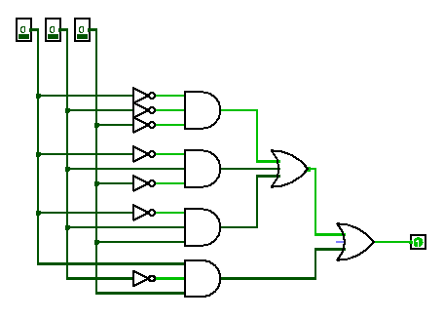
Computation with circuits
Evaluate (garbled) circuit gate by gate

Slide 4
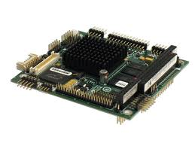

Computation with random access machines (RAMs)
LOAD #5
EQUAL 15
JUMP #6
HALT
STORE 15
LOAD #0
ADD #1
JUMP #3
LOAD #5
EQUAL 15
JUMP #6
HALT
STORE 15
LOAD #0
ADD #1
JUMP #3
LOAD #5
EQUAL 15
JUMP #6
HALT
STORE 15
LOAD #0
ADD #1
JUMP #3
CPU
memory
RAM representation always more efficient than circuit
RAM running time T ⇒ circuit size O(T³ log T) [CR73][PF79]
Notes:
Stephen A. Cook and Robert A. Reckhow. Time bounded random access machines
Nicholas Pippenger and Michael J. Fischer. Relations among complexity measures

Slide 5

Sublinear computations
Each record must be “touched”
Circuit as big as the memory even if computation is sublinear
Alice’s records must be on the left!
Accessed
Not Accessed
Find all records
for Alice

Slide 6
Secure computation with RAMS
memory
CPU
Secure computation with circuits of constant size
Oblivious RAM (ORAM) [GO’96]
Hides access pattern
Efficient – polylog access complexity
Shared ORAM parameters
Amortized secure two party computation proportional to the running time of the RAM [OS’97, GKKKMRV’12]
Reveals running time

Slide 7
Our work
Two Party Protocol: Private Keyword Search
Optimizations for Binary tree ORAM constructions
  Binary search in a single ORAM operation not log N
  Better concrete storage and computation overhead
    Lower depth binary tree
    Higher branching factor
    Deterministic eviction algorithm
Use homomorphic encryption for two party computation steps
  Devise protocols using low degree polynomials
  Explore benefits from such alternative implementation
    Communication
    Computation - particular protocols, e.g. comparison

Slide 8
ORAM Structure – Binary tree
[SCSL’11]
Notes:
Elaine Shi, T.-H. Hubert Chan, Emil Stefanov, and Mingfei Li

Slide 9

ORAM Structure – Binary tree
Database size: N
[SCSL’11]
Node size: log N

Slide 10

Record Leaf Identifier
[SCSL’11]
3
1
2
3
4
5
6
7
8

Slide 11
Possible Record Locations
[SCSL’11]
3
1
2
3
4
5
6
7
8

Slide 12

ORAM Look-Up
v
[SCSL’11]
1
2
3
4
5
6
7
8

Slide 13
Find Leaf Identifier
v
3
[SCSL’11]
1
2
3
4
5
6
7
8

Slide 14
Search Nodes on the Path
v
3
[SCSL’11]
1
2
3
4
5
6
7
8

Slide 15
Insert in Root Node
[SCSL’11]
3
1
2
3
4
5
6
7
8

Slide 16
Assign New Leaf Identifier
[SCSL’11]
7
1
2
3
4
5
6
7
8

Slide 17
Eviction
After each ORAM access
[SCSL’11]
1
2
3
4
5
6
7
8

Slide 18
Eviction
After each ORAM access
evict two nodes per level
[SCSL’11]
1
2
3
4
5
6
7
8

Slide 19
Eviction
OBLIVIOUSLY:
touch both children
After each ORAM access
evict two nodes per level
[SCSL’11]
4
1
2
3
4
5
6
7
8

Slide 20
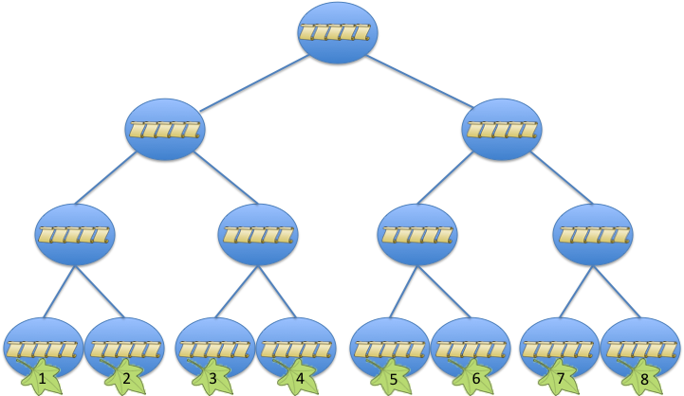
Look more carefully:
“Find Leaf Identifier”
v₁
[SCSL’11]
3
v₂
Client memory:
size of database
1
v₃
7
v_{N}
2

Slide 21
Recursive solution
v₁
[SCSL’11]
3
Record 1
v₂
Store recursively in a tree
1
PACK multiple address-leaf pairs in one record
v₃
7
Record 2
Record n/2
v_{N}
2

Slide 22
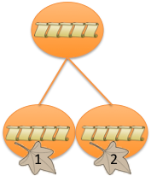
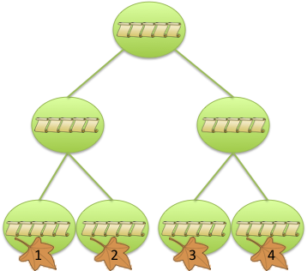
Recursive Solution
Scan to find leaf identifier in Tree 2
Search path to find leaf identifier in Tree 1
Search path to find record
Tree 3
Tree 2
Tree 1

Slide 23
ORAM Optimization

Slide 24
Reduce Tree Depth
Storage: from kN to 2N
Computation: from klog² N to k log²(N/k)
k items per node
log (N/k)
Reduce the depth of the tree
N/k leaves instead of N
Node size – 2k
log N

Slide 25
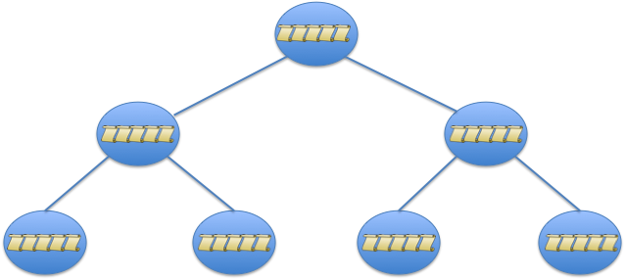
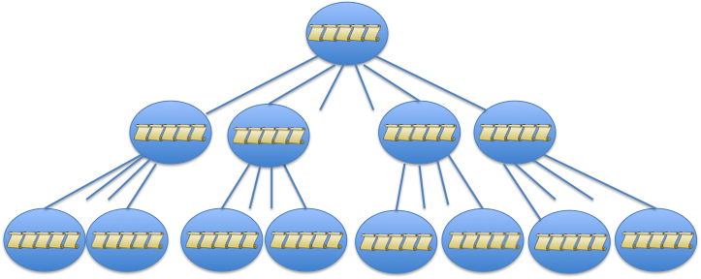
Increasing Branching factor
More nodes per level and smaller depth log_{k} (N/k)
Computation: k log²_{k} (N/k)
2 children
k children

Slide 26
Deterministic eviction
k children
Path ORAM [SDSFRYD’13]
Eviction on look-up path
Eviction:
  Access all k children – factor k overhead
  New eviction:
    Try to evict along a path from the root to a leaf
    Deterministic schedule for eviction: L = DigitReverse_{k}(t mod k^{height})
      nodes at each level accessed in round-robin order
Notes:
Emil Stefanov Marten van Dijk Elaine Shi Christopher Fletcher Ling Ren Xiangyao Yu Srinivas Devadas

Slide 27
Binary search
log N ORAM accesses → 1 ORAM access

Slide 28
ORAM Modification
Start with sorted data!
1
5
data1
2
20
data2
3
100
data3
4
500
data4
5
1001
data5
.
.
.
.
.
.
.
.
.

Slide 29
Intermediate tree record
v^{i}₁
Each data item in an intermediate tree consists of value-leaf pairs
Record 1
3
v^{i}₂
1
v^{i}₃
Record 2
7
Record n/2
v^{i}_{k}
2

Slide 30
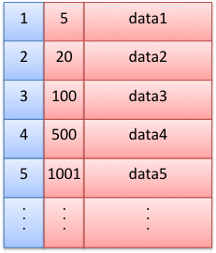
Search for a Virtual Address
v
During search in an intermediate tree T_{i}:
Use a leaf label L^{i} found in the previous tree
Search for virtual address v^{i} derived from v and the tree number i
Identify the data for v^{i} - address-leaf pairs
Find the pair (v^{i-1}, L^{i-1}): v^{i-1} derived from v
MatchedRecord
v^{i}₁
3
v^{i}₂
1

Slide 31
Additional Data in Intermediary node
Store the data range corresponding to the items in top tree that map to each virtual address in the intermediate tree
v₁ -> d₁
v₂ -> d₂
v^{i-1}₁ -> d^{i-1}₂
Largest tree records
v_{k} -> d_{k}
v^{i-1}_{k’} -> d^{i-1}_{k’}
v^{i}₁
d₁ , d_{k}
3
Record
v_{k+1} -> d_{k+1}
v^{i-1}_{k’+1} -> d^{i-1}_{k’+1}
v^{i}₂
d_{k+1} , d_{2k}
v_{k+2} -> d_{k+2}
1
v^{i-1}_{2k’} -> d^{i-1}_{2k’}
v_{2k} -> d_{2k}

Slide 32
Search for a Data Value
During search in an intermediate tree T_{i}:
Use a leaf label L^{i} found in the previous tree
Search for virtual address v^{i} from the previous tree
Identify the data for v^{i} - address-leaf pairs
Check the range for each pair and select the one that contains d
d
v^{i}₁
d₁ , d_{k}
3
Record
v^{i}₂
d_{k+1} , d_{2k}
d_{k+1} <= d <= d_{2k}
1
search value

Slide 33
Two Party computation with homomorphic encryption

Slide 34
Equal-to-Zero Protocol
Client chooses random 𝑛-bit 𝑅, sends to server 𝐶 = 𝐻𝐸_{𝑠𝑒𝑟𝑣𝑒𝑟}(𝑋 + 𝑅)
  Note, 𝐶 encrypts 𝑅 iff 𝑋 = 0
Also sends 𝐶_{𝑖} = 𝐻𝐸_{𝑐𝑙𝑖𝑒𝑛𝑡}(𝑅_{𝑗})
  𝑗’th bit of 𝑅, plaintext space mod-2^{𝑚}, 2^{𝑚} > n
Server decrypts 𝑋 + 𝑅, xors the bits into 𝐶_{j}’s
  Using a⊕𝑏=𝑎+𝑏−2𝑎𝑏(𝑚𝑜𝑑 2^{𝑚})
  Gets 𝐶’_{𝑗} = 𝐻𝐸_{𝑐𝑙𝑖𝑒𝑛𝑡}(𝑅_{𝑗} ⊕ (𝑋 + 𝑅_{𝑗}))
  Note: 𝑋 = 0 iff all the 𝐶’_{𝑖}’s encrypt 0’s

Slide 35
Equal-to-Zero Protocol
Summing up the 𝐶’_{𝑖} ’s, server gets 𝐻𝐸_{𝑐𝑙𝑖𝑒𝑛𝑡}(𝑌)
  𝑌=0 iff 𝑋=0
  Gain: plaintext space mod 2^{𝑚} rather than 2^{𝑛}
Repeat this procedure again, reducing the plaintext space to 𝑙 ≈ log₂ 𝑚
  After log 𝑛 iterations get plaintext space mod-4
  At this point we can use depth-2 circuits

Slide 36
(ROUGH) Comparison
[GKKKMRV’12]
✦
HE implementation
DB size = 2²²
item size = 112 bits
GC implementation
DB size = 2¹⁸
item size = 512 bits
22

Slide 37
Conclusions
Use RAMs for secure computation
Specialized ORAM – integrate computation for the functionality in the ORAM access algorithm
Low degree homomorphic encryption with SIMD operations can be efficient

Slide 38

Thank you!

