Slide 1



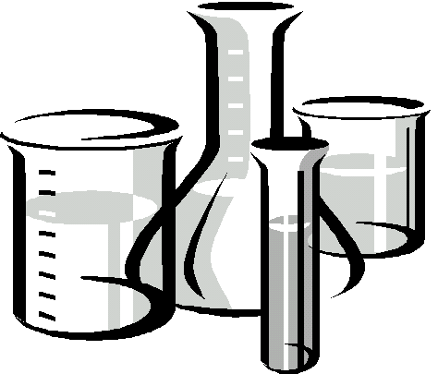
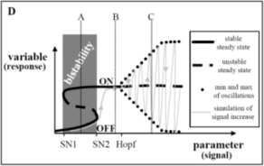
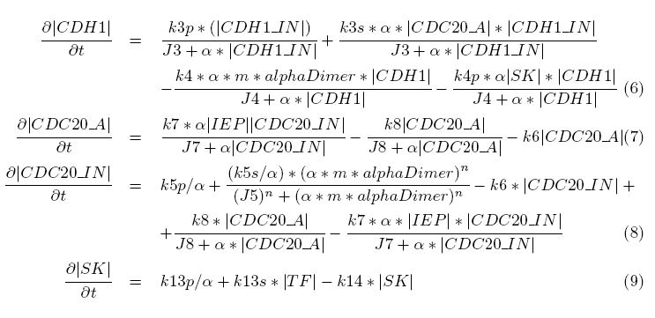
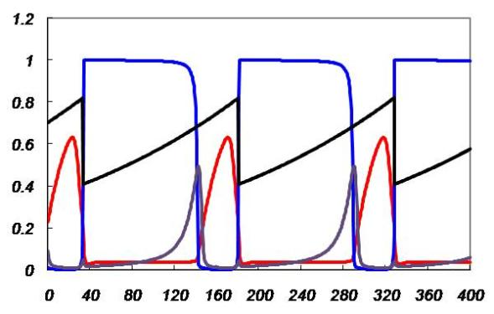
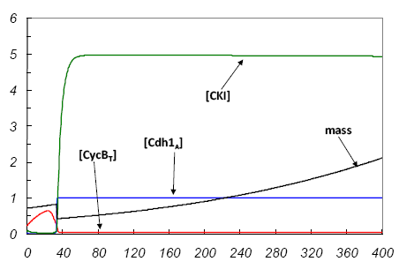
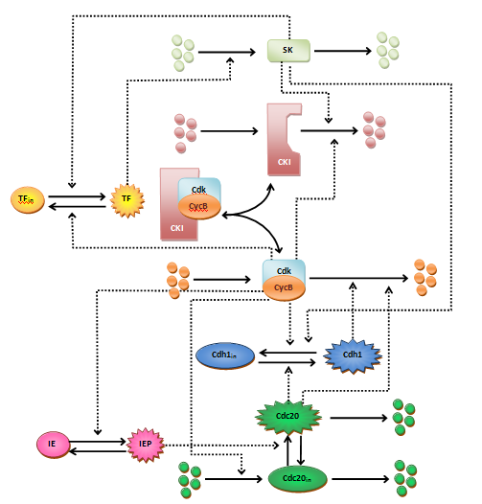
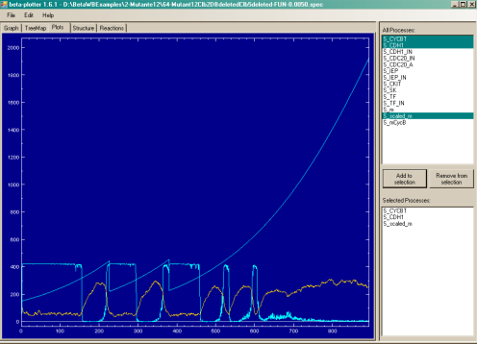

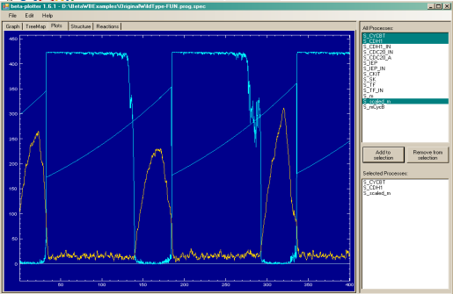
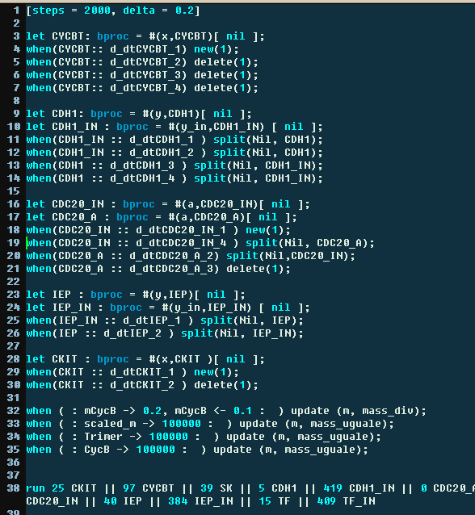
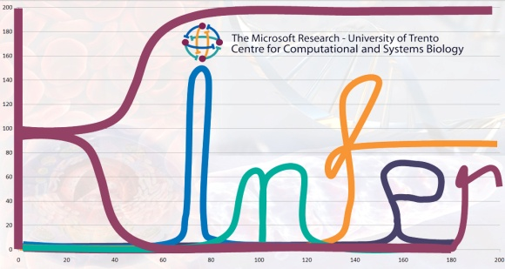



h
e
C
y
c
l
h
e
C
y
c
l
T
e
t
e
M
g
of
m
g
o
d
e
l
i
n
o
d
e
l
i
n
Alida Palmisano
The Microsoft Research – University of Trento Centre for Computational and Systems Biology
Dipartimento di Ingegneria e Scienza dell'Informazione, Università di Trento
The background
Computer Science has been (and is) used to support Biology in the storage and analysis of huge amounts of data: this is a service of Computer Science to Biology. This approach can be modified in a more peer-to-peer vision, where Computer Science can grab solution strategies from biological phenomena (e.g. applying the genetic selection/mutation mechanism to the optimization problem: this has been called Genetic Algorithm [1]) and Computer Science can be used to tackle the complexity of biological phenomena (e.g. using strategies that has been used in theoretical computer science to analyze complex code).
Our approach
Abstract models of biological systems are becoming an indispensable conceptual and computational tool for biologists.
A model is a “representation of the essential aspects of an existing system which presents knowledge of that system in usable form” [2]. In order to be useful, the model has to be computable, to allow automatic analysis, and extensible, to permit the addition of further details without changing too much the already modeled knowledge.
The classical modeling approach in biology is the mathematical one. After the work of Regev et al. [3] a promising trend is to use a programming language based approach to generate executable models at a linguistic level. This strategy drastically diverges from the classical mathematical modeling, because it is executable and not just simply solvable and it is very similar to programming the behavior of a system rather than describing only its outcome with respect to time.
The classical modeling cycle
(new)
Wet Experiments
Model Parameters Inference
Model 1
Model 2
...
Model N
Model Discrimination
Model Structure Inference
Solution
Analysis of parameters and structure
(a posteriori)
Ranking of parameters
The executable modeling cycle
Model of the Budding Yeast Cell Cycle
supported by our tools
(new)
Wet Experiments
Model Parameters Inference
[4]
Model Discrimination
Model 1
Model 2
...
Model N
Execution
[5]
Programming
Model Structure Inference
[4]
Analysis of parameters and structure
(a posteriori)
Ranking of parameters
References:
[1] D.E. Goldberg, Genetic algorithms in search, optimization and machine learning, Addison Wesley (1989)
[2] P. Eykhoff, System identication: Parameter and state estimation, John Wiley and Sons, London, UK (1974)
[3] A. Regev , E. Shapiro, Cells as computation,Nature (2002)
[4] L. Dematté, C. Priami, A. Romanel, The Beta Workbench: a computational tool to study the dynamics
of biological systems, Briefings in Bioinformatics (2008)
[5] P. Lecca, G. Sanguinetti, A. Palmisano, C. Priami,
A new method for inferring rate coefficients from experimental
time-consecutive measurements of reactant concentrations.
Proceedings of ICSB 2007, (2007)

