Slide 1

Interactive Matting
Christoph Rhemann
Supervised by:
Margrit Gelautz and Carsten Rother

Slide 2
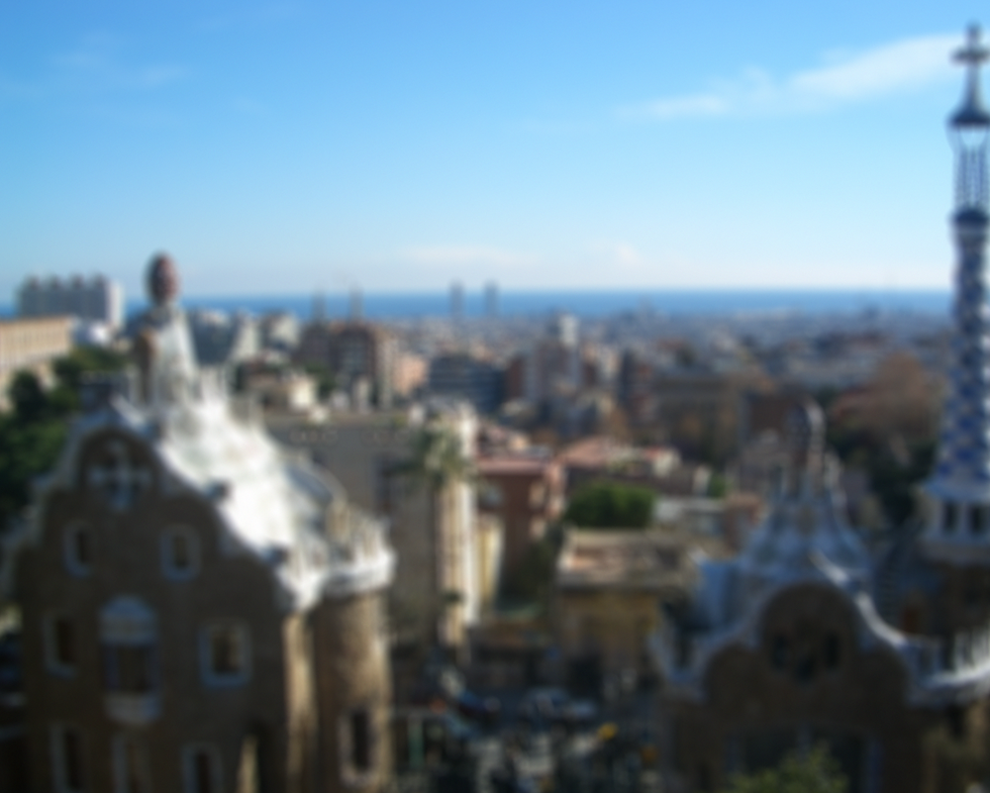

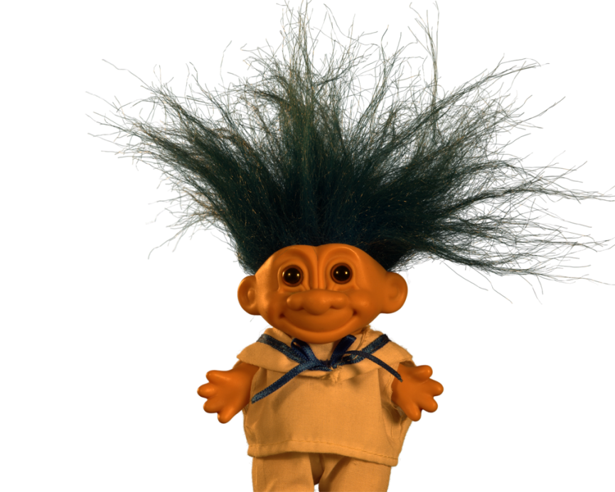
Matting and compositing

Slide 3
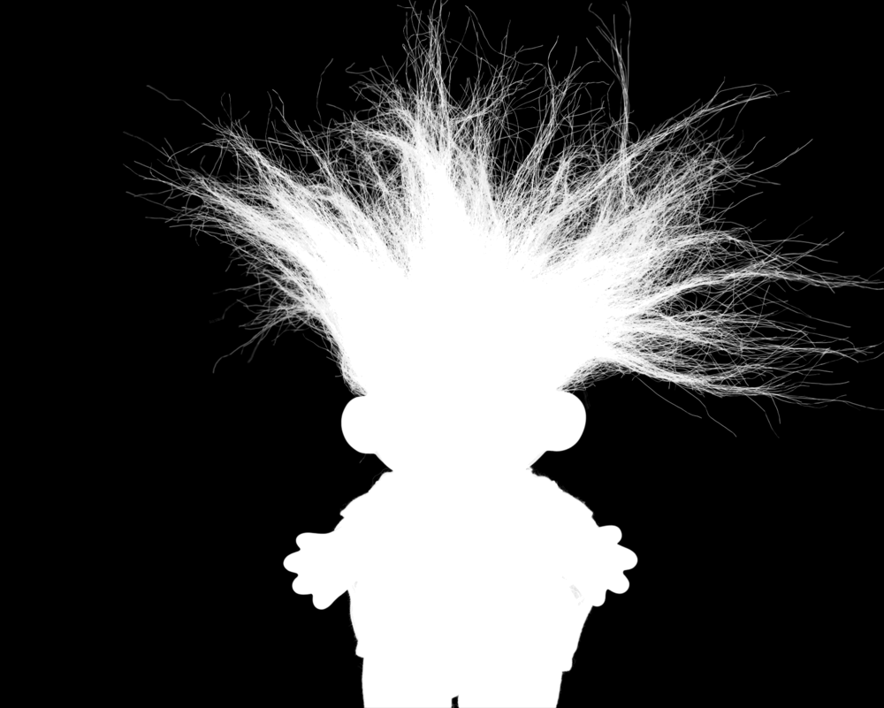
Matting and compositing

Slide 4
Outline
Talk Outline:
  Introduction & previous approaches
  Our matting model
  Evaluation strategy

Slide 5
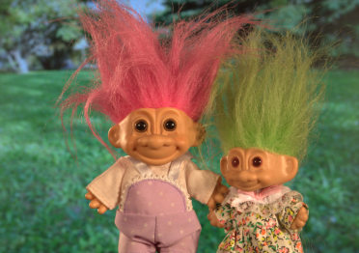
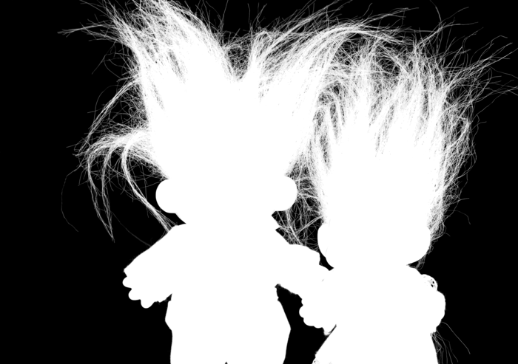
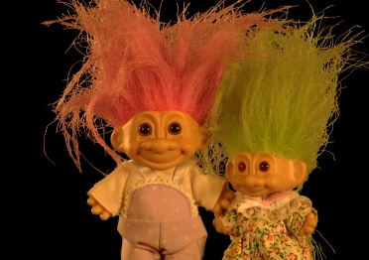
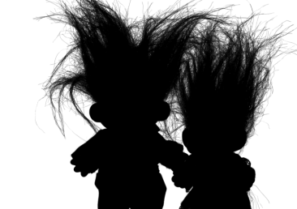
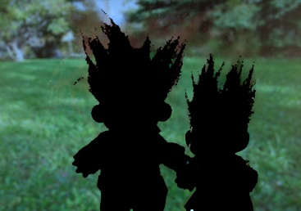
Matting is ill posed
=
●
+
●
C^{r,g,b} = α F^{r,g,b} + (1 - α) B^{r,g,b}
●
●
Inverse process of compositing:
Determine: F, B, α
Given: C

Slide 6
Matting is ill posed
=
●
+
●
C^{r,g,b} = α F^{r,g,b} + (1 - α) B^{r,g,b}
●
●
C^{r} = α F^{r} + (1 - α) B^{r}
C^{g} = α F^{g} + (1 - α) B^{g}
C^{b} = α F^{b} + (1 - α) B^{b}
Underconstrained problem:
7 Unknowns in only 3 Equations

Slide 7
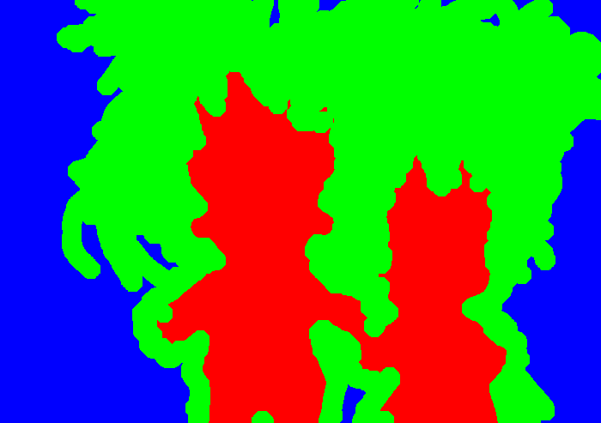
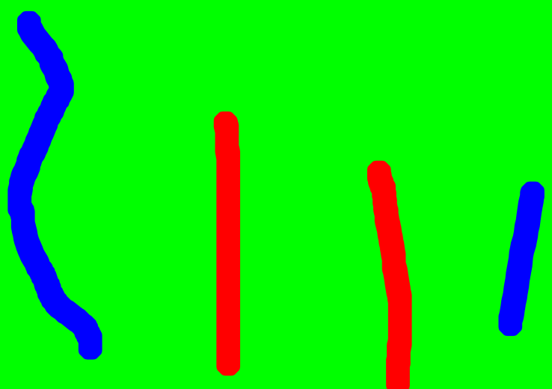
User interaction
Trimap
Scribbles
Unknown
Foreground
Background
Unknown
Background
Foreground

Slide 8
Previous approaches
Recall compositing equation:
C = α F + (1 – α) B
●
●

Slide 9
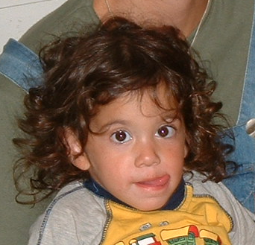


Previous approaches
C = α F + (1 – α) B
  Closed Form Matting [Levin et al. 06]
Recall compositing equation:
●
●
B
R
G

Slide 10
Previous approaches
C = α F + (1 – α) B
  Closed Form Matting [Levin et al. 06]
    Assumption: F and B colors in a local window lie on color line
Recall compositing equation:
●
●
B
R
G

Slide 11
Previous approaches
C = α F + (1 – α) B
  Closed Form Matting [Levin et al. 06]
    Assumption: F and B colors in a local window lie on color line
    Analytically eliminate F,B.
    Alpha can be solved in closed form
Recall compositing equation:
●
●
B
R
G

Slide 12
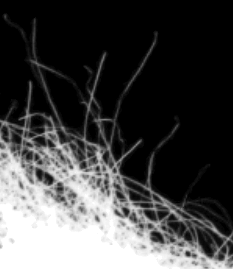
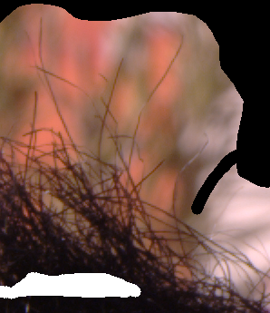
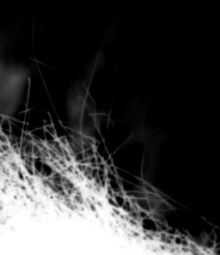
Previous approaches
  Result of Closed Form Matting [Levin et al. 06]:
    Result imperfect: Hairs cut off
    Problem: Cost function has large solution space
True Solution
Input image + Trimap
Result of [Levin et al 06]

Slide 13
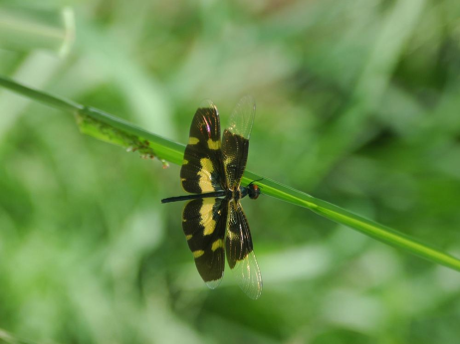
Segmentation – based matting
  What are the reasons for pixels to be transparent?
Defocus Blur

Slide 14
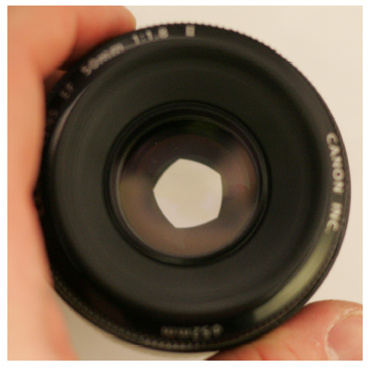
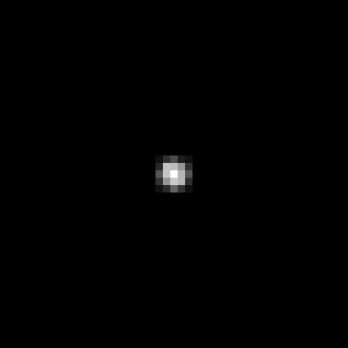
Lens and defocus
Lens’ aperture
Point Spread Function
Lens
Camera sensor
Point spread function
Focal plane
Slides by Anat Levin

Slide 15
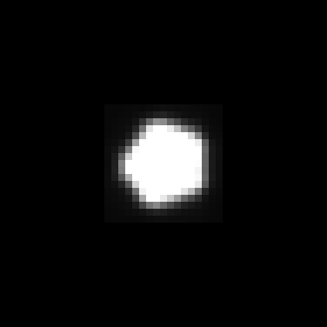
Lens and defocus
Lens’ aperture
Point Spread Function
Object
Lens
Camera sensor
Point spread function
Focal plane
Slides by Anat Levin

Slide 16
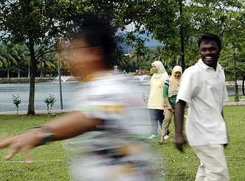
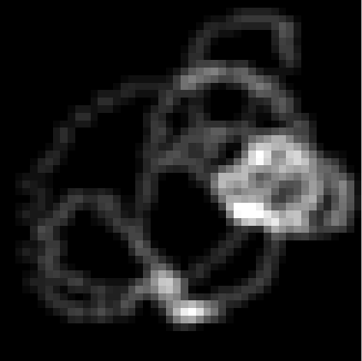
Segmentation – based matting
  What are the reasons for pixels to be transparent?
Defocus Blur
Motion Blur
PSF for
Motion Blur

Slide 17
Segmentation – based matting
  What are the reasons for pixels to be transparent?
Defocus Blur
Motion Blur
Discretization

Slide 18
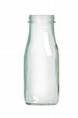
Segmentation – based matting
  What are the reasons for pixels to be transparent?
    → Observation: Apart from translucency mixed pixels are caused by camera’s Point Spread Function (PSF)
Defocus Blur
Motion Blur
Discretization
Translucency

Slide 19
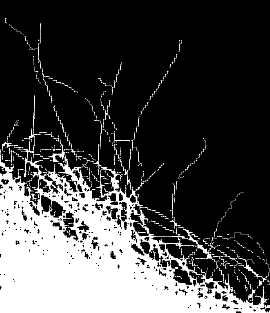
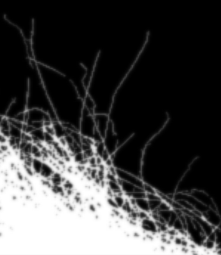
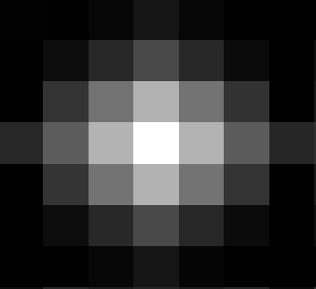
Model for alpha
  Basic idea:
  Model alpha as convolution of a binary segmentation with PSF
  Approach taken [Rhemann et al. 08]:
  Use this model as prior in framework of [Levin et al. 06]
Input image + Trimap
Binary segmentation
PSF
Observed alpha

Slide 20
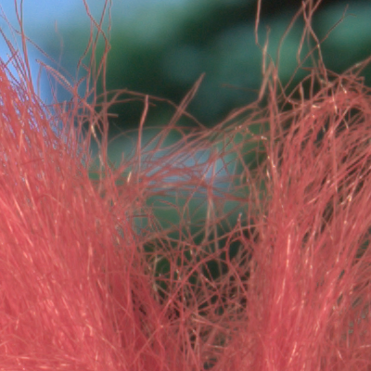
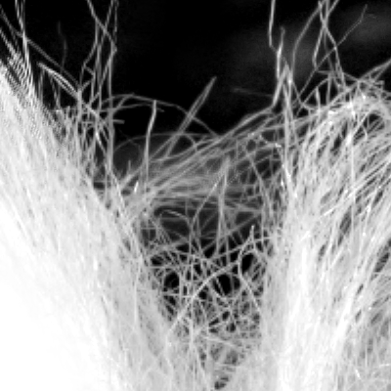
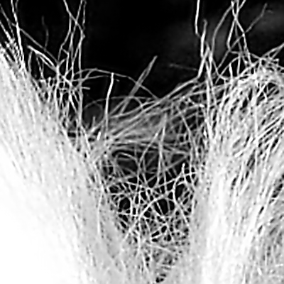
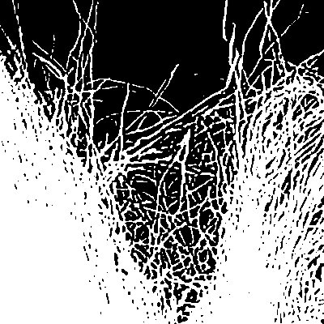
Matting process
Input image
Iterate a few times
Initial alpha using [Wang et al. ´07]
(Result is imperfect)
Initialize PSF/
deblur alpha
Deblured (sparse) alpha
Binarized (sparse) alpha using gradient preserving MRF prior

Slide 21
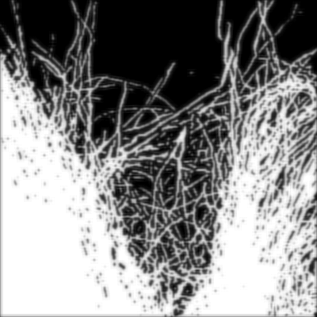
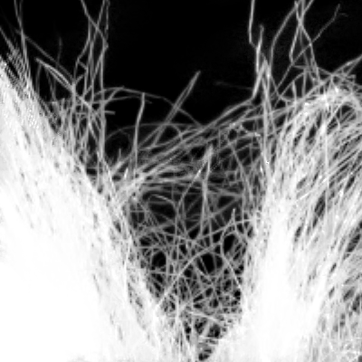
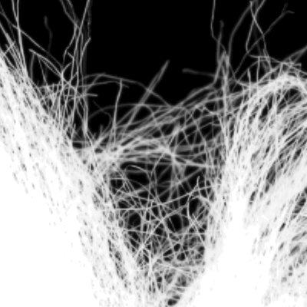
Matting process
Binarized (sparse) alpha using gradient preserving MRF prior
Segmentation prior
Final alpha
Ground truth

Slide 22

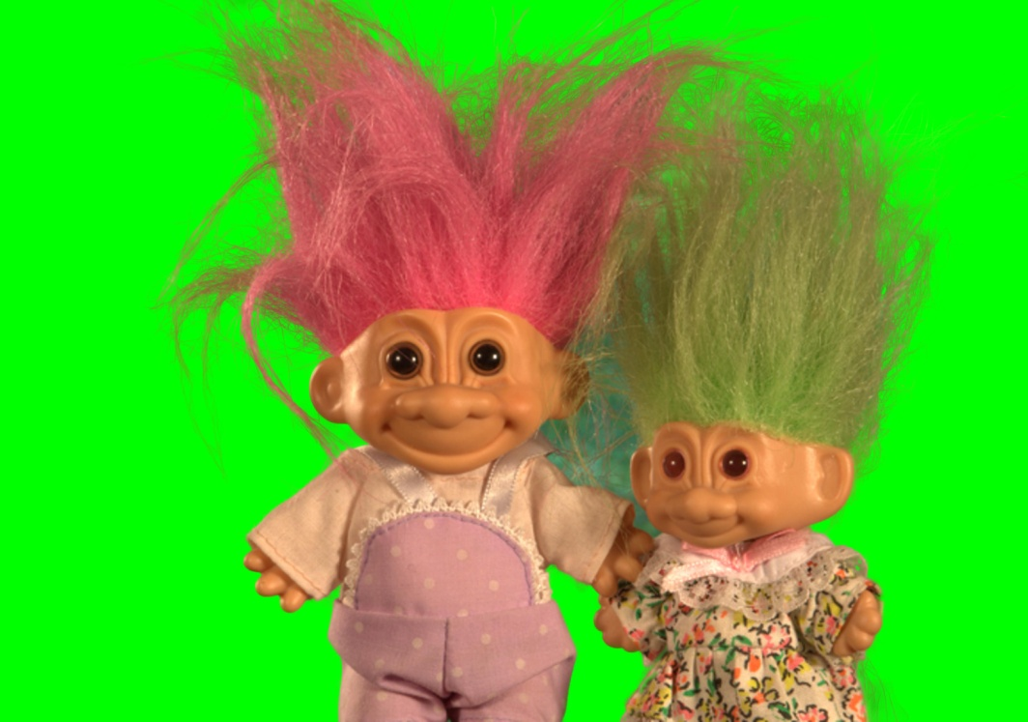
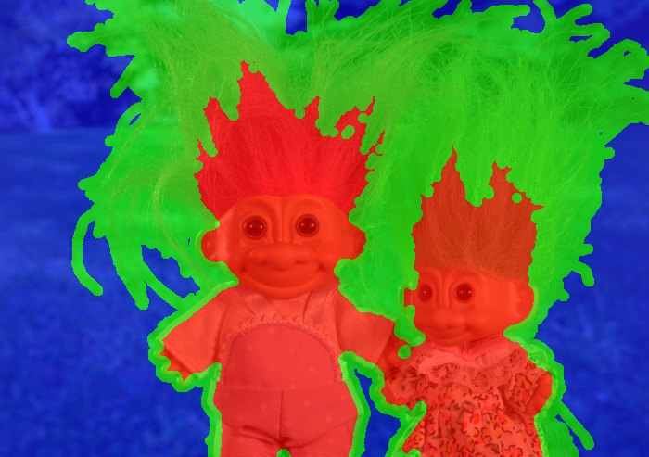
Comparison
Input image
Result for [Levin et al. ’06]
Input image + trimap

Slide 23

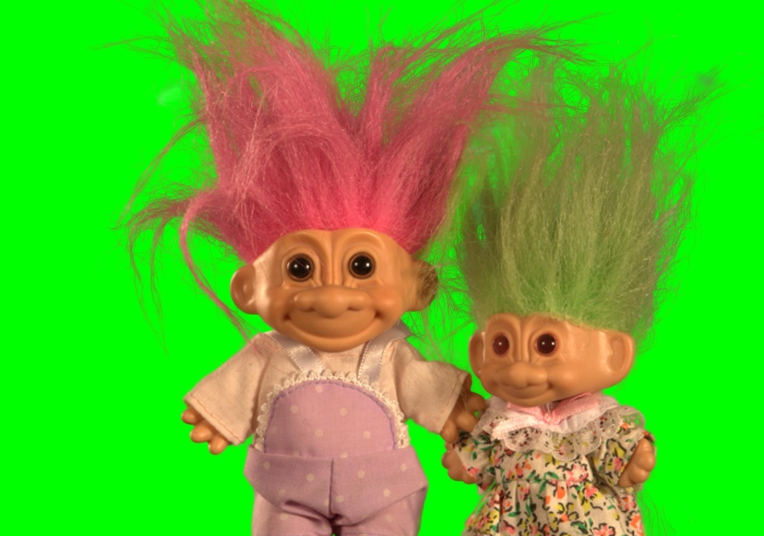
Comparison
Input image
Result of [Wang et al. ’07]
Input image + trimap

Slide 24
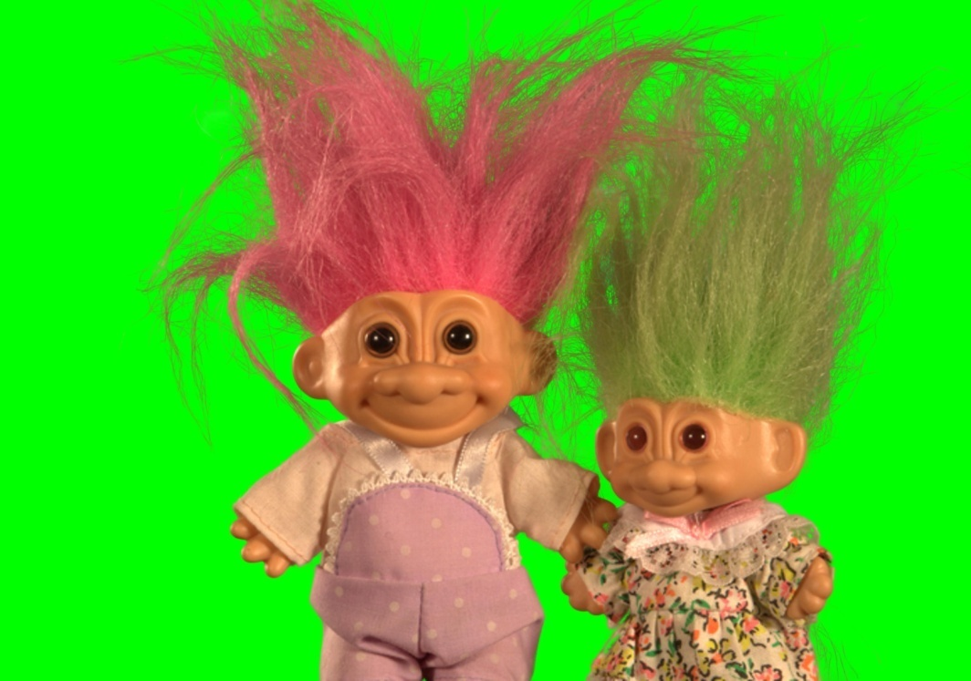
Comparison
Input image
Result of [Rhemann et al. ’08]
Input image + trimap

Slide 25
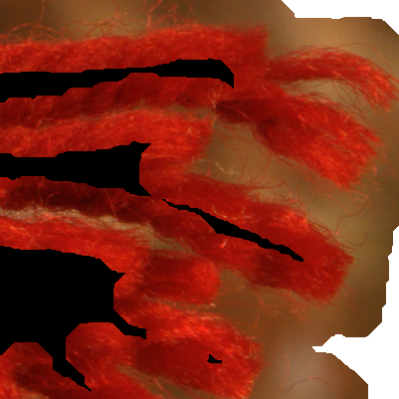
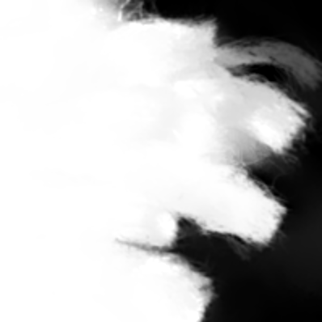
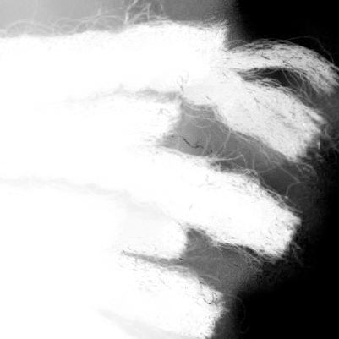

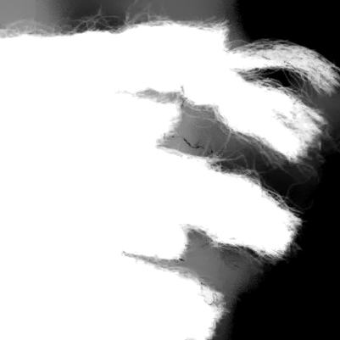
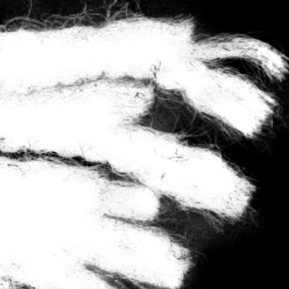
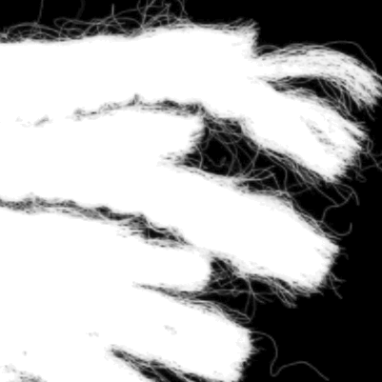
Comparison – Close up
Input image + trimap
[Levin et al. ’07]
[Levin et al. ’06]
[Wang et al. ’07]
[Rhemann et al. ’08]
Ground truth alpha

Slide 26
Evaluation of matting algorithms
  How to compare performance of algorithms?
  Showing some qualitative results
  OR
  Quantitative evaluation using reference solutions

Slide 27
Evaluation of matting algorithms
  Key Factors for a good quantitative evaluation
    Ground truth dataset
    Online evaluation
    Perceptual error functions

Slide 28
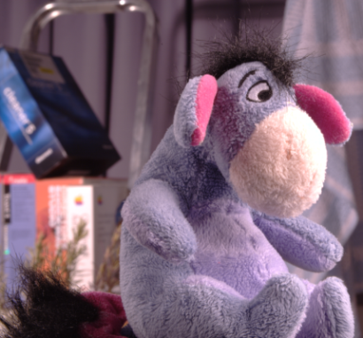
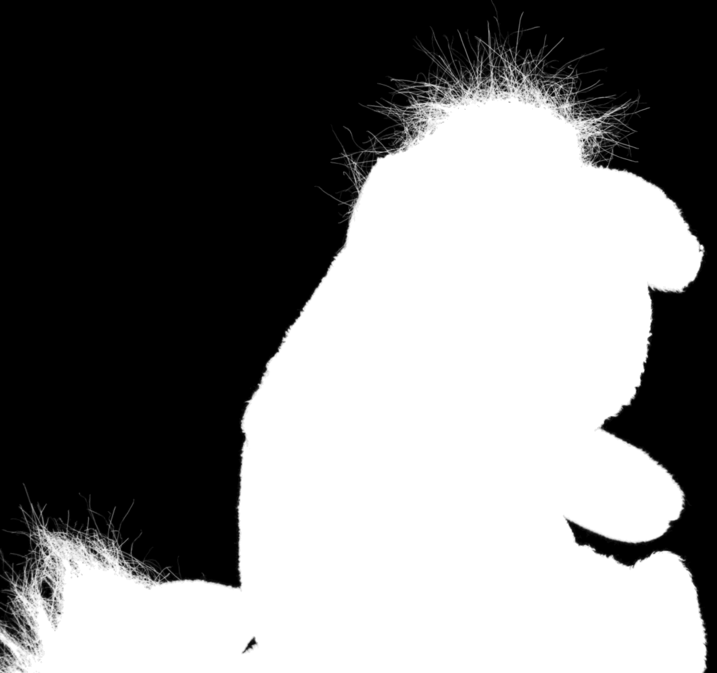
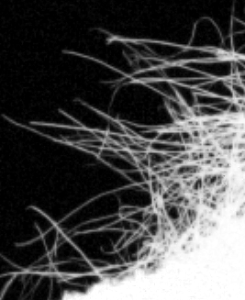
Ground truth dataset
  35 natural images
  High resolution
  High quality
  Triangulation Matting [Smith, Blinn 96]
  - Photograph object against 2 different backgrounds
  → True solution to matting problem
Input image
Ground truth
Zoom in

Slide 29
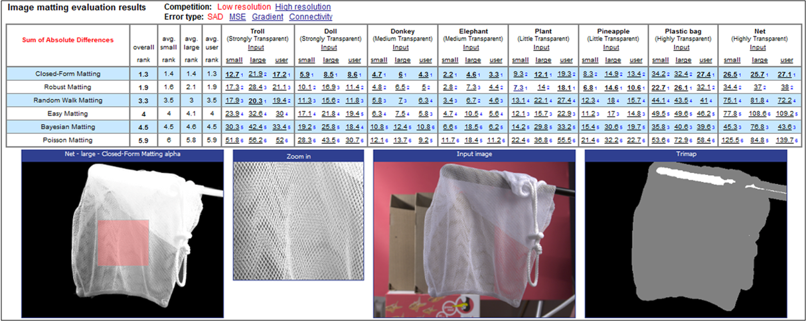
Online evaluation
  Data and evaluation scripts online
  Advantages:
    Investigate results
    Upload novel results
www.alphamatting.com

Slide 30
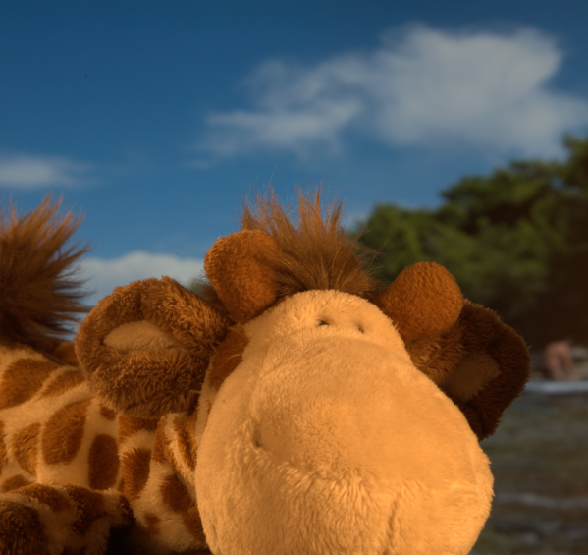



Perceptually motivated error functions
  Motivation:
  Simple metrics not always correlated with visual quality
Input image
Zoom in
Result 1
SAD: 1215
Result 2
SAD: 806

Slide 31
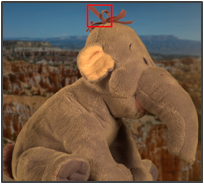



Perceptually motivated error functions
  Develop error measures for two properties:
    Connectivity of foreground object
    Gradient of the alpha matte
Input image
Zoom in
Result 1
SAD: 312
Result 2
SAD: 83

Slide 32
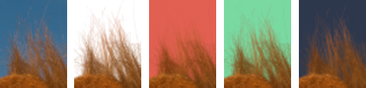
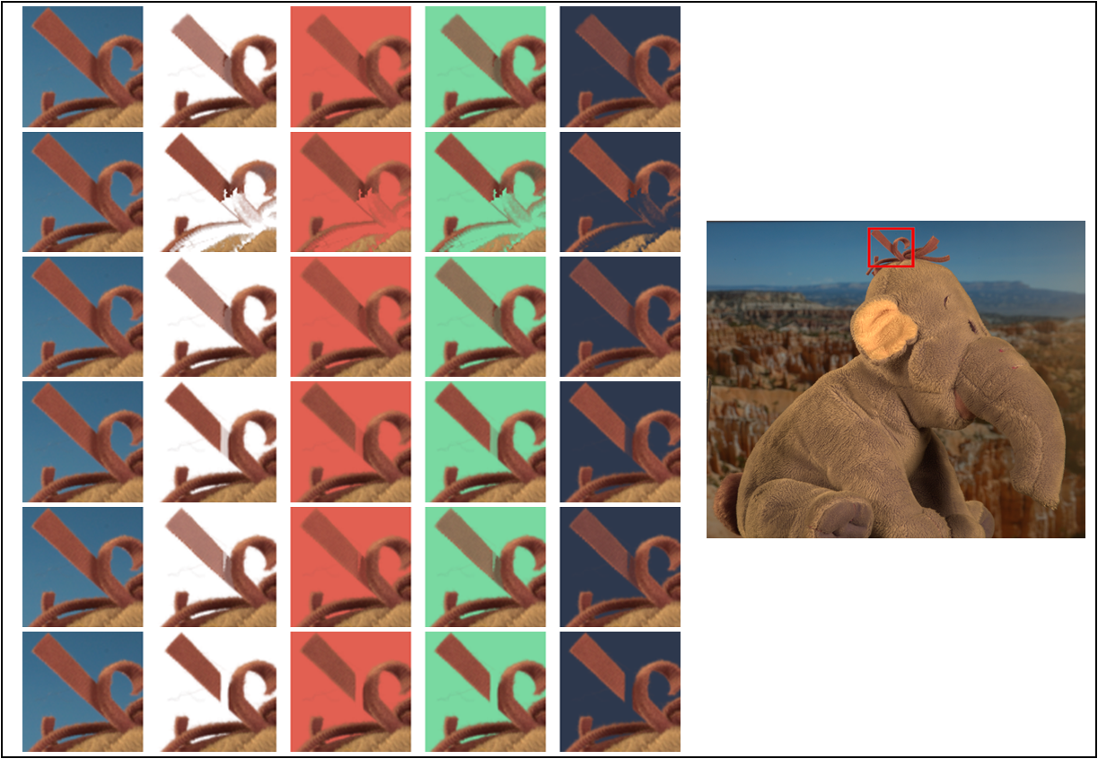
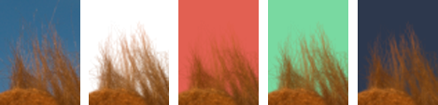





Perceptually motivated error functions
  User Study:
    Goal: Infer visual quality of image compositions
    Task: Rank to according to how realistic they appear
Gradient artifacts
Connectivity artifacts

Slide 33
Perceptually motivated error functions
  Correlation of error measures to average user ranking

Slide 34
Conclusions
  Model for alpha → overcomes ambiguities
  Model-based algorithm: Performs better than competitors
  Perceptual motivated evaluation
  Message to you: Evaluation of your algorithm is important
    Use ground truth data to make quantitative comparisons
    Use a large dataset
    Use a training / test split

Slide 36

Previous approaches
C = α F + (1 – α) B
  Data driven approaches (e.g. [Wang et al. 07])
    Model color distribution of F and B (from the user defined trimap)
    Observed color more likely under F or B model?
    Use likelihood in framework of [Levin et al 06]
Recall compositing equation:
●
●
B
Model of F
Model of B
R
Observed color
G

Slide 37

Previous approaches
  Result of data driven approaches [Wang et al. 07]:
    Hair is better captured
    Many artifacts in the background
True Solution
Input image + Trimap
Result of [Levin et al 06]
Result of [Wang et al 07]

