Slide 1
Third Generation Machine Intelligence
Christopher M. Bishop
Microsoft Research, Cambridge
Microsoft Research Summer School 2009

Slide 2

First Generation
“Artificial Intelligence” (GOFAI)
Within a generation ... the problem of creating ‘artificial intelligence’ will largely be solved
Marvin Minsky (1967)
Expert Systems
  rules devised by humans
Combinatorial explosion
General theme: hand-crafted rules

Slide 3
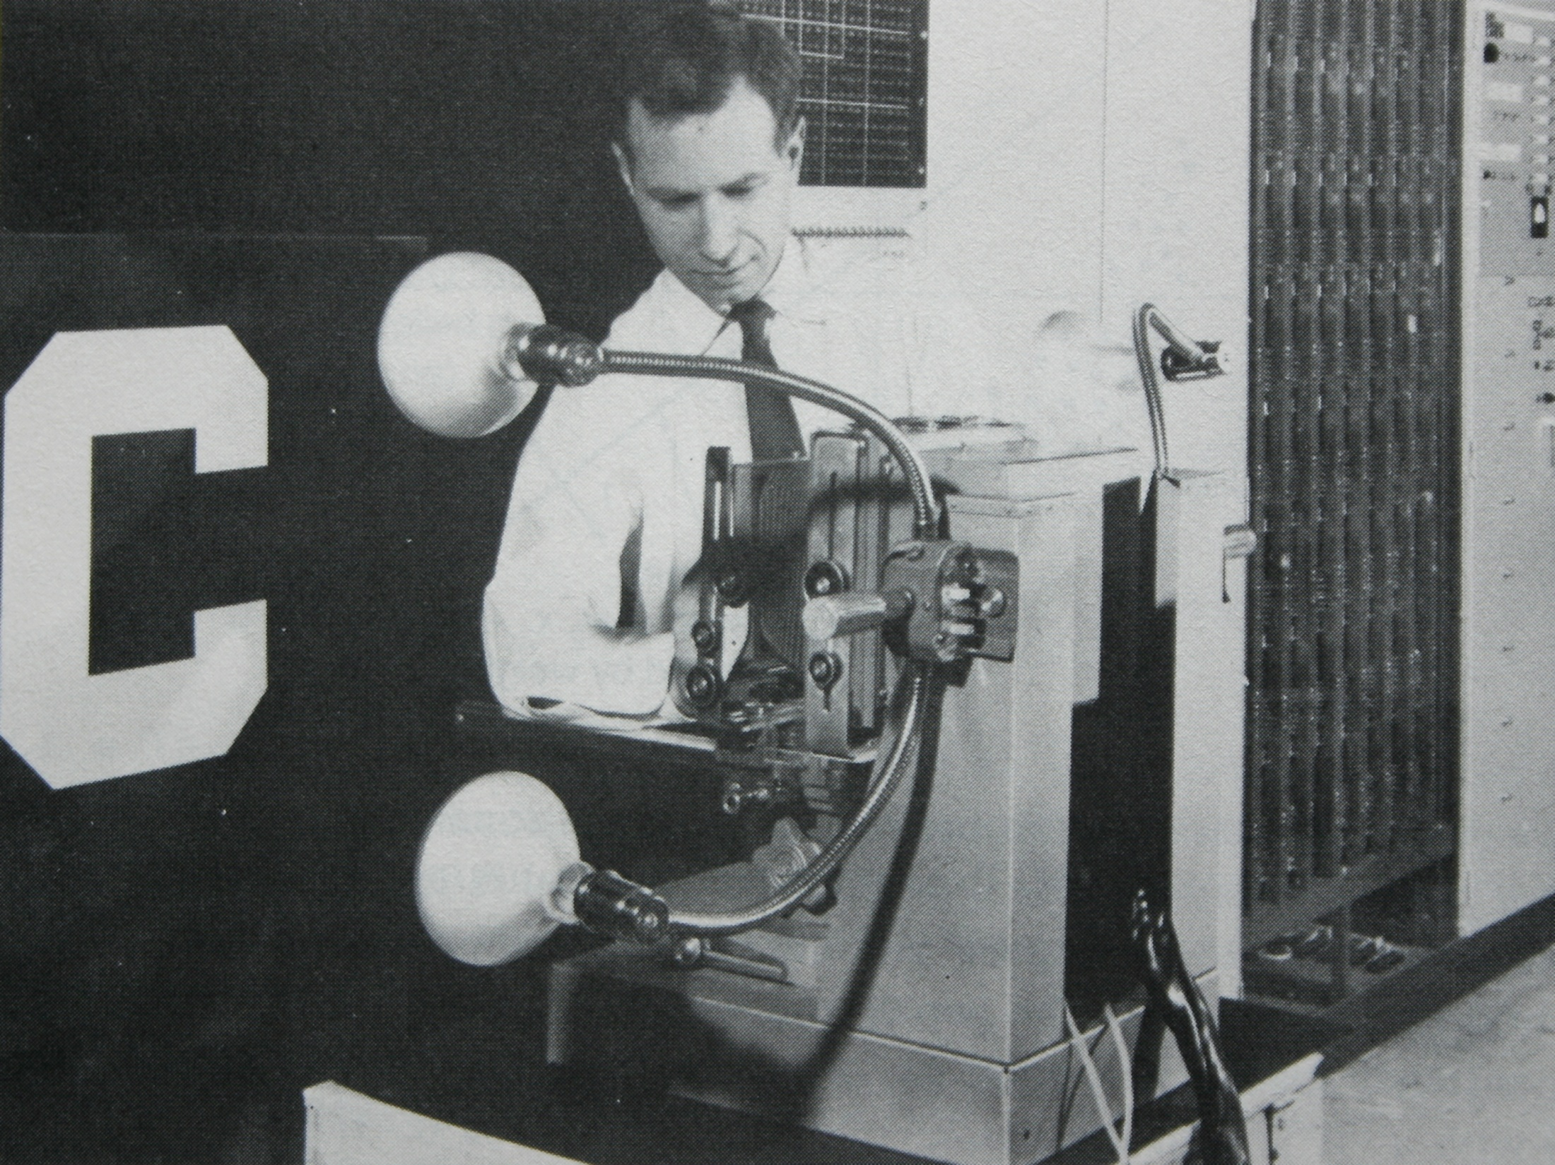
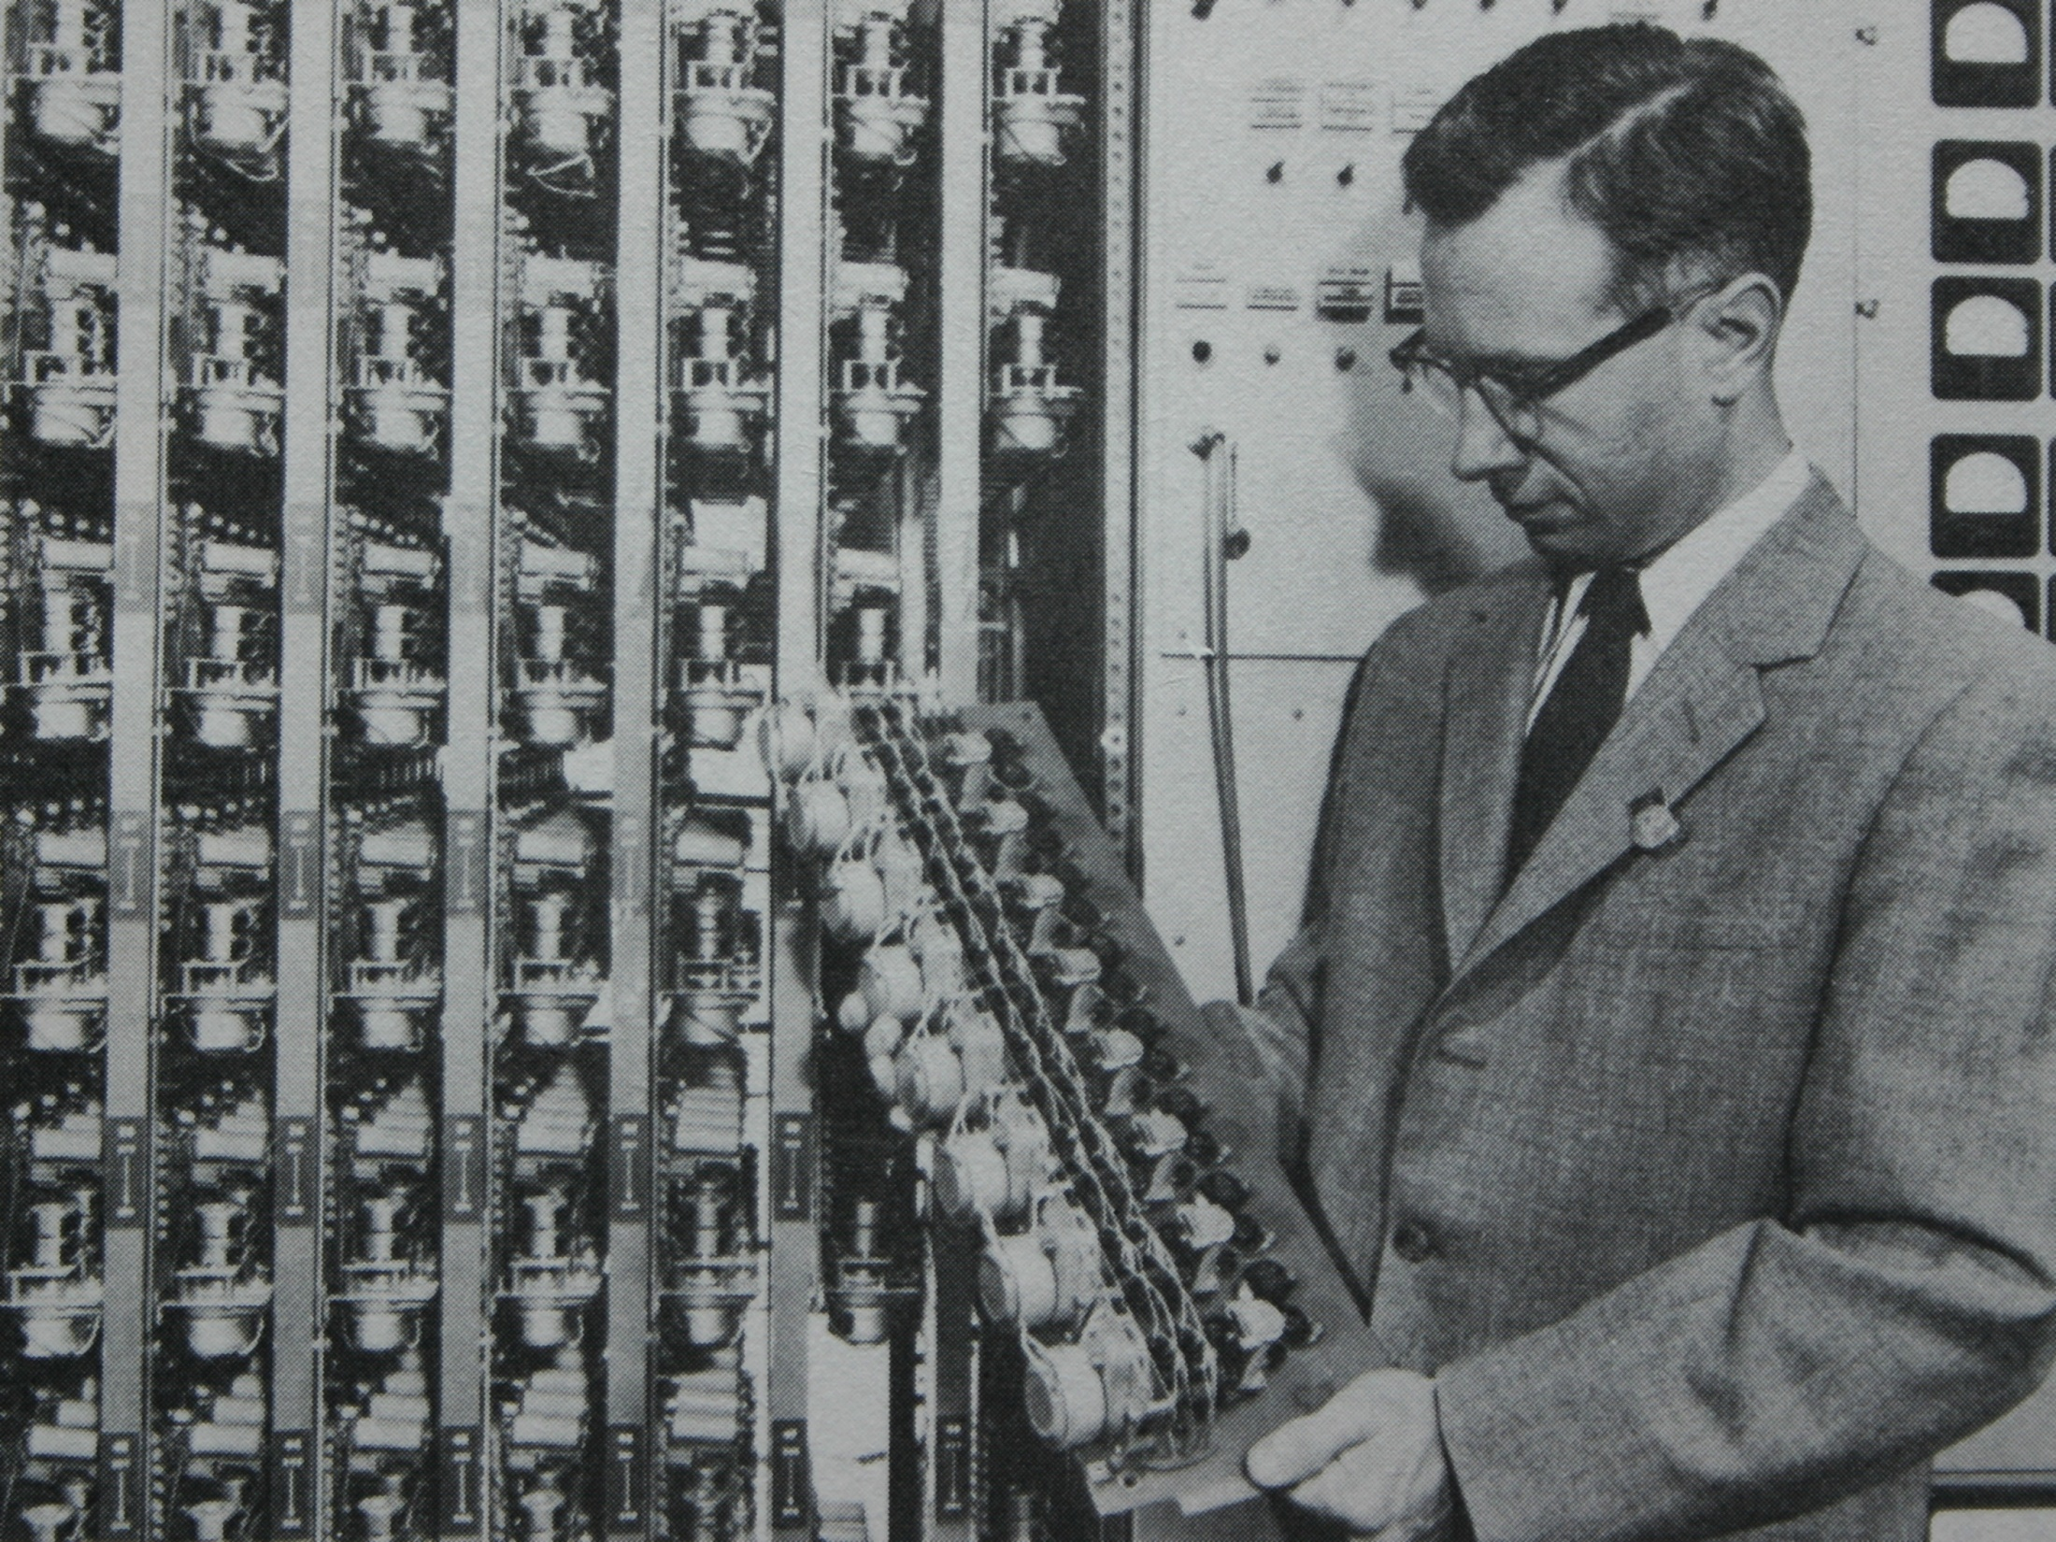
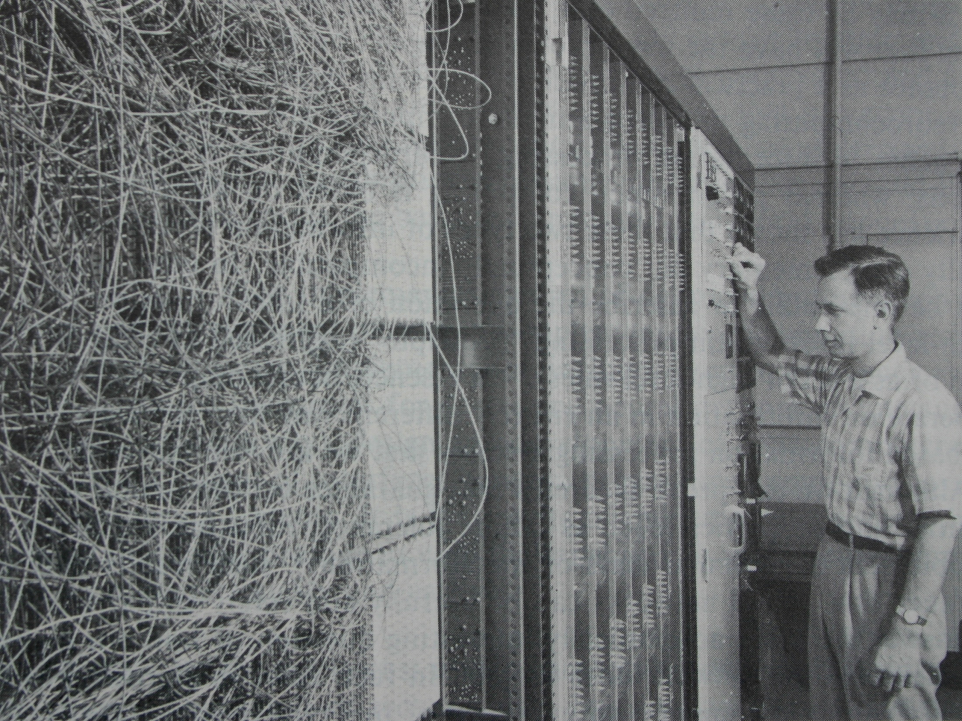
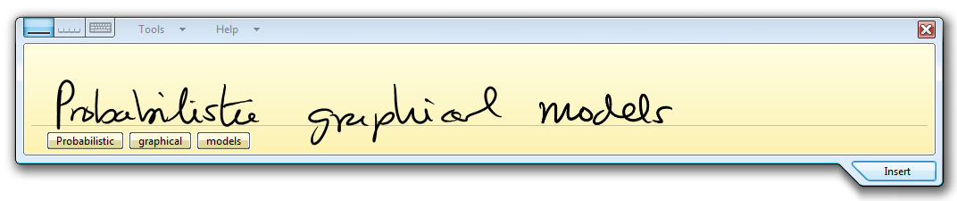
Second Generation
Neural networks, support vector machines
Difficult to incorporate complex domain knowledge
General theme: black-box statistical models

Slide 4
Third Generation
General theme: deep integration of domain
knowledge and statistical learning
Probabilistic graphical models
  Bayesian framework
  fast inference using local message-passing
Origins: Bayesian networks, decision theory, HMMs, Kalman filters, MRFs, mean field theory, ...

Slide 5
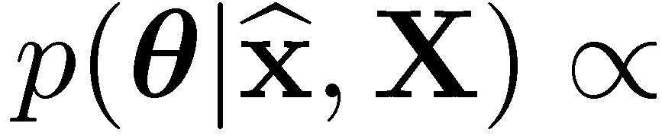
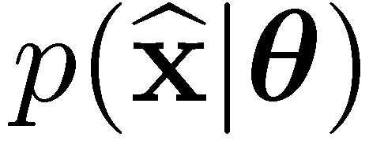
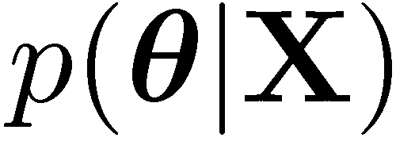
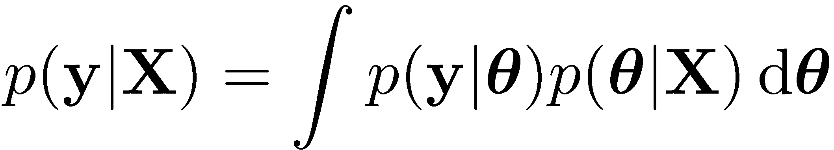
Bayesian Learning
Consistent use of probability to quantify uncertainty
Predictions involve marginalisation, e.g.

Slide 6
Why is prior knowledge important?
?
y
x

Slide 7
Probabilistic Graphical Models
Probability theory + graphs
New insights into existing models
Framework for designing new models
Graph-based algorithms for calculation and computation (c.f. Feynman diagrams in physics)
Efficient software implementation
Directed graphs to specify the model
Factor graphs for inference and learning

Slide 8
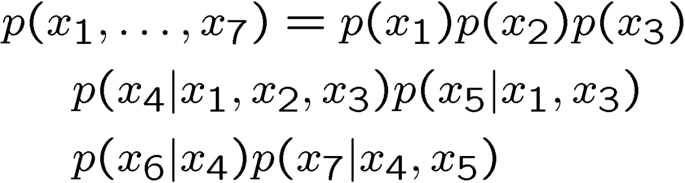
Directed Graphs

Slide 9
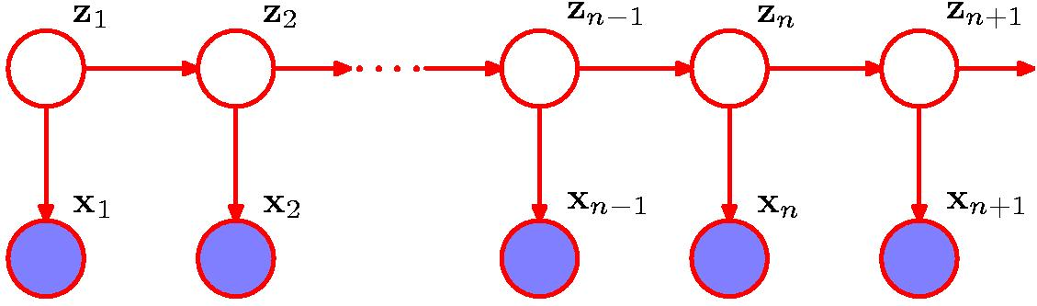
Example: Time Series Modelling

Slide 10
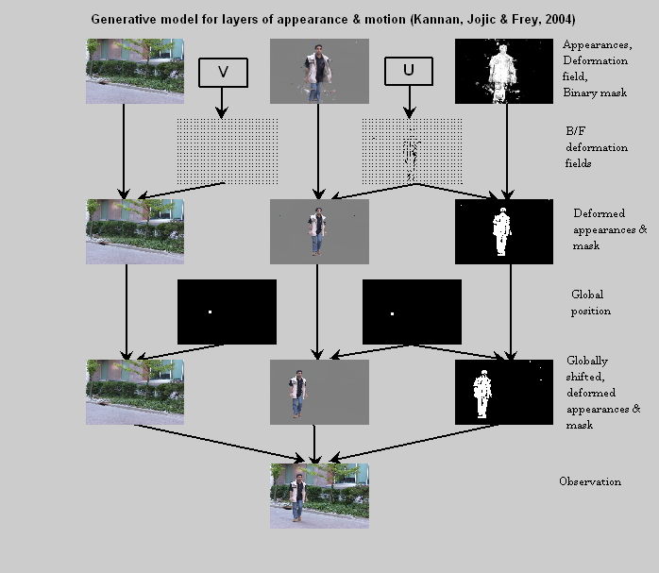

Slide 11
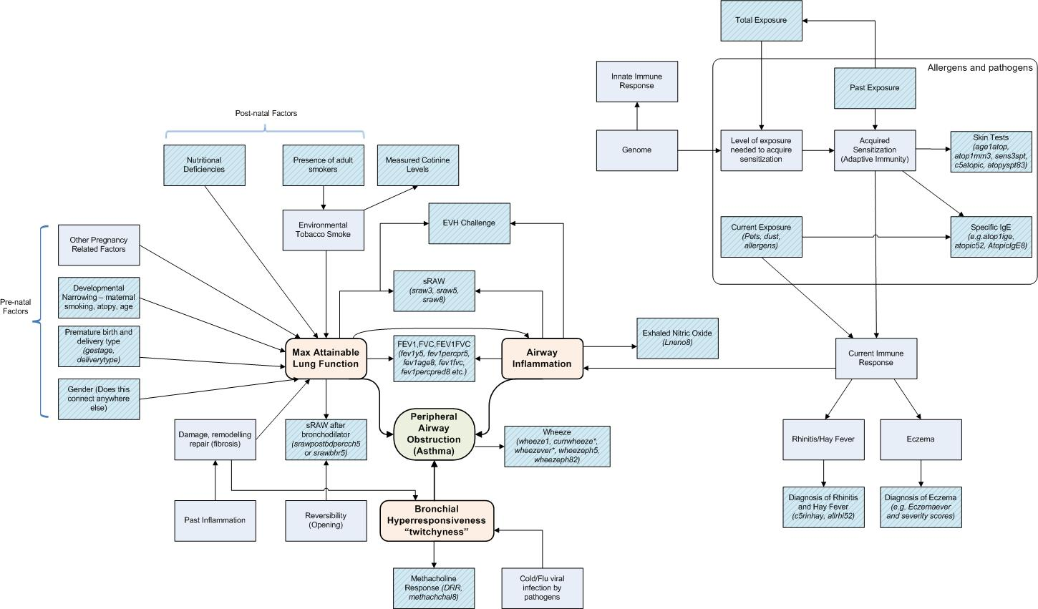
Manchester Asthma and Allergies Study
Chris Bishop
Iain Buchan
Markus Svensén
Vincent Tan
John Winn

Slide 12
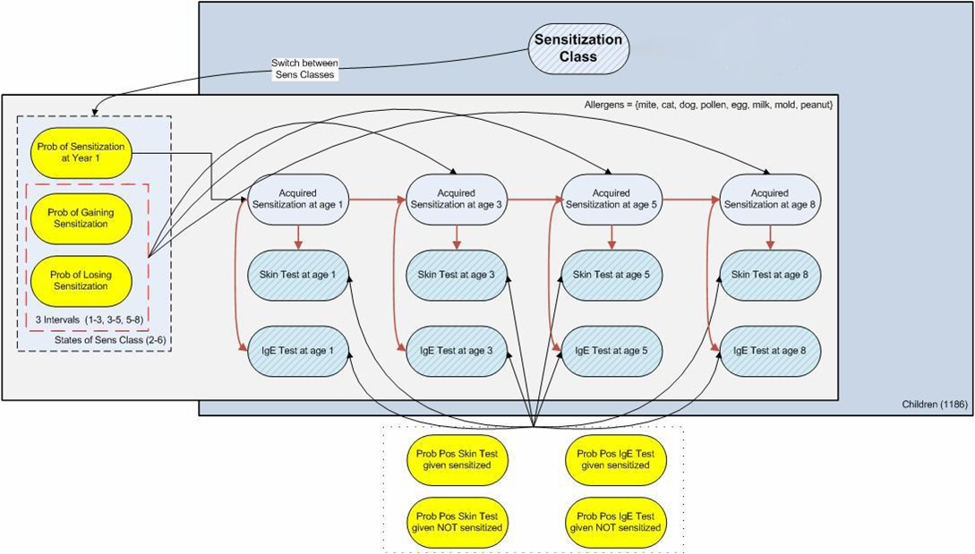

Slide 13
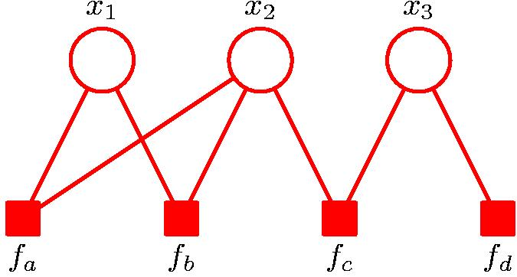
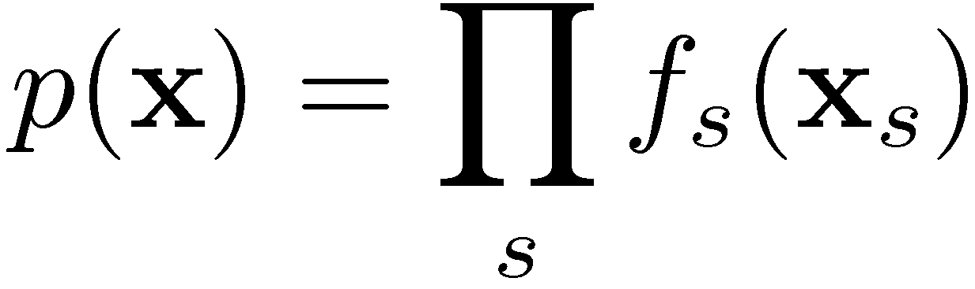
Factor Graphs

Slide 14
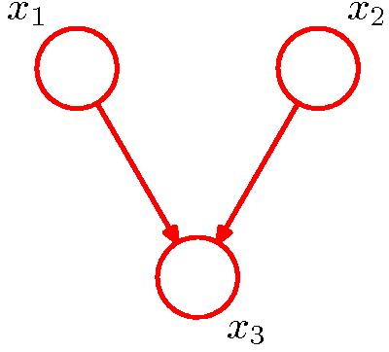
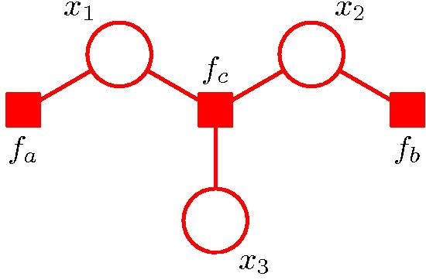
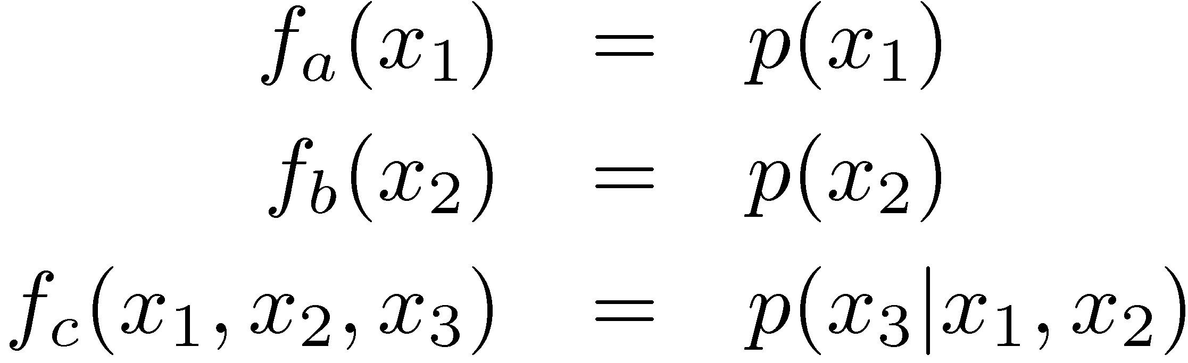
From Directed Graph to Factor Graph

Slide 15
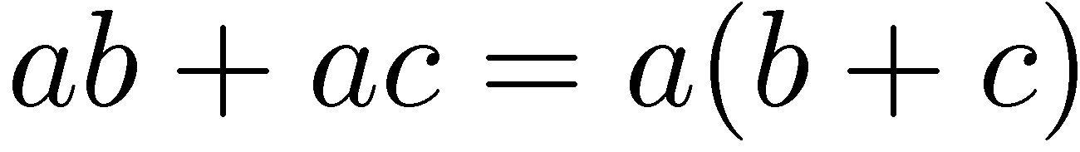
Local message-passing
Efficient inference by exploiting factorization:

Slide 16




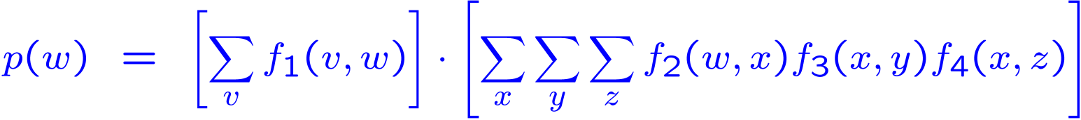
Factor Trees: Separation
y
f₃(x,y)
v
w
x
f₁(v,w)
f₂(w,x)
z
f₄(x,z)

Slide 17


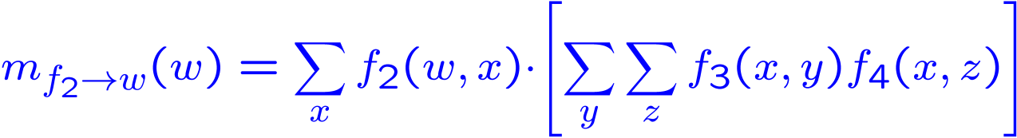
Messages: From Factors To Variables
y
f₃(x,y)
w
x
f₂(w,x)
z
f₄(x,z)

Slide 18




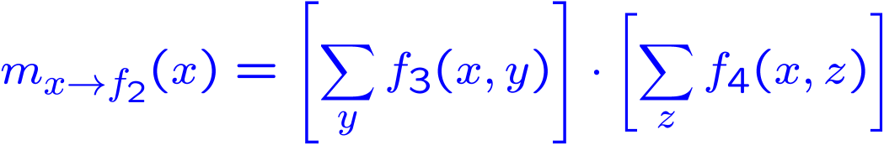
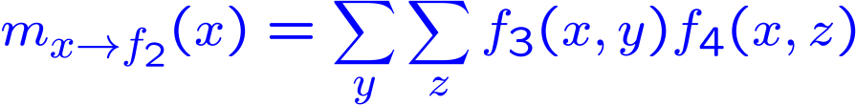
Messages: From Variables To Factors
y
f₃(x,y)
x
f₂(w,x)
z
f₄(x,z)

Slide 19
What if marginalisations are not tractable?
True distribution
Monte Carlo
Variational Bayes
Loopy belief propagation
Expectation propagation

Slide 20
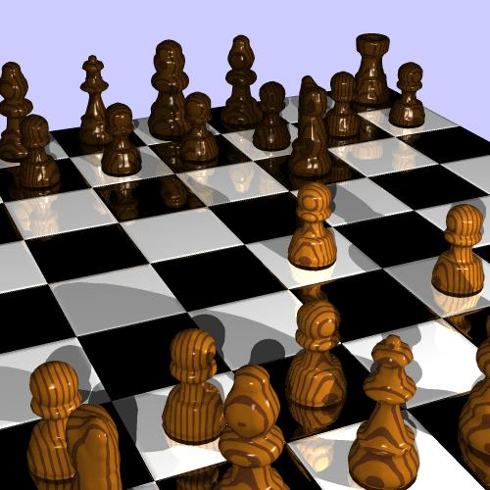
Illustration: Bayesian Ranking
Ralf Herbrich
Tom Minka
Thore Graepel

Slide 21
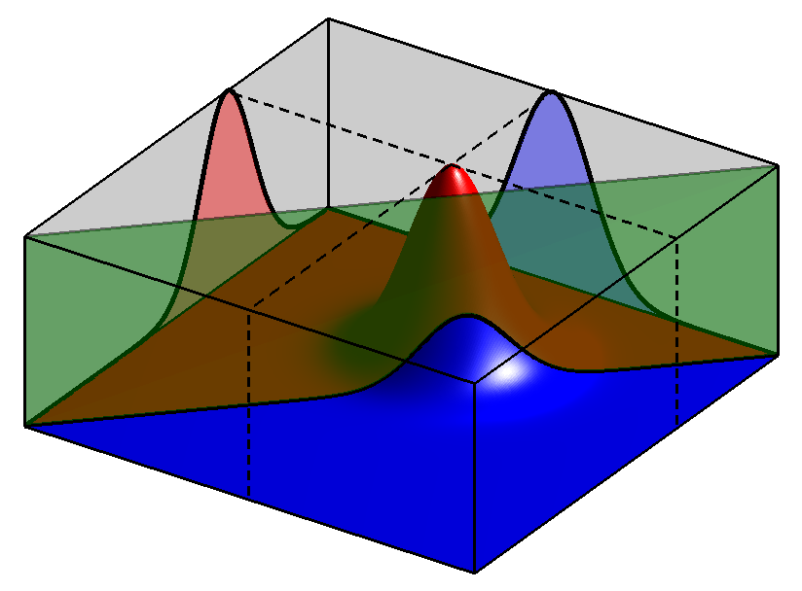
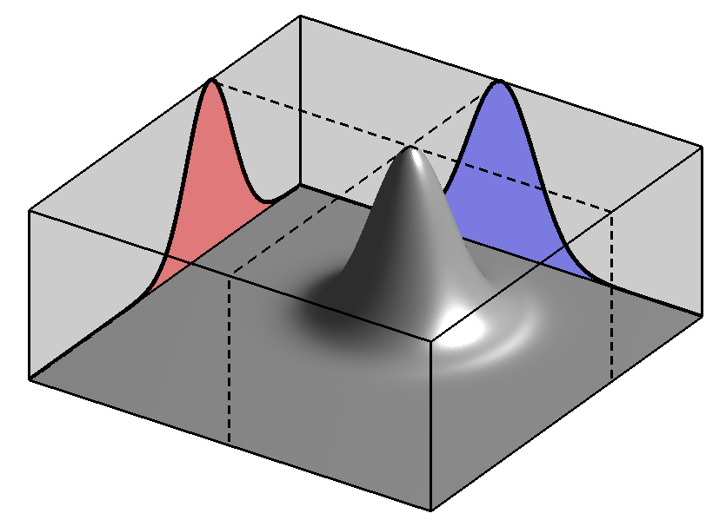
Two Player Match Outcome Model
s₁
s₂
π₁
π₂
y₁₂

Slide 22
Two Team Match Outcome Model
s₁
s₂
s₃
s₄
t₁
t₂
y₁₂

Slide 23
Multiple Team Match Outcome Model
s₁
s₂
s₃
s₄
t₁
t₂
t₃
y₁₂
y₂₃

Slide 24
Efficient Approximate Inference
Gaussian Prior Factors
s₁
s₂
s₃
s₄
Ranking Likelihood Factors
t₁
t₂
t₃
y₁₂
y₂₃

Slide 25
Convergence
40
35
30
25
Level
20
15
char (TrueSkill™)
10
SQLWildman (TrueSkill™)
5
char (Elo)
SQLWildman (Elo)
0
0
100
200
300
400
Number of Games

Slide 26



TrueSkillTM

Slide 27
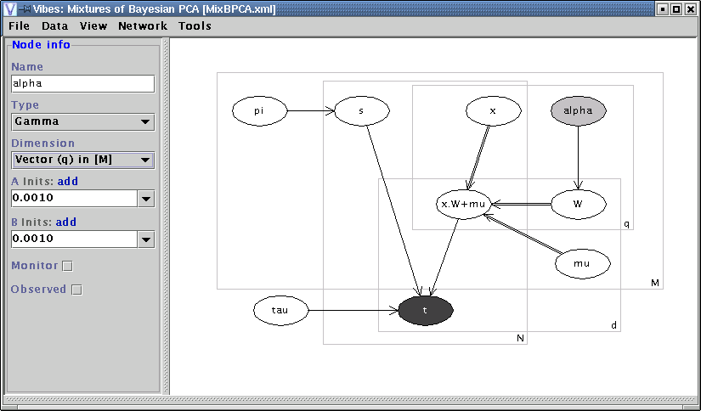
John Winn
Chris Bishop

Slide 28

research.microsoft.com/infernet
Tom Minka
John Winn
John Guiver
Anitha Kannan

Slide 29
Summary
New paradigm for machine intelligence built on:
  a Bayesian formulation
  probabilistic graphical models
  fast inference using local message-passing
Deep integration of domain knowledge and statistical learning
Large-scale application: TrueSkillTM
Toolkit: Infer.NET

Slide 30
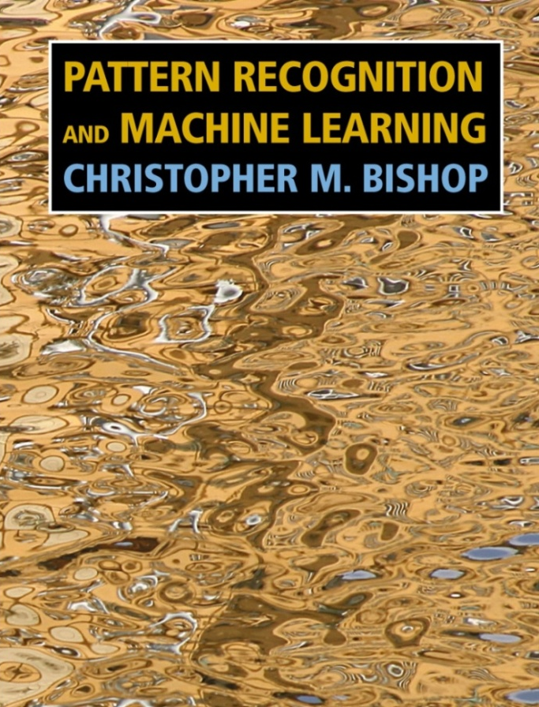
http://research.microsoft.com/~cmbishop

