Slide 1
Science Cloud
Paul Watson
Newcastle University, UK
^{paul.watson@ncl.ac.uk}
Notes:
I want to talk about a new approach to e-science that we’ve been pursuing in the CARMEN project, addressing some of the problems we’ve had with previous e-science projects. I’ll talk about those problems, why neuroscience is an interesting and challenging area, and the solutions we’ve adopted.

Slide 2

Research Challenge
Understanding the brain is the greatest informatics challenge
Enormous implications for science:
  Medicine
  Biology
  Computer Science

Slide 3
Collecting the Evidence
100,000 neuroscientists generate huge quantities of data
  molecular (genomic/proteomic)
  neurophysiological (time-series activity)
  anatomical (spatial)
  behavioural
Notes:
Complex – 100 billion neurons; up to 10K connections each

Slide 4
Neuroinformatics Problems
Data is:
  expensive to collect but rarely shared
  in proprietary formats & locally described
The result is:
  a shortage of analysis techniques that can be applied across neuronal systems
  limited interaction between research centres with complementary expertise

Slide 5
Data in Science
Bowker’s “Standard Scientific Model”
  Collect data
  Publish papers
  Gradually loose the original data
The New Knowledge Economy & Science & Technology Policy, G.C. Bowker
Problems:
  papers often draw conclusions from data that is not published
  inability to replicate experiments
  data cannot be re-used

Slide 6
Codes in Science
Three stages for codes
  Write code and apply to data
  Publish papers
  Gradually loose the original codes
Problems:
  papers often draw conclusions from codes that are not published
  inability to replicate experiments
  codes cannot be re-used

Slide 7
Plan
Neuroinformatics - a challenging e-science application
CARMEN – addressing the challenges
Cloud Computing for e-science
  Lessons we’ve Learnt
The Promise of Commercial Clouds

Slide 8
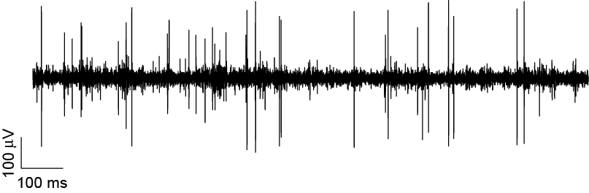
Focus on Neural Activity
  raw voltage signal data typically collected using single or multi-electrode array recording
neurone 1
neurone 2
neurone 3
cracking the neural code

Slide 9
Epilepsy Exemplar
Data analysis guides surgeon during operation
Further analysis provides evidence
WARNING!
The next 2 Slides show an exposed human brain
Notes:
Hi Paul, okay so the patient is usually worked up using scalp EEG and other imaging (MR) techniques (to ascertain if there is say a distinct lesion perhaps that is causing the pathological activity). If this does not lead to a conclusive answer they also carry out ECoG (electrocorticography). The neurophysiologist, records from the brain during surgery and then instructs the neurosurgeon as to what areas he thinks are pathological. The tissue is then removed, we receive it and we record from this tissue using even more refined processes ( ie recordings from single neurons, large groups of neurons etc etc) Mark Cunningham

Slide 10
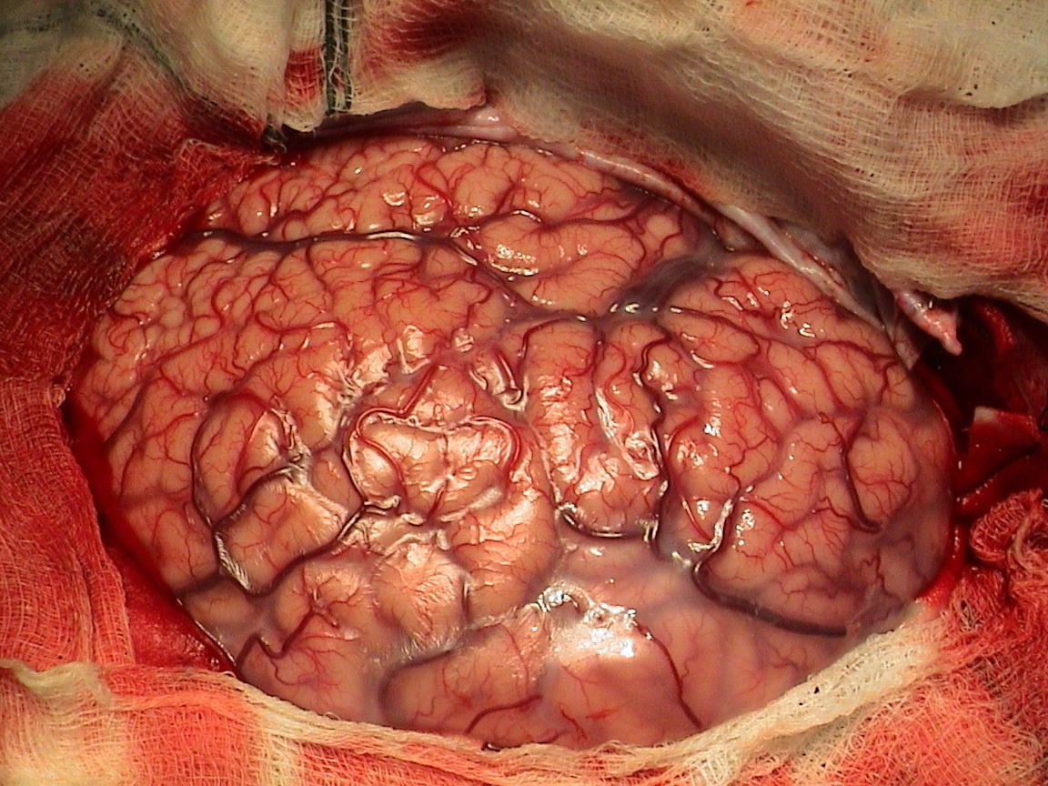

Slide 11
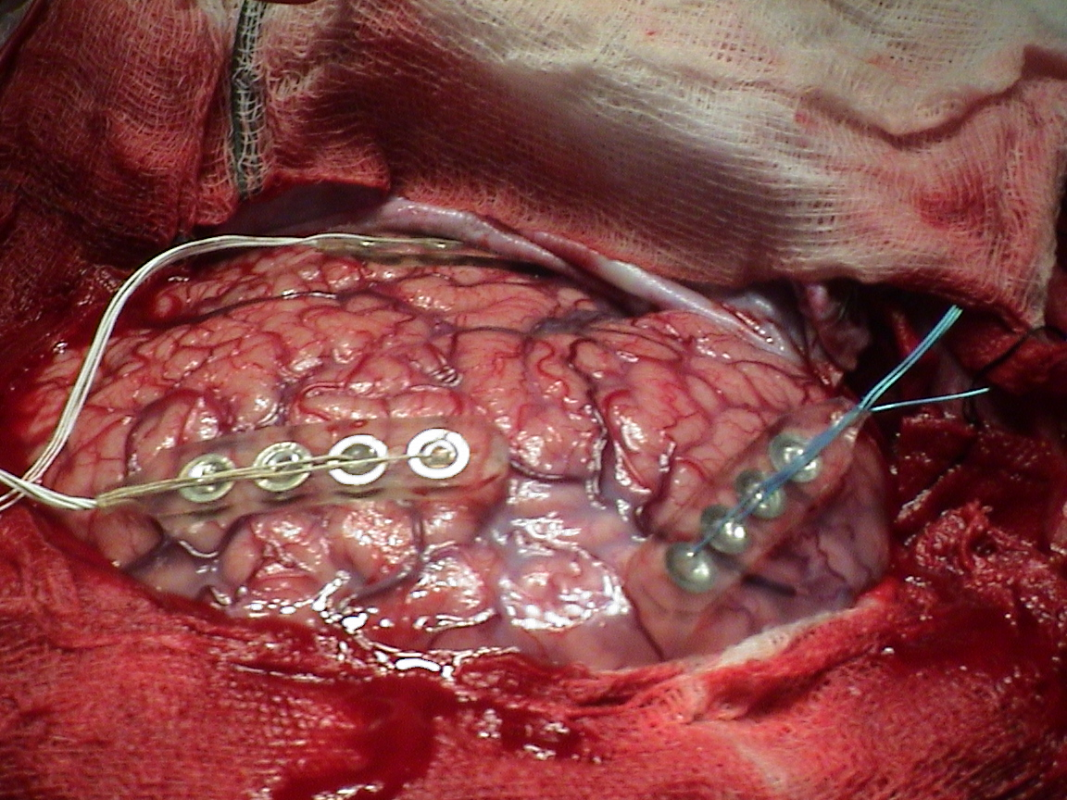

Slide 12



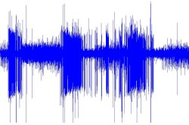
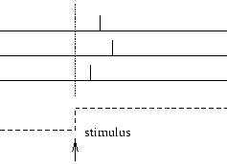
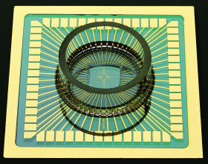
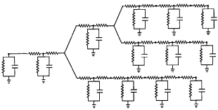
CARMEN
enables sharing and collaborative exploitation of data, analysis code and expertise that are not physically collocated

Slide 13
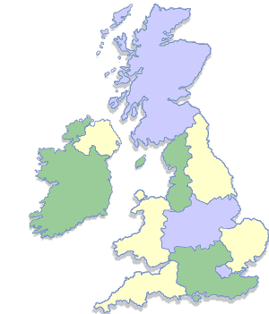
CARMEN Project
UK EPSRC e-Science Pilot
$7M (2006-10)
20 Investigators
Stirling
St. Andrews
Newcastle
Manchester
York
Sheffield
Leicester
Warwick
Cambridge
Plymouth
Imperial

Slide 14











Industry & Associates

Slide 15
CARMEN e-Science Requirements
Store
  very large quantities of data (100TB+)
Analyse
  suite of neuroinformatics services
  support data intensive analysis
Automate
  workflow
Share
  under user-control
Notes:
Rest of talk explores these and their solns in more detail

Slide 16
Background: North East Regional e-Science Centre
25 Research Projects across many domains:
    Bioinformatics, Ageing & Health, Neuroscience, Chemical Engineering, Transport, Geomatics, Video Archives, Artistic Performance Analysis, Computer Performance Analysis,....
Same key needs:
Store
Analyse
Automate
Share

Slide 17


Result: e-Science Central
Integrated Store-Analyse-Automate-Share infrastructure
Web-based
Generic
  CARMEN neuroinformatics & chemistry as pilots

Slide 18

Science Cloud Architecture
Access over Internet
(typically via browser)
Data storage
and
analysis
Upload data & services
Run analyses

Slide 19
Cloud Services Continuum (based on Robert Anderson)
http://et.cairene.net/2008/07/03/cloud-services-continuum/
Software
(SaaS)
Google Apps
Salesforce.com
Platform
(PaaS)
Google AppEngine
Microsoft Azure
Infrastructure
(IaaS)
Amazon EC2 & S3
Notes:
The diagram to the right shows this continuum from infrastructure to platform to software. Brief definitions of these parts are:
Infrastructure includes provisioning of hardware or virtual computers on which one generally has control over the OS; therefore allowing the execution of arbitrary software.
Platform indicates a higher-level environment for which developers write custom applications. Generally the developer is accepting some restrictions on the type of software they can write in exchange for built-in application scalability.
Software (as a Service) indicates special-purpose software made available through the Internet.

Slide 20
Science Cloud Options
✗
Users
Science
App 1
Science
App n
Service Developers
....
Science Platform
Science
App 1
Science
App n
....
Cloud Infrastructure:
Storage & Compute
Cloud Infrastructure: Storage & Compute

Slide 21


CARMEN Cloud
Filestore with Pattern
Search
Workflow
Database
Security
Workflow
Enactment
Metadata
Service
Repository
Browsers
&
Rich Clients
Processing

Slide 22
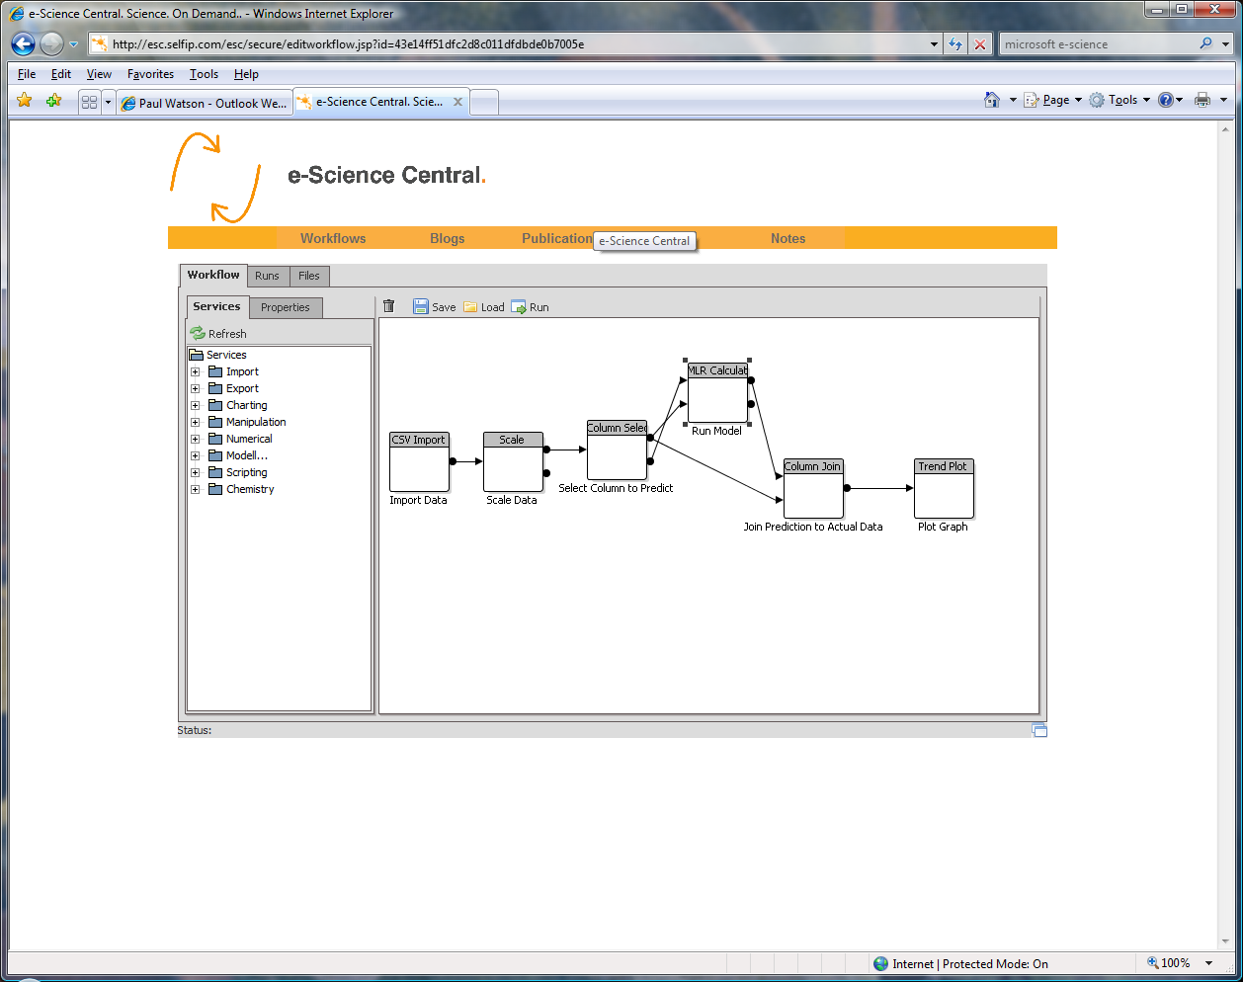
Editing and Running a Workflow on the Web
Notes:
Bus Phone

Slide 23
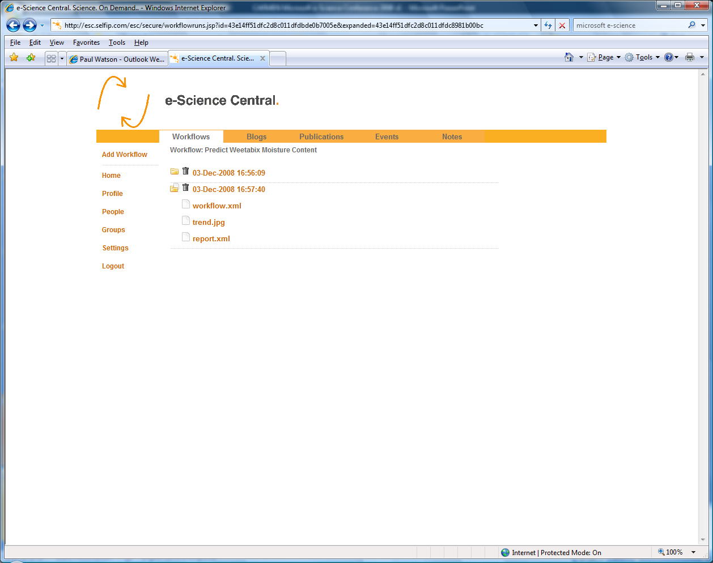
Workflow
Result File
Viewing the output of Workflow Runs

Slide 24
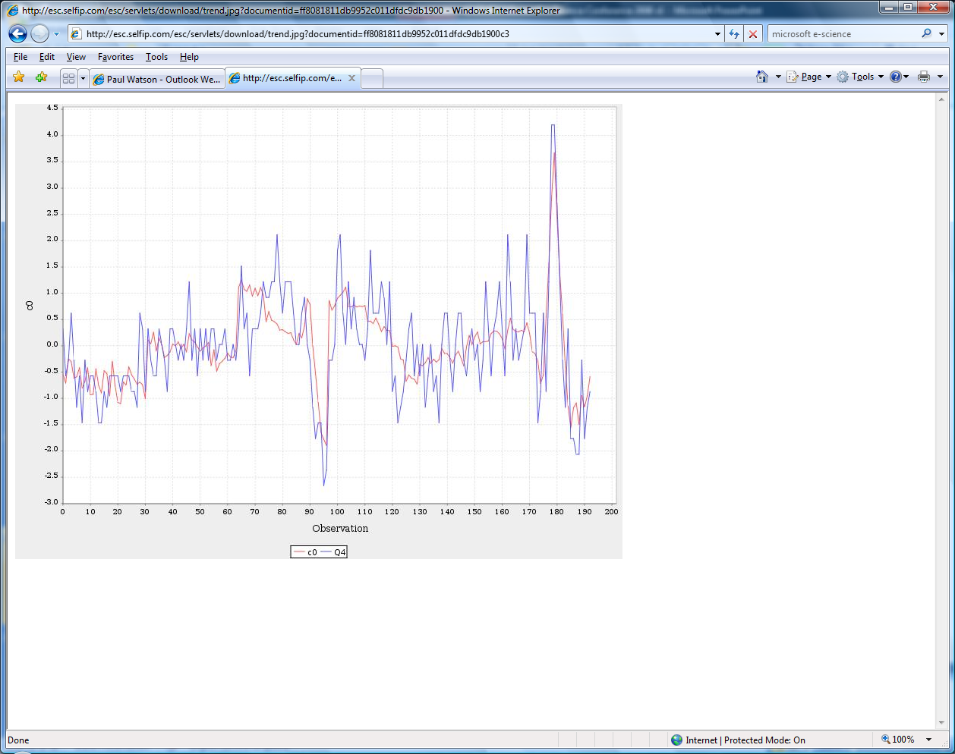
Viewing results

Slide 25
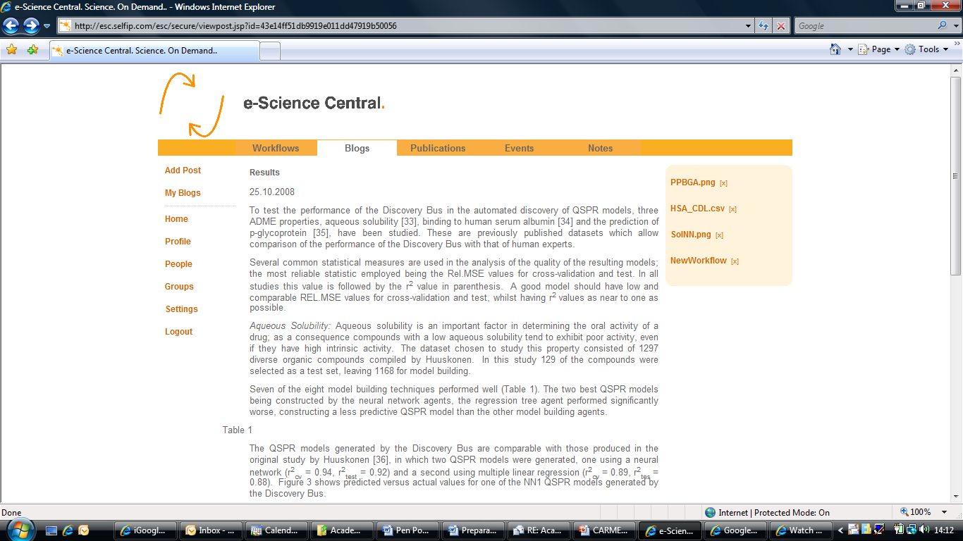
Blogs and links
Communicating Results
Linking to
results & workflows
Notes:
A start towards reproducibility

Slide 26
What we learnt: Moving into a Cloud
Moving existing technologies into a cloud can be difficult
  some can’t run in a Cloud at all

Slide 27
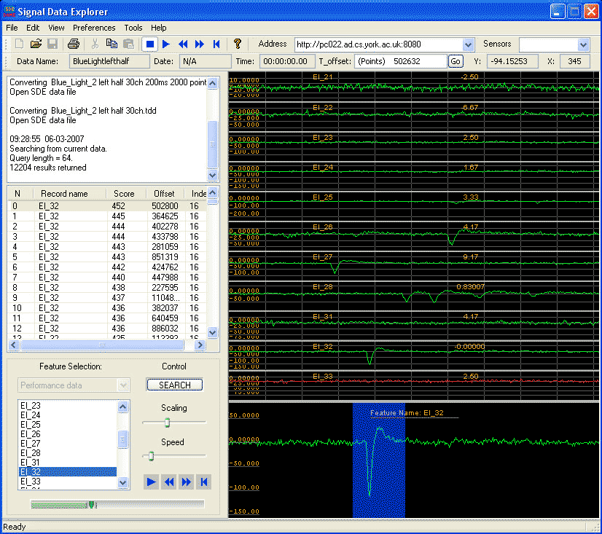
Raw Data Exploration with Signal Data Explorer

Slide 28
What we learnt : Scalability
Clouds offer the potential for scalability
  grab compute power only when needed
But developers have to write scalable code
  for Infrastructure as a Service Clouds

Slide 29

Dynasoar: Dynamic Deployment
A request to s4
R
The deployed service remains in place and
can be re-used
- unlike job scheduling

Slide 30
Dynasoar
A request for s2 is routed to an existing
deployment of the service

Slide 31
Adaptive Dynamic Deployment with Dynasoar
Commercial Pay-as-you-go clouds
Would allow us to avoid this limit
Adding Processors as you need them optimises resources and saves money in pay-as-you-go clouds

Slide 32
Hot Off the Press..
Recent experiments with Microsoft Azure Cloud
  running Chemical analyses
  Silverlight UI
Thanks to:
- Paul Appleby & Team at the Microsoft Technology Centre, Reading
- & MS e-Science Group

Slide 33
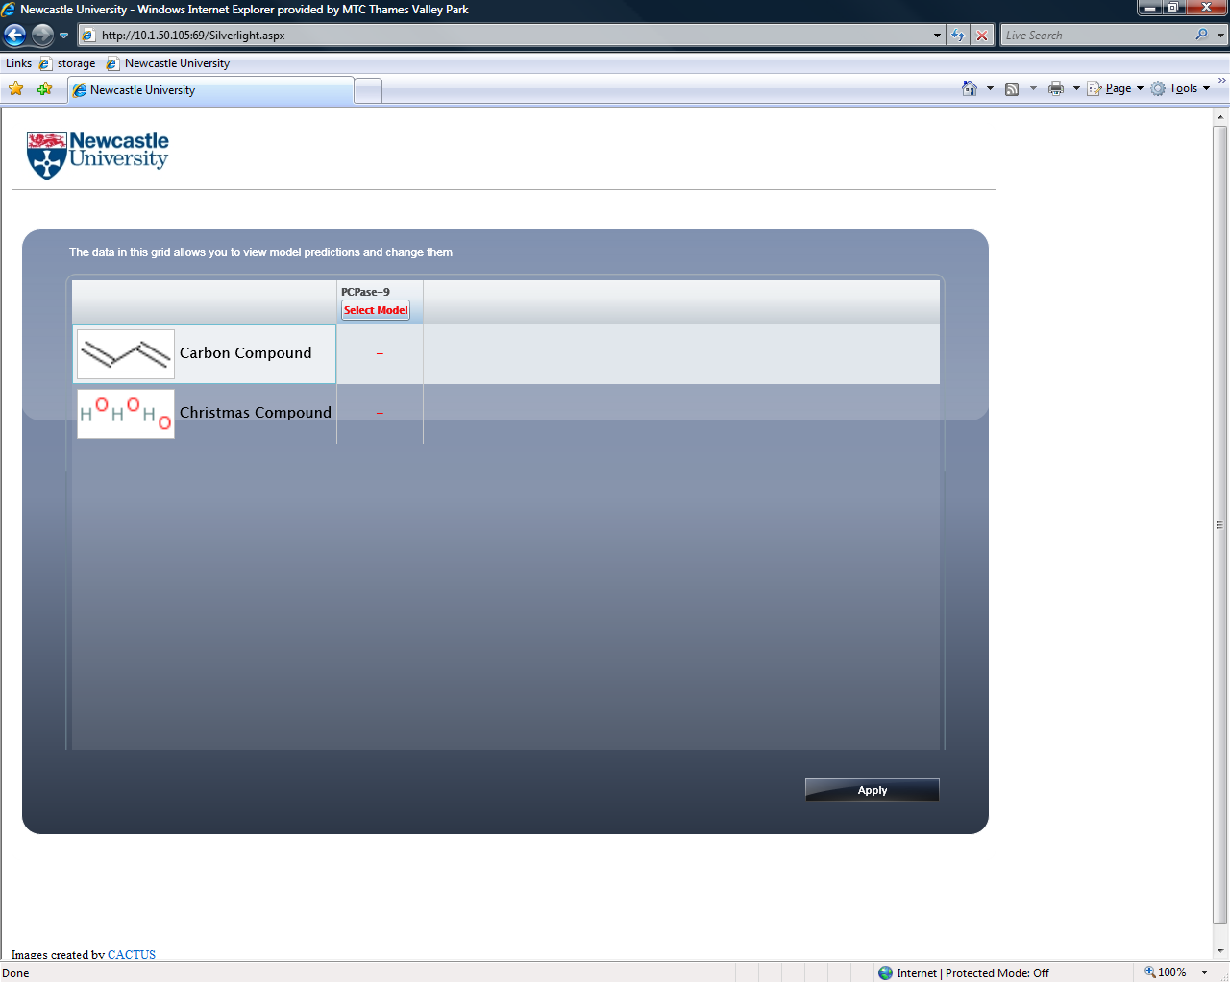

Slide 34
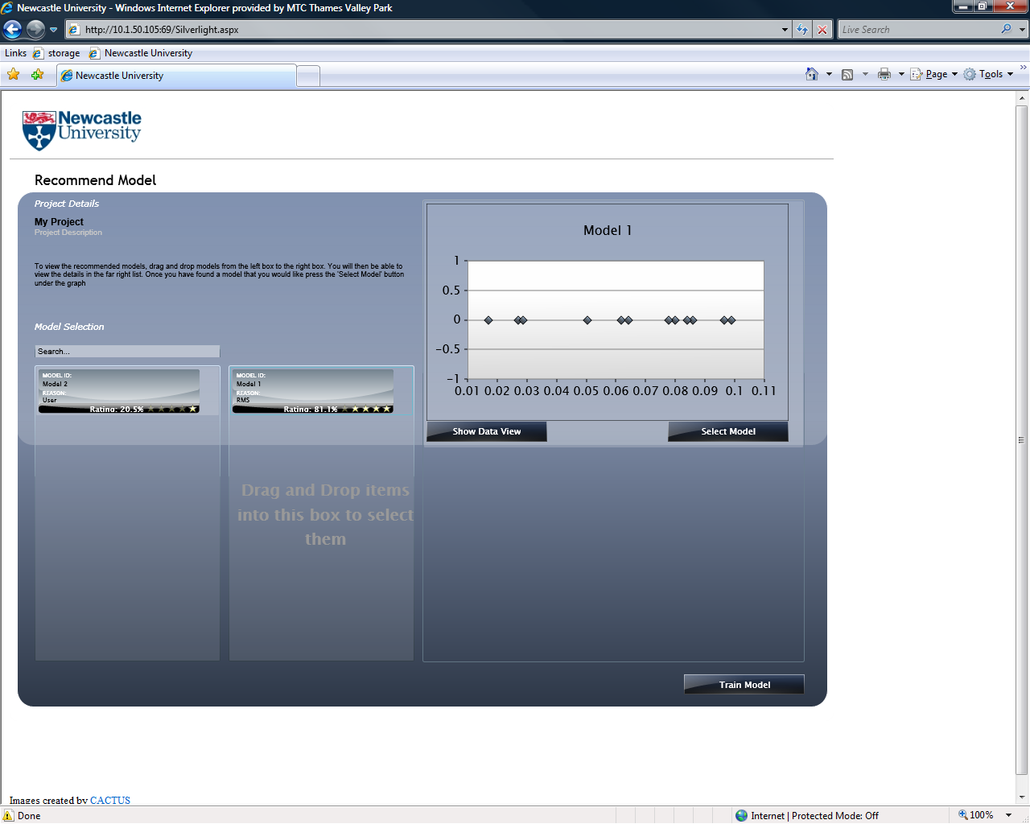

Slide 35
Microsoft Azure Cloud for e-Science Demo

Slide 36
Why are Commercial Clouds Important: Before
Research
Have good idea
Write proposal
Wait 6 months
If successful, wait 3 months
Install Computers
Start Work
Science Start-ups
Have good idea
Write Business Plan
Ask VCs to fund
If successful..
Install Computers
Start Work

Slide 37
Why Use Commercial Clouds:
Have good idea
Grab nodes from Cloud provider
Start Work
Pay for what you used
also scalability, cost, sustainability

Slide 38
Commercial Clouds to the Rescue?
Focus currently on infrastructure as a service
But, this is only part of the stack
Can we have pay-as-you-go Science Cloud Platforms?

Slide 39

A Sustainable Science Cloud
Science
App 1
Science
App n
?
....
Science Platform as a Service
Problem:
delivering
the e-science
platform
e-Science Central
?
www.inkspotscience.com
Commercial
Clouds
✓
Cloud Infrastructure: Storage & Compute
Notes:
Existing clouds like Amazon provide generic capabilities
Interesting to see if in future companies will build on those to provide more specialist clouds with domain-specific services sitting on top of the low-level storage & compute processes. And that’s we’re looking to do for science.

Slide 40
Summary: e-Science Central & CARMEN
Web based
Works anywhere
e-Science Central /
CARMEN
Software as a Service
Cloud Computing
Social Networking
Dynamic Resource
Allocation
Pay-as-you-Go*
Controlled Sharing
Collaboration
Communities

Slide 41
Summary
e-Science Central
  Store-Analyse-Automate-Share e-science platform
  Adding content from a range of domains
CARMEN is piloting this approach for neuroinformatics
Cloud computing can revolutionise e-science
  reduce time from idea to realisation

