Slide 1
From GPS Traces to a
Routable Road Map
Lili Cao
University of California
Santa Barbara, California, USA
John Krumm
Microsoft Research
Redmond, Washington, USA

Slide 2




Local Arrangements
For negative comments, complaints
For positive comments, compliments

Slide 3



Tickets
1 Drink
1 Drink
Drink tickets for Wednesday (today) reception
Reception
Wednesday
4 November 2009
Reception
Wednesday
4 November 2009
ACM-GIS Banquet
1 Drink
1 Drink
Thursday, November 5, 7:30 p.m.
Banquet
Thursday
5 November 2009
Banquet
Thursday
5 November 2009
Banquet and drink tickets for Thursday (tomorrow) banquet

Slide 4
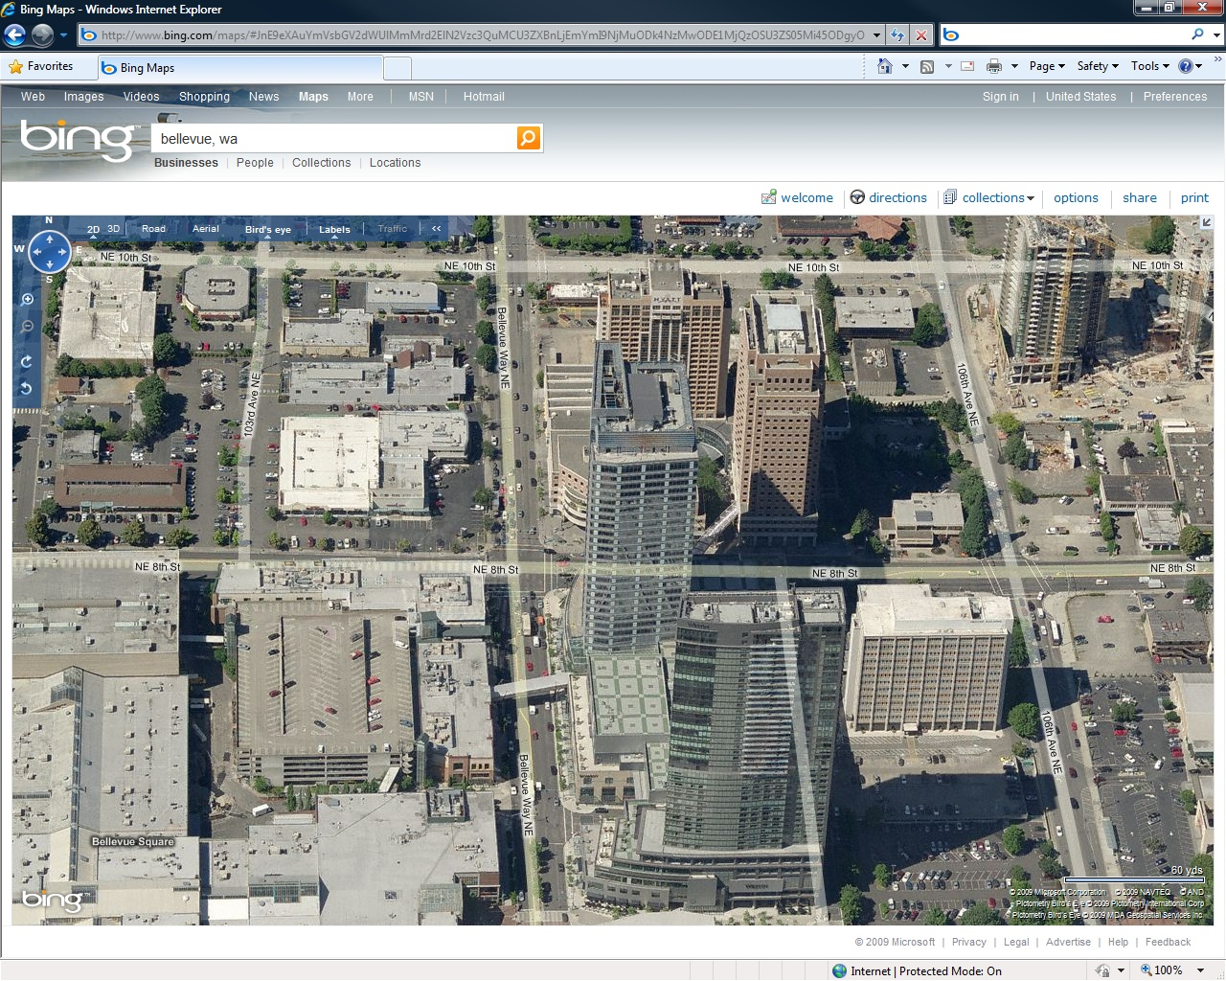
Lunches on Your Own
Hyatt (you are here)
Food (Bellevue Way)

Slide 5
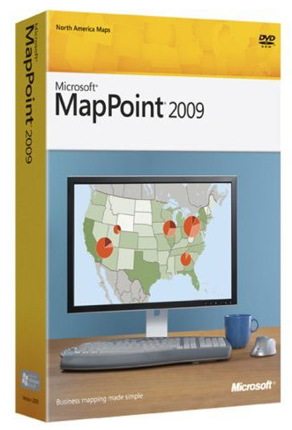
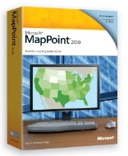
Giveaway
5 copies
Blue star on name badge
Pick up at conference registration table
MapPoint 2009
5 copies
Red star on name badge
Give me your mailing address
MapPoint 2010

Slide 6
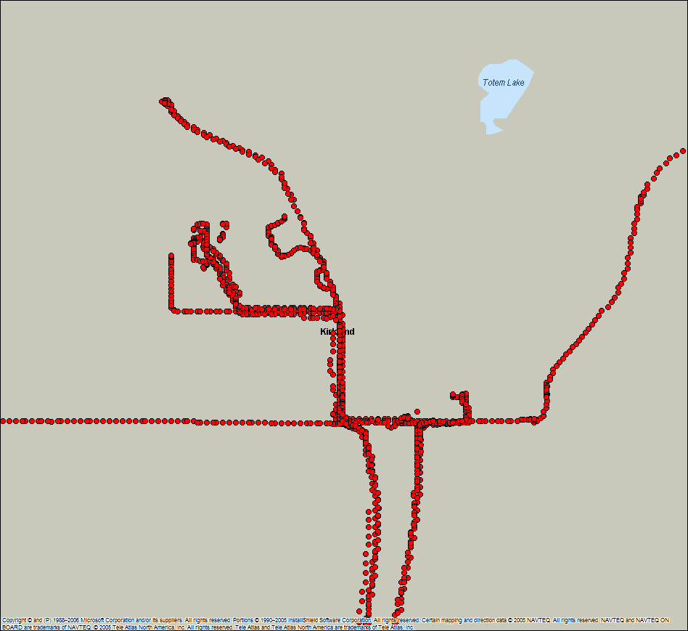
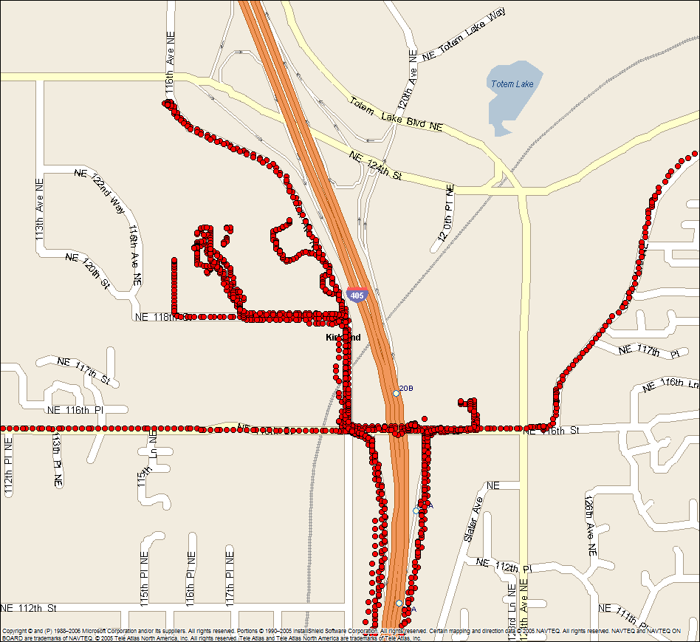

Basic Idea
Crowdsource GPS traces from everyday vehicles
From this …
… to this
Create road map data from GPS traces

Slide 7
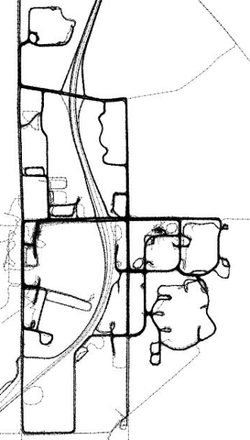
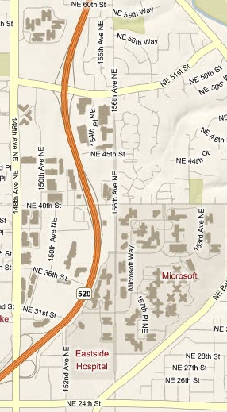
Basic Idea
Raw GPS
Map
Crowdsource GPS traces from everyday vehicles
From this …
… to this
Create road map data from GPS traces

Slide 8




Road Data: Useful but Expensive
Navteq
Printed maps
Digital maps
Tele Atlas

Slide 9


Roads Change
Road closures
New roads
Road changes, e.g. from two-way to one-way
October 29, 2009

Slide 10
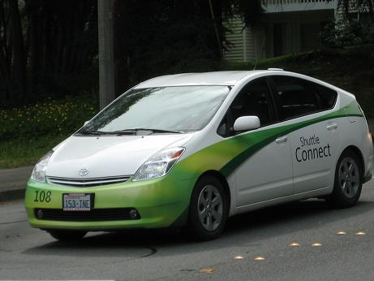
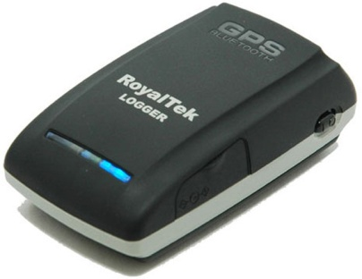
GPS Data
55 Microsoft Campus Shuttles
On demand and scheduled routes
~100 hours of data from each vehicle
RoyalTek RBT-2300 GPS Logger
1 Hz sampling rate
Powered from cigarette lighter
Uploaded to SQL Server database
Raw Data
Commercial Map

Slide 11
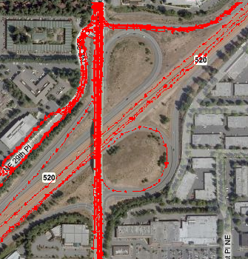
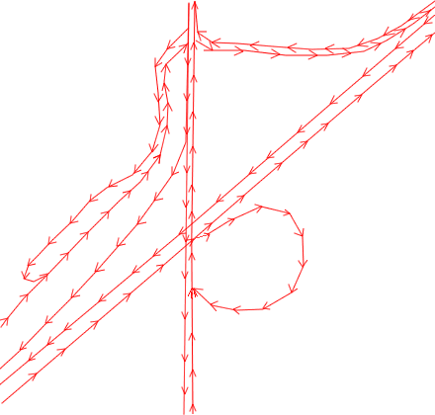
Goal – Routable Road Network
Infer Road Network Data
Connectivity and geometry
Road type (e.g. highway, arterial)
Number of lanes
Lane restrictions
Speeds
Road names
Ideal output

Slide 12
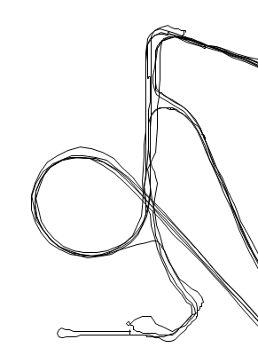

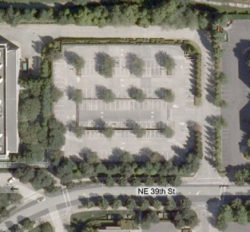
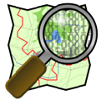
Why Is This Hard?
GPS data is noisy
Random data in parking lots
Most well-known solution requires human editing
openstreetmap.org

Slide 13
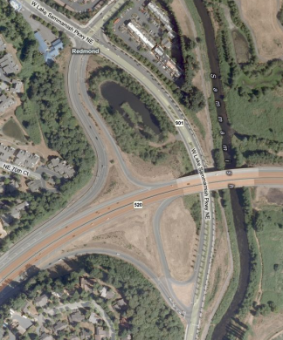

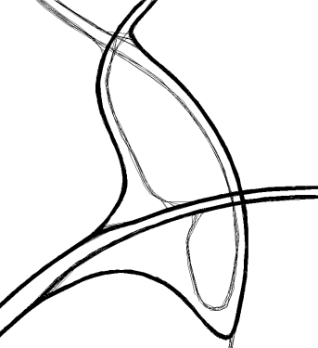
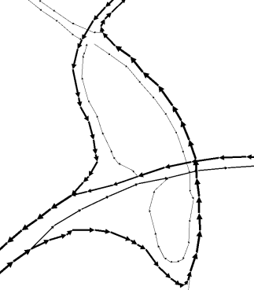
Overview
Original GPS traces
Clarified GPS traces
Routable map graph
Step 1: Clarify GPS traces
Step 2: Generate map graph

Slide 14
Clarifying GPS Traces
Apply imaginary forces to bundle nearby GPS traces
jumbled GPS traces
clarified GPS traces

Slide 15
1: Pull Toward Other Traces
Virtual potential well generated by blue segment (upside-down Gaussian)
force = d/dx potential
GPS point
Avoid force from perpendicular traces
Repellent force from opposite direction traces
force’ = cos(θ)*force
θ

Slide 16
2: Keep Point Near Home
Virtual potential well generated by blue segment
Parabolic potential corresponds to linear spring force
GPS point

Slide 17
Sum Forces
+
+
Sum potentials (forces) to get net effect on GPS point

Slide 18
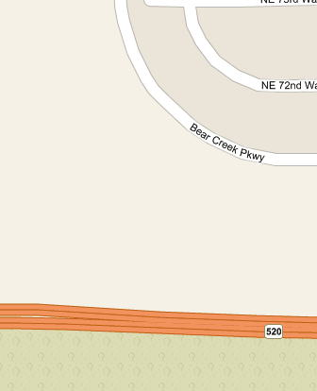




Clarifying GPS Traces
For each GPS point
Add all potential wells
Move point
Iterate until converge
Original
Processed
Twisting Problem
Final
Twisting Problem
Happens when GPS point crosses over opposite traffic lane
Heuristic: If cos(θ) < 0 AND point is on right side of trace, force = 0
Fixes twist problem
Reverse heuristic in Anguilla, Antigua & Barbuda, Australia, Bahamas, Bangladesh, Barbados, Bermuda, Bhutan, Bophuthatswana, Botswana, British Virgin Islands, Brunei, Cayman Islands, Channel Islands, Ciskei, Cyprus, Dominica, Falkland Islands, Fiji, Grenada, Guyana, Hong Kong, India, Indonesia, Ireland, Jamaica, Japan, Kenya, Lesotho, Macau, Malawi, Malaysia, Malta, Mauritius, Montserrat, Mozambique, Namibia, Nepal, New Zealand, Pakistan, Papua New Guinea, St. Vincent & Grenadines, Seychelles, Sikkim, Singapore, Solomon Islands, Somalia, South Africa, Sri Lanka, St Kitts & Nevis, St. Helena, St. Lucia, Surinam, Swaziland, Tanzania, Thailand, Tonga, Trinidad & Tobago, Uganda, United Kingdom, US Virgin Islands, Venda, Zambia, Zimbabwe
θ

Slide 19
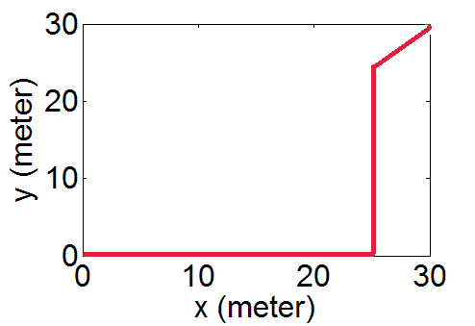
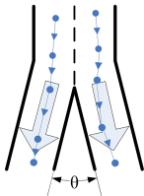
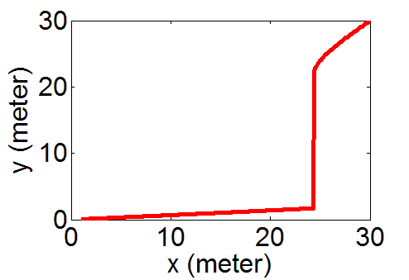
Parameter Selection
M,σ₁
k
Other trace potential
Spring potential
Ideal
x
y
Actual
jumbled
clarified
σ₂: Error of GPS N: # of traces

Slide 20
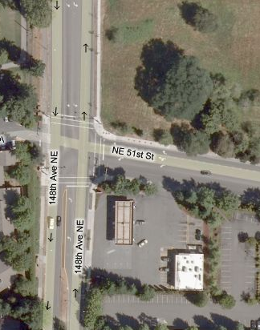
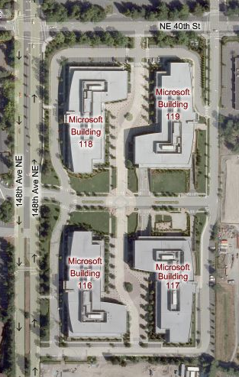
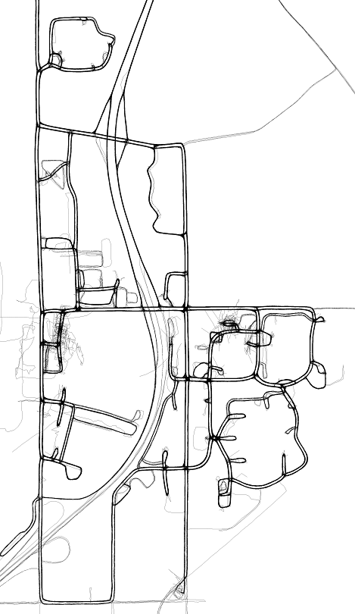
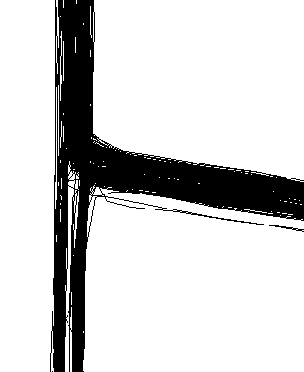

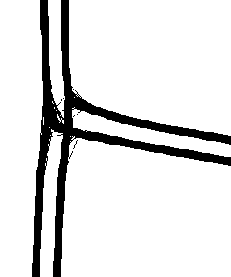
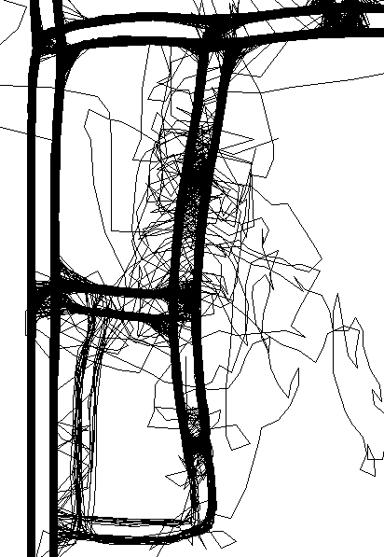
GPS Clarification Results
Overview
Satellite
Original
GPS data
Clarified
GPS data

Slide 21
Making it Scale
Naïve implementation: for each node, scan all other segments
  20 minutes per iteration
  Θ(n²) complexity, suffers when map gets large
Optimization: for each node, only search segments within small distance
  Use kD-tree to index nodes
  15 seconds per iteration
  Θ(n logn) complexity, good scalability

Slide 22
Generating Map Graph
Sequentially process the traces and incrementally build the graph
  Merge nodes to existing nodes if distances are small & directions match
  Create new nodes & edges otherwise

Slide 23
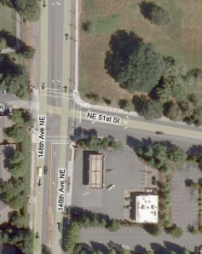
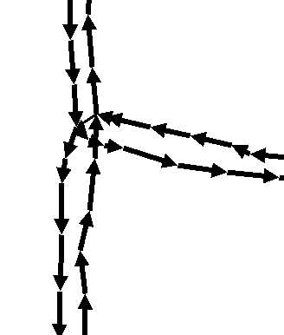
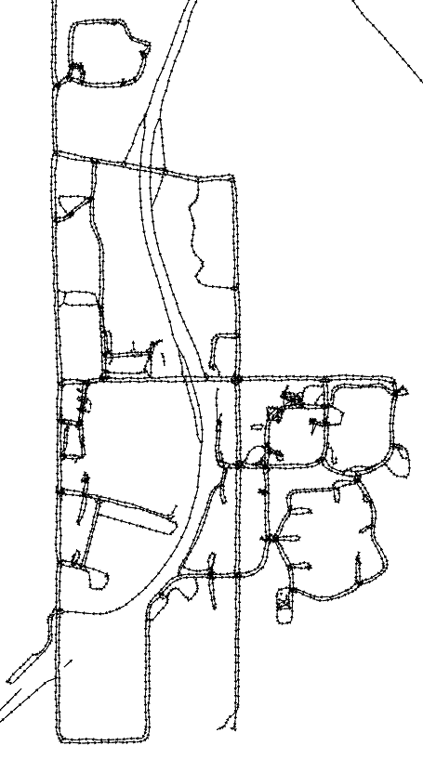





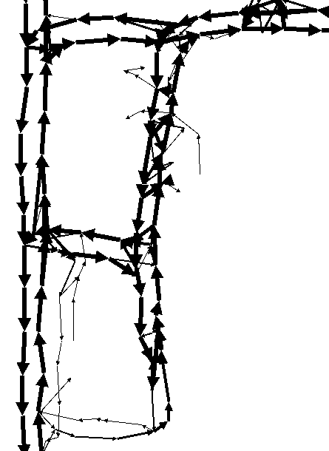
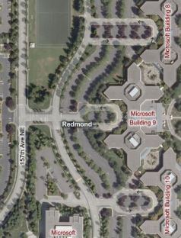
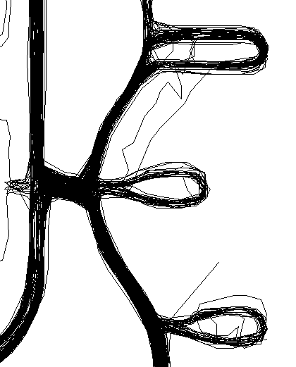
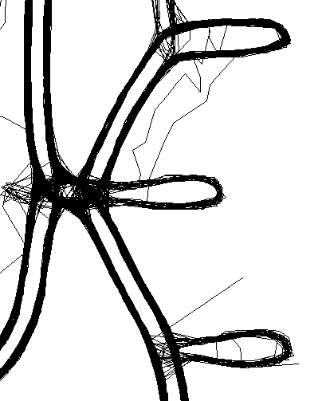
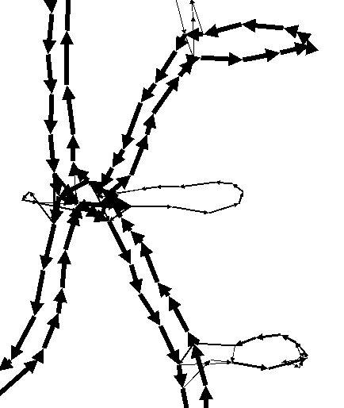
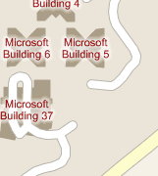
Results of Graph Generation

Slide 24
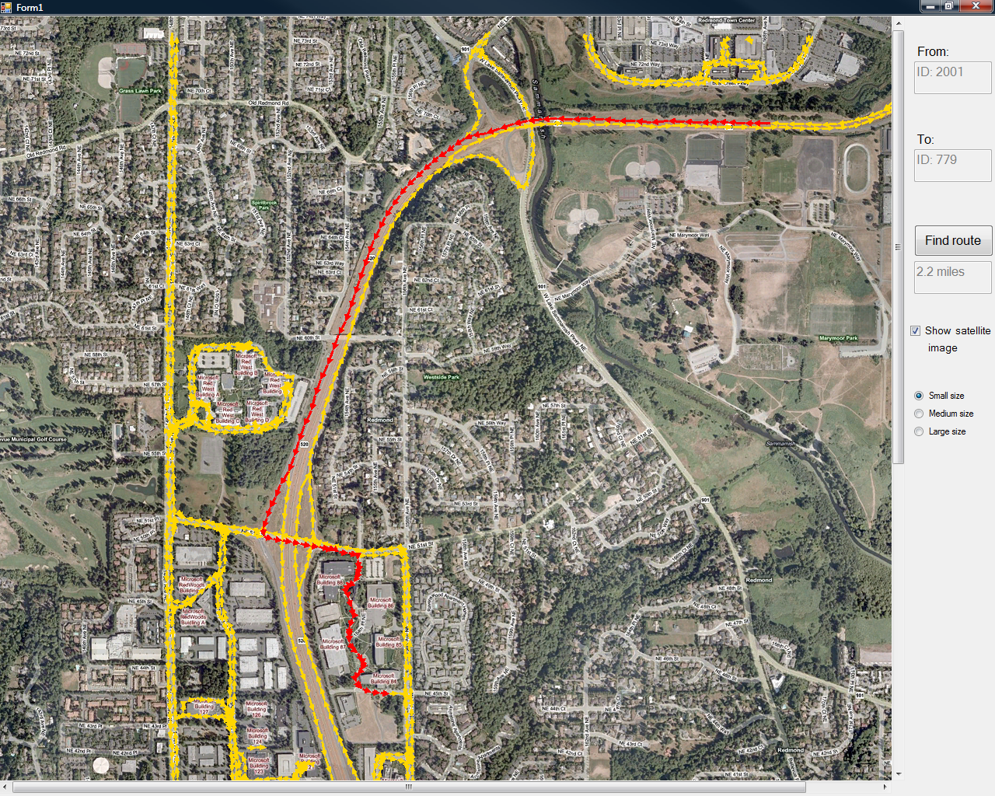
Demonstration

Slide 25
Summary
Raw GPS
Clarified GPS
Routable Roads
GPS clarification with forces from potential wells
  Principled setting of parameters
  Efficient implementation
Merge traces into road network
Route planner

Slide 26
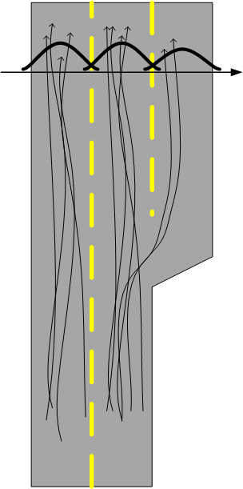
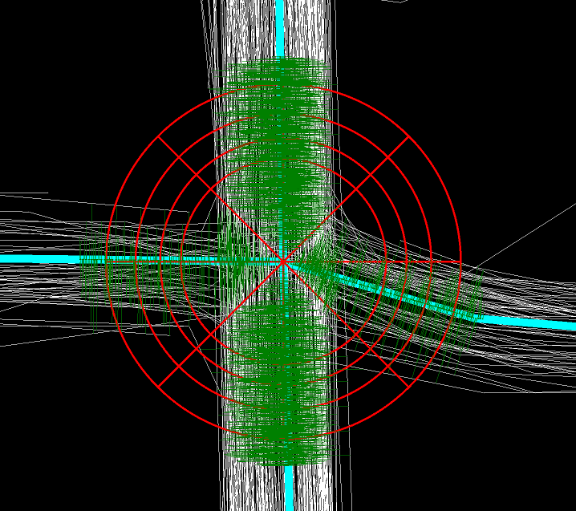
Further Work
Intersection Detector
With Alireza Fathi, Georgia Tech
Lane Counting
With James Chen, U. Washington

