Slide 1
Applications of
Program Synthesis (aka, domain-specific search)
to
End-user Programming
&
Intelligent Tutoring Systems
Invited Talk @ GECCO (GP Track) 2014
Sumit Gulwani
Microsoft Research, Redmond

Slide 2
Program Synthesis
Goal: Synthesize a program in the underlying domain-specific language (DSL) from user intent using some search algorithm.
Significance:
Various computational devices & programming languages/models
Billions of non-experts have access to these!
Enabling technology is now available.
Better search algorithms
Faster machines (good application for multi-cores)
State of the art: We can synthesize programs of size 10-20.
But this itself is a revolutionary capability if we
target the right set of application domains, and
provide the right intent specification mechanism.
PPDP 2010 [Invited talk paper]: “Dimensions in Program Synthesis”;

Slide 3
Potential Users of Synthesis Technology
Algorithm
Designers
Software Developers
End-Users
Students and Teachers

Slide 4
Success Story: Algorithm Designer/Software Developer
Our techniques can synthesize a wide variety of algorithms/programs from logic descriptions.
Bit-vector algorithms (e.g., turn-off rightmost one bit)
[PLDI 2011, ICSE 2010]
SIMD algorithms (e.g., vectorization of CountIf)
[PPoPP 2013]
Undergraduate book algorithms (e.g., sorting, dynamic prog)
[POPL 2010]
Program Inverses (e.g, deserializers from serializers)
[PLDI 2011]
Graph Algorithms (e.g., bi-partiteness check)
[OOPSLA 2010]
Search Methodology 1: Reduce synthesis problem to solving SAT/SMT constraints.

Slide 5
Potential Users of Synthesis Technology
Algorithm
Designers
Software Developers
Most Transformational Target
End-Users
Students and Teachers
Vision for End-users: Automate repetitive tasks

Slide 6
FlashFill Demo

Slide 7
Syntactic String Transformations: Language
Guarded Expression G := Switch((b₁,e₁), …, (b_{n},e_{n}))
Boolean Expression b := c₁ Æ … Æ c_{n}
Atomic Predicate c := Match(v_{i},k,r)
Trace Expression e := Concatenate(f₁, …, f_{n})
Atomic Expression f := s // Constant String
| SubStr(v_{i}, p₁, p₂)
Index Expression p := k // Constant Integer
| Pos(r₁, r₂, k) // k^{th} position in string whose left/right side matches with r₁/r₂
Regular Expression r := TokenSequence(T₁,…,T_{n})
POPL 2011: “Automating String Processing in Spreadsheets using Input-Output Examples”; Gulwani;

Slide 8
Substring Operator
Let w = SubString(s, p, p’)
where p = Pos(r_{1,} r₂, k) and p’ = Pos(r₁’, r₂’, k’)
w₁
w₂
w₁’
w₂’
r₁ matches w₁
r₂ matches w₂
r₁’ matches w₁’
r₂’ matches w₂’
p
p’
w
s
Two special cases:
r₁ = r₂’ = $ε$ : This describes the substring
r₂ = r₁’ = $ε$ : This describes boundaries around the substring
The general case allows for the combination of the two and is thus a powerful operator!

Slide 9
Syntactic String Transformations: Example
Format phone numbers
Input v₁ | Output
(425)-706-7709 | 425-706-7709
510.220.5586 | 510-220-5586
235 7654 | 425-235-7654
745-8139 | 425-745-8139
Switch((b₁, e₁), (b₂, e₂)), where
b₁ ´ Match(v₁,NumTok,3), b₂ ´ :Match(v₁,NumTok,3),
e₁ ´ Concatenate(SubStr2(v₁,NumTok,1), ConstStr(“-”),
SubStr2(v₁,NumTok,2), ConstStr(“-”),
SubStr2(v₁,NumTok,3))
e₂ ´ Concatenate(ConstStr(“425-”),SubStr2(v₁,NumTok,1),
ConstStr(“-”),SubStr2(v₁,NumTok,2))

Slide 10
Synthesis Algorithm for String Transformations
Goal: Given input-output pairs: (i₁,o₁), (i₂,o₂), (i₃,o₃), (i₄,o₄), find P such that P(i₁)=o₁, P(i₂)=o₂, P(i₃)=o₃, P(i₄)=o₄.
Algorithm:
Learn set S₁ of trace expressions s.t. 8e in S₁, [[e]] i₁ = o₁. Similarly compute S₂, S₃, S₄. Let S = S₁ ÅS₂ ÅS₃ ÅS₄.
2(a). If S ≠ ; then result is S.
Challenge: Each S_{i} may have a huge number of expressions.
Key Idea: We have a DAG based data-structure that allows for succinct representation and manipulation of S_{i}.

Slide 11
Synthesis Algorithm for String Transformations
Goal: Given input-output pairs: (i₁,o₁), (i₂,o₂), (i₃,o₃), (i₄,o₄), find P such that P(i₁)=o₁, P(i₂)=o₂, P(i₃)=o₃, P(i₄)=o₄.
Algorithm:
Learn set S₁ of trace expressions s.t. 8e in S₁, [[e]] i₁ = o₁. Similarly compute S₂, S₃, S₄. Let S = S₁ ÅS₂ ÅS₃ ÅS₄.
2(a). If S ≠ ; then result is S.
2(b). Else find a smallest partition, say {S₁,S₂}, {S₃,S₄}, s.t. S₁ ÅS₂ ≠ ; and S₃ ÅS₄ ≠ ;.
3. Learn boolean formulas b₁, b₂ s.t.
b₁ maps i₁, i₂ to true, and b₂ maps i₃, i₄ to true.
4. Result is: Switch((b₁,S₁ ÅS₂), (b₂,S₃ ÅS₄))
Search Methodology 2: Reduce learning of an expression to learning of sub-expressions (Divide-and-Conquer!)

Slide 12
Ranking
General Principles
Prefer shorter programs.
Fewer number of conditionals.
Shorter string expression, regular expressions.
Prefer programs with less number of constants.
Strategies
Baseline: Pick any minimal sized program using minimal number of constants.
Machine Learning: Programs are scored using a weighted combination of program features.
Weights are learned using training data.

Slide 13
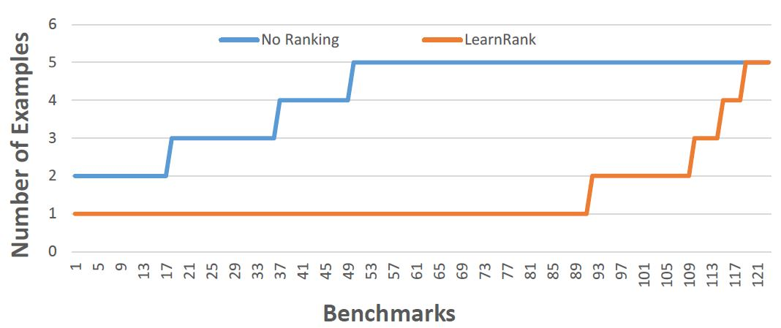
Experimental Comparison of various Ranking Strategies
Strategy | Average # of examples required
Baseline | 4.17
Learning | 1.48
Technical Report: “Predicting a correct program in Programming by Example”; Singh, Gulwani

Slide 14
Generic Methodology for End User Programming
Problem Definition: Identify a vertical domain of tasks that users struggle with.
Domain-Specific Language (DSL): Design a DSL that can succinctly describe tasks in that domain.
Synthesis Algorithm: Develop an algorithm that can efficiently translate intent into likely concepts in DSL.
Machine Learning: Rank the various concepts.
User Interface: Provide an appropriate interaction mechanism to resolve ambiguities.
CACM 2012: “Spreadsheet Data Manipulation using Examples”, Gulwani, Harris, Singh

Slide 15
Data Manipulation
Extraction
FlashRelate: Extract data from spreadsheets
FlashExtract: Extract data from text files, web pages [PLDI 2014]
Transformation
Flash Fill: Excel feature for Syntactic String Transformations [POPL 2011]
Semantic String Transformations [VLDB 2012]
Number Transformations [CAV 2013]
Querying
NLyze: an Excel programming-by-natural-lang add-in [SIGMOD 2014]
Formatting
Table re-formatting [PLDI 2011]
FlashFormat: a Powerpoint add-in [AAAI 2014]

Slide 16
FlashExtract Demo

Slide 17
Programming using Natural Language
When I receive a new SMS, if the phone is connected to my car’s bluetooth, read the message content and reply to the sender “I’m driving.”

Slide 18
DSL for SmartPhone Programming
SmartPhone Program $P$ := $I when E U if C then M$
Parameter $I$ := $Input(i1, …, in) | ε$
Event $E$ :=$\vec{x}≔EventName() | ε$
Side-effect Free Computation $U$ := $F_{1};…{; F}_{n};$
Utility Function $F$ := $x≔UtilityName\left(\vec{a}\right)$
Argument $a$ := $i \left| c \right| x | s$
Condition $C$ := $π_{1}∧ …∧π_{n}$
Predicate $π$ := $PredicateName\left(\vec{a}\right) \left| a1=a2 \right| a1∈a2$
Body $M$ := $Stmt1; … Stmtn;$
Statement $Stmt$ :=$S$ | $foreach x∈a do S1; … Sm; od$
Atomic Statement $S$ :=$A | F$
Action $A$ := $\vec{x} ≔ActionName\left(\vec{a}\right)$

Slide 19
Programming using Natural Language
When I receive a new SMS, if the phone is connected to my car’s bluetooth, read the message content and reply to the sender “I’m driving.”
Synthesis
when (number, content) := MessageReceived()
if (IsConnectedToBTDevice(Car_BT) then
Speak(content);
SendMessage(number, "I'm driving");

Slide 20
Synthesis Algorithm for Natural Language Programming
Script = Components/APIs + Relations/Connections
Rule-based techniques to infer components & some relations.
Infer missing relations using type-based synthesis over underlying DSL.
Select among multiple candidates using ranking.
MobiSys 2013: “SmartSynth: Synthesizing Smartphone Automation Scripts from Natural Language”; Le, Gulwani, Su

Slide 21
TouchDevelop Synthesis Demo

Slide 22
New Directions in End User Programming
Multi-modal programming models that
Allow different intent forms like examples & natural language
Leverage power of different synthesizers
Support debugging experience including active learning, paraphrasing and editing of synthesized programs
Frameworks for synthesizing synthesizers!
Synthesis expert simply defines a DSL using pre-defined components equipped with modular search strategies.
FlashExtract [PLDI 2014]
Systematic divide-and-conquer based search
Test-driven Synthesis [PLDI 2014]
Heuristic search that leverages sequence of examples

Slide 23
Test Driven Development (TDD): Example¹
Test Cases:
Wrap(“word”,5)
== “word”
Program:
Wrap(string s, int len) {
// do nothing
throw new NotImplementedException();
}
¹ http://blog.8thlight.com/uncle-bob/2013/05/27/TheTransformationPriorityPremise.html

Slide 24
Test Driven Development (TDD): Example¹
Test Cases:
Wrap(“word”,5)
== “word”
2. Wrap(“foobar”, 6)
== “foobar”
Program:
Wrap(string s, int len) {
// return constant “word”
return “word”;
}
¹ http://blog.8thlight.com/uncle-bob/2013/05/27/TheTransformationPriorityPremise.html

Slide 25
Test Driven Development (TDD): Example¹
Test Cases:
Wrap(“word”,5)
== “word”
2. Wrap(“foobar”, 6)
== “foobar”
3. Wrap(“LongWord”, 4)
== “Long\nWord”
Program:
Wrap(string s, int len) {
// return input string
return s;
}
¹ http://blog.8thlight.com/uncle-bob/2013/05/27/TheTransformationPriorityPremise.html

Slide 26
Test Driven Development (TDD): Example¹
Test Cases:
Wrap(“word”,5)
== “word”
2. Wrap(“foobar”, 6)
== “foobar”
3. Wrap(“LongWord”, 4)
== “Long\nWord”
4. Wrap(“LongerWord”, 6)
== “Longer\nWord”
Program:
Wrap(string s, int len) {
// return input if short
if (s.Len ≤len)
return s;
else
return “Long\nWord”
}
¹ http://blog.8thlight.com/uncle-bob/2013/05/27/TheTransformationPriorityPremise.html

Slide 27
Test Driven Development (TDD): Example¹
Test Cases:
Wrap(“word”,5)
== “word”
2. Wrap(“foobar”, 6)
== “foobar”
3. Wrap(“LongWord”, 4)
== “Long\nWord”
4. Wrap(“LongerWord”, 6)
== “Longer\nWord”
5. Wrap(“LongerWord”, 2)
== “Lo\nng\ner\nWo\nrd”
Program:
Wrap(string s, int len) {
// split string at len
if (s.Len ≤len)
return s;
else
return s[0:len] + “\n” + s[len:];
}
¹ http://blog.8thlight.com/uncle-bob/2013/05/27/TheTransformationPriorityPremise.html

Slide 28
Test Driven Development (TDD): Example¹
Test Cases:
Wrap(“word”,5)
== “word”
2. Wrap(“foobar”, 6)
== “foobar”
3. Wrap(“LongWord”, 4)
== “Long\nWord”
4. Wrap(“LongerWord”, 6)
== “Longer\nWord”
5. Wrap(“LongerWord”, 2)
== “Lo\nng\ner\nWo\nrd”
Program:
Wrap(string s, int len) {
// wrap word to length len
if (s.Len ≤len)
return s;
else
return s[0:len] + “\n” + wrap(s[len:], len);
}
¹ http://blog.8thlight.com/uncle-bob/2013/05/27/TheTransformationPriorityPremise.html

Slide 29
Google’s Automation of TDD²
² http://googletesting.blogspot.com/2014/04/the-real-test-driven-development.html

Slide 30
Google’s Automation of TDD² (April 1 Joke)
² http://googletesting.blogspot.com/2014/04/the-real-test-driven-development.html

Slide 31
Our Synthesis Algorithm for TDD Automation
User provides a sequence of increasingly sophisticated test cases
Make small change to the existing program to make it pass the next test case.
Replace single sub-expression on new test case’s path
Where to modify?
What to replace with?
PLDI 2014: “Test-Driven Synthesis”;
Perelman, Gulwani, Grossman, Provost

Slide 32
Where to modify to fit the next test case?
Test Cases:
Wrap(“word”,5)
== “word”
2. Wrap(“foobar”, 6)
== “foobar”
3. Wrap(“LongWord”, 4)
== “Long\nWord”
4. Wrap(“LongerWord”, 6)
== “Longer\nWord”
5. Wrap(“LongerWord”, 2)
== “Lo\nng\ner\nWo\nrd”
Program:
Wrap(string s, int len) {
// split string at len
if (s.Len ≤len)
return s;
else
return s[0:len] + “\n” + s[len:];
}

Slide 33
Where to modify to fit the next test case?
Test Cases:
Wrap(“word”,5)
== “word”
2. Wrap(“foobar”, 6)
== “foobar”
3. Wrap(“LongWord”, 4)
== “Long\nWord”
4. Wrap(“LongerWord”, 6)
== “Longer\nWord”
5. Wrap(“LongerWord”, 2)
== “Lo\nng\ner\nWo\nrd”
Program:
Wrap(string s, int len) {
// split string at len
if (s.Len ≤len)
return s;
else
return s[0:len] + “\n” + s[len:];
}

Slide 34
Where to modify to fit the next test case?
Test Cases:
Wrap(“word”,5)
== “word”
2. Wrap(“foobar”, 6)
== “foobar”
3. Wrap(“LongWord”, 4)
== “Long\nWord”
4. Wrap(“LongerWord”, 6)
== “Longer\nWord”
5. Wrap(“LongerWord”, 2)
== “Lo\nng\ner\nWo\nrd”
Program:
Wrap(string s, int len) {
// split string at len
if (s.Len ≤len)
return s;
else
return s[0:len] + “\n” + s[len:];
}

Slide 35
Where to modify to fit the next test case?
Test Cases:
Wrap(“word”,5)
== “word”
2. Wrap(“foobar”, 6)
== “foobar”
3. Wrap(“LongWord”, 4)
== “Long\nWord”
4. Wrap(“LongerWord”, 6)
== “Longer\nWord”
5. Wrap(“LongerWord”, 2)
== “Lo\nng\ner\nWo\nrd”
Program:
Wrap(string s, int len) {
// split string at len
if (s.Len ≤len)
return s;
else
return s[0:len] + “\n” + s[len:];
}

Slide 36
Where to modify to fit the next test case?
Test Cases:
Wrap(“word”,5)
== “word”
2. Wrap(“foobar”, 6)
== “foobar”
3. Wrap(“LongWord”, 4)
== “Long\nWord”
4. Wrap(“LongerWord”, 6)
== “Longer\nWord”
5. Wrap(“LongerWord”, 2)
== “Lo\nng\ner\nWo\nrd”
Program:
Wrap(string s, int len) {
// split string at len
if (s.Len ≤len)
return s;
else
return s[0:len] + “\n” + s[len:];
}

Slide 37
Where to modify to fit the next test case?
Test Cases:
Wrap(“word”,5)
== “word”
2. Wrap(“foobar”, 6)
== “foobar”
3. Wrap(“LongWord”, 4)
== “Long\nWord”
4. Wrap(“LongerWord”, 6)
== “Longer\nWord”
5. Wrap(“LongerWord”, 2)
== “Lo\nng\ner\nWo\nrd”
Program:
Wrap(string s, int len) {
// split string at len
if (s.Len ≤len)
return s;
else
return s[0:len] + “\n” + s[len:];
}

Slide 38
Where to modify to fit the next test case?
Test Cases:
Wrap(“word”,5)
== “word”
2. Wrap(“foobar”, 6)
== “foobar”
3. Wrap(“LongWord”, 4)
== “Long\nWord”
4. Wrap(“LongerWord”, 6)
== “Longer\nWord”
5. Wrap(“LongerWord”, 2)
== “Lo\nng\ner\nWo\nrd”
Program:
Wrap(string s, int len) {
// split string at len
if (s.Len ≤len)
return s;
else
return s[0:len] + “\n” + Wrap(s[len:], len);
}

Slide 39
Our Synthesis Algorithm for TDD Automation
User provides a sequence of increasingly sophisticated test cases
Make small change to the existing program to make it pass the next test case.
Replace single sub-expression on new test case’s path
Where to modify?
What to replace with?
DSL defines space of expressions
Prefer expressions found in previous program
E.g., Wrap(s[len:], len) contains s[len:]
Search Methodology 3: Heuristic Search (AI, GP)

Slide 40
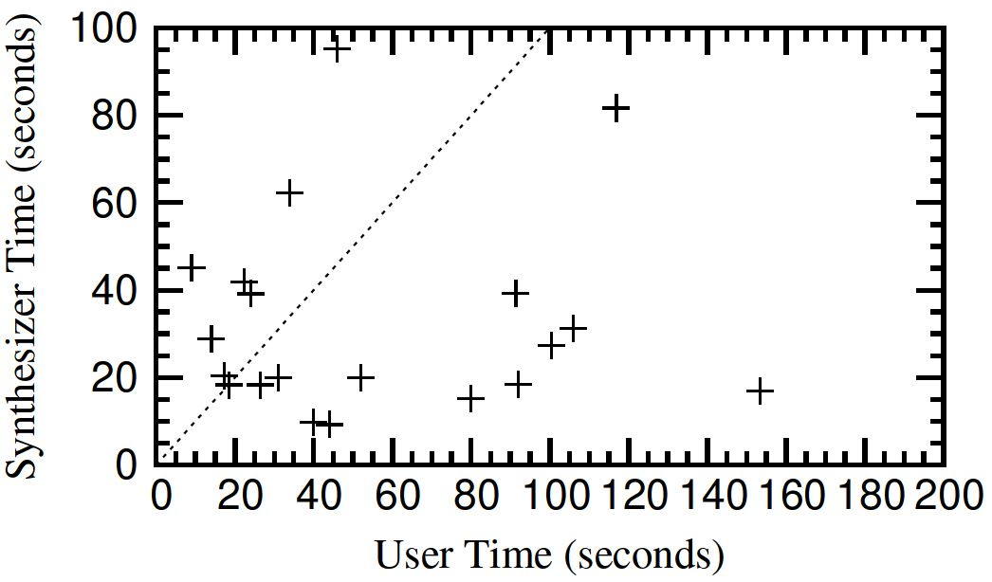
Experimental Results (on Pex4Fun coding duels)
Completion time comparable to humans!
Robust to small reorderings of examples but fails on large reorderings!

Slide 41
New Directions in End-User Programming
Multi-modal programming models that
Allow different intent forms like examples & natural language
Leverage power of different synthesizers
Support debugging experience including active learning, paraphrasing and editing of synthesized programs
Frameworks for synthesizing synthesizers!
Synthesis expert simply defines a DSL using pre-defined components equipped with modular search strategies.
FlashExtract [PLDI 2014]
Systematic divide-and-conquer based search
Test-driven Synthesis [PLDI 2014]
Heuristic search that leverages sequence of examples

Slide 42
Potential Users of Synthesis Technology
Algorithm
Designers
Software Developers
Most Transformational Target
End-Users
Students and Teachers
Vision for End-users: Automate repetitive tasks
Vision for Education: Interactive & personalized

Slide 43
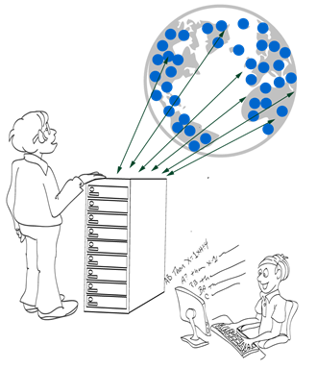
Connections between End-User Programming & Intelligent Tutoring Systems
Both involve automation of domain-specific repetitive tasks using search algorithms
Interactivity between End-User & Computer to resolve ambiguities is similar to
Interactivity between Student & Computer
to resolve student’s confusions.
Implications:
End-User Programming research can fuel Intelligent Tutoring Systems research.
And vice-versa!

Slide 44
Problem Synthesis
Motivation
Problems similar to a given problem.
Avoid copyright issues
Prevent cheating in MOOCs (Unsynchronized instruction)
Problems of a given difficulty level and concept usage.
Generate progressions
Generate personalized workflows
Key Ideas
Test input generation techniques [CHI 2013]
Reverse of solution generation [IJCAI 2013]
Template-based generalization

Slide 45
Problem Synthesis: Algebra (Trigonometry)
$$\text{Example} \text{Problem}\text{:}{ \left(\sec{x+ \cos{x}}\right) \left(\sec{x−\cos{x}}\right)}= \tan^{2}{x+\sin^{2}{x}}$$
$$\text{Query}\text{: }\left(T_{1}\left(x\right)±T_{2}(x)\right) \left(T_{3}\left(x\right)±T_{4}\left(x\right)\right)=T_{5}^{2}\left(x\right)±T_{6}^{2}(x)$$
$${ T}_{1}≠T_{5}$$
New problems generated:
$$\left(\csc{x}+\cos{x}\right)\left(\csc{x}−\cos{x}\right)=\cot^{2}{x}+\sin^{2}{x}$$
$$(\csc{x−\sin{x)(\csc{x+\sin{x)=\cot^{2}{x+\cos^{2}{x}}}}} }$$
$$(\sec{x+\sin{x)(\sec{x−\sin{x)=\tan^{2}{x+\cos^{2}{x}}}}}}$$
:
$$(\tan{x+\sin{x)(\tan{x−\sin{x)=\tan^{2}{x −\sin^{2}{x} }}}}}$$
$$(\csc{x+\cos{x)(\csc{x−\cos{x)=\csc^{2}{x −\cos^{2}{x}}}}}}$$
:
AAAI 2012: “Automatically generating algebra problems”;
Singh, Gulwani, Rajamani.

Slide 46
Problem Synthesis: Algebra (Trigonometry)
$$\text{Example} \text{Problem}\text{:}{ \left(\sec{x+ \cos{x}}\right) \left(\sec{x−\cos{x}}\right)}= \tan^{2}{x+\sin^{2}{x}}$$
$$\text{Query}\text{: }\left(T_{1}\left(x\right)±T_{2}(x)\right) \left(T_{3}\left(x\right)±T_{4}\left(x\right)\right)=T_{5}^{2}\left(x\right)±T_{6}^{2}(x)$$
$${ T}_{1}≠T_{5}$$
New problems generated:
$$\left(\csc{x}+\cos{x}\right)\left(\csc{x}−\cos{x}\right)=\cot^{2}{x}+\sin^{2}{x}$$
$$(\csc{x−\sin{x)(\csc{x+\sin{x)=\cot^{2}{x+\cos^{2}{x}}}}} }$$
$$(\sec{x+\sin{x)(\sec{x−\sin{x)=\tan^{2}{x+\cos^{2}{x}}}}}}$$
:
$$(\tan{x+\sin{x)(\tan{x−\sin{x)=\tan^{2}{x −\sin^{2}{x} }}}}}$$
$$(\csc{x+\cos{x)(\csc{x−\cos{x)=\csc^{2}{x −\cos^{2}{x}}}}}}$$
:
AAAI 2012: “Automatically generating algebra problems”;
Singh, Gulwani, Rajamani.

Slide 47
Problem Synthesis: Algebra (Limits)
$$\text{Example} \text{Problem}\text{:} \lim_{n→∞}{\sum_{i=0}^{n}{\frac{2i^{2}+i+1}{5^{i}}= \frac{5}{2}} }$$
$$\text{Query}\text{:} \lim_{n→∞}{\sum_{i=0}^{n}{\frac{C_{0}i^{2}+C_{1}i+C_{2}}{{C_{3}}^{i}}= \frac{C_{4}}{C_{5}}} }$$
$${ C}_{0}≠0 ∧ \gcd\left(C_{0},C_{1},C_{2}\right)=\gcd\left(C_{4},C_{5}\right)=1$$
New problems generated:
$$\lim_{n→∞}{\sum_{i=0}^{n}{\frac{3i^{2}+2i+1}{7^{i}}= \frac{7}{3} }\lim_{n→∞}{\sum_{i=0}^{n}{\frac{3i^{2}+3i+1}{4^{i}}=4 } }}$$
$$\lim_{n→∞}{\sum_{i=0}^{n}{\frac{i^{2}}{3^{i}}= \frac{3}{2}} \lim_{n→∞}{\sum_{i=0}^{n}{\frac{5i^{2}+3i+3}{6^{i}}=6 } }}$$

Slide 48
Problem Synthesis: Algebra (Integration)
$$\text{Example} \text{Problem}\text{:} \int{(\csc{x) (\csc{x−\cot{x) dx= \csc{x}−\cot{x}}}}}{ }$$
$$\text{Query}\text{: }\int{T_{0}\left(x\right)\left(T_{1}\left(x\right)±T_{2}\left(x\right)\right)dx=T_{4}\left(x\right)±T_{5}(x)}$$
$${ T}_{1}≠T_{2} ∧ T_{4}≠T_{5}$$
New problems generated:
$$\int{(tan{x) (\cos{x}+ \sec{x) dx= \sec{x}− \cos{x}}}}$$
$$\int{(sec{x) (\tan{x}+ \sec{x) dx= \sec{x}+\cot{ x}}}}$$
$$\int{(\cot{x) (\sin{x+ \csc{x) dx= \sin{x−\csc{x}}}}}}$$

Slide 49
Problem Synthesis: Algebra (Determinant)
$$\text{Ex}\text{. }\text{Problem} \left|\begin{matrix}{\left(x+y\right)}^{2} & zx & zy \\ zx & {\left(y+z\right)}^{2} & xy \\ yz & xy & {\left(z+x\right)}^{2}\end{matrix}\right|{ }=2xyz {\left(x+y+z\right)}^{3}$$
$$\text{Query} \left|\begin{matrix}F_{0}(x,y,z) & F_{1}(x,y,z) & F_{2}(x,y,z) \\ F_{3}(x,y,z) & F_{4}(x,y,z) & F_{5}(x,y,z) \\ F_{6}(x,y,z) & F_{7}(x,y,z) & F_{8}(x,y,z)\end{matrix}\right|{ }=C_{10}F_{9}(x,y,z)$$
$${ F}_{i}≔F_{j}\left[x→y;y→z;z→x\right] where \left(i,j\right)∈\{\left(4,0\right), \left(8,4\right), \left(5,1\right),…\}$$
New problems generated:
$$\left|\begin{matrix}y^{2} & x^{2} & {\left(y+x\right)}^{2} \\ {\left(z+y\right)}^{2} & z^{2} & y^{2} \\ z^{2} & {\left(x+z\right)}^{2} & x^{2}\end{matrix}\right|{ }=2{\left(xy+yz+zx\right)}^{3}$$
$$\left|\begin{matrix}yz+y^{2} & xy & xy \\ yz & zx+z^{2} & yz \\ zx & zx & xy+x^{2}\end{matrix}\right|{ }=4x^{2}y^{2}z^{2}$$

Slide 50
Synthesis Algorithm for Finding Instantiations
Enumerate all possible choices for the various holes.
Test the validity of an instantiation using random testing.
Why does this work?
Background: Classic Polynomial Identity Testing
Problem: Given two polynomials P1 and P2, determine whether they are equivalent.
The naïve deterministic algorithm of expanding polynomials to compare them term-wise is exponential.
A simple randomized test is probabilistically sufficient:
Choose random values r for polynomial variables x
If P1(r) ≠ P2(r), then P1 is not equivalent to P2.
Otherwise P1 is equivalent to P2 with high probability.
New Result
Above approach also extends to analytic functions.

Slide 51
Problem Synthesis
Motivation
Problems similar to a given problem.
Avoid copyright issues
Prevent cheating in MOOCs (Unsynchronized instruction)
Problems of a given difficulty level and concept usage.
Generate progressions
Generate personalized workflows
Key Ideas
Test input generation techniques [CHI 2013]
Reverse of solution generation [IJCAI 2013]
Template-based generalization

Slide 52
Problem Synthesis: Sentence Completion
The principal characterized his pupils as _________ because they were pampered and spoiled by their indulgent parents.
The commentator characterized the electorate as _________ because it was unpredictable and given to constantly shifting moods.
(a) cosseted (b) disingenuous (c) corrosive (d) laconic (e) mercurial
One of the problems is a real problem from SAT (standardized US exam),
while the other one was automatically generated!
From problem 1, we generate template T₁: *₁ characterized *₂ as *₃ because *4
We specialize T₁ to template T₂: *₁ characterized *₂ as mercurial because *₄
Problem 2 is an instance of T₂
Related projects in End-user programming:
LaSEWeb: Automating search strategies over web data [KDD 2014]
Bing Code Search: Visual Studio add-in
found using web search!
Search Methodology 4: Information Retrieval

Slide 53
Feedback Synthesis
Motivation
Makes teachers more effective.
Saves them time.
Provides immediate insights on where students are struggling.
Can enable rich interactive experience for students.
Generation of hints.
Pointer to simpler problems depending on kind of mistake.
Key Ideas:
Use PBE techniques to learn buggy procedure in student mind
Counterexamples

Slide 54
Counterexamples are not sufficient!
"Not only did it take 1-2 weeks to grade problem, but the comments were entirely unhelpful in actually helping us fix our errors. …. Apparently they don't read the code -- they just ran their tests and docked points mercilessly. What if I just had a simple typo, but my algorithm was fine? ....“
- Student Feedback from MIT 6.00 course, 2013.

Slide 55
Feedback Synthesis
Motivation
Makes teachers more effective.
Saves them time.
Provides immediate insights on where students are struggling.
Can enable rich interactive experience for students.
Generation of hints.
Pointer to simpler problems depending on kind of mistake.
Key Ideas:
Use PBE techniques to learn buggy procedure in student mind
Counterexamples
Nearest correct solution

Slide 56
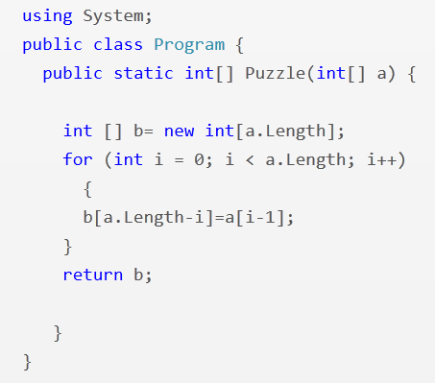
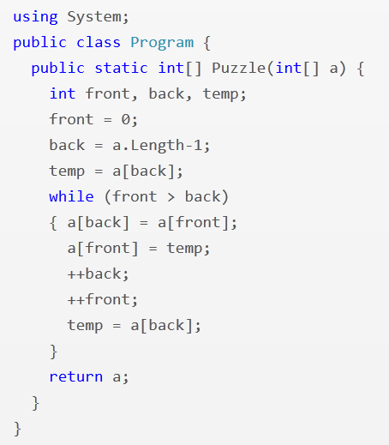
Feedback Synthesis: Programming (Array Reverse)
i = 1
i <= a.Length
front <= back
--back
PLDI 2013: “Automated Feedback Generation for Introductory Programming Assignments”; Singh, Gulwani, Solar-Lezama

Slide 57
Experimental Results
13,365 incorrect attempts for 13 Python problems.
(obtained from Introductory Programming course at MIT and its MOOC version on the EdX platform)
Average time for feedback = 10 seconds
Feedback generated for 64% of those attempts.
Reasons for failure to generate feedback
Completely incorrect solutions
Big conceptual errors
Timeout (4 min)
Tool accessible at: http://sketch1.csail.mit.edu/python-autofeedback/

Slide 58
Feedback Synthesis
Motivation
Makes teachers more effective.
Saves them time.
Provides immediate insights on where students are struggling.
Can enable rich interactive experience for students.
Generation of hints.
Pointer to simpler problems depending on kind of mistake.
Key Ideas:
Use PBE techniques to learn buggy procedure in student mind
Counterexamples
Nearest correct solution
Nearest problem description (corresponding to student solution)

Slide 59
Feedback Synthesis: Finite State Automata
Draw a DFA that accepts: { s | ‘ab’ appears in s exactly 2 times }
Grade: 9/10
Feedback: One more state should be made final
Attempt 1
Based on nearest correct solution
Grade: 6/10
Feedback: The DFA is incorrect on the string ‘ababb’
Attempt 2
Based on counterexamples
Grade: 5/10
Feedback: The DFA accepts {s | ‘ab’ appears in s at least 2 times}
Attempt 3
Based on nearest problem description
IJCAI 2013: “Automated Grading of DFA Constructions”;
Alur, d’Antoni, Gulwani, Kini, Viswanathan

Slide 60
Experimental Results
800+ attempts to 6 automata problems (obtained from automata course at UIUC) graded by tool and 2 instructors.
95% problems graded in <6 seconds each
Out of 131 attempts for one of those problems:
6 attempts: instructors were incorrect (gave full marks to an incorrect attempt)
20 attempts: instructors were inconsistent (gave different marks to syntactically equivalent attempts)
34 attempts: >= 3 point discrepancy between instructor & tool; in 20 of those, instructor agreed that tool was more fair.
Instructors concluded that tool should be preferred over humans for consistency & scalability.
Tool accessible at: http://www.automatatutor.com/

Slide 61
New Directions in Intelligent Tutoring Systems
Domain-specific natural language understanding to deal with word problems.
Leverage large amounts of student data.
Leverage large populations of students and teachers.

Slide 62
Conclusion
Synthesis is a hard problem that can be tamed with proper choices for the various dimensions.
Domain-specific language: design proper abstractions
Intent specification: allow under-specifications & interactivity
Search techniques: SAT/SMT constraint solving, systematic divide & conquer, heuristic enumerative search, information retrieval
Two important applications with large scale societal impact.
End-User Programming: data manipulation, programming of smartphones and robots
Intelligent Tutoring Systems: problem & feedback synthesis
References:
“Spreadsheet Data Manipulation using Examples”; CACM 2012
“Example-based Learning in Computer-aided STEM Education”; CACM 2014

Slide 63
Backup Demo Slides

Slide 64
Flash Fill Demo

Slide 65
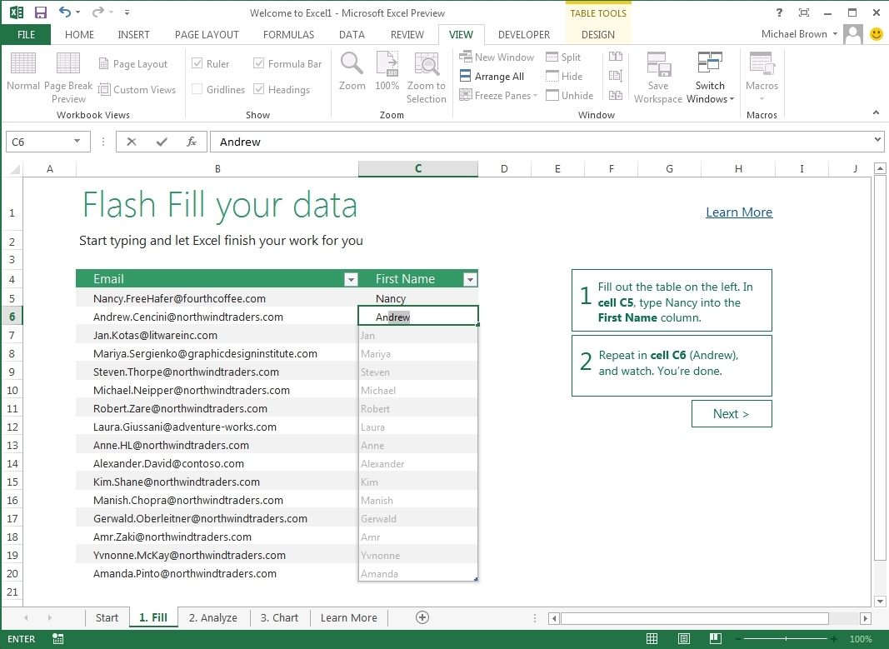
Flash Fill (Excel 2013 feature) in Action

Slide 66
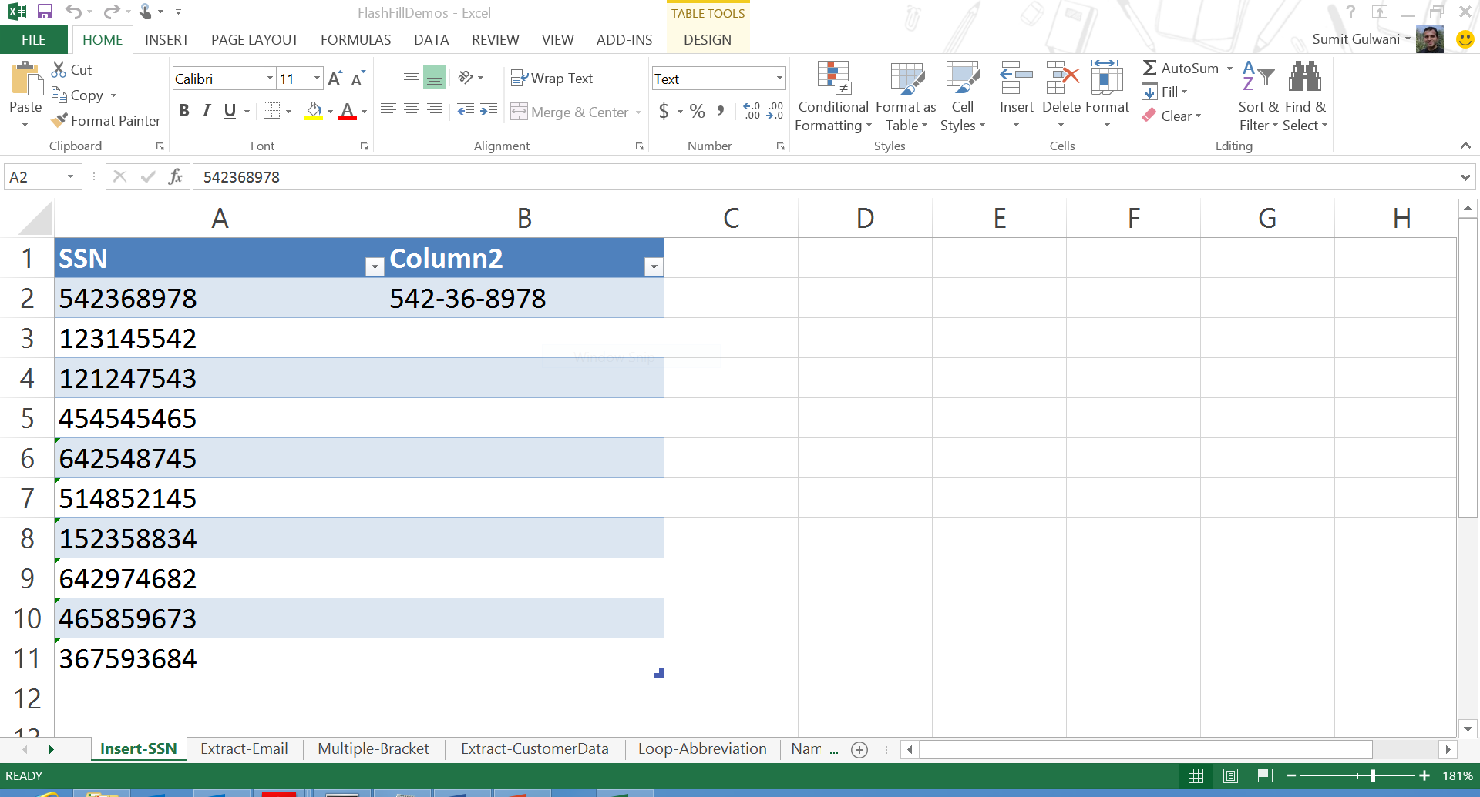

Slide 67
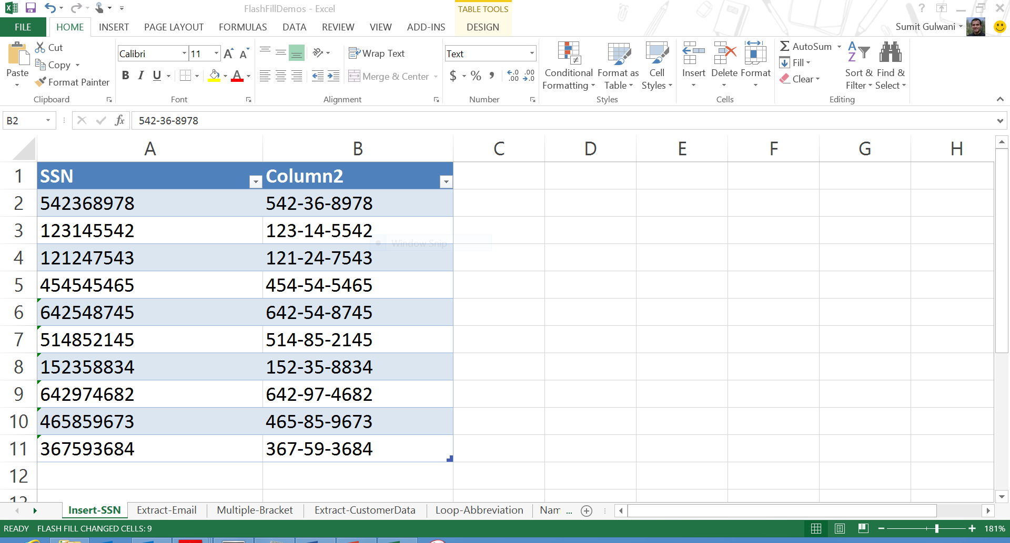

Slide 68
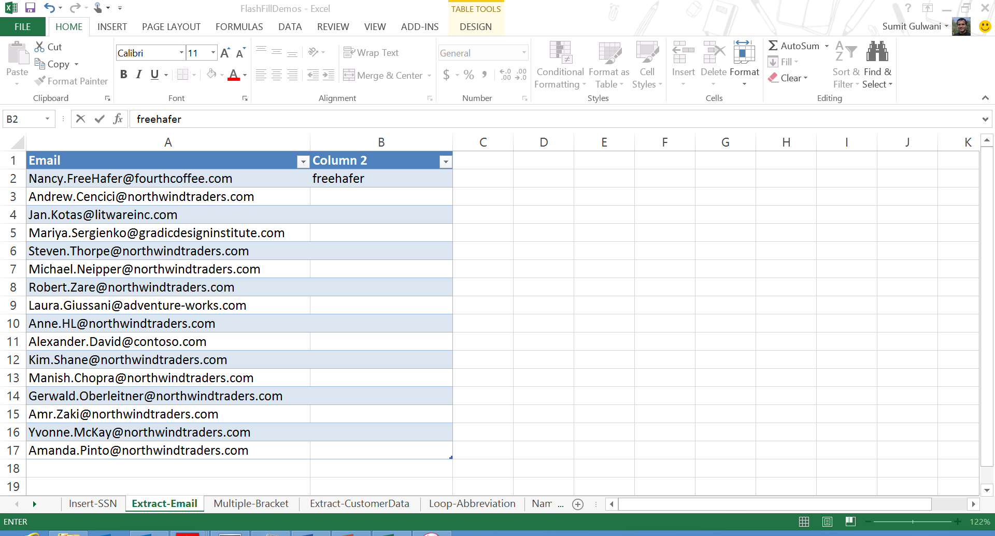

Slide 70
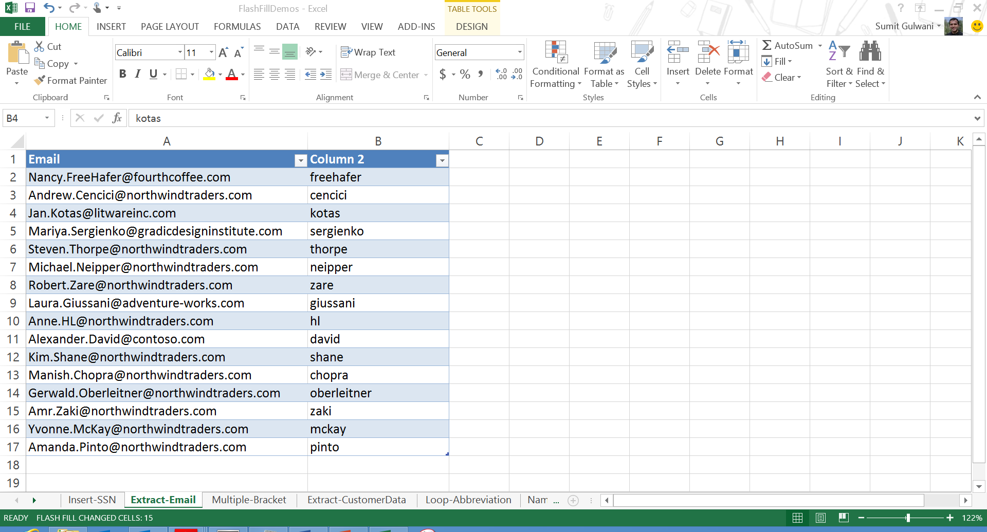

Slide 71
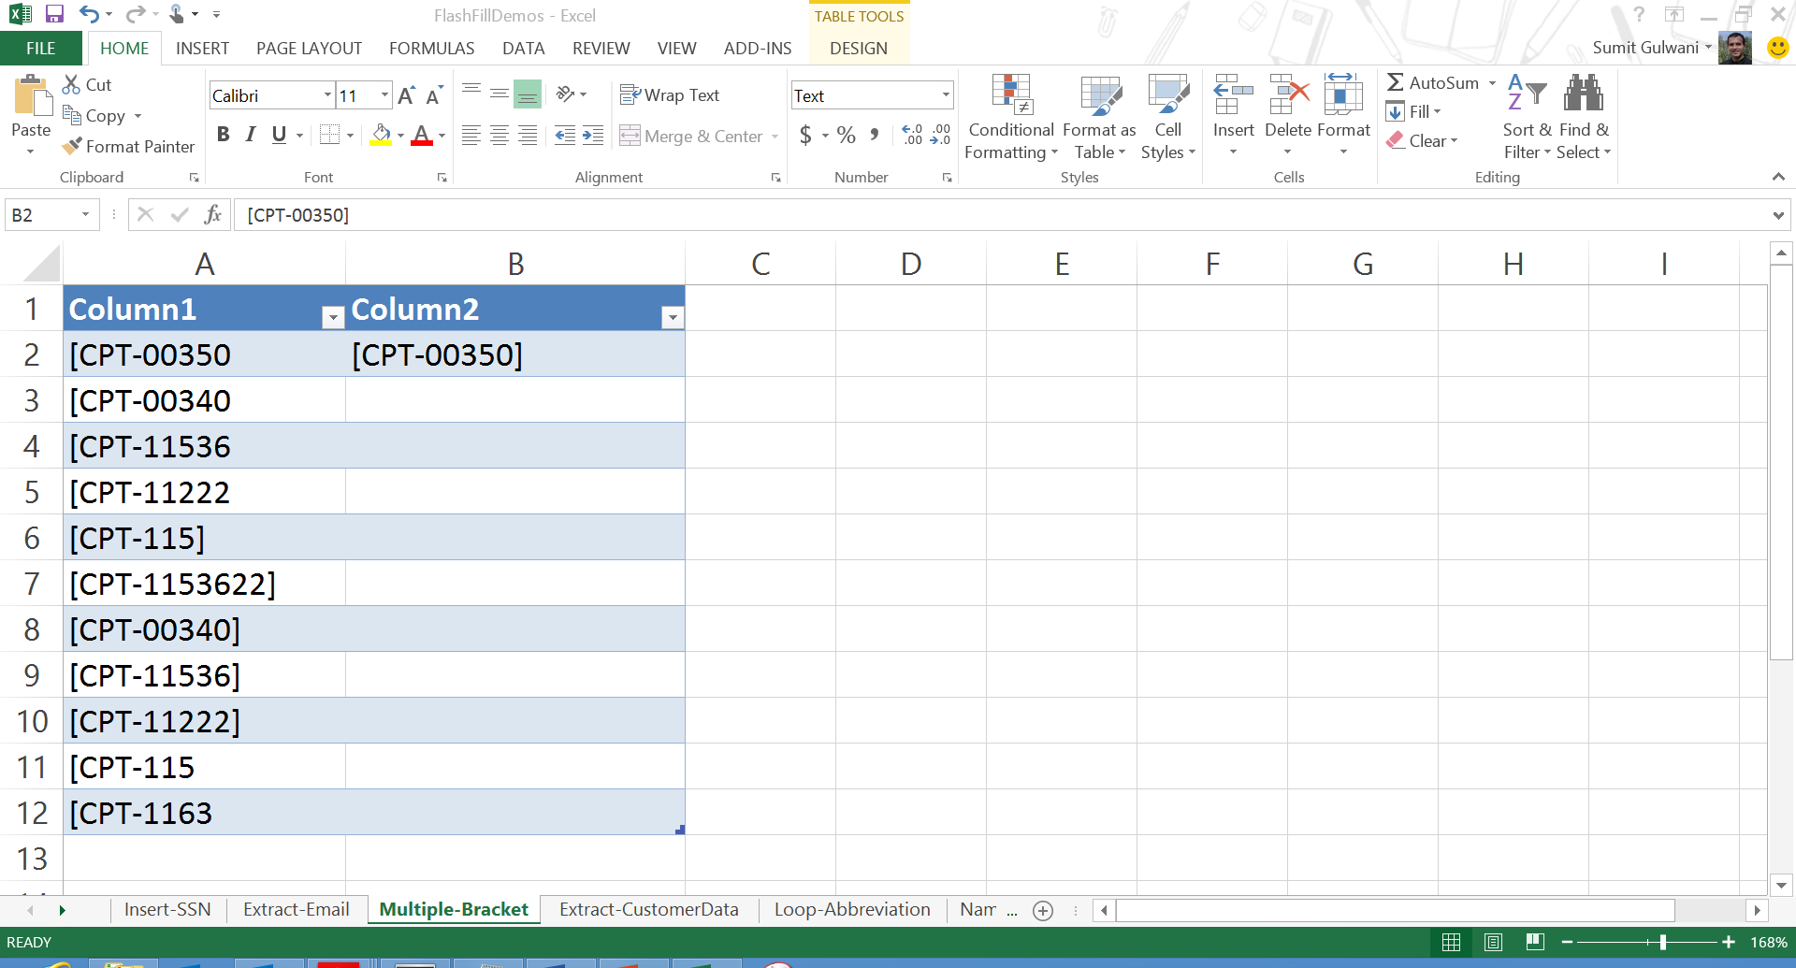

Slide 72
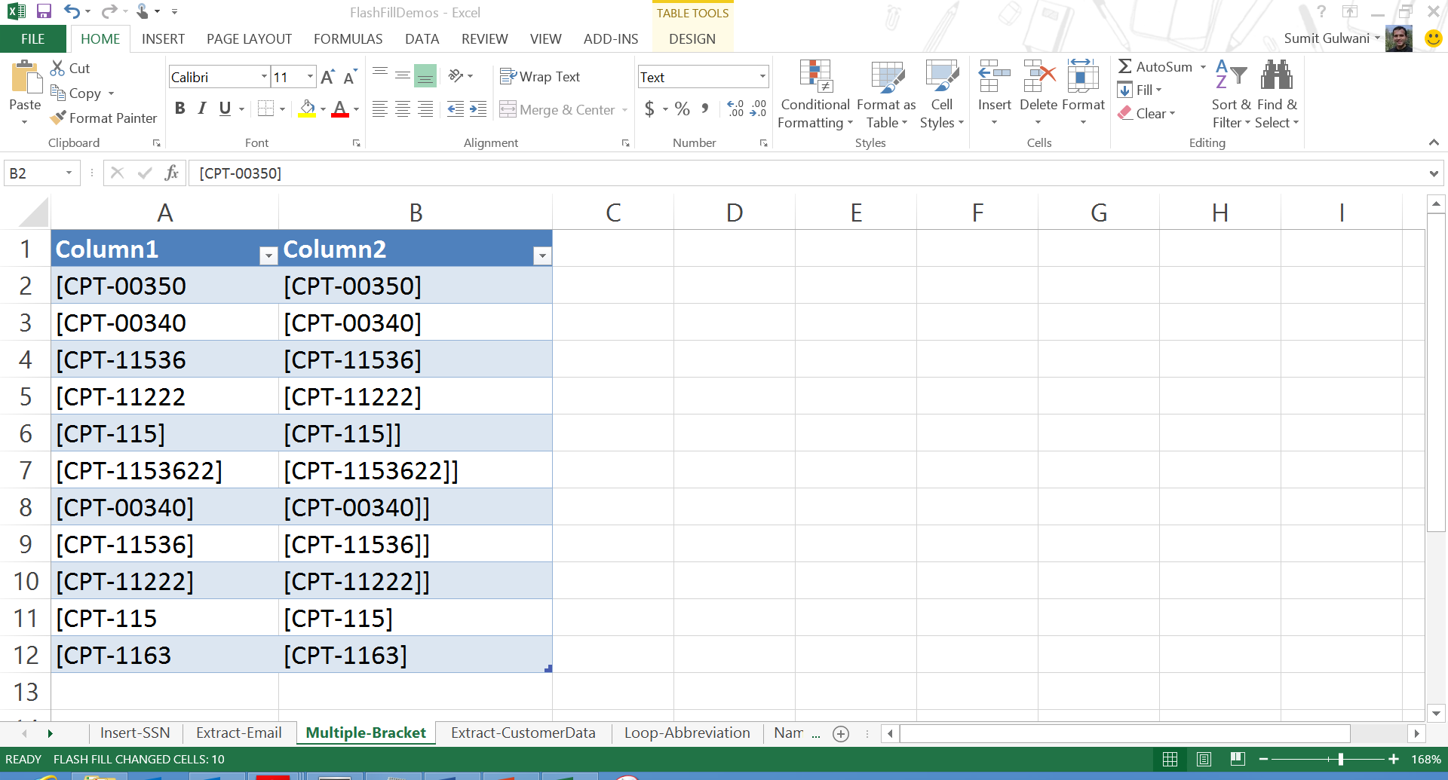

Slide 73
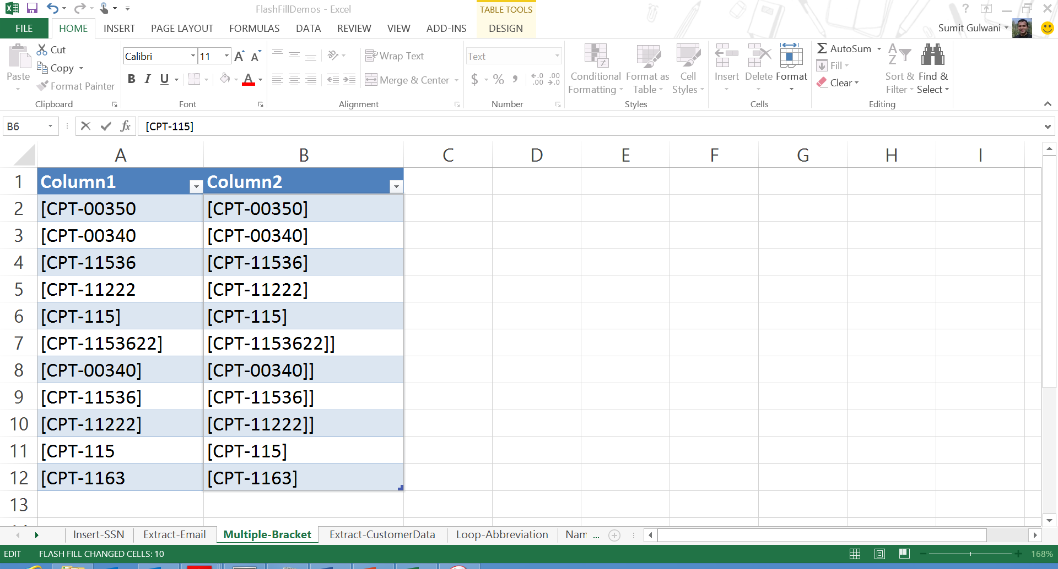

Slide 74
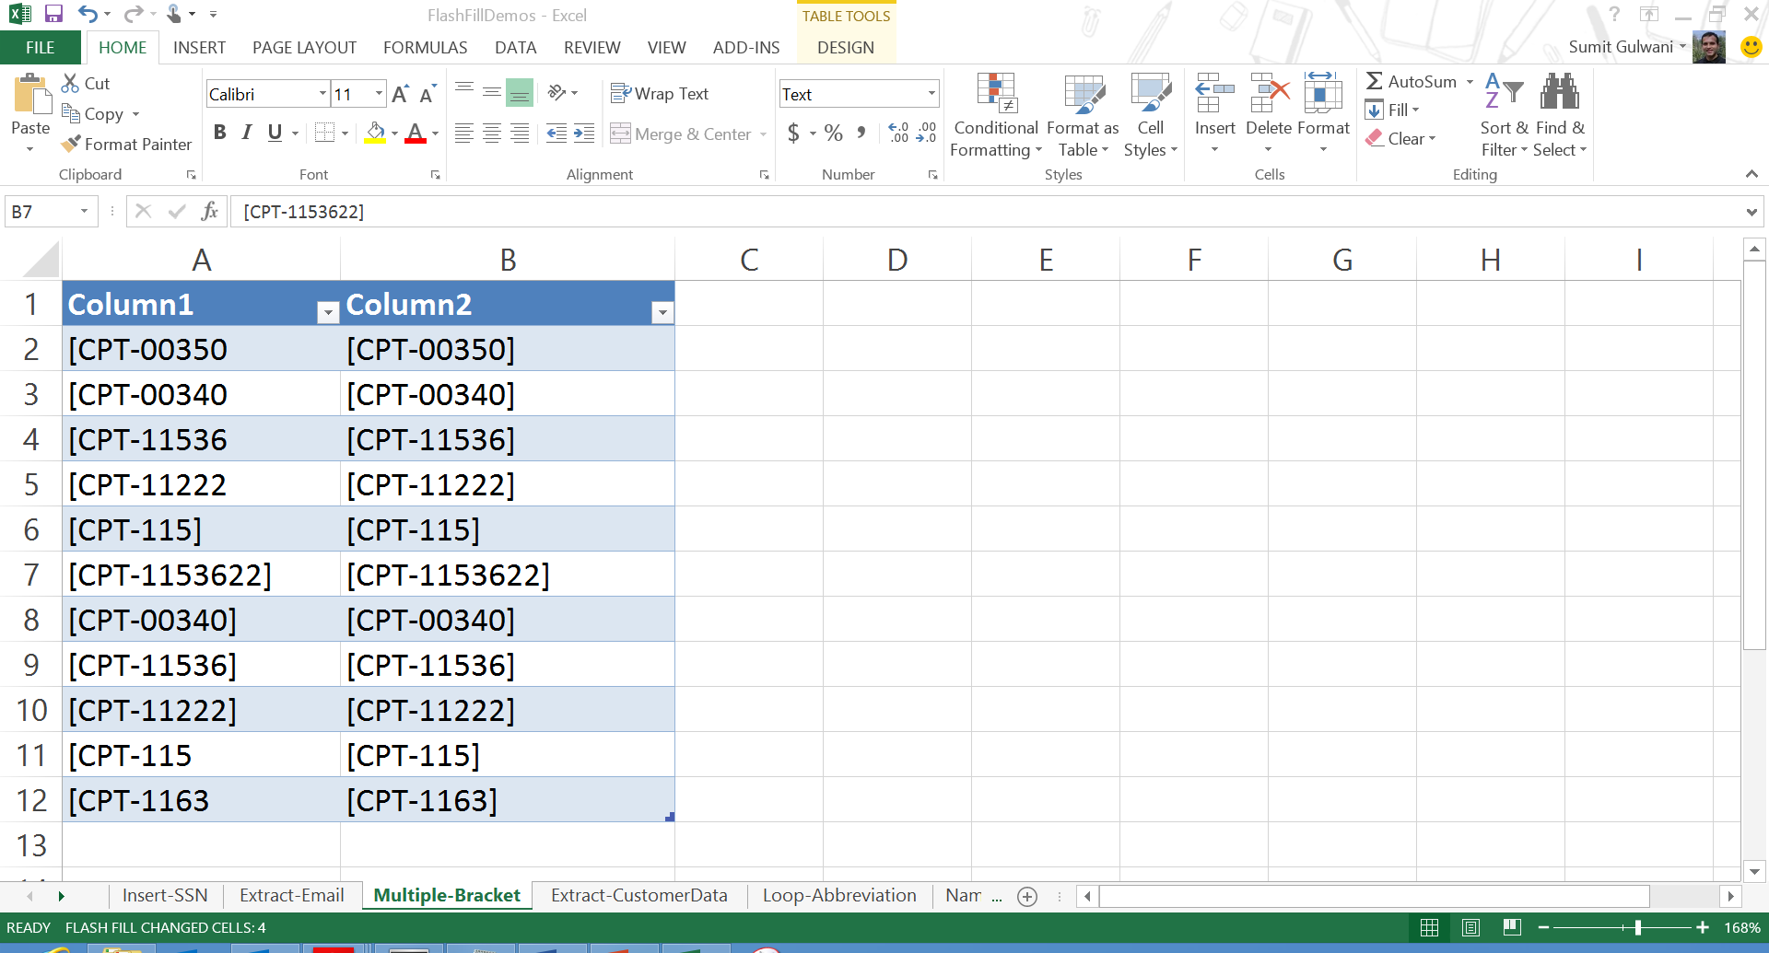

Slide 75
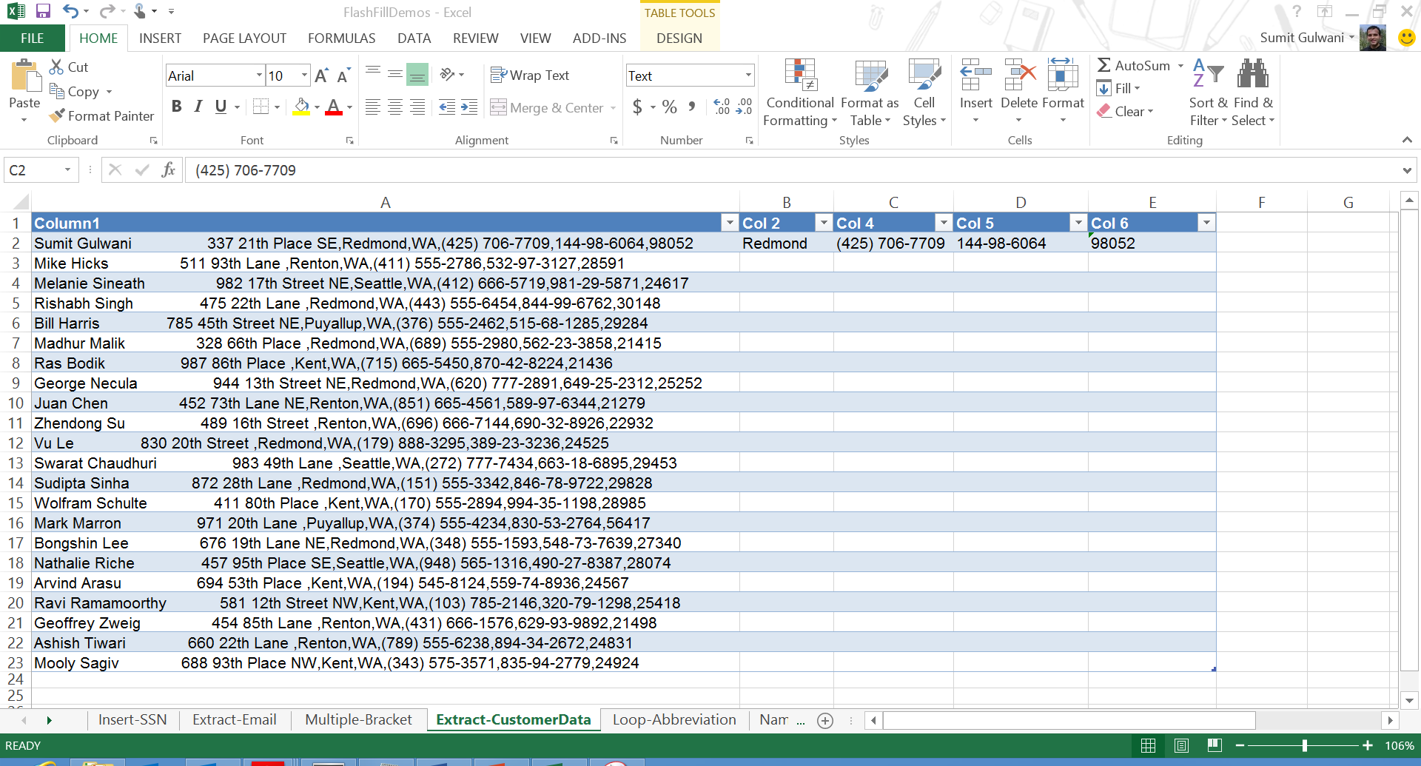

Slide 76
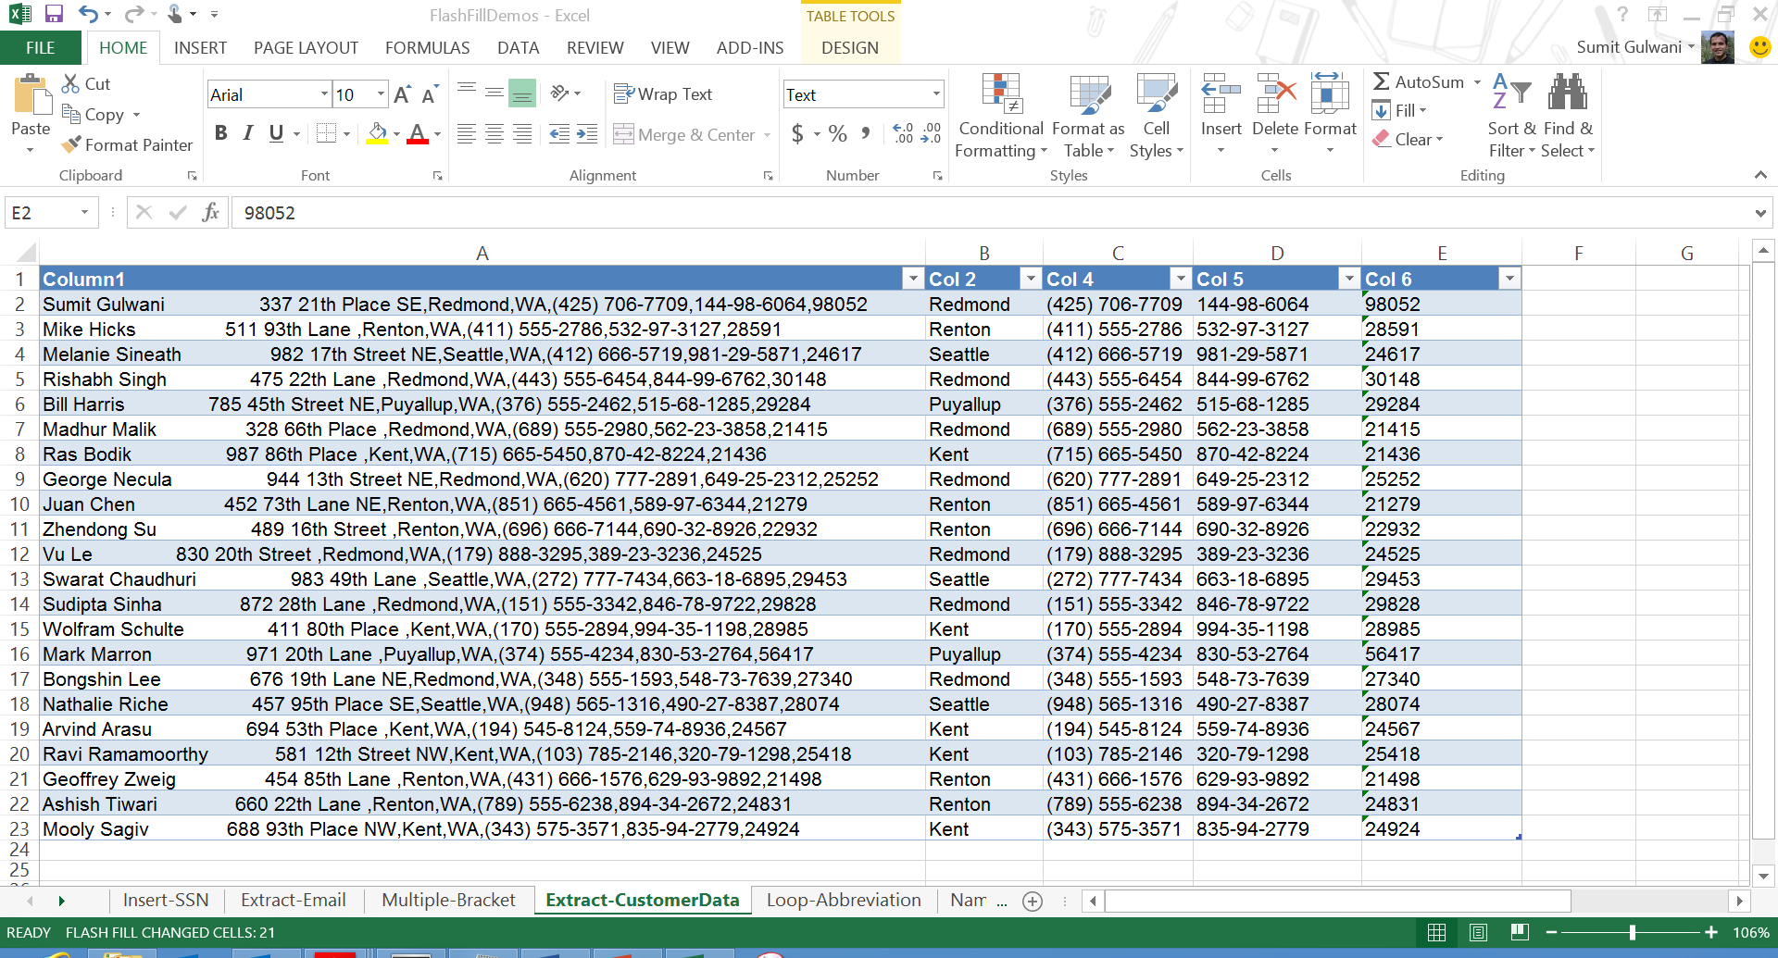

Slide 77
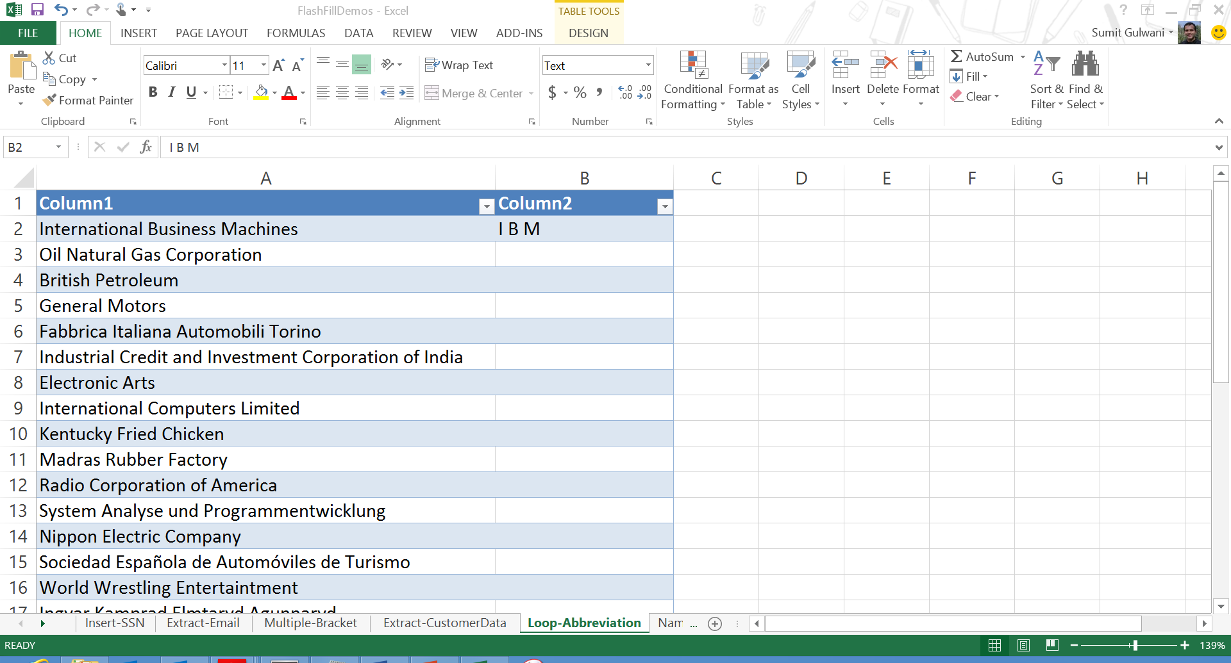

Slide 78
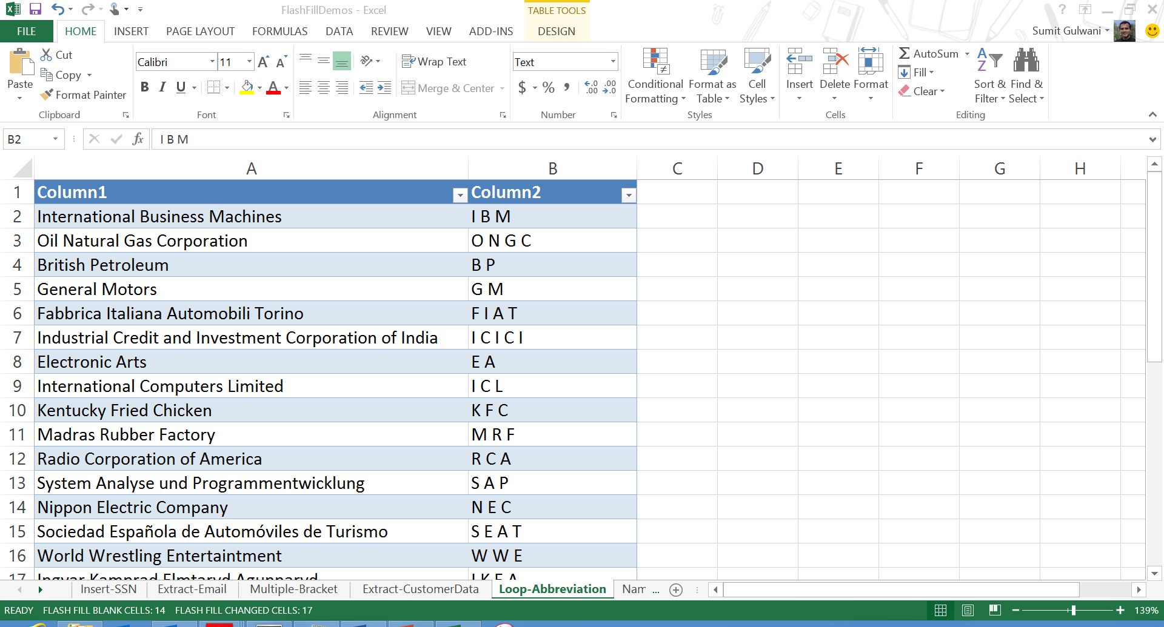

Slide 79
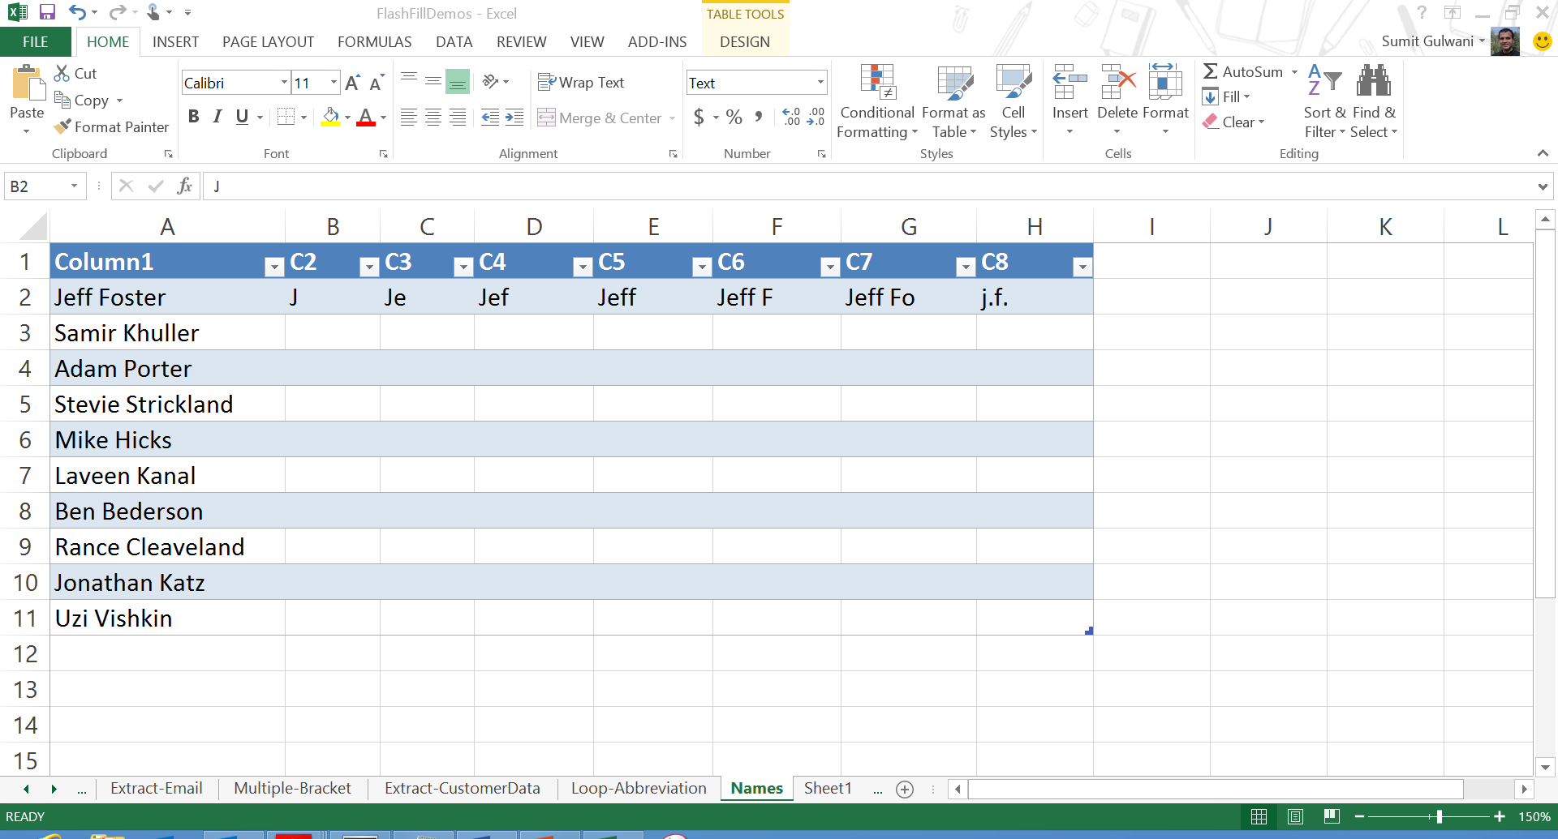

Slide 80
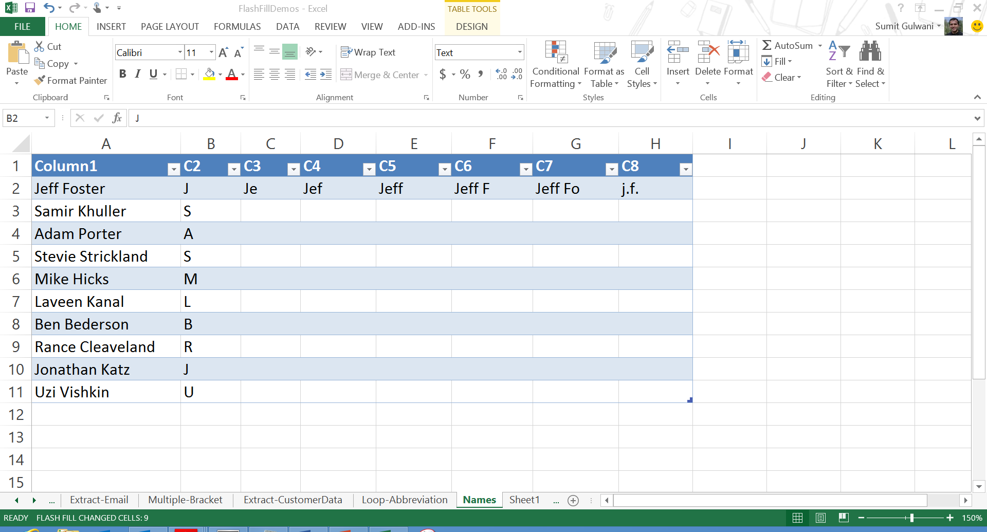

Slide 81
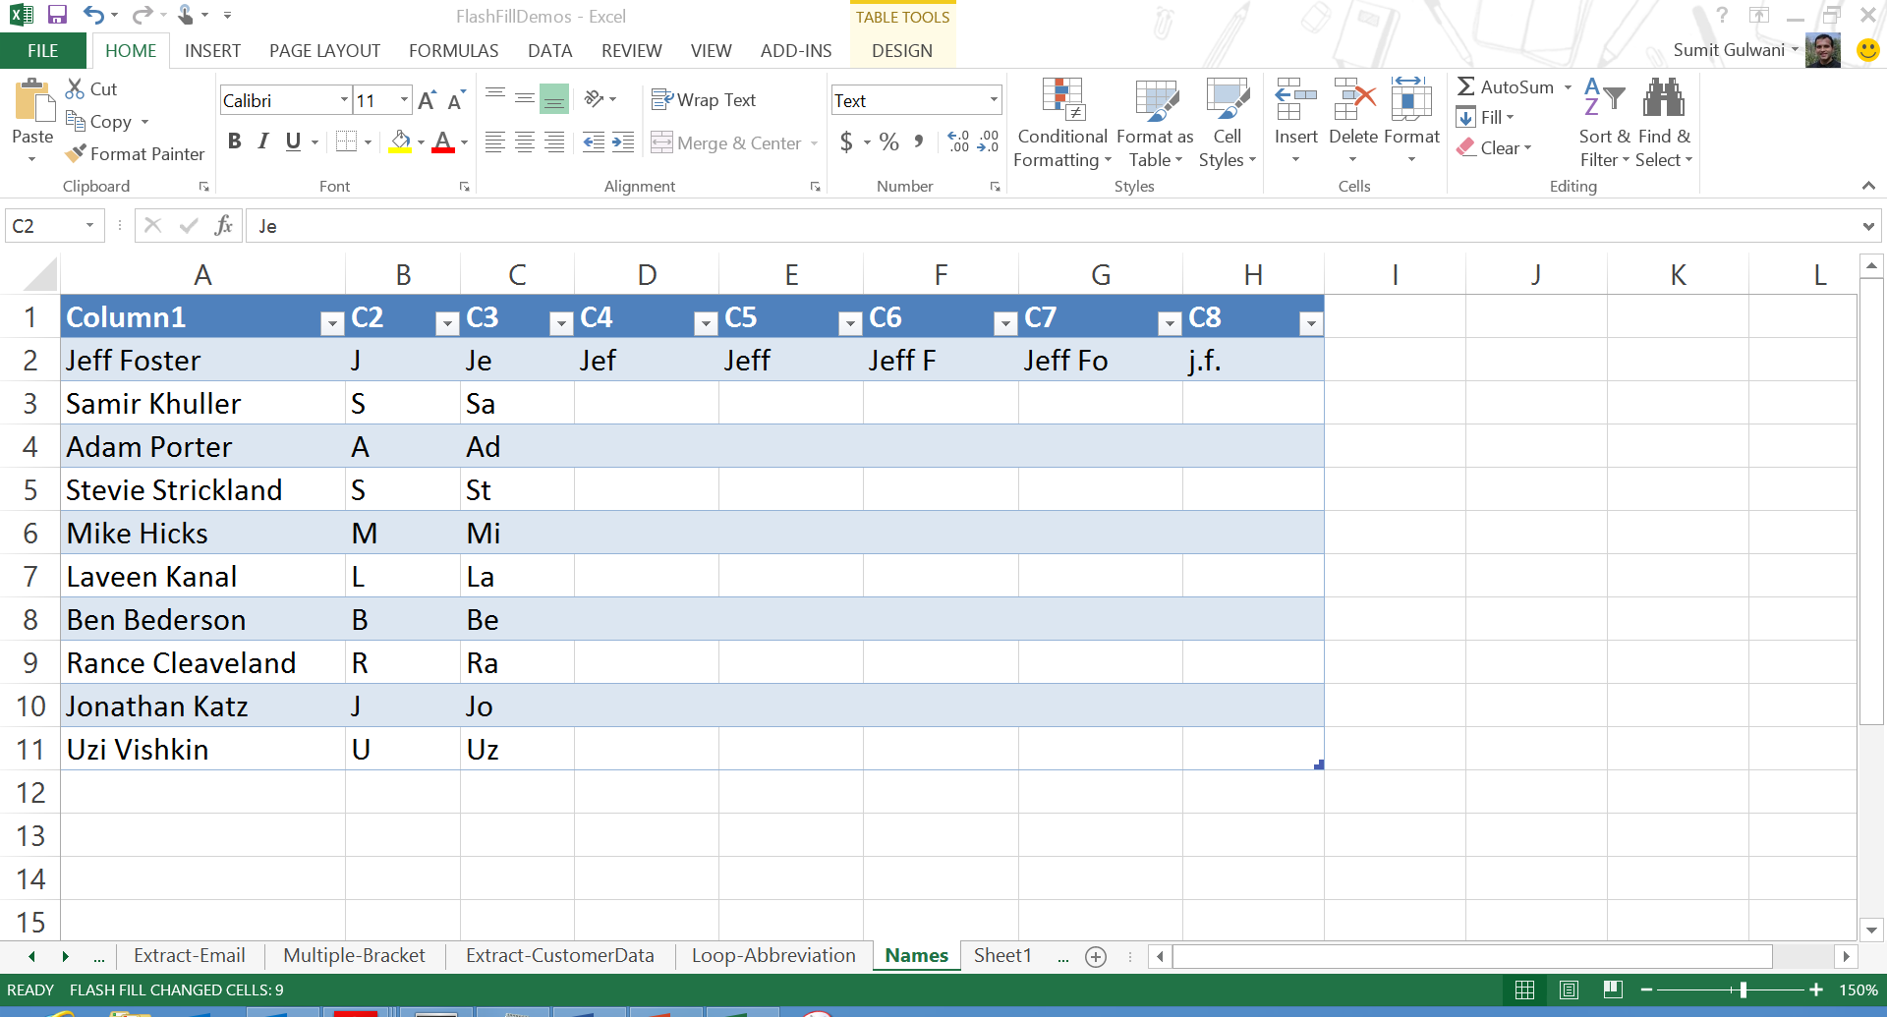

Slide 82
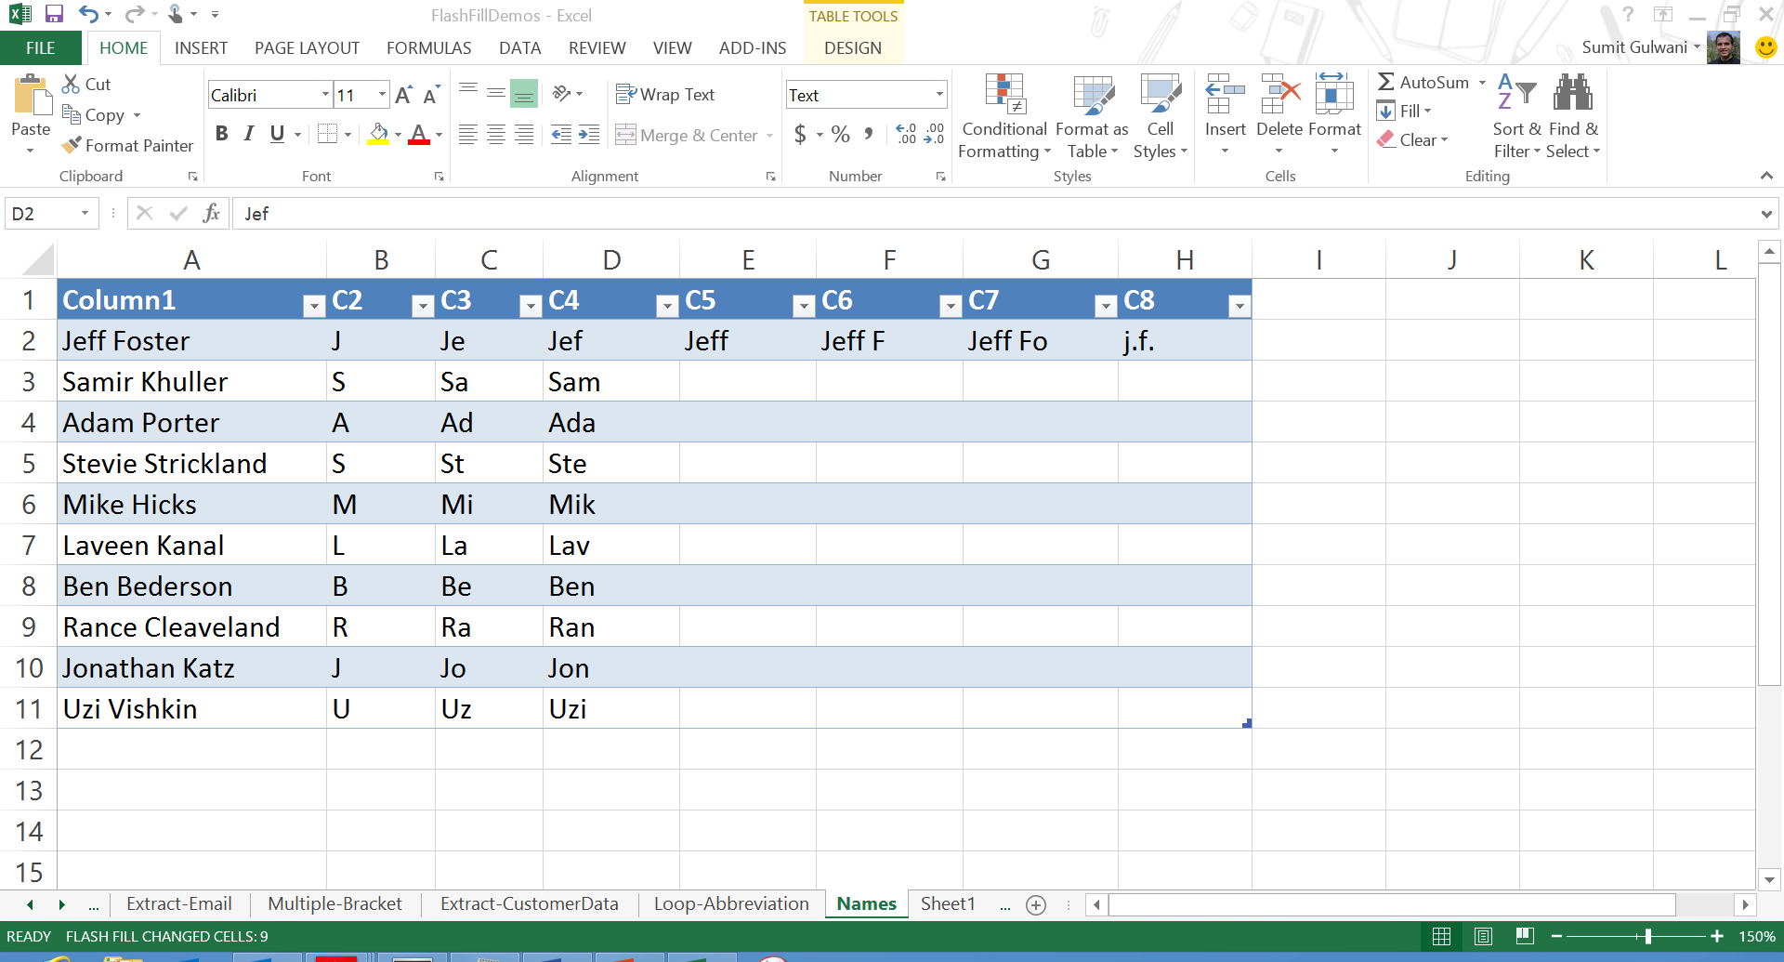

Slide 83
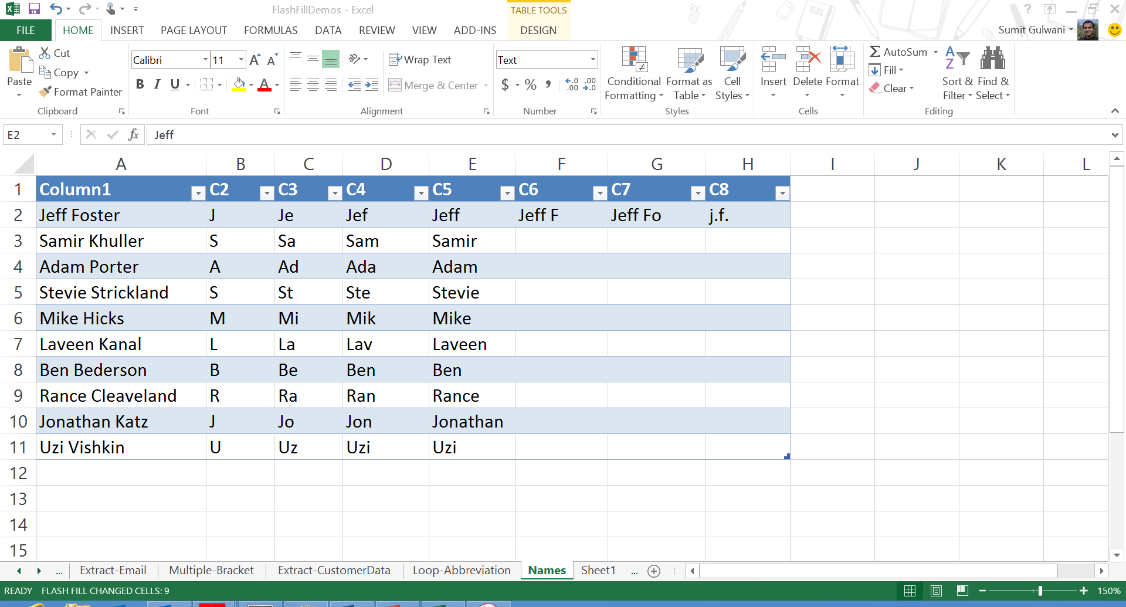

Slide 84
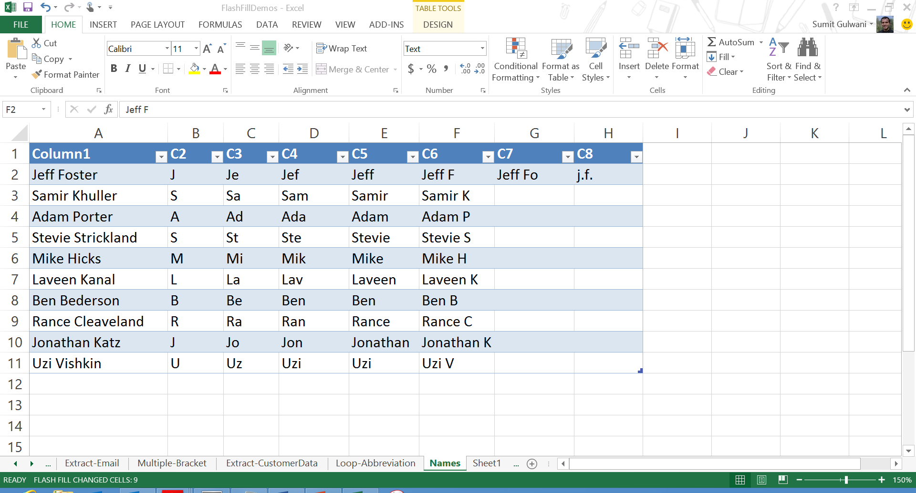

Slide 85
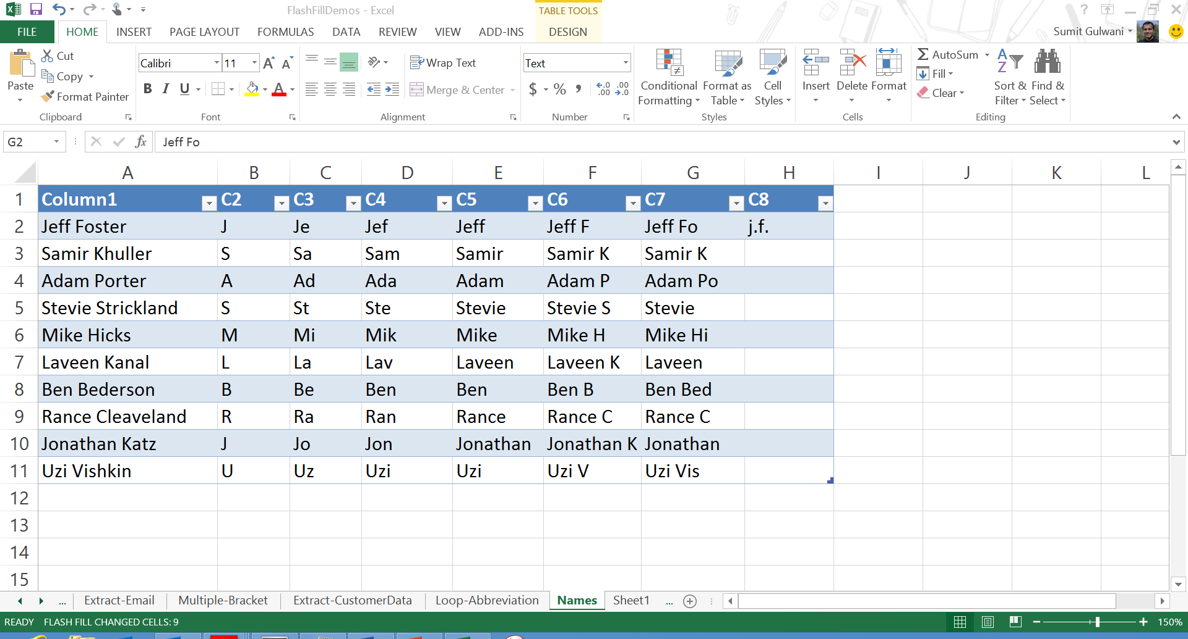

Slide 86
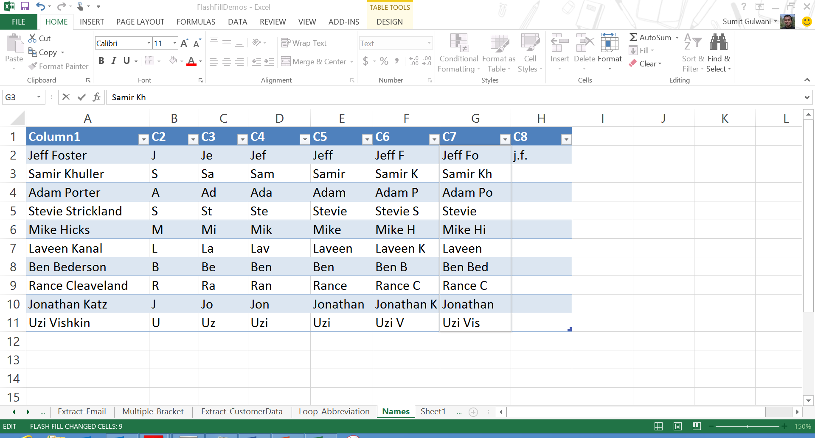

Slide 88
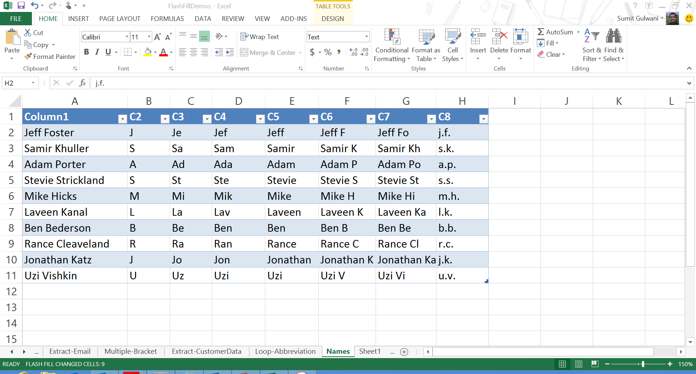

Slide 89
FlashExtract Demo

Slide 90
FlashExtract: Text File Instantiation

Slide 91
FlashExtract: Text File Instantiation

Slide 92
FlashExtract: Text File Instantiation

Slide 93
FlashExtract: Text File Instantiation

Slide 94
FlashExtract: Text File Instantiation

Slide 95
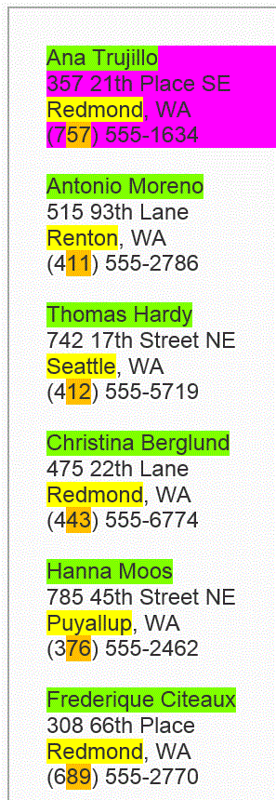
FlashExtract: Text File Instantiation

Slide 96
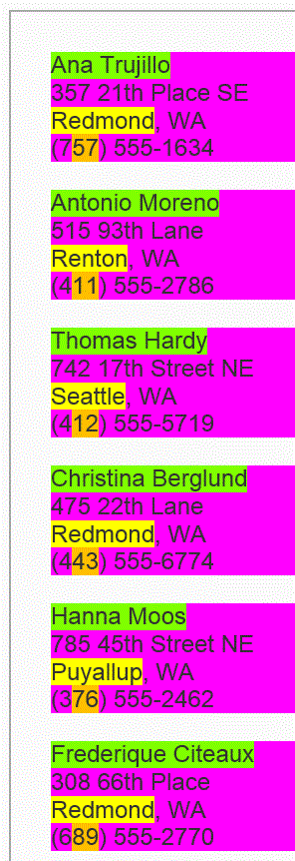
FlashExtract: Text File Instantiation

Slide 97
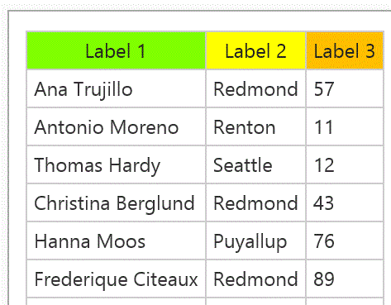
FlashExtract: Text File Instantiation

Slide 98
FlashExtract: Text File Instantiation

Slide 99
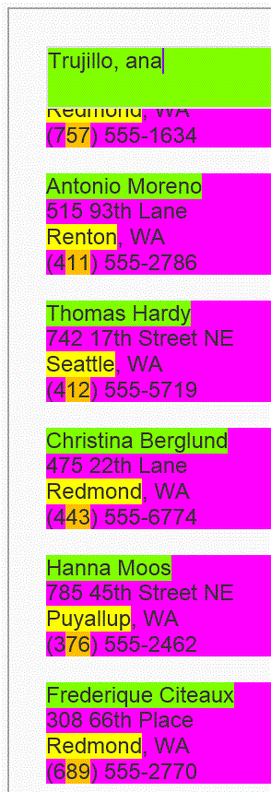
FlashExtract: Text File Instantiation

Slide 100
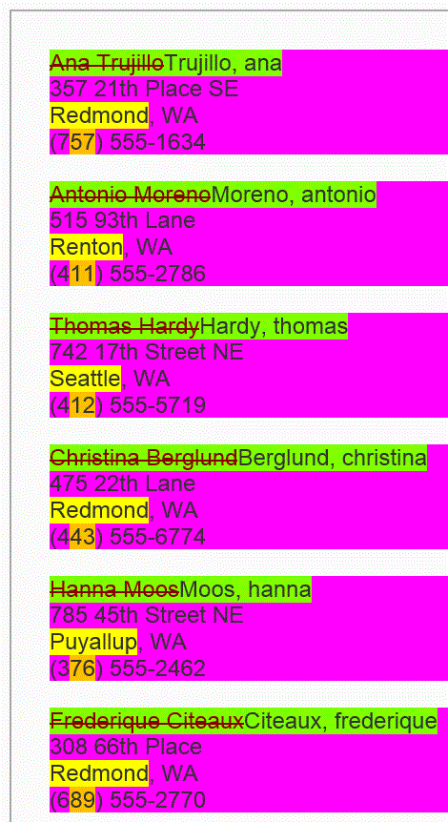
FlashExtract: Text File Instantiation

