Slide 1
FlashMeta Microsoft PROSE SDK: A Framework for Inductive Program Synthesis
Oleksandr Polozov University of Washington
Sumit Gulwani Microsoft Research

Slide 2
Why do people create frameworks?
Industrialization (a.k.a. “Tech Transfer”)

Slide 3
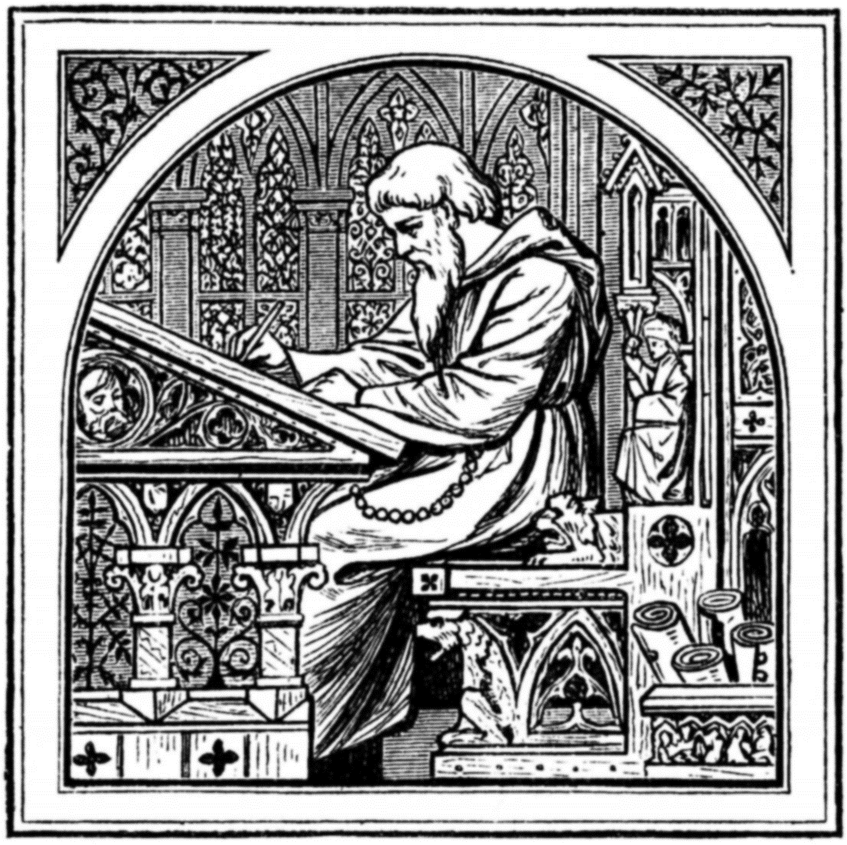

Slide 5
Program Synthesis: “The Ultimate Dream” of CS
Programming
Language
Program
Search Algorithm
User Intent
Notes:
Dimensions in Program Synthesis

Slide 6
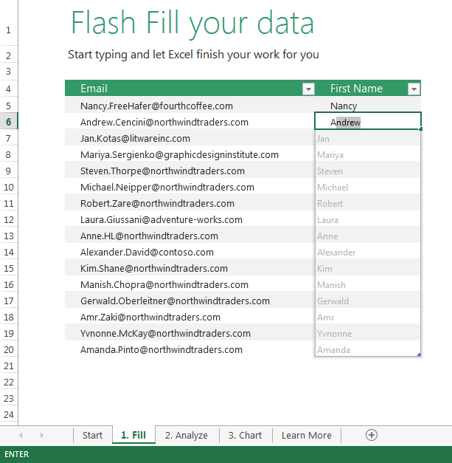
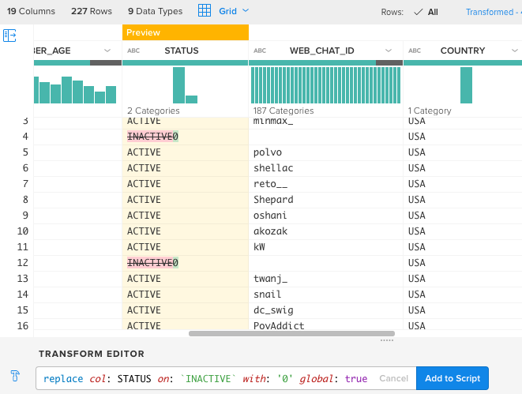
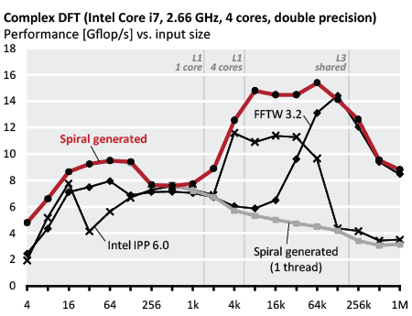
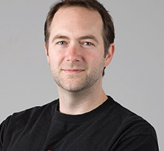
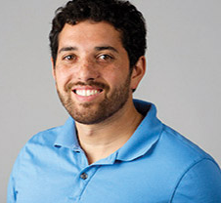
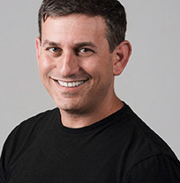
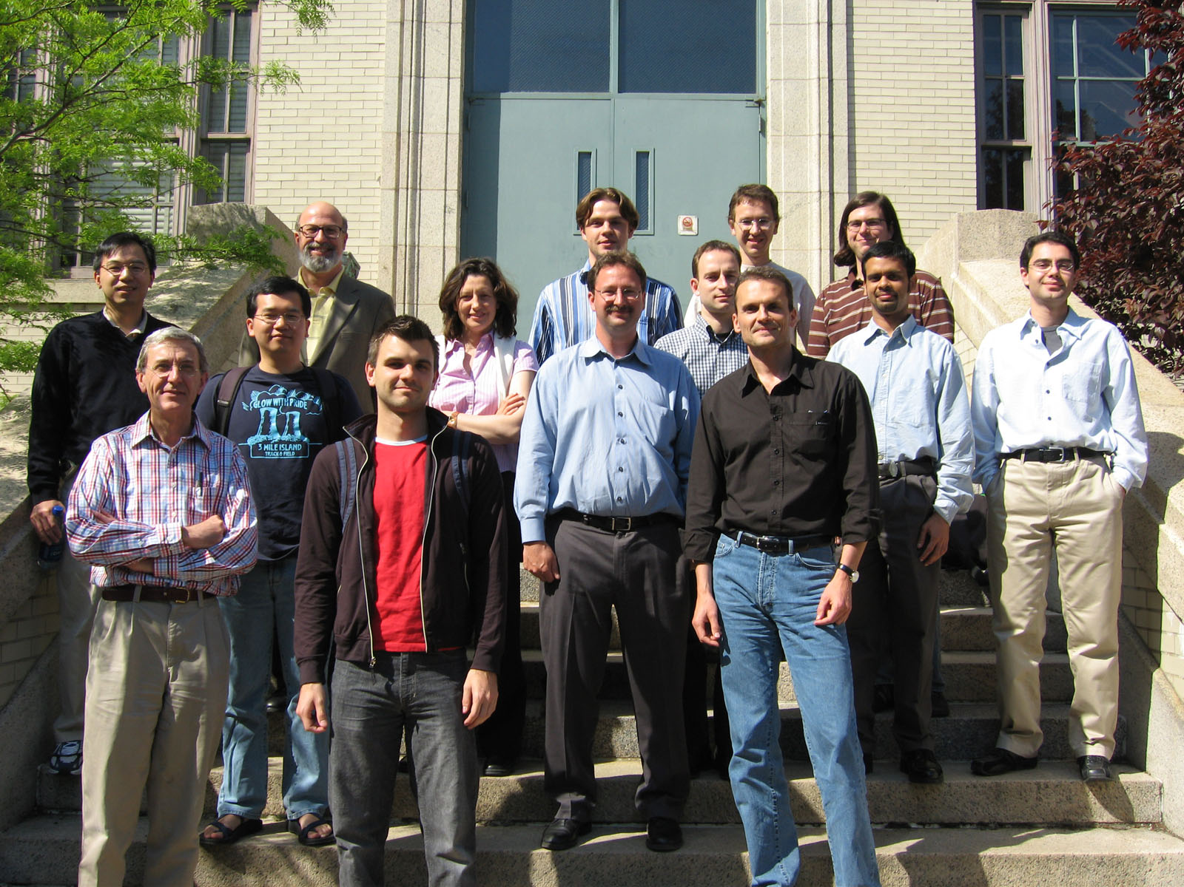
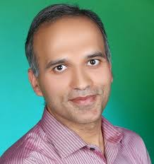
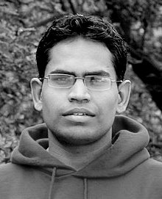
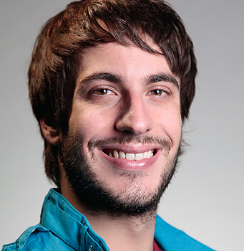
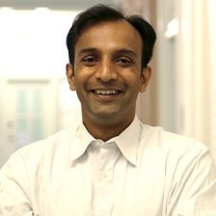
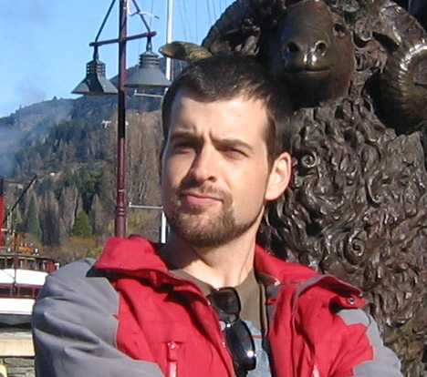
Industrialization Time?
Flash Fill (2010-2012)
Trifacta (2012-2015)
SPIRAL (2000-2015)
$+114$ more

Slide 7
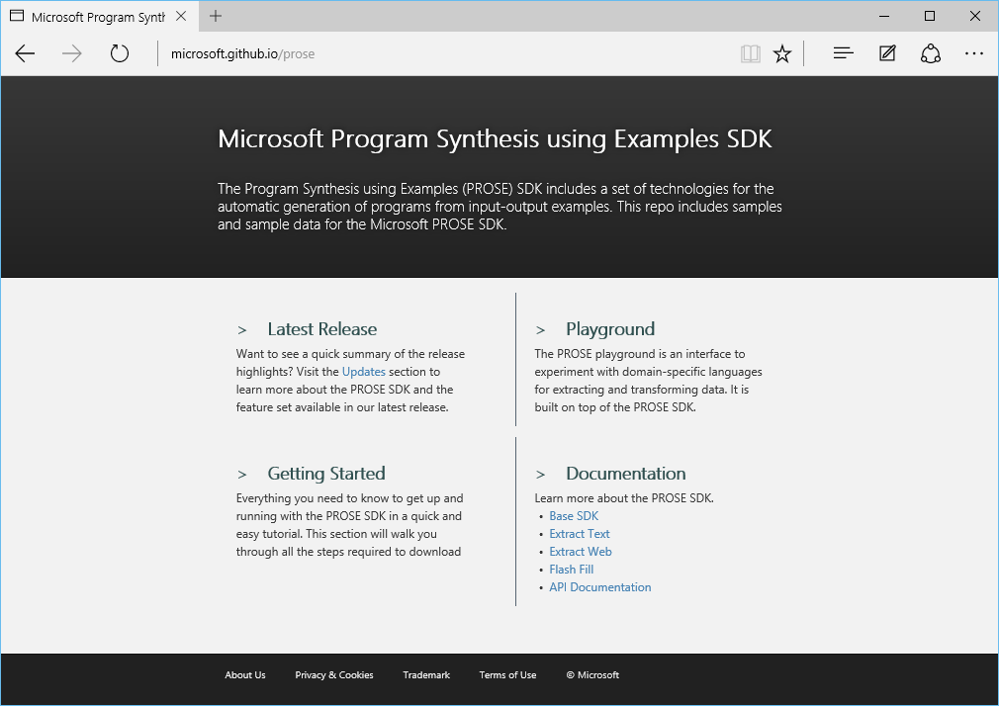
Microsoft Program Synthesis using Examples SDK
https://microsoft.github.io/prose
Notes:
You can download it, build apps, or do research with it.
In the rest of the talk, I’ll tell how it works, what have we done with it, and what interesting things you can enable with it.

Slide 8
Shoulders of Giants
PROSE
Deductive Synthesis
Syntax-Guided Synthesis
Domain-Specific Inductive Synthesis

Slide 9
Shoulders of Giants
Deductive Synthesis
$+$ No invalid candidates $⟹$ fast
$−$ [Usually] complete specs
$−$ Domain axiomatization
Püschel et al. [IEEE '05]
Panchekha et al. [PLDI '15]
Manna, Waldinger [TOPLAS '80]
PROSE

Slide 10
Shoulders of Giants
Syntax-Guided Synthesis
Alur et al. [FMCAD '13]
$+$ Shrinks the search space
$+$ Generic algorithms
$−$ No domain-specific insights
$−$ Limited to SMT-LIB
PROSE

Slide 11
Shoulders of Giants
$+$ Arbitrarily complex DSLs
$+$ Input/output examples
$−$ 1-2 person-years (PhD)
$−$ One-off
Domain-Specific Inductive Synthesis
Lau et al. [ICML '00]
Gulwani [POPL '10] etc.
Feser et al. [PLDI '15]
PROSE

Slide 12
Shoulders of Giants
“Divide & Conquer”
“Search over a DSL”
“Learn from examples”
Deductive Synthesis
Syntax-Guided Synthesis
Domain-Specific Inductive Synthesis
$$⇓$$
$$⇓$$
$$⇓$$
Search Algorithm
Programming
Language
User Intent

Slide 13
PROSE
I/O Specification
Input
Meta-synthesizer framework
Synthesis Strategies
App
PROSE
Programs
Synthesizer
DSL Definition
Output

Slide 14
Domain-Specific Language

Slide 15
FlashFill (portion) as a PROSE DSL
string output(string[] inputs) :=
| ConstantString(s)
| let string x = std.list.Kth(inputs, k) in Substring(x, positionPair(x));
Tuple<int, int> positionPair(string s) := std.Pair(positionIn(s), positionIn(s));
int positionIn(string s) := AbsolutePosition(s, k) | RegexPosition(s, std.Pair(r, r), k);
const int k; const RegularExpression r; const string s;

Slide 16
DSL design $=$ Art $+$ Lots of iterations

Slide 17
Inductive Specification

Slide 18
Input-Output Examples
input state $σ$ $⟹$ output value $o$ut
“206-279-6261” $⟹$ “(206) 279-6261”
“415.413.0703” $⟹$ “(415) 413-0703”
“(646) 408 6649” $⟹$ “(646) 408-6649”

Slide 19
When one example is too many
$$⟹$$

Slide 20
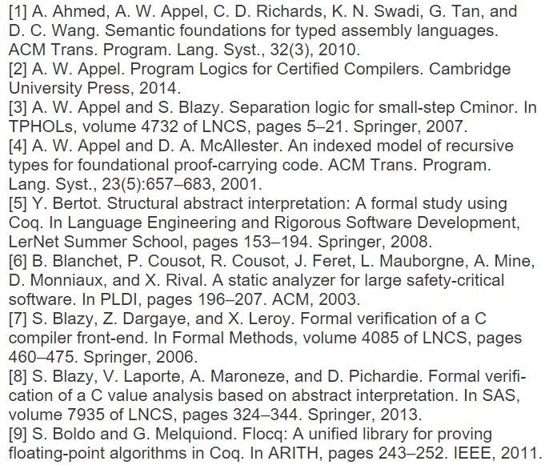
Inductive Specification
input state $σ$ $⟹$ output constraint $φ$(out)
$⟹$ $out⊒\left["2010","2014",…\right]$

Slide 21
Inductive Specification
input state $σ$ $⟹$ output constraint $φ$(out)
$$∧$$
$$∨$$
$$…$$
$$∨$$
$$⊒\left["2010","2014",…\right]$$
$$\overline{∋\text{"}\text{Springer}\text{"}}$$
$$\overline{∋\text{"[11]"}}$$

Slide 22
Examples are ambiguous!

Slide 23
From:
all lines ending with “Number $∘$ Dot” “Space $∘$ Number $∘$ Dot”
starting with “Word $∘$ Space $∘$ CamelCase”
Extract:
the first “Number” before a “Dot” the last “Number” before a “Dot” the last “Number” before a “Dot $∘$ LineBreak” the last “Number” text between the last “Space” and the last “Dot” the first “Comma $∘$ Space” and the last “Dot $∘$ LineBreak”
…and up to ${10}^{20}$ more candidates

Slide 24
One program is insufficient.
Program Set $⟹$ Ranking
User interaction
Runtime correction
…
(Version Space Algebra)

Slide 25
Synthesis Strategy

Slide 26
Observation 1: Inverse Semantics
$F\left(A, B\right)⊨φ$?
𝐹(𝐴, 𝐵)⊨𝜙?
$B⊨φ_{B}$?
𝐵⊨𝜙_𝐵?
$A⊨φ_{A}$?
𝐴⊨𝜙_𝐴?

Slide 27
$\text{Concat}(F, E)$
“Kathleen S. Fisher” $⟹$ “Dr. Fisher”
“Bill Gates, Sr.” $⟹$ “Dr. Gates”
$$φ:$$
$∃E: \text{Concat}(F, E)$ satisfies $φ$ if and only if $F$ satisfies ___________ ?
$∃\text{F}\text{: }\text{Concat}(F, E)$ satisfies $φ$ if and only if $E$ satisfies ___________ ?
$F$ and $E$ are not independent!
“Kathleen S. Fisher” $⟹$ “D” $∨$ “Dr” $∨$ “Dr.” $∨$ “Dr. ” $∨$ “Dr. F” $∨$ …
“Bill Gates, Sr.” $⟹$ “D” $∨$ “Dr” $∨$ “Dr.” $∨$ “Dr. ” $∨$ “Dr. G” $∨$ …
$$φ_{f}:$$

Slide 28
Observation 2: Skolemization
$F\left(A, B\right)⊨φ$?
𝐹(𝐴, 𝐵)⊨𝜙?
$B⊨φ_{B}$?
𝐵⊨𝜙_𝐵?
$A⊨φ_{A}$?
𝐴⊨𝜙_𝐴?
given $A\left(σ\right)=a$

Slide 29
$\text{Concat}(F, E)$
“Kathleen S. Fisher” $⟹$ “Dr. Fisher”
“Bill Gates, Sr.” $⟹$ “Dr. Gates”
$$φ:$$
$∃\text{E}\text{: }\text{Concat}(F, E)$ satisfies $φ$ if and only if $F$ satisfies ___________ ?
Given an output of $F$, $\text{Concat}(F, E)$ satisfies $φ$ if and only if $E$ satisfies ___________ ?
“Kathleen S. Fisher” $⟹$ “D” $∨$ “Dr” $∨$ “Dr.” $∨$ “Dr. ” $∨$ “Dr. F” $∨$ …
“Bill Gates, Sr.” $⟹$ “D” $∨$ “Dr” $∨$ “Dr.” $∨$ “Dr. ” $∨$ “Dr. G” $∨$ …
$$φ_{f}:$$
“Kathleen S. Fisher” $⟹$ “Dr. ”
“Bill Gates, Sr.” $⟹$ “Dr. ”
$$φ_{E}:$$
“Kathleen S. Fisher” $⟹$ “Fisher”
“Bill Gates, Sr.” $⟹$ “Gates”
$$F=$$

Slide 30
Inverse Semantics $+$ Skolemization $=$ Witness Function
Witness function: $φ↦φ_{F}$
$∃E: \text{Concat}(F, E)$ satisfies $φ$ if and only if $F$ satisfies ___________ ?
Given an output of $F$, $\text{Concat}(F, E)$ satisfies $φ$ if and only if $E$ satisfies ___________ ?
Conditional witness function: $\left(φ∣F\left(σ\right)=f\right)↦φ_{E}$
Domain-Specific
Modular
No synthesis reasoning
Enable efficient deduction
Notes:
Small pieces of domain-specific insight that can be written once for an operator and reused in any DSL where it’s embedded. Most importantly, they can be written by a person without any background in …
We verified it when we had implemented PROSE and built several applications on top of it.

Slide 31
Results

Slide 32
Unifies 10+ prior POPL/PLDI/… papers
Lau, T., Domingos, P., & Weld, D. S. (2000). Version Space Algebra and its Application to Programming by Demonstration. In ICML (pp. 527–534).
Kitzelmann, E. (2011). A combined analytical and search-based approach for the inductive synthesis of functional programs. KI-Künstliche Intelligenz, 25(2), 179–182.
Gulwani, S. (2011). Automating string processing in spreadsheets using input-output examples. In POPL (Vol. 46, p. 317).
Singh, R., & Gulwani, S. (2012). Learning semantic string transformations from examples. VLDB, 5(8), 740–751.
Andersen, E., Gulwani, S., & Popovic, Z. (2013). A Trace-based Framework for Analyzing and Synthesizing Educational Progressions. In CHI (pp. 773–782).
Yessenov, K., Tulsiani, S., Menon, A., Miller, R. C., Gulwani, S., Lampson, B., & Kalai, A. (2013). A colorful approach to text processing by example. In UIST (pp. 495–504).
Le, V., & Gulwani, S. (2014). FlashExtract : A Framework for Data Extraction by Examples. In PLDI (p. 55).
Barowy, D. W., Gulwani, S., Hart, T., & Zorn, B. (2015). FlashRelate: Extracting Relational Data from Semi-Structured Spreadsheets Using Examples. In PLDI.
Kini, D., & Gulwani, S. (2015). FlashNormalize : Programming by Examples for Text Normalization. IJCAI.
Osera, P.-M., & Zdancewic, S. (2015). Type-and-Example-Directed Program Synthesis. In PLDI.
Feser, J., Chaudhuri, S., & Dillig, I. (2015). Synthesizing Data Structure Transformations from Input-Output Examples. In PLDI.
…

Slide 33
Program Synthesis meets Software Engineering
Project | Reference | Lines of Code |  | Development Time
 |  | Original | PROSE | Original | PROSE
Flash Fill | POPL 2010 | 12K | 3K | 9 months | 1 month
Text Extraction | PLDI 2014 | 7K | 4K | 8 months | 1 month
Text Normalization | IJCAI 2015 | 17K | 2K | 7 months | 2 months
Spreadsheet Layout | PLDI 2015 | 5K | 2K | 8 months | 1 month
Web Extraction | — | — | 2.5K | — | 1.5 months
Notes:
New implementations are deployed

Slide 34
Performance: $0.5−3$X Original
More general $⇒$ Slower Algorithmic advances $⇒$ Faster
Example: FlashExtract
3 examples till task completion
Learning time = 1.6 sec
$2300$ nodes in a VSA data structure $≈$ $log($# of programs$)$

Slide 35
Performance: $0.5−3$X Original
More general $⇒$ Slower Algorithmic advances $⇒$ Faster
Example: FlashExtract

Slide 36
Applications

Slide 37
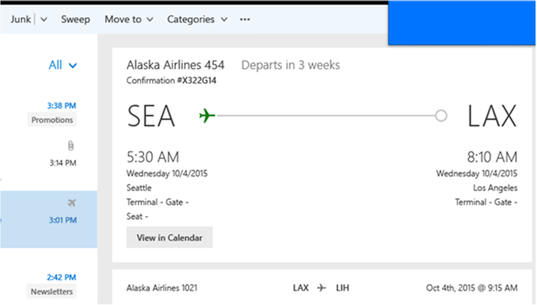
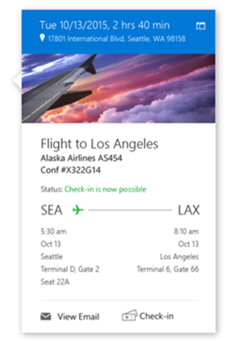
Email Parsing in Cortana

Slide 38
ConvertFrom-String in PowerShell

Slide 39
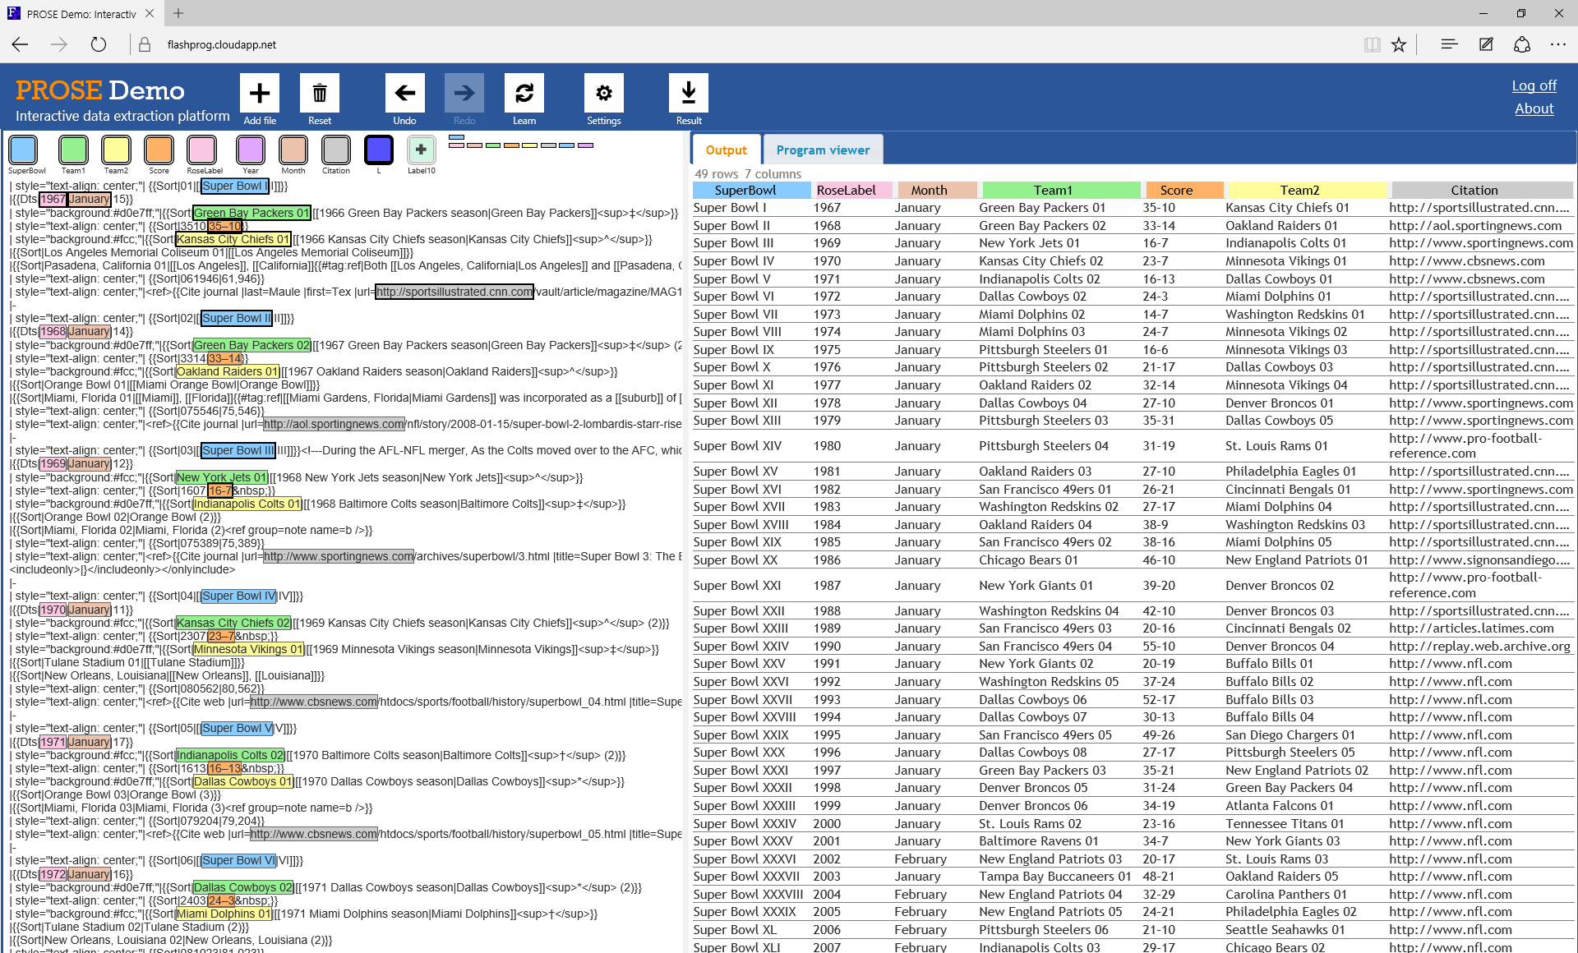
Research: https://microsoft.github.io/prose
Play: https://microsoft.github.io/prose/demo
Contact: prose-contact@microsoft.com
See our demo @ MSR table:
Thank you!
Questions?

