Slide 1
Synthesis from Examples
Sumit Gulwani
sumitg@microsoft.com
Microsoft Research, Redmond
Invited Talk @ SYNASC
Sep 2012
Notes:
nifojuvaleda

Slide 2
Synthesis
Goal: Synthesize a computational concept such as a program/query/sequence in the underlying language.
Significance:
Variety of computational devices, platforms, models.
Billions of non-experts have access to these!
Enabling technology is now available.
Better search algorithms
Faster machines (good application for multi-cores)
State of the art: We can synthesize programs of size 10-20.
This is a revolutionary capability if we
target the right set of application domains, and
provide the right intent specification mechanism

Slide 3
Dimensions in Synthesis
Application domain
Software Developers
End-Users
Intelligent Tutoring Systems
Specification of intent
Logic
Examples
Search technique
SAT/SMT solvers (Formal Methods)
Version space algebras (Machine Learning)
A*-style goal-directed search (AI)
PPDP 2010: “Dimensions in Program Synthesis”, Gulwani.

Slide 4
Potential User Interaction Models
A key challenge in synthesis from examples is to provide interaction models to resolve ambiguities in the specification.
System asks directed questions.
User inspects results and provides more examples.
Show all solutions in ranked order.
Probabilistic guarantees on randomly chosen examples.
WAMBSE 2012: “Synthesis from Examples”, Gulwani.

Slide 5
Applications
Bit-vector Algorithms
Spreadsheet Macros
Geometry Constructions
Grading of Programs
Algebra Problems
Mathematical Intellisense
Drawing Intellisense

Slide 6
Bitvector Algorithms
Straight-line programs that use
Arithmetic Operators: +,-,*,/
Logical Operators: Bitwise and/or/not, Shift left/right

Slide 7
Examples of Bitvector Algorithms
Turn-off rightmost 1-bit
1 0 1 0 1 1 0 0
Z
1 0 1 0 1 0 0 0
Z & (Z-1)
1 0 1 0 1 1 0 0
Z
&
1 0 1 0 1 0 1 1
Z-1
1 0 1 0 1 0 0 0
Z & (Z-1)

Slide 8
Examples of Bitvector Algorithms
Turn-off rightmost contiguous sequence of 1-bits
1 0 1 0 1 1 0 0
Z
1 0 1 0 0 0 0 0
Z & (1 + (Z | (Z-1)))
Ceil of average of two integers without overflowing
(Y|Z) – ((Y©Z) >> 1)

Slide 9
Examples of Bitvector Algorithms
Round up to next
highest power of 2
o1 := sub(x,1);
o2 := shr(o1,1);
o3 := or(o1,o2);
o4 := shr(o3,2);
o5 := or(o3,o4);
o6 := shr(o5,4);
o7 := or(o5,o6);
o8 := shr(o7,8);
o9 := or(o7,o8);
o10 := shr(o9,16);
o11 := or(o9,o10);
res := add(o10,1);
Higher order half
of product of x and y
o1 := and(x,0xFFFF);
o2 := shr(x,16);
o3 := and(y,0xFFFF);
o4 := shr(y,16);
o5 := mul(o1,o3);
o6 := mul(o2,o3);
o7 := mul(o1,o4);
o8 := mul(o2,o4);
o9 := shr(o5,16);
o10 := add(o6,o9);
o11 := and(o10,0xFFFF);
o12 := shr(o10,16);
o13 := add(o7,o11);
o14 := shr(o13,16);
o15 := add(o14,o12);
res := add(o15,o8);

Slide 10
Synthesis from Logical Specification
Turn off rightmost 1-bit
Functional Specification:
b
Æ[ (I[p]=1 Æ (I[j]=0)) ) (J[p]=0 Æ(J[j] = I[j])) ]
b
p=1
j=p+1
j≠p
Tool Output:
J = I & (I-1)
PLDI 2011: Gulwani, Jha, Tiwari, Venkatesan.

Slide 11
Interactive Synthesis using Examples
Turn-off rightmost contiguous string of 1’s
User: I want a program that maps 01011 -> 01000
Tool: There exist at least two programs that match the spec
Program 1: (x+1) & (x-1) Program 2: (x+1) & x
But they differ on 00000 (Distinguishing Input)
What should 00000 be mapped to?
User: 00000 -> 00000


ICSE 2010: Jha, Gulwani, Seshia, Tiwari.

Slide 12
Interactive Synthesis using Examples
Turn-off rightmost contiguous string of 1’s
User: 01011 -> 01000
Tool: 00000 ?
User: 00000
Tool: 01111 ?
User: 00000
Tool: 00110 ?
User: 00000
Tool: 01100 ?
User: 00000
Tool: 01010 ?
User: 01000
Tool: Your program is x & (1 + ((x-1)|x))

Slide 13
Applications
Bit-vector Algorithms
Spreadsheet Macros
Geometry Constructions
Grading of Programs
Algebra Problems
Mathematical Intellisense
Drawing Intellisense

Slide 14
Language for Constructing Output Strings
Guarded Expression G := Switch((b₁,e₁), …, (b_{n},e_{n}))
Boolean Expression b := c₁ Æ … Æ c_{n}
Atomic Predicate c := Match(v_{i},k,r)
Trace Expression e := Concatenate(f₁, …, f_{n})
Atomic Expression f := s // Constant String
| SubStr(v_{i}, p₁, p₂) | Loop(¸w: e)
Index Expression p := k // Constant Integer
| Pos(r₁, r₂, k) // k^{th} position in string whose left/right side matches with r₁/r₂
Regular Expression r := TokenSequence(T₁,…,T_{n})
POPL 2011: Gulwani

Slide 15
Synthesis Algorithm for String Manipulation
Goal: Given input-output pairs: (i₁,o₁), (i₂,o₂), (i₃,o₃), (i₄,o₄), find P such that P(i₁)=o₁, P(i₂)=o₂, P(i₃)=o₃, P(i₄)=o₄.
Algorithm:
Learn set S₁ of trace expressions s.t. 8e in S₁, [[e]] i₁ = o₁. Similarly compute S₂, S₃, S₄. Let S = S₁ ÅS₂ ÅS₃ ÅS₄.
2(a). If S ≠ ; then result is S.
Challenge: Each S_{i} may have a huge number of expressions.
Key Idea: We have a DAG based data-structure that allows for succinct representation and manipulation of S_{i}.

Slide 16
Synthesis Algorithm for String Manipulation
Goal: Given input-output pairs: (i₁,o₁), (i₂,o₂), (i₃,o₃), (i₄,o₄), find P such that P(i₁)=o₁, P(i₂)=o₂, P(i₃)=o₃, P(i₄)=o₄.
Algorithm:
Learn set S₁ of trace expressions s.t. 8e in S₁, [[e]] i₁ = o₁. Similarly compute S₂, S₃, S₄. Let S = S₁ ÅS₂ ÅS₃ ÅS₄.
2(a). If S ≠ ; then result is S.
2(b). Else find a smallest partition, say {S₁,S₂}, {S₃,S₄}, s.t. S₁ ÅS₂ ≠ ; and S₃ ÅS₄ ≠ ;.
3. Learn boolean formulas b₁, b₂ s.t.
b₁ maps i₁, i₂ to true and i₃, i₄ to false.
b₂ maps i₃, i₄ to true and i₁, i₂ to false.
4. Result is: Switch((b₁,S₁ ÅS₂), (b₂,S₃ ÅS₄))

Slide 17
End-User Programming
Spreadsheet Data Manipulation (CACM 2012)
Syntactic String Transformations (POPL 2011)
Flash Fill feature in Excel 2013
Semantic String Transformations (VLDB 2012)
Number Transformations (CAV 2012)
Table Transformations (PLDI 2011)
Joint work with Bill Harris and Rishabh Singh

Slide 18
End-User Programming
Spreadsheet Data Manipulation (CACM 2012)
Syntactic String Transformations (POPL 2011)
Flash Fill feature in Excel 2013
Semantic String Transformations (VLDB 2012)
Number Transformations (CAV 2012)
Table Transformations (PLDI 2011)
SmartPhone Programming
Robot Programming

Slide 19
Education: Intelligent Tutoring Systems
Aspects
Solution Generation (PLDI 2011)
Automated Grading
Problem Generation (AAAI 2012)
Content Entry
Subject Domains:
Math, Science
Programming, Automata Theory, Logic
Language Learning

Slide 20
Applications
Bit-vector Algorithms
Spreadsheet Macros
Geometry Constructions
Grading of Programs
Algebra Problems
Mathematical Intellisense
Drawing Intellisense

Slide 21
Ruler/Compass based Geometry Constructions
Given a triangle XYZ, construct circle C such that C passes through X, Y, and Z.
C
L1
L2
N
Z
X
Y
PLDI 2011: Gulwani, Korthikanti, Tiwari.

Slide 22
Other Examples of Geometry Constructions
Draw a regular hexagon given a side.
Given 3 parallel lines, draw an equilateral triangle whose vertices lie on the parallel lines.
Given 4 points, draw a square whose sides contain those points.

Slide 23
Solution Description Language
Geometry Program: A straight-line composition of geometry methods.
Geometry Types: Point, Line, Circle
Geometry Methods:
Ruler(Point, Point) -> Line
Compass(Point, Point) -> Circle
Intersect(Circle, Circle) -> Pair of Points
Intersect(Line, Circle) -> Pair of Points
Intersect(Line, Line) -> Point

Slide 24
Example of Geometry Program
Given a triangle XYZ, construct circle C such that C passes through X, Y, and Z.
C1 = Compass(X,Y);
C2 = Compass(Y,X);
<P1,P2> = Intersect(C1,C2);
L1 = Ruler(P1,P2);
D1 = Compass(Z,X);
D2 = Compass(X,Z);
<R1,R2> = Intersect(D1,D2);
L2 = Ruler(R1,R2);
N = Intersect(L1,L2);
C = Compass(N,X);
C
L1
L2
N
C1
C2
P1
D1
Z
R1
X
Y
R2
D2
P2

Slide 25
Synthesis of Geometry Constructions
Idea 1 (Theory): Reduce Symbolic Reasoning to Concrete.
Choose a random input-output example (I’,O’). Use exhaustive search to obtain a construction that can generate O’ from I’.
Idea 2 (PL): Use high-level abstractions.
Extend set of methods with commonly used patterns. E.g., perpendicular/angular bisector, midpoint, tangent etc.
Idea 3 (AI): Perform goal-directed search.

Slide 26
Experimental Results
25 benchmark problems.
such as: Construct a square whose extended sides pass through 4 given points.
18 problems less than 1 second.
4 problems between 1-3 seconds.
3 problems 13-82 seconds.
Idea 2 (high-level abstractions) reduces programs of size 3-45 to 3-13.
Idea 3 (goal-directedness) improves performance by factor of 10-1000 times on most problems.

Slide 27
Architecture
Problem Description in English
Natural Language Processing
Problem Description as Logical Relation
Synthesis Engine
Solution as Functional Program
Paraphrasing
Solution in English

Slide 28
GeoSynth Demo
Construct a triangle ABC with AB = 7 cm, angle B = 60 degree and BC + CA = 10 cm.

Slide 29
Applications
Bit-vector Algorithms
Spreadsheet Macros
Geometry Constructions
Grading of Programs
Algebra Problems
Mathematical Intellisense
Drawing Intellisense

Slide 30
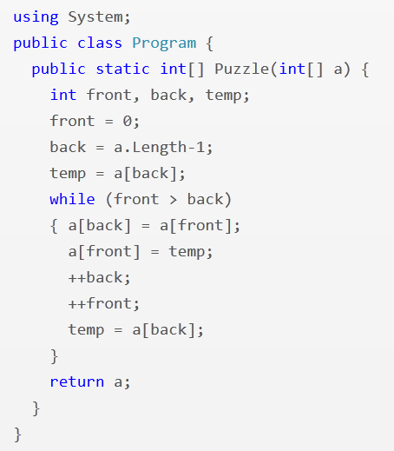
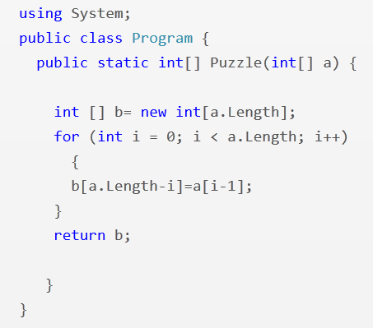
Array Reverse
i = 1
front <= back
i <= a.Length
--back
ArXiv TechReport: Singh, Gulwani, and Solar-Lezama

Slide 31
Error Model for Array Reverse Problem
Array Index Fuzzing: v[a] -> v[{a+1, a-1, v.Length-a-1}]
Initialization Fuzzing: v=n -> v={n+1, n-1, 0}
Increment Fuzzing: v++ -> { ++v, v--, --v }
Return Value Fuzzing: return v -> return ?v
Conditional Fuzzing: a op b -> a’ ops { a+1, a-1, 0 }
where ops = { <, >, <=, >=, ==, != }

Slide 32
Effectiveness of Error Model

Slide 33
Efficiency of Synthesizer

Slide 34
Applications
Bit-vector Algorithms
Spreadsheet Macros
Geometry Constructions
Grading of Programs
Algebra Problems
Mathematical Intellisense
Drawing Intellisense

Slide 35
Trigonometry Problem
$$\text{Example} \text{Problem}\text{:}{ \left(\sec{x+ \cos{x}}\right) \left(\sec{x−\cos{x}}\right)}= \tan^{2}{x+\sin^{2}{x}}$$
$$\text{Query}\text{: }\left(T_{1}\left(x\right)±T_{2}(x)\right) \left(T_{3}\left(x\right)±T_{4}\left(x\right)\right)=T_{5}^{2}\left(x\right)±T_{6}^{2}(x)$$
$${ T}_{1}≠T_{5}$$
New problems generated:
$$\left(\csc{x}+\cos{x}\right)\left(\csc{x}−\cos{x}\right)=\cot^{2}{x}+\sin^{2}{x}$$
$$(\csc{x−\sin{x)(\csc{x+\sin{x)=\cot^{2}{x+\cos^{2}{x}}}}} }$$
$$(\sec{x+\sin{x)(\sec{x−\sin{x)=\tan^{2}{x+\cos^{2}{x}}}}}}$$
:
$$(\tan{x+\sin{x)(\tan{x−\sin{x)=\tan^{2}{x −\sin^{2}{x} }}}}}$$
$$(\csc{x+\cos{x)(\csc{x−\cos{x)=\csc^{2}{x −\cos^{2}{x}}}}}}$$
:
AAAI 2012: Singh, Gulwani, Rajamani.

Slide 36
Trigonometry Problem
$$\text{Example} \text{Problem}\text{:}{ \left(\sec{x+ \cos{x}}\right) \left(\sec{x−\cos{x}}\right)}= \tan^{2}{x+\sin^{2}{x}}$$
$$\text{Query}\text{: }\left(T_{1}\left(x\right)±T_{2}(x)\right) \left(T_{3}\left(x\right)±T_{4}\left(x\right)\right)=T_{5}^{2}\left(x\right)±T_{6}^{2}(x)$$
$${ T}_{1}≠T_{5}$$
New problems generated:
$$\left(\csc{x}+\cos{x}\right)\left(\csc{x}−\cos{x}\right)=\cot^{2}{x}+\sin^{2}{x}$$
$$(\csc{x−\sin{x)(\csc{x+\sin{x)=\cot^{2}{x+\cos^{2}{x}}}}} }$$
$$(\sec{x+\sin{x)(\sec{x−\sin{x)=\tan^{2}{x+\cos^{2}{x}}}}}}$$
:
$$(\tan{x+\sin{x)(\tan{x−\sin{x)=\tan^{2}{x −\sin^{2}{x} }}}}}$$
$$(\csc{x+\cos{x)(\csc{x−\cos{x)=\csc^{2}{x −\cos^{2}{x}}}}}}$$
:
AAAI 2012: Singh, Gulwani, Rajamani.

Slide 37
Limits/Series Problem
$$\text{Example} \text{Problem}\text{:} \lim_{n→∞}{\sum_{i=0}^{n}{\frac{2i^{2}+i+1}{5^{i}}= \frac{5}{2}} }$$
$$\text{Query}\text{:} \lim_{n→∞}{\sum_{i=0}^{n}{\frac{C_{0}i^{2}+C_{1}i+C_{2}}{{C_{3}}^{i}}= \frac{C_{4}}{C_{5}}} }$$
$${ C}_{0}≠0 ∧ \gcd\left(C_{0},C_{1},C_{2}\right)=\gcd\left(C_{4},C_{5}\right)=1$$
New problems generated:
$$\lim_{n→∞}{\sum_{i=0}^{n}{\frac{3i^{2}+2i+1}{7^{i}}= \frac{7}{3} }\lim_{n→∞}{\sum_{i=0}^{n}{\frac{3i^{2}+3i+1}{4^{i}}=4 } }}$$
$$\lim_{n→∞}{\sum_{i=0}^{n}{\frac{i^{2}}{3^{i}}= \frac{3}{2}} \lim_{n→∞}{\sum_{i=0}^{n}{\frac{5i^{2}+3i+3}{6^{i}}=6 } }}$$

Slide 38
Integration Problem
$$\text{Example} \text{Problem}\text{:} \int{(\csc{x) (\csc{x−\cot{x) dx= \csc{x}−\cot{x}}}}}{ }$$
$$\text{Query}\text{: }\int{T_{0}\left(x\right)\left(T_{1}\left(x\right)±T_{2}\left(x\right)\right)dx=T_{4}\left(x\right)±T_{5}(x)}$$
$${ T}_{1}≠T_{2} ∧ T_{4}≠T_{5}$$
New problems generated:
$$\int{(tan{x) (\cos{x}+ \sec{x) dx= \sec{x}− \cos{x}}}}$$
$$\int{(sec{x) (\tan{x}+ \sec{x) dx= \sec{x}+\cot{ x}}}}$$
$$\int{(\cot{x) (\sin{x+ \csc{x) dx= \sin{x−\csc{x}}}}}}$$

Slide 39
Determinant Problem
$$\text{Ex}\text{. }\text{Problem} \left|\begin{matrix}{\left(x+y\right)}^{2} & zx & zy \\ zx & {\left(y+z\right)}^{2} & xy \\ yz & xy & {\left(z+x\right)}^{2}\end{matrix}\right|{ }=2xyz {\left(x+y+z\right)}^{3}$$
$$\text{Query} \left|\begin{matrix}F_{0}(x,y,z) & F_{1}(x,y,z) & F_{2}(x,y,z) \\ F_{3}(x,y,z) & F_{4}(x,y,z) & F_{5}(x,y,z) \\ F_{6}(x,y,z) & F_{7}(x,y,z) & F_{8}(x,y,z)\end{matrix}\right|{ }=C_{10}F_{9}(x,y,z)$$
$${ F}_{i}≔F_{j}\left[x→y;y→z;z→x\right] where \left(i,j\right)∈\{\left(4,0\right), \left(8,4\right), \left(5,1\right),…\}$$
New problems generated:
$$\left|\begin{matrix}y^{2} & x^{2} & {\left(y+x\right)}^{2} \\ {\left(z+y\right)}^{2} & z^{2} & y^{2} \\ z^{2} & {\left(x+z\right)}^{2} & x^{2}\end{matrix}\right|{ }=2{\left(xy+yz+zx\right)}^{3}$$
$$\left|\begin{matrix}yz+y^{2} & xy & xy \\ yz & zx+z^{2} & yz \\ zx & zx & xy+x^{2}\end{matrix}\right|{ }=4x^{2}y^{2}z^{2}$$

Slide 40
Applications
Bit-vector Algorithms
Spreadsheet Macros
Geometry Constructions
Grading of Programs
Algebra Problems
Mathematical Intellisense
Drawing Intellisense

Slide 41
Mathematical Intellisense
State-of-the-art Mathematical Editors
Text editors like Latex
Unreadable text in prefix notation
WYSIWIG editors like Microsoft Word
Change of cursor positions multiple times.
Back and forth switching between mouse & keyboard
Our proposal: An intelligent predictive editor.
Mathematical text has low entropy and hence amenable to prediction!
MSR Technical Report: Polozov, Gulwani, Rajamani.

Slide 42
Reducing (Term) Prediction to Learning-By-Examples
Terms connected by the same AC operator can be thought of as terms belonging to a sequence.
There are 2 opportunities for predicting such terms.
Sequence Creation: T₁, T₂, T₃, …
Learn a function F such that F(T_{i}) = T_{i+1}
Sequence Transformation: S₁, S₂, S₃, S₄ -> T₁, T₂, …
Learn a function F such that F(S_{i}) = T_{i}

Slide 43
Mathematical (Syntactic) Intellisense
$$\tan{3x\tan{2x\tan{x=\tan{3x−\tan{2x −\tan{x}}}}}}$$
$$\left(\begin{matrix}yz−x^{2} & zx−y^{2} & xy−z^{2} \\ zx−y^{2} & xy−z^{2} & yz−x^{2} \\ xy−z^{2} & yz−x^{2} & zx−y^{2}\end{matrix}\right)$$
$$\left(\begin{matrix}A_{1}\sin^{3}{α} & B_{1}\sin^{3}{β} & C_{1}\sin^{3}{γ} \\ A_{2}\sin{α} & B_{2}\sin{β} & C_{2}\sin{γ}\end{matrix}\right)$$

Slide 44
Mathematical (Semantic) Intellisense
Prove $(\csc{x−\sin{x)(\sec{x −\cos{x)(\tan{x+\cot{x)=1}}}}}}$
$$\text{L}\text{.}\text{H}\text{.}\text{S}\text{. = }\left(\frac{1}{\sin{x}}−\sin{x}\right)\left(\frac{1}{\cos{x}}−\cos{x}\right)\left(\frac{\sin{x}}{\cos{x}}+\frac{\cos{x}}{\sin{x}}\right)$$
$$\text{= }\left(\frac{1−\sin^{2}{x}}{\sin{x}}\right)\left(\frac{1−\cos^{2}{x}}{\cos{x}}\right)\left(\frac{\sin^{2}{x+\cos^{2}{x}}}{\cos{x}\sin{x}}\right)$$
$$\text{= }\left(\frac{\cos^{2}{x}}{\sin{x}}\right)\left(\frac{\sin^{2}{x}}{\cos{x}}\right)\left(\frac{1}{\cos{x}\sin{x}}\right)$$
= 1

Slide 45
Results
45 benchmark sessions containing a total of 186 sequences.
Effectiveness of underlying pattern language: 60%
114/186 sequences can be expressed using this language.
Effectiveness of learning algorithm: 52%
For 60/114 sequences, more than half are predicted in top-5.

Slide 46
Applications
Bit-vector Algorithms
Spreadsheet Macros
Geometry Constructions
Grading of Programs
Algebra Problems
Mathematical Intellisense
Drawing Intellisense

Slide 47
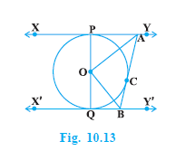
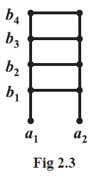
Challenges in Drawing Figures
Sometimes require extreme precision.
Can be tedious to draw sometimes.
CHI 2012: Cheema, Gulwani, LaViola.
Notes:
People everywhere draw diagrams
In some cases like geometry, the diagrams have to be very precise
For example, in figure 10.13 on the right, you can see that the three tangents have to be drawn so that they touch the circle
At only one point each. Similarly the line PQ must be perpendicular to the parallel tangents and the angle AOB must be a right angle
When someone is drawing this figure, ensuring all these constraints can take a great amount of time
Diagrams can also have repetitive patterns in them. Figure 2.3 is a fairly trivial example of a ladder

Slide 48
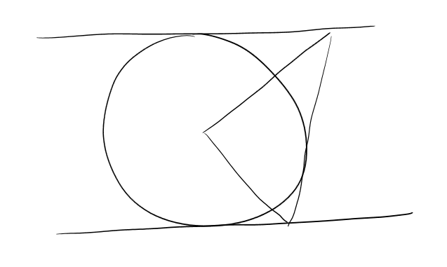
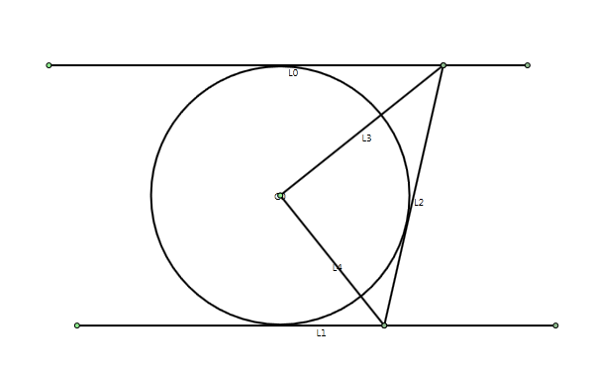
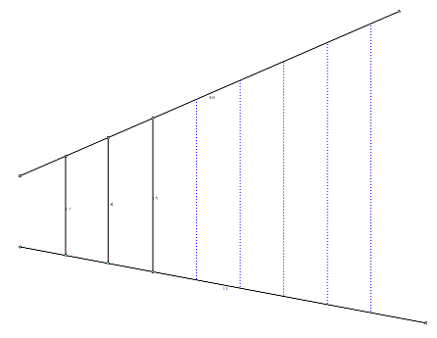
QuickDraw
Allow users to easily sketch difficult diagrams.
Infer repetition and automatically fill-in the rest

Slide 49
Architecture
(Partial) Sketch/Ink Strokes
Sketch Recognition Engine [HCI]
Circle/Line Objects
Constraint Inference Engine [Machine Learning]
Constraints between Objects
Model Synthesis/Beautification Engine [Theorem Proving]
(Partial) Drawing
Pattern Recognition Engine [Synthesis]
Suggestions for Drawing
Completion

Slide 50
Dimensions in Synthesis
Application domain
Software Developers
End-Users
Intelligent Tutoring Systems
Specification of intent
Logic
Examples
Natural Language, Keywords
Search technique
SAT/SMT solvers (Formal Methods)
Version space algebras (Machine Learning)
A*-style goal-directed search (AI)
PPDP 2010: “Dimensions in Program Synthesis”, Gulwani.

Slide 51
Potential Users of Synthesis Technology
Algorithm
Designers
Software Developers
Most Useful Target
End-Users
Most Transformational Target
Students and Teachers
Vision for End-users: Enable people to have (automated) personal assistants.
Vision for Education: Enable every student to have access to free/high-quality education.

